Slide 1
Vulnerability Scan Report
URL: http://zero.webappsecurity.com
Page: /login.html
Scan Time: 25/09/2025 9:45:46 AM

Slide 2
Vulnerability Found
Password transmitted over HTTP protocol
Impact
If attacker intercepts traffic, they can steal user credentials

Slide 3
Summary
The web app https://zero.webappsecurity.com uses http protocol, which is vulnerable to multiple attacks including man-in-the-middle (MITM) attack. Login credentials are being transmitted over HTTP where there is no encryption and this can lead to credentials breach of users when the traffic is intercepted.

Slide 4
Steps to reproduce
Attacker has to be on the same network with the User.
Opens any sniffing tools like ettercap or bettercap.
Spoofs the target user and sniffs their packets.
The username and password are transmitted in plain text.
Hence are compromised easily.

Slide 5
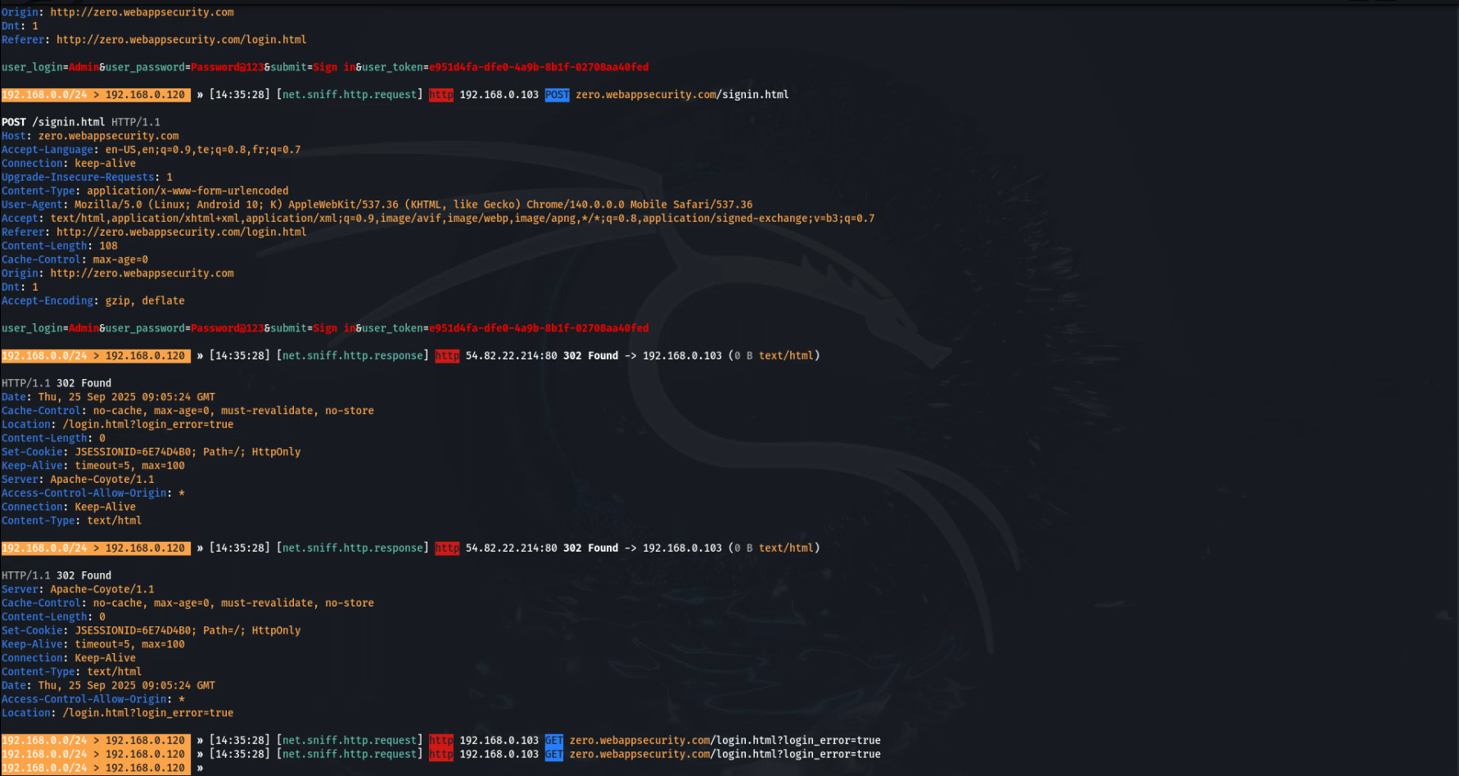
Proof of Concept

Slide 6
Video Demonstration
See video ./internship_proof_of_concept.mp4

Slide 7
Action to take
All critical and confidential forms or pages should not be served over HTTP.
All sensitive data should be transferred over HTTPS rather than HTTP.
All aspects of the application that accept user input, starting from the login process, should only be served over HTTPS.

