Slide 1
Vulnerability Report
URL: http://testasp.vulnweb.com
Page: /login.asp
Scan Time: 26/09/2025 00:54:46 AM

Slide 2
Vulnerability Found
SQL injection
Impact
SQL injection is allowing login bypass and taking over of user accounts.

Slide 3
Summary
The url http://testasp.vulnweb.com is susceptible to SQL injection attacks, which can be used to bypass authentication and take over user accounts.

Slide 4
Steps to reproduce
Attacker has to just know the username of their target.
Attacker then enters the username on the input box with an SQL syntax “ ‘-- “ in front so as to temper around the query and ignore password and authenticate.
For example username: admin’-- and password: anything can take over the admin account without its password.

Slide 5
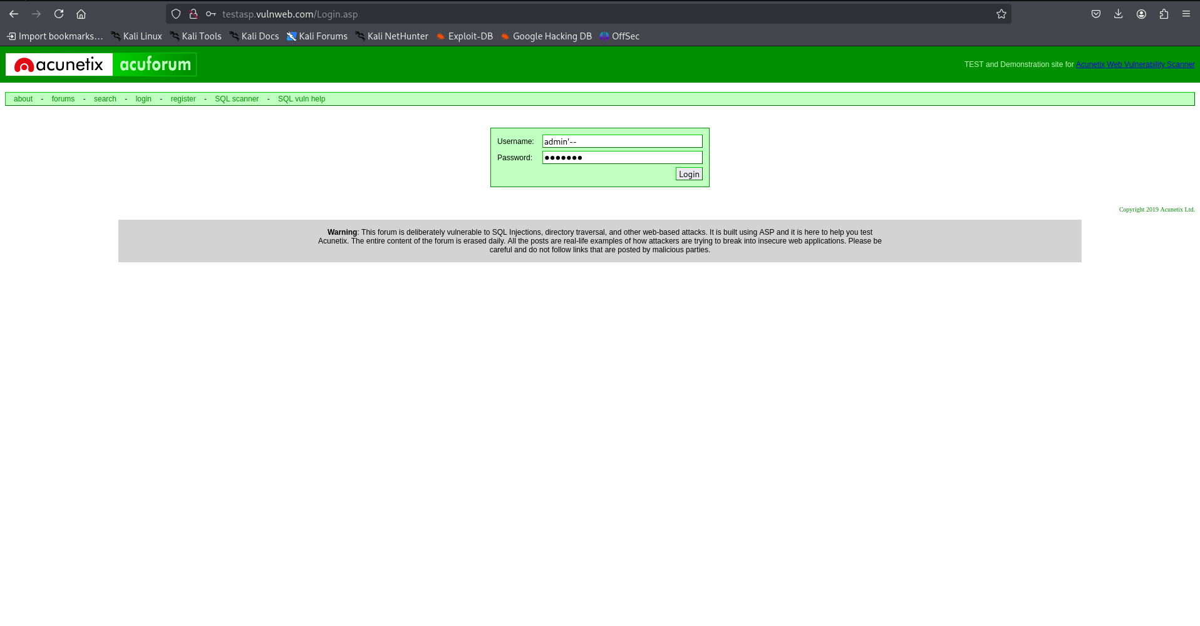
Proof of Concept

Slide 6
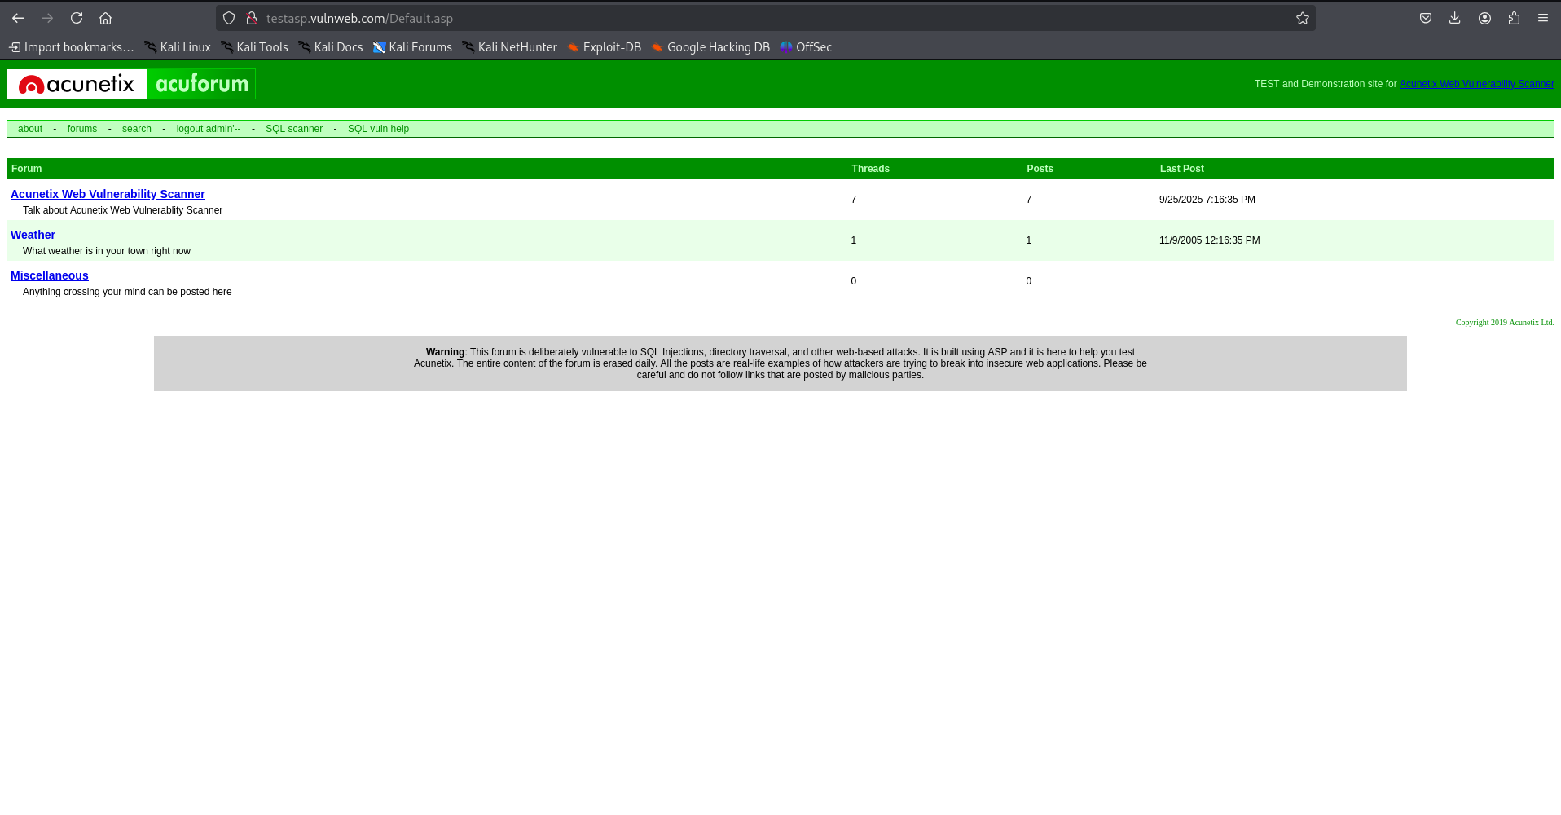

Slide 7
Video Demonstration
See video ./proof_of_concept_testasp_vulnweb.mp4

Slide 8
Action to take
Use parameterized queries (prepared statements) or stored procedures to ensure user input is treated as data, not executable code, preventing attackers from injecting malicious SQL commands.
Validate and sanitize all user inputs rigorously with whitelist input validation to accept only expected characters and patterns, removing potentially harmful input.
Enforce the principle of least privilege by granting minimal database permissions needed for application functionality, reducing attack impact if exploited.
Avoid displaying detailed database error messages to users; instead, log errors internally while showing generic messages to prevent attackers from gaining insights.

