Slide 1
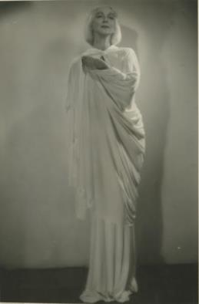
Ruth St. Denis
Zoe MacLeod
CFPRT
December 4, 2013

Slide 2
Series
Journals
Correspondence
Writings
Performance and dance materials
Media
Ephemera, clippings and publications
Books from personal library
Business materials

Slide 3
St. Denis was a pioneer of modern dance
Combined spirituality and dance
Denishawn School of Dance
Society of Spiritual Arts
Jacob’s Pillow
Rhythmic Choir
Dance program at Adelphi University

Slide 4
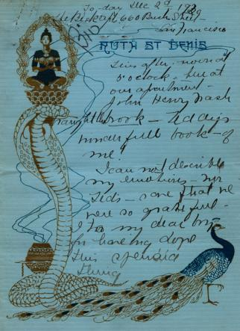
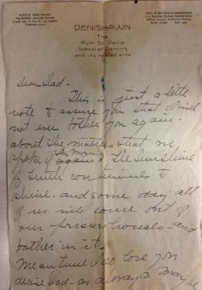
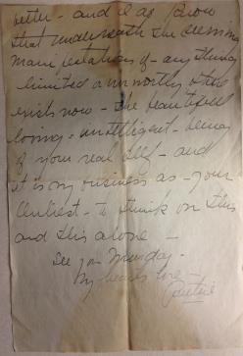
Journals and Correspondence
Letter to father
Journal entry

Slide 5
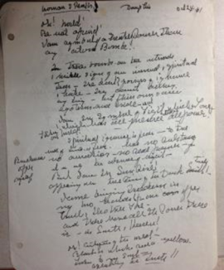
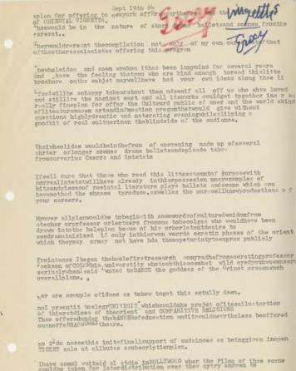
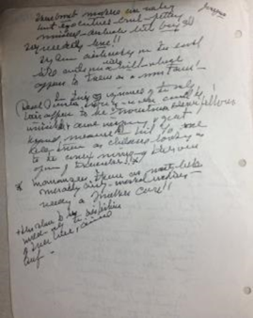
Writings
“Woman Speaks,” 1961
Essay, 1964

Slide 6
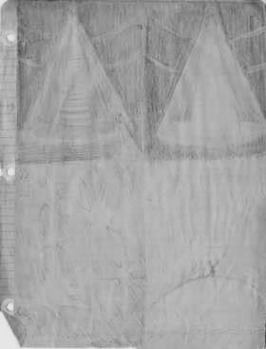
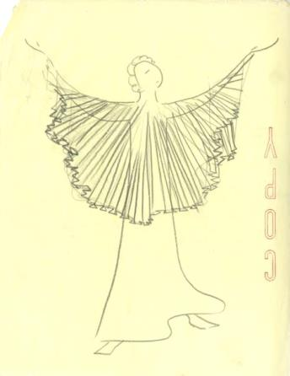
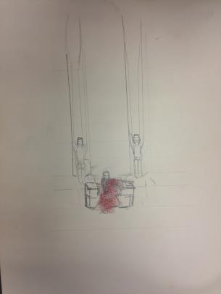
Dance Sketches

Slide 7
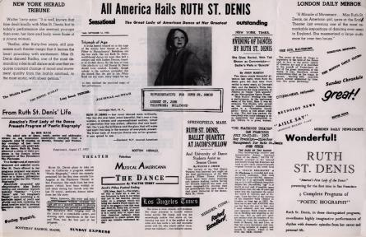
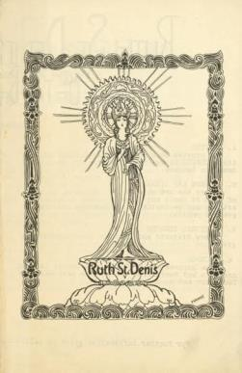
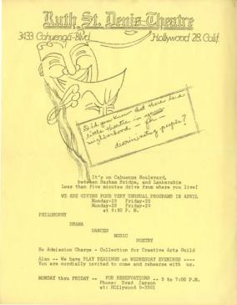
Ephemera

Slide 8
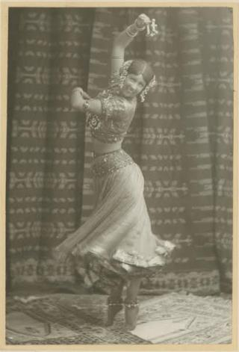
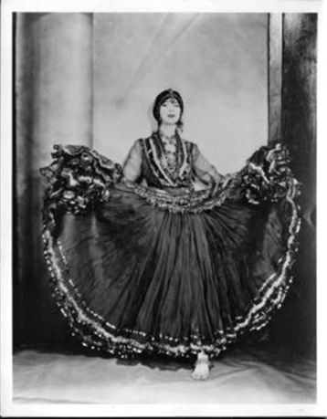
Photographs
Radha, 1906
The Nautch

Slide 9
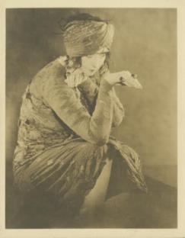
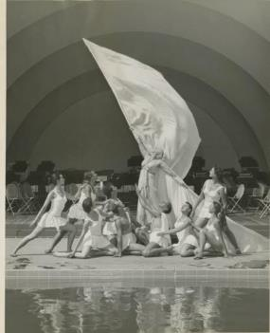
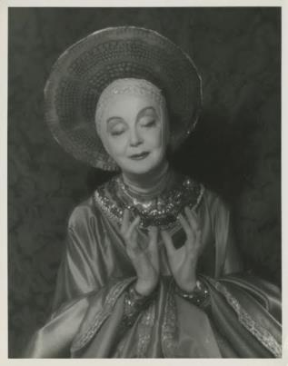
Photographs
The Cobra
Ballet of Light, 1950s
Blue Madonna, 1955

Slide 10
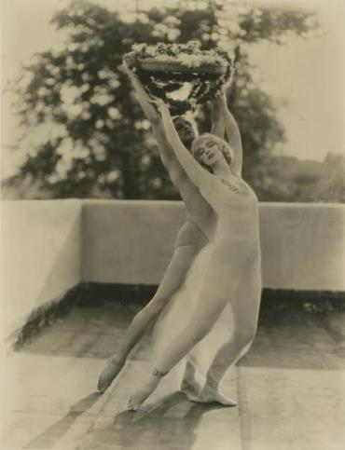
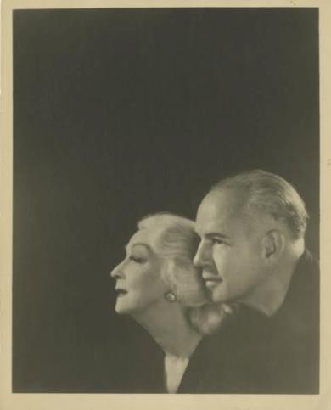
Photographs
Idyll, 1932
Ruth St. Denis and Ted Shawn, 1956

