Slide 1
Emotional Release
Sara Fahring

Slide 2
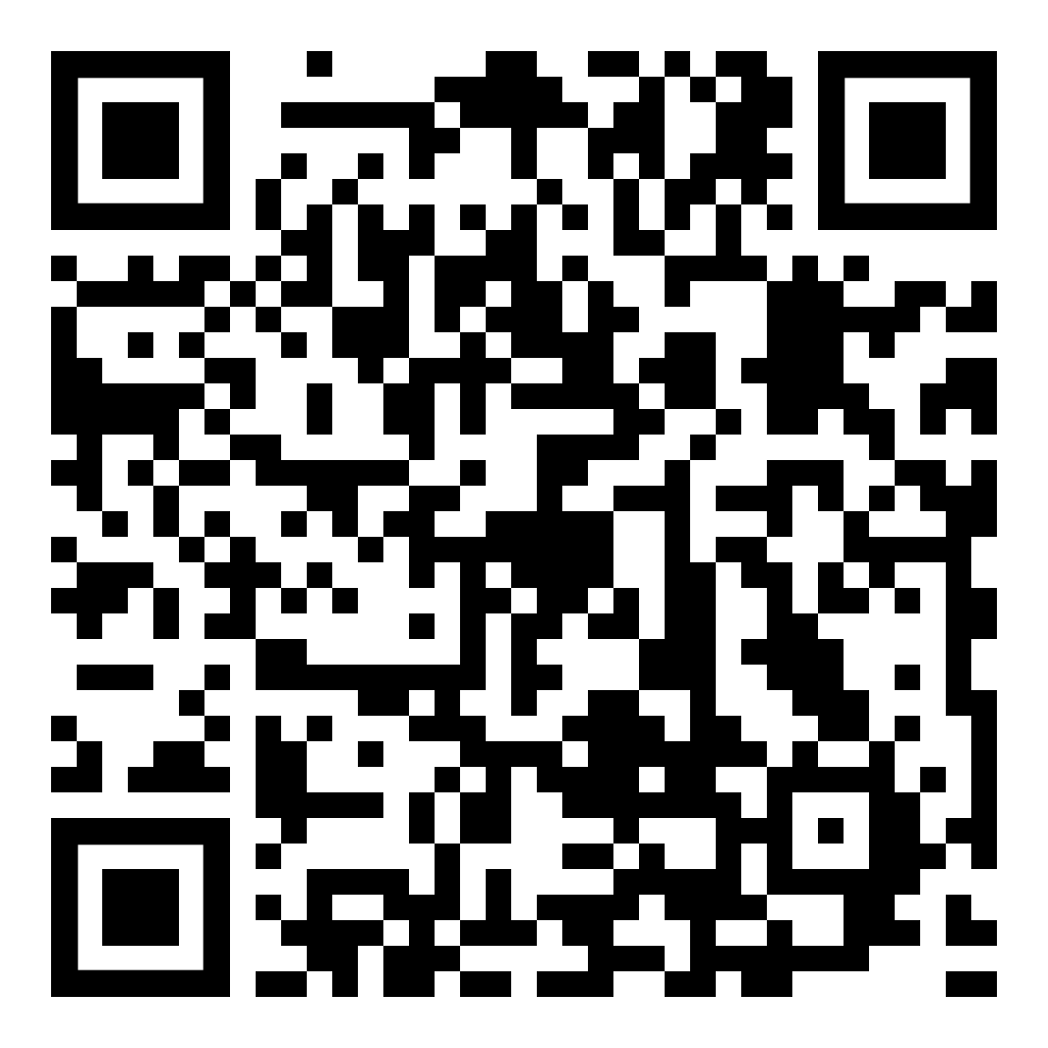
Resources
github.com/DancinFosse/Talks/blob/main/emotional_release.md
Notes:
https://github.com/DancinFosse/Talks/blob/main/emotional_release.md

Slide 3

Setup
Bed
(or Yoga Mat)
2 Pillows
(with pillow cases)

Slide 4
Why?

Slide 5
Why?
Release emotion
Express yourself
Feels good
Healthy

Slide 6


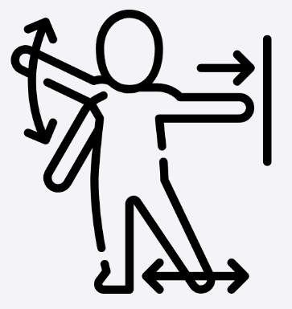
Three Elements of Somatic Release
Breath
Sound
Movement

Slide 7
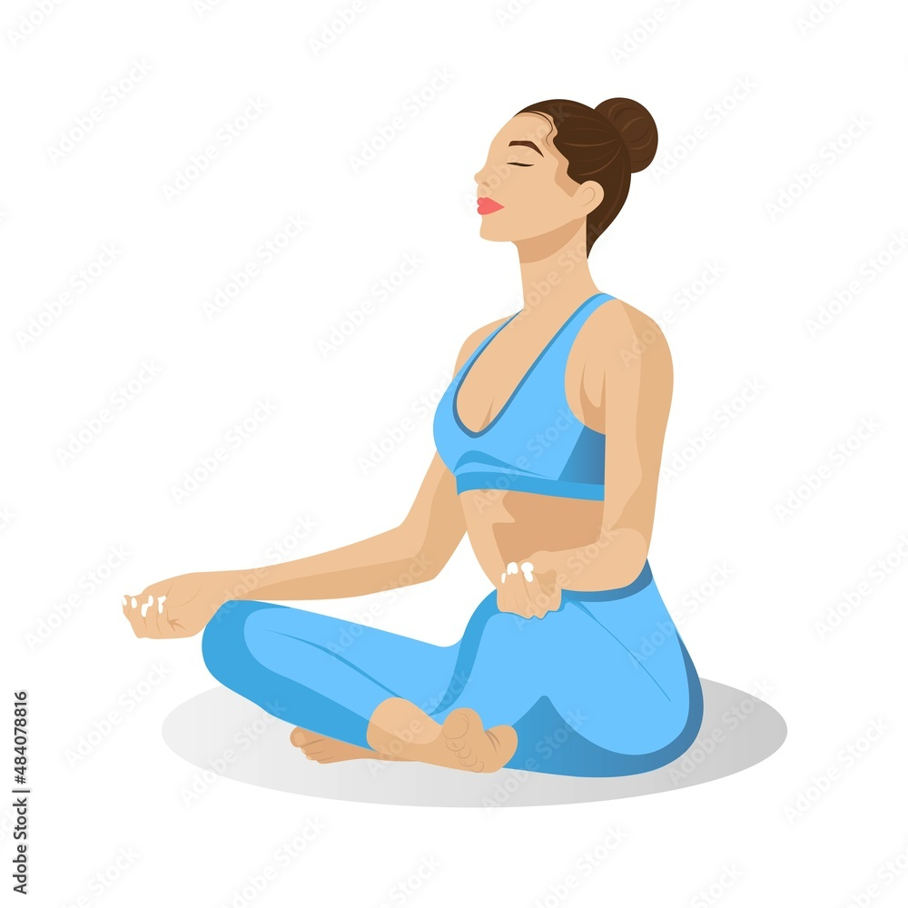
Breath
1. Nose
4. Mouth - Huh
2. Belly - Out
3. Belly - In

Slide 8

Hand Scream
Technique #1
Exhale
“Augghh”
Wiggle

Slide 9

Foot Stomping
Technique #2
Exhale
“NO!”
Stomping

Slide 10
Hand Scream and Foot Stomping
Bonus Technique

Slide 11

Pillow Screaming
Technique #3
Exhale
Belly scream
Exhale
Wiggling

Slide 12
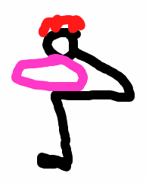
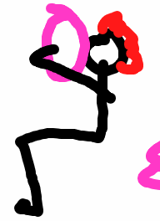

Alternative Positions
Pillow Screaming

Slide 13

Pillow Pounding
Technique #4
Exhale
“NO!”
Hitting the pillow

Slide 14
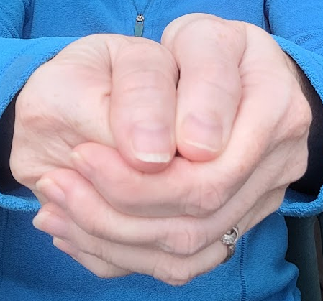
Hand Position
1. Make a fist.
3. Wrap second hand around
the closed fist.
2. Thumb on the outside.
4. Second thumb sits beside the first

Slide 15
Strike

Slide 16
Hinge

Slide 17
Tantrum
Technique #5
“Ahhh!!”
“I said no!”
Slapping the bed
Stomping feet
Exhale

Slide 18
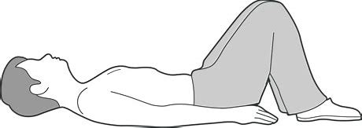
Lying on Back
Tantrum Position #1

Slide 19
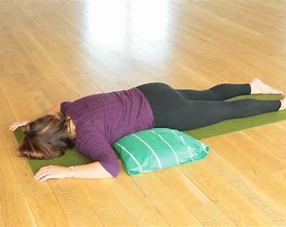
Face Down
Tantrum Position #2

Slide 20
Grief Ritual or Wailing
Technique #6
Thoughts- Still from the video?? One on my knees and another with the towel??
Cry
Wail
Arms open to
the side,
shoulders back
body shaking
Exhale

Slide 21
On knees
Grief Ritual #1

Slide 22
On back with towel
Grief Ritual #2

Slide 23
Pillow Humping
Technique #7
Pillow between
knees; Focus
on hip thrusting
“NO!”
“Uh”
Exhale

Slide 24


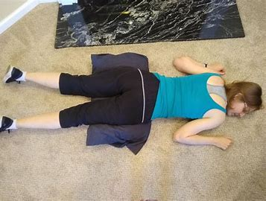
Positions

Slide 25
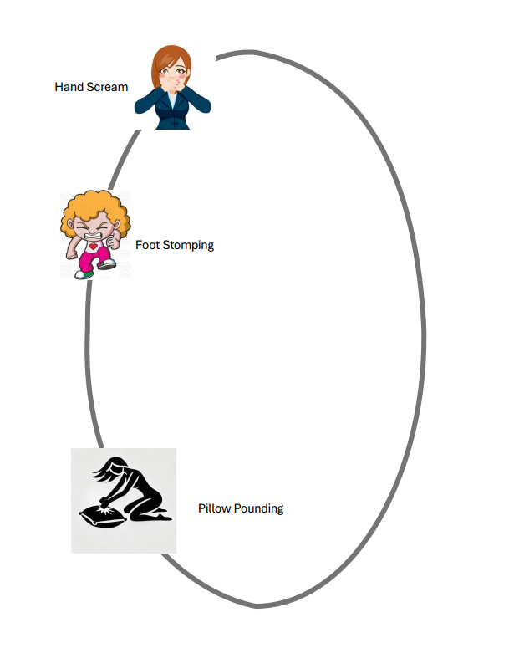

Slide 26

Thank You
github.com/DancinFosse/Talks/blob/main/emotional_release.md
Notes:
https://github.com/DancinFosse/Talks/blob/main/emotional_release.md

