Slide 1
Pycroscopy Data Formatting
Stephen Jesse, Suhas Somnath, Chris Smith
01/30/2017

Slide 2
SPM Data Formatting and Analysis Efforts at CNMS
Data Format:
Data stored in HDF5 format
Open source format. Hierarchical Data Format v5 (HDF5)
Same standard for different microscopes and microscopy methods
Works for standard imaging and spectroscopic measurements as well
Conventional AFM images would have a single data point at each spatial location. Eg – tapping mode imaging, contact mode imaging
Spectral images : One or more parameters systematically varied over a range of values at different spatial positions in a grid or cloud of points. Example – band excitation data

Slide 3

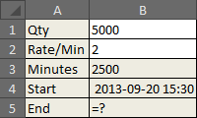
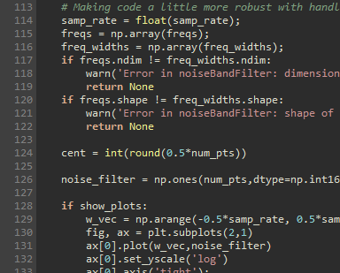
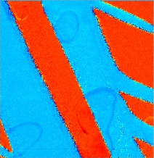
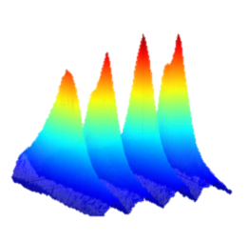
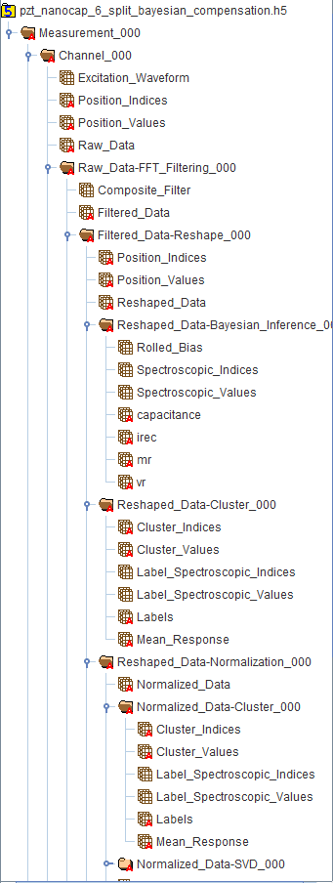
What is an HDF5 File?
An HDF5 file is a smart container
Hierarchical / tree structure
Capable of storing:
Multidimensional datasets
Images
text
Contents organized like traditional folders and files
Important components:
Datagroup - Analogous to folders in a file system
Dataset – contains 1 to N dimensional data
Integer, floating point, complex numbers etc
Attributes – Key : value pairs that contain information to describe the data. Eg – units.
References – Analogous to shortcuts / links
See here for more information on HDF5: http://extremecomputingtraining.anl.gov/files/2015/03/HDF5-Intro-aug7-130.pdf

Slide 4
Data Formatting – Main Datasets
All data, regardless of dimension, is laid out into a 2D array
The first dimension for location index
The second dimension for spectral index
Keys provide instructions on original data dimensionality
Allows for irregular position arrays (cloud of points)
Allows for irregular spectral measurements (set-pulses,…)
Keeps track measurement sequence
Format matches what PCA, ICA, etc. expects

Slide 5
HDF5 File Format for BE: Ver. 4
Root
Contains top level attributes
If measurement conditions change (e.g. adjustments to the band width or center) during a measurement, a new folder within the full data set will be created. Presumably this will not happen often.
Measurement conditions 1
Group
Measurement conditions 2
Attribute A
…
Attribute Z
Note:
This example represents 5D data:
3 spatial dimensions
2 spectral dimension
Position Matrices
value matrix of instances
Index matrix of instances
1D time vector of excitation
2D Matrix for an Entire Spectral-Image Chunked by outermost position loop.
These results have been already normalized by the excitation band
Frequency index
Cycle index
Value matrix for observables
Normalization matrix

Slide 6
Data Formatting – Cont.
All data, regardless of dimension, is laid out into a 2D array
The first dimension for location index
The second dimension for spectral index
Keys provide instructions on original data dimensionality
Allows for irregular position arrays (cloud of points)
Allows for irregular spectral measurements (set-pulses,…)
Keeps track measurement sequence
Format matches what PCA, ICA, etc. expects
Subsequent analysis, such as fitting, is contained in ‘subfolders’
of the parent data within the HDF5 structure

Slide 7
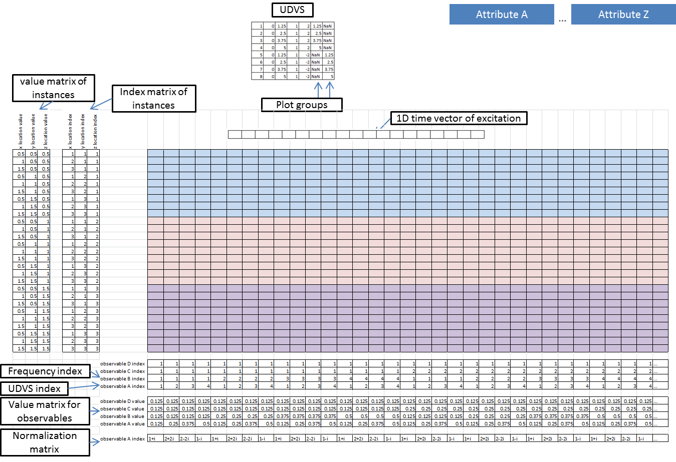
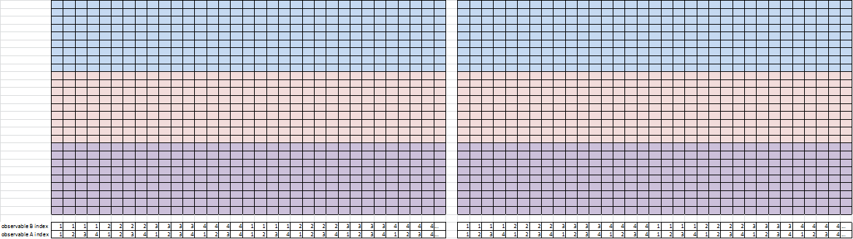
HDF5 File Format for BE: Ver. 4
Root
Measurement conditions 1
Group
Measurement conditions 2
Parent data
Fitting results (and fit guesses) get their own group within the parent data group.
References to fit procedures are contained in attributes.
Adoption of new fit parameter indices reflects dimensionality reduction.
Continue to share location indices with the parent data.
SHO Fit Results, Measurement conditions 1 - subGroup
Attribute A
…
Attribute Z
SHO Fit guess matrix
SHO Fit results matrix
Fit parameter index
UDVS index

Slide 8
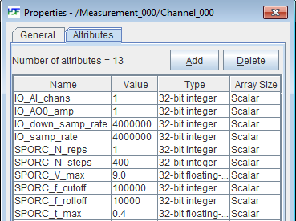
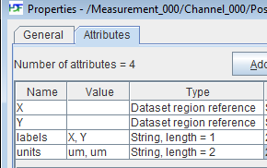
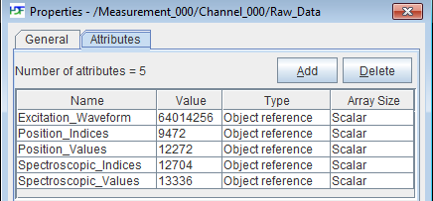
Example Datafile
Metadata stored as attributes
Data columns / rows can be accessed by name instead of indices
Nomenclature of datagroups provides simple way to understand sequence of steps applied to process data
Datasets link to relevant ancillary data

Slide 9
Generic File Rules – Mandatory Datasets
<Root>
Measurement_000 (new measurement group each time parameters change)
Channel_000 (one for each physical channel like deflection, lateral.. All channels should be recorded simultaneously.)
<Raw_Data> (positions x time or spectroscopic values)
type : uint8, float32, complex64 etc.
Required attributes:
Position_Indices – HDF5 Object reference to the <Position_Indices> Dataset
Position_Values – HDF5 Object reference to the <Position_Values> Dataset
Spectroscopic_Indices – HDF5 Object reference to the <Spectroscopic_Indices> Dataset
Spectroscopic_Values – HDF5 Object reference to the <Spectroscopic_Values> Dataset
Quantity - Single string that explains the data – eg – Current or Voltage
units – list of a single string for units like nA, V, F, etc.
Region references that match those in the <Position_Indices> Dataset
Region references that match those in the <Spectroscopi_Indices> Dataset
<Position_Indices> (positions x spatial dimensions)
type : uint32
Required attributes:
labels - list of strings for the column names
Region references based on column names
<Position_Values> (positions x spatial dimensions)
type : float32
Required attributes:
labels - list of strings for the column names
units – list of strings for units like nm / um
Region references based on column names
<Spectroscopic_Indices> (spectroscopic parameter x spectroscopic indices)
type : uint32
Required attributes:
labels - list of strings for the row names
Region references based on row names
<Spectroscopic_Values> (spectroscopic parameter x spectroscopic values)
type : (at least) float32 or complex64
Required attributes:
labels - list of strings for the row names
units – list of strings for units like mV / rad / sec
Region references based on row names
Measurement_001…
Legend:
Dataset
Datagroup
Attribute
Additional datasets, data groups, and attributes can be added as necessary depending on the measurement

Slide 10
Generic SPM File Rules – Attributes for Root
<Root>:
comments = ’10X amplifier used’
data_tool = ‘be_analyzer’
data_type = ‘BELine’ ← mandatory – used for reading data
experiment_date = 2015_10_15-14_55_05
experiment_unix_time = 1.35654765E+9
microscope = ‘Asylum Research Cypher’
instrument = ‘Cypher West CNMS’
project_id = ‘CNMS_2015B_X0252’
project_name = ‘HfO2 investigation’
sample_description = ‘8 nm HfO2 with 300um2 capacitors’
sample_Name = ‘HFO2’
translate_date = 2015_10_15-14_55_05
translator = ‘ODF’
user_name = ‘John Doe’
xcams_id = ‘jdoe’
Incorporating units:
attribute_name_[unit] = Value
read_voltage_[V] = 3.9
Time stamp:
YYYY_MM_DD-HH_mm_ss
24 hour format for hours

Slide 11
Nomenclature for Processing Tools
Analysis tools include function fitting, multivariate analysis functions etc. while processing tools include signal / image filtering, flattening functions etc.
General Rule
Example -> Chain of analysis tools (SVD and kMeans)
DatasetName
DatasetName-ToolName_00x
time_stamp
machine_id
tool_name
algorithm
Other relevant attributes
ToolResult0
Reference to DatasetName
Reference to mapping matrices (position / spectroscopic) for unpacking and/or plotting
labels
units
ToolResult1
…..
Raw_Data
Raw_Data-SVD_000
<SVD Attributes>
S
<Relevant references>
U
<Relevant references>
V
<Relevant references>
U-Cluster_000
Type = ‘KMeans’
Labels
<Relevant references>
Mean_Response
<Relevant references>
Raw_Data-SVD_001
S
U…
Legend:
Dataset
Datagroup
Attribute
Current methodology facilitates:
Same tool (with different parameters) to be applied to same dataset (different suffixes)
Tracing of all processing applied to any given dataset (using paths)

Slide 12
Example Rules for Processing Tool – Singular Value Decomposition (SVD)
Raw_Data
Raw_Data-SVD_000
time_stamp
machine_id
tool_name
algorithm
S
Component_Indices
U
Copy of the Position_Values attribute of Raw_Data
Copy of the Position_Indices attribute of Raw_Data
Reference to Component_Indices named as ‘Spectroscopic_Indices’
Reference to S named as ‘Spectroscopic_Values’
labels
units
V
Reference to Component_Indices named as ‘Position_Indices’
Reference to S named as ‘Position_Values’
Copy of the Spectroscopic_Values attribute of Raw_Data
Copy of the Spectroscopic_Indices attribute of Raw_Data
labels
units
Legend:
Dataset
Datagroup
Attribute
Do NOT store references to source dataset – Should the user want to only export a certain analysis / processing result (group), all the references within the group will also be copied over.

