Slide 1

USED CARS DATA ANALYSIS
TEAM MEMBERS:BADRINATH,UPENDAR

Slide 2

ABOUT US
DANDA UPENDAR REDDY
BTECH(MECHINAL ENGINEERING)
INTRESTED TO LEARN DATA SCIENCE
FOR BETTER CARRER TRANSFORMATION

Slide 3
TABLE OF CONTENTS
PROBLEM STATEMENT
INTRODUCTION
WEBSCRAPING
DATA CLEANING
DATA VISUALIZATION
CONCLUSION

Slide 4
PROBLEM STATEMENT
The objective of this study is to analyse used cars prices in America, by scraping data from website cars.com, and analysing different aspects and factors that lead to actual used car price valuation.
The purpose of this study is to understand and evaluate the used car prices and to develop an idea of buying cars.

Slide 5
INTRODUCTION
The second-hand car market has been growing in popularity , providing opportunities for both buyers and sellers.
Buying a used car is the best option for costumers for those who cannot afford a new branded car because the price is fair and affordable.
However many factors affect the price a of used cars , including brand name, number of miles travelled & year of manufacturing.

Slide 6
LIBRARIES USED
Seaborn
Pandas
Numpy
Matplotlib
Requests
BeautifulSoup
Regular Expression

Slide 7

WEB SCRAPING
Web scraping is the process of using bots to extract content and data from a website.
Most of this data is unstructured data in an HTML format which is then converted into structured data in a spreadsheet or a database so that it can be used in various applications.

Slide 8
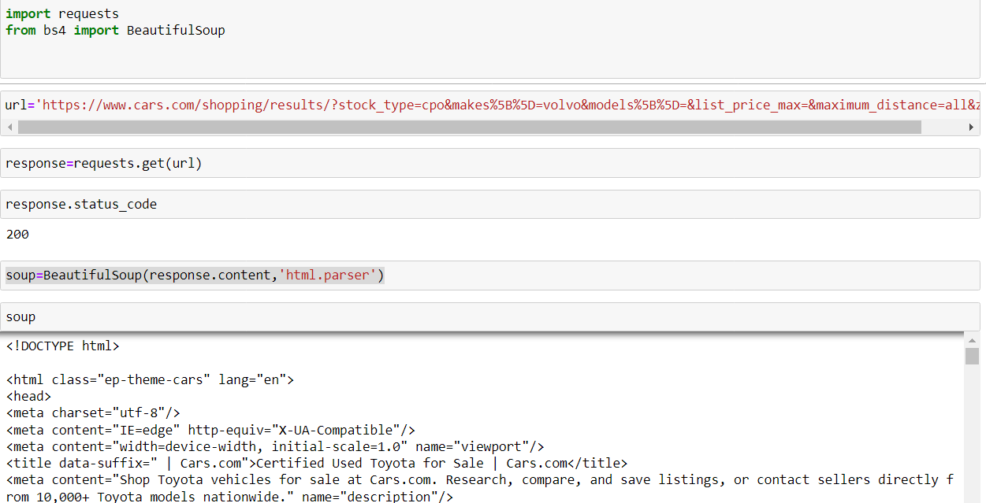
This is how unstrucred data is created using Request library from website URL’s

Slide 9
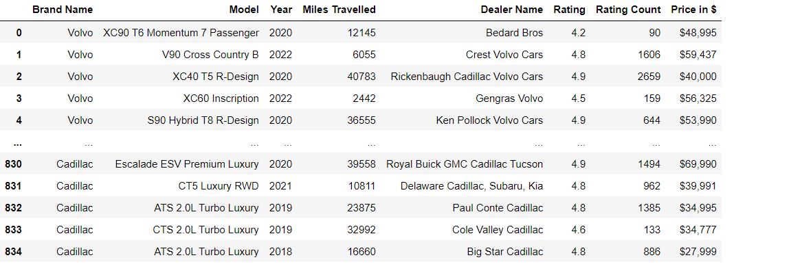

Now we have Created Data Frame Using Pandas Library.

Slide 10
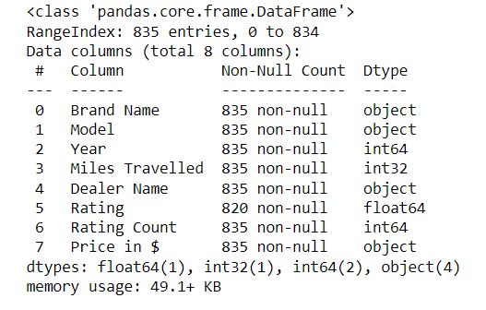
SUMMARY OF THE DATA
In the Previous slide we got a Data frame.
We have secured 834 rows and 8 columns .
we have taken the Brand names ,Prices , and other
Required data of it.
We have taken 8 brands of cars for analysis
The Data which we got is uncleaned
So the data has to cleaned for further analysis.

Slide 11
PROCESS OF DATA CLEANING
Identifying Null values .
Extracting required data from columns
Create another columns using regular expressions.
Dropping the unwanted Data.
Removing the symbols and punctuation marks .
Treating columns and converting required columns from object.
Those columns can be converted into int or float data types.

Slide 12
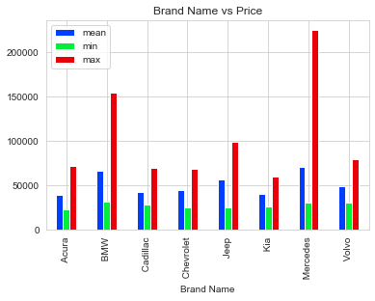
Here we observed that every car brand has different prices from the above bar plot we found that Mercedes-Benz has maximum price when compared to other brand cars price.

Slide 13
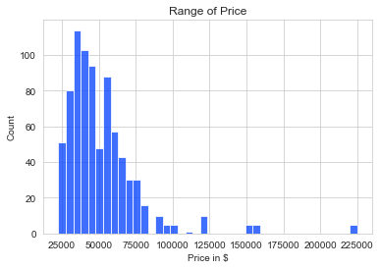

From the above plot we found that more number of cars are available below $100,000

Slide 14
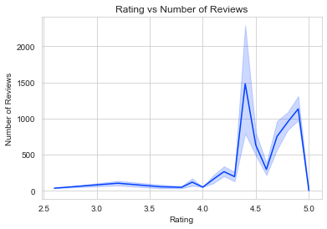
From this plot we found that many of them given rating above 4.

Slide 15
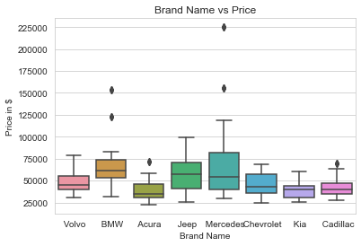
From this plot we found that some outliers in the BMW, Acura, Mercedes and Cadillac.
Mercedes-Benz has more price when compared with the other brand car prices

Slide 16
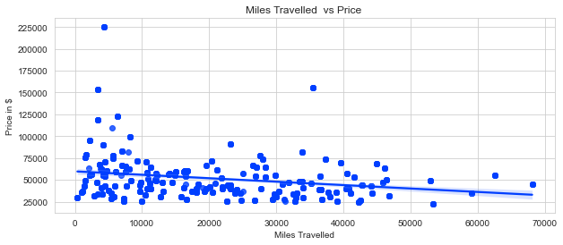
From this plot we found that miles travelled is negatively correlated with price as the number miles travelled increases Price decreases.

Slide 17
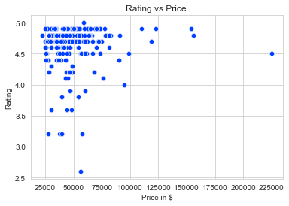
From the above plot we found that there are more number of cars available less than $100,000 which are rated above 4.

Slide 18
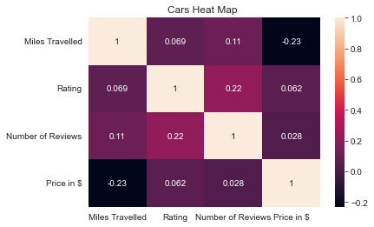
From the above plot we found that miles Travelled is negatively correlated with Price.As Miles Travelled increases Price decreases.

Slide 19
CONCLUSION
Using this analysis we found that the Price of car increases with decrease in miles travelled.
From the taken brand of cars we found that Mercedes-Benz has maximum price when compared with other brand of cars.
From the taken cars we found that more number of cars are available below $100,000.

Slide 20
CHALLENGES WORKING ON WEB SCRAPING – DATA ANALYSIS PROJECT
One of biggest challenge we faced on our web scraping project is selecting the website which allows us to scrap the data.
Even after selecting the website we might find null values in that particular cells.
Splitting the data according to our requirements is one of biggest challenges we faced.
Data cleaning is one of major challenge treating null values, treating objects and
Converting it into the required data type.

Slide 21

THANK YOU

