Slide 1
Bike Sharing
Demand Prediction
End-to-end data science project
Hourly rentals | model evaluation | Streamlit deployment
2011–2012 project records
Notes:
Introduce the project as an end-to-end hourly bike-demand forecasting workflow. The presentation distinguishes notebook-reported scores from the unresolved chronology issue.
Source: user-provided Bike_Rental.ipynb and Streamlit deployment log from the referenced conversation.

Slide 2
Project summary
A full regression workflow moved from hourly rental records to a Streamlit prediction and monitoring interface.
17,379
17
20
61.52
hourly records
source variables
regression models
best reported test RMSE
Validation caveat
The notebook reports 10,501 missing dates after parsing, then forward-fills them. Its held-out window covers only about a week. Fixing chronology may change every time-series score.
02
Notes:
The final reported all-model successive-halving result selected XGBoost: RMSE 61.5193, MAE 39.5729, R² 0.9234. These metrics are provisional until date parsing and the holdout window are revalidated.
Source: user-provided Bike_Rental.ipynb and Streamlit deployment log from the referenced conversation.

Slide 3
Business objective and prediction target
Business objective
Prediction problem
Forecast hourly rental demand so an operator can plan bike availability, station rebalancing and service capacity ahead of expected peaks.
Input
Calendar, hour, season, weather and engineered demand-context features
Target
cnt = total hourly rentals
Type
Supervised regression. Errors are measured in bikes rented per hour.
03
Notes:
The operational value statements describe intended uses of a demand forecast. The notebook does not quantify staffing, availability or revenue impact.
Source: user-provided Bike_Rental.ipynb and Streamlit deployment log from the referenced conversation.

Slide 4
Dataset and analytical scope
17,379
Feature groups
Time and calendar
dteday, yr, mnth, hr, weekday, holiday, workingday
hourly observations
17
Weather
season, weathersit, temp, atemp, hum, windspeed
columns in the source file
Rental counts
casual, registered, cnt
No latitude, longitude or station identifier appears in the supplied schema. The project visual is a workflow map, not a geographic map.
04
Notes:
The notebook describes 17,379 rows and 17 columns. The target cnt is total hourly demand; casual and registered are its component counts and must stay out of the predictors.
Source: user-provided Bike_Rental.ipynb and Streamlit deployment log from the referenced conversation.

Slide 5
Cleaning and data quality checks
Checks that passed
Issues to resolve
0 duplicate rows
0 invalid values in checked hour, weekday, normalized weather and nonnegative target ranges
IQR outliers retained because peaks can be genuine demand
10,501 dteday values became missing after conversion. The notebook forward-filled dates.
Six categorical values remained missing after cleaning: holiday (1) and workingday (5). The training pipeline later imputes categorical features by most frequent value.
Target cnt was not imputed. Numeric question-mark sentinels were converted to missing values; numerical features used median imputation.
IQR counts: 505 cnt • 1,192 casual • 680 registered • 341 windspeed • 22 humidity
05
Notes:
The notebook date conversion output is the central unresolved data-quality problem. The later model split is chronological by row, but its timestamps are not trustworthy while this issue remains.
Source: user-provided Bike_Rental.ipynb and Streamlit deployment log from the referenced conversation.

Slide 6
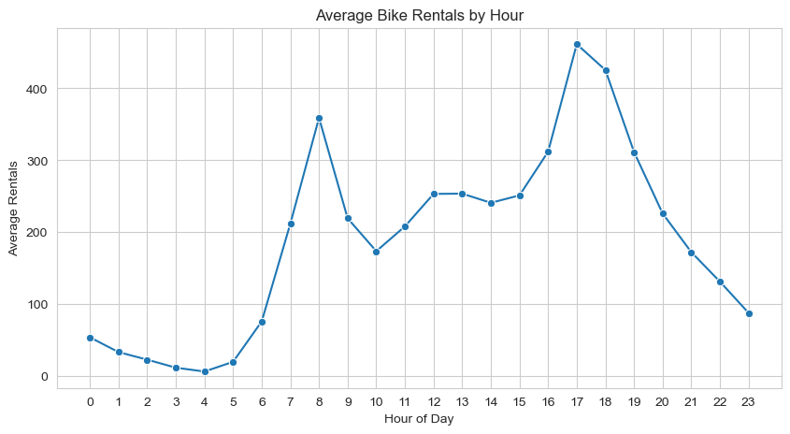
EDA: demand follows the hour of day
Commute peaks
Average rentals rise sharply around 08:00 and peak again around 17:00–18:00.
Quiet overnight
Demand reaches its lowest point around 04:00, then climbs through the morning.
The target distribution is right-skewed, with a small number of high-demand hours.
06
Notes:
This source plot is a notebook output and is embedded as a figure. Demand peaks are approximate readings from the chart, not forecast results.
Source: user-provided Bike_Rental.ipynb and Streamlit deployment log from the referenced conversation.

Slide 7
EDA: weather and calendar signals
Correlation with hourly rentals
Positive association
Temperature, feels-like temperature and hour show the strongest positive linear correlations.
Negative association
Humidity is negatively correlated with demand. Notebook EDA also reports lower rentals in poorer weather and summer/fall seasonality.
temp 0.404 • atemp 0.401 • hour 0.394 • humidity −0.323. Correlations describe association, not cause.
07
Notes:
Notebook correlations: temp 0.404482, atemp 0.400890, hr 0.394071, yr 0.250454, mnth 0.120658, windspeed 0.093320, weekday 0.026900, holiday -0.030926 and hum -0.322823.
Source: user-provided Bike_Rental.ipynb and Streamlit deployment log from the referenced conversation.

Slide 8
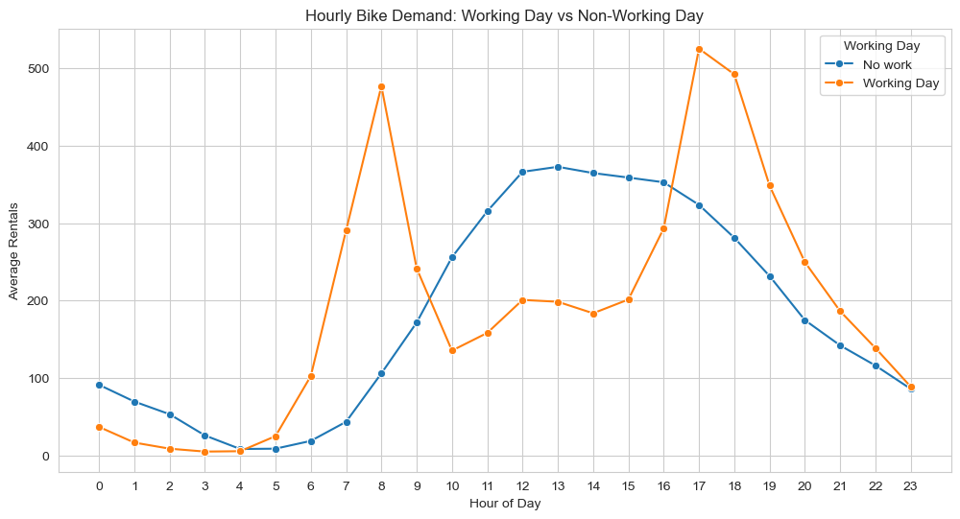
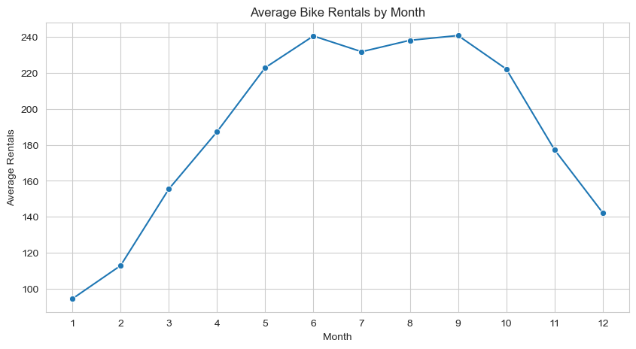
EDA: workday patterns and monthly demand
Different daily rhythms
Working days show sharper morning and evening peaks. Non-working days rise more gradually into the afternoon.
Seasonal cycle
Notebook summary: demand builds into mid-year, peaks around June–September, then falls toward winter.
08
Notes:
The two plots are source figures from the notebook. Month-of-year and workday patterns are grouped by source calendar fields; they do not rely on the parsed date column.
Source: user-provided Bike_Rental.ipynb and Streamlit deployment log from the referenced conversation.

Slide 9
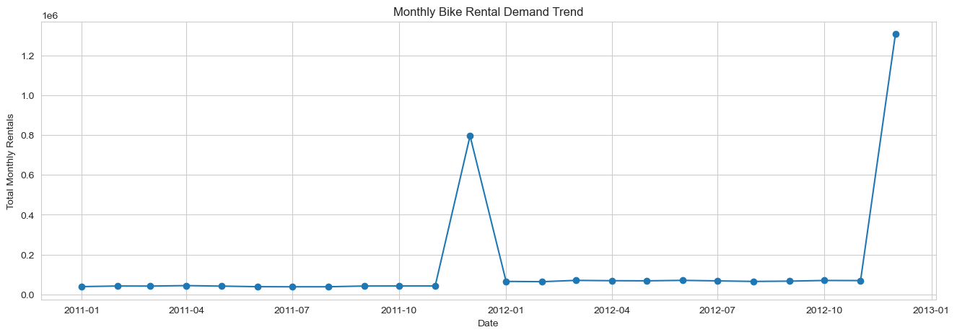
Time-series analysis and chronology check
Treat this plot as a QA signal
The monthly series contains extreme spikes after the notebook reports 10,501 missing parsed dates and forward-fills them.
A one-week holdout cannot test full seasonal generalization. Parse dates explicitly, verify unique increasing timestamps and rerun all time-based analysis before trusting these metrics.
Notebook split dates
Train: 1 Jan 2011 to 5 Dec 2012, 12:00
Test: 5 Dec 2012, 12:00 to 12 Dec 2012, 23:00
09
Notes:
The notebook monthly resample plot is included to show the chronology problem, not as a valid business trend. The reported train/test timestamps share the 5 Dec 2012 12:00 boundary, so strict timestamp separation should also be checked.
Source: user-provided Bike_Rental.ipynb and Streamlit deployment log from the referenced conversation.

Slide 10
Project workflow map
01
02
03
04
05
06
07
Source
Quality
Explore
Engineer
Validate
Model
Serve
Hourly CSV
17 fields
Clean types
check gaps
EDA and
time patterns
Calendar and
weather signals
Chronological
80 / 20 split
20 models
CV + tuning
Streamlit
predict + log
The source fields support time and weather analysis. They do not support a geographic map.
Next release gate: repair the date parse, rebuild the chronological split, then refresh model results and deployment artifacts.
10
Notes:
This editable workflow map summarizes the project stages. It is deliberately not a geographic map because the provided data contains no location coordinates or station identifier.
Source: user-provided Bike_Rental.ipynb and Streamlit deployment log from the referenced conversation.

Slide 11
Feature engineering
Temporal structure
Demand and weather context
Year, day, day of year and week of year
Time-of-day band
Rush-hour and peak-hour flags
Weekend indicator
Temperature × humidity comfort score
Squared temperature and humidity terms
High-wind, high-humidity and adverse-weather flags
Working-day commute and season–weather interactions
Leakage control
casual and registered were excluded because cnt = casual + registered. instant was excluded as an identifier.
11
Notes:
Feature names and interactions reflect the notebook’s engineered and domain-driven feature cells. Some engineered features may be redundant; validation-based feature selection was recommended.
Source: user-provided Bike_Rental.ipynb and Streamlit deployment log from the referenced conversation.

Slide 12
Encoding and scaling pipeline
Numeric features
Categorical features
Median imputation
Standard scaling
Most-frequent
imputation
One-hot encoding
unknown-safe
The fitted preprocessing sits inside the model pipeline and is learned from training folds. Tree models use imputation without scaling.
Encoding methods explored: label, ordinal, one-hot, binary, frequency and target encoding. One-hot was preferred for nominal categories; target encoding requires train-only fitting.
12
Notes:
Benchmark pipelines use ColumnTransformer, median numeric imputation and StandardScaler, plus most-frequent categorical imputation and OneHotEncoder(handle_unknown="ignore"). Tree preprocessing omits scaling.
Source: user-provided Bike_Rental.ipynb and Streamlit deployment log from the referenced conversation.

Slide 13
Regression models evaluated
Linear and robust
Nonlinear and kernel
Tree ensembles
Neural network
Linear Regression
Ridge Regression
Lasso Regression
Elastic Net
Huber Regression
Bayesian Ridge
SGD Regression
Passive Aggressive
Polynomial Regression
KNN Regression
SVR
Decision Tree
Random Forest
Extra Trees
Gradient Boosting
HistGradient Boosting
AdaBoost
XGBoost
LightGBM
MLP Regressor
20 models completed in the final benchmark. CatBoost was not installed and was skipped.
13
Notes:
The notebook has an initial 15-model algorithm overview and a later 20-model training and successive-halving benchmark. This list matches the completed benchmark; CatBoost was skipped.
Source: user-provided Bike_Rental.ipynb and Streamlit deployment log from the referenced conversation.

Slide 14
Benchmark results: stronger performers
Test RMSE in rentals per hour. Lower is better.
XGBoost led the all-model run. LightGBM and HistGradient Boosting were close behind.
14
Notes:
Final all-model successive-halving test RMSE: XGBoost 61.5193, LightGBM 63.4886, HistGradient Boosting 63.6411, Random Forest 63.8596, Extra Trees 65.1504, Gradient Boosting 65.3626, SVR 65.8388, MLP 69.7551, Polynomial 72.3978, Decision Tree 75.4819.
Source: user-provided Bike_Rental.ipynb and Streamlit deployment log from the referenced conversation.

Slide 15
Benchmark results: remaining models
Test RMSE in rentals per hour. Lower is better.
The linear family clustered near 132 RMSE, well above the boosted-tree results on this holdout.
15
Notes:
Final all-model successive-halving test RMSE: KNN 84.4888, AdaBoost 110.0824, Ridge 131.8194, Linear 131.8536, Bayesian Ridge 131.9040, Lasso 132.0612, Elastic Net 132.3125, Huber 133.4974, SGD 135.1676, Passive Aggressive 147.5976.
Source: user-provided Bike_Rental.ipynb and Streamlit deployment log from the referenced conversation.

Slide 16
Successive halving and temporal cross-validation
Search design
Best all-model CV RMSE
TimeSeriesSplit: 3 expanding folds
20 candidates per model
Initial resource: 1,000 rows
Maximum resource: 13,903 training rows
Halving factor: 3
LightGBM 66.89
XGBoost 66.98
HistGradient Boosting 67.25
Gradient Boosting 67.36
Random Forest 69.62
Other notebook searches used different model subsets and split counts. One five-fold subset run reported Gradient Boosting test RMSE 61.16; an additional three-model randomized CV run selected Random Forest at 64.80. These runs are not directly comparable.
16
Notes:
Successive-halving final comparison used TimeSeriesSplit with 3 folds across 20 models. Separate experiments used 5 folds on a subset and a second 3-model randomized search, so their results are kept distinct.
Source: user-provided Bike_Rental.ipynb and Streamlit deployment log from the referenced conversation.

Slide 17
Final model and regression metrics
XGBoost
61.52
39.57
0.9234
45.19%
Selected by the lowest test RMSE in the final 20-model tuned comparison
RMSE
MAE
R²
MAPE
How to read the result
Interpret MAPE carefully
RMSE penalizes large misses and is expressed in bikes per hour. MAE is the average absolute error. R² indicates 92.34% of test-set variance explained.
The 45.19% MAPE excludes zero targets but remains sensitive to very small rental counts. It can look high even when RMSE and R² are strong.
Final all-model output: Test MSE 3,784.63; Train RMSE 26.06; Test RMSE gap 35.46.
17
Notes:
XGBoost: CV RMSE 66.9800, Test RMSE 61.5193, Test MAE 39.5729, Test MSE 3784.6260, Test R² 0.9234, MAPE 45.1876%. Metrics are provisional until chronology is corrected.
Source: user-provided Bike_Rental.ipynb and Streamlit deployment log from the referenced conversation.

Slide 18
Deployment architecture
Operator
Streamlit app
Feature builder
Model
Outputs
Select forecast
conditions
Input controls
analytics
Align expected
model columns
Preprocessing
+ XGBoost
Prediction
+ log entry
Files shipped with the app
Interface pages
Runtime dependency
bike_demand_model.pkl
dashboard_data.csv
model_metadata.json
prediction_log.csv
Executive Dashboard
Interactive prediction form
Demand analytics
Model Monitoring
The serialized pipeline needs the same estimator libraries used during training.
18
Notes:
The notebook code saves the model pickle, historical dashboard data, model metadata and prediction log. The app loads these files, constructs model inputs and logs predictions.
Source: user-provided Bike_Rental.ipynb and Streamlit deployment log from the referenced conversation.

Slide 19
Streamlit dashboard and monitoring
User-facing dashboard
Monitoring workflow
Executive view with rental history and summary analytics
Input form for date, hour, season, weather and normalized conditions
Historical demand analyses split across dashboard tabs
Each prediction is appended to prediction_log.csv with a timestamp and model inputs. The monitoring page reads prediction history and can compare predicted with actual counts when actual labels are available.
Operational metrics
Monitor MAE / RMSE once outcomes arrive, along with feature ranges, missing-value rates and prediction volume. Retraining is a future operating step, not a measured result in the notebook.
The provided code creates a monitoring page and log. It does not establish production traffic, realized forecast quality or an automated retraining schedule.
19
Notes:
The Streamlit code has Executive Dashboard and Model Monitoring pages, app controls, dashboard analytics, prediction history and metadata display. The log supports later metric calculation when actual outcomes are supplied.
Source: user-provided Bike_Rental.ipynb and Streamlit deployment log from the referenced conversation.

Slide 20
Streamlit deployment issue and fix
Observed failure
Recommended correction
pickle.load() failed with ModuleNotFoundError: No module named xgboost.
Add XGBoost to requirements.
Pin scikit-learn to 1.7.2 to match training.
Use Python 3.13 for a reproducible deployment environment.
Redeploy and verify the model loads.
The cloud log also showed scikit-learn 1.9.1 loading a model created with 1.7.2, plus Python 3.14.9 in the runtime.
The referenced conversation documented the recommended fix. It did not confirm that the cloud app was successfully redeployed.
20
Notes:
The deployment log shows Python 3.14.9, scikit-learn 1.9.1 and an XGBoost import failure when loading the pickle. The prior troubleshooting recommended adding xgboost, pinning scikit-learn 1.7.2 and selecting Python 3.13; no successful redeploy was recorded.
Source: user-provided Bike_Rental.ipynb and Streamlit deployment log from the referenced conversation.

Slide 21
Project conclusions
A complete demand-prediction workflow is in place: data checks, exploratory analysis, domain-driven features, chronological validation, model benchmarking and a Streamlit interface.
Best reported all-model result
Tuned XGBoost
Test RMSE 61.52 • MAE 39.57 • R² 0.9234
Interpretation depends on correcting the date parse and rerunning the holdout. The model score is a notebook result, not a production guarantee.
21
Notes:
Close with the strongest supported conclusion: the notebook completed broad model comparison and Streamlit implementation, while the current evidence has a chronology caveat that must be resolved before using the reported score operationally.
Source: user-provided Bike_Rental.ipynb and Streamlit deployment log from the referenced conversation.

Slide 22
Limitations and future enhancements
Limitations
Future enhancements
Date parsing created 10,501 missing timestamps; forward filling can distort resampling and engineered calendar fields.
The test period is about one week and the notebook split boundary repeats a timestamp.
Model selection used reported test results, which can make the selected score optimistic.
MAPE is sensitive to low-demand hours.
No station geography or station-level availability fields are present.
Parse dates with the source format and verify unique, strictly increasing hourly timestamps.
Rerun rolling-origin CV and keep a future season as an untouched final test.
Report per-hour / per-weather errors and prediction intervals.
Add station, availability, event and richer weather inputs if collected.
Set monitoring thresholds and a versioned retraining process.
These improvements are proposed next steps; they are not completed project results.
22
Notes:
The first two limitations are directly evidenced by the notebook date parse and split outputs. Other items are proposed next steps to strengthen generalization, monitoring and spatial utility.
Source: user-provided Bike_Rental.ipynb and Streamlit deployment log from the referenced conversation.

