Slide 1
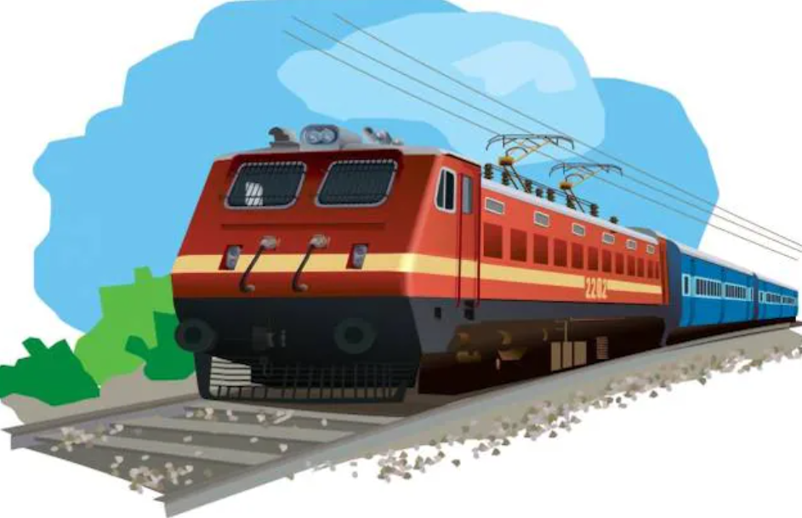
Forecasting train delays for providing advance information to passengers
UNDER THE ESTEEMED GUIDENCE OF:-
Dr. D.KISHORE BABU
PRESENTED BY :-
D. Kusumitha – Y20ACS433
Ch. Sri Vyshnavi –Y20ACS429
Ch. Greeshma – Y20ACS421
I . Kavya Sudha – Y20ACS460

Slide 2
CONTENTS
Abstract
Existing System
Proposed System
Design
Implementation
Results
Conclusion

Slide 3
Abstract
Efficient transportation is crucial for modern societies, yet unpredictable train delays pose challenges for commuters, impacting work, school, and appointments. Service disruption is a root cause for train delays. Service disruptions results from various conditions or factors such as accidents ,extreme Weather conditions and technical issues.
This project helps in predicting whether a train will be delayed or not by applying the machine learning techniques on the Real time data and also by building a Webpage with Django will provide information to the Passengers in their Regional Languages.

Slide 4
Existing System
The Existing System uses machine learning algorithms such as random forest , gradient boost to tackle train delays.
It deals with how historical data influence predictions of train delays.
Despite utilizing machine learning algorithms and considering historical data, the system struggles with efficiency , impacting its ability to make accurate predictions.

Slide 5
Proposed System
Continuously collect real-time data from sources such as APIs providing live train information and weather updates.
Preprocess the real-time data and extract relevant features.
Apply the trained model to predict delays based on cosine similarity and TF-IDF weighted features.
Deploy the prediction system as a service accessible to users or integrate it into existing train management systems for real-time decision-making.
And Build a Webpage that will answer the passengers queries in their regional languages.

Slide 6
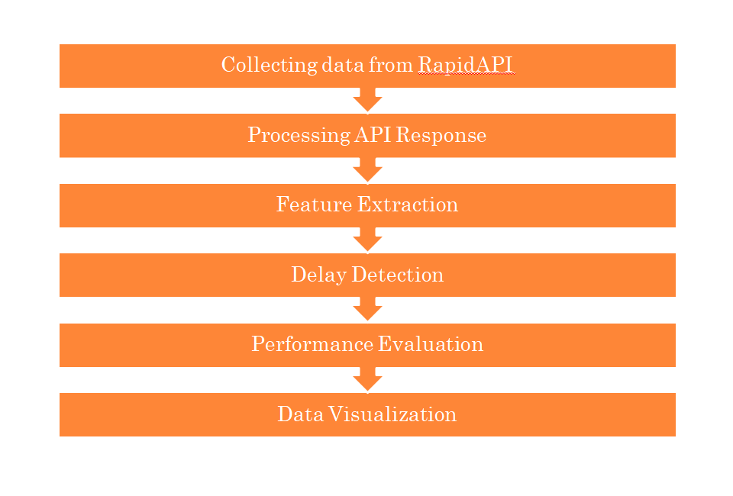
Design

Slide 7
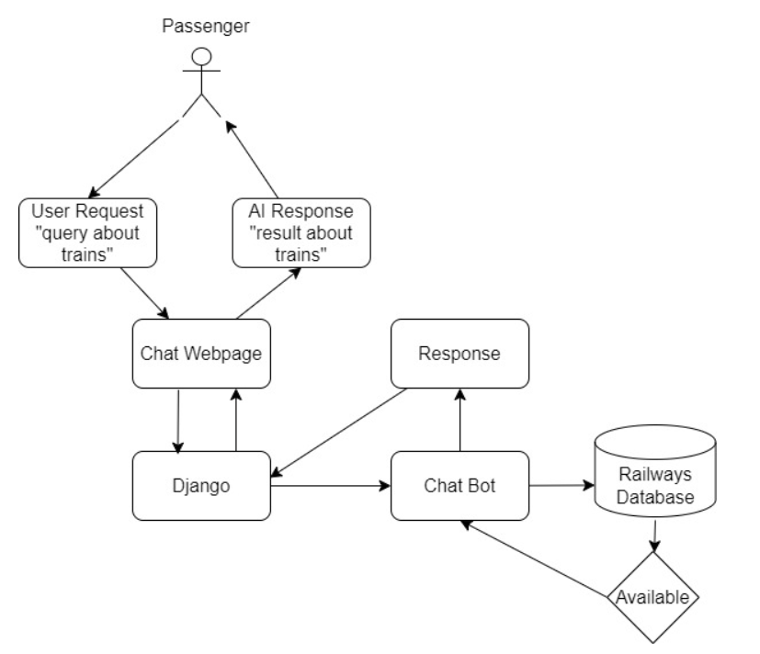
Design

Slide 8
Implementation
Data Collection: Obtain Real time train data from a reliable source. You can also collect data from the Rapid API.
Preprocessing: Preprocess the real-time data. This may involve handling missing values, converting categorical variables into numerical representations, and scaling the features if necessary.
Feature Engineering: Extract relevant features from the data that can help predict train delays.In essence, it involves selecting or deriving a subset of features from the original dataset that captures the most essential information for the task at hand

Slide 9
Implementation
Delay Detection: Train a cosine similarity-based model using the real time data. Cosine similarity can be used to measure the similarity between delay patterns and the real-time data.
Performance Evaluation: Evaluate the performance of your model using some of the performance Evaluation metrics like accuracy,precision,recall,f1score.
Data Visualization:Data visualization is the graphical representation of data and information. It involves the use of visual elements such as charts, graphs, and maps to communicate insights, patterns, and trends hidden within datasets

Slide 10
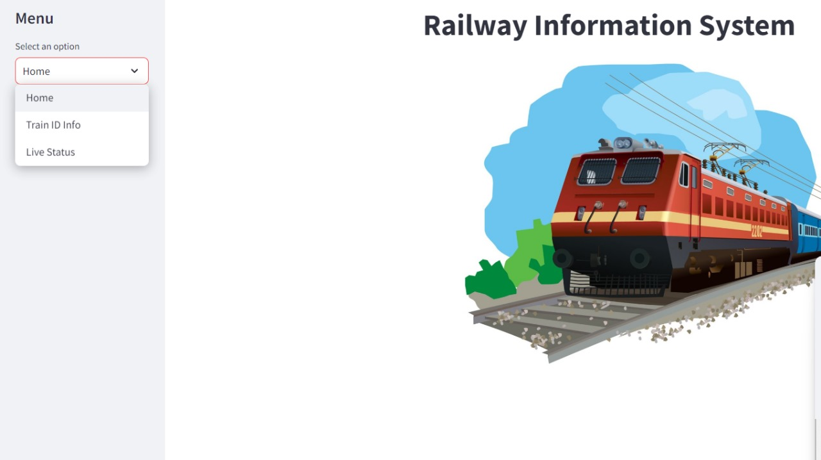
Results

Slide 11
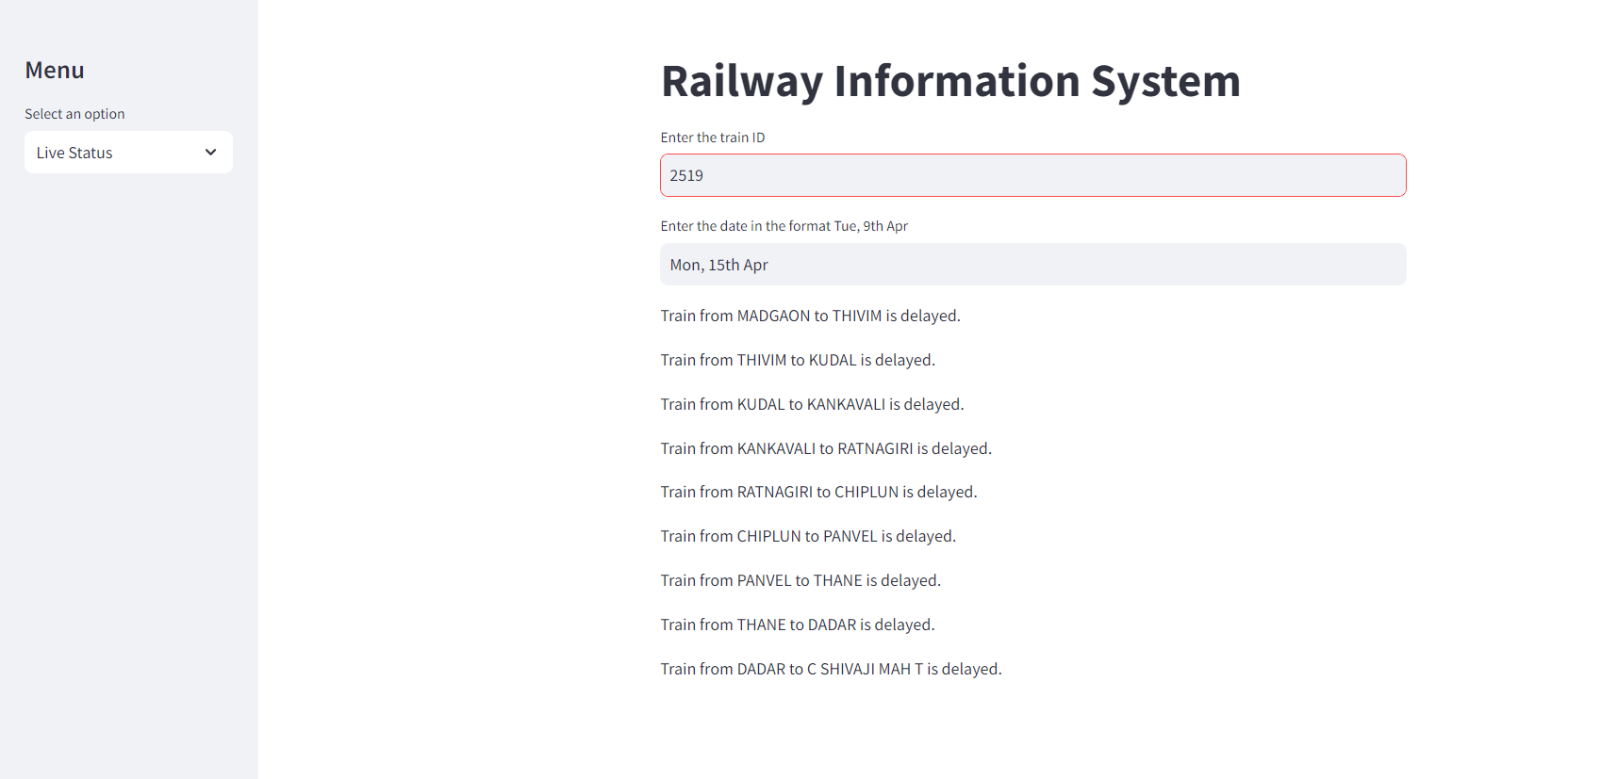
Results

Slide 12
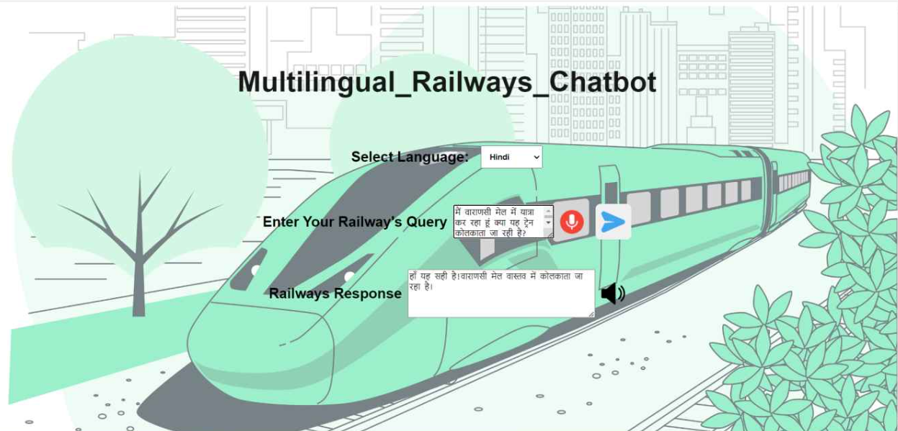
Results

Slide 13
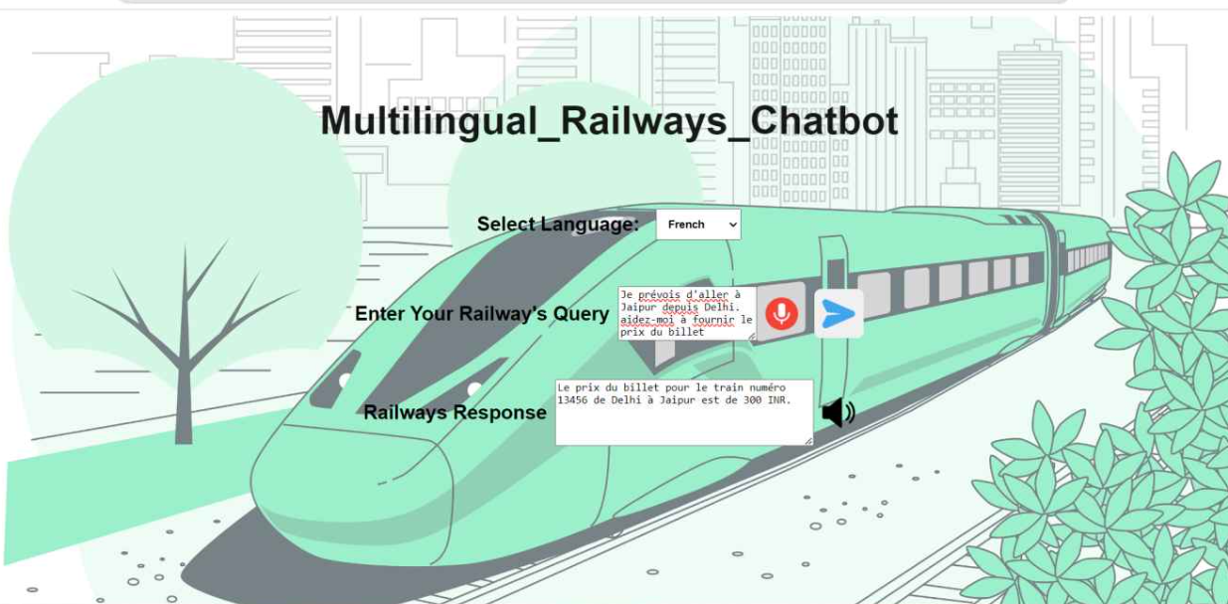
Results

Slide 14
Conclusions
In conclusion, the integration of real-time data sources, cosine similarity, TF-IDF techniques, and the development of a multilingual railway query answering web page represent significant advancements in the domain of train delay prediction and passenger inquiry systems.
Moreover, techniques such as cosine similarity and TF-IDF facilitate the extraction of valuable insights from textual data, enhancing the predictive capabilities of the models.
Simultaneously, the development of a multilingual web page for railway inquiries addresses the diverse linguistic needs of users, fostering inclusivity and accessibility. Integration of natural language processing technologies enables seamless translation of queries and responses, facilitating efficient communication between users and the railway system across different languages

