Slide 1
Campus Tour – Team C
Presenters:
Kotu Chiranjeevi Sneha
Mallikharjuna Rao Dande

Slide 2
Agenda
Project Overview
Requirements
Project Management plan
Issues
Use Cases
Estimation

Slide 3
Project Overview
Campus tour application provides users with interactive and dynamic interface
Gives Audio heads up and scans QR codes on building and retrieve details
Tracks the user’s path(visited places) on a GPS enabled map and highlights unvisited places
Campus tour application provides virtual tour

Slide 4
Requirements
The Application provides a Campus tour of registered universities
Shows the campus map of all the buildings and parking lots in and around the campus
Gives user an option to choose the starting point of the tour
The GPS in the system is linked with the QR Code scanner and function accordingly

Slide 5
Requirements contd...
Scans the QR Code outside the building and records the information
Error message is displayed if there is an interrupted error message
Tour continues if there is an active internet connection
If location service is disabled application gives user a message asking him/her to go to nearest building

Slide 6
Requirements contd...
If the user is not in the range of the campus then application tells user to go near the university in order to start the campus tour
QR Code placed outside the building, the GPS and in sync from the time the campus tour starts till the tour ends

Slide 7
Project Management Plan
Scope Management
Requirements Management
Schedule Management
Resource Management
Communications Management
Change Management
Risk Management
Stakeholder Management
Financial Management
Quality Management

Slide 8
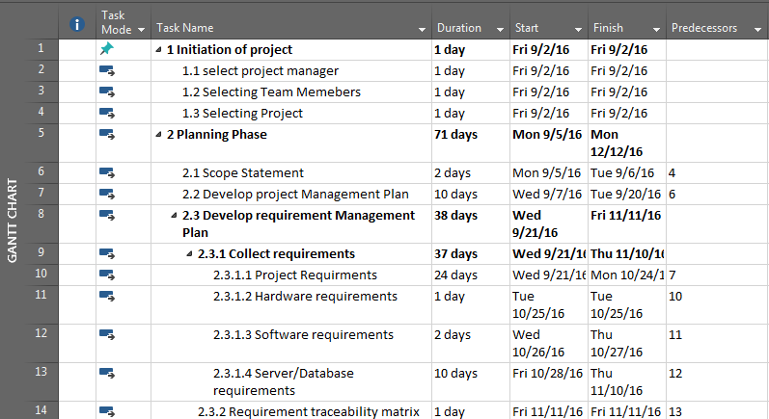
Work Breakdown Structure

Slide 9
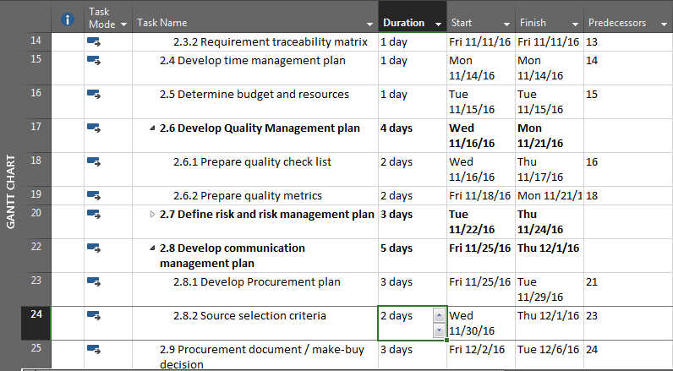
Work Breakdown Structure

Slide 10
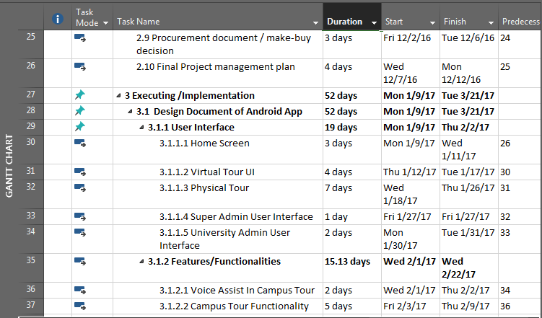
Work Breakdown Structure

Slide 11
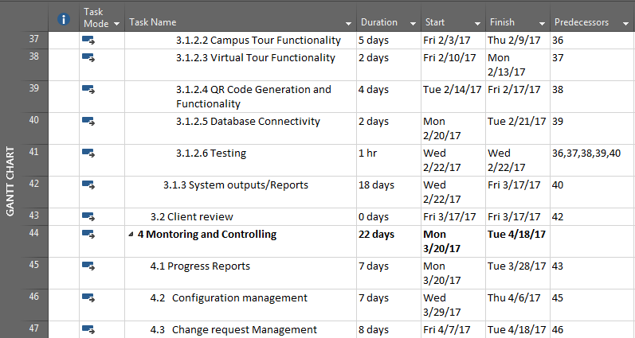
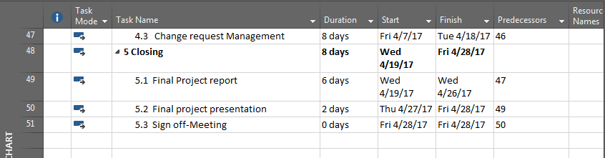
Work Breakdown Structure

Slide 12
Issues
DataBase Failure
Team mate’s un expected departure or long leave
Security Breach for Administrator passwords
Communication gaps within team

Slide 13
Strategy
Don’t Assume anything
Work division
Maximum client interaction
Maximum utilization of work force

Slide 14
Estimate
How Much:
1500 lines of code in Java & 3000 lines in Android – Based on our skill set and expertise we arrived at this figure
How Long:
28 weeks – The tasks were sub divided and approximate time has been calculated realistically. (WBS for details)
(28 weeks)*(5 days per week)*(3 hours per day)*(6 people)

Slide 15
Conclusion
Requirements are in place and Waiting on Client’s approval for next phase
All artifacts are available for client examinatioin
Issues and Risks are thought of and managed appropriately
Any unplanned events during execution will be dealt with aggressively
Strategy – Involve client for any major change and Keep them informed

Slide 16
Repositories
Microsoft One Drive Link
Git Hub Link Link

Slide 17
Questions
Any questions?

Slide 18


