Slide 1
Workshop-1 GitHub
By: Sahil Nokhwal
Sanket Selokar
Vinay Banala
Chiranjeevi Sneha Kotu

Slide 2
Agenda
1.Introduction
2.Version Control
3.What is git?
4.How does git work?
5.What is GitHub?
6.Create Github account demo
2

Slide 3





History
Created by Linus Torvalds for work on the
Linux kernel ~2005
Some of the companies that use git
Notes:
Git was originally created by Linus for work on the Linux kernel right around 2005.
Although git has its origins in the Open source community, git is being used within close source projects also.
This is just some of the many companies that are using git for both oss and closed sourced projects.

Slide 4
How we share code
Working in a team, you need to share code
How?
Email attachments?
Sneakernet?
What if two people edit the same file at the same time?
Google Docs? Dropbox?
No merging in Dropbox
Google Docs not meant for code
4

Slide 5
Version control
Version control (or revision control, or source control) is about managing multiple versions of documents, programs, websites, etc.
Some well-known version control systems are CVS, Subversion, Mercurial, and Git
CVS and subversion are centralized version controls
5

Slide 6
Why version control?
Gives you a “time machine” for going back to earlier versions
Gives you great support for different versions (standalone, web app, etc.) of the same basic project
Greatly simplifies concurrent work, merging changes
A system that keeps records of your changes
Allows for collaborative development
Allows you to know who made what changes and when
6

Slide 7
Types of version control systems
Local only - keeps a local database of changes in your local machine file system
Centralized - (Subversion, CVS), require a connection to a central server and “checkout”
Distributed - (Git, Mercurial) allow for local systems to be “mirrors” of the central repo. You don’t need to be connected to the central server to get work or commits done.
7

Slide 8
Centralized version control
A single server holds the code base
Clients access the server by means of check-in/check-outs
Examples include CVS, Subversion, Visual Source Safe
Advantages: Easier to maintain a single server
Disadvantages: Single point of failure

Slide 9
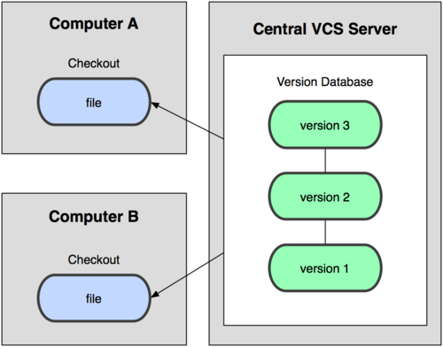

Slide 10
Distributed version control
Each client (essentially) holds a complete copy of the code base.
Code is shared between clients by push/pulls
Advantages: Many operations cheaper. No single point of failure
Disadvantages: A bit more complicated!
Everyone has the complete history and no central authority
Everything is done offline
Changes can be shared without a server

Slide 11
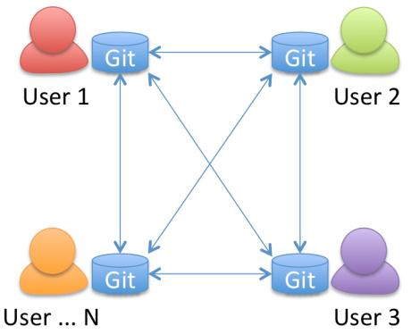

Slide 12
Centralized VC vs. Distributed VC
Central
Server
Remote Server
Notes:
This is over simplifying the story, but the basics are that centralized version control system define a central authority.
I am not saying one system is better that the other, it is just that each model that its benefits.
In the distributed model by definition everything is expected to be off line. To have a system that expects everything to be offline, you have to build in several local capabilities that are not required in a centralized model.
Such as local branching. And to make branching fast and lightweight you better make merging great also.
I won’t go into the guts of git that enables some of this capability in this talk, but if you are interested I will highlight some resources at the end of the talk where you can go deeper.

Slide 13
Git AND Github
2005 born after spectacular Linux tooling failure
Social web, leads to social coding
Git is for command line, GitHub is the web interface
Cross-platform tooling - Windows, Mac, Linux
Merge files rather than a “lock and checkout” model
Non-linear branching model
13

Slide 14
What's Git?
Version control and source control
tracks all changes submitted to the codebase
revert changes
Create working branches without affecting stable releases
14

Slide 15
Why Git?
So fast it makes your head spin (demo)‏
Allows for human error (reset/combine commits)‏
Entire History Local
Guaranteed to retrieve what people put in
Optimized network transfers
15

Slide 16
Install git
Linux (Debian) - Command: sudo apt-get install git
Linux (Fedora) - Command: sudo yum install git
Mac - http://git-scm.com/download/mac
Windows - http://git-scm.com/download/win
16

Slide 17
Using a git repository
$ git init
$ git add <filename>
$ git commit –a
$ git branch
$ git checkout
$ git push
$ git pull

Slide 18
Terminologies
Repository
Pull
Fetch
Branch
Merge
Commit
Stash
Stage
18

Slide 19
What's Github?
A web-based hosted service for Git repositories
A source code hosting services like SourceForge or Google Code
Founded by Werner, Wanstrath and Hyett in 2008
Allows for code collaboration with anyone online
Adds extra functionality on top of Git
UI, documentation, bug tracking, feature requests, pull requests, and more!
19

Slide 20
What's special about Github?
Uses Git as revision control
User-centric, not project-centric
“Follow” other people's projects/changes
Sharing new ideas, brainstorming
Extremely well implemented Branching/Merging, supported by Git
Also has an Enterprise edition for businesses
20

Slide 21
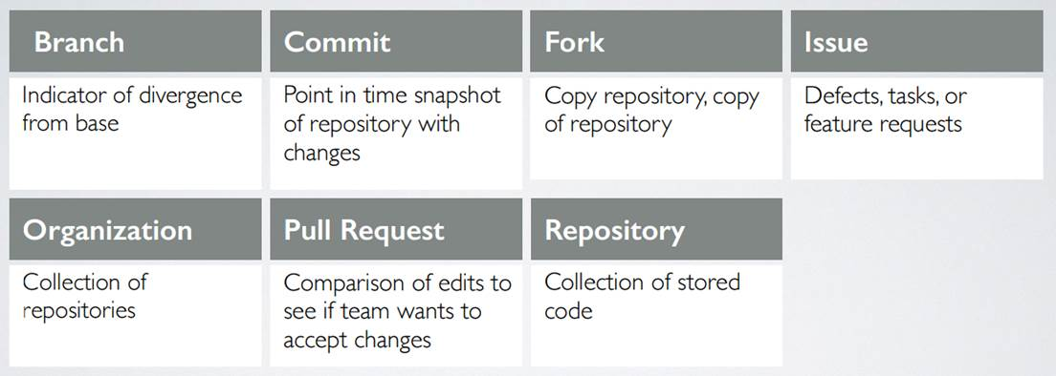
Github terminologies
21

Slide 22
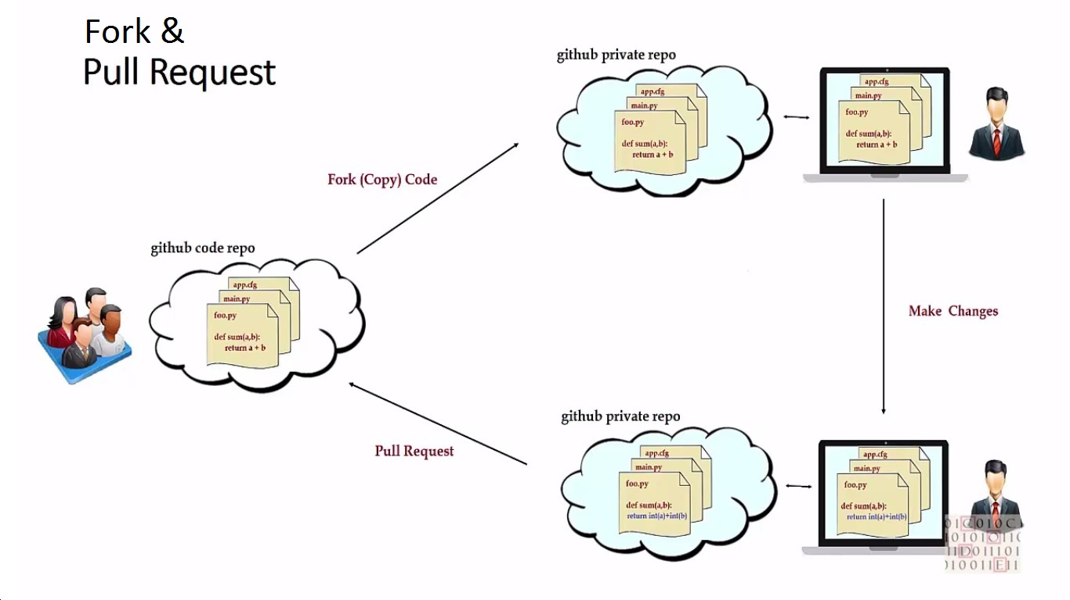
Forking and Pulling request

Slide 23
Branching
Branches allows multiple copies of the code base within a single repository
Work independently
The two primary branches
Master branch
Develop branch
Feature, Release and Hotfix are the secondary branches
Different versions can easily be maintained
Each customer has their own branch

Slide 24

Merging
There are occasions when multiple versions of a file need to be collapsed into a single version
E.g. A feature from one branch is required in another
This process is known as a merge
Difficult and dangerous to do in CVS
Easy and cheap to do it in Git

Slide 25
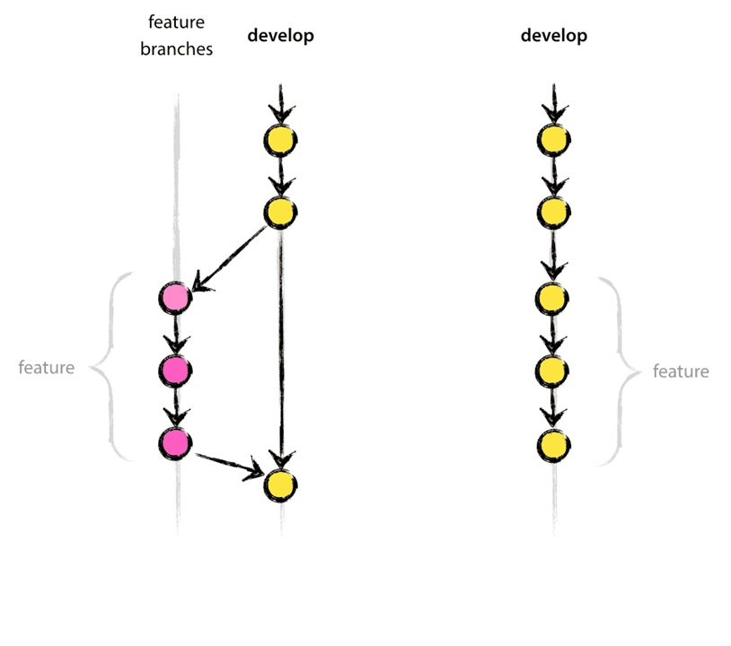
Flow diagram
25

Slide 26
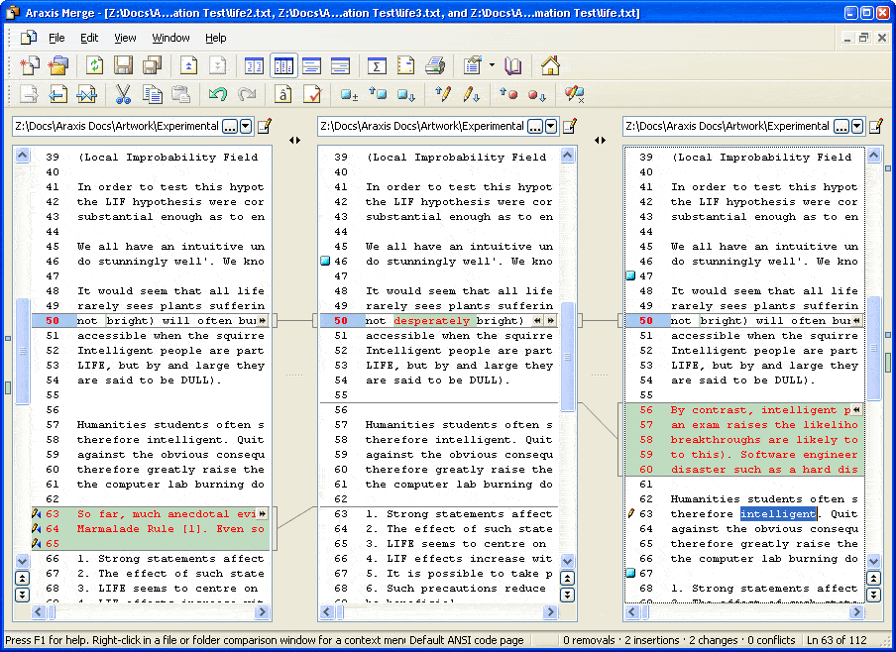
26

Slide 27
References
Github: http://github.com
The ProGit book (A-press) but also online at http://git-scm.com/book
http://gitimmersion.com - a great tutorial that will get you far and teach some great shortcuts.

Slide 28
THANK YOU
28

