Slide 1
DIGISIM-PS2
PROJECT NAME-IMPLEMENTING JARVIS MARCH ALGORITHM

Slide 2
AGENDA
INTRODUCTION
APPROACH TO THE CIRCUIT
SUBCIRCUITS INVOLVED
SPECIAL FEATURES
USED COMPONENTS
COST TABLE

Slide 3
INTRODUCTION
ALGORITHM
->JARVIS MARCH ALGORITHM IS USED TO FIND CONVEX HULL OF A SET OF GIVEN POINTS. CONVEX HULL SHOULD HAVE MINIMUM NUMBER OF VERTICES INVOLVED SO THERE IS A SEPARATE CONDITION FOR COLLINEAR POINTS.
->ACCORDING TO ALGORITHM IF THERE ARE COLLINEAR POINTS WE TAKE POINT FAR AWAY FROM ON HULL POINT AS NEXT POINT .
THIS IS THE CONDITION FOR COLLINEAR POINTS ACCORDING TO THE RULE GIVEN ABOVE

Slide 4
APPROACH TO THE CIRCUIT
BASICALLY TRIED TO UNDERSTAND ALGORITHM BY C CODE AND TRIED TO IMPLEMENT IT.
USED REGISTERS TO STORE VALUES AND COUNTERS TO KEEP TRACK OF ITERATIONS AND USED FSM'S TO IMPLEMENT LOOPS ,USED COMPARATORS TO COMPARE VALUES.
I USED A SUBCIRCUIT NAMED AS ORIENTATION ,WHICH IS USED TO FIND ORIENTATION OF GIVEN POINTS.
USED SUBCIRCUIT TO FIND DISTANCE BETWEEN POINTS ,IT IS USED IN COLLINEARITY CONDITION.

Slide 5
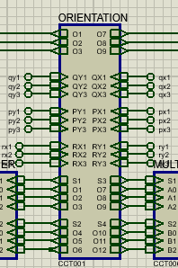
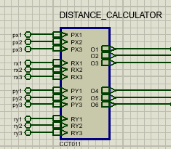
SUBCIRCUITS INVOLVED
ORIENTATION-IT IS USED TO FIND ORIENTATION OF POINTS.
DISTANCE CALCULATOR-IT IS USED FIND DISTANCE BETWEEN POINTS

Slide 6
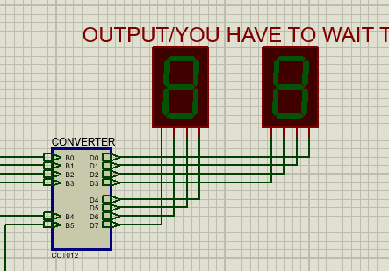
SPECIAL FEATURES
1)USED SINGLE ROM AND SINGLE CLOCK AND WITH GOOD EFFICIENCY .
IT IS EFFICIENT WITH LESS COST.
2)USED FSM'S TO IMPLEMENT FOR LOOPS AND OTHER LOOPS TO DO REQUIRED OPERATIONS.
3)USED DOUBLE DABBLE ALGORITHM CIRCUIT TO CONVERT BINARY NUMBER TO BCD ,TO DISPLAY ON 7 SEGMENT DISPLAY.

Slide 7
USED COMPONENTS
1)GATES
2)REGISTERS
3)COUNTERS
4)FLIP FLOP
5)ROM
6)7 SEGMENT DISPLAY
7)ADDER,COMPARATOR
8)MULTIPLEXER
9)

Slide 8
COST TABLE
½ IN-GATES= 341 3 IN-GATES =11 4 IN-GATES=2
COUNTERS=2
REGISTERS=10
COMPARATOR=8
MUX=4
ADDERS=7
ROM=1
CLOCK=1
FLIP FLOPS=6
7 SEGMENT DISPLAY=2
TOTAL COST =221.9

Slide 9
THANK YOU BY TEAM SSS ->TEAM MEMBERS 1)DANDE VAMSHI VARDHAN 2)B.PAVAN CHANDRA YADAV

