Slide 1
AprioriHybrid
Finding association rules with limited memory

Slide 2
Project Details
The paper “Fast Algorithms for Mining Association Rules” by Rakesh Agrawal and Ramakrishnan Srikant (1994), attempts to offer better solutions for mining association rules by introducing two slightly different Apriori methods as replacement to the SETM and AIS algorithms.
In addition to showing that the Apriori and AprioriTid algorithms outperform the other two methods, they show how the best features of the two proposed algorithms can be combined into a hybrid algorithm, the AprioriHybrid algorithm. The AprioriHybrid algorithm seems to be faster than both algorithms Agrawal and Srikant offer in the paper according to comparison of completion time given a minimum support.
Notes:
Hamza

Slide 3
Objectives
Find rules that will predict the occurrence of an item based on the occurrences of the other items in the list of transactions.
Minimize the the computation time for generating the association rules used for prediction using AprioriHybrid given limited memory resources.
Show that our implementation of AprioriHybrid would results in a better runtime speed than the Apriori and AprioriTid algorithms described in the paper.
Notes:
Andrew

Slide 4
Apriori
In the Apriori algorithm, candidate itemsets are generated using only the frequent itemsets of the previous pass without considering the transactions in the database.
The frequent itemset of the previous pass is joined with itself to generate all itemsets with size greater than 1.
Finally, each generated itemset that has a subset which is not frequent is deleted. The remaining itemsets are the candidate itemsets.
Notes:
Hamza

Slide 5
AprioriTid
In the AprioriTid algorithm, candidate itemsets are generated in the same manner as in the Apriori algorithm.
However, it does not use the database for counting the support of candidate itemsets after the first pass.
Another set C’ is generated, of which each member has the TID of each transaction and the frequent itemsets present in this transaction. This set is then used to count the support of each candidate itemset.
Notes:
Andrew

Slide 6
AprioriHybrid
AprioriHybrid is a combination of both the Apriori and AprioriTid algorithms. It functions by using Apriori when there is insufficient memory to hold all tuples that have the minimum support required.
When the amount of tuples is inevitable reduced by the apriori generation, the memory will eventually be able to handle the load.
When this occurs we can make the switch from the Apriori algorithm to the AprioriTid algorithm.
Given large sets or insufficient memory, the algorithm will run faster than both algorithms above.
Notes:
Hamza

Slide 7
Evaluation
To compare the results we need a sufficiently large database, or sufficiently small memory allocation for the programs.
The paper was written in 1994, meaning total memory available would have been much smaller compared to what we have today.
Finding a sufficiently large dataset to fill a large amount of RAM is a difficult task compared to limiting total amount of RAM available to a program.
Limiting memory resource will be necessary for testing the programs.
Once a limit is set, checking the amount of time it takes to complete an iteration over the data (there will be multiple passes) will give an idea of the details behind the execution for each algorithm.
Notes:
Andrew

Slide 8
Dataset
The dataset is a csv file containing approximately 1000 tuples with 32 attributes surrounding the details of a student's life and drinking habits.
The attributes include things such as the students school, time spent studying, reason for attending school, weekend alcohol consumption, etc.
For Apriori-based algorithms, this data set seemed appropriate due to the useful rules that could be generated from it.
The datasets size would be too small if we were not controlling the amount of memory available to the program.
Dataset can be found at : https://archive.ics.uci.edu/ml/datasets/STUDENT+ALCOHOL+CONSUMPTION
Notes:
Hamza

Slide 9
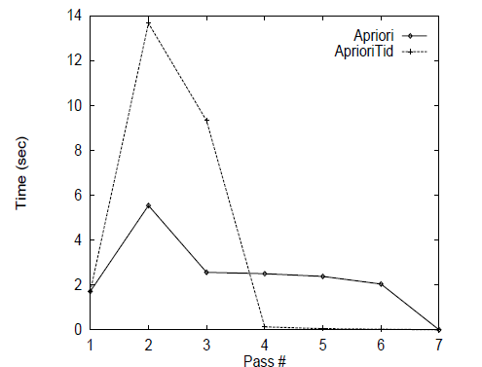
Validation
To validate our results, we will compare the run time over the dataset for each of the 3 algorithms. From the results graphs that will better describe the results, changing the amount of available memory each time.
The Apriori paper gives results that can be compared against the testing results, lts helping to verify correct results versus incorrect results.
Notes:
Andrew

Slide 10
Implementation
Each of the 3 algorithms is developed in python 2.7. Python will be used due to ease of development and the languages dictionary/list implementations (very easy to create and modify).
The environment that runs the algorithm solutions will be bluenose.
Each algorithms program will be run on different levels of memory constraints using the ‘ulimit -v’ command. This command reduces the amount of virtual memory available to the users session.

Slide 11
Contributions
Once complete, the project’s work will be evenly distributed by Andrew and Hamza with both working on each section of the project together.

