Slide 1

Cinema Village
Brno university of technology
Autor: Daniel Prachař
Subject: Security of database systems
Field: Information security
Year of studies: 2
Date of creation: 29. 12. 2022

Slide 2
Basic points
Introduction
Schema and diagrams
Project changes
Project DEMO
Conclusion

Slide 3
Introductrion
This project is about creating a desktop application in java that would be connected to our PostgresSQL database
The application allows basic data operations like select, update, insert, delete
The project also deals with user authentication

Slide 4
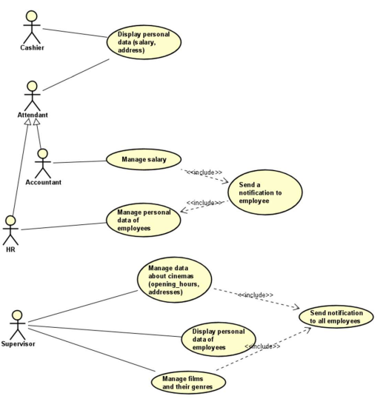
Schema and diagrams – Use case diagram

Slide 5
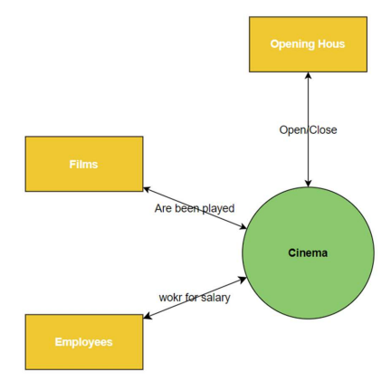
Schema and diagrams – System context diagram

Slide 6
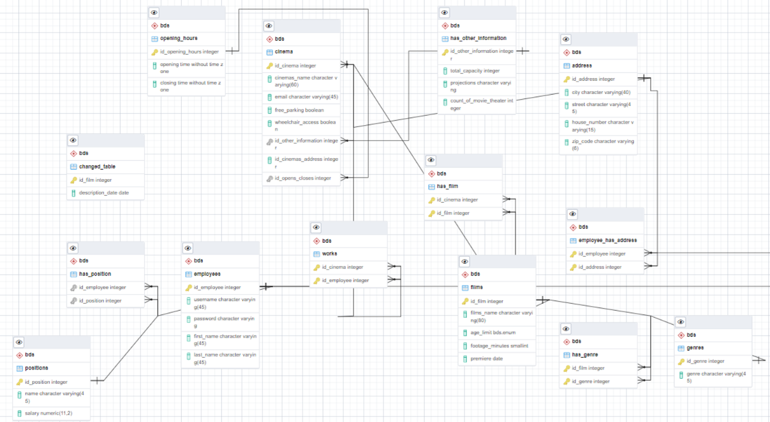
Schema and diagrams – ERD

Slide 7

Project changes
I changed the structure of the database, I removed some tables
I fixed cascading and foreign keys
I changed the form of the hashed passwords

Slide 8
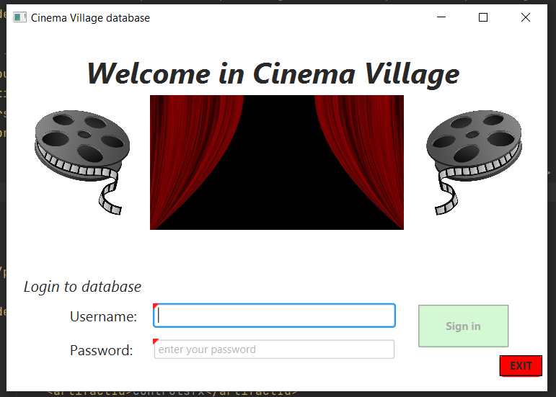
Project DEMO

Slide 9
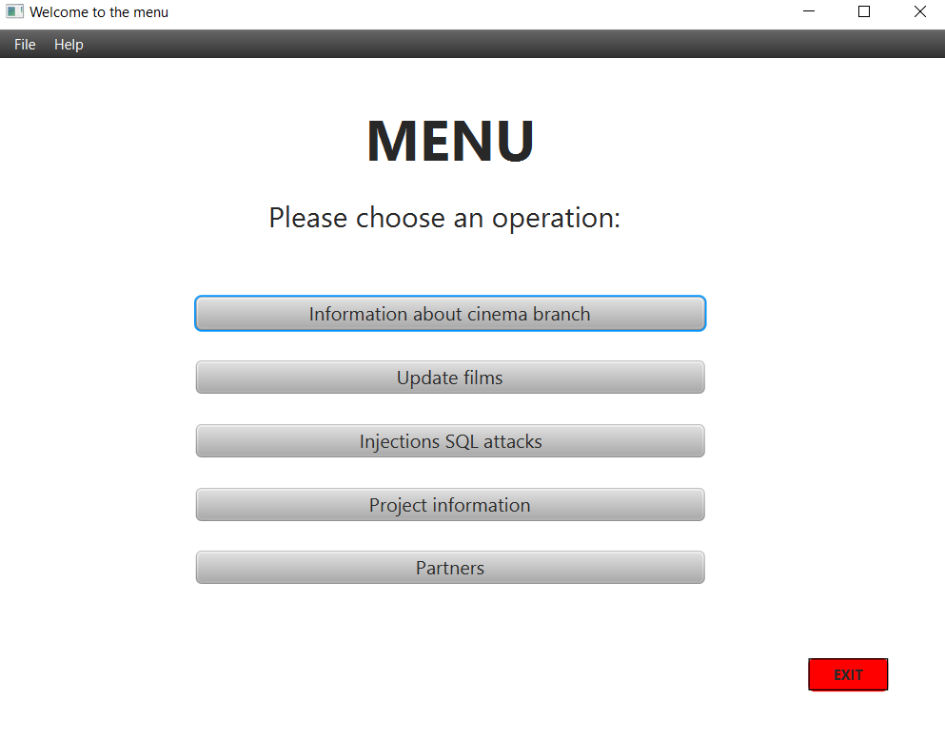

Slide 10
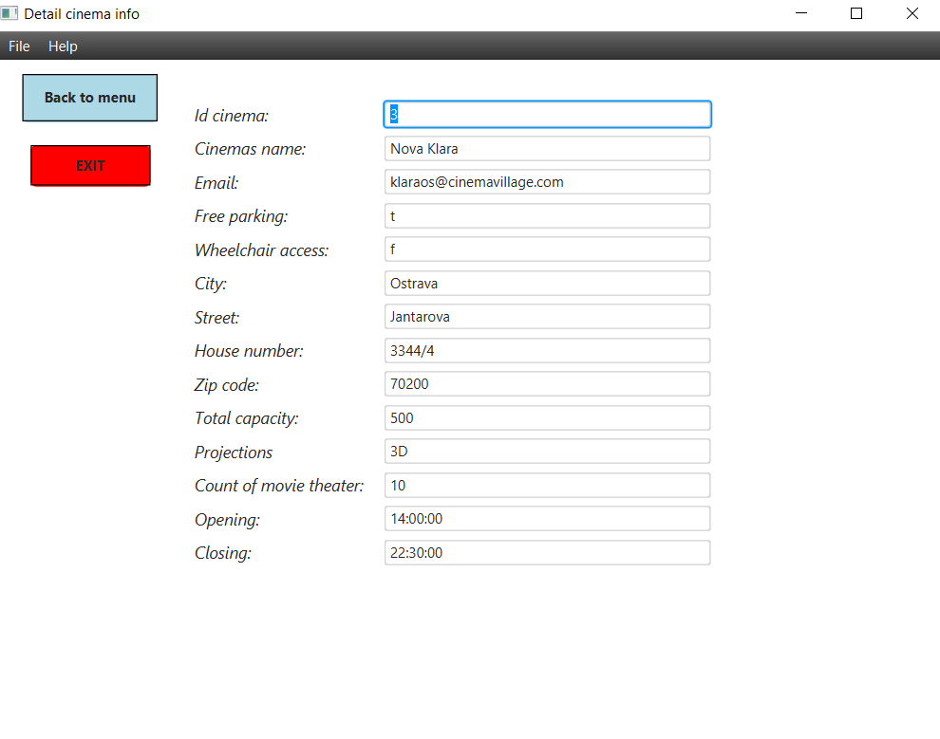

Slide 11
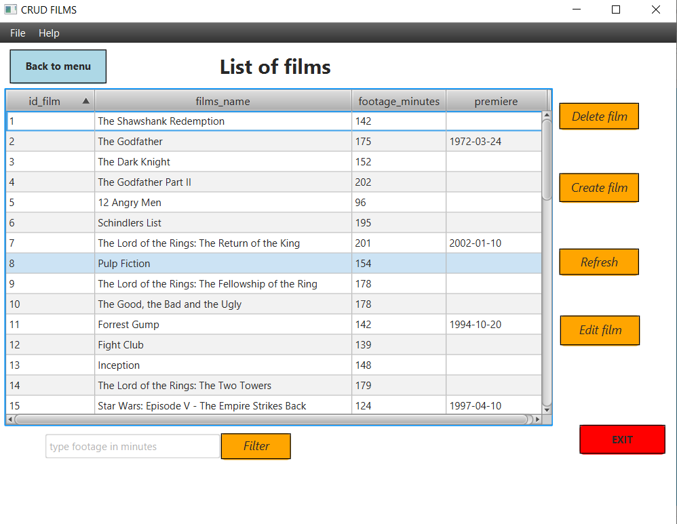

Slide 12
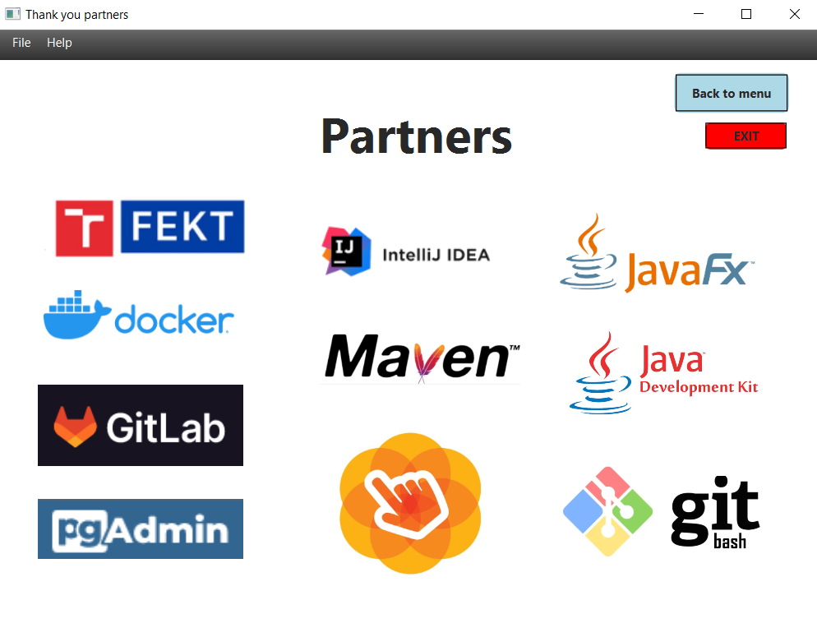

Slide 13
Current exhibiton of the project

Slide 14


Conclusion
Future changes:
I would devote more time to the project and complete other functionalities
I will try to complete a simulation of SQL injections attacks
I will work on better documentation and readme file
Problems:
The biggest problem I had was with the login form, when I had badly hashed passwords
Further search for errors in the code, for example: a space in the sql command, a defined button as a label

Slide 15
Thank you for your attention

