Slide 1

MHSDS (and IAPT)
Dataset(s) overview*
Andy Hood | Coffee and Coding |10th April 2025
* DISCLAIMER: I’m only an expert in relative terms and take no liability for any partial, incorrect or misleading information provided in this session!

Slide 2
Brief history
The most changingist mandatory dataset in the history of the NHS (probably!)…collecting data on NHS funded mental health referrals, contacts and treatments
Mental Health Minimum Dataset (MHMDS) | Apr 2006 to Aug 2014 | 3 tables (Records, Events, Episodes)
Mental Health & Learning Disabilities Dataset (MHLDDS) | Sept 2014 to Dec 2015 | 3 tables (as above)
Mental Health Services Dataset (MHSDS) | Jan 2016 to current | 71 tables and counting! | Currently on v6.0.
Despite nearly 20 years of data specs and mandatory provider submissions, data quality is still < good. Poor coverage of assessment / outcomes / improvement data. Independent provider data = worse.

Slide 3
Scope (current)
MHSDS:
Patients of any age in England referred to, assessed by, treated by or admitted to a specialist acute or community mental health service paid for by the NHS.
Includes common disorders (anxiety/depression), severe mental illness (e.g. schizophrenia, bipolar), dementia, learning disability & autism, children & adolescent MH, other emotional and behavioural disorders and substance misuse.
IAPT:
Patients aged 16+ in England referred to, assessed by or treated by a ‘talking therapies’ service paid for by the NHS.
Typically for mild to moderate common disorders, phobias, PTSD and OCD.
There was previously a pilot for psychological therapy for patients with long-term conditions – that’s now a universal offer.

Slide 4
MH services in numbers
2 million people in contact with MH services @ Jan ‘25
500k CYP in contact with MH services @ Jan ‘25
300k with LD or Autism in contact with MH services @ Jan ‘25
16k detained under the MHA @ Jan ‘25
500k referrals each month and 2.3 million care contacts
In 2025/26, mental health services will receive £15.6bn which amounts to 8.71% of the NHS baseline funding. The social and economic costs of poor MH are c£300bn per year!
Key national performance measures are:
  Referral to Treatment Times (EIP, Eating Disorders)
  Out-of-area placements
  Physical health checks in SMI patients
  Rates of reliable improvement (IAPT)
c30% IAPT referrals and c20% of inpatient admissions to independent providers

Slide 5
Notable use cases to date
Integrating Mental and Physical health (2016/17) – national & STP reports.
Exploring MH inpatient capacity (2018/19) – policy report for RCP
Inequalities in perinatal mental health (2018/19) - publication
Mental Health (covid) surge model (2020) – flow rates and distributions for SD model
Air quality and health outcomes (2020) – London study for Guys and St Thomas charity
Workforce impacts of MHA reforms (2021) – support RCP policy
Inequalities in CYP services (2021/22) – NHSE national commission
Resetting the conversation on LDA (2022) – NHSE mixed methods commission
MH inpatient D&C model (2024) – NHSE West Midlands / ICB
Supporting CQC on MHA and emergency MH care (2024/25)

Slide 6
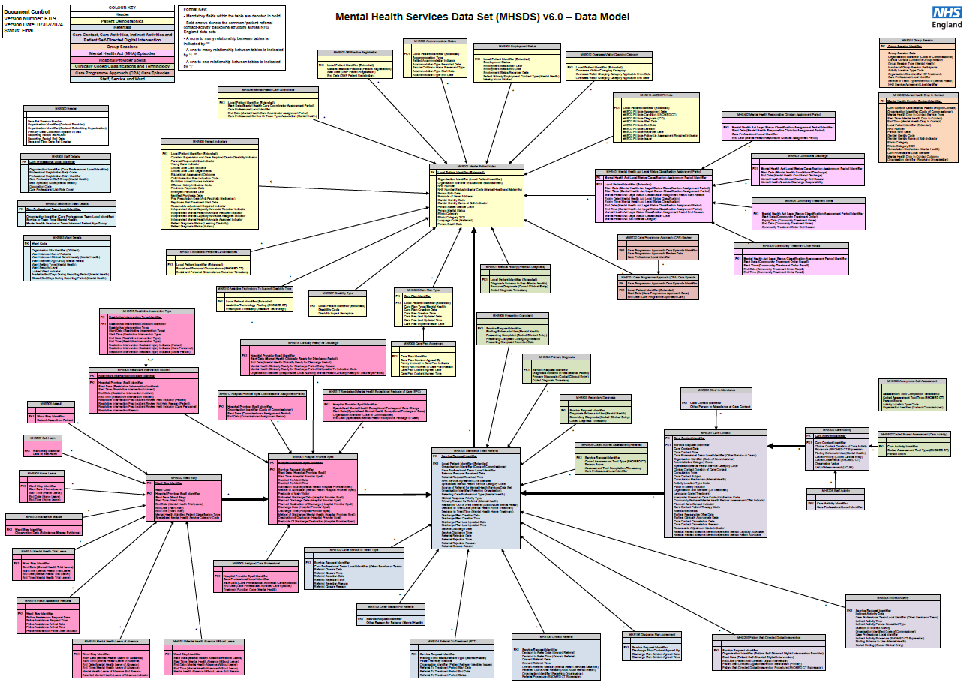
Yay, lots of tables!
Booo, lots of tables!

Slide 7
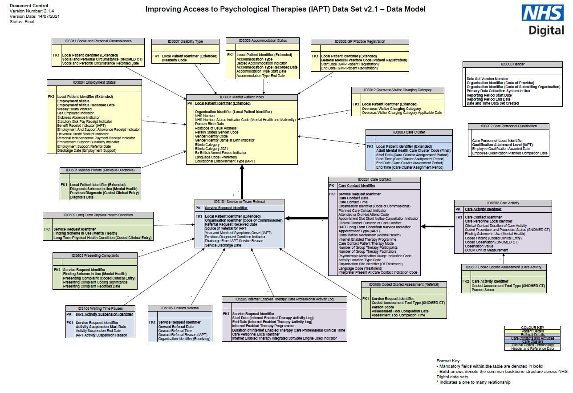

Slide 8
Access
Bunch of publicly available aggregated data reports:
https://digital.nhs.uk/data-and-information/data-tools-and-services/data-services/mental-health-data-hub
Record-level data through NCDR/UDAL. Core datasets so shouldn’t need to request access.
Reference tables / definitions: https://www.datadictionary.nhs.uk/data_sets/clinical_data_sets/mental_health_services_data_set.html
https://www.datadictionary.nhs.uk/data_sets/clinical_data_sets/improving_access_to_psychological_therapies_data_set.html

Slide 9

Duplication aaaaaaahhhhhh!
Monthly submission cumulative dataset.
Should be change only updates; but it isn’t 😥.
No reliable duplicate record flag.
Multiple records per patient in the MPI table.
ML de-duplicate for CSU feeds of MHSDS – not done nationally.

Slide 10
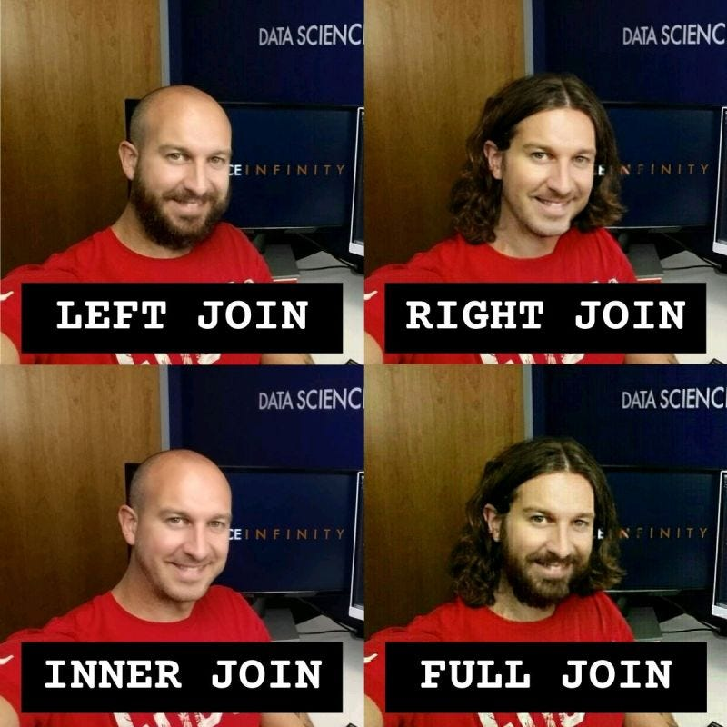
Internal linkage
Can’t escape it. If you can’t beat them then Inner Join, Left Outer Join, Right Join them!
Typically to get usable extracts:
  start with the activity table you’re interested in – MHA episode, admission, contact, IAPT sessions etc.
    constrain on e.g. dates / providers
  Link to MPI for patient details
    further constrain on e.g. age-groups, geographical area
  Link to referrals table for clinical ‘ownership’ and routes in/out of services
    further constrain on e.g. service areas/teams
  Link to diagnosis tables
    further constrain OR categorise

Slide 11
External linkage
Super easy to link to/from activity in other settings – SUS, CSDS, MSDS, ECDS, Mortality etc…using the [der_pseudo_nhs_number].

Slide 12


MHSDS and IAPT walk-through

Slide 13

Potential uses…
Needs and inequality analysis
Time series analysis and projection
Explanatory models and prediction
Classification and clustering
Evaluation of impacts
Other modelling and simulation (system linkage)

Slide 14
Other things to note
There is no unit ‘currency’ for MH. PbR clusters didn’t gain traction. Most contracts are block contracts.
Waiting lists for most pathways are increasing – ED, Dementia, Autism & ADHD, Addiction services.
Significant crossover with SEND and Education, Health and Care (EHC) plan…but no routine way to link to DfE/LA data.
There is a Mental Health Knowledge and Skills Network (KSN) in ML whose members work with MHSDS, IAPT and other related datasets much more frequently than us.

Slide 15

Questions, comments and suggestions…?

