Slide 1
PlayCruzer

Slide 2
About us
Danijel Pejic:
Role: group-leader
Tasks: develop the functionalities
Christoph Moosbrugger:
Tasks: design, ideas

Slide 3
Idea
We like playing videogames
We wanted to do something with videogames
Videogames are our passion

Slide 4
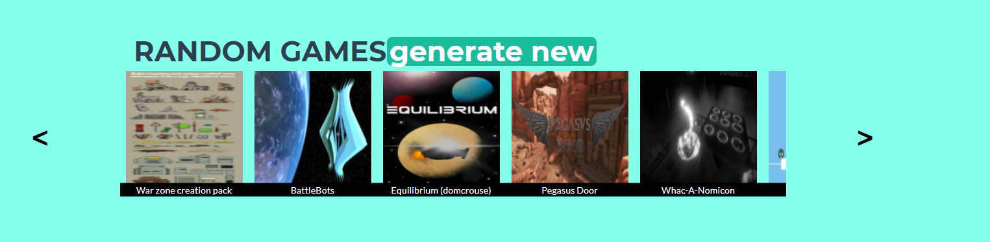
Generate Random Games

Slide 5
Search Games

Slide 6
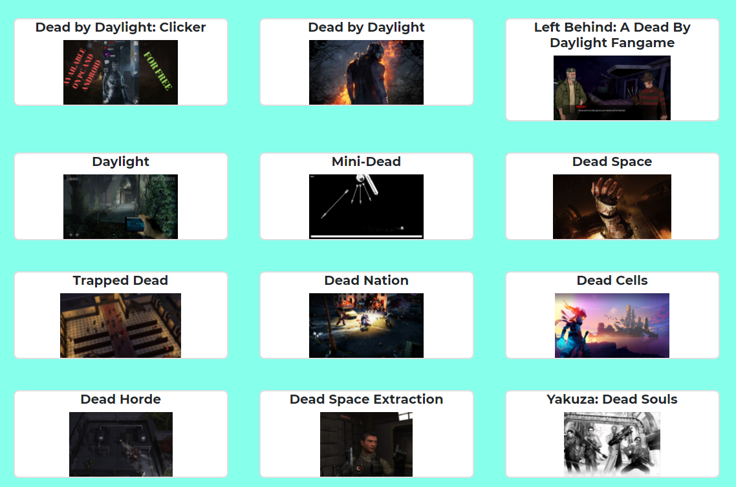
View searched game

Slide 7
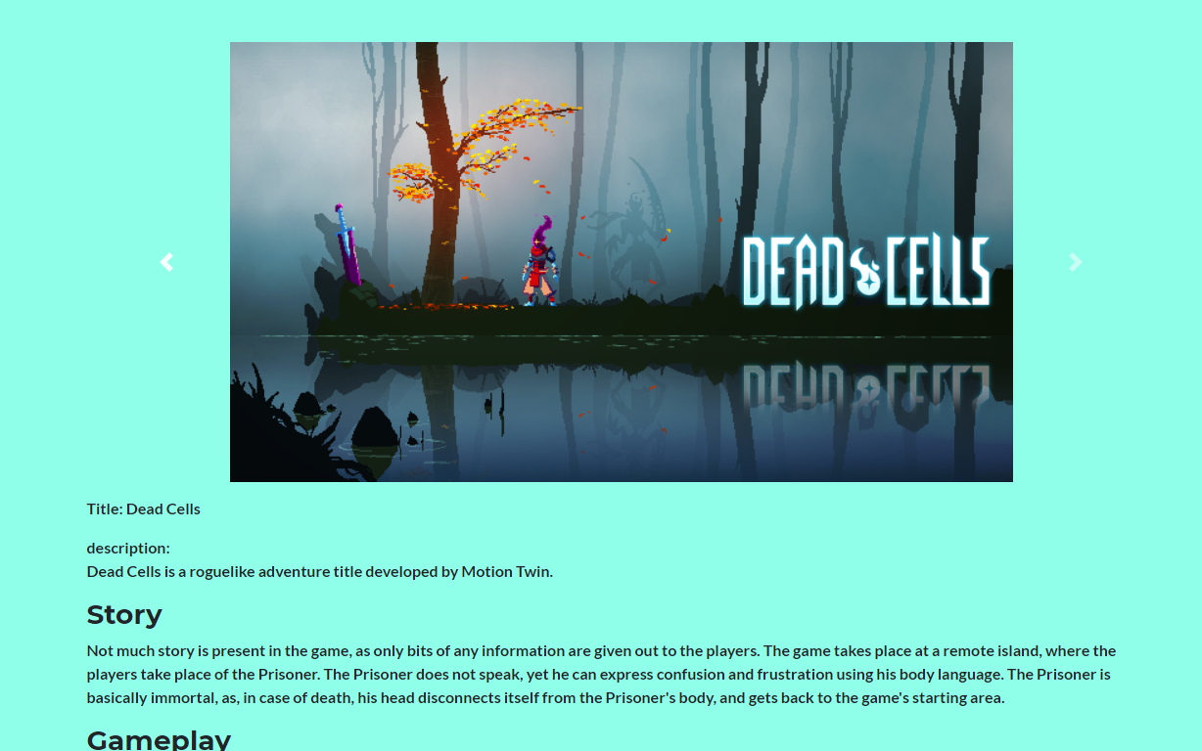
Game information

Slide 8
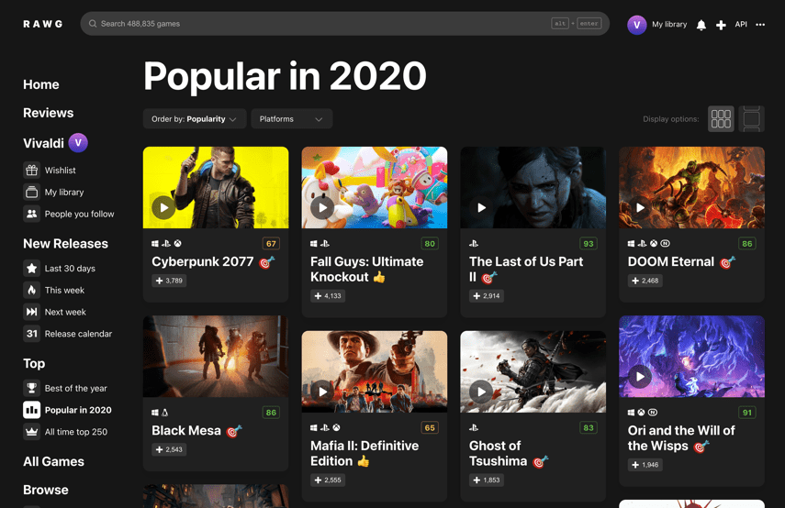
Data

Slide 9
Thanks for your attention!

