Slide 1

PyLifetime A Python-based postprocessing tool
Dane Lacey
March 28th, 2022
Notes:
Introduce self.
9 months

Slide 2

Overview
What are we doing?
Advantages of PyLifetime over MLife
General usability
Shortcomings of PyLifetime
Future directions
Notes:
Will not go into any theory
Mlife is predecessor

Slide 3
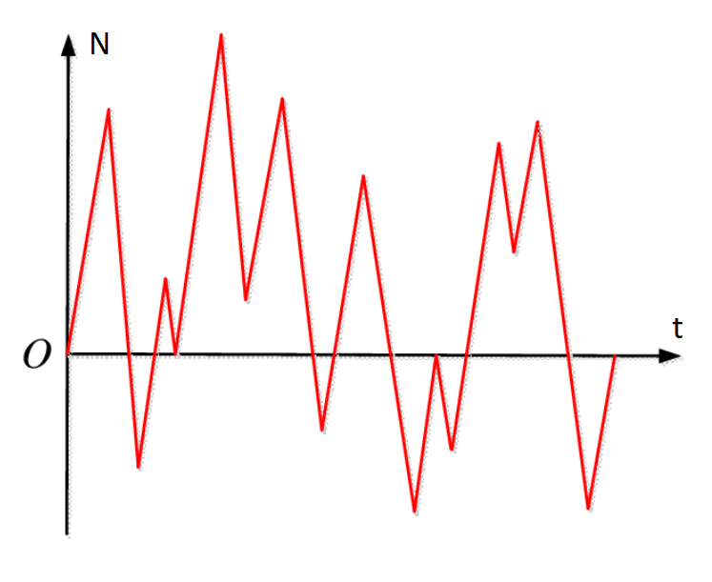
Introduction
Postprocessing of what?
The variable amplitude loads that result from a wind turbine simulation
Realized as a time series
PyWiT (Python Framework) -> PyLifetime via .mat files
For a given interval of time, these .mat files contain
The time steps
the load inflicted upon one or more turbine sensors
The wind direction/speed at each time step
All of it is encoded, as well as other information not considered
Notes:
Variety of files from python framework

Slide 4
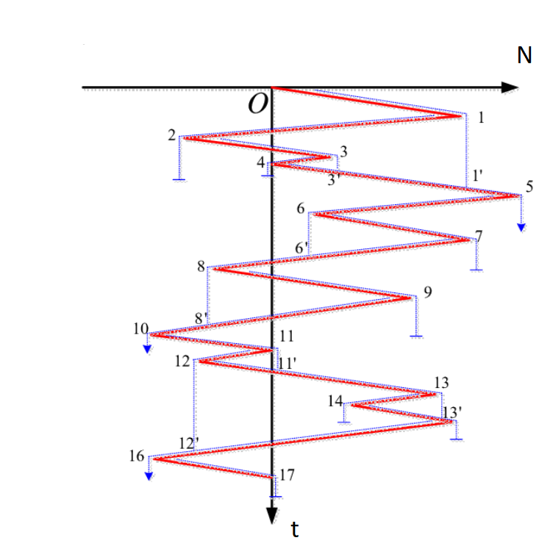
Introduction
What exactly is meant by postprocessing?
Given a set of timeseries representing variable amplitude loads:
Statistical Information
Fatigue estimates (Damages and DELs)
The timeseries are transformed into “hysteresis cycles” by a rainflow counting algorithm
The individual cycles are made by matching local minima with local maxima
DELs: constant-amplitude loads that occur at a fixed mean and frequency
Produce a damage equivalent to the variable loads (both short term and lifetime)
Notes:
Many more timesteps than needed for fatigue analysis

Slide 5
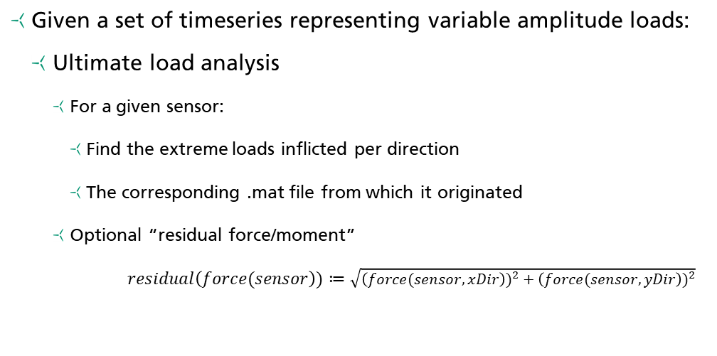
Introduction
What exactly is meant by postprocessing?
Given a set of timeseries representing variable amplitude loads:
Ultimate load analysis
For a given sensor:
Find the extreme loads inflicted per direction
The corresponding .mat file from which it originated
Optional “residual force/moment”
$residual\left(force(sensor\right))≔\sqrt{{\left(force(sensor, xDir\right))}^{2}+{\left(force(sensor, yDir\right))}^{2}}$

Slide 6
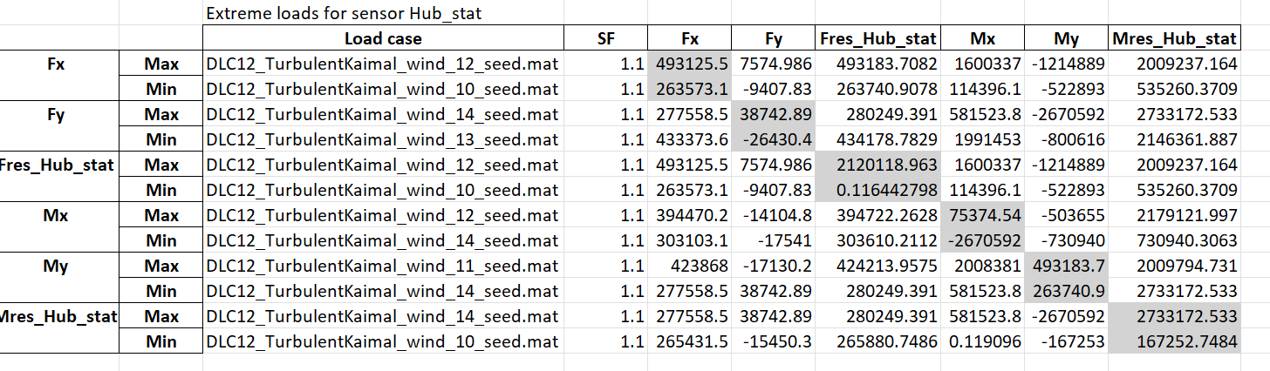
Introduction
Example of an Ultimate Load Analysis

Slide 7
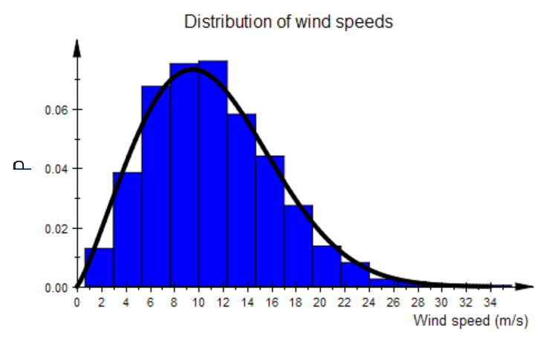
MLife introduction
What is MLife actually doing?
A MATLAB-based tool for postprocessing
Annex G of IEC 61400-1 edition 3
Accumulates fatigue damage
Does so over design life of the turbine, assume Miner’s Rule
Discretize wind speed, given wind direction
Extrapolates damages based on the file’s “wind bin”
In conjunction with settings.txt, reports results
Fatigue/Ultimate/Statistics (previously mentioned)

Slide 8

Advantages of PyLifetime over MLife
Mlife sounds good enough?
Why not just use MLife?
Requires an additional layer of manual reformatting of Dymola results (.mat -> .csv)
The settings.txt file is completely inflexible
Not very conducive to further analysis (opinion)
Not user friendly, hard to parse error messages (opinion)
It would be nice if there was something similar, but in…

Slide 9
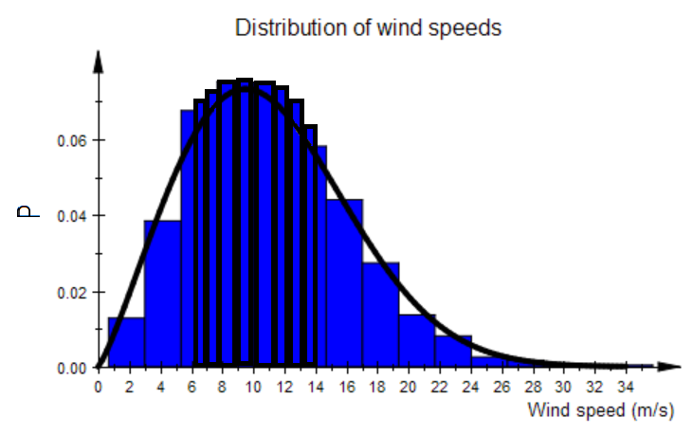
Advantages of PyLifetime over MLife
A working alternative
PyLifetime is a Python-based implementation of the same IEC standards
Fully integrated into PyWiT (no data conversion needed)
No licensing fees
The settings.yaml file layout notably simpler than Mlife’s
Format of exported results similar to Mlife, also get returned object
Much more user friendly and better error handling
Explicit multi-core usage through multiprocessing module
Manual wind binning option

Slide 10
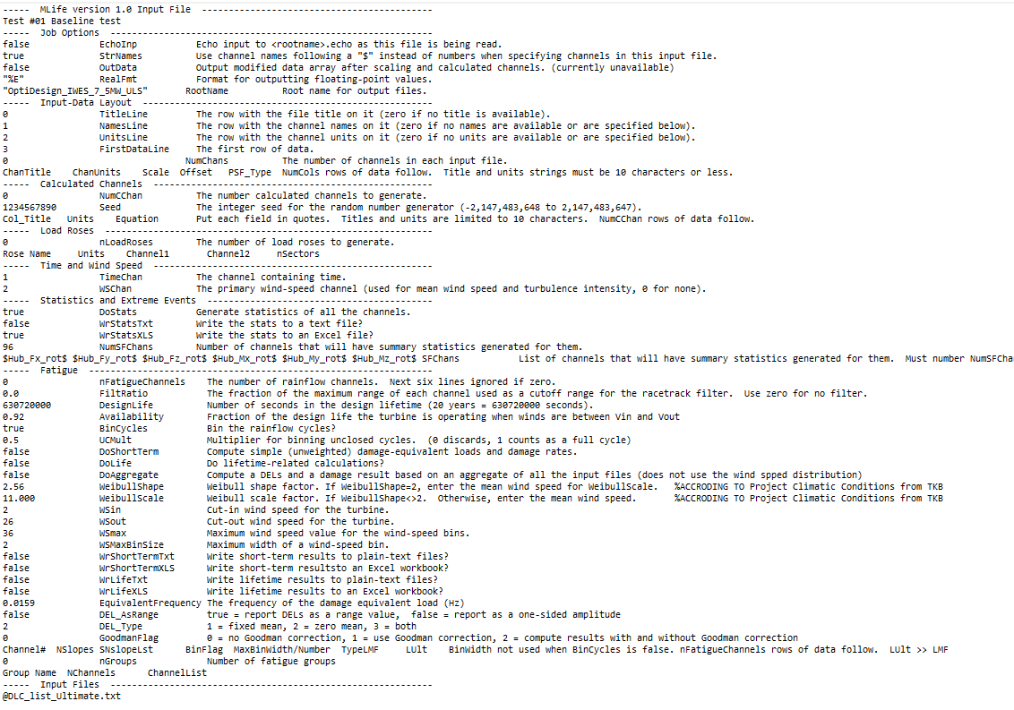
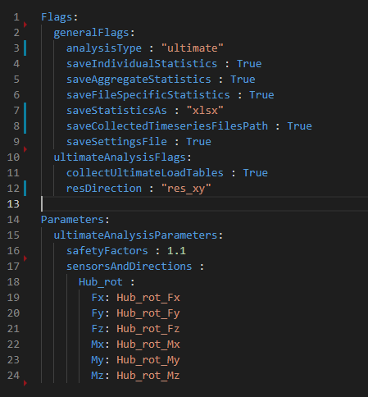
Advantages of PyLifetime over MLife
Settings file comparisons

Slide 11
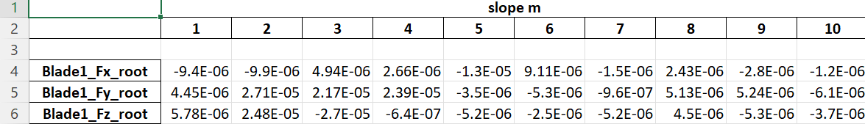
Advantages of PyLifetime over MLife
A working alternative
Verified against MLife for combinations of all 3 DLC types

Slide 12
Usability of PyLifetime
How do I use PyLifetime?
All you need is two things: a directory of .mat files, and a settings file
Two options: automatically, or as a standalone script
Automatically (in the current implementation)
Connected to the end of PyWiT via. simulationManager.py
Standalone
Assign data directory and settings file paths to respective variables

Slide 13
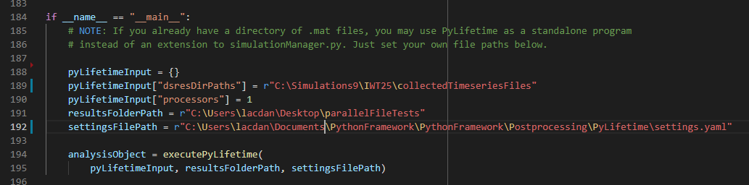
Usability of PyLifetime
Standalone Example

Slide 14
Shortcomings of PyLifetime
Where does PyLifetime fall short of MLife?
High Memory Usage => Worse Performance
Several features have yet to be fully implemented:
Aggregate fatigue grouping
Racetrack filtering (performance-based)
load binning (performance-based)
Various other features mentioned in MLife
TTC calculations, Markov matricies, and load roses

Slide 15
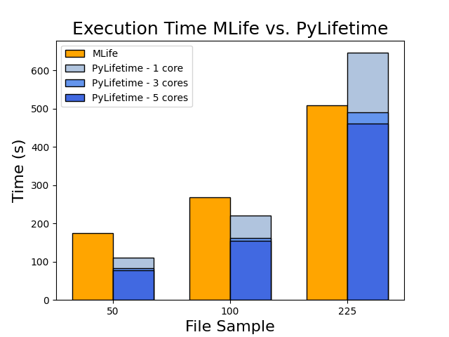
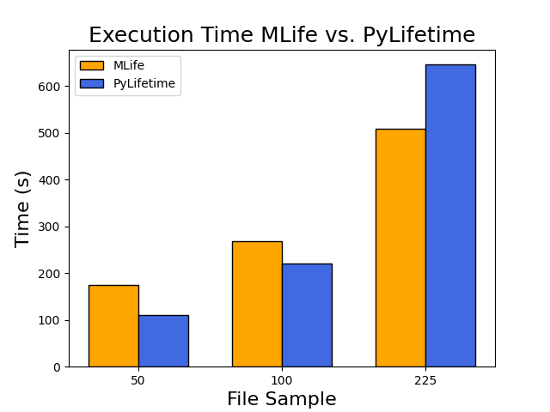
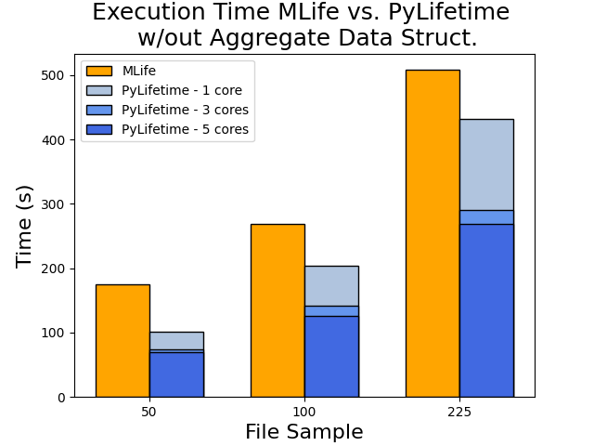
Shortcomings of PyLifetime
Performance
Machine:
Intel i7-8850H @ 2.6GHz
32GB RAM
Benchmark:
Fatigue Analysis
Standard settings
5 sensors, 5 slopes each
Data:
640s per file @ .05 steps
Not a 1 -> 1 comparison!

Slide 16
Future Directions and Improvements
Finish implementing other features
More opportunities for parallelism
More areas could make use of code modularization
Design choices that still need to be made:
How to robustly encode DLC type within .mat files?
How to better incorporate PyLifetime options within PyWiT (i.e. settings.yaml file location)
Some ideas for improvements are left as in-code comments

Slide 17
Closing Remarks
Documentation
There is in-code documentation and a README.md, and it is duplicated on the PyLifetime Sharepoint page
Also, these slides (soon)
Examples
Two basic settings.yaml templates are provided for new users, and are duplicated on the Sharepoint
Other caveats
All other known bugs and issues are listed on the Sharepoint as well

Slide 18
Citations
[Chen, Jing & Yongxing, Jin & Mao, Qihuang & Xiao, Yingjie & Wu, Huafeng & Chen, Guochu. (2014). Fourier Hull Fatigue Assessment Method’s Proposing and Software Development. Sensors and Transducers. 171. 78-85.
“Practices for Cycle Counting in Fatigue Analysis.” ASTM E1049-85, 2017, https://doi.org/10.1520/e1049-85r17.
“Rainflow Cycle Counting Part 2/3--Algorithm Development.” YouTube, YouTube, 8 Jan. 2018, https://www.youtube.com/watch?v=CZ0SbW89F1o.

Slide 19
Thank you!

Slide 20
Questions?

