Slide 1
Ultimate-SpMV Update
Dane Lacey, Christie Alappat
Erlangen National High Performance Computing Center (NHR@FAU)
Sept 26th, 2022
Notes:
Introduce self, and christie is advisor

Slide 2
Introduction
What are we doing?

Slide 3
Introduction
What are we doing?
MPI+X SpMV with SELL-C-σ benchmark in C++
Similar ideas in GHOST, but we have the aim to simplify
The “X SpMV” is already well implemented
We’re essentially “laying” MPI on top
Notes:
The X is OpenMP
GPU capabilities exist, but there is work to be done for extending it
“For those of you familiar with GHOST…”

Slide 4
Introduction
What are we doing?
MPI+X SpMV with SELL-C-σ benchmark in C++
Similar ideas in GHOST, but we have the aim to simplify
The “X SpMV” is already well implemented
We’re essentially “laying” MPI on top
Contents
Review
SpMV in a distributed setting; challenges and benefits
Crash course on SELL-C-σ sparse matrix storage format
Progress & Results
Future direction

Slide 5

Review - SpMV
Just a matrix vector multiplication
Matrix A sparse, and usually large
Vectors x, y dense
$$y=y+A∗x$$
Notes:
A very simple, yet very important kernel

Slide 6
Review - SpMV
Just a matrix vector multiplication
Matrix A sparse, and usually large
Vectors x, y dense
The most time-consuming kernel in many algorithms
Strongly main memory bound!
Due to A needing to be loaded from main memory every iteration
Although blocking strategies may alleviate this somewhat
Hence, matrix storage format is very relevant to performance
$$y=y+A∗x$$
Notes:
Blocking strategies outside the scope of this presentation

Slide 7
Review - SpMV Example
3 | 5 | 3
 | 2 | 1 | 1 |  |  |  | 1
 |  | 1 | 5 | 5
 |  |  | 1 |  |  |  | 1
 |  | 2 | 9 | 2 | 3
 | 4 |  |  | 1 | 3 | 2
 |  |  |  |  | 2 | 7 | 3
 |  |  |  |  |  | 1 | 2
1
3
2
8
9
0
1
1
0
0
0
0
0
0
0
0
A =
x =
y =

Slide 8
Review - SpMV Example
3 | 5 | 3
 | 2 | 1 | 1 |  |  |  | 1
 |  | 1 | 5 | 5
 |  |  | 1 |  |  |  | 1
 |  | 2 | 9 | 2 | 3
 | 4 |  |  | 1 | 3 | 2
 |  |  |  |  | 2 | 7 | 3
 |  |  |  |  |  | 1 | 2
1
3
2
8
9
0
1
1
0
0
0
0
0
0
0
0
24
17
87
*
=
9
94
23
10
3

Slide 9

Review - Distributed SpMV Example
MPI Proc. 0
3 | 5 | 3
 | 2 | 1 | 1 |  |  |  | 1
 |  | 1 | 5 | 5
 |  |  | 1 |  |  |  | 1
 |  | 2 | 9 | 2 | 3
 | 4 |  |  | 1 | 3 | 2
 |  |  |  |  | 2 | 7 | 3
 |  |  |  |  |  | 1 | 2
1
3
2
8
9
0
1
1
MPI Proc. 1
MPI Proc. 2
MPI Proc. 3
The x vector is also “partitioned”, to reduce redundant data across processes
Notes:
Might even get some caching effects, when work is distributed enough! ☺
You probably already see the problem

Slide 10
Review - Distributed SpMV Example
MPI Proc. 0
3 | 5 | 3
 | 2 | 1 | 1 |  |  |  | 1
1
3
*
MPI Proc. 1
 |  | 1 | 5 | 5
 |  |  | 1 |  |  |  | 1
2
8
*
MPI Proc. 2
 |  | 2 | 9 | 2 | 3
 | 4 |  |  | 1 | 3 | 2
9
0
*
MPI Proc. 3
 |  |  |  |  | 2 | 7 | 3
 |  |  |  |  |  | 1 | 2
1
1
*
Notes:
Obviously, if all of x was on each process, there would be no issue
This was my very first implementation, but not realistic

Slide 11
Review - SELL-C-σ
Our storage format of choice. Why exactly?
To be seen!

Slide 12
Review - SELL-C-σ
Our storage format of choice. Why exactly?
To be seen!
SELL-C-σ is tunable enough to be a “catch-all” format [1]
C parameter should be chosen to correspond to SIMD width
e.g. If using doubles, C = 8 => 8 * 64 bit => 512 bit register width

Slide 13
Review - SELL-C-σ
Our storage format of choice. Why exactly?
To be seen!
SELL-C-σ is tunable enough to be a “catch-all” format [1]
C parameter should be chosen to correspond to SIMD width
e.g. If using doubles, C = 8 => 8 * 64 bit => 512 bit register width
σ parameter is for row reordering
It will be seen that this can reduce overhead

Slide 14
Review - SELL-C-σ
Our storage format of choice. Why exactly?
To be seen!
SELL-C-σ is tunable enough to be a “catch-all” format [1]
C parameter should be chosen to correspond to SIMD width
e.g. If using doubles, C = 8 => 8 * 64 bit => 512 bit register width
σ parameter is for row reordering
It will be seen that this can reduce overhead
Trend of increasing heterogeneity in supercomputers (i.e. accelerators)
A unifying format could greatly reduce code complexity

Slide 15
Review - SELL-C-σ
Why not just use CRS?
It’s well known, cache friendly, and the corresponding SpMV kernel is simple
// N := number of rows of matrix
// rpt[] := starting row offsets
// val[] := by-row non zero matrix entries
// col[] := original column entries of val
for(i=0; i<N; ++i){
for(j = rpt[i]; j < rpt[i + 1]; ++j){
y[i] += val[j] * x[col[j]];
}
}
Notes:
Why CRS is cache friendly: consecutive data access

Slide 16
Review - SELL-C-σ
Answer lies in SIMD usage
for(i=0; i<N; ++i){
tmp0 = tmp1 = tmp2 = tmp3 = 0.;
for(j = rpt[i]; j < rpt[i + 1]; j+=4){
tmp0 += val[j + 0] * x[col[j + 0]];
tmp1 += val[j + 1] * x[col[j + 1]];
tmp2 += val[j + 2] * x[col[j + 2]];
tmp3 += val[j + 3] * x[col[j + 3]];
}
y[i] += tmp0 + tmp1 + tmp2 + tmp3;
for(j = j – 4; j < rpt[i + 1]; ++j){
y[i] += val[j] * x[col[j]];
}
}
Serial code.
Destroys
performance!
Notes:
Assuming 4 doubles, an AVX register for SIMD
The compiler does this unrolling itself, but it’s shown just for presentation
The inner loop unrolled, since CRS is stored row-wise, and it gives consecutive access along rows

Slide 17
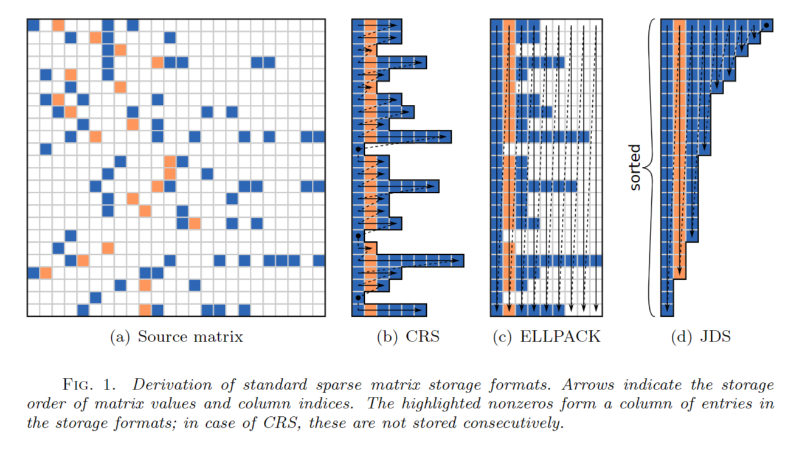
Review - SELL-C-σ
ELLPACK is an alternative, as is JDS on vector computers
[1]
Notes:
Notice the row-wise vs. column-wise data layouts
Make special note of ELLPACK padding

Slide 18
Review - SELL-C-σ
Sliced-ELLPACK reduces ELLPACK padding overhead [2]
Notes:
Show there is less padding to contend with, i.e. in our case, less *0s to do

Slide 19
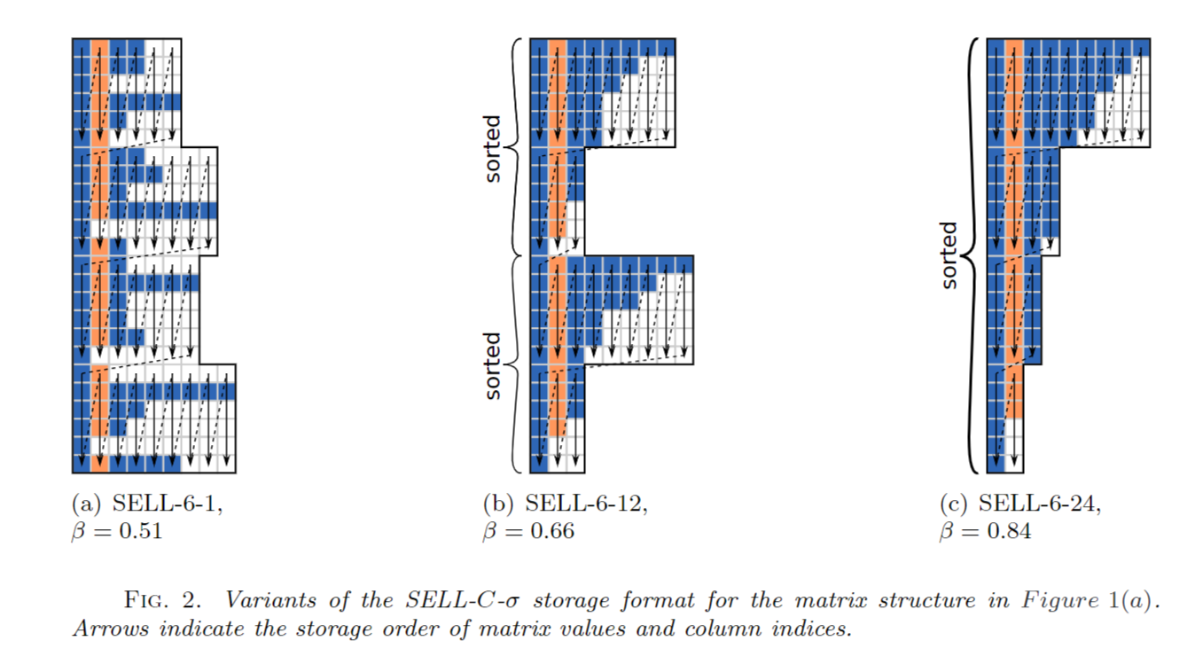
Review - SELL-C-σ
Sliced-ELLPACK reduces ELLPACK padding overhead [2]
SELL-C-σ introduces a new sorting scope σ
All elements in a chunk are stored consecutive in memory
[1]
Notes:
Show there is less padding to contend with, i.e. in our case, less *0s to do
Beta := “chunk occupancy”, is just the ratio of nnz to all n_elements

Slide 20
Review - SELL-C-σ
Sliced-ELLPACK reduces ELLPACK padding overhead [2]
SELL-C-σ introduces a new sorting scope σ
Optimally, C should divide N
If not, SELL-C-σ will pad with rows, consisting themselves of only padding
All elements in a chunk are stored consecutive in memory
[1]
Notes:
Show there is less padding to contend with, i.e. in our case, less *0s to do
Beta := “chunk occupancy”, is just the ratio of nnz to all n_elements

Slide 21
Review - SELL-C-σ
Finally, what is the advantage? Corresponding SpMV kernel:
// cs[] := starting chunk offset
// cl[] := length of lonest row in the chunk
for(i=0; i<N/4; ++i){
for(j = 0; j < cl[i]; ++j){
y[i*4+0] += val[cs[i]+j*4+0] * x[col[cs[i]+j*4+0]];
y[i*4+1] += val[cs[i]+j*4+1] * x[col[cs[i]+j*4+1]];
y[i*4+2] += val[cs[i]+j*4+2] * x[col[cs[i]+j*4+2]];
y[i*4+3] += val[cs[i]+j*4+3] * x[col[cs[i]+j*4+3]];
}
}
No remainder loop, due to padding of rows to C multiple
No horizontal add instruction
Notes:
Here is the same SpMV kernel, using a now with SCS.
Still 4 way unrolled, i.e. C = 4, now going along columns

Slide 22
Progress - (Apr. - June)
The first several weeks were devoted to:
Literature review
Getting accustomed to the code base

Slide 23
Progress - (Apr. - June)
The first several weeks were devoted to:
Literature review
Getting accustomed to the code base
The first task was splitting up the work between MPI processes
The means segmenting the matrix into (somewhat) even parts
Root process reads .mtx file via mmio.h to MtxData struct “total_mtx”
Then, root process segments and sends the corresponding “local_mtx”

Slide 24
Progress - (Apr. - June)
template <typename VT, typename IT>
struct MtxData
{
IT n_rows{};
IT n_cols{};
IT nnz{};
bool is_sorted{};
bool is_symmetric{};
std::vector<IT> I;
std::vector<IT> J;
std::vector<VT> values;
};
Notes:
Notice COO format
“is_sorted” and “is_symmetric” not very relevant for local_mtx structs, but they are for the total_mtx struct

Slide 25
Progress - (Apr. - June)
The first several weeks were devoted to:
Literature review
Getting accustomed to the code base
The first task was splitting up the work between MPI processes
The means segmenting the matrix into (somewhat) even parts
Root process reads .mtx file via mmio.h to MtxData struct “total_mtx”
Then, root process segments and sends the corresponding “local_mtx”
Considerations had to be taken for load balancing
Segmentation by rows, or number of non-zeros
The row offsets are stored in a “work sharing” array

Slide 26

Progress - (Apr. - June)
MPI Proc. 0
3 | 5 | 3
 | 2 | 1 | 1 |  |  |  | 1
local_mtx
3 | 5 | 3
 | 2 | 1 | 1 |  |  |  | 1
 |  | 1 | 5 | 5
 |  |  | 1 |  |  |  | 1
 |  | 2 | 9 | 2 | 3
 | 4 |  |  | 1 | 3 | 2
 |  |  |  |  | 2 | 7 | 3
 |  |  |  |  |  | 1 | 2
MPI Proc. 1
 |  | 1 | 5 | 5
 |  |  | 1 |  |  |  | 1
local_mtx
total_mtx
MPI Proc. 2
 |  | 2 | 9 | 2 | 3
 | 4 |  |  | 1 | 3 | 2
local_mtx
MPI Proc. 3
 |  |  |  |  | 2 | 7 | 3
 |  |  |  |  |  | 1 | 2
local_mtx
Notes:
In this example, segmentation by rows was used

Slide 27
Progress - (Apr. - June)
Now, every MPI process has it’s own local_mtx struct
It is also crucial that each process has a copy of the work sharing array

Slide 28
Progress - (Apr. - June)
Now, every MPI process has it’s own local_mtx struct
It is also crucial that each process has a copy of the work sharing array
The next task was having each process converts it’s COO formatted “local_mtx” into a SELL-C-σ formatted “local_scs”
Additionally, a “local_context” struct is generated on each process
local_context holds local communication data collected during the set-up phase
Notes:
This routine was not implemented by me, but just converts COO -> SCS

Slide 29
Progress - (Apr. - June)
MPI Proc. 0
3 | 5 | 3
 | 2 | 1 | 1 |  |  |  | 1
local_scs_0
local_ctx_0
MPI Proc. 1
 |  | 1 | 5 | 5
 |  |  | 1 |  |  |  | 1
local_scs_1
local_ctx_1
MPI Proc. 2
 |  | 2 | 9 | 2 | 3
 | 4 |  |  | 1 | 3 | 2
local_scs_2
local_ctx_2
MPI Proc. 3
 |  |  |  |  | 2 | 7 | 3
 |  |  |  |  |  | 1 | 2
local_scs_3
local_ctx_3
Notes:
For all intents and purposes, local_scs_x are just the local A

Slide 30
Progress - (Apr. - June)
template <typename VT, typename IT>
struct ScsData
{
IT C{}; IT sigma{};
IT n_rows{}; IT n_cols{};
IT n_rows_padded{};
IT n_chunks{};
IT n_elements{}; // No. of nz + padding.
IT nnz{}; // No. of nz only.
V<IT, IT> chunk_ptrs; // Chunk start offsets
V<IT, IT> chunk_lengths;
V<IT, IT> col_idxs;
V<VT, IT> values;
V<IT, IT> old_to_new_idx;
};

Slide 31
Progress - (Apr. - June)
template <typename VT, typename IT>
struct ContextData
{
std::vector<std::vector<IT>> send_tags;
std::vector<std::vector<IT>> recv_tags;
std::vector<std::vector<IT>> comm_idxs;
std::vector<std::vector<VT>> elems_to_send;
std::vector<IT> recv_counts_cumsum;
std::vector<IT> send_counts_cumsum;
IT amnt_local_elems;
IT scs_padding;
IT total_nnz;
};
Notes:
Could have implemented as array of vectors, because outer vector length known, but inner vectors have an unknown size
Actually, the tags should be array of arrays, it’s the comm_idxs and elems_to_send could be arrays of vectors
Cumulative sums used for offsets in the receive buffers
Amnt_local_elems just difference in work_sharing_array_[i+i] - work_sharing_array_[i]

Slide 32
Progress - (Apr. - June)
Recall the issue stated at the beginning

Slide 33
Progress - (Apr. - June)
MPI Proc. 0
3 | 5 | 3
 | 2 | 1 | 1 |  |  |  | 1
1
3
*
MPI Proc. 1
 |  | 1 | 5 | 5
 |  |  | 1 |  |  |  | 1
2
8
*
MPI Proc. 2
 |  | 2 | 9 | 2 | 3
 | 4 |  |  | 1 | 3 | 2
9
0
*
MPI Proc. 3
 |  |  |  |  | 2 | 7 | 3
 |  |  |  |  |  | 1 | 2
1
1
*

Slide 34
Progress - (Apr. - June)
Recall the issue stated at the beginning
One way to address this issue, is with the idea of “halo communication”
Before each SpMV, there must be a communication routine
“fills up” each local x vector, so that multiplication can execute properly

Slide 35
Progress - (Apr. - June)
Recall the issue stated at the beginning
One way to address this issue, is with the idea of “halo communication”
Before each SpMV, there must be a communication routine
“fills up” each local x vector, so that multiplication can execute properly
The steps are roughly as follows:
Identify the “remote elements” of each process

Slide 36
Progress - (Apr. - June)
MPI Proc. 0
3 | 5 | 3
 | 2 | 1 | 1 |  |  |  | 1
1
3
local A
local x
MPI Proc. 1
 |  | 1 | 5 | 5
 |  |  | 1 |  |  |  | 1
2
8
local A
local x
MPI Proc. 2
 |  | 2 | 9 | 2 | 3
 | 4 |  |  | 1 | 3 | 2
9
0
local A
local x
MPI Proc. 3
 |  |  |  |  | 2 | 7 | 3
 |  |  |  |  |  | 1 | 2
1
1
local A
local x

Slide 37
Progress - (Apr. - June)
Recall the issue stated at the beginning
One way to address this issue, is with the idea of “halo communication”
Before each SpMV, there must be a communication routine
“fills up” each local x vector, so that multiplication can execute properly
The steps are roughly as follows:
Identify the “remote elements” of each process
Increase buffer size of each local x accordingly

Slide 38
Progress - (Apr. - June)
MPI Proc. 0
3 | 5 | 3
 | 2 | 1 | 1 |  |  |  | 1
1
3
MPI Proc. 1
 |  | 1 | 5 | 5
 |  |  | 1 |  |  |  | 1
2
8
MPI Proc. 2
 |  | 2 | 9 | 2 | 3
 | 4 |  |  | 1 | 3 | 2
9
0
MPI Proc. 3
 |  |  |  |  | 2 | 7 | 3
 |  |  |  |  |  | 1 | 2
1
1

Slide 39
Progress - (Apr. - June)
Recall the issue stated at the beginning
One way to address this issue, is with the idea of “halo communication”
Before each SpMV, there must be a communication routine
“fills up” each local x vector, so that multiplication can execute properly
The steps are roughly as follows:
Identify the “remote elements” of each process
Increase buffer size of each local x accordingly
Reindex remote element column indices in a L -> R manner
This ensures “lower” processes communicate “earlier”

Slide 40
Progress - (Apr. - June)
0
1
3
MPI Proc. 0
3 | 5 | 3
 | 2 | 1 | 1 |  |  |  | 1
0
1
2
0
2
8
MPI Proc. 1
 |  | 1 | 5 | 5
 |  |  | 1 |  |  |  | 1
1
1
2
9
0
MPI Proc. 2
 |  | 2 | 9 | 2 | 3
 | 4 |  |  | 1 | 3 | 2
0
3
0
1
1
MPI Proc. 3
 |  |  |  |  | 2 | 7 | 3
 |  |  |  |  |  | 1 | 2
Notes:
Take time to EXPLAIN
The COLUMNs in local A correspond to the ROWS in local x
So, if a remote color is in the left column; it corresponds to the TOP local x being NEEDED

Slide 41
Progress - (Apr. - June)
Recall the issue stated at the beginning
One way to address this issue, is with the idea of “halo communication”
Before each SpMV, there must be a communication routine
“fills up” each local x vector, so that multiplication can execute properly
The steps are roughly as follows:
Identify the “remote elements” of each process
Increase buffer size of local_x accordingly
Reindex remote element column indices in a L -> R manner
This ensures “lower” processes communicate “earlier”
Communicate halo elements
The only performance relevant part so far

Slide 42
Progress - (Apr. - June)
0
1
3
2
1
MPI Proc. 0
3 | 5 | 3
 | 2 | 1 | 1 |  |  |  | 1
0
1
2
8
0
2
8
9
MPI Proc. 1
 |  | 1 | 5 | 5
 |  |  | 1 |  |  |  | 1
1
1
1
2
9
0
MPI Proc. 2
 |  | 2 | 9 | 2 | 3
 | 4 |  |  | 1 | 3 | 2
3
8
0
3
2
1
0
1
1
0
MPI Proc. 3
 |  |  |  |  | 2 | 7 | 3
 |  |  |  |  |  | 1 | 2
Notes:
STOP! Take time to explain a few example…
Notice, one process having multiple remote elements in a column doesn’t add to communication!

Slide 43
Progress - (Apr. - June)
Recall the issue stated at the beginning
One way to address this issue, is with the idea of “halo communication”
Before each SpMV, there must be a communication routine
“fills up” each local x vector, so that multiplication can execute properly
The steps are roughly as follows:
Identify the “remote elements” of each process
Increase buffer size of local_x accordingly
Reindex remote element column indices in a L -> R manner
This ensures “lower” processes communicate “earlier”
Communicate halo elements
Our first working (naïve) communication scheme!
Notes:
Solver mode uses swapping to maintain correct results

Slide 44

Progress (July - Sept.)
0
1
3
2
1
MPI Proc. 0
3 | 5 | 3
 | 2 | 1 | 1 |  |  |  | 1
0
1
2
*
8
0
2
8
9
MPI Proc. 1
 |  | 1 | 5 | 5
 |  |  | 1 |  |  |  | 1
1
*
1
1
2
9
0
MPI Proc. 2
 |  | 2 | 9 | 2 | 3
 | 4 |  |  | 1 | 3 | 2
3
8
0
3
*
2
1
0
1
1
0
MPI Proc. 3
 |  |  |  |  | 2 | 7 | 3
 |  |  |  |  |  | 1 | 2
*

Slide 45
Progress - (July - Sept.)
Update communication scheme:
Instead of sending element-wise, first collect “to_process” contiguous buffers
Also, implement a non-blocking strategy

Slide 46
Progress - (July - Sept.)
0
1
3
1
MPI Proc. 0
3 | 5 | 3
 | 2 | 1 | 1 |  |  |  | 1
2
0
1
2
8
0
2
8
MPI Proc. 1
 |  | 1 | 5 | 5
 |  |  | 1 |  |  |  | 1
9
1
1
1
2
9
0
MPI Proc. 2
 |  | 2 | 9 | 2 | 3
 | 4 |  |  | 1 | 3 | 2
3
8
0
3
2
1
0
1
1
0
MPI Proc. 3
 |  |  |  |  | 2 | 7 | 3
 |  |  |  |  |  | 1 | 2

Slide 47
Progress - (July - Sept.)
Update communication scheme:
Instead of sending element-wise, first collect “to_process” contiguous buffers
Also, implement a non-blocking strategy
Need various improvements and optimizations in “set-up” phase
Notably, reindexing of remote element column indices very slow

Slide 48

Progress - (July - Sept.)
Update communication scheme:
Instead of sending element-wise, first collect “to_process” contiguous buffers
Also, implement a non-blocking strategy
Need various improvements and optimizations in “set-up” phase
Notably, reindexing of remote element column indices very slow
First attempt, “trace” columns L -> R
$\sim O\left(nnz\right)+2 ∗O\left(2∗N^{2}\right)⇒O(N^{2}$)

Slide 49

Progress - (July - Sept.)
Update communication scheme:
Instead of sending element-wise, first collect “to_process” contiguous buffers
Also, implement a non-blocking strategy
Need various improvements and optimizations in “set-up” phase
Notably, reindexing of remote element column indices very slow
First attempt, “trace” columns L -> R
Second “hash map” solution reduced time considerably, but not scalable
$\sim O\left(nnz\right)+2 ∗O\left(2∗N^{2}\right)⇒O(N^{2}$)
$\sim 2 ∗O\left(2∗N^{2}\right)⇒O(N^{2}$)

Slide 50

Progress - (July - Sept.)
Update communication scheme:
Instead of sending element-wise, first collect “to_process” contiguous buffers
Also, implement a non-blocking strategy
Need various improvements and optimizations in “set-up” phase
Notably, reindexing of remote element column indices very slow
First attempt, “trace” columns L -> R
Second “hash map” solution reduced time considerably, but not scalable
Third and current solution, only need to touch nnz elements twice
$\sim O\left(nnz\right)+2 ∗O\left(2∗N^{2}\right)⇒O(N^{2}$)
$\sim 2 ∗O\left(2∗N^{2}\right)⇒O(N^{2}$)
$\sim 2 ∗O(nnz)⇒O(nnz$)

Slide 51
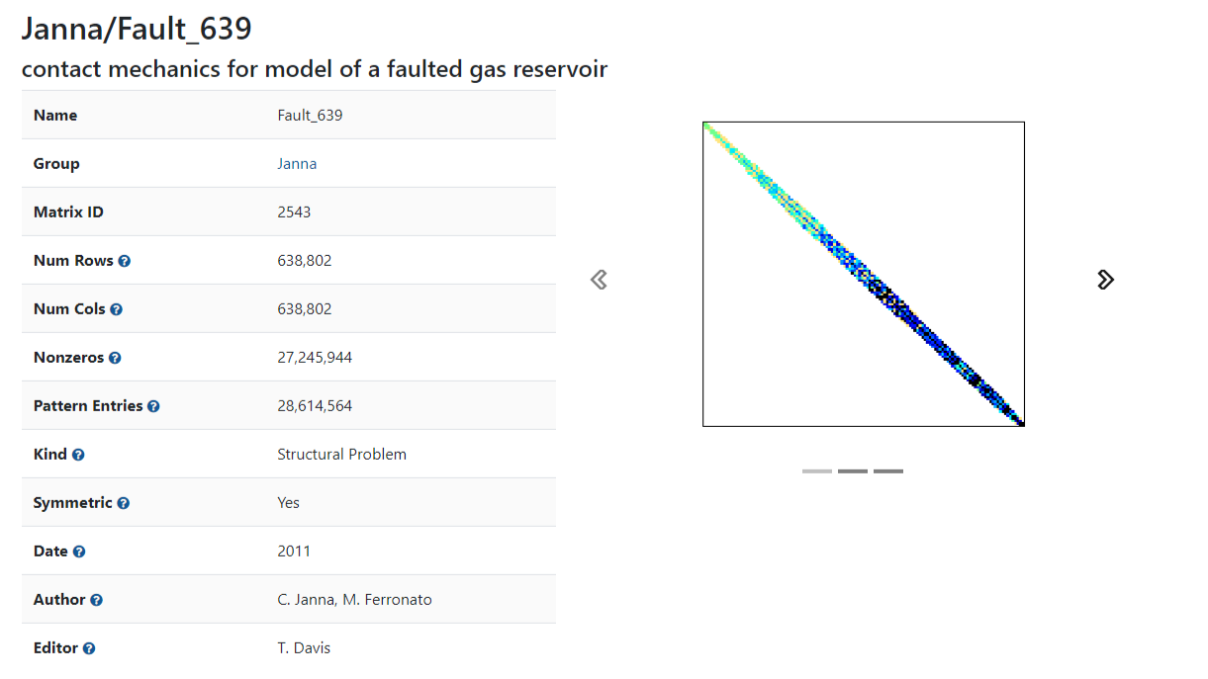
Results

Slide 52
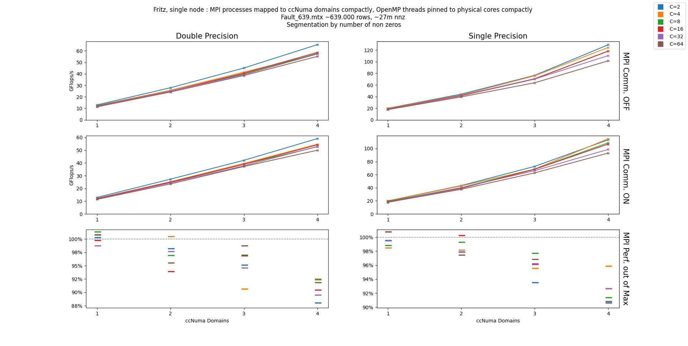
Results
Notes:
Fritz is AVX512 capable, so C=8 should peak for (8*64bit = 512), and C=16 should peak for floats (16*32bit = 512)
C will make an impact on other architectures like GPUs and A64FX. Not on the typical CPU architectures, because they can hit the memory bandwidth even with scalar instructions

Slide 53
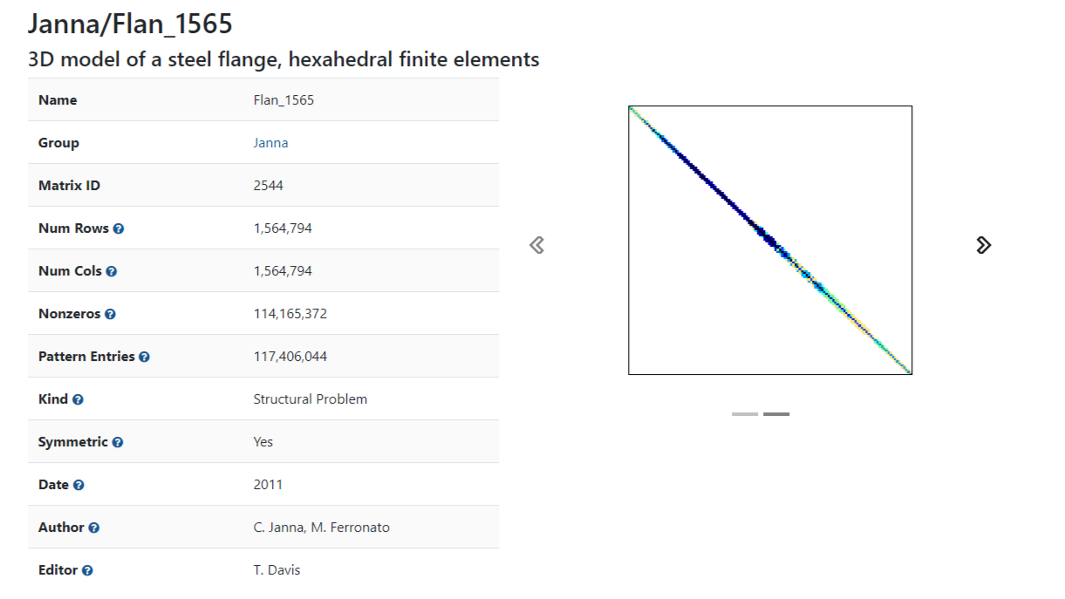
Results

Slide 54
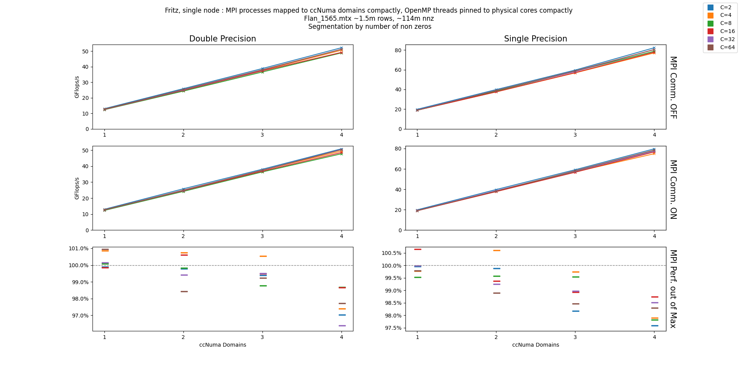
Results

Slide 55
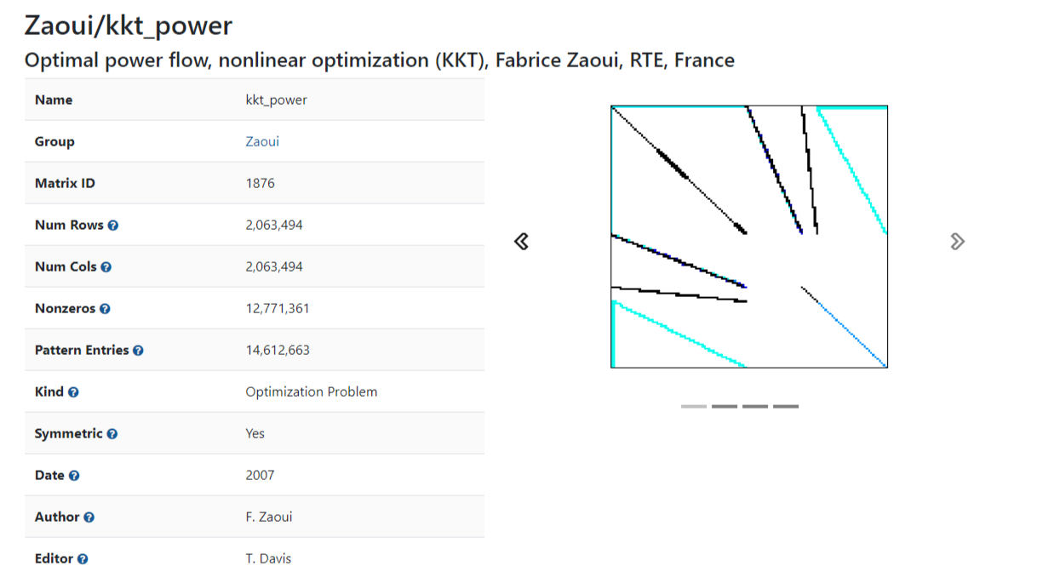
Results

Slide 56
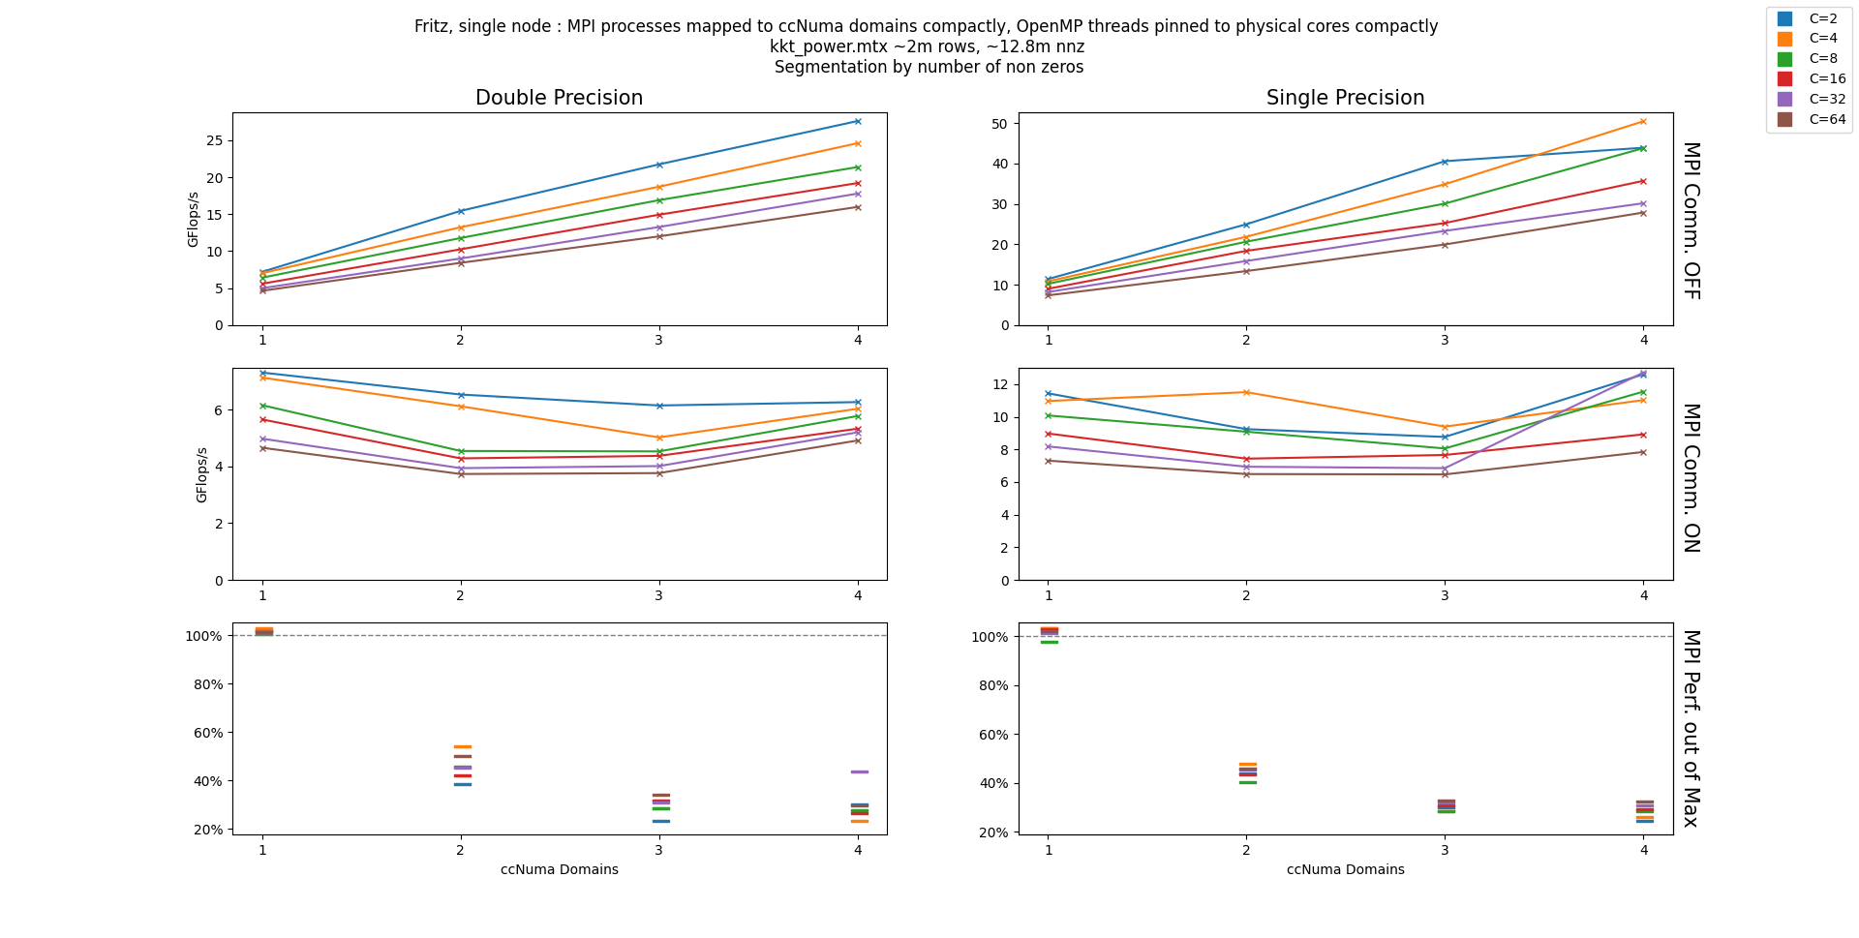
Results
Notes:
Brown on the lowest makes sense, with all the extra padding

Slide 57
Future Direction
More inclusive benchmarking
Make use the sorting scope σ, and other formats (COO, CRS, ELL)
Scale up to multi-node benchmarks
Notes:
Support for sigma is there, just like GPU, but some leg work needs to be done

Slide 58
Future Direction
More inclusive benchmarking
Make use the sorting scope σ, and other formats (COO, CRS, ELL)
Scale up to multi-node benchmarks
Integration of METIS for (possibly) better partitioning of total_mtx
Notes:
METIS is a graph partitioner, very commonly used

Slide 59
Future Direction
More inclusive benchmarking
Make use the sorting scope σ, and other formats (COO, CRS, ELL)
Scale up to multi-node benchmarks
Integration of METIS for (possibly) better partitioning of total_mtx
Experiment with alternative MPI communication schemes
Local computations can take place while we’re waiting for communication
Using neighborhood collectives from MPI 3.0

Slide 60
Future Direction
More inclusive benchmarking
Make use the sorting scope σ, and other formats (COO, CRS, ELL)
Scale up to multi-node benchmarks
Integration of METIS for (possibly) better partitioning of total_mtx
Experiment with alternative MPI communication schemes
Local computations can take place while we’re waiting for communication
Using neighborhood collectives from MPI 3.0
Upcoming MA using related ideas
Extending RACE [3] into the distributed setting for use in MPK
Use of communication-avoidance techniques
“Easy” integration into pre-existing frameworks

Slide 61
Future Direction
More inclusive benchmarking
Make use the sorting scope σ, and other formats (COO, CRS, ELL)
Scale up to multi-node benchmarks
Integration of METIS for (possibly) better partitioning of total_mtx
Experiment with alternative MPI communication schemes
Local computations can take place while we’re waiting for communication
Using neighborhood collectives from MPI 3.0
Upcoming MA using related ideas
Extending RACE [3] into the distributed setting for use in MPK
Use of communication-avoidance techniques
“Easy” integration into pre-existing frameworks
More to come in November

Slide 62
References
[1] Kreutzer, Moritz, et al. “A Unified Sparse Matrix Data Format for Efficient General Sparse Matrix-Vector Multiplication on Modern Processors with Wide SIMD Units.” SIAM Journal on Scientific Computing, vol. 36, no. 5, 2014, https://doi.org/10.1137/130930352.
[2] Monakov, Alexander, et al. “Automatically Tuning Sparse Matrix-Vector Multiplication for GPU Architectures.” High Performance Embedded Architectures and Compilers, 2010, pp. 111–125., https://doi.org/10.1007/978-3-642-11515-8_10.
[3] Alappat, Christie, et al. “A Recursive Algebraic Coloring Technique for Hardware-Efficient Symmetric Sparse Matrix-Vector Multiplication.” ACM Transactions on Parallel Computing, vol. 7, no. 3, 2020, pp. 1–37., https://doi.org/10.1145/3399732.

Slide 63
Thank you

