Slide 1
Campaign Analysis & Dashboard
Final Project
Dane Turnbull
June 19th, 2021

Slide 2
Agenda
01. Introduction
02. Website Metrics
03. February Campaign
04. Conversions Breakdown
05. Closing and Dashboard

Slide 3
Introduction
Using the data from Beeline Tees, I have put together a campaign performance summary.
Campaign Dates: Feb 1 - Feb 29, 2021

Slide 4
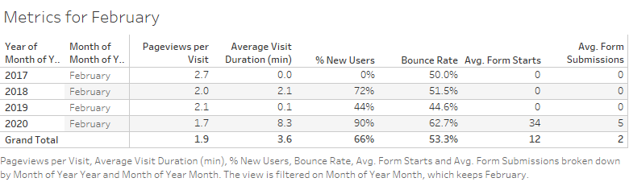
Metrics

Slide 5
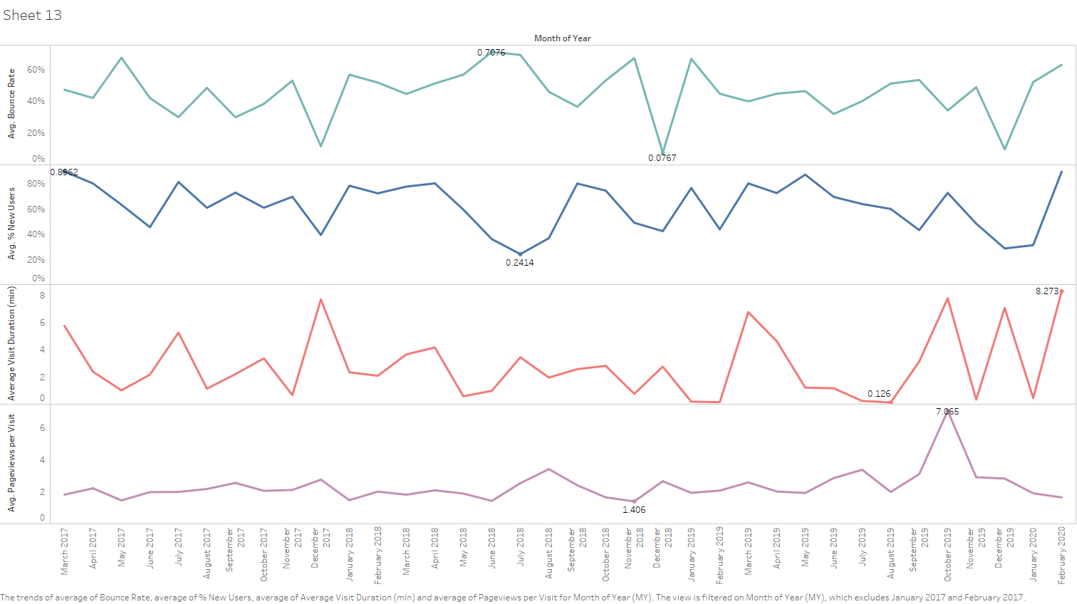
Metric Trends over Time

Slide 6
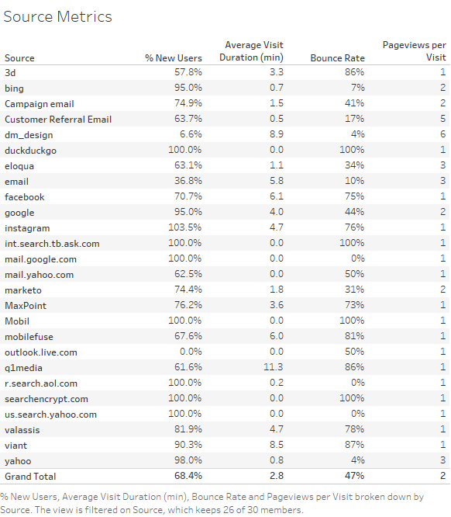
Source Metrics

Slide 7
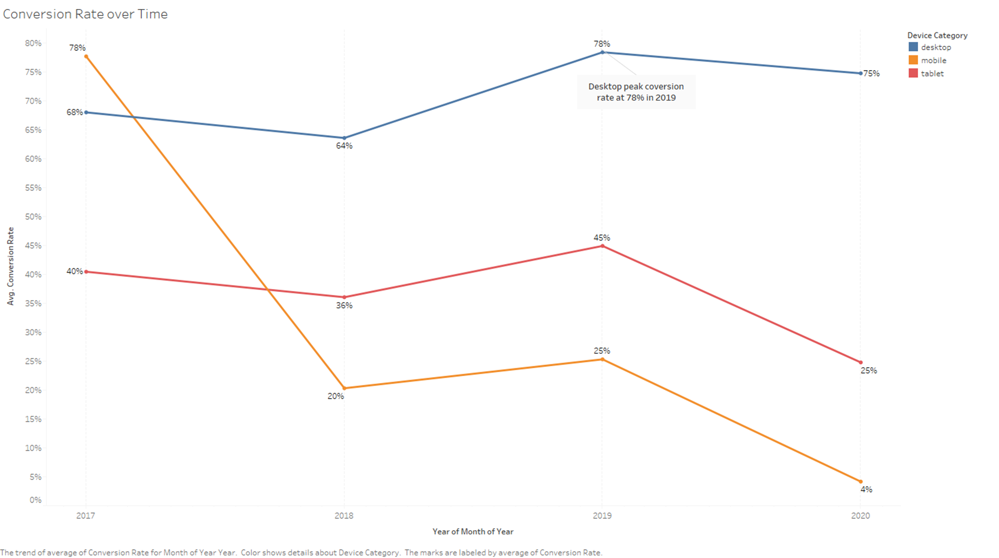
Conversions

Slide 8
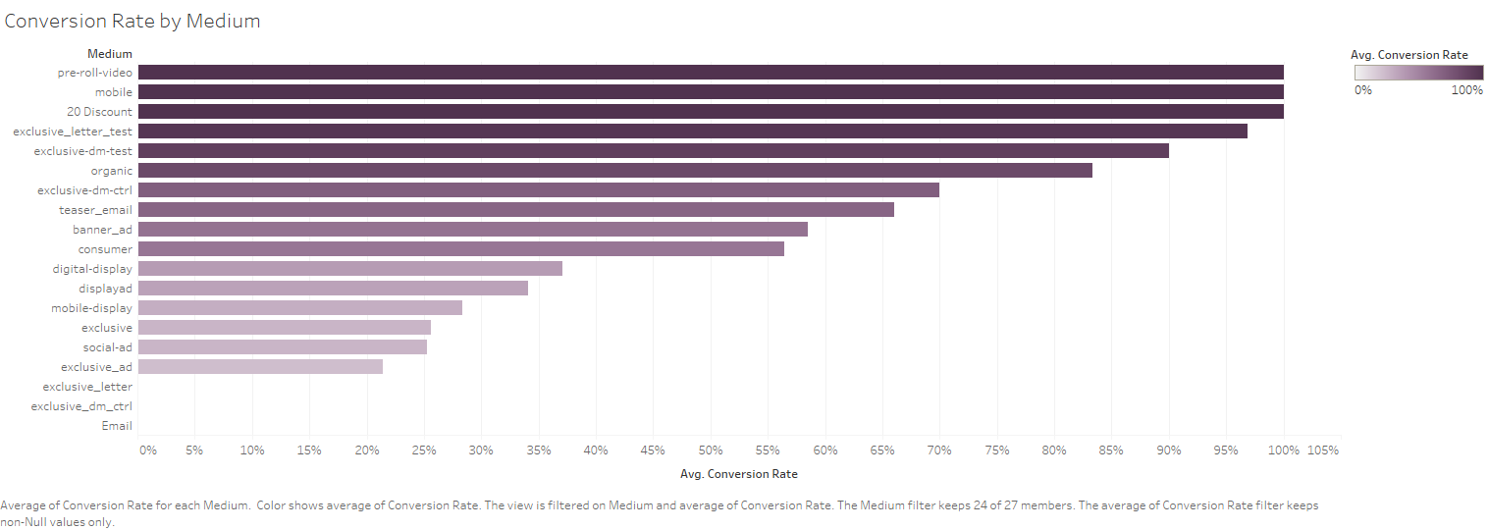
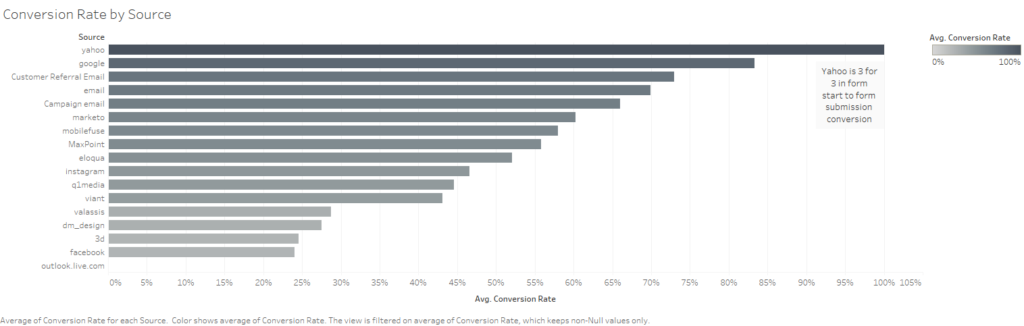

Slide 9
Summary
February 2020
New Users
February 2020 Campaign had a large spike in
traffic and conversions
50 percent increase in new users for Feb 2020
Conversion Rates
Successful Mediums
Conversions were at all time high in 2020
20-Discount, Mobile, and pre-roll-video provided a 100% conversion rate

Slide 10

Client Dashboard

Slide 11
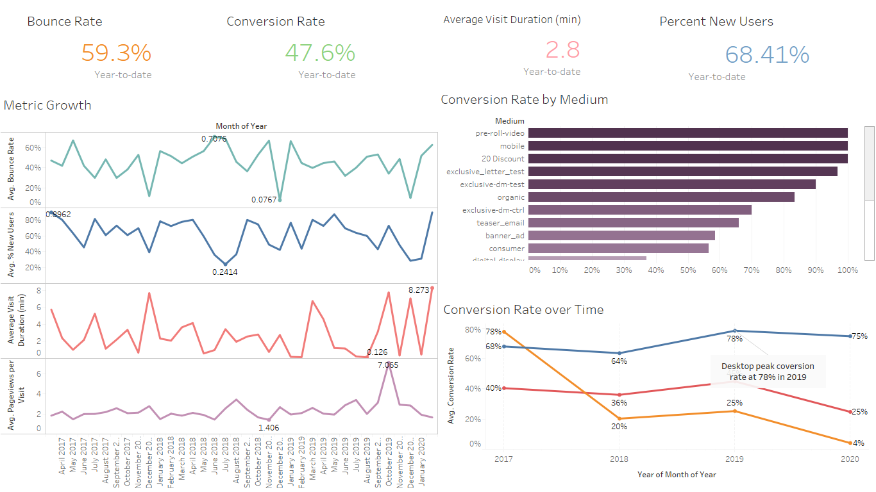

Slide 12
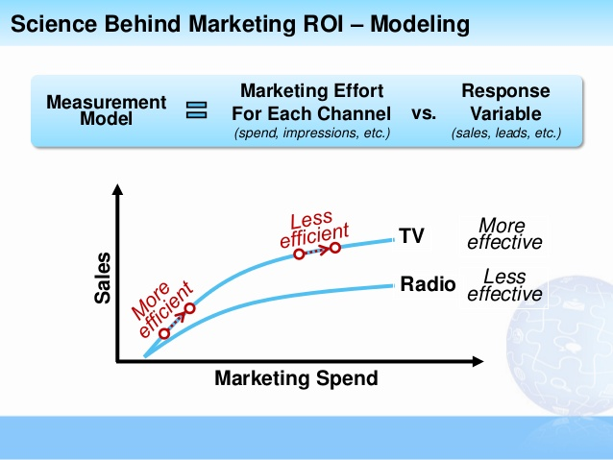
Modeling Recommendations
Affinity Analysis
Marketing Mix Optimization
Determine how to allocate marketing budgets to achieve maximum ROI
Quantify marketing effectiveness
Also known as Market Basket Analysis
Used to understand customer purchase behaviors
ideal for:
Cross-selling strategies
Purchase suggestions for online retail
Promotions and pricing strategy

Slide 13

Thank you
Dane Turnbull
DA430

