Slide 1

Web Traffic Forecasting
DA485 Capstone Project
Dane Turnbull

Slide 2
What is Web traffic forecasting?
Predict web traffic trends based on historic data
Develop strategies for Load balancing applications
Better understand user behavior

Slide 3

Potential Customers
Businesses looking for insights on web traffic to improve efficiency and gain a competitive edge
Forecasting is ubiquitous across industries:
Operations
Retail
Marketing
Logistics

Slide 4
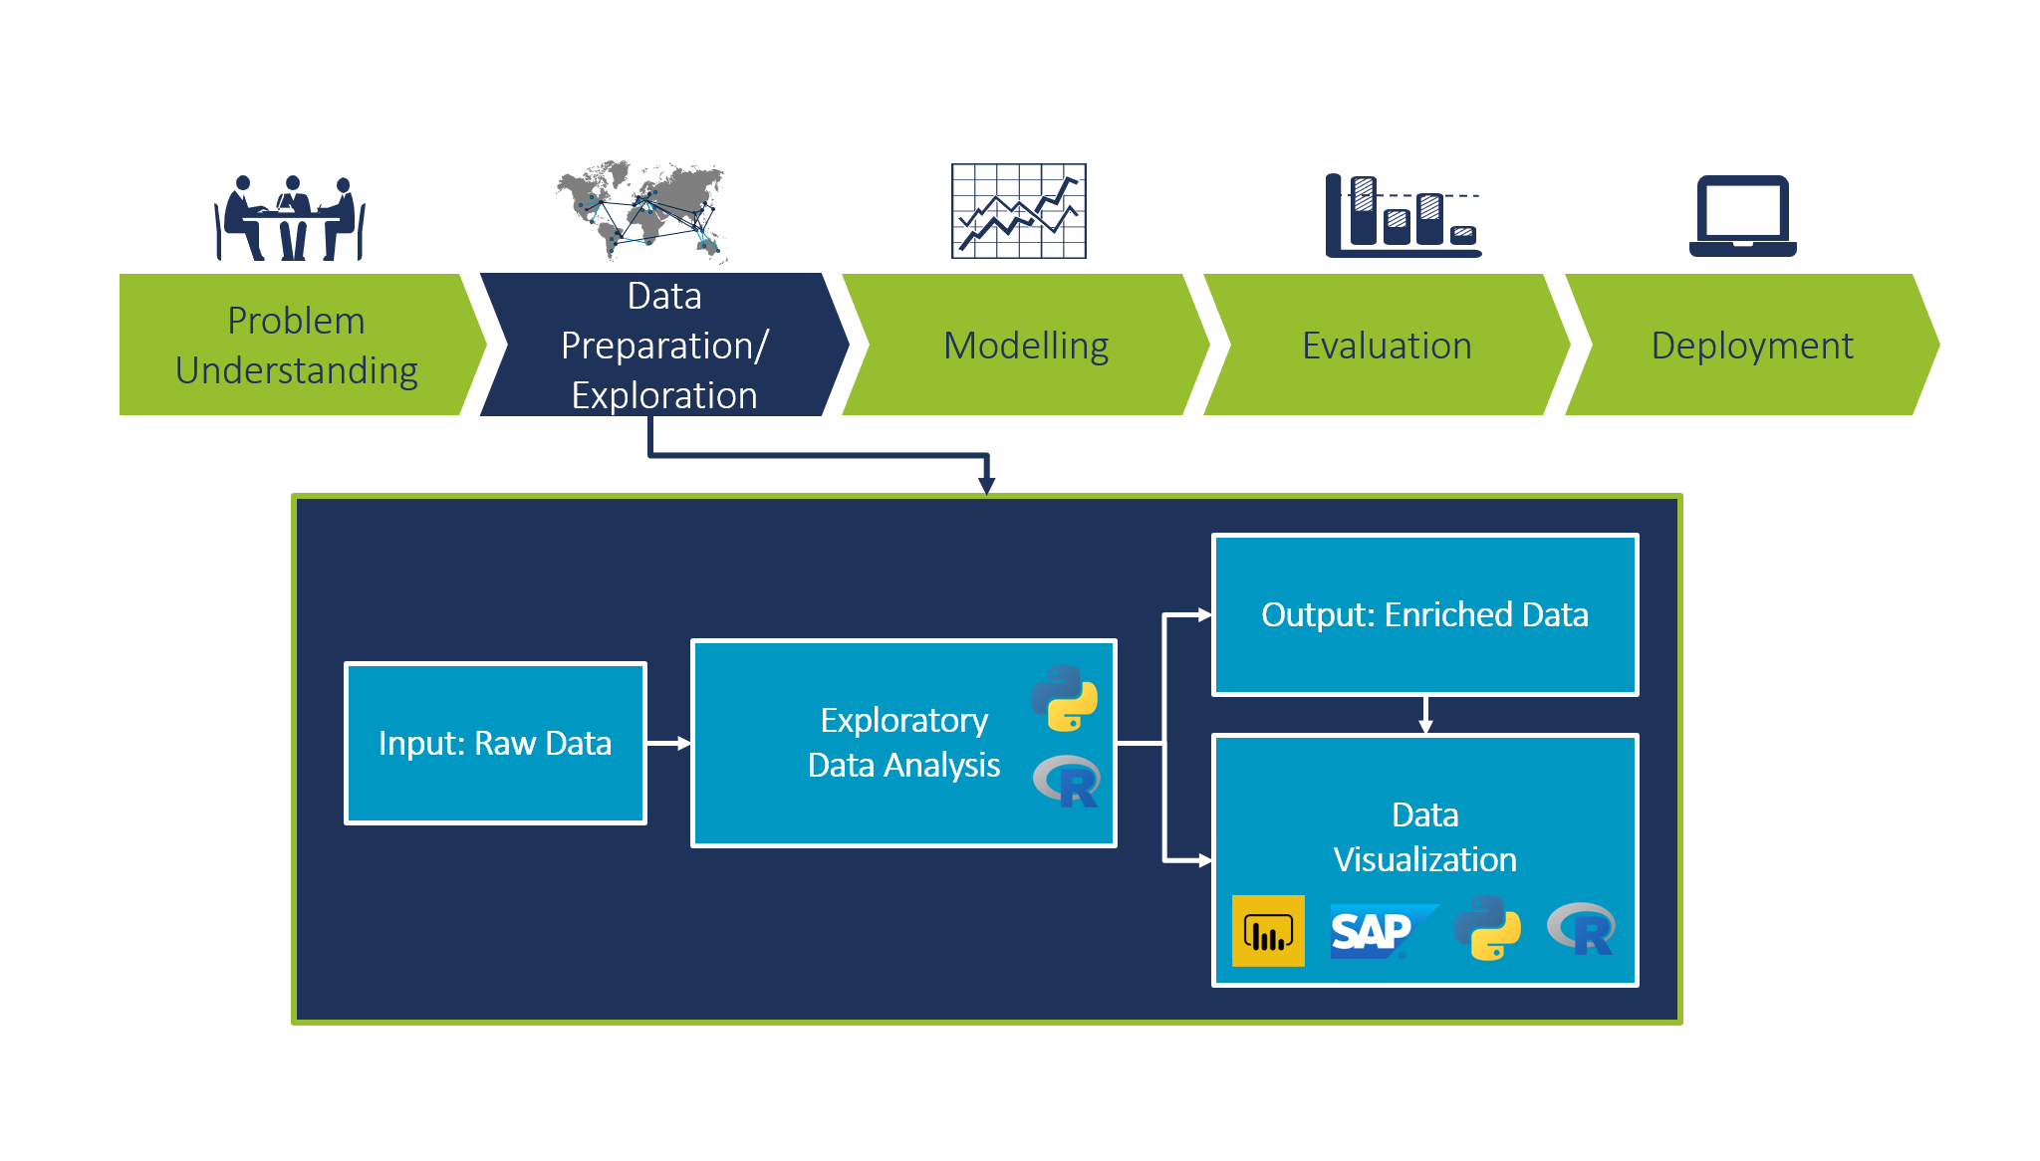
Exploratory data analysis (EDA)

Slide 5

Analysis Software
Primarily RStudio to do analysis
tidyverse
plotly
forecast
prophet
Python used for some visuals
plotly
ggplot

Slide 6
Data Source
145,000 time series:
Daily page views, 2015-07-01 to 2016-12-31
Source: https://www.kaggle.com/c/web-traffic-time-series-forecasting/data
page name
traffic data

Slide 7
Cleaning and Transformation
Checked for missing values and found about 8%
Separate the date and pages to make it easier to visualize:

Slide 8
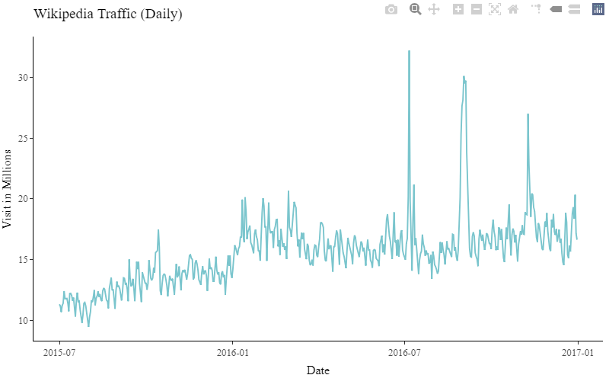
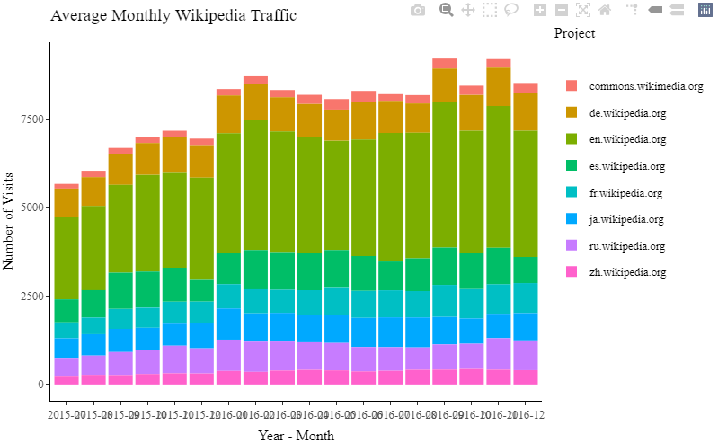
Cleaning and Transformation
Extraction of time-series

Slide 9
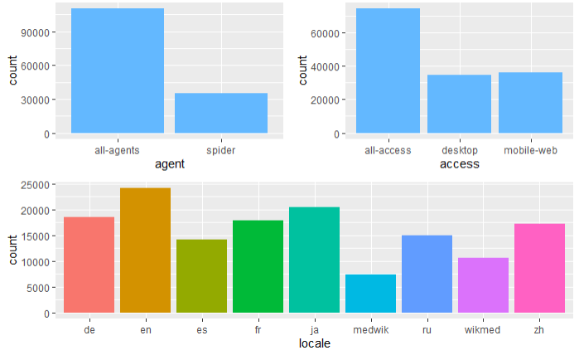
The variables
locale data includes 7 languages: German, English, Spanish, French, Japanese, Russian, and Chinese
Access: Platform used to view page
Agent being a real person, spider being a bot used to index content

Slide 10
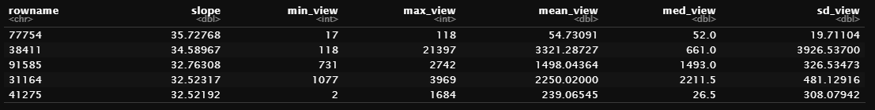
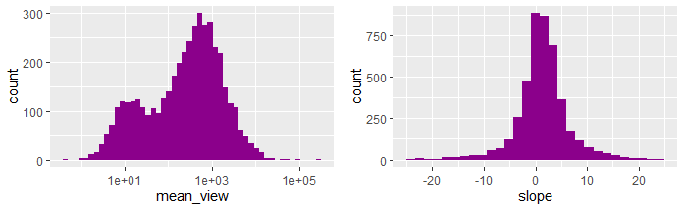
Understanding trends
*mean_view is scaled down by log10

Slide 11
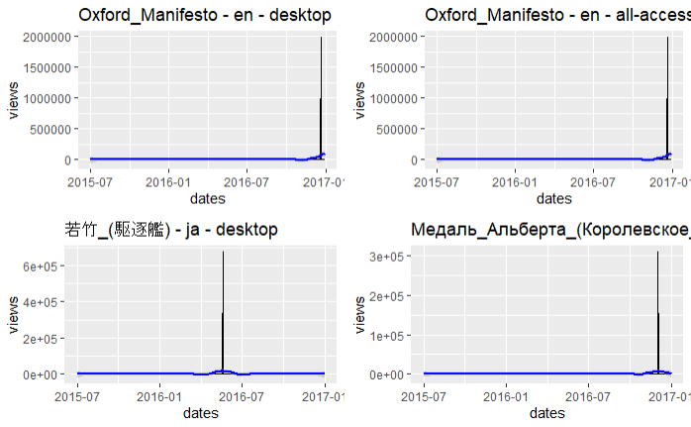
Outliers

Slide 12
Model Selection - ARIMA
Stands for Auto Regressive Integrated Moving Average
ARIMA has a fixed structure that is built for time-series
Captures complex relationships through an iterative process of regressing a variable:
- Views ~ Dates

Slide 13
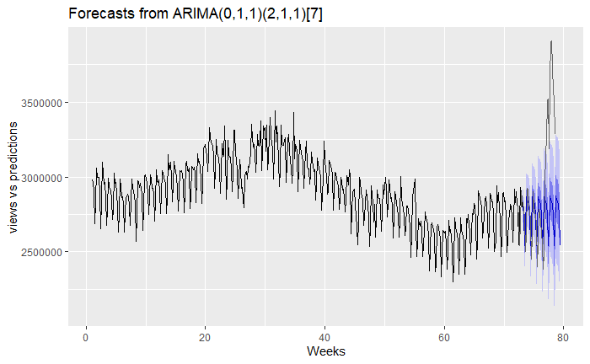
Auto.Arima Results
Prediction length of 45 days

Slide 14
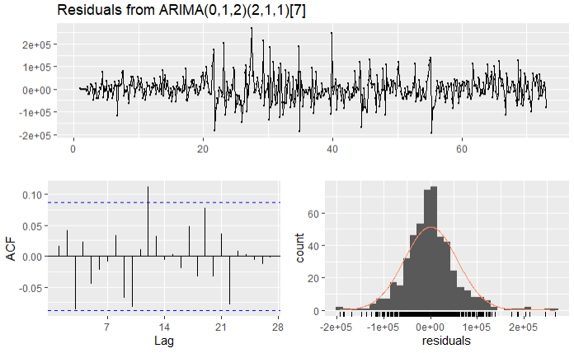
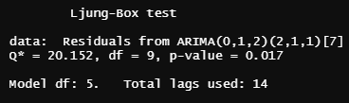
residuals
Strong p-value = 0 .017 (less than 0.05)
Residuals are normally distributed
Mostly absent of autocorrelation

Slide 15
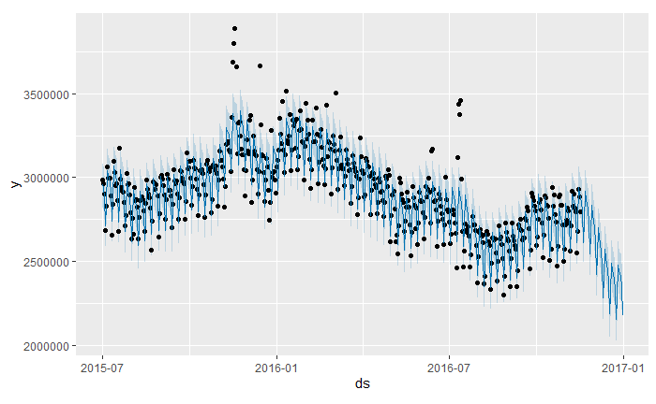
Prophet Model
Implementation of the Prophet library
non-linear trends are fit with yearly seasonality effects

Slide 16
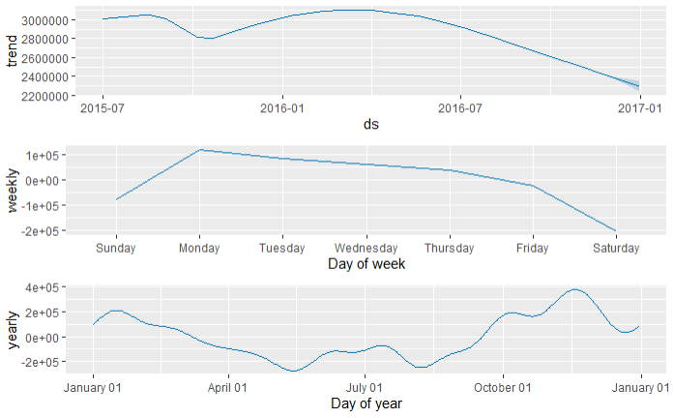
Prophet Model
Prophet components plotted
Clear dip in views for middle of year

Slide 17
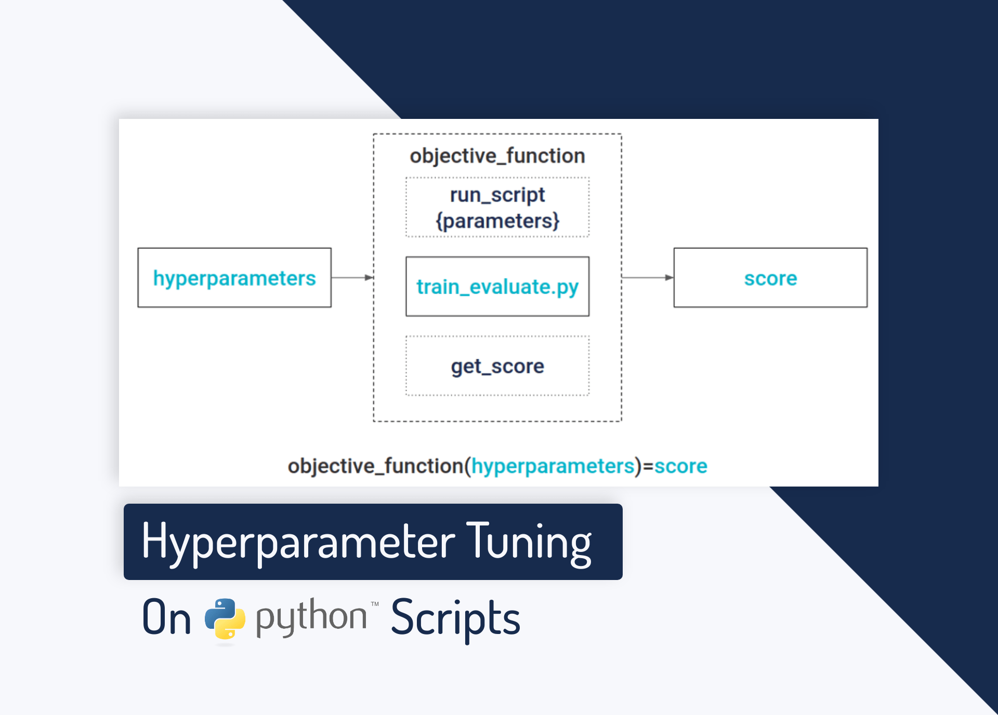
Improvements
Include more relevant dates - Kaggle and API only provided up to 2016
Determine specific seasonality effects and tune accordingly
Overall increase in model performance

Slide 18
References
https://www.mediawiki.org/wiki/API:Main_page
https://www.kaggle.com/c/web-traffic-time-series-forecasting
https://www.rdocumentation.org/packages/forecast/versions/8.15/topics/auto.arima
https://otexts.com/fpp2/arima-r.html
https://plotly.com/ggplot2/
https://www.rstudio.com/wp-content/uploads/2015/02/data-wrangling-cheatsheet.pdf
https://medium.com/swlh/wikipedia-web-traffic-time-series-forecasting-part-1-e43734adca3d

