Slide 1

FoundInTranslation Serverless Translating ChatRoom https://codepen.io/dan_pyon/pen/wRgyZr
Dan Pyon

Slide 2

Goals and Objectives
Provide an open chatroom for users to join and converse in different languages with text and speech output options
Serverless, scalable, and robust architecture needed to meet demand of many different users
Service must be instantaneous and flexible during real-time conversation
Chat-room interface must be intuitive and easy to utilize

Slide 3

Tech Stack
Front-End
HTML, JS, CSS
ChatEngine UI
Back-End
Python
AWS
DynamoDB
Lambda
Polly
AWS Translate
IAM Authentication
API Gateway
S3
IAM

Slide 4
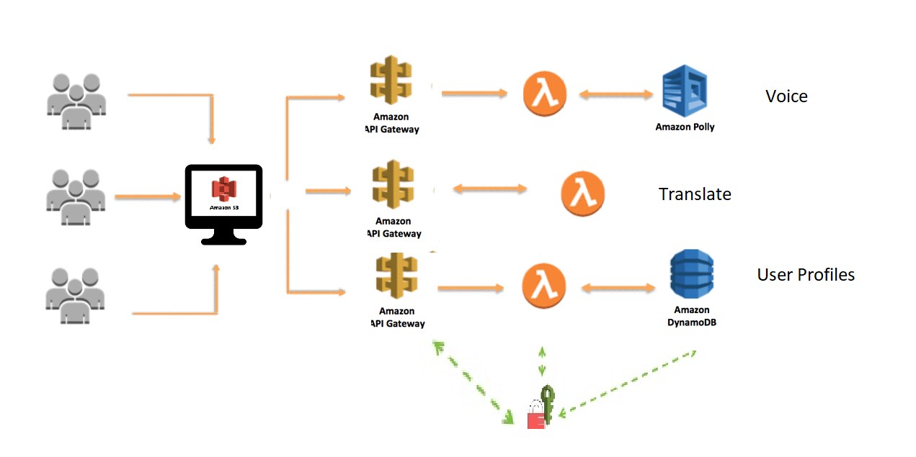
Architecture

Slide 5

Going Forward
Add more languages
Provide more base languages (EN being default)
Provide Voice-to-text functionality
Transcription of Conversations
SNS features to expand out of chatroom

Slide 6

Questions?

