Slide 1
MHF4U · GRADE 12 ADVANCED FUNCTIONS
WHAT THIS PORTFOLIO SHOWS
My understanding of polynomial functions, using the language of the course and work from this unit.
Polynomial
Functions
01 C1 Graphs and equations
Degree, end behaviour, finite differences, order of a zero, and the parameters a, k, d, and c.
Math Communication Portfolio
Strand C · Polynomial and Rational Functions
Expectations C1, C3, and C4
02 C3 Polynomial equations
Synthetic division, long division, the remainder theorem, the factor theorem, and the rational zero theorem.
03 C4 Polynomial inequalities
Factor tables, interval notation, and a model whose domain has to be restricted.
Name ________________________________
26 October 2026

Slide 2
COURSE OUTLINE · OVERALL EXPECTATIONS
Learning goals for this unit
These are the polynomial expectations from the MHF4U course. Each artifact is tied to the specific expectation it shows.
C1 Connecting graphs and equations of polynomial functions
Identify and describe key features of polynomial functions, and make connections between the numeric, graphical, and algebraic representations.
C1.1 recognize a polynomial · C1.2 compare representations, including finite differences · C1.3 describe key features · C1.5 factored form and x-intercepts · C1.6 parameters a, k, d, c · C1.8 families of functions · C1.9 even and odd functions
C3 Solving polynomial equations
Solve polynomial equations of degree at most four by factoring, and connect the real roots of an equation to the x-intercepts of the graph.
C3.1 remainder theorem and factor theorem · C3.2 factor polynomials · C3.3 roots and x-intercepts · C3.4 solve equations · C3.7 applications, including unknown coefficients
C4 Solving polynomial inequalities
Explain how the solution of an inequality differs from the solution of an equation, and solve a factorable polynomial inequality.
C4.1 equation versus inequality · C4.2 solve from a graph · C4.3 solve with zeros, a test point or a factor table, and interval notation
MHF4U · Advanced Functions · Polynomial Functions · Communication Portfolio
2 / 18

Slide 3
SUCCESS CRITERIA
What I am using as evidence of success
I wrote these from the specific expectations. An artifact belongs in the portfolio only if it meets one of them.
C1 Graphs and equations
C3 & C4 Equations and inequalities
I can state the degree, the leading coefficient, and the constant term of a polynomial function.
I can give the domain, the range, the end behaviour, and any symmetry, using interval notation.
I can tell a local maximum or minimum from an absolute maximum or minimum.
I can use finite differences to find the degree and the leading coefficient, with Δⁿy = a · n!.
I can use the order of each zero to sketch from factored form and to write a family of functions.
I can describe a, k, d, and c, and apply the mapping (x, y) → (x/k + d, ay + c).
I can separate an even or odd degree from an even or odd function.
I can choose synthetic division for a divisor x − b, and long division when the divisor is not linear.
I can write the division statement P(x) = (divisor)(quotient) + remainder, with the remainder of smaller degree.
I can use the remainder theorem, including a divisor ax − b, where the remainder is P(b/a).
I can use the factor theorem and the rational zero theorem to factor a cubic or a quartic.
I can state the roots of an equation and, separately, the x-intercepts of the graph.
I can solve a polynomial inequality with a factor table and matching interval notation.
I can restrict an answer so that it makes sense in the context of the problem.
MHF4U · Advanced Functions · Polynomial Functions · Communication Portfolio
3 / 18

Slide 4
C1 · STRAND REFLECTION
What the graph is telling me before I plot points
End behaviour is decided first
Degree limits the graph. It does not fill it in.
Even degree is not an even function.
The degree tells me whether the ends behave in the same way or in opposite ways. The leading coefficient tells me which quadrants. A positive odd degree extends from Quadrant 3 to Quadrant 1. A negative odd degree extends from Quadrant 2 to Quadrant 4. A positive even degree extends from Quadrant 2 to Quadrant 1. A negative even degree extends from Quadrant 3 to Quadrant 4.
A polynomial of degree n has at most n distinct zeros and at most n − 1 turning points. An odd degree must have at least one real zero, because the ends go to opposite infinities, so the graph has to cross the x-axis. An even degree can have no x-intercept at all. A particular graph can have fewer turning points than the maximum.
An even function satisfies f(−x) = f(x) and has line symmetry about the y-axis. An odd function satisfies f(−x) = −f(x) and has point symmetry about the origin. Every exponent has to agree, and an odd function cannot have a constant term. f(x) = x³ + 1 is degree 3, but it is neither even nor odd.
MHF4U · Advanced Functions · Polynomial Functions · Communication Portfolio
4 / 18

Slide 5
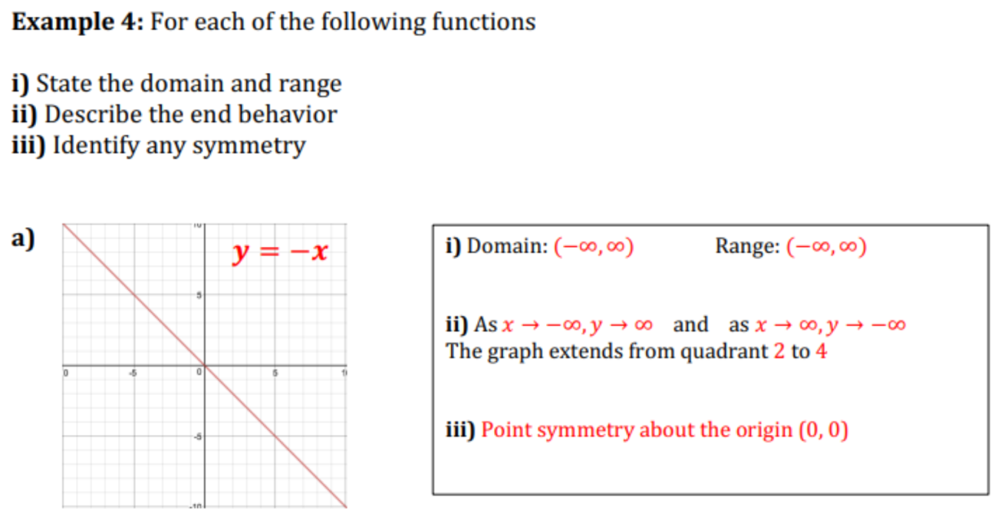
ARTIFACT 1 · POWER FUNCTIONS, EXAMPLE 4(a) · C1.3, C1.9
Key features of y = −x
What this work shows
y = −x is a power function, f(x) = axⁿ, with a = −1 and n = 1. The domain and the range are both (−∞, ∞).
End behaviour: as x → −∞, y → ∞, and as x → ∞, y → −∞. The graph extends from Quadrant 2 to Quadrant 4. That is the negative odd-degree case.
It has point symmetry about the origin, so it is an odd function. I can also check the rule: f(−x) = −(−x) = x = −f(x).
The degree being odd is not what makes it an odd function. f(x) = −x + 1 is still degree 1, but f(−x) = x + 1, which is neither f(x) nor −f(x). The constant term breaks the point symmetry.
MHF4U · Advanced Functions · Polynomial Functions · Communication Portfolio
5 / 18

Slide 6
C1.9 · TERMINOLOGY
Even and odd: the degree compared with the function
A polynomial can have an even or odd degree without being an even or odd function. The function test is algebraic.
 | Even function | Odd function | Neither
Symmetry | Line symmetry about the y-axis | Point symmetry about (0, 0) | Neither of those symmetries
Rule | f(−x) = f(x) | f(−x) = −f(x) | Neither equation holds
Exponents | Every exponent is even | Every exponent is odd | The exponents are mixed
Constant term | A constant term is allowed | The constant term must be 0 | A constant term is allowed
Example | f(x) = x⁴ − x² | f(x) = −2x³ + 5x | f(x) = x³ + 1
End behaviour | Same on both ends | Opposite ends | Depends on the degree and on a
On the characteristics quiz, the statement “all odd-degree polynomial functions are odd functions” is false. f(x) = x³ + 1 has odd degree, but f(−x) = −x³ + 1, and −f(x) = −x³ − 1. Those are not equal. The same quiz item is why I keep “degree” and “function” as two different words.
MHF4U · Advanced Functions · Polynomial Functions · Communication Portfolio
6 / 18

Slide 7
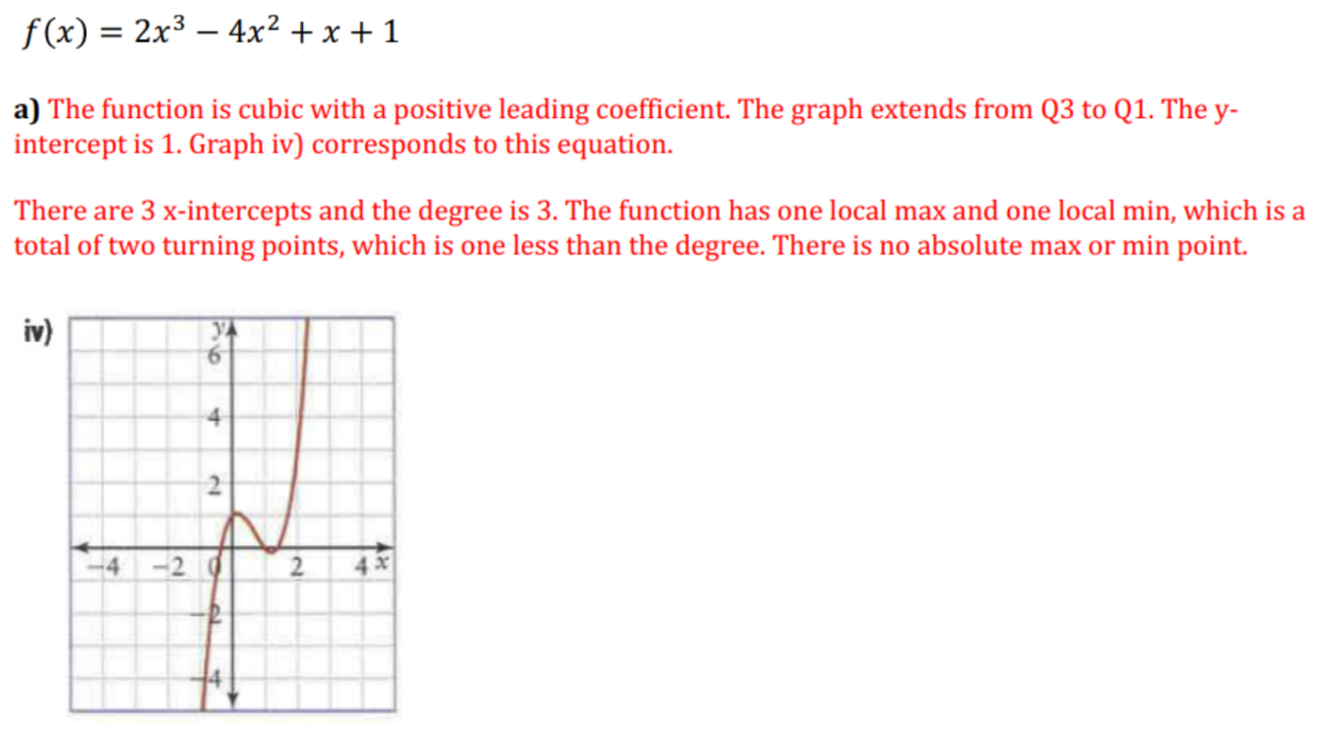
ARTIFACT 2 · CHARACTERISTICS OF POLYNOMIAL FUNCTIONS, EXAMPLE 3(a) · C1.2, C1.3
Reading a cubic from its equation
f(x) = 2x³ − 4x² + x + 1
Degree 3, leading coefficient 2 > 0, so the graph extends from Quadrant 3 to Quadrant 1. The constant term is the y-intercept, so the y-intercept is 1. That matched graph (iv).
The graph has 3 x-intercepts, the most a cubic can have, and 2 turning points, which is n − 1: one local maximum and one local minimum. There is no absolute maximum and no absolute minimum, because an odd-degree polynomial is unbounded in both directions.
I checked the zeros afterwards. f(1) = 0, so x − 1 is a factor. The quotient 2x² − 2x − 1 has two more real zeros, since its discriminant is 4 + 8 = 12. Three real zeros agrees with the graph.
MHF4U · Advanced Functions · Polynomial Functions · Communication Portfolio
7 / 18

Slide 8
ARTIFACT 3 · CHARACTERISTICS, EXAMPLE 4 · C1.2
Finite differences: the table I left blank, completed
x | y | First | Second | Third
−3 | −36 | — | — | —
−2 | −12 | 24 | — | —
−1 | −2 | 10 | −14 | —
0 | 0 | 2 | −8 | 6
1 | 0 | 0 | −2 | 6
2 | 4 | 4 | 4 | 6
3 | 18 | 14 | 10 | 6
4 | 48 | 30 | 16 | 6
What the constant row tells me
The third finite differences are the first ones that are constant, so the degree is 3.
They are positive, so the leading coefficient is positive. The value comes from Δⁿy = a · n!.
Δ³y = a · 3! = 6a
6 = 6a, so a = 1.
The polynomial that fits the table is y = x³ − x². It has leading coefficient 1, and it matches every value, including y(−1) = −2.
This is the same rule as the quiz item where the fourth finite differences were −48: Δ⁴y = a · 4! = 24a, so a = −2.
MHF4U · Advanced Functions · Polynomial Functions · Communication Portfolio
8 / 18

Slide 9
ARTIFACT 4 · FACTORED FORM OF A POLYNOMIAL · C1.5, C1.8
Order of a zero, and where the graph changes sign
f(x) = (x + 1)²(x + 2)(x − 1) degree 4, leading coefficient positive, y-intercept (0, −2)
 | x = −2 | x = −1 | x = 1
Factor | (x + 2) | (x + 1)² | (x − 1)
Order | 1 | 2 | 1
Shape at the x-axis | Crosses, linear shape | Bounces, parabolic shape | Crosses, linear shape
Sign of f(x) | Changes | Does not change | Changes
SIGN OF f(x)
Interval | Sign
(−∞, −2) | +
(−2, −1) | −
(−1, 1) | −
(1, ∞) | +
The course uses order for the exponent on a factor. A zero of odd order changes the sign: the graph crosses the x-axis. Order 1 crosses in a linear shape. Order 3 flattens and crosses in an S-shape. A zero of even order does not change the sign. Order 2 bounces off the x-axis.
On my sign chart the sign stays negative on both sides of x = −1. That is the order 2 zero. The two order 1 zeros are where the sign changes. These zeros do not give only one equation. The family is f(x) = k(x + 1)²(x + 2)(x − 1), k ≠ 0. One other point determines k. That is C1.8.
MHF4U · Advanced Functions · Polynomial Functions · Communication Portfolio
9 / 18

Slide 10
ARTIFACT 5 · TRANSFORMATIONS OF POWER FUNCTIONS, EXAMPLE 3 · C1.6
Getting g(x) into the form a[k(x − d)]ⁿ + c
The parent is f(x) = x⁴. The given equation is g(x) = −((1/3)x + 2)⁴ − 1. I factored k out before I named d:
g(x) = −[(1/3)(x + 6)]⁴ − 1
a = −1
k = 1/3
d = −6
c = −1
Reflection in the x-axis. |a| = 1, so there is no vertical stretch or compression.
Horizontal stretch by a factor of 3. k is positive, so there is no reflection in the y-axis.
Translation 6 units left. The +2 in the original equation was part of k, not the value of d.
Translation 1 unit down. Stretches and reflections, from a and k, come before translations.
Mapping rule
(x, y) → (x/k + d, ay + c) = (3x − 6, −y − 1)
The point (2, 16) on the parent maps to (0, −17). That matches the table in my notes. Domain: (−∞, ∞). The parent range [0, ∞) is reflected to (−∞, 0] and then moved down 1, so the range is (−∞, −1]. The absolute maximum point is (−6, −1).
End behaviour: even degree, negative leading coefficient, Quadrant 3 to Quadrant 4. The parent has line symmetry about the y-axis. After the translation, the line of symmetry is x = −6. g is not an even function.
MHF4U · Advanced Functions · Polynomial Functions · Communication Portfolio
10 / 18

Slide 11
ARTIFACT 6 · ASSIGNMENT 1A, PROBLEM 1 · C1.6
A cubic image point, with a and k both different from 1
Parent f(x) = x³. g(x) = −2[3(x − 1)]³ − 5
The point (2, 8) lies on the parent. I mapped it after every transformation.
1 Name the parameters
2 Write the mapping
3 Substitute (2, 8)
a = −2, k = 3, d = 1, c = −5
(x, y) → (x/3 + 1, −2y − 5)
(2/3 + 1, −16 − 5) = (5/3, −21)
Key features of g
Point of inflection, the centre of point symmetry: (d, c) = (1, −5).
Domain (−∞, ∞). Range (−∞, ∞), because the degree is odd.
End behaviour: odd degree and a < 0, so the graph extends from Quadrant 2 to Quadrant 4.
One valid order
Horizontal compression by a factor of 1/3, vertical stretch by a factor of 2, and a reflection in the x-axis.
Then a translation 1 unit right and 5 units down.
Stretches and reflections come before translations. Translating first would move the wrong point.
MHF4U · Advanced Functions · Polynomial Functions · Communication Portfolio
11 / 18

Slide 12
C3 · STRAND REFLECTION
Division is how an equation becomes factors
Remainder theorem
Factor theorem
When P(x) is divided by x − b, the remainder is P(b). When the divisor is ax − b, with a ≠ 0, the remainder is P(b/a). I do not have to divide if all I need is the remainder.
x − b is a factor of P(x) if and only if P(b) = 0. For a divisor ax − b, the test is P(b/a) = 0. A zero remainder means the divisor is a factor, so it can be used to reduce the degree.
Rational zero theorem
Division algorithm
If a rational number p/q, in lowest terms, is a zero, then p is a factor of the constant term and q is a factor of the leading coefficient. The integral zero theorem is the case where the leading coefficient is 1, so q = 1.
P(x) = (divisor)(quotient) + remainder, and the degree of the remainder is less than the degree of the divisor. A linear divisor leaves a constant remainder. A quadratic divisor leaves a remainder of the form ax + b.
MHF4U · Advanced Functions · Polynomial Functions · Communication Portfolio
12 / 18

Slide 13
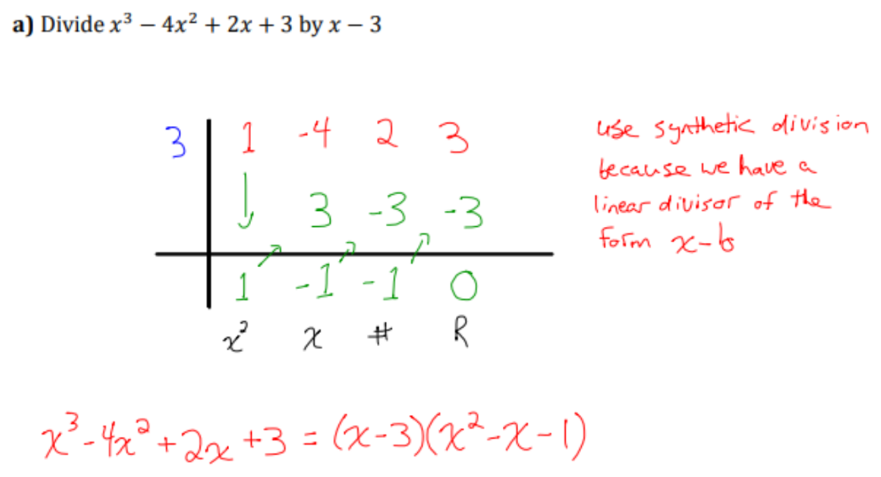
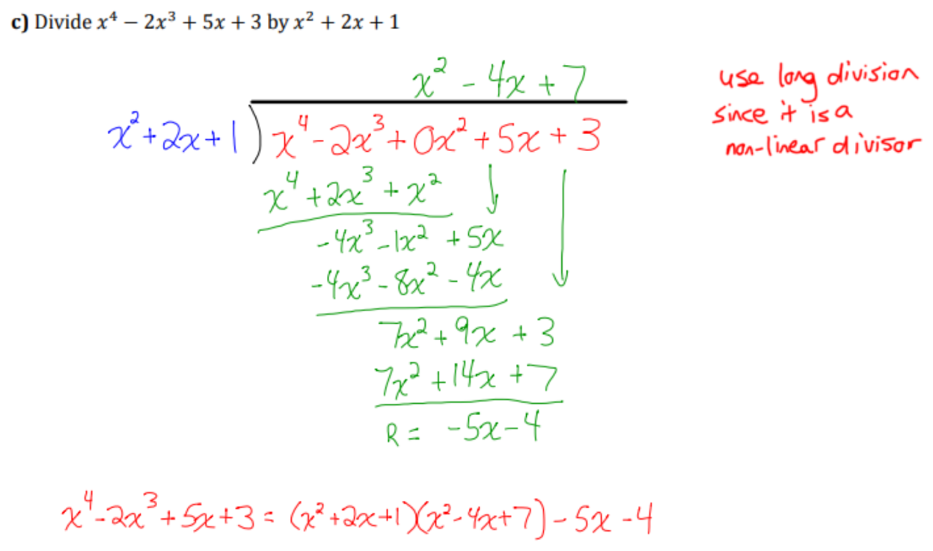
ARTIFACT 7 · SYNTHETIC DIVISION, YOU TRY · C3.1, C3.2
The divisor decides the method
Synthetic division, because the divisor is x − b.
x³ − 4x² + 2x + 3 = (x − 3)(x² − x − 1). The remainder is 0, so both factors divide the dividend. In quotient form, the restriction is x ≠ 3.
Long division, because the divisor is not linear.
I inserted 0x² so no power was missing. The remainder is −5x − 4. A degree 2 divisor can leave a linear remainder. Synthetic division does not apply here.
MHF4U · Advanced Functions · Polynomial Functions · Communication Portfolio
13 / 18

Slide 14
ARTIFACT 8 · FACTOR THEOREM, EXAMPLE 6, AND SOLVING EQUATIONS, EXAMPLE 3 · C3.2, C3.3
A root is an x-value. An x-intercept is a point.
Factor P(x) = 2x³ + x² − 7x − 6
Possible values of b, factors of the constant term −6: ±1, ±2, ±3, ±6.
Possible values of a, factors of the leading coefficient 2: ±1, ±2.
Possible rational zeros b/a: ±1, ±1/2, ±2, ±3, ±3/2, ±6.
P(−1) = 0, so x + 1 is a factor. Synthetic division gives the quotient 2x² − x − 6.
2x² − x − 6 = (2x + 3)(x − 2), by grouping.
P(x) = (x + 1)(x − 2)(2x + 3)
Zeros: x = −1, x = 2, x = −3/2.
x-intercepts: (−1, 0), (2, 0), (−3/2, 0).
The equation I solved
2x³ + 3x² − 11x − 6 = 0
By the rational zero theorem I tested x = 2. f(2) = 0, so x − 2 is a factor. The quotient is 2x² + 7x + 3 = (2x + 1)(x + 3).
(x − 2)(2x + 1)(x + 3) = 0
The solutions of the equation, the roots, are x = 2, x = −1/2, and x = −3.
In my lesson note I wrote the solutions as the points (2, 0), (−1/2, 0), and (−3, 0). Those points are the x-intercepts of y = f(x). C3.3 asks for the connection between the two, and it also asks me to keep the names separate. The equation is solved by the three x-values.
MHF4U · Advanced Functions · Polynomial Functions · Communication Portfolio
14 / 18

Slide 15
ARTIFACT 9 · ASSIGNMENT 1A, PROBLEM 4 · C3.1, C3.7
When the remainder is not a constant
Find the remainder when P(x) = x³ + 3x² − x − 2 is divided by (x + 3)(x + 5).
Why ax + b
Use the zeros
Two equations
The remainder
The divisor has degree 2. The division algorithm says the remainder has degree less than 2, so R(x) = ax + b. It is not a single number.
P(x) = (x + 3)(x + 5)Q(x) + ax + b. At a zero of the divisor, the product is 0, so P(zero) = R(zero).
P(−3) = 1 gives −3a + b = 1. P(−5) = −47 gives −5a + b = −47. Subtracting gives 2a = 48.
a = 24 and b = 73. The remainder is 24x + 73. I can check: R(−3) = −72 + 73 = 1, and R(−5) = −120 + 73 = −47.
The same idea, with an unknown polynomial
If f(x) leaves a remainder of 3 when it is divided by x + 2, then f(−2) = 3. For g(x) = f(x) + 4x + 7, the remainder on division by x + 2 is g(−2) = 3 + 4(−2) + 7 = 2. I never need an expression for f(x). The remainder theorem is a statement about the value of the function, not about finding every coefficient.
MHF4U · Advanced Functions · Polynomial Functions · Communication Portfolio
15 / 18

Slide 16
ARTIFACT 10 · SOLVING POLYNOMIAL INEQUALITIES, YOU TRY (b) · C4.1, C4.3
Solve −2x³ − 6x² + 12x ≤ −16
SOLUTION ON THE NUMBER LINE
[−4, −1] ∪ [2, ∞)
−4
−1
2
Algebra
Move every term to one side. The symbol stays ≤ until I multiply or divide by a negative.
−2x³ − 6x² + 12x + 16 ≤ 0
−2(x³ + 3x² − 6x − 8) ≤ 0
Divide by −2 and reverse the inequality.
(x + 4)(x + 1)(x − 2) ≥ 0
The product is positive or zero on [−4, −1] and on [2, ∞). At each zero the polynomial equals 0, and 0 satisfies ≥, so the brackets are closed.
Brackets, and the list of possible zeros
The solution I wrote, −4 ≤ x ≤ −1 or x ≥ 2, matches the interval notation. The brackets are closed because the inequality is inclusive. That is the difference C4.1 asks for: the equation has three solutions, and the inequality has two intervals.
In the list of candidates I wrote ±1, ±2, and ±3 as factors of −8. The integral zero theorem only allows integer factors of the constant term. 3 does not divide 8. The full list is ±1, ±2, ±4, ±8. I still found the factor x + 1, so the zeros did not change, but the list of possible rational zeros was not complete.
MHF4U · Advanced Functions · Polynomial Functions · Communication Portfolio
16 / 18

Slide 17
ARTIFACT 11 · ASSIGNMENT 1B, PROBLEM 3 · C3.4, C3.7
A volume model, with a restriction from the context
V(y) = 2y³ + y² − 27y − 36 gives the volume, in cm³. The height is h(y) = y + 3.
Divide by the height
Factor the base
Restrict the domain
The volume is length times width times height, so the quotient is the area of the base. Synthetic division with root −3 gives quotient 2y² − 5y − 12 and remainder 0. The factor theorem agrees: a given linear factor must make the remainder 0.
2y² − 5y − 12 = (2y + 3)(y − 4). So one possible set of dimensions, in centimetres, is y + 3, 2y + 3, and y − 4. Length and width can be swapped. The algebra does not decide which is which.
A dimension of a box has to be positive. y + 3 > 0 and 2y + 3 > 0 are both true once y − 4 > 0. The model describes a possible box only when y > 4. That restriction is part of the solution, not an extra comment.
Division statement
2y³ + y² − 27y − 36 = (y + 3)(2y + 3)(y − 4), for y > 4.
MHF4U · Advanced Functions · Polynomial Functions · Communication Portfolio
17 / 18

Slide 18
ACROSS C1, C3, AND C4
The graph, the equation, and the inequality are one polynomial
01
Same zeros, three questions
f(x) = 0 asks for the roots. The graph shows those roots as x-intercepts, and the order of each zero tells me whether the graph crosses or turns. f(x) ≥ 0 asks which intervals between those zeros make the product positive or zero. A factor table is the sign chart I already used when I sketched from factored form.
02
The algebra is the bridge
Synthetic division and the factor theorem turn an expanded polynomial into factors. The division algorithm tells me what degree of remainder to expect, including a linear remainder when the divisor is quadratic. Finite differences and the leading coefficient tell me the end behaviour when I start from a table instead of an equation.
03
The precise words are the mathematics
A root is an x-value. An x-intercept is a point. An odd degree does not make an odd function. k has to be factored into k(x − d) before I name the translation. Square brackets belong to an inclusive inequality, because the zeros satisfy ≥ or ≤ and do not satisfy a strict inequality. Those are the places my own notes had to get more careful.
MHF4U · Advanced Functions · Polynomial Functions · Communication Portfolio
18 / 18

