Slide 1
Summer Work
TECHNIA 2019
Exploring and researching the possibilities of the tools of AI for TECHNIA
Week 29-33 Kista, Stockholm

Slide 2
Presentation
Introduction of work
Introduction of AI and machine learning
What work I have done
What work could be done
Related work
Conclusion
Notes:
Introduction of work
Introduction of AI and machine learning
What work I have done
What work could be done
Related work
Conclusion
The presentation starts with an introduction to the work carried out by me the latest 5 weeks and then an introduction of AI and machine learning. This is followed by a discussion and analysis on what things could be implemented with what is being collected right now in terms of logs and other data, and what could be done in future work and what steps would be needed. Programs implemented during the work are discussed. The presentation then presents and discuss other related work to this area and how this could be linked to applications for TECHNIA. The presentation finishes with a short conclusion.
What I am proposing is not a traditional presentation but more a discussion between us.
You're welcome to interrupt and ask question whenever you feel like it and i will try to answer.

Slide 3
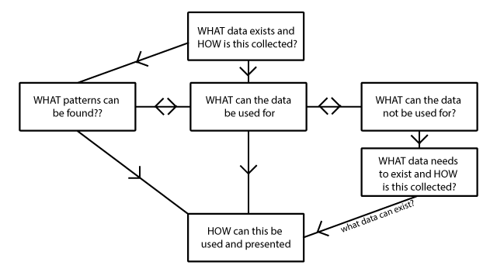
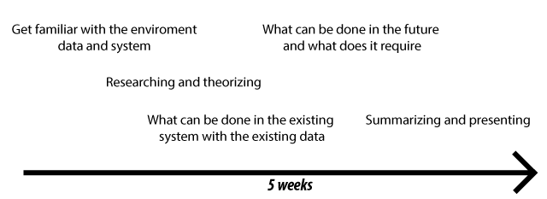
Introduction of work
Intro
Workflow
Result
Notes:
Intro
This work was to investigate the possibilities of implementing the powerful tools of AI and machine learning into TECHNIA's already existing system. Focus of the work which was agreed upon by both parties was put on personalization. This to ease the use and navigation for the user of the programs TECHNIA are developing and selling. Several other possible applications were also researched and investigated.
How data collection could be changed and work in the future is discussed with concrete suggestions on what to collect, as well as where the specific information could be needed.
The work was done three stages; analyzing and researching the tools at TECHNIA and similar work, theorizing and testing what is possible and how it could be done and at last summarizing for the work to be of use in the future.
Workflow
During the work much focus was put on what exists right now, what could be done (both now and in the future) and what it would take for this to be possible. This instead of just coding the final implementations as they would be useless without proper preparatory work and research. This is also due to this area of work being in such an early stage for TECHNIA as well as the scope of the work.
Bild på workflow o timeline
Result Rapport , diverse program[R and Python]

Slide 4
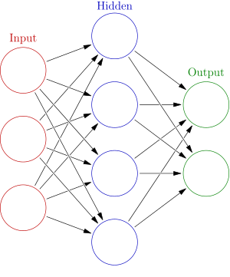
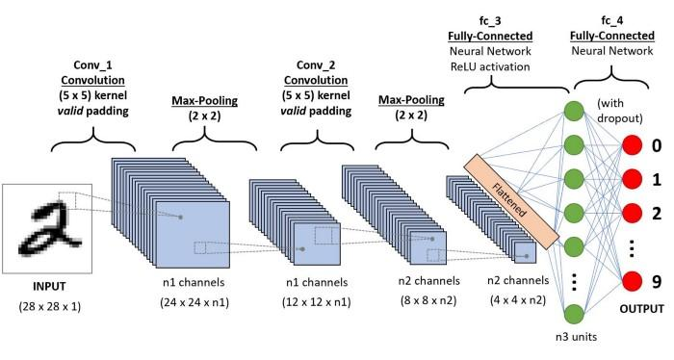
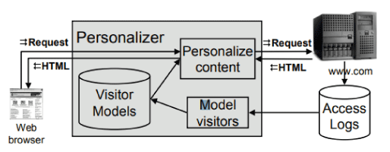
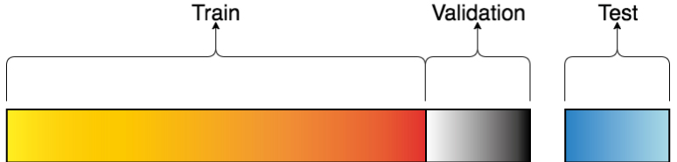
Introduction of AI
Why AI?
What is AI?
(Data setup)
(Data collection)
Training
Testing
(Implementation)
(Deployment)
Models
Programs
Notes:
Why AI?
Artificial intelligence (AI) is a diverse field, held together by common goals and similar methods. The general aim is to improve performance on some task, and the general approach involves using a machine to find and exploit regularities in data, i.e. learning using repetitive learning and discovery to --- at an unprecedented speed to a human --- gain knowledge in terms of experience. AI is swiftly rising in popularity and capability in almost all conceivable fields and this rise is mainly as a result of the the dramatic increases in computation power as well as the massive amount of data that is being created every day. Nowadays, the same amount of data is created in two days as was created from the dawn of time until 2003; which illustrates the present massive transition . Many studies state that companies that don't follow on this AI train will in the long run lose, which is why it is vital to at least investigate and evaluate the possibilities.
What is AI? So as you expressed about being beginners to AI I thought it would be a good thing to do an introduction for this. Very much material is available on the web if you want to know more. Throughout the work and in this presentation it has been kind of difficult to know what level i should put the work at. I tried therefore to throughout the work being as clear as possible, while still being concrete with examples and suggestions catered to Technia’s needs.
There are some key parts of a typical AI project workflow, from data preparation to model build to evaluation and deployment. The parts in parantheize is not by definition part of the area of AI, but is generally parts that are typically needed in a complete AI-system. An AI-system can be as easy as a self going vacuum cleaner, which does not require all these steps, or a complete personalization system as Netflix has, which personalize every part of the system for every user and needs. This is why AI is such a broad area. Machine learning is a subset of AI.
(Data setup) First and foremost a lot of thought and work has to be put into what data to collect and how to compile this into different parameters which will be used much later in time, when training the model. Some examples of what usually is collected for it to be a functional system is presented soon, what TECHNIA is collecting and what more it should and is possible to collect is discussed later.
(Data collection)When the setup is done and all the prework is finalized, the actual data collection can start. This will usually take several months, depending on the user base and how much data is needed for the desired applications.
bilddataset
The data is then usually split into 2 or 3 data sets. One is used to actually train the model and the other, the validiation set is used for tweaking the model by evaluating it, and the test data is used to test the final model, in order to know how good the model is on never-before-seen data.
Training
When the data is collected we can start with the training, the most important step. The training data is key, this is the foundation of the entire system and needs to include such general data that the trained model can be applicable on completely new users or new behaviour. The training data set includes all the parameters collected, as well as the label that you want to classify with the model. Say for example you want to suggest a shortcut to another site for a user, then the data would be “user, time, currentsite, web history and much much more” and the label would be the site to suggest. You can see it as input and output. That means that in order for the final model to have the ability to suggest a shortcut, it has be learned from several other examples before and learned what is right and wrong. That is why the data setup is such an important step, if this data doesn't exist the model can't suggest it. May sound obvious but many has the assumption that machines can learn from nothing, which is certainly not the case. For example classifying images with hand drawn number 1-9, I implemented a program that i will show later that uses 60000 images as training data.
Neural network
If we for example have this neural network. Dra parrallel mellan neural networks and the brain, Neurons and brain pulses “Neural networks are organized in layers. Layers are made up of interconnected nodes. Patterns are presented to the network via the ‘input layer’, which links to one or more ‘hidden layers’ where the actual processing is done via a system of weighted connections. The hidden layer then links to an ‘output layer’.” In the training phase the training data set will take the data, run it through this network and due to weights and biases on the nodes, decide what classification is done. By having the correct label associated with this data, it know if it did the right or wrong classification. If it did wrong, it will increase the weights on the nodes it went through, decreasing the possibility for this classification to occur again with the same data. This is done iteratively and many many times, and with enough data and enough good data it can properly make a classification on never-before-seen data, without the label. This means that if you sent the same data as before, but not the correct suggested shortcut, it would be able to predict this.
Testing
Often several different models are tried and evaluated before choosing the final model. One metric to choose from is the accuracy of the model. This can be achieved by having a test dataset. This does sort of the same thing when traverings through the network but instead of changing values if the classification is wrong, it just notes this and continue. This means the test data needs labels too. By doing this you can see how many, never before seen, entries the model classified correctly and how many it failed. That's the most important difference to training data, the test data has to be never before seen by the model for it to be unbiased
(Implementation)
To implement this model into Technia’s system, it could be done in several different ways. How and where is discussed later but the most important thing, and the aspect of machine learning that makes it so good and scalable, is that the training data is now in a way incorporated into the created model, and only the values on the nodes has to be saved and can be used to classify future data. This also makes it important for the training data being sufficiently good, otherwise the model isn't useful.
(Deployment)
AI-flow
A user requests e.g. a site from the server and also sends the appropriate data with it (such as username etc.) which returns the page, the AI-system uses the models and the data to personalize the content. This is the actual site that is returned. This data is saved to the access logs which the system can use to update the model.
Models
These steps stay the same for generally all AI-project. One thing that differs between most of them is the model used. Both the type, such as a network or a tree, and the structure, how many nodes or layers is chosen, can differ. This is very dependent on what data exists and what it is to be used for, which differs from every single case. I will therefore not go into much detail but just present some shortly.
There are simple models that are used in your system today, that doesn't need to be trained. Two examples are MFU and MRU which means most frequently used and most recently used, which works as it sounds.
NEURAL NETWORKS --- as the image we saw earlier a neural network is composed by nodes that have values associated with them. The nodes in the hidden layers have weight and biases, the input nodes have the parameters from the data, and the output nodes has the classification labels. A more advanced network is a deep neural network.
CNN
Deeplearning --- Deep learning works in the way that a hierarchy of layers make a more abstract version of the information in e.g. an image. By doing this more complex data can be processed and more classes can be differentiated between. The data traverses through the layers varying the possible dimensions of the data, and then decreases it, in this case to 10. In this example we have 28x28x1 dimensions as input, where each pixel is represented by an integer on its pixel value. Each pixel value traverses through all layers and the complete image is classified as 1-9. I have a program showing this in code to show.
Programs *Då det inte samlades in mycket olika paramterar på datan använde jag istället data set på en sida som heter kaggle, som ofta har optimiseringstävlingar. Detta för att få en idé av hur data brukar se ut och vad man då gör för att använda denna data.
TODO prata mer, endast image_class

Slide 5
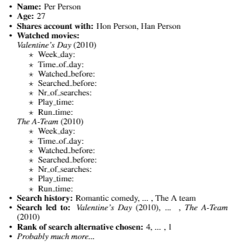
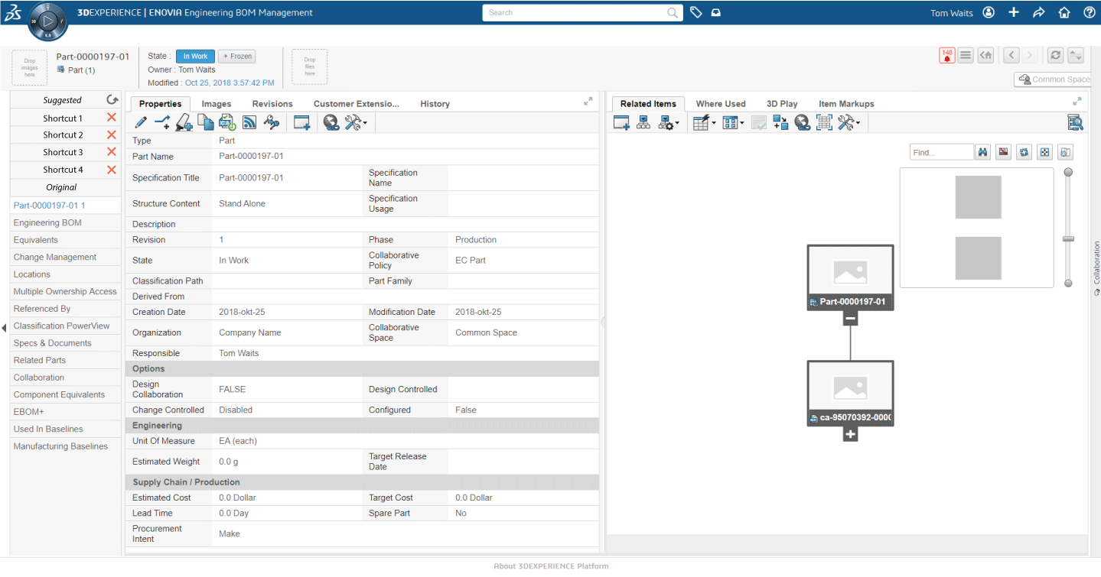
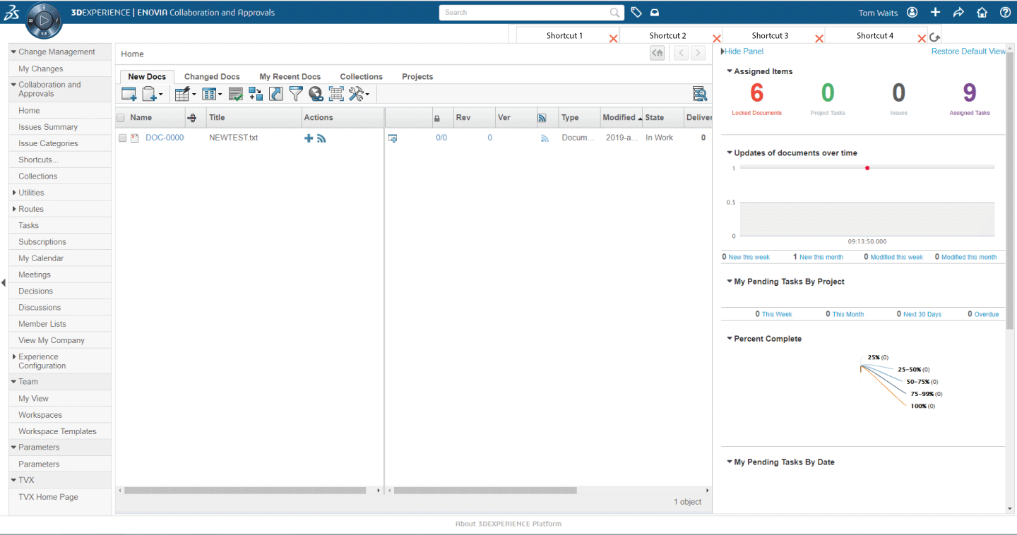
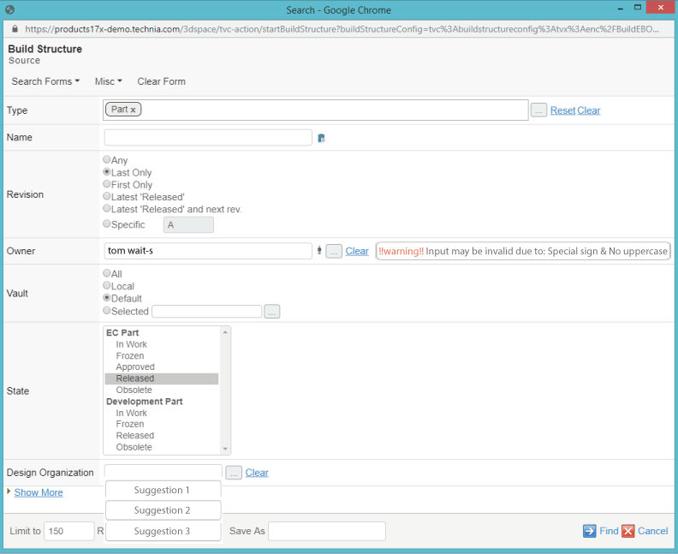
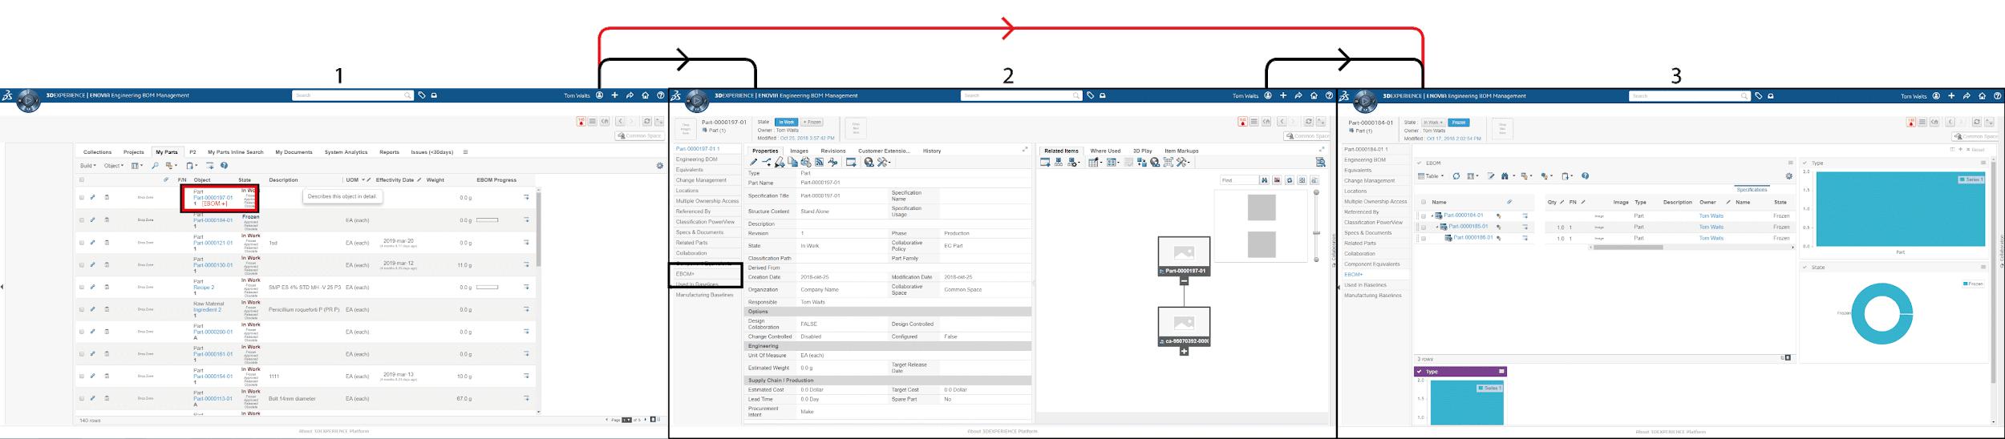
What work I have done
Analyzing and researching
Data available
Navigate in system
Theorizing and testing
Similar works
Code examples
Summarizing and presenting
Implemented programs
Shortcuts, Homepage & Edit form suggestions, Prevention of validation errors
What was not done?
Data limitations
Netflix-tabell
Notes:
Analyzing and researching --- Much of the work with such a new area in a already existing and established system and company needs a lot of research, theorizing and discussion, before actually writingthe first row of code. Much of the work that goes unpresented was done here, such as navigating in the system, looking at what the request was sent by performing different actions, and looking at what was logged in the data that was available. The most useful data was in .log format and there was a lot of it. One entry looked like this after I had separated the data and compiled it to a csv. This was done by creating a program that does this for a complete folder, and it was done for easier analyzing and filtration of the data. The data in .log file were unfortunately the ones logged by the server, and therefore the ones that your team do not apparently have as much possibility to configure as the .json files, which includes more error logs. Either way, due to the focus of the paper, this data was most focus put on.
Data available bilddataentry
Navigate in system
Theorizing and testing
Similar works From the knowledge of the system, data and similar works the time was spent theorizing what was possible to do and how it would be possible. I tried to present the result of this by including as many examples as possible in a concrete way for the work to be applicable for TECHNIA.
Code examples - All final material is added either in the references or in the Appendix, or GitHub. There are also many programs that were written just to test if things was possible. Most of these are not included but gave answers to things that I wondered during the work.
Summarizing and presenting
In order to make the work done in these 5 weeks to hold for future work, carried out either by me at some other occasion, a consultant or TECHNIA themselves, I needed some way of summarizing and presenting. That's why this presentation was made, and also the paper.
Implemented programs
Unfortunately the available data from Technia was not sufficient to work on for implementations, which is why I had to go with a different approach and use other data. I tried with the available data by compiling the current data from many sources but did not get it to work.
Some programs were written to give suggestions on how to do things and give examples for implementation. The previous program of classifying a image, or a hotel cluster were done. The hotel cluster program could work in a similar way in Technia’s system, by for example having clusters of people that behave similarly in the system and therefore should be given the same suggestions (as in shortcuts, in a edit form or something else.) For this to be possible a lot more data is needed, and in a similar forms as the hotel data, where much more parameters are collected which makes the classification possible. draw differences between available data and in hotel
A program was also written to, as mentioned earlier, to compile the data from the log files to a more easily handled and read csv file, where the correct information was put into the correct columns. This program has two parts, one for the .json files and one for the .log files, and gives the same result for both, a csv file to easier analyze the data in the future. The CSV-format is also often the format that is used to train a model.
Shortcuts, Homepage & Edit form suggestions, Prevention of validation errors
The applications that were found and focused on were these four. They offer a personalization for the user, which was the focus, and are also appropriate functionality to introduce in the TECHNIA system, in my opinion.
HOMEPAGE no image done
A Netflix-like home page, also called a web portal or montage is a page (often presented as the first page for the user) with links and content presented for the viewer for easier accessibility to different sites. A montage is more than “just a list of favorites,” for three reasons. One reason is that remote pages may be embedded in the montage, aggregating content from multiple sites. Another is that the content depends on the user’s context of browsing (e.g., the topic of recently viewed pages, or the time of day, etc.), so the content is relevant to the task at hand. Third, MONTAGE automatically selects and manages the appropriate content, without the need for explicit input from the user
SHORTCUT
The way I am thinking of shortcuts is presenting small icons (With small icons I suggest e.g. a hyperlink) in the program that will give the user a shortcut to a site (that is not reachable from the current site) if it predicts the user want to end up here, or at least a site on the path to the end goal. This can be illustrated by these figures. This is similar to homepage but not as a big of change for the user.
EDIT INPUT
Works as expected, similar to a MFU or MRU model but uses the user’s current context and usual short and long term behavior of the user in order to suggest input for the user in a more clever way. This may include different types of fields in different kinds of form often requires special input and so on. This was not done implementation-wise because of the lack of data features available as explained
PREVENTION OF VALIDATION ERRORS
One more advanced version of this smart system in forms would be to warn the user if the input does not satisfied predetermined rules or does not cohere with the general input of the same kind of field. This could be done by looking if the input is an outlier in the available data, and therefore probably not a valid input, or in some other way that takes context, field and form type into consideration in order to prevent future validation errors, or even inconsistencies in the data.
What was not done?
The main restriction and the work area that Technia should work on next, is the data collection. As previously said, the training data is like the foundation of the entire system, and by looking at the data collected and available today at technia, it is unfortunately not enough. If we compare the hotel cluster program and the data entry from the available data, the hotel has 24 features, which isn't even enough but transformed to 270 in various ways in the program. This is for 100 clusters. If we instead look at the available data we maybe have 5-10 features that are useful, and most of them needs further work for it to be understandable for the system. Like assigning IP’s to a IP-cluster instead so it know what IP’s “fit” together.
Data limitations Netflix-tabell
If we look at what data I have guessed netflix is collecting, by looking at a videoconference they gave and what I think is reasonable we can get this item list. Probably this isn't even half of the data that is collected, which only proves that much more different kinds of data is needed to be collected at Technia for this to be functional system. I give several examples of what data could be collected for different applications in the report, but for example if you want to give suggestions for input in a form, you need to both have trained the model on what kind of form there are, what kind of fields mean what, but you also need to send this data to the model when entering a form. This means that there are some data that needs to be sent and collected at different times, depending on what data type it is.
I suggest that even though these suggested application and the other applications i propose in the report too sounds like they lie long in the future, I still suggest you to put one or two people on researching what data could be collected in the system (because you have more insight in what data is available than me), what data should be appropriate to collect, and how this would be done. This could be done right now even though you implement models and AI in the system in years, more data is generally better as said. This would require input and consultation by the entire team, as well as customer probably.

Slide 6
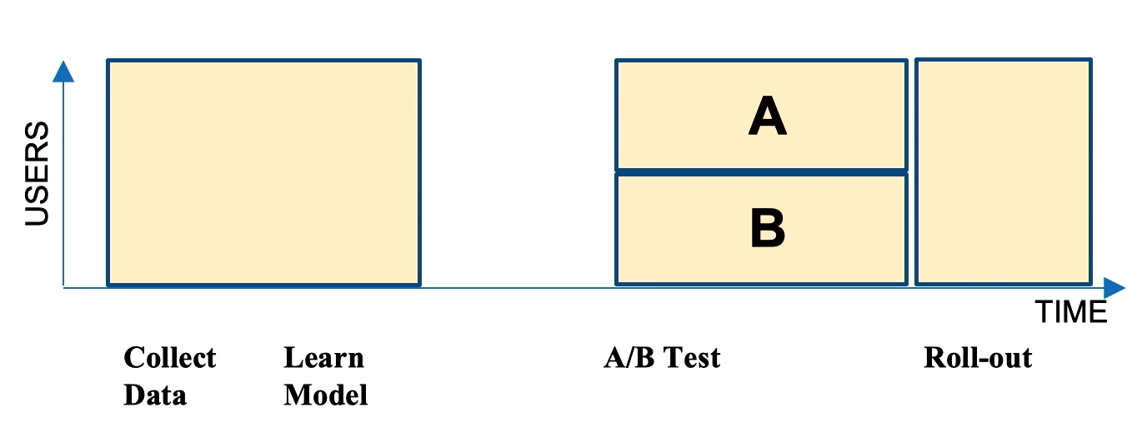
What work could be done/Discussion
Data collection
How and where
Implementation and deployment
How and where
Global versus local
Other applications
Where is AI needed?
Notes:
Data collection As previously mentioned the most lacking part, and most vital part in this early stage of the work is to find what data is needed to be collected and how to do this.
How and where There are several ways to actually collect this data, this depends on what information is actually available in the system. You can add to the current log collection by just adding more information, such as what previous sites the user has visited or what type of form a user is filling in.
An even better way, and probably easier in the long run, is to set up an additional server and database that is logging all the needed data. This would mean that you sort of have to start from the bottom, but there are two great pros with this. First of all, the system becomes entirely separated from the current existing and functional system, meaning you can tweak and work with this part without interfering with other parts of the system. This also works because the AI-components I suggest never take away information on the page, only adds it. This makes it independent on other components of the system. One other advantage is that you easier can split the data into the features you want which makes it easier to handle later. As i have discovered now when I have deep dived into the logs is that are very much inconsistencies and useless data in there, at least for this application. By creating a system when already knowing what to collect, this can be avoided.
Implementation and deployment AB.png
When introducing an AI-component you often follow this structure where you collect data (often in months) you learn a model, and find a way of implementing it into the system. Then a popular approach is to do a A/B Test where you introduce the changes to half your user base and not to the other half and watch the result. After some appropriate tweaking you should finally come to the stage where you roll out the change.
Some things to think about when implementing a new system are:
Don't elude or rearrange content, instead add new information in a subtle but accessible way. Don't overflow the users in new information and options, and enable these to be disabled in the settings. If something is catered for experienced users vs newbies is also an important aspect that needs to be considered when weighing if it should be implemented or not. From these aspects I have come up with things that could be further researched for suitable implementations, which are discussed in the report.
How and where
There are several possible ways to implement this system. With such a rise in popularity resources are available in all forms. There are possibilities to buy or rent a so called, AI platform, which may house both the data collection part and modelling, meaning that this would only need to be implemented to the system. In the system it would work like calling the platforms api at an appropriate place, say for example when landing on a new page and then depending on what response the model returns, take appropriate action, say for example suggest a shortcut. There are also consultants that do the same, but more inline with Technia because the discussion becomes easier. This may be me in the future *hinthint*
There are also enough resources on the web which makes it possible for a employee at technia to implement this. The first part would then be as i said earlier, to start looking at what data is needed.
Global versus local One more thing to consider when modelling is whether to do it global, local or even individual. Global means that everyone's data is used for one single model that everyone uses, which may not be such an improvement in personalization if users behave much differently because of different roles, different companies or other reasons. Local means that you cluster people together in groups, either based on location or on behaviour and use of the system. Maybe everyone at H&M uses the tool in a similar way, maybe all responsible for sales are in one group, or maybe, which is the most probable, the system has sufficient data in order to cluster together similar people with similar behaviour and needs, regardless of their location and role. This depends on the system, but also on what application the model is needed for. Maybe more individual modelling is needed when editing forms, but the model can suggest shortcuts in a netflix home page from what people generally visit globally.
Other applications There are also several other applications I have figured fit into the Technia system. There are those that we discussed in the beginning which most of them still being applicable and useful for the system, but to different degree after I have learned more. This ranking is discussed in the report. There are also several other things, such as suggesting gadgets to add in the EBOM+ configuration in the system, choosing colors depending on what person and what kind of gadget it is and much much more, most of it discussed in the report.
Other ways like how to improve sales with AI is also discussed, and there are a lot of resources on the web about this.
Where is AI needed? However, one misunderstanding about AI is that it should be applicable everywhere to make an improvement. While this generally holds, there are some things where it isn't even worth the benefit to first collect data, implement and train a model, and evaluate the result.
Such things are mostly obvious, things where a Most recently used model works just as well for example.

Slide 7
Related Work
Several papers, tools, videos and code is available on the web
Mentioned or referred to in the paper
Lot of things noticed by people doing previous work is also mentioned
Videos explaining the basic and tools of AI
Code and programs implementing various work
Notes:
Several papers, tools, videos and code is available on the web
Mentioned or referred to in the paper
Lot of things noticed by people doing previous work is also mentioned
Videos explaining the basic and tools of AI --- Nämn netflix filmen
Code and programs implementing various work
Due to AI and machine learning being such a popular and up-to-date area of work, there are many resources available. Both in terms of learning and understanding what it is and what it can do, but also in terms of solutions and services.
The papers read and their content is added to the report, either as a source or just in some thought written. Their discoveries and conclusions are added for mistakes not to be repeated.
There are also a lot of video sources available, for AI but also more specific. As previously discussed, netflix collects a huge amount of data, and as this is such a vital concept for TECHNIA to understand in these early stages of the AI-implementation, i recommend the video about a Netflix employee discussing their work, which is attached in the report.
Resources such as program and other code is also available in huge amounts. These are often small examples and I haven’t found an example of how a entire AI-system is done, but i'm sure you have the ability to connect with people or companies with this knowledge if desired.

Slide 8
Conclusion
AI and its possibilities
Personalization for the user
Investigated possibilities, created a small foundation
What are the next steps?
Report and programs for knowledge and inspiration
Notes:
AI and its possibilities
As is clear, the possibility of AI and machine learning are limitless, and as several studies suggest companies that dont “jump on the hype train” will lose in the long run. TECHNIA seems to want to utilize these tools and have a lot of ideas of what it can achieve which is the first step.
Personalization for the user
In the area of personalization, which is a small part of what is possible with AI, many things can be done in the existing system. Most of the things discussed in this work has to with easing the use of the tolls for the end user, such as suggesting shortcuts, input to a form and search and so on.
Investigated possibilities, created a small foundation
These possibilities where investigated and discussed, somewhere also tested to get an idea of how it would work. This creates a part of the foundation needed for what is to be created. In this early stage of the work, much work has to be around what is desired, what is possible and how to do it. Even if it feels like you get nowhere and just want to code, these are vital steps to take and put time on, before even writing the first row of code in order to collect data.
What are the next steps? For Technia to create a functional system, several steps are needed.
First having the logistics fixed --- such as where the data is collected and what that is saved --- is required. Then comes the most work consuming and vital part because you need to figure out all the data that needs to be collected in order to achieve all the functionality in the future. In most cases more is better than less, not just in the quantity but also different kinds of data. This would require input from people experienced with the system as well as what people want to utilize the data for. Then the data can be collected, which usually takes months for it to be sufficient. Later a actual model can be trained, which requires many models tested and evaluated. This could then be implemented in a appropriate way for the users and further work needs to be taken to monitor the result and tweak if needed. All these points are thoroughly discussed in this paper, with other papers, code examples and data extractions included in order for the result of this work to be concrete.
Report and programs for knowledge and inspiration Go through the report and explain the different parts, I have been trying to give as much useful examples as possibilities in the most concrete way. Go through list and programs in appendix
If questions arise about my work --- either this presentation, the report or some program here or on GitHub --- don't be afraid to contact me on my mail or on LinkedIn. It is also worth mentioning one more time that all material as well as similar work is on the GitHub. The things i have talked about are explained more in depth in the report but if you don't understand, or dont want to read, just ask me or search the web.
Finally, thanks for your time and the opportunity to carry out this work.

