Slide 1
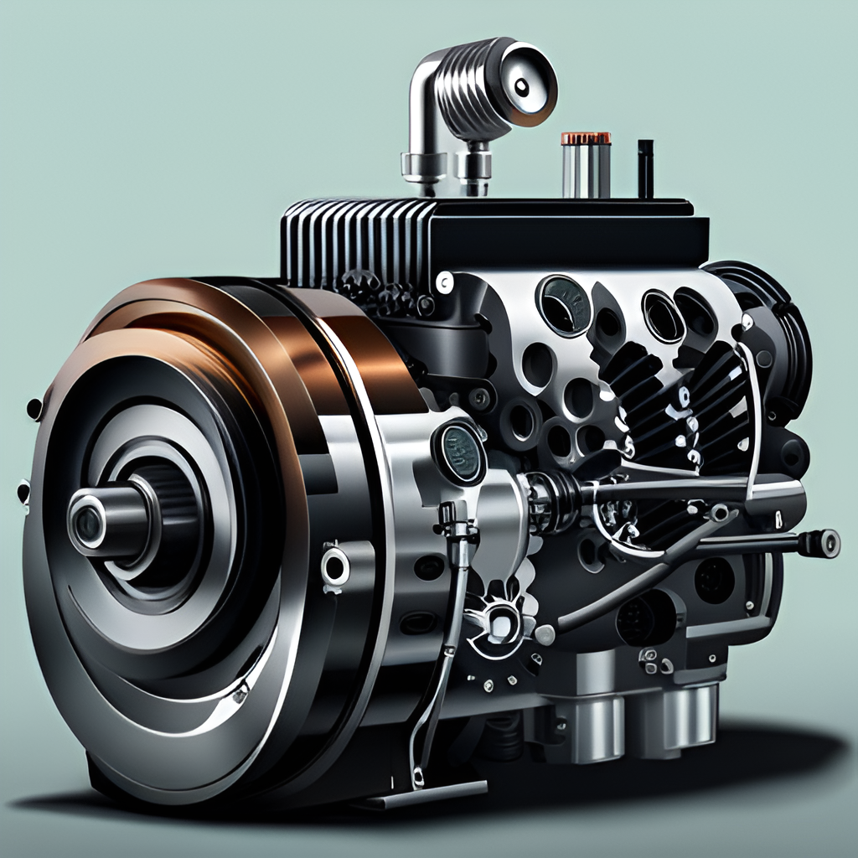
CO2 Emissions Based on Car Engine Features
GROUP 2
Yash Mukesh Mishra
Kaivalya suresh patil
S M Aanantha Priya
Rugved Umesh Hirlekar
MRS.R.SAMATHA
Daneti Devi Chandini

Slide 2

INDEX
Business Objective: Reducing CO2 Emissions with Engine Features
Data Set Details
Analysis of Numeric Variables
Analysis of Categorical Variables
Encoding Categorical features
Model building
List of regression algorithms
Deployment

Slide 3
Business Objective: Reducing CO2 Emissions with Engine Features
As the world becomes increasingly aware of the impact of climate change, it is critical for businesses to take action to reduce their carbon footprint. Our goal is to model CO2 emissions as a function of car engine features, with the ultimate objective of building mode by analyzing these emissions and data improvements in engine design.
By analyzing data on engine features such as make(car brand), model, vehicle class, engine size, cylinders, transmission, and fuel type, we can identify which features have the greatest impact on CO2 emissions. This information will enable us to develop more efficient engines that produce fewer emissions, helping to mitigate the impact of climate change.
The fundamental goal is to model the CO2 emissions as a function of several car engine features.

Slide 4
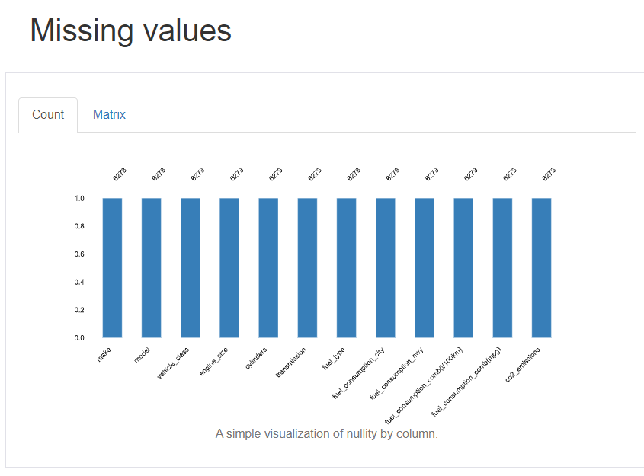
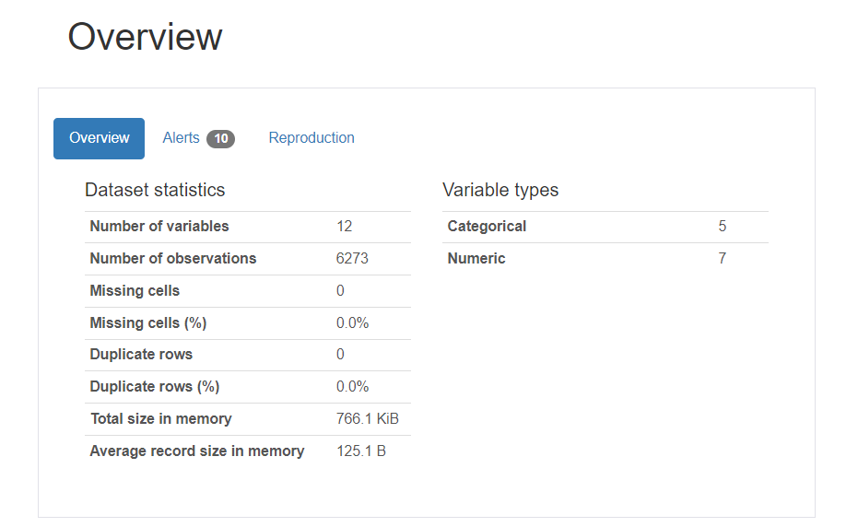
DATA SET DETAILS
We have totally 7385 rows and 12 columns.
After removing duplicated rows ie. 1112 rows we have 6281 records and 12 features .
No null values found in data set.

Slide 5
Analysis of Numeric Variables
Descriptive Statistics Analysis
Data Visualization- Pair plot
Data Visualization- Histogram
Correlation Analysis

Slide 6
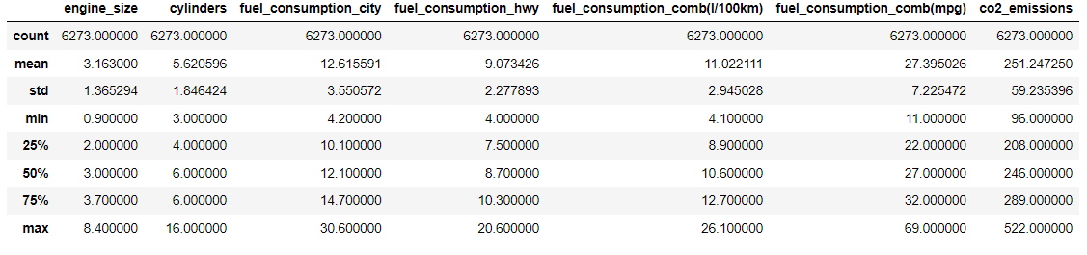
1. Descriptive Statistics Analysis
Most of the cars are having engine size is 3
Most of the cars are having nearly 6 cylinder.
The amount of fuel consumed by cars on city roads is comparatively greater than that of highway (12.61>9.07)
The average amount of CO2 emitted from cars is 251 g/km

Slide 7
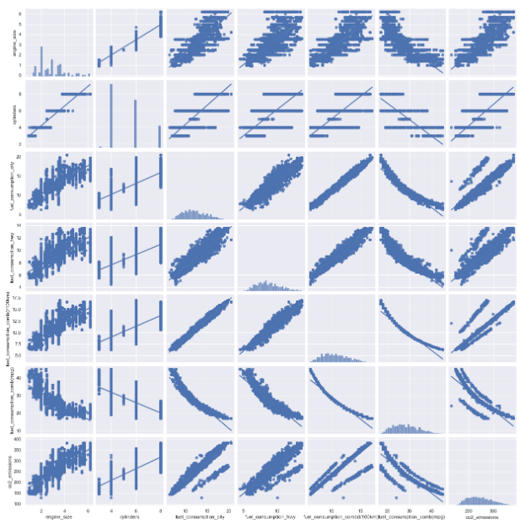
2. Data Visualization- Pair plot
CO2 Emissions generally increase when engine_size,cylinders, fuel_consumption_city,fuel_consumption_hwy, fuel_consumption_comb(l/100km) increases.
As engine size increases, fuel_consumption_comb(L/100km), fuel consumption__hwy and number of cylinders are increases.
Size of cylinders shows a negative relation with fuel_consumption_comb(mpg).
fuel_consumption_comb(mpg) shows a negative relation with all the other variables.

Slide 8
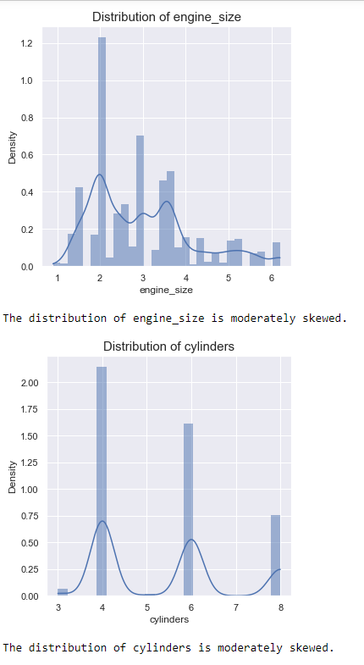
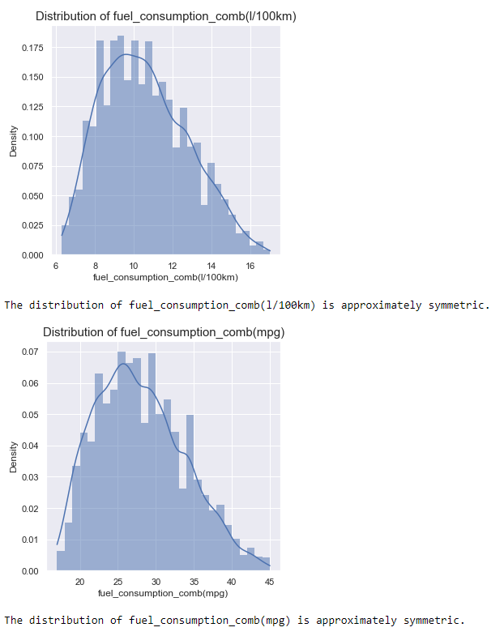
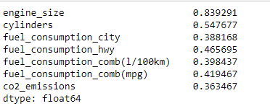
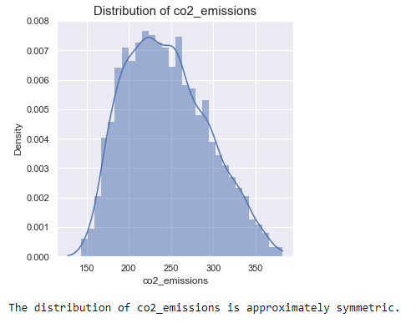
3. Data Visualization- Histogram

Slide 9
Continue…
All the variables are positively skewed
It appears that most of the variables related to fuel consumption and CO2 emissions have approximately symmetric distributions, which means that their data is reasonably balanced around the central value. This is a desirable property for many statistical analyses and modeling techniques.
On the other hand, the engine_size and cylinders variables are moderately skewed, which suggests that their distributions are not perfectly symmetrical. The skewness in these variables might influence the analysis or modeling outcomes

Slide 10
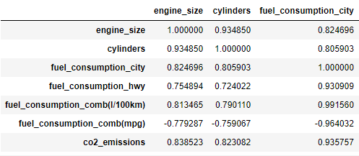
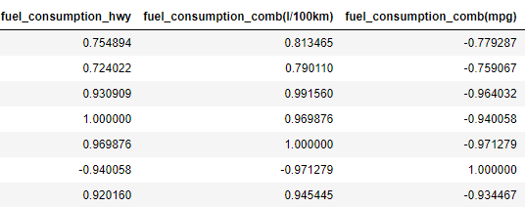
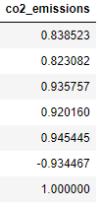
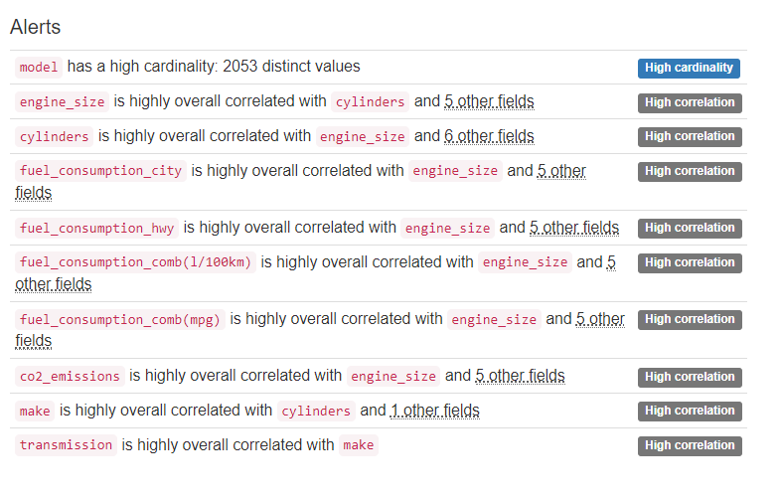
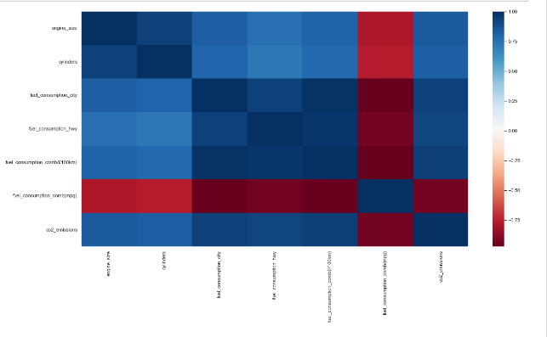
4. Correlation Analysis

Slide 11
Analysis of CATEGORICAL Variables
Frequency Distribution
Bar Charts
Cross-tabulation
Chi-Square Test

Slide 12
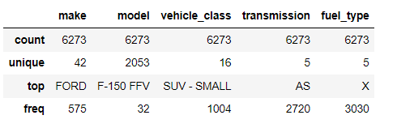
1. Frequency Distribution
42 different companies = Ford company are holding high frequency
2053 unique models = F-150 FFV is holding high frequency
16 vechile_class with SUV-model = on the top of frequency
Most of the cars have AS['Automatic with select shift] transmission
Most of the cars have Regular gasoline type of fuel

Slide 13
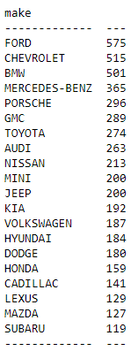
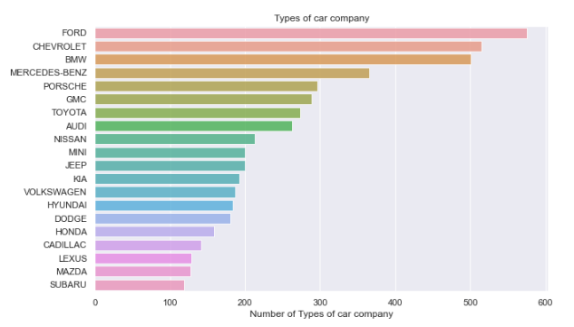
2. Bar Charts
There are total 42 types of car brand.
Among them Ford has high frequency.
Bugatti and SRT are having low frequency.

Slide 14
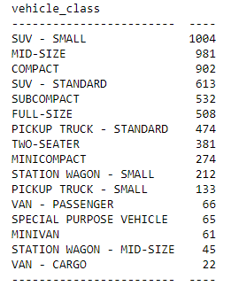
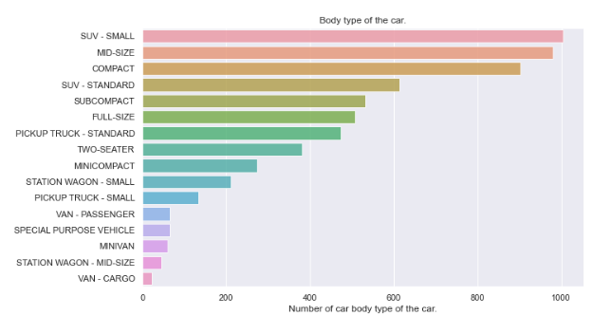
Continue…
There are total 16 unique vehicle_class.
SUV-Small(1004) and MID-Size(981) vehicles are the most frequently used car body type.

Slide 15
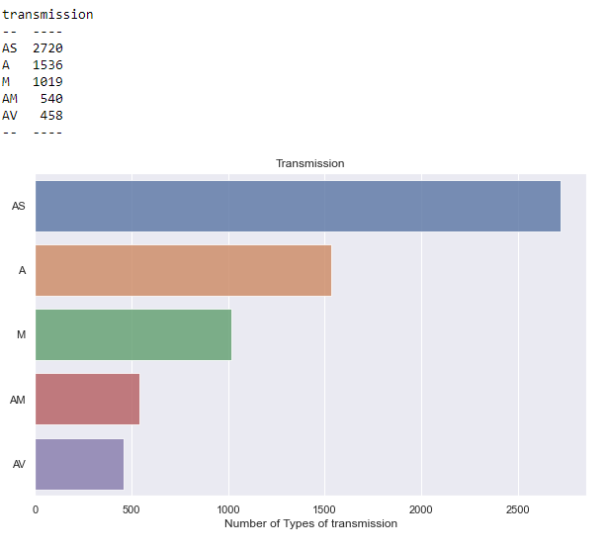
Continue…
There are 5 different types of transmission
AS[Automatic with select shift] transmission type have high frequency of 2720 and AV have low transmission frequency of 458

Slide 16
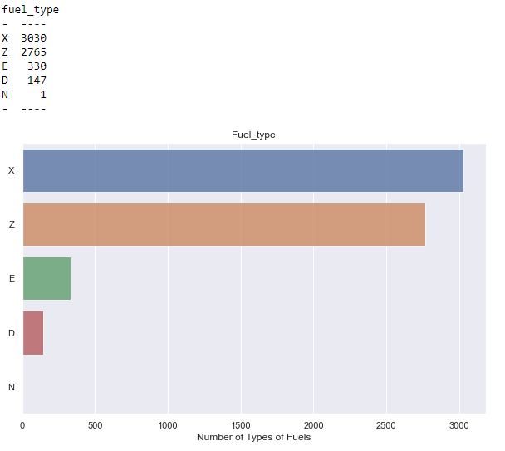
Continue…
There are 5 types of fuels
"X" for 'Regular gasoline' has high frequency and very low frequency "N" for 'Natural gas.
There are total 2053 unique car model. These neither can be converted into any dummy variable nor it can be used for analysis. So we can drop this column.

Slide 17
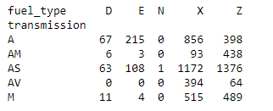
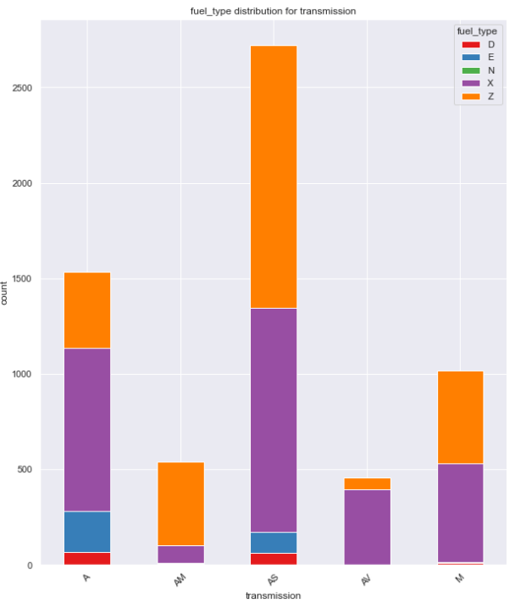
Continue…
"AS[Automatic with select shift]" has the highest count across all fuel types.
Fuel Type "N['Natural gas']" is not present in most transmission types.
The fuel type "Z[Premium gasoline]" appears to have a more balanced distribution among different transmission types, with counts ranging from 398 to 1376. This suggests that multiple transmission types use fuel type "Z."

Slide 18
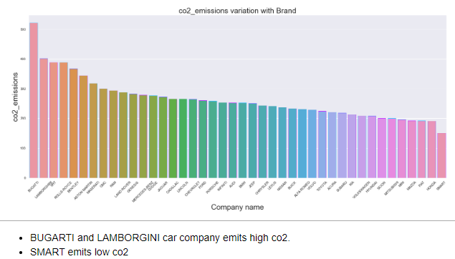
Comparing Variation in CO2 emissions with other variables
CO2 Variation with brands

Slide 19
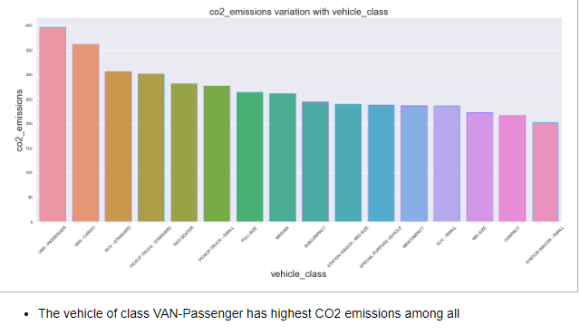
Continue…
CO2 Variation with vehicle_class

Slide 20
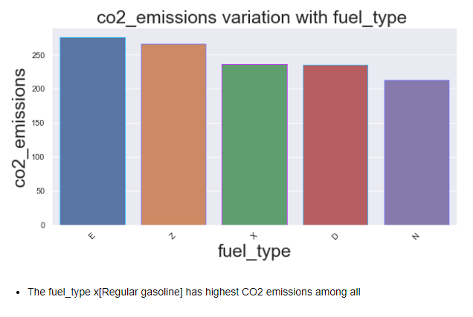
Continue…

Slide 21
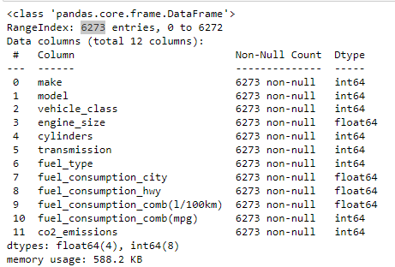
encoding
After proceeding with encoding for 'make','model', 'vehicle_class', 'transmission', 'fuel_type', our data contains 6273 records and 12 features .

Slide 22
Model building
Here we used 20% of the data for testing, and 80% used for training
That is we have 5007 samples (rows) and 11 features (columns) in the training set.
There are 1252 samples (rows) and 11 features (columns) in the testing set.
There are 5018 target values (elements) in the training set and there are 1255 target values (elements) in the testing set

Slide 23
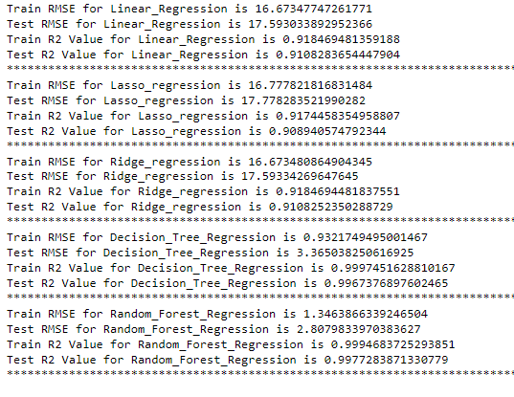
The Random Forest Regression model seems to be the best choice.
It exhibits high R-squared values and low RMSE on both training and testing data, suggesting accurate predictions and strong generalization.
Despite its complexity, it captures intricate patterns and interactions in the data.
While linear models are simpler and interpretable, Random Forest strikes a balance between complexity and performance, making it a versatile option for predictive tasks.

Slide 24
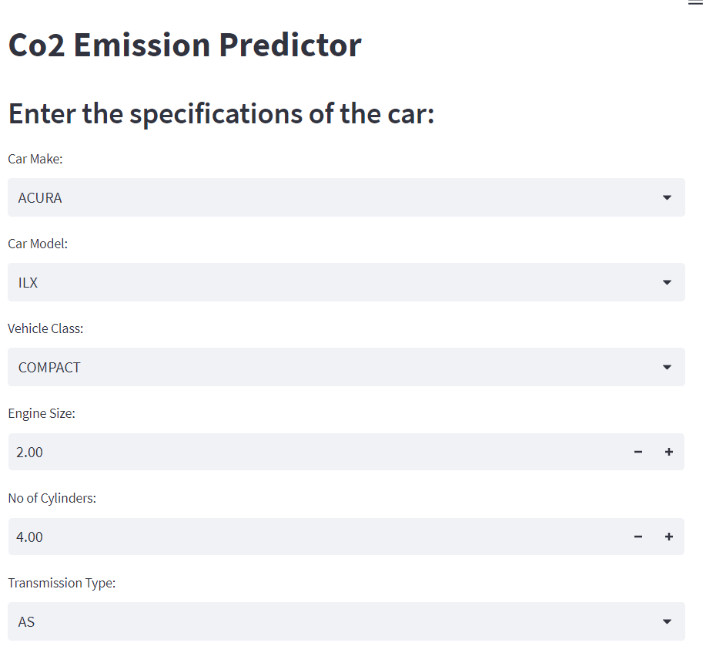
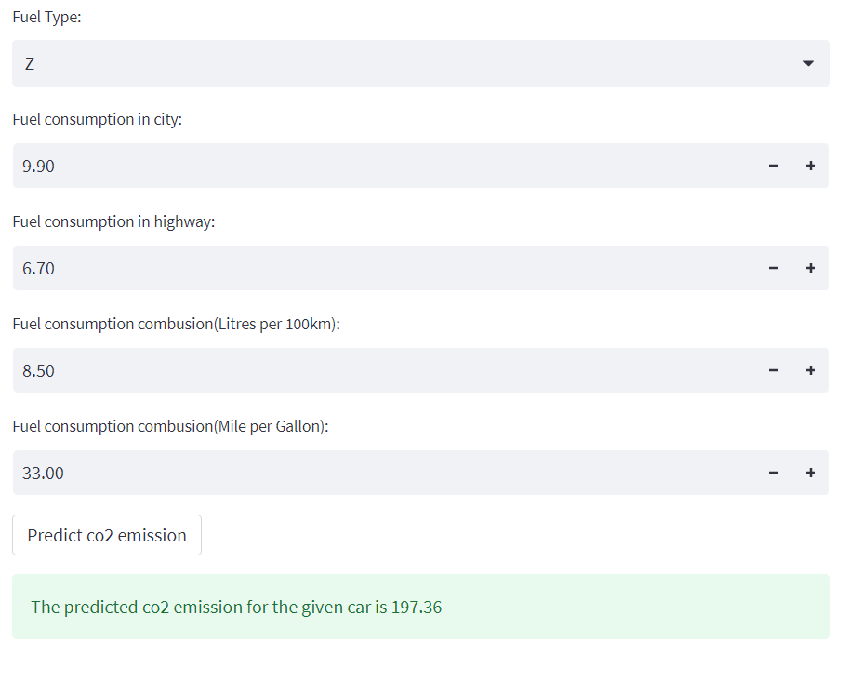
Deployment(sTeamlit)

Slide 25
CONCLUSION
Reducing carbon footprint in the automotive industry is crucial for mitigating climate change. The advancements in CO2 emission control, including electric vehicles, hybrid systems, and innovative technologies, present promising solutions for a greener future. By embracing these advancements, we can work towards a sustainable transportation system that ensures a cleaner and healthier environment for future

Slide 26
THANK YOU

