Slide 1
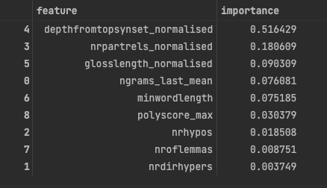

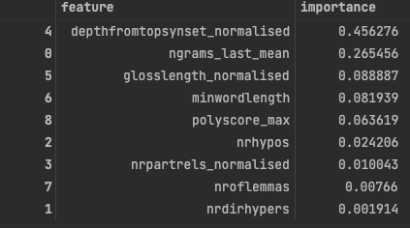

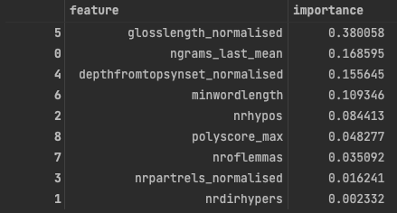

Results of EX1
Local Model(1)

Slide 2
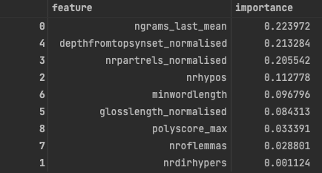

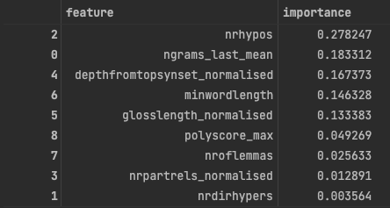

Results of EX1
Local Model(2)

Slide 3
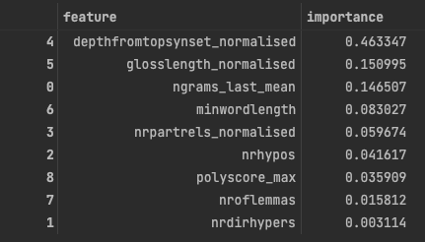

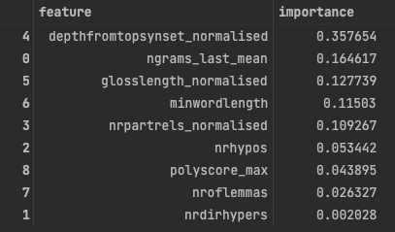

Results of EX1
Global Model

Slide 4
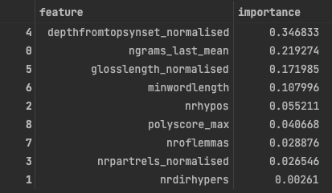

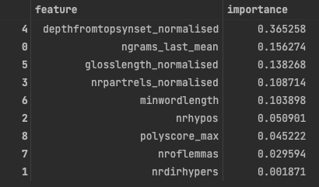

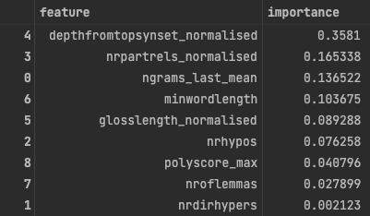

Results of EX1
Unseen Domain Model(1)
Slightly vary in ’cohen kappa’ from the paper

Slide 5
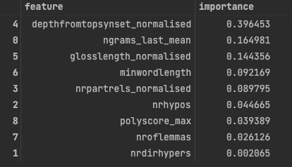

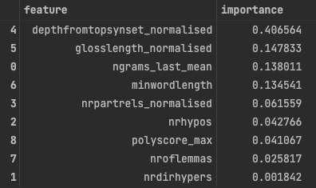

Results of EX1
Unseen Domain Model(2)
Largely vary in ’cohen kappa’ from the paper

Slide 6
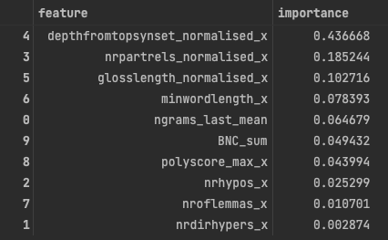

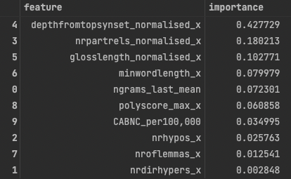

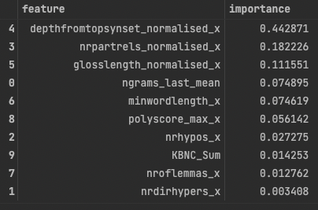

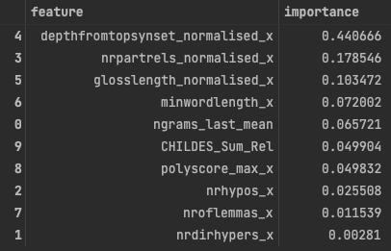

Results of EX2
Local Model(1)
BNC Sum: Written General
CABNC per 100K: Spoken General
KBNC Sum: Written Children
CHIDES relative Sum: Spoken Children

Slide 7
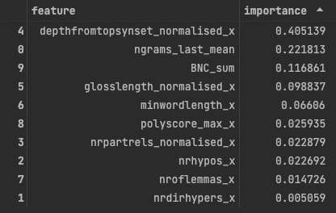

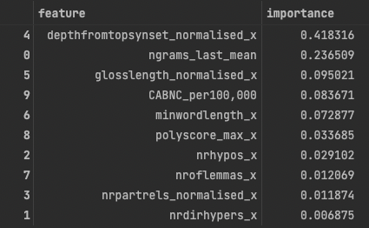

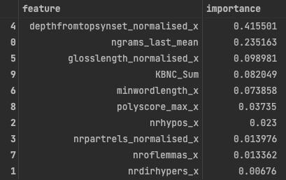

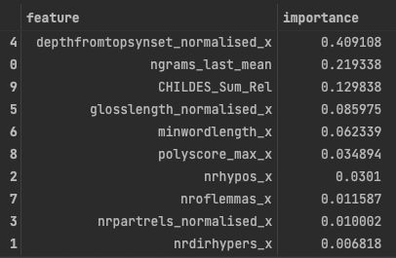

Results of EX2
Local Model(2)
BNC Sum: Written General
CABNC per 100K: Spoken General
KBNC Sum: Written Children
CHIDES relative Sum: Spoken Children

Slide 8
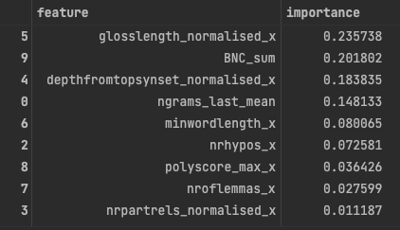

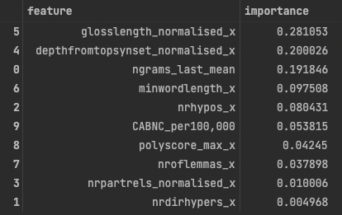

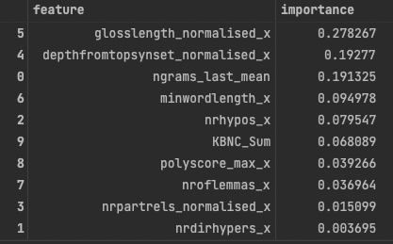

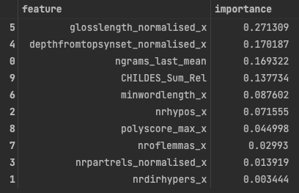

Results of EX2
Local Model(3)
BNC Sum: Written General
CABNC per 100K: Spoken General
KBNC Sum: Written Children
CHIDES relative Sum: Spoken Children

Slide 9
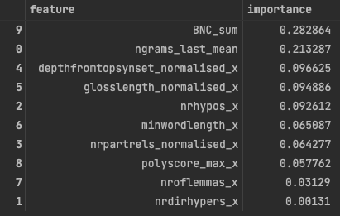

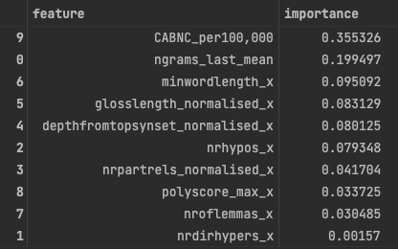

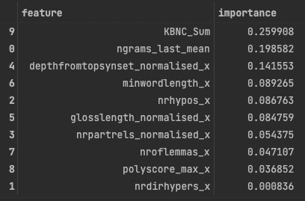

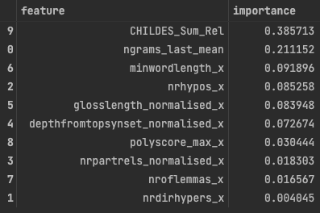

Results of EX2
Local Model(4)
BNC Sum: Written General
CABNC per 100K: Spoken General
KBNC Sum: Written Children
CHIDES relative Sum: Spoken Children

Slide 10
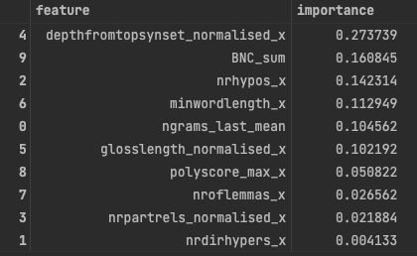

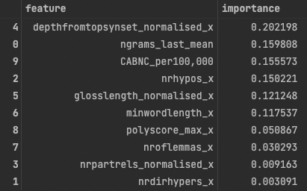

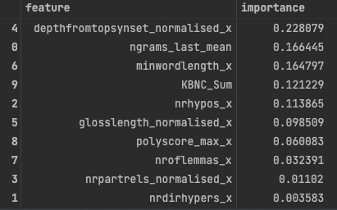

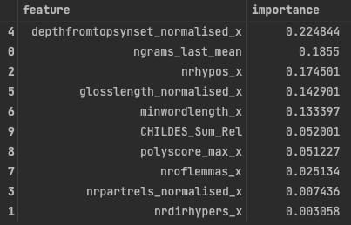

Results of EX2
Local Model(5)
BNC Sum: Written General
CABNC per 100K: Spoken General
KBNC Sum: Written Children
CHIDES relative Sum: Spoken Children

Slide 11
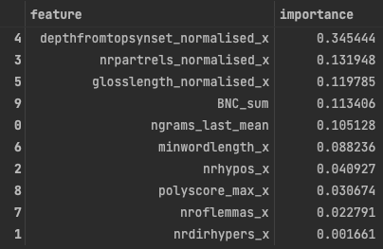

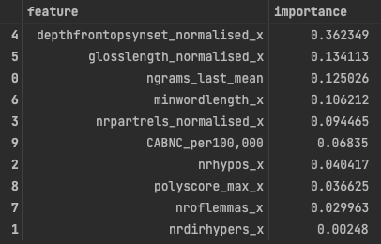

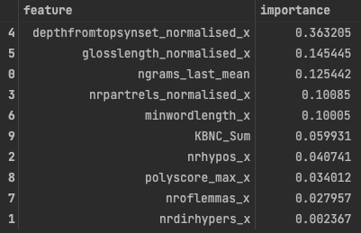

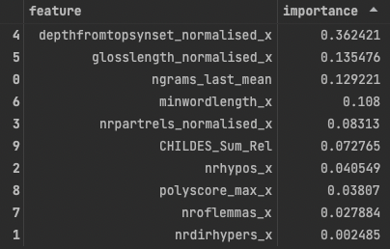

Results of EX2
Global Model
BNC Sum: Written General
CABNC per 100K: Spoken General
KBNC Sum: Written Children
CHIDES relative Sum: Spoken Children

Slide 12



Results of EX2
Unseen Domain Model(1)
Largely vary in ’cohen kappa’ from the paper

Slide 13


Results of EX2
Unseen Domain Model(2)

