Slide 1
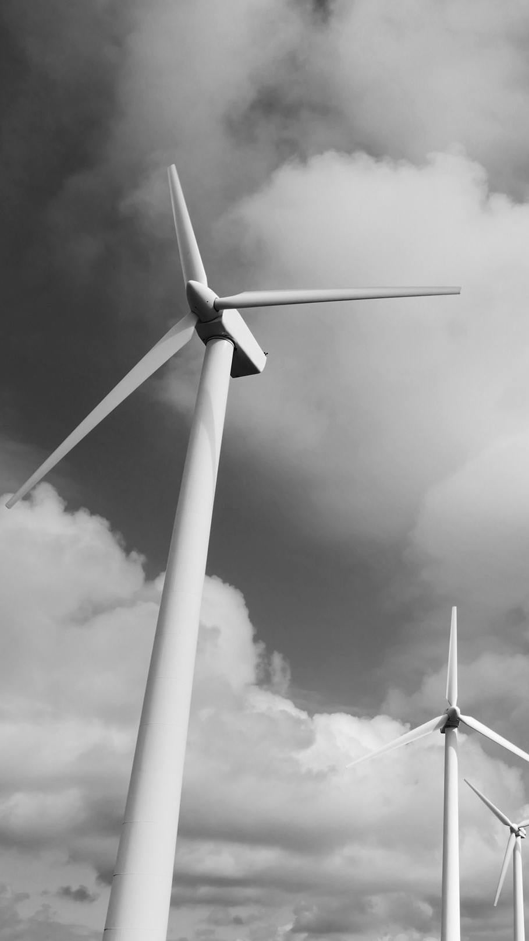
CLIMATE CHANGE AND RESOURCES AVAILABILITY
Dan Furman
Marcus Pames
Sueli yahara

Slide 2

Motivation
Project One by DMS Team
Our project is to uncover patterns on resources availability among developed nations due to climate change
Temperature change vs. natural capital
Temperature vs. agricultural land per capital
Temperature change vs. wealth per capita
We asked these questions because we would like to learn more about the impact of climate change on resources availability

Slide 3

FINDINGS
Project One by DMS Team
We found that Agricultural Capital has an inverse relationship to the temperature change, but we could not find a correlation between Natural capital and Wealth per capita to temperature change for an interval confidence of 95%.

Slide 4
Hypothesis change
Project One by DMS Team
We changed our initial questions related to carbon emission, water availability, and agriculture and forestry, because we chose a broader indicator, natural capital, that encompasses all the indicators mentioned above, giving a global view of the natural resources that are all interconnected
Since one of our dataset did not have the years that we have to compare to our other dataset, we had to change the year 2009 to 2010.
We did not use the temperature change for each country, but we grouped all the temperature for all the countries to make our graphs and comparisons.

Slide 5

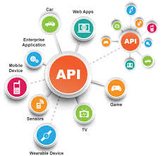

QUESTIONS AND DATA
Project One by DMS Team
To answer our questions related to climate change and resources availability we needed data on temperature change, natural resources and economic indicators
We found all this data on the World Bank API, using two libraries: wbdata and wbpy. The first library helped us to collect data on natural resources and other indicators. The wbpy library was used to collect data on temperature change

Slide 6

DATA CLEANUP & EXPLORATION
Project One by DMS Team
The exploration and cleanup process was not an easy one. It took most of our time, almost 80%. First, we had to find the right database that would be useful to answer our questions. Next, we look for libraries that could help us pull and format the data

Slide 7
DATA CLEANUP & EXPLORATION
Project One by DMS Team
•We found two libraries: wbdata and wbpy. Both libraries offer a lot of functions/objects that make easier to interact with the World Bank API; however, in our case, both libraries have their limitations, such as missing data, data structure, etc. Since we were trying to merge different tables from different libraries, there were some incompatibilities that we had not anticipated, such different timeframes. The solution was to work with a shorter period of time that we planned and that might have affected the outcomes of our project.

Slide 8
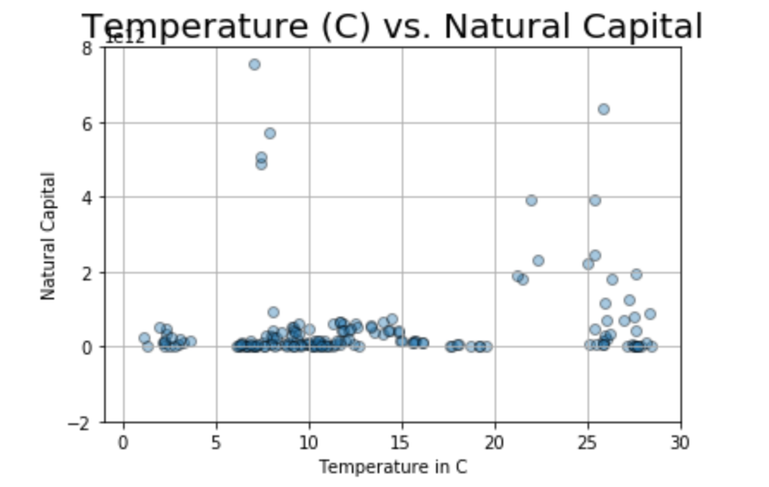
Temperature vs Natural Capital
Project One by DMS Team

Slide 9
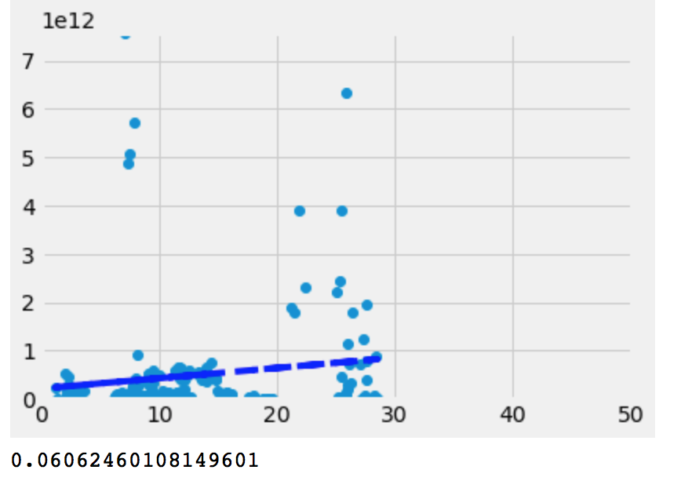
Temperature vs Natural Capital
Project One by DMS Team
p- value greater than 0.05 therefore no correlation

Slide 10
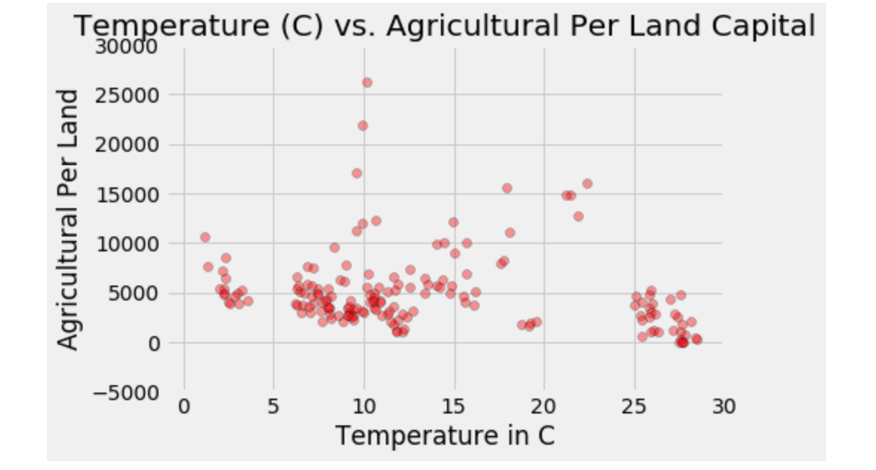
Temperature VS. Agricultural Land Per Capita
Project One by DMS Team

Slide 11
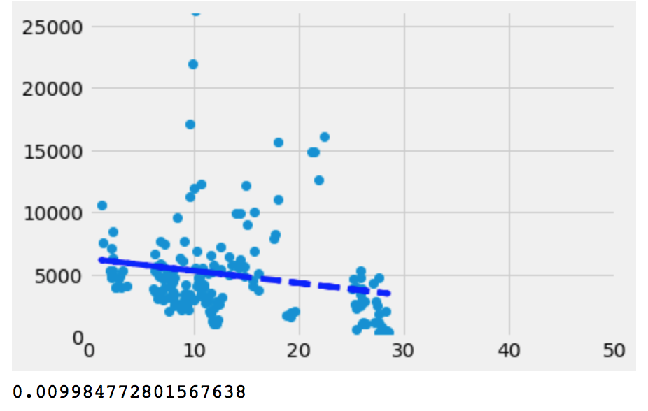
Temperature VS. Agricultural Land Per Capita
Project One by DMS Team
p-value lower than 0.05, therefore there is a correlation

Slide 12
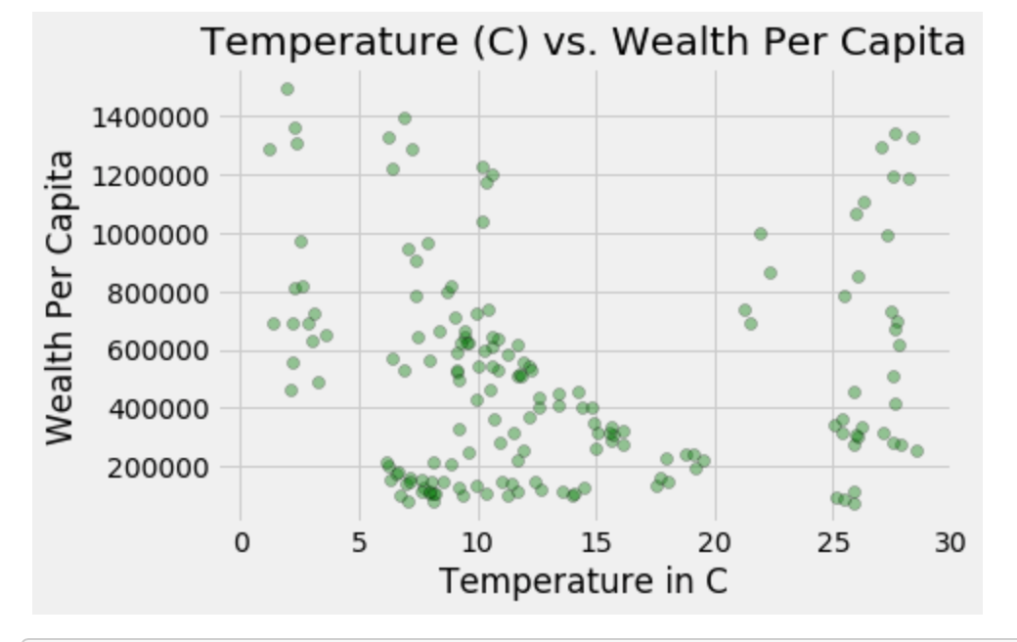
Temperature vs Wealth per Capita
Project One by DMS Team

Slide 13
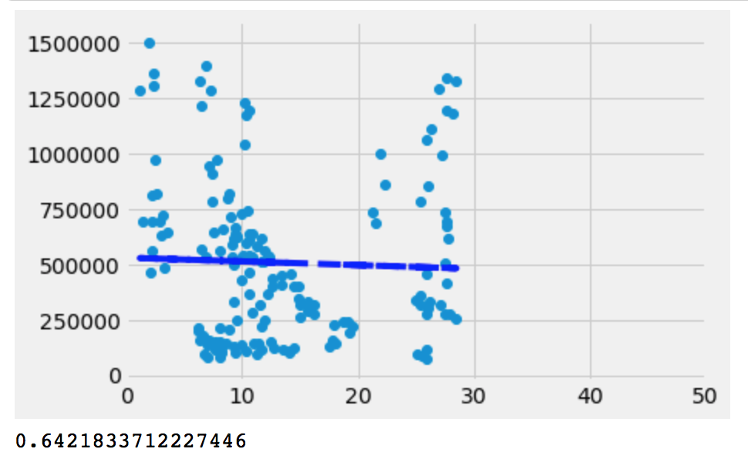
Temperature vs Wealth per Capita
Project One by DMS Team
p-value greater than 0.05, therefore there is no correlation

Slide 14
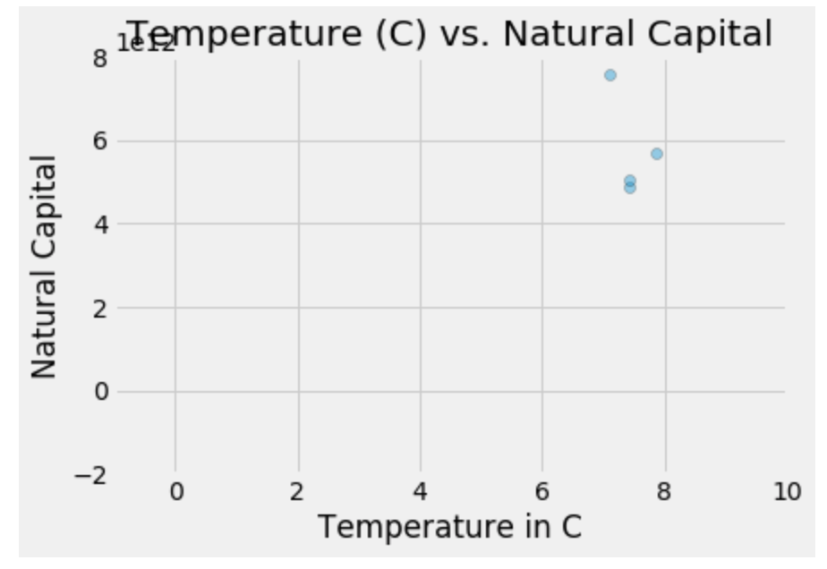
Temperature vs Natural Capital (USA)
Project One by DMS TeamText

Slide 15
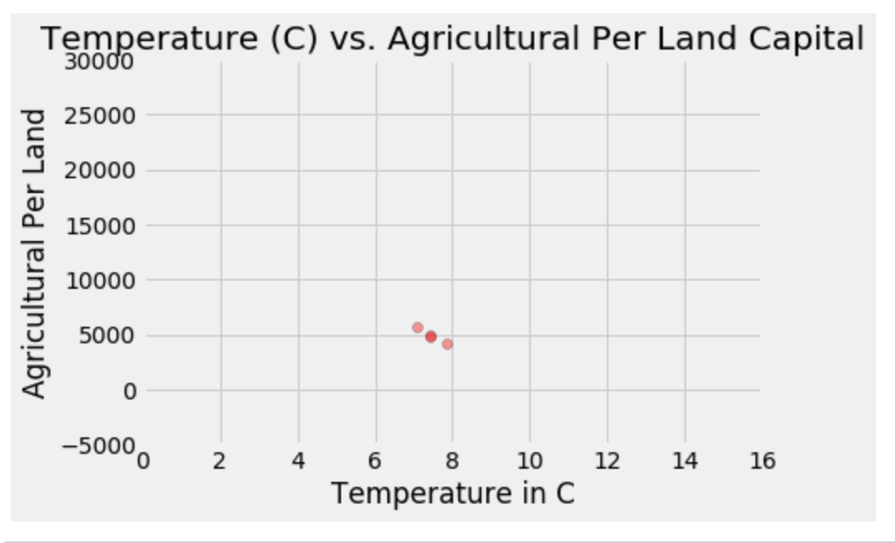
Temperature VS. Agricultural Land Per Capita
Project One by DMS Team

Slide 16
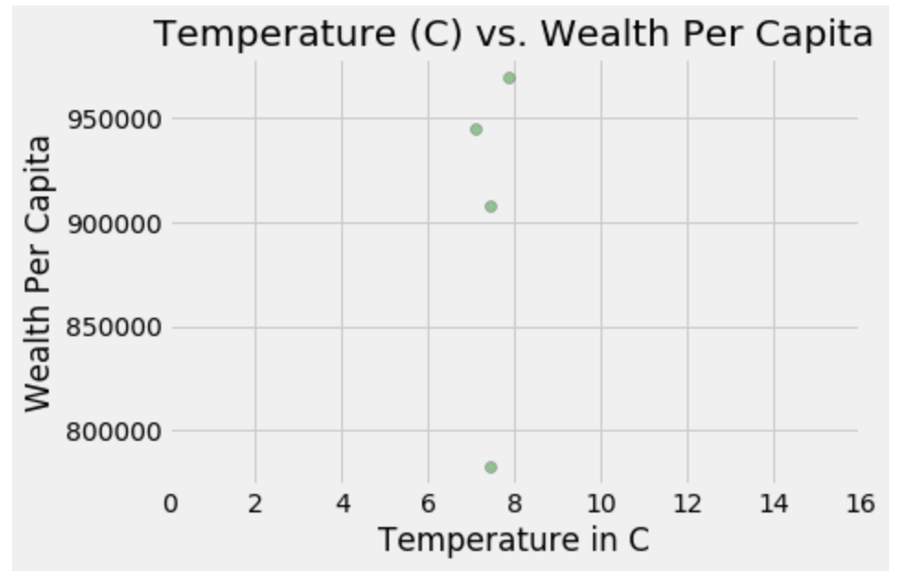
Temperature vs Wealth per Capita (USA)
Project One by DMS Team

Slide 17
Data Analysis
Project One by DMS Team
In order to analyze the data and answer each question, we first create a scatter plot with all the countries classified as developed ones according do the OEDC classification and temperature data that we had.
Next we plot the regression lines in order to find out if there was a correlation between climate change and natural resources and other indicators for all the developed countries
We look closer into the USA data to see how the data was distributed in order to compared to the data for the combined developed countries

Slide 18
DATA ANALYSIS
Project One by DMS Team
We did not find a correlation between Natural Capital and temperature change taking into consideration the confidence level of 95%. The p-value of 0.0602 which is greater than 0.065. This might be explained by the short timeframe that we used (1995-2010), or by the green policies that have been in effect since the Kyoto protocol (1992) and CO2 emission control policies.
We did find an inverse correlation between Agricultural land per Capita. The p-value of 0.009 is lower than 0.05. We did expect that outcome, taking into consideration that any change in temperature affects that water available for irrigation, soil fertility, water availability, harvest outcomes, etc.

Slide 19
DATA ANALYSIS
Project One by DMS Team
We did not find a correlations between temperature change and wealth income per capita. The p-value of 0.64 which is greater than 0.05. This might be explained by the dataset that we chose to work with, meaning developed countries. The result might have been different if we were working with developing countries, where change in agricultural land affects the income of part of the population in rural areas. In developing countries the rural population is bigger than in developed countries.

Slide 20
DISCUSSION
Project One by DMS Team
We expected to find a correlation between climate change and natural resources availability. We found only for agricultural land per capita. We believe that the dataset that we worked on did not provided enough context to demonstrate if there is a correlation between all the variables that we chose to work with or not.
Although we had only for points in our dataset for the USA, we could observe the the SUA data corroborate our findings.
The libraries can be helpful, but sometimes can be more difficult to work with, especially if you are using different libraries

