Slide 1
Fourier Transform

Slide 2
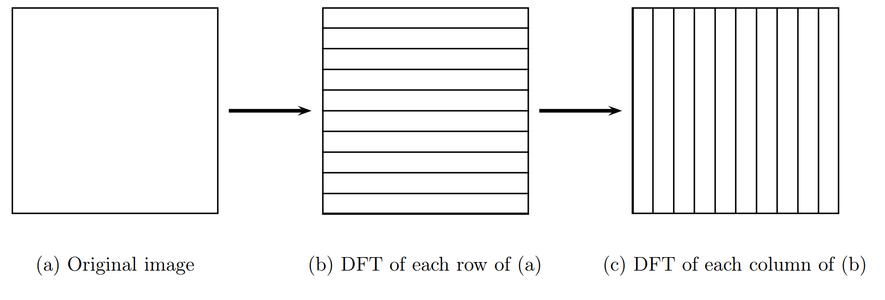
Extend from 1D --> 2D signal

Slide 3
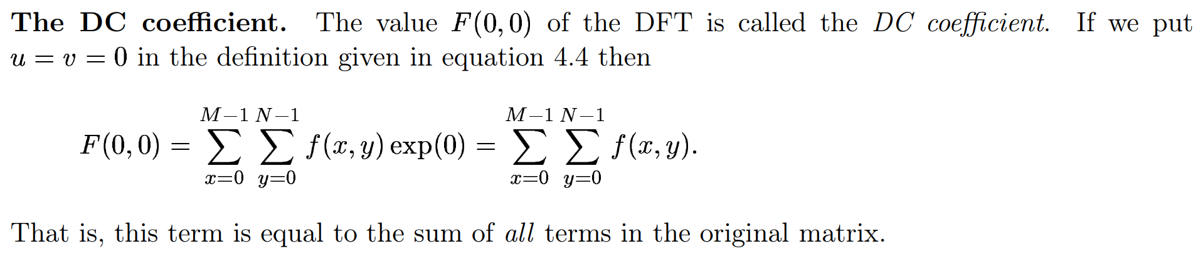
Physical meaning of each element in frequency domain

Slide 4
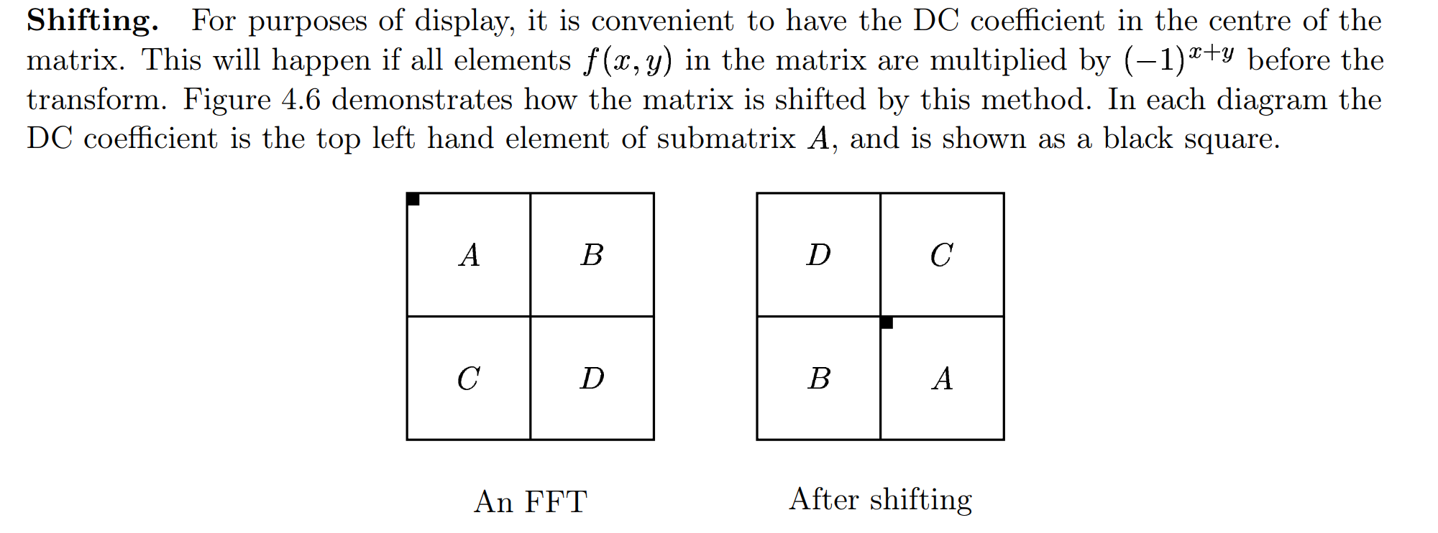

Slide 5
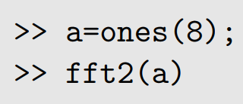
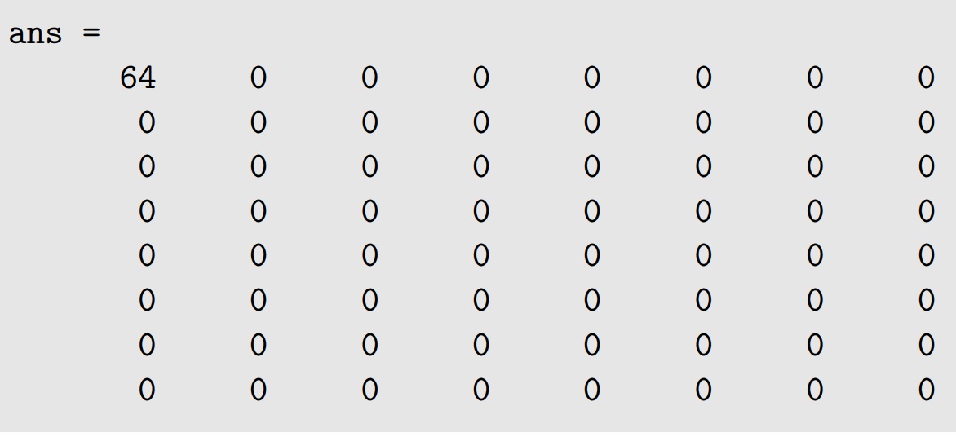
DC cofficent example

Slide 6
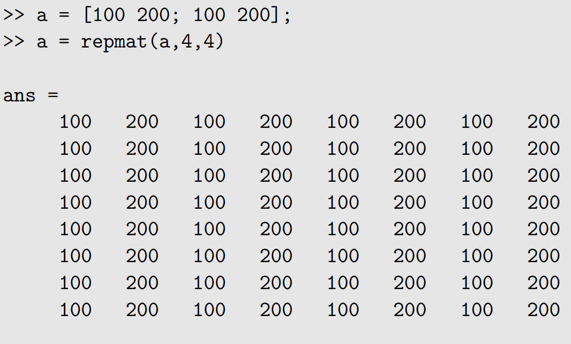
Physical meaning of each element in frequency domain

Slide 7
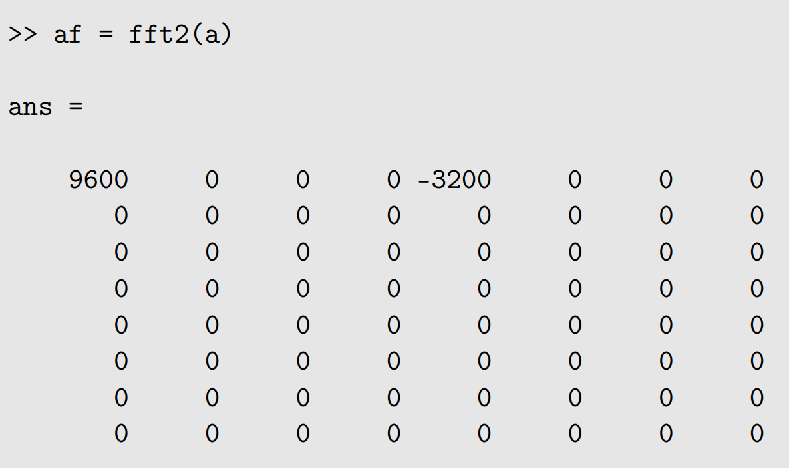

Slide 8
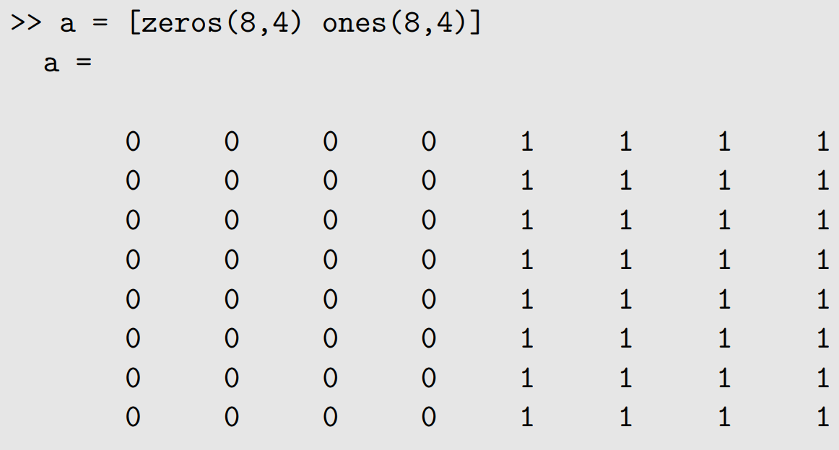

Slide 9
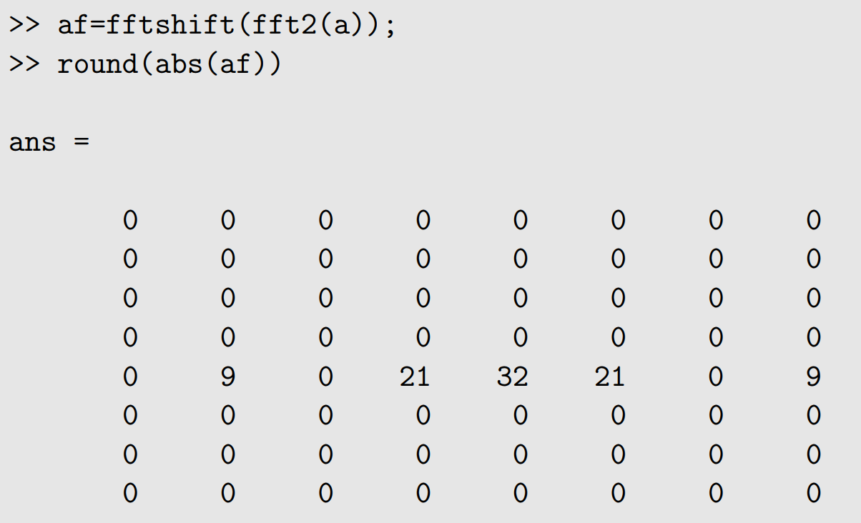

Slide 10
Show image in FFT domain
a=[zeros(256,128) ones(256,128)];
﻿af=fftshift(fft2(a));
﻿afl=log(1+abs(af));
imshow(afl/afl(129,129))
﻿imshow(mat2gray(log(1+abs(af))))
Show invert image in spatial domain
A_invet=abs(ifft2(af))
Imshow(A_invet/ max(A_inv))

Slide 11


Slide 12


Slide 13
