Slide 1
Image Processing Lecture 4
Gaurav Gupta

Slide 2
Today
Image Enhancement Techniques
Spatial Domain Method
Histogram Methods
Frequency Domain Methods

Slide 4
Spatial Domain Methods
In these methods a operation (linear or non-linear) is performed on the pixels in the neighborhood of coordinate (x,y) in the input image F, giving enhanced image F’
Neighborhood can be any shape but generally it is rectangular ( 3x3, 5x5, 9x9 etc)
g(x,y) = T[f(x,y)]

Slide 5
Grey Scale Manipulation
Simplest form of window (1x1)
Assume input gray scale values are in range [0, L-1] (in 8 bit images L = 256)
N^{th} root Transformation
s = c (r)^{n}

Slide 6
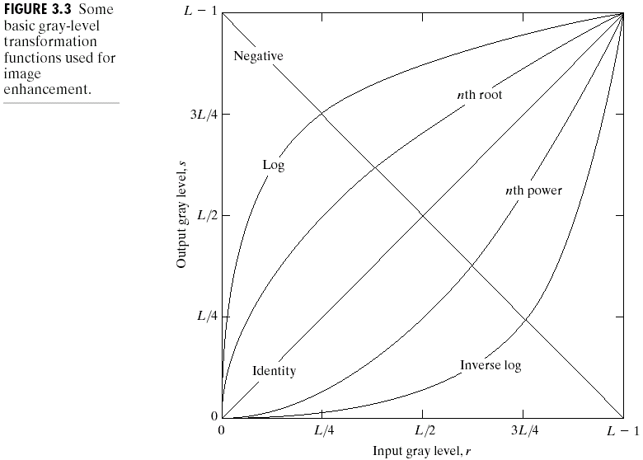
contd…
Linear: Negative, Identity
Logarithmic: Log, Inverse Log
Power-Law: nth power, nth root

Slide 7
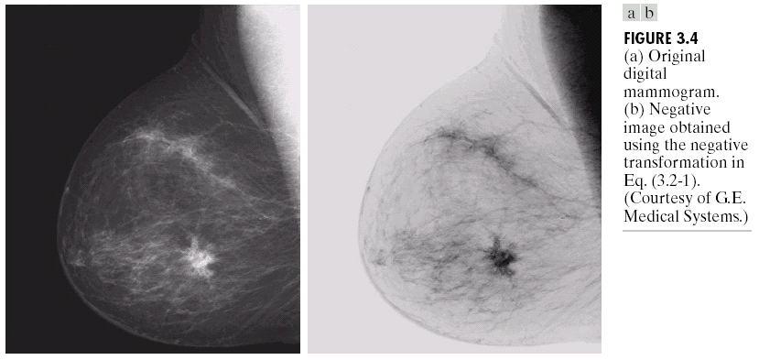
Image Negative
Image Negative: s = L – 1 – r

Slide 8
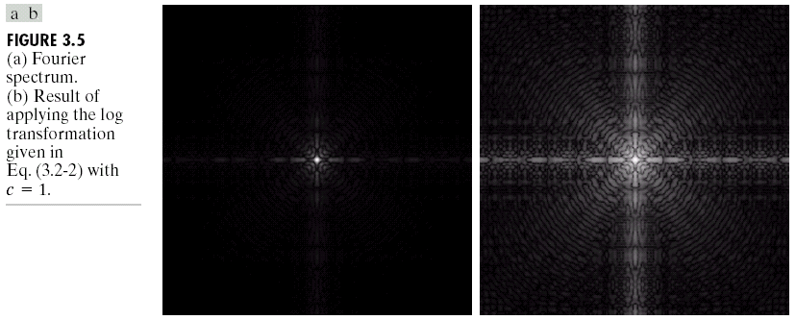
Log Transformation
s = c log(1+r)
c: constant
Compresses the dynamic range of images with large variations in pixel values

Slide 9
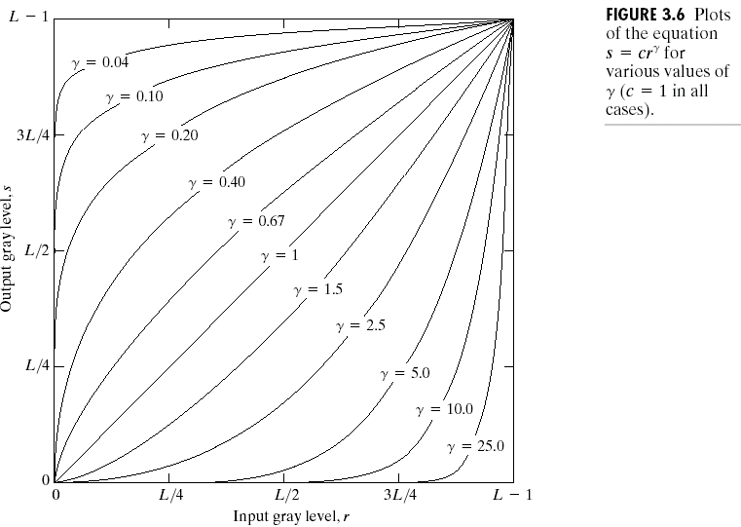
Power Law Transformation
s = cr^{γ}
C, γ : positive constants
Gamma correction

Slide 10
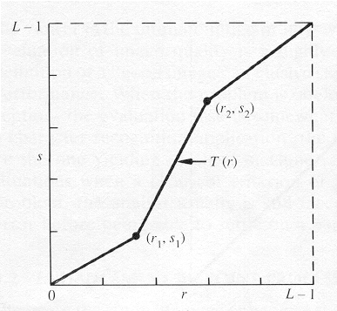
Contrast Stretching
To increase the dynamic range of the gray levels in the image being processed.

Slide 11
contd…
The locations of (r₁,s₁) and (r₂,s₂) control the shape of the transformation function.
If r₁= s₁ and r₂= s₂ the transformation is a linear function and produces no changes.
If r₁=r₂, s₁=0 and s₂=L-1, the transformation becomes a thresholding function that creates a binary image.
Intermediate values of (r₁,s₁) and (r₂,s₂) produce various degrees of spread in the gray levels of the output image, thus affecting its contrast.
Generally, r₁≤r₂ and s₁≤s₂ is assumed.

Slide 12
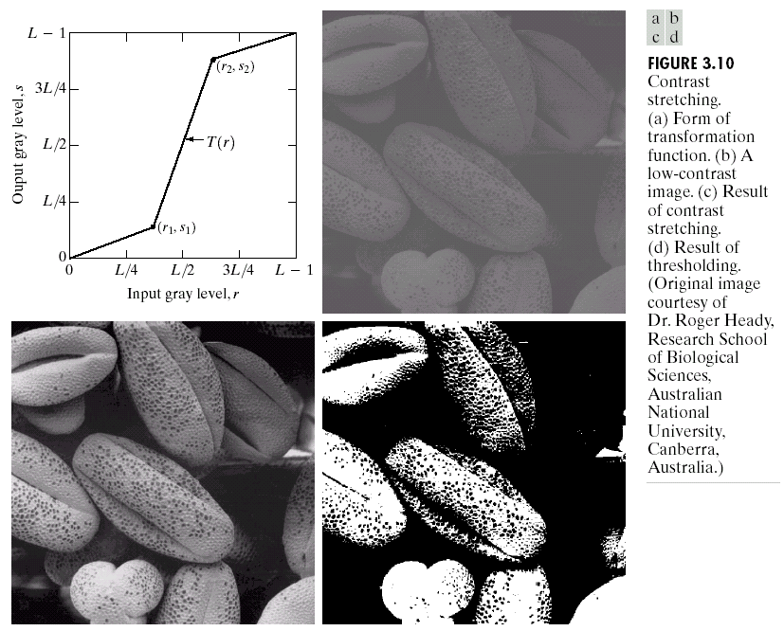
Example

Slide 13
Bit-Plane Slicing
To highlight the contribution made to the total image appearance by specific bits.
i.e. Assuming that each pixel is represented by 8 bits, the image is composed of 8 1-bit planes.
Plane 0 contains the least significant bit and plane 7 contains the most significant bit.
Only the higher order bits (top four) contain visually significant data. The other bit planes contribute the more subtle details.

Slide 14
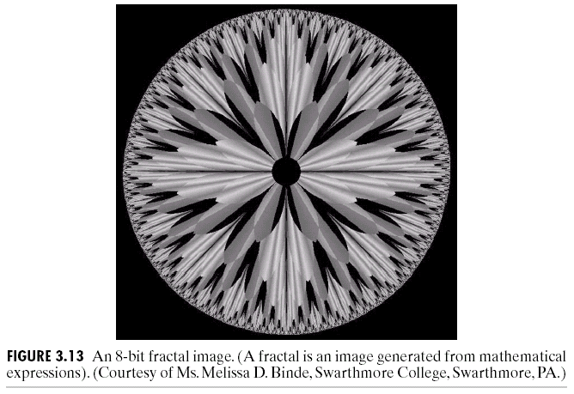

Slide 15
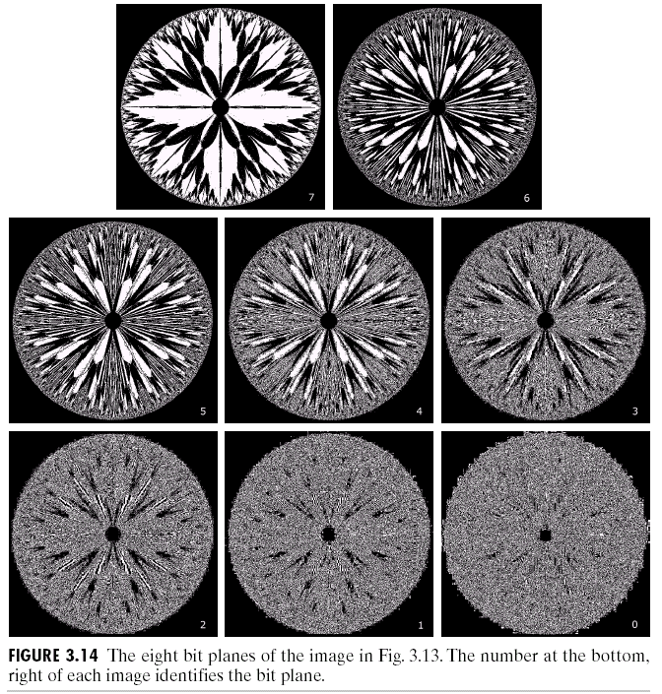

Slide 16
Histogram Processing
The histogram of a digital image with gray levels from 0 to L-1 is a discrete function h(r_{k})=n_{k}, where:
r_{k} is the kth gray level
n_{k} is the # pixels in the image with that gray level
n is the total number of pixels in the image
k = 0, 1, 2, …, L-1
Normalized histogram: p(r_{k})=n_{k}/n
sum of all components = 1

Slide 17
Types of processing:
Histogram equalization
Histogram matching (specification)
Local enhancement

Slide 18
Histogram Equalization
Histogram equalization (HE) results are similar to contrast stretching but offer the advantage of full automation, since HE automatically determines a transformation function to produce a new image with a uniform histogram.

Slide 19
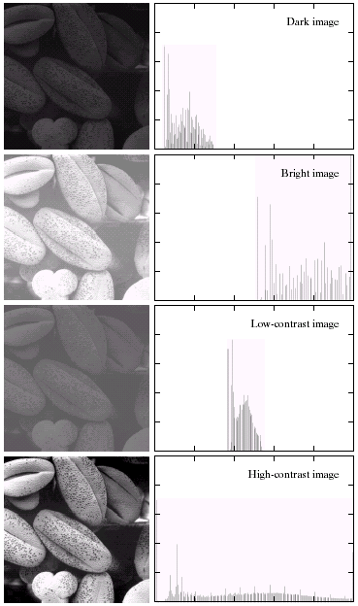
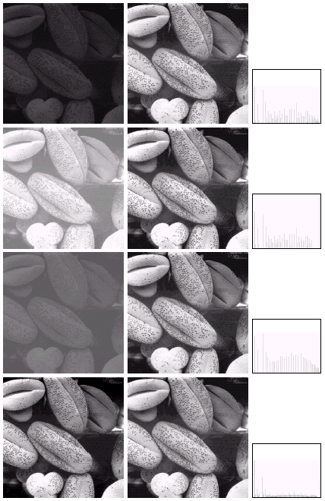

Slide 20
Histogram Matching (or Specification)
Histogram equalization does not allow interactive image enhancement and generates only one result: an approximation to a uniform histogram.
Sometimes though, we need to be able to specify particular histogram shapes capable of highlighting certain gray-level ranges.

Slide 21
Method
Specify the desired density function and obtain the transformation function G(z):
pz: specified desirable PDF for output
Apply the inverse transformation function z=G⁻¹(s) to the levels obtained in step 1.

Slide 22
Image Smoothing or Averaging
A noisy image:
Averaging M different noisy images:
As M increases, the variability of the pixel values at each location decreases.
This means that g(x,y) approaches f(x,y) as the number of noisy images used in the averaging process increases.

Slide 23
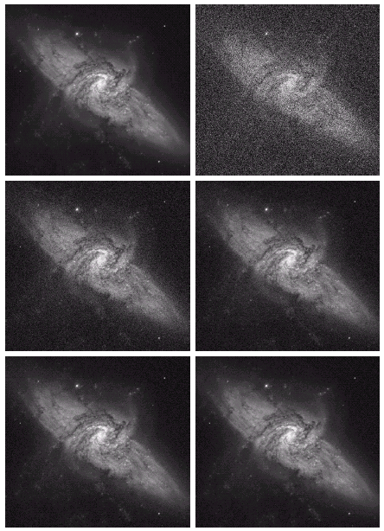
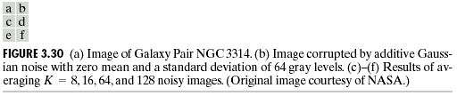
Example

Slide 24
Spatial Filtering
Use of spatial masks for image processing (spatial filters)
Linear and nonlinear filters
Low-pass filters eliminate or attenuate high frequency components in the frequency domain (sharp image details), and result in image blurring.

Slide 25
a=(m-1)/2 and b=(n-1)/2,
m x n (odd numbers)
For x=0,1,…,M-1 and y=0,1,…,N-1
The basic approach is to sum products between the mask coefficients and the intensities of the pixels under the mask at a specific location in the image:
(for a 3 x 3 filter)

Slide 26
Neighborhood Averaging

Slide 27
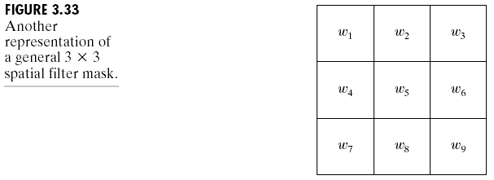
General Spatial Filter

Slide 28
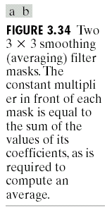
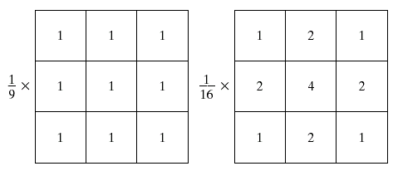

Slide 29
Non-linear Filter
Median filtering (nonlinear)
Used primarily for noise reduction (eliminates isolated spikes)
The gray level of each pixel is replaced by the median of the gray levels in the neighborhood of that pixel (instead of by the average as before).

Slide 31
Sharpening Filters
The main aim in image sharpening is to highlight fine detail in the image
With image sharpening, we want to enhance the high-frequency components; this implies a spatial lter shape that has a high positive component at the centre

Slide 32
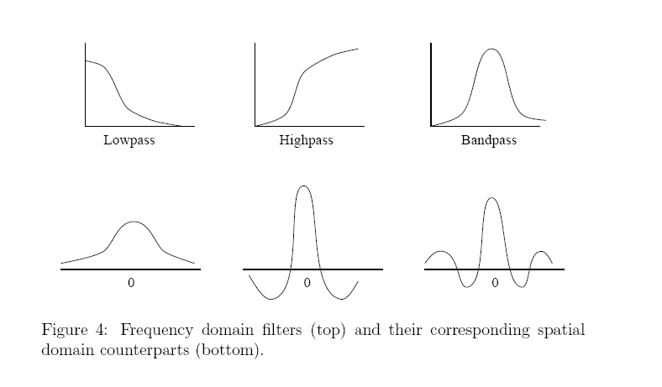

Slide 33
Derivatives
First derivative
Second derivative

Slide 34
Observations
1st order derivatives produce thicker edges in an image
2nd order derivatives have stronger response to fine detail
1st order derivatives have stronger response to a gray lever step
2nd order derivatives produce a double response at step changes in gray level

Slide 35
Since the sum of all the weights is zero, the resulting signal will have a zero DC value

Slide 36
Frequency Domain Methods
We simply compute the Fourier transform of the image to be enhanced, multiply the result by a filter (rather than convolve in the spatial domain), and take the inverse transform to produce the enhanced image.
Low pass filtering involves the elimination of the high frequency components in the image. It results in blurring of the image

Slide 37
Frequency Domain Methods

Slide 38
ThE eNd

