Slide 1
Histogram Equalization

Slide 2
Probability density functions (PDF)

Slide 5
Example: histogram equalization
• Consider an 8-level 64 x 64 image with gray values (0, 1, …,
7). The normalized gray values are (0, 1/7, 2/7, …, 1). The
normalized histogram is given below:
NB: The gray values in output are also (0, 1/7, 2/7, …, 1).

Slide 6
# pixels
Fraction of # pixels
Gray value
Normalized gray value

Slide 7
• Applying the transformation,
we have

Slide 8
• Notice that there are only five distinct gray levels --- (1/7, 3/7,
5/7, 6/7, 1) in the output image. We will relabel them as (s₀,
s₁, …, s₄ ).
• With this transformation, the output image will have
histogram

Slide 9
Histogram of output image
# pixels
Gray values
• Note that the histogram of output image is only approximately, and not exactly, uniform. This should not be surprising, since there is no result that claims uniformity in the discrete case.

Slide 10
Example
Original image and its histogram

Slide 11
Histogram equalized image and its histogram

Slide 12
Histogram matching (specification)

Slide 13
Histogram matching (specification)
is the desired PDF

Slide 14
Example:
• Consider an 8-level 64 x 64 previous image.
# pixels
Gray value

Slide 15
• It is desired to transform this image into a new image, using a transformation Z=H(r)= G⁻¹[T(r)], with histogram as specified below:
# pixels
Gray values

Slide 16
• The transformation T(r) was obtained earlier (reproduced
below):
• Now we compute the transformation G as before.

Slide 18
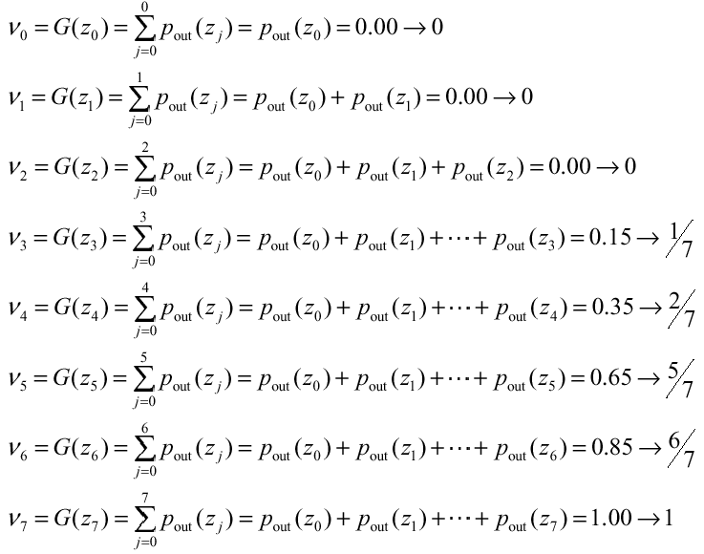
• Computer z=G⁻¹ (s), Notice that G is not invertible.
G⁻¹(0) = ?
G⁻¹(1/7) = 3/7
G⁻¹(2/7) = 4/7
G⁻¹(3/7) = ?
G⁻¹(4/7) = ?
G⁻¹(5/7) = 5/7
G⁻¹(6/7) = 6/7
G⁻¹(1) = 1

Slide 19
• Combining the two transformation T and G⁻¹ , compute z=H(r)= G⁻¹[v=s=T(r)]

Slide 20
• Applying the transformation H to the original image yields an image with histogram as below:
• Again, the actual histogram of the output image does not exactly but only approximately matches with the specified histogram. This is because we are dealing with discrete histograms.

Slide 21
Original image and its histogram
Histogram specified image and its histogram

