Slide 1

Housemates
Capstone Group #9
Justin Dang
Fady Morcos
Harris Hamid
Rizwan Ahsan
Sheikh Afsar

Slide 2
The Problem
Housing Situation in Canada
Increasing Number of People with Housemates

Slide 3
Challenges of Living with Housemates
Managing Expenses
Balancing Chores
Event Coordination
Communication

Slide 4
User Needs
Expense Splitting
Task Management
Event Scheduling
Wide Availability
User-Friendly Interface

Slide 5
Existing Solutions
Expense-Splitting
Splitwise
Splitser
Settle Up
Task Management
Google Tasks
Todoist
Tody
Scheduling
Google Calendar
Apple Calendar
Outlook Calendar

Slide 6
Housemates
All-in-one solution
Expense Splitting
Task Management
Event Scheduling
Streamline Household Management

Slide 7
Demonstration

Slide 8
Technologies Used
React
MongoDB
Firebase
Node.js
Express

Slide 9
Target Users
College Students
Young Workers
Families
Property Managers

Slide 10
Usability Survey
First Impressions
How easy is it to locate main features?
Visual Appeal?
How responsive does it feel?
Would you use Housemates in real life?

Slide 11
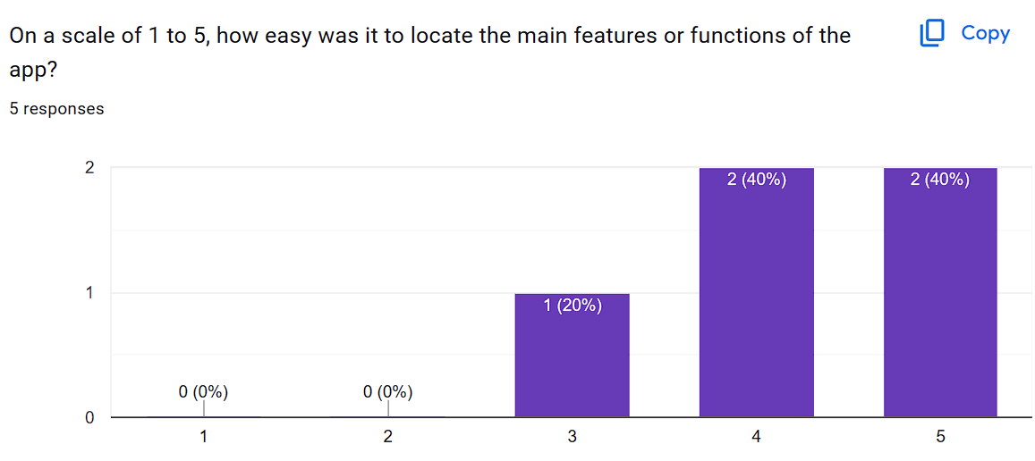
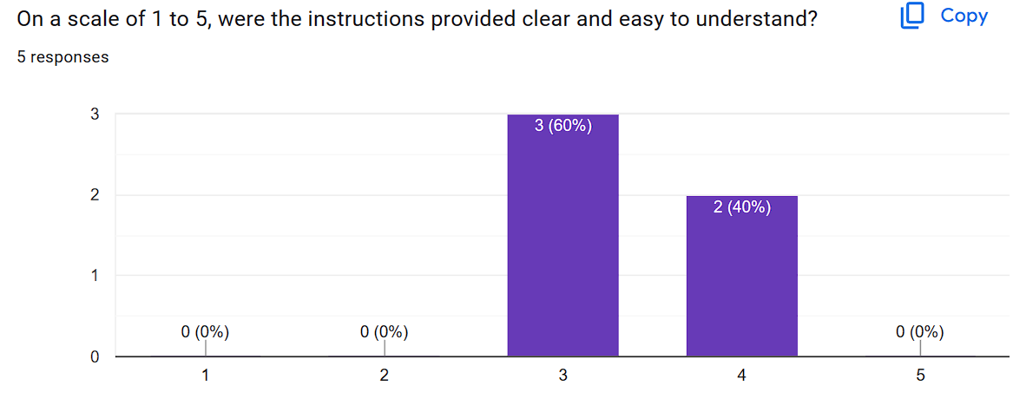
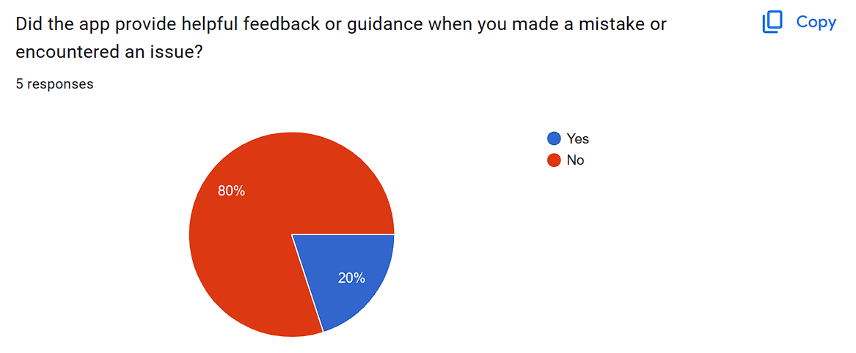
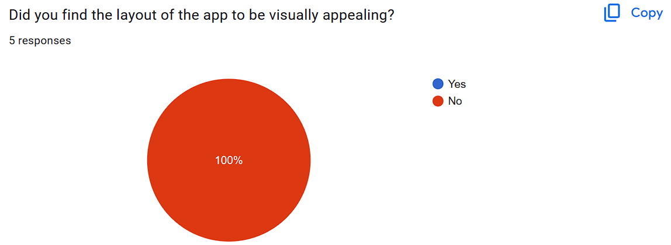
Revision 0 Feedback

Slide 12

Revision 0 Feedback
“Unpolished”
“Bland”
“Generic”
“Nothing that catches the eye”
“Too much typing”

Slide 13
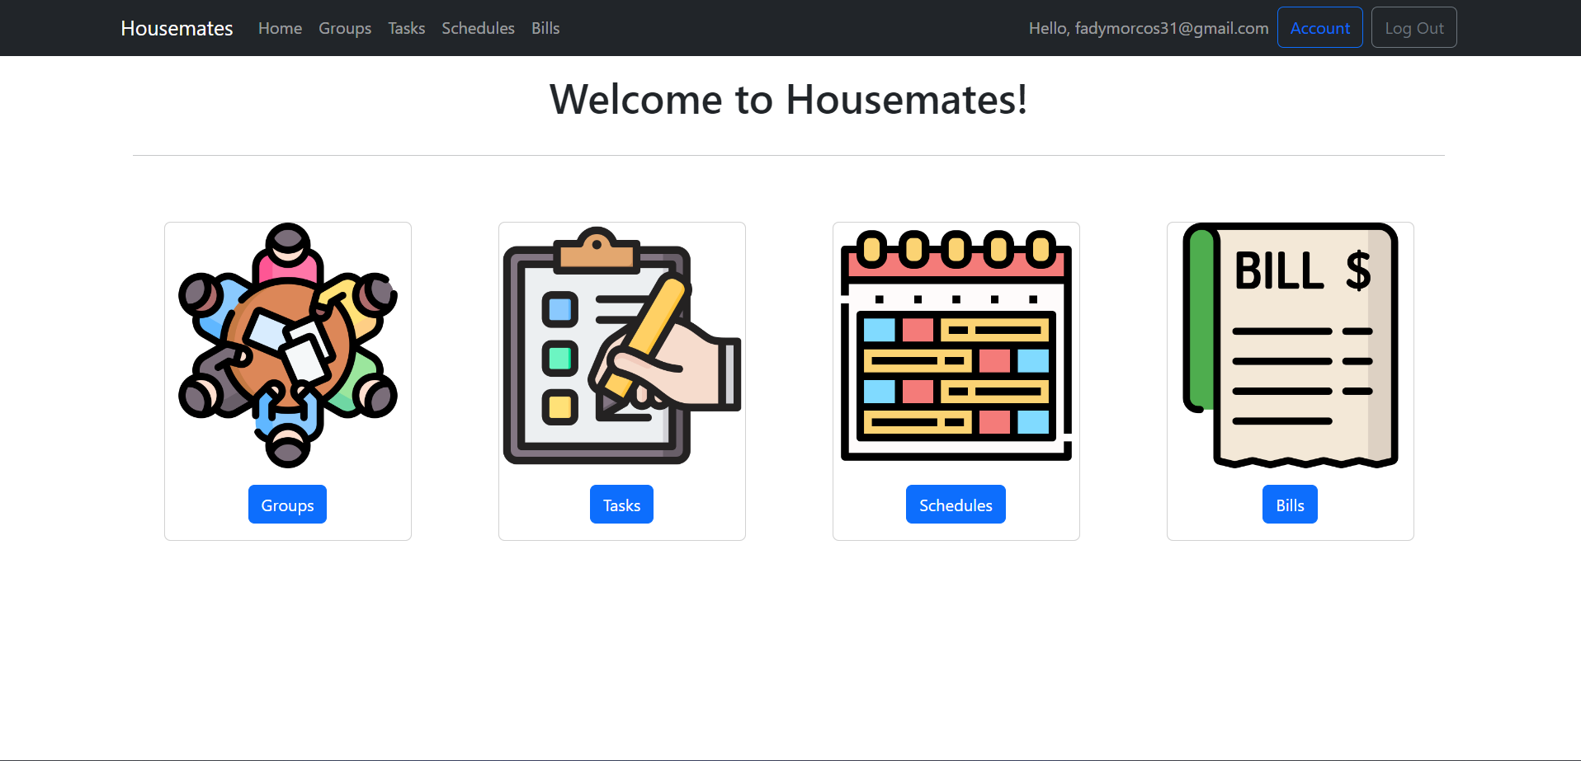
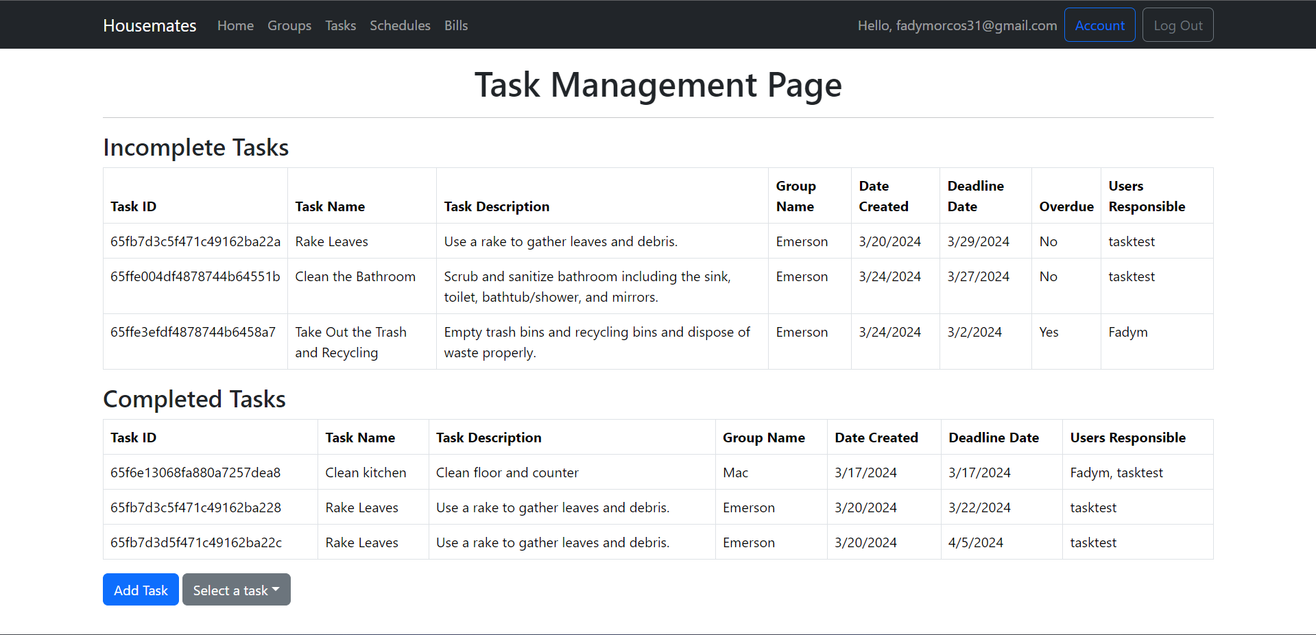
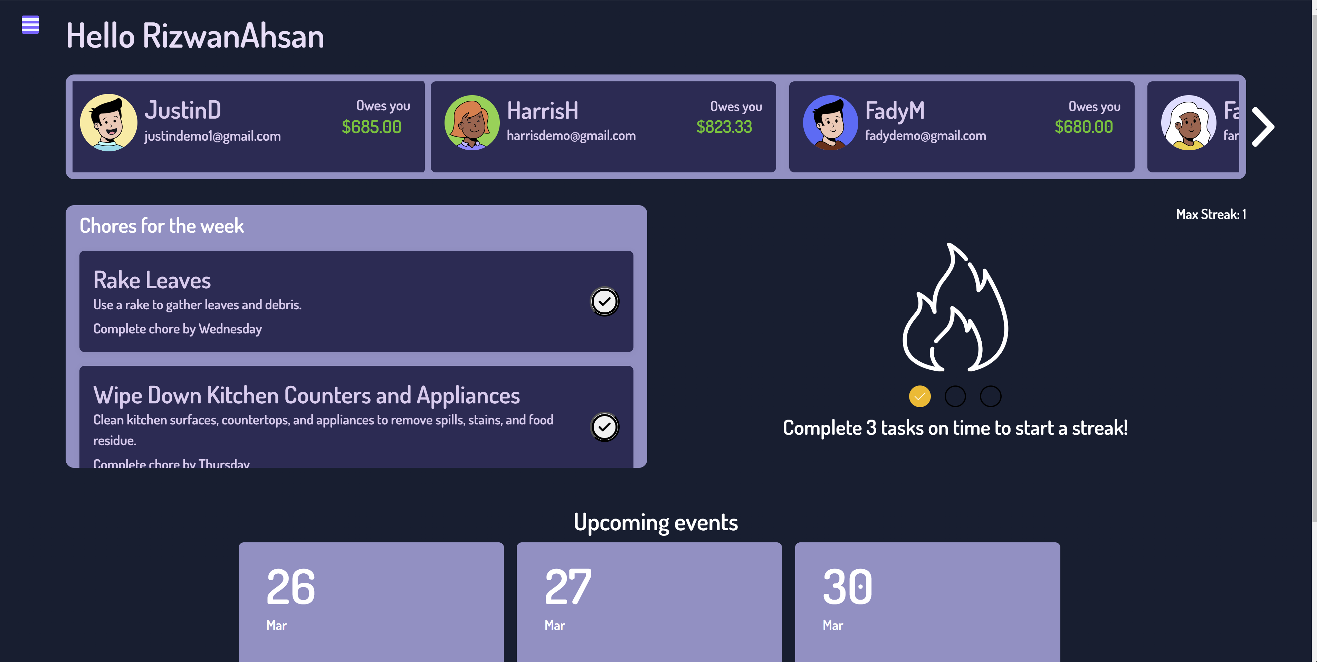
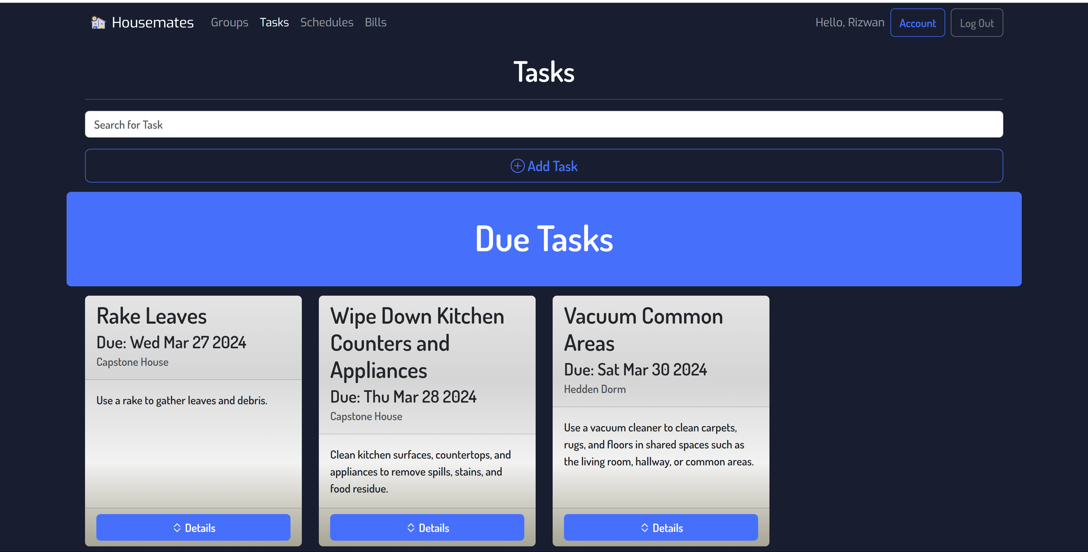
Before and After

Slide 14
Usability Improvements
New User Interface
Less Typing Required
Enhanced Responsiveness
Faster Navigation
Additional Features
Search Bars
Calendar Display
Task Presets

Slide 15
Performance
Main Goal: Fast Response Times
Performance Testing Of Housemates Conducted Using Jmeter
Simulate 100 Simultaneous Users Using Housemates
Measure Response Time Of Common User Requests

Slide 16
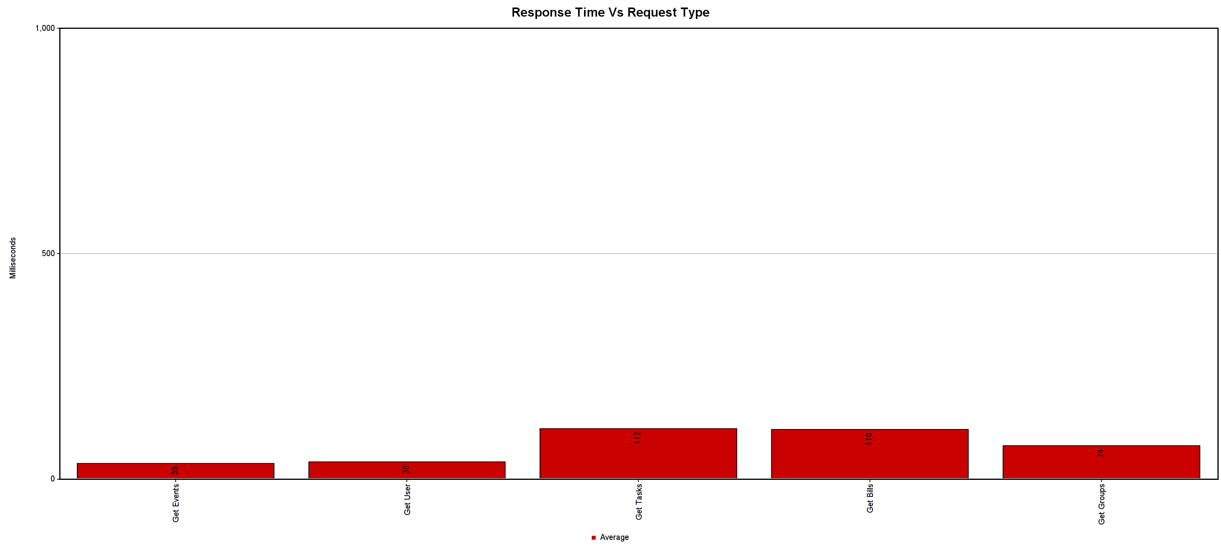
Performance Results
Acceptance Criteria: < 500 ms
Average Response time ~ 100 ms
Conclusion: Housemates is sufficiently responsive

Slide 17
Future Features
Image Attachments
User Defined Presets
Notifications
App Integrations (e.g. Google Calendar)
Natural Language Processing

Slide 18

Conclusion
All-in-one solution
Expense Splitting
Task Management
Scheduling
Improved Household Experience
More Organized
More Efficient
Less Stress

Slide 19
Q&A

