Slide 1

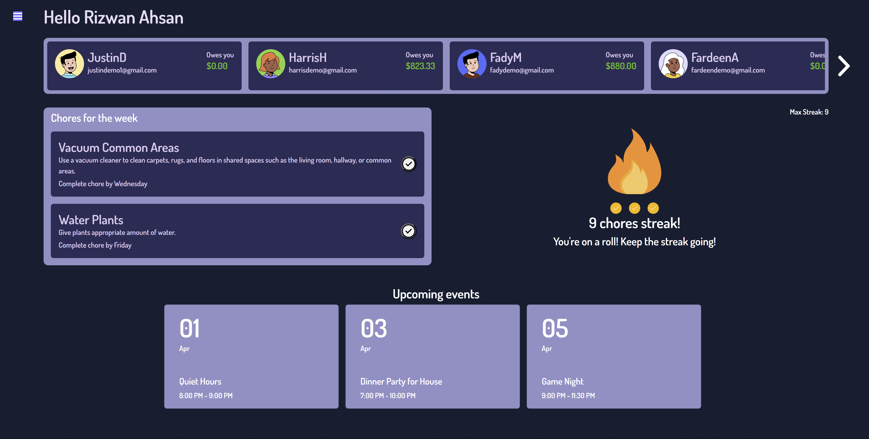



Housemates
Justin Dang, Fady Morcos, Harris Hamid, Rizwan Ahsan, Sheikh Afsar
Software Engineering Capstone Group #9
The Problem
The Solution
Target Users and Advantages
HOUSING SITUATION IN CANADA
INCREASING NUMBER OF PEOPLE WITH HOUSEMATES
Introducing Housemates
All-in-one solution
Expense Splitting
Task Management
Event Scheduling
Streamline Household Management
Target Users
College Students
Young Workers
Families
Property Managers
Challenges of Living with Housemates
Managing Expenses
Balancing Chores
Event Coordination
Communication
Advantages
All-in-one Solution
Simple and Intuitive
Multiplatform
Responsive
User Needs
Expense Splitting
Task Management
Event Scheduling
Wide Availability
User-Friendly Interface
Expense Splitting
Task Management
Event Scheduling
Acknowledgements
Many Thanks To
Dr. Spencer Smith
Christopher Schankula
CAS Department

