Slide 1

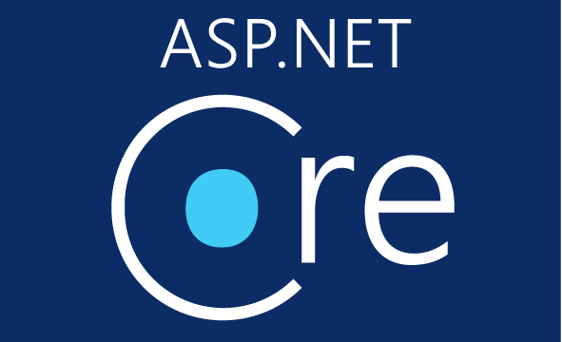
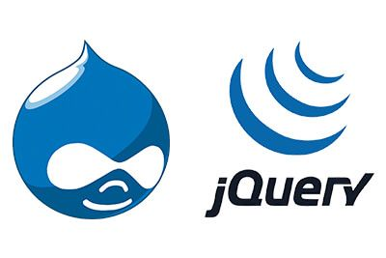
Lesson 02
.NET Core Overview
Developed by: Toan Bach Ngoc| TEDU
Website: www.tedu.com.vn

Slide 2


Slide 3
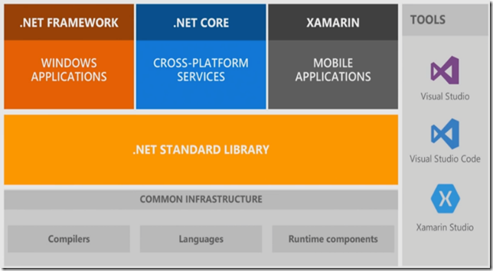
Unified Platform

Slide 4
Highlights
Runs everywhere | Runs on Windows, Linux and MacOS
Completely Open source | Libraries, compiler, languages, and tools developed in the open in GitHub. Licensing model: Source (MIT), Binary (Microsoft EULA)
Modular deployment model | Released through NuGet in smaller feature-centric packages, rather than one large assembly, that contains most of the core functionality. Only need to use the modules required by the application.
Middleware pipeline is completely pluggable and replaceable | Dependency injection is built from base to framework. Logging infrastructure is pluggable right from base, i.e. booting, to API level.
Faster and Secure applications | Having a smaller app surface area enables tighter security and improved performance. Benchmarks performed by TechEmpower shows that .NET core performs much faster than Node.js and GO.

Slide 5
Supported Application Models
Currently .NET Core supports the following application models including Console Applications, ASP.NET Core, Class libraries, Universal Windows Applications (UWA) and Xamarin Forms.
This list will continue to grow in the future as Microsoft adds support for more application models

Slide 6
Tooling support
Command Line Interface: The .NET Core command-line interface (CLI) is a new foundational cross-platform tool for developing .NET Core applications.
Visual Studio 2017: The .NET Core tools are integrated into Visual Studio 2017 for Windows and Mac versions.

Slide 7
Deployment Model
The .NET core provides a flexible deployments model.
Framework-dependent deployment (FDD) : In Framework-dependent deployment, only the application and third-party dependencies are installed. The application depends on a system-wide version of .NET Core to be present.
Self-contained deployment (SCD): In self-contained deployment, the .NET Core version used to build the application is also deployed along with the application and third party dependencies and can run side-by-side with other versions.

Slide 8
Docker support
.NET Core supports container technologies and works well with Docker images.
The developer image is ideal for fast iterations through code changes and to debug the changes.
Build image is meant to be used in continuous integration/ build environments including compiler and any other dependencies to optimize the binaries
Production image is a small image for fast deployment and startup time.

Slide 9
References
Documentation: http://docs.dot.net
.NET Core: https://www.microsoft.com/net/core
Introducing .NET Core: https://blogs.msdn.microsoft.com/dotnet/2014/12/04/introducing-net-core/
.NET Standard Library: https://github.com/dotnet/standard
.NET Core framework source code: https://github.com/dotnet/corefx/tree/master/src
ASP.NET Core benchmarks: https://github.com/aspnet/benchmarks
.NET Core Docker image: https://hub.docker.com/r/microsoft/dotnet/

