Slide 1



Lesson 4
MVC Architecture
Developed by: Toan Bach Ngoc| TEDU
Website: www.tedu.com.vn

Slide 2
MVC Architecture
The MVC architectural pattern has existed for a long time in software engineering.
MVC stands for Model, View and Controller. MVC separates application into three components - Model, View and Controller.

Slide 3
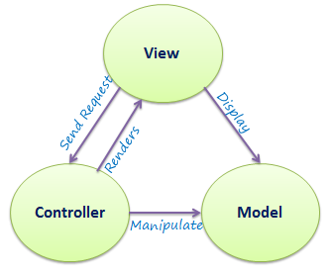
MVC Architecture
The following figure illustrates the interaction between Model, View and Controller.

Slide 4
MVC Architecture
Model: Model represents shape of the data and business logic. It maintains the data of the application. Model objects retrieve and store model state in a database.
Model is a data and business logic.
View: View is a user interface. View display data using model to the user and also enables them to modify the data.
View is a User Interface.
Controller: Controller handles the user request. Typically, user interact with View, which in-tern raises appropriate URL request, this request will be handled by a controller. The controller renders the appropriate view with the model data as a response.
Controller is a request handler.

Slide 5
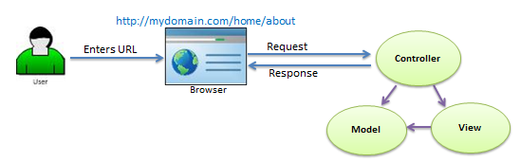
MVC Architecture
The following figure illustrates the flow of the user's request in ASP.NET MVC.

