Slide 1



Extension 01
Common issues fix &
Architecture explainnation
Developed by: Toan Bach Ngoc| TEDU
Website: www.tedu.com.vn

Slide 2
Some important notes
Link template for shop: at slide lesson 10
Please join group and post questions instead of private messages.
Please put hashtag to each question
Search and read error message before ask.
Learn coding idea better than how to use language.

Slide 3
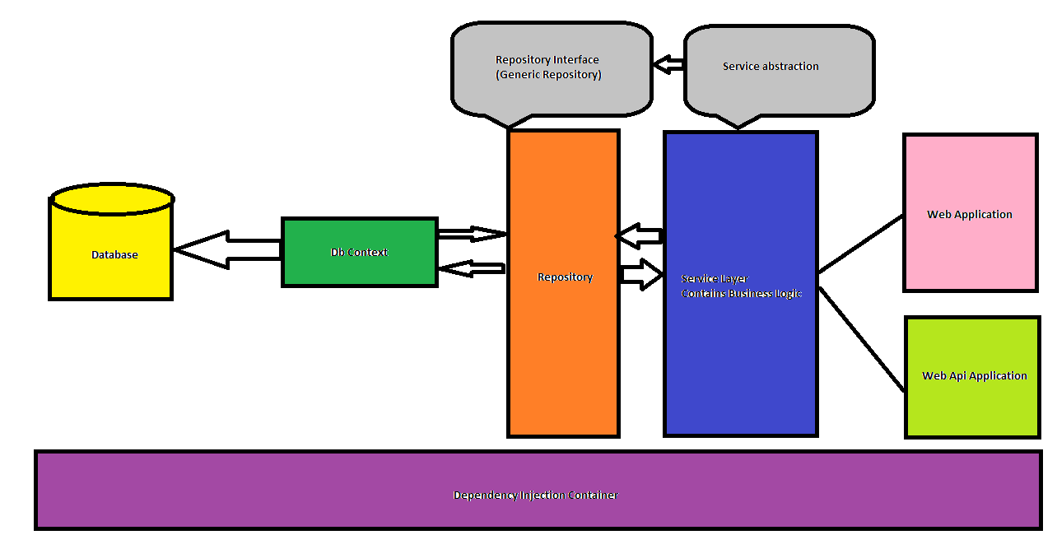
Architecture

Slide 4
Some common issues
Migration issue
Seeding issues
Debug javascript
Upload image in ckeditor
Load detail product admin
Treeview drag and drop
Login form
Parentid load

Slide 5
Improvement
Generic repository
AsNoTracking for select only
Rewrite for alias only
Link download project template in slide lesson 10
Create bower.json
Create hastag when post question

