Slide 1



Lesson 8
Introduction ASP.NET
Identity
Developed by: Toan Bach Ngoc| TEDU
Website: www.tedu.com.vn

Slide 2
Overview
ASP.NET Core Identity is a membership system which allows you to add login functionality to your application.
Users can create an account and login with a user name and password or they can use an external login provider such as Facebook, Google, Microsoft Account, Twitter or others.
You can configure ASP.NET Core Identity to use a SQL Server database to store user names, passwords, and profile data.
Alternatively, you can use your own persistent store, for example Azure Table Storage.

Slide 3
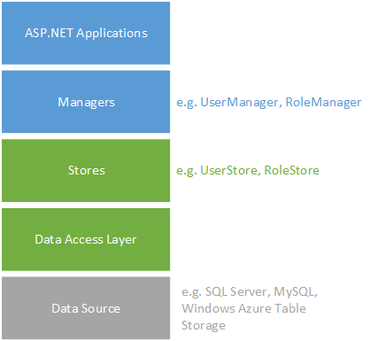
Architect

Slide 4
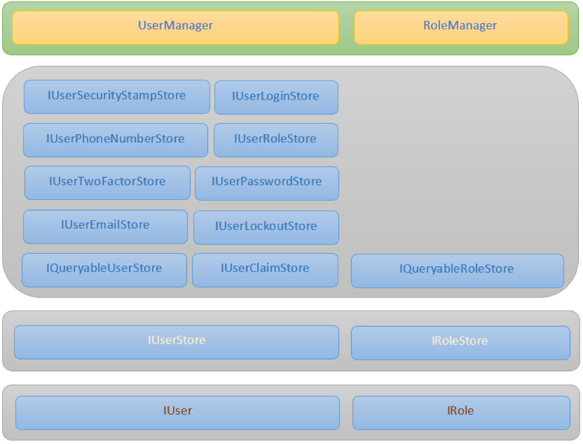
Libraries

