Slide 1



Lesson 9
Security concepts
in ASP.NET Core
Developed by: Toan Bach Ngoc| TEDU
Website: www.tedu.com.vn

Slide 2
Overview
Security Misconfiguration (Error Handling Must Setup Custom Error Page)
Cross-Site Request Forgery (CSRF)
Cross-Site Scripting (XSS) attacks
Malicious File Upload.
Version Discloser
SQL Injection Attack.
Sensitive Data Exposure
Audit trail
Broken authentication and session management
Invalidated Redirects and Forwards

Slide 3
Some common risks
Cross-Site Request Forgery (CSRF)
Cross-Site Scripting (XSS) attacks
Invalidated Redirects and Forwards
Malicious File Upload.

Slide 4
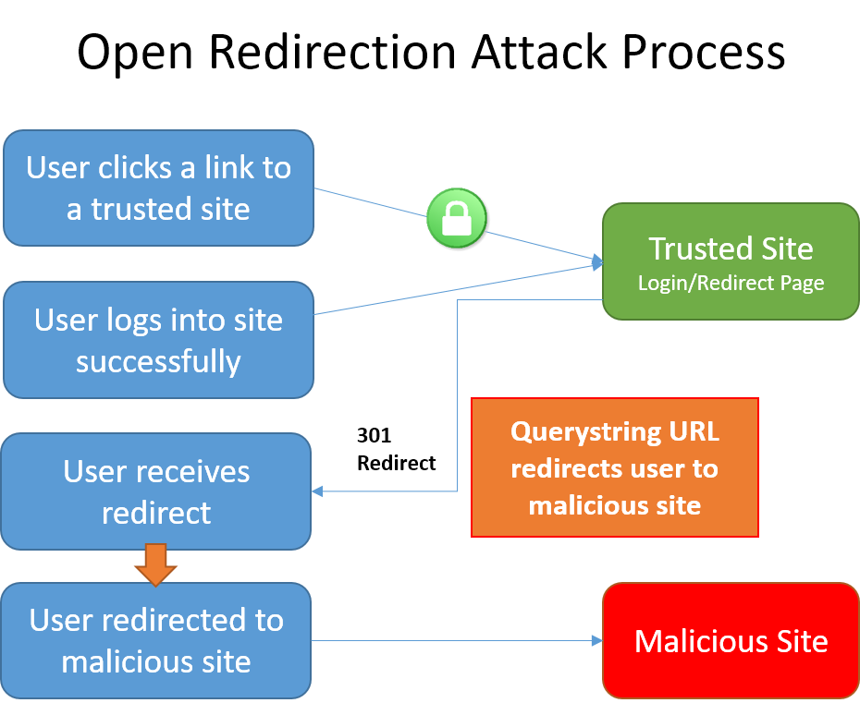
Open Redirection Attack Process

Slide 5
References
https://docs.microsoft.com/en-us/aspnet/core/security/

