Slide 1
Building Cross-platform Sales Applications
Student: Nguyen Ha Hai Dang – 20IT091
Le Van Nhat – 20IT168
Instructors: MSc. Nguyen Ngoc Huyen Tran

Slide 2
– Table of contents –
01
02
Introduction of the topic
Supported Languages
03
04
Result
Demo App

Slide 3
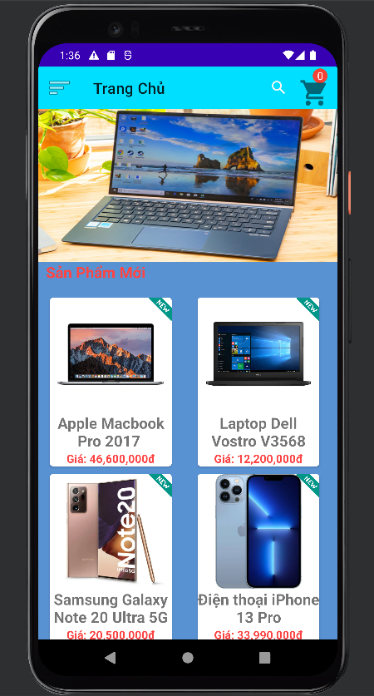
01
Introduction of the topic

Slide 4
Introduction of the topic
Information technology is developing strongly, leading to the development of e-commerce
The impact of the covid 19 epidemic. So buying and selling phones and computers online is a safe solution

Slide 5
02
Supported Languages

Slide 6
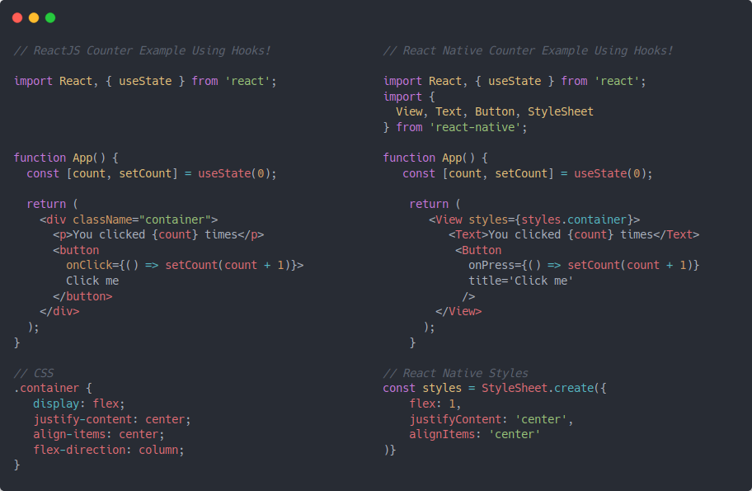

Supported Languages
React Native

Slide 7


– Supported Languages–

Slide 8
03
Result

Slide 9
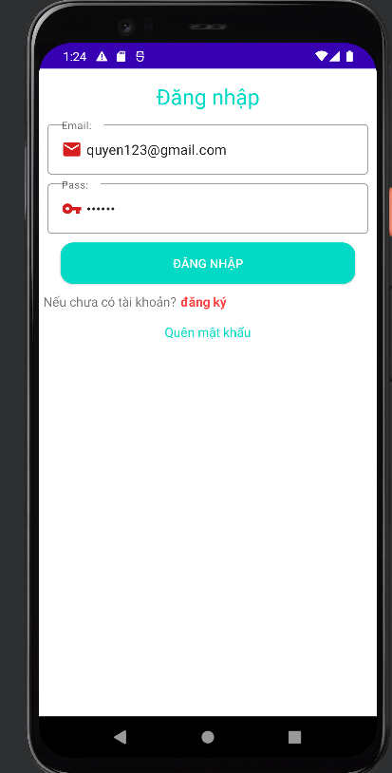
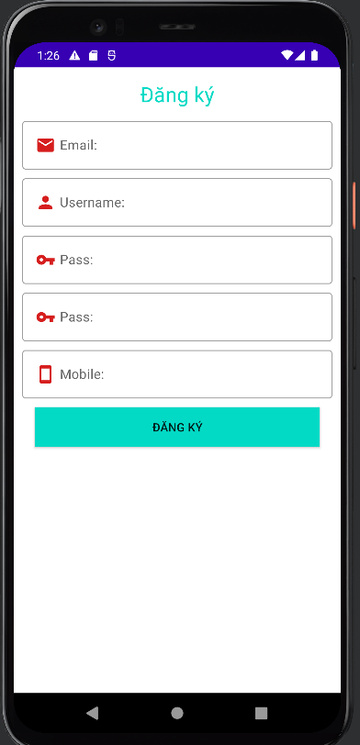
Login and registration interfaces

Slide 10
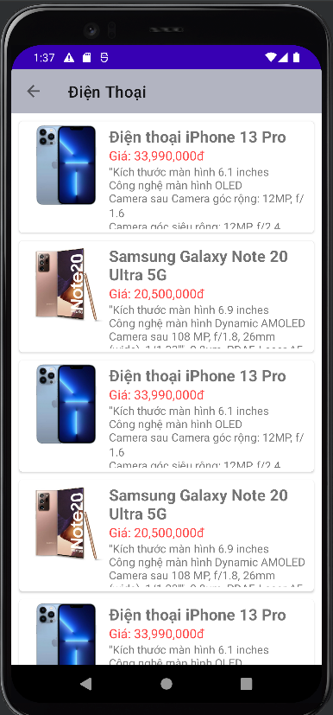
Home interface

Slide 11
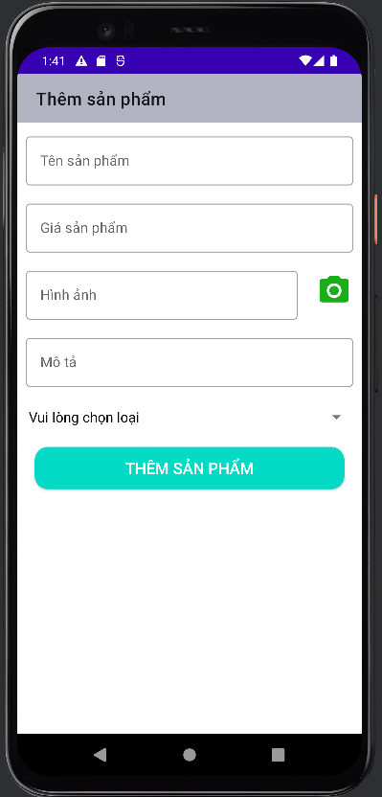
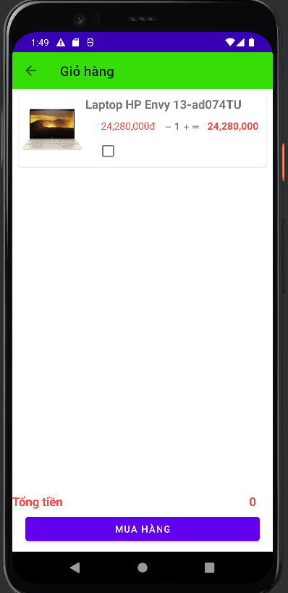
Interface add product editing

Slide 12
Demo App

