Slide 1
LLM ENGINEERING
Agentic Dependency Parsing
in Low-Resource Settings
Jan Raring, Dang Nhat Quang, Nikhila Gadge, Han Dai

Slide 2
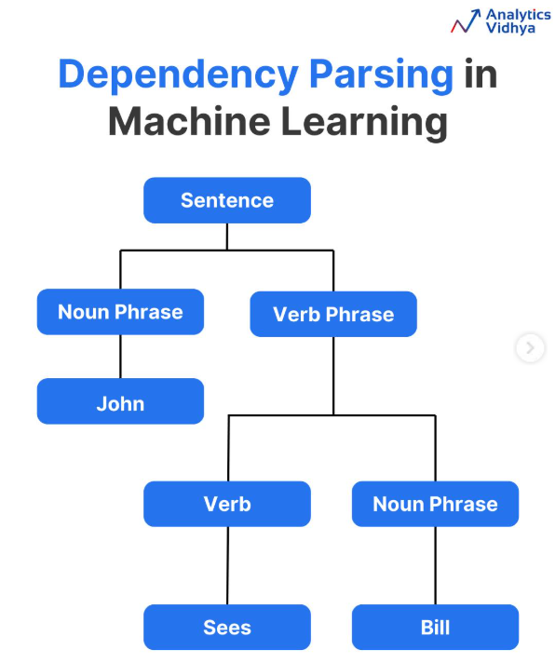
Introduction
What is & Why should we care?
What are dependency Trees
Dependency parsing builds a tree structure for a sentence
Resolves ambiguities in language processing
It shows how words are syntactically related by connecting each word to its head `
Applications:
machine translation
Sentiment Analysis
information extraction
Supports complex Applications: Q-A & Voice recognition systems
img source: https://www.instagram.com/analytics_vidhya/

Slide 3
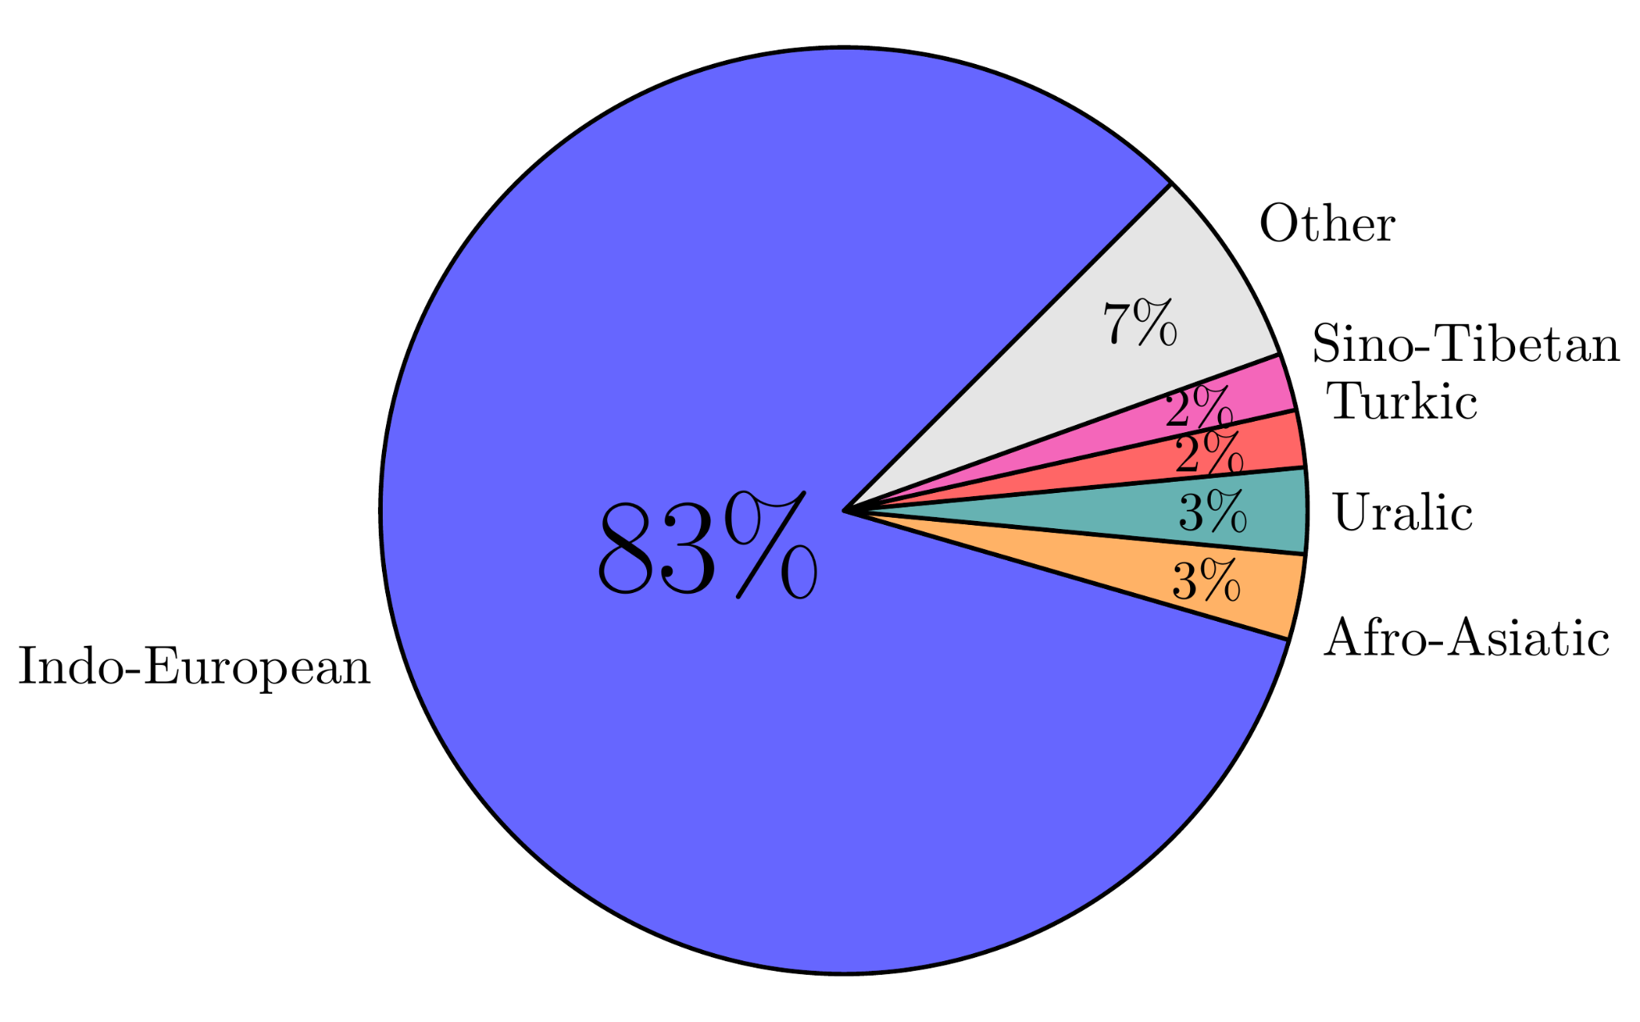
Introduction
The Bottleneck of Syntax Research
Treebanks are essential, but building them is extremely EXPENSIVE!!
Dependency parsing builds a tree of head–dependent relations for every sentence, forming the indispensable backbone of syntax, grammar, and typology research
The Dilemma:
Manual annotation of syntax trees is slow.
While high-resource languages leverage semi-automatic annotation tools, low-resource languages are left with nothing but raw manual labor
img source: universaldependencies.org

Slide 4
Introduction
The Resource Gap in Modern NLP
High-Resource Languages
Low-Resource Languages
Ready-to-use Tools:
Stanza, spaCy, and NLTK provide highly robust pre-trained supervised parsers
Plentiful Data:
Thousands of sentences of gold-standard labeled treebanks already exist
Accelerated Growth:
Pre-annotation speeds up further scaling effortlessly
No Existing Parsers:
0 trained parsers exist for minor or regional dialects
Expert Bottleneck:
Treebank construction relies completely on slow, expert linguistic labor
Our Idea:
Skip training purpose-built neural nets entirely.
Can we equip a general-purpose LLM with the right tools to parse directly?

Slide 5
Introduction
Research Questions
Can an LLM agent, equipped with adequate tools, function as a general-purpose dependency parser a.k.a. eliminating the need to train purpose-built neural networks for every new language?
If the agent's tools (validity checking, retrieval, morphology, valency) generalize across languages, the same recipe could bootstrap treebanks anywhere UD-style data is scarce

Slide 6
Introduction
Related Work
Neural dependency parsers
Stanza, spaCy, and NLTK train supervised models per language, accurate, but only where labeled treebanks already exist
Cross-lingual transfer
García-Ferrero transfers parsing knowledge from high to low-resource languages via shared representations, without training data in the target language
Our gap to fill
No prior work tests whether an off-the-shelf LLM agent with retrieval, validity-checking, and lexical tools, and whether they can parse a language directly, with zero trained parser

Slide 7
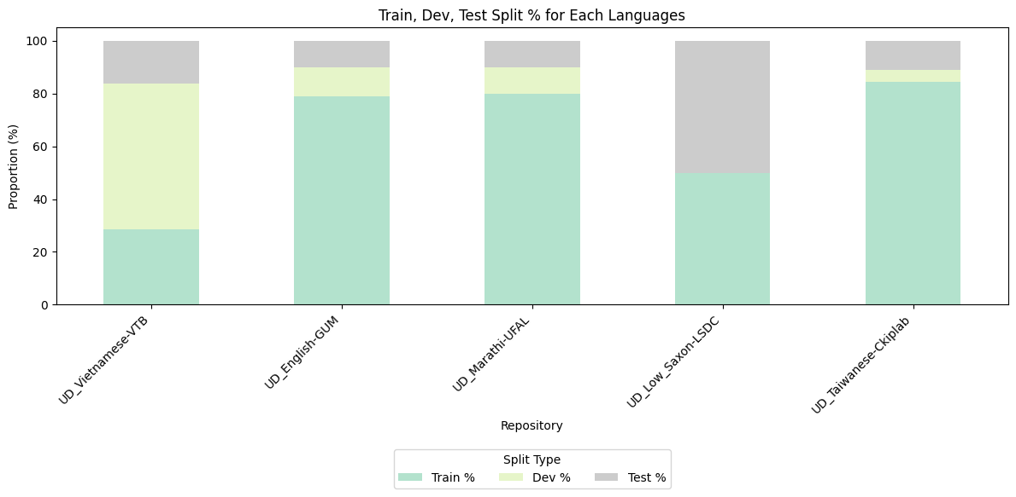
Data & Experiment
Languages
5 Universal Dependencies treebanks:
Low Saxon
Marathi
Vietnamese
Taiwanese
English

Slide 8
Data & Experiment
Project Pipeline
0
Data Audit
1
Baselines
2
Agentic Parsing
Download & verify 4-5 UD treebanks, count sentences/tokens, and measure non-projectivity rates
Direct prompting
No tools
Measure UAS and parsing success
Build the tool-calling harness:
🛠️ Morphology lookup
🛠️ Sentence retrieval
🛠️ BoW retrieval
🛠️ Tree validation
3
Without Tools
4
Evaluation
The NLP pipeline was run without tool calling access
Unlabeled Attachment Score
Parsing rate
Number of tokens generated
Number of tools called per input

Slide 9
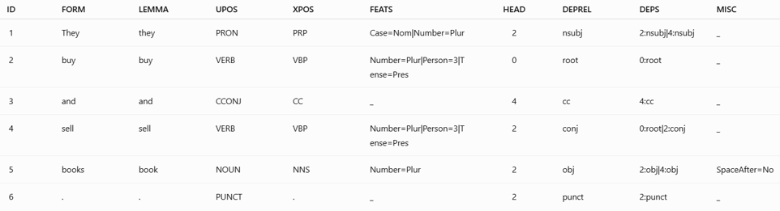
Data & Experiment
Data Structure
The input: JSON array of token objects ({ID, FORM})
All linguistic annotations are removed.
Output: JSON array of token objects ({ID, HEAD})

Slide 10
Data & Experiment
Agentic Architecture
The LLM parses by calling a small set of purpose-built tools
Sentence Form/ BoW Retrieval
Surface-form / POS n-gram similarity from train data
Validity Checker
Single root, connected, acyclic, valid indices
LLM AGENT
BoW Retrieval
BoW overlap + length similarity
Morphology Lookup
Returns frequency counts of LEMMA, UPOS, FEATS for every token
Notes:
This slide shows the agentic architecture.
The language model is the central dependency parser
It can call four supporting tools when needed
Morphology lookup provides LEMMA UPOS and FEATS information
N-gram retrieval finds similar annotated sentences using FORM and POS patterns.
Bag-of-words retrieval uses word overlap and sentence-length similarity.
The validity checker detects invalid heads, cycles, connectivity problems, and multiple roots.
The tools provide evidence, while the model makes the final parsing decision.

Slide 11
Data & Experiment
LLM Models
Models
Qwen 3.5-9B
Qwen 3.5-9B-GGUF
Model Card: Qwen/Qwen3.5-9B
Quantization: BitsAndBytes 4-bit NF4
Architechture: Transformers
Hardware: NVIDIA A100 GPU
Model Card: unsloth/Qwen3.5-9B-GGUF
Quantization: GGUF Q4_K_M
Architechture: llama.cpp
Hardware: Intel Core Ultra 7 H155

Slide 12
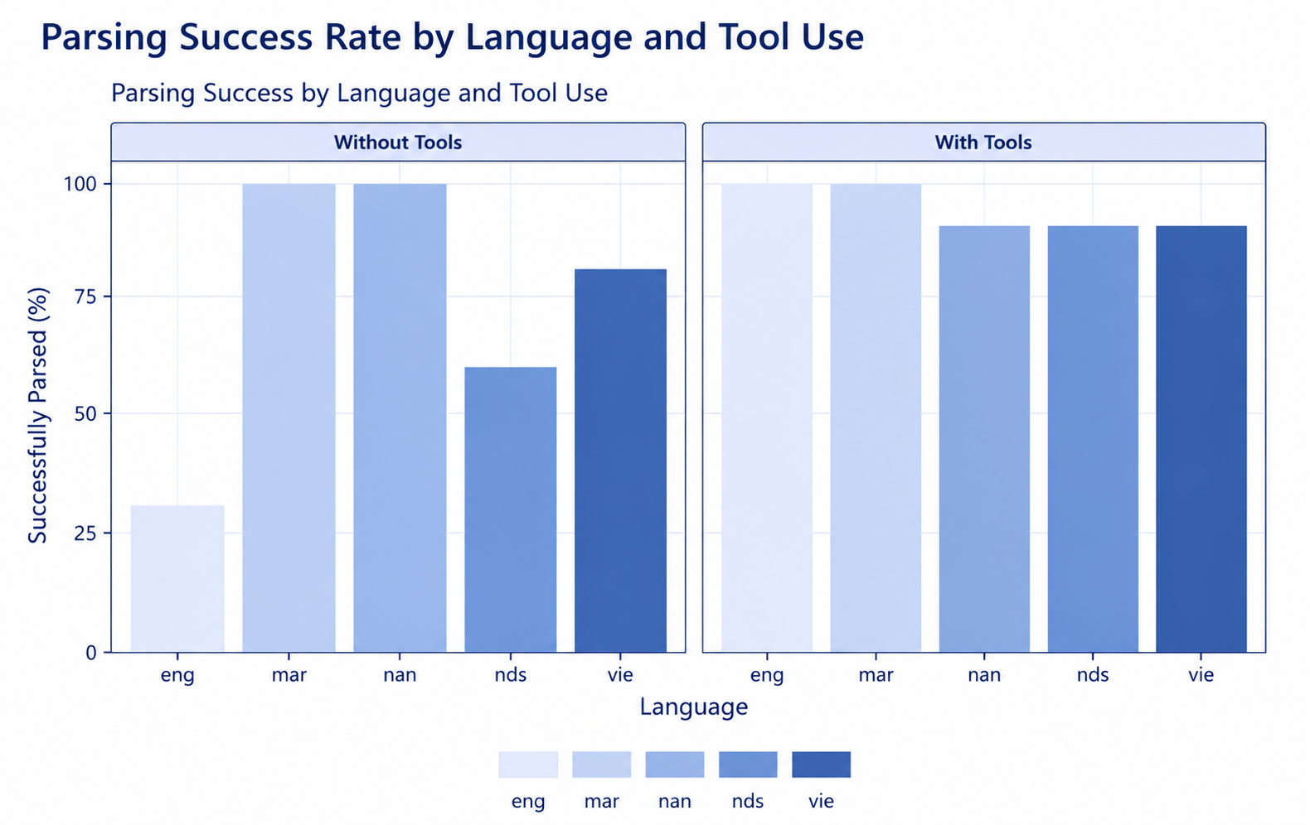
Conclusion
Results
Tools turn scarce evidence into structured support
On an average the tools support increased the Unlabeled Attachment Score by +3%
On an average the Parsing success improved with the tools
English benefited the most with +15% UAS score increase
img generated for reference

Slide 13
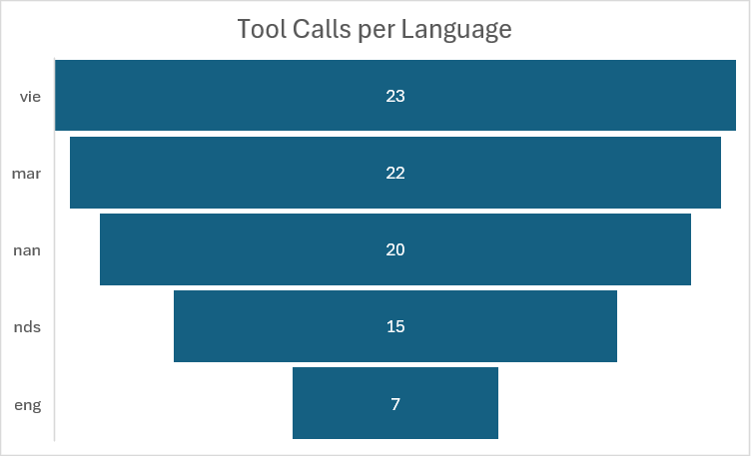
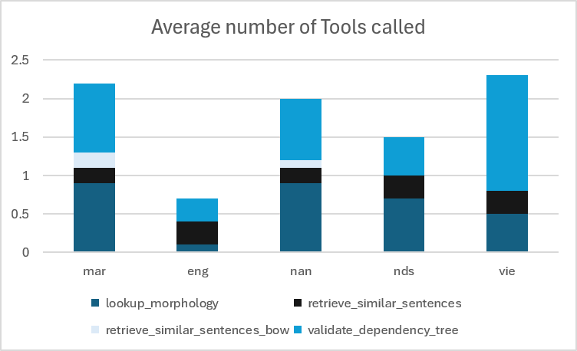
Methodology
Results
Most tools were called for Vietnamese while English called the least number of tools
Validate Dependencies tool was called the most number of times
Morphology Statistics was called the most for lower resource languages
img generated for reference

Slide 14
Discussion
Conclusion
On average, having tools at its disposal, the model used much fewer tokens to give a final output, thereby increasing the chance of producing any output at all.
The downside to the faster output generation seems to be increased sloppiness when it comes to generating structurally valid trees.
Considering English and Low Saxon, seemingly contradictory to the above observations, it looks like having the option to use auxiliary tools noticeably increased the accuracy on longer, more complicated sentences.
img generated for reference

Slide 15
Discussion
Limitations and Future Scope
Ablation Experiment could be conducted to know the performance and preference of tools individually
Experimentation with more tools and models with greater multilingual support
Prompt Engineering and Hyperparameters adjustment like Temperature, Top_p, max_new_tokens
img generated for reference

Slide 16
Thank you for your attention
Questions & discussion welcome

