Slide 1
Speech Acts and Politeness Strategies in Customer Service Chatbots
Research Project 1
Dang Nhat Quang

Slide 2
What does “speech acts” mean here?
A speech act is an utterance considered as an action, such as promising, questioning, or apologizing, and is used to perform a function in communication, not just to say something.
Actions we perform through language (not just words).
Examples: apologizing, requesting, refusing, thanking. Each message has an intended action (illocution) that affects the listener.

Slide 3
What does “polite” mean here?
What is “face”? According to Brown and Levinson, face is a person’s social self-image:
Positive face: the desire to feel valued, acknowledged, and respected
Negative face: the desire to have autonomy and not be pressured
What is “politeness”?
Politeness is the set of language strategies used to protect these two needs—by showing empathy, apologizing when necessary, using softeners, and giving guidance in a non-imposing way. This reduces face-threat and maintains cooperation.

Slide 4
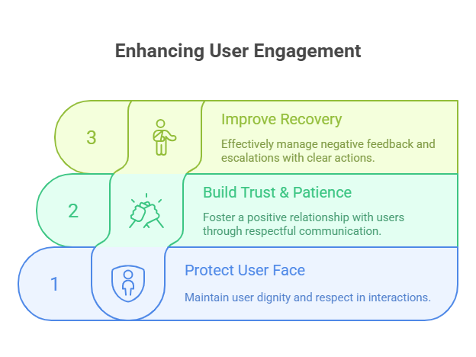
“Why Should a Customer Service Chatbot Be Polite?”
“$75 billion lost per year due to poor customer service - much of it from robotic, impolite chatbot AI.” (Source: Glance/Accenture)
Protects the user’s “face” (Brown & Levinson) by softening refusals, limits, and corrections
Builds trust and patience in the interaction
Keeps users engaged longer -> increases willingness to follow instructions
Improves recovery after bad news: brief apology + clear next step reduces frustration and escalation
“Even a simple apology can reduce customer churn by up to 67%.” (Source: Glance/Accenture)

Slide 5
Project aims
What is this project about?
Compare linguistic strategies (apologies, hedging, empathy, tone) between two chatbots
Determine whether these linguistic choices enhance users’ satisfaction, clarity, and cooperation.

Slide 6
Methodology
Question: Do replies from Chatbot A and Chatbot B differ in perceived:
Politeness (PI), Satisfaction (CSAT), Helpfulness/Clarity (HL), and Compliance (CMP)?
Design:
Matched-pair comparison within the same prompt; brand identities masked;
Presentation order ignored by design to isolate content effects. In short, 30 identical prompts will be used across 2 bots, combined 60 prompts as the result.

Slide 7
Methodology
Survey (measurement):
A short, anonymized survey gathers 1–5 human ratings on the four outcomes. Each reply is rated by multiple people; scores are averaged to improve stability and reduce noise.
Theory & tags:
Guided by Brown & Levinson’s politeness theory, each reply is assigned one rule-based tag that captures its main politeness strategy:
Empathy/Gratitude, Apology, Positive Flexibility, Mitigation/Hedging, Refusal-Minus, with General as the fallback category.

Slide 8



Working tools
Primary workspaces: JupyterLab + Python for cleaning, preprocessing, and analysis; Label Studio for rule-based tagging and QC.

Slide 9
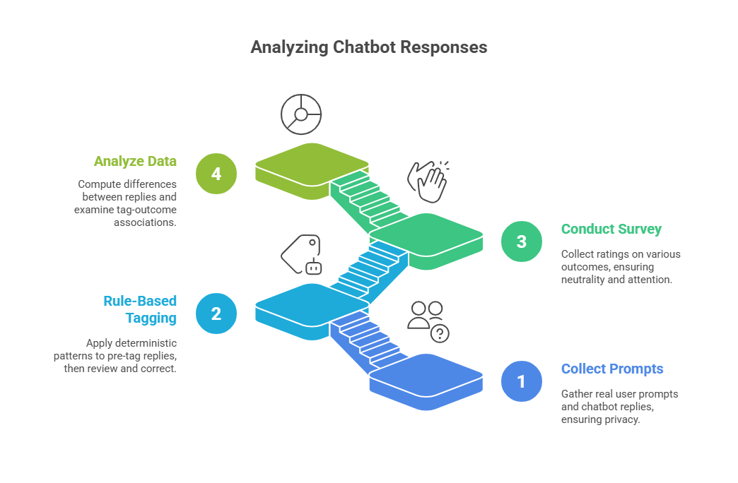
Annotation Workflow

Slide 10
1. Collect & Prepare (Prompts -> Reply Pairs)
Scope prepared:
60 prompts gathered; each has two masked replies -> 120 reply texts total Cleaning & pairing: Text normalized and deduplicated; every prompt kept with exactly two replies (no mismatches).
Identification for joins: Each item carries a prompt code plus a simple chatbot label (used later to link tags ↔ ratings).

Slide 11
1. Collect & Prepare (Prompts -> Reply Pairs)
Task build (workspace): 120 reply-level tasks created in Label Studio (prompt + one reply per task).
Pre-tag setup:
Rule-based Tagbook v1.1 loaded for deterministic pre-tags; quick human review to confirm coverage. (Shadish, Cook, & Campbell, 2002).
Primary tools: JupyterLab for text cleaning/QA; Label Studio for task review.

Slide 12
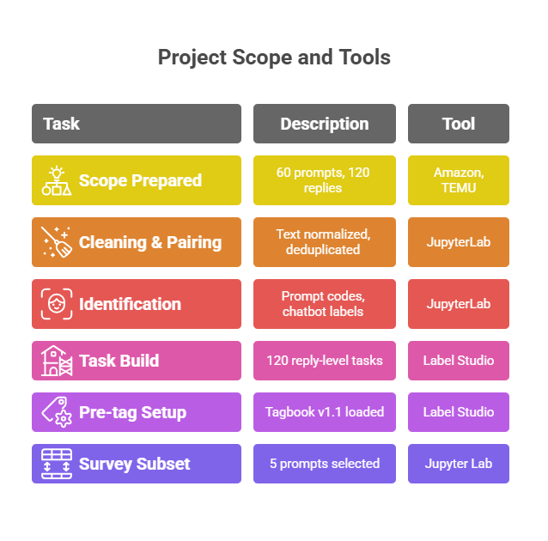
Collect & Prepare

Slide 13
2. Tag Setup and rule-based tagging
What tags are: Short labels (T01–T06) that describe the type of politeness strategy in a reply (e.g., Empathy, Apology, Hedging, Refusal).
Why we need them: Tags turn the reply’s wording into structured data, so we can compare replies using statistics instead of opinions.
What they help us do: By linking each tag to human ratings, we can see which strategies are associated with higher or lower politeness.
This shows patterns, but not causation.

Slide 14
2. Tag Setup and rule-based tagging
What gets tagged: Each reply receives one label that best describes its wording:
Empathy/Gratitude (shows care/thanks),
Apology (clear sorry),
Positive-Flexibility (offers options/next step),
Mitigation/Hedging (softens with “might/usually/if possible”),
Refusal-Minus (plain no/policy block)
General (none of the above). (Brown & Levinson, 1987).

Slide 15
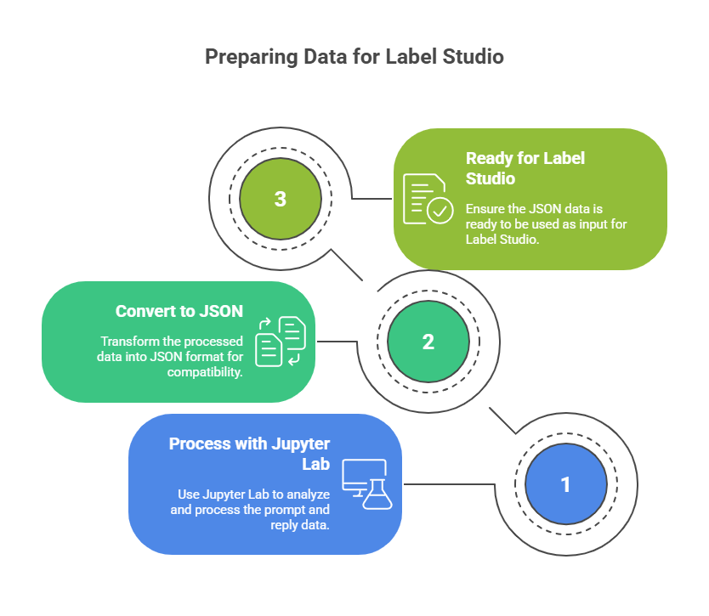
Tag Setup -> Label Studio (Prediction -> Final Tags)
How the rules are built (in JupyterLab): I turn the theory into simple pattern rules and make a rule tag book.
Automatic prediction Label Studio: With the prompt and reply csv and the rule tag book, I can process with Jupyter lab to turn them into a JSON file ready as an input for Label Studio.
Quality check and handoff

Slide 16
3. Ratings Survey: outcomes, setup, and data
How many prompts? 5 selected prompts (from a pool of 60)
What participants saw: Each prompt showed two masked replies -> one from Chatbot A, one from Chatbot B
What they rated: 4 items per reply (PI, CSAT, HL, CMP) -> 40 total rating questions (5 × 2 × 4)
Why these 5 prompts? Chosen to cover common customer issues (damaged item, missing package, returns, address change, escalations)
Survey platform: Google Forms

Slide 17
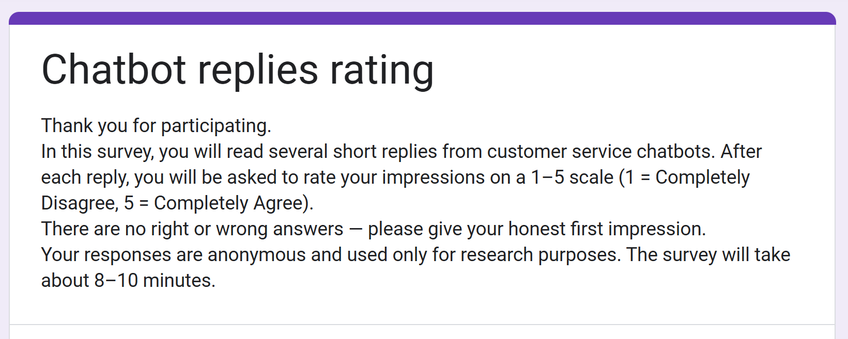
3. Survey
Extra item: “Is English your first language?” (Yes/No). Why include it: to check for possible perception bias (e.g., different use of the 1–5 scale or different sensitivity to tone). It is not used to change scores; it supports subgroup or robustness checks only.

Slide 18
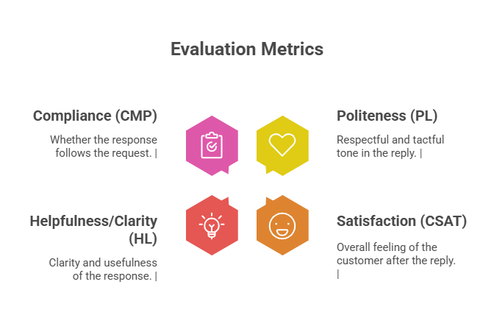
Expected grade outcomes
PI – Politeness How respectful, tactful, and face-saving the reply sounds.
CSAT – Satisfaction How satisfied the reader feels after reading the reply.
HL – Helpfulness / Clarity How clear, informative, and actionable the reply is.
CMP – Compliance Intention How likely the reader is to follow the instructions in the reply.
Quality note: Sometimes a reverse-coded item (“The reply feels curt or blaming”) replaces the politeness item to reduce bias; it still measures PI. (a score of 5 becomes 1, and a score of 1 becomes 5.)
References: Brown & Levinson (1987); Parasuraman, Zeithaml, & Berry (1988); ISO 9241-11 (2018); Likert (1932); Oliver (1997).

Slide 19
Tag and survey used
Before the survey: I select prompts that naturally trigger different strategies (e.g., apology, empathy, refusal, hedging).
During the survey: Tags are not shown to participants and not used to calculate scores.
After the survey: I link each reply’s tag with its PI/CSAT/HL/CMP scores to see:
which strategies are linked to higher politeness or satisfaction
which strategies lower clarity or satisfaction
what patterns can become practical writing rules

Slide 20
4. Survey to Data Assets
What I get from the survey: A table of numeric ratings for every reply:
PI
CSAT
HL
CMP
Each rating is linked to:
the participant
the prompt
whether it was Reply A or Reply B
What I add next: I join these scores with:
the reply text
the politeness tag (T01–T06)
any reverse-coded items
attention-check status

Slide 21
Preprocess aggregate example (chatbot amazon participant 17)
participant | reply (Prompt_ID+cond) | construct | score
U17 | P07_A | PI | (4+5)/2 = 4.5
U17 | P07_A | CSAT | 3.0
U17 | P07_A | HL | 4.0
U17 | P07_A | CMP | 2.0
Some prompt reply showed both PI and CSAT

Slide 22
Analysis Overview (What I Do With the Data)
Pair A vs B for each person For every prompt, I subtract A from B -> Delta Δ = B – A. This removes individual rating habits (some people give 5s to everything, some are strict).
Summarize the results
Average Δ across all participants
95% confidence interval
Effect size (how big the difference is)
Check individual prompts See which prompts show the strongest A–B differences.
Check tag associations Compare ratings for replies with a tag vs without that tag (e.g., Does Apology give higher PI?)

Slide 23
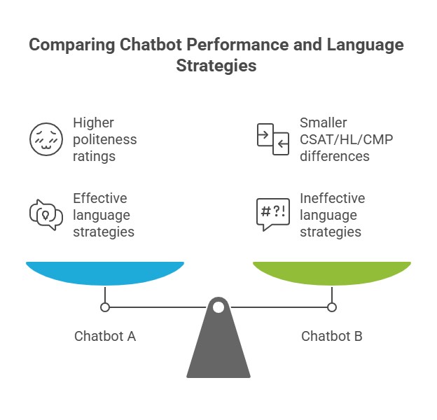
Analysis
Interpreting Δ (B – A):
Δ > 0 -> Chatbot B scored higher
Δ < 0 -> Chatbot A scored higher
Confidence interval includes 0 No reliable difference between A and B
Interpreting tag patterns: Tags show which politeness strategies are linked to higher or lower PI / CSAT / HL / CMP scores. (These patterns show association, not causation.)

Slide 24
Why do we check correlation between tags and ratings?
Because this project is not only comparing Chatbot A vs B, but also trying to understand WHY one reply feels more polite than another.
In order to answer these questions:
Do these strategies actually matter for human perception? Which strategies increase politeness? Which strategies decrease satisfaction or clarity?
Without this step, you only know:
“Chatbot A is more/less polite.”
But you don’t know why.

Slide 25
Correlation Between Tags & Ratings
Join the data Match each reply’s tag (T01–T06) with its PI/CSAT/HL/CMP scores.
Split into two groups Replies with the tag Replies without the tag
Compare the averages If the “with-tag” group has higher PI/CSAT/HL/CMP -> the tag is positively associated with good ratings.
Calculate a simple effect size to show how strong the difference is.
This shows association, not causation.

Slide 26
Challenges Expected
Theoretical
Construct validity & confounds
Politeness may overlap with tone, length, or difficulty
Some items may unintentionally touch multiple constructs
Mitigation: length-match replies (±15%), fix the item -> Make sure Chatbot A and Chatbot B replies for the same prompt are roughly the same length, so that length does not unfairly influence ratings of politeness or clarity.
Associational (not causal) tag effects
Tags can co-vary with prompt content, which inflates correlations
Mitigation: treat tag effects as correlational, report CIs, and check robustness with/without certain prompts.

Slide 27
Challenges Expected
Technical
Mapping layer
Risks: column mismatches, ID inconsistencies, construct-map errors
Fix: alias map, normalized IDs, versioned construct map, strict referential checks
Tagging engine
Risks: false Apology hits, hedge/general confusion
Fix: apply Tagbook v1.1 with negation window + precedence; validate with tests and audit logs. Also Tag book – rules have to be strictly controlled by me and follow strict academic theories.

Slide 28
Literature RevieId and Applied
Brown & Levinson (1987): Politeness: Some Universals in Language UsageFoundational framework for analyzing linguistic politeness strategies in human and chatbot interactions.
Pagidyala, S. (2023): Key Lessons from Amazon’s Customer Service Chatbot RufusInsights into Amazon's chatbot design priorities and customer interaction strategies.
Cleverence: How Shopify and Amazon Use AI-PoIred Chatbots to Improve Customer ServiceIndustry perspectives on AI chatbot deployment and response strategies.
Quidget.ai: 7 Challenges of Chatbot Integration and SolutionsDiscussion on technical and human-centered challenges in chatbot systems.
Glance & Accenture: The PoIr of Empathy in Customer ServiceEmphasis on the role of emotional intelligence in enhancing digital service experiences.

Slide 29
References data and code libraries
pandas. (n.d.). pandas.read_csv — pandas documentation. PyData. https://pandas.pydata.org/docs/reference/api/pandas.read_csv.html (Retrieved September 1, 2025). pandas.pydata.org
pandas. (n.d.). pandas.merge — pandas documentation. PyData. https://pandas.pydata.org/docs/reference/api/pandas.merge.html (Retrieved September 1, 2025). pandas.pydata.org
Pandera Developers. (n.d.). DataFrame Schemas — pandera documentation. Read the Docs. https://pandera.readthedocs.io/en/stable/dataframe_schemas.html (Retrieved September 1, 2025). pandera.readthedocs.io
Great Expectations. (n.d.). Great Expectations documentation. https://docs.greatexpectations.io/docs/home/ (Retrieved September 1, 2025). docs.greatexpectations.io
SciPy. (n.d.). ttest_ind — SciPy v1.16.1 Manual. https://docs.scipy.org/doc/scipy/reference/generated/scipy.stats.ttest_ind.html (Retrieved September 1, 2025). docs.scipy.org
statsmodels. (n.d.). statsmodels.stats.multitest.multipletests. https://www.statsmodels.org/dev/generated/statsmodels.stats.multitest.multipletests.html (Retrieved September 1, 2025). statsmodels.org
Benjamini, Y., & Hochberg, Y. (1995). Controlling the false discovery rate: A practical and powerful approach to multiple testing. Journal of the Royal Statistical Society: Series B, 57(1), 289–300. https://doi.org/10.1111/j.2517-6161.1995.tb02031.x rss.onlinelibrary.wiley.com
Pingouin Developers. (n.d.). compute_effsize — Pingouin 0.5.5 documentation. https://pingouin-stats.org/build/html/generated/pingouin.compute_effsize.html (Retrieved September 1, 2025). pingouin-stats.org
Python Software Foundation. (n.d.). Regular Expression HOWTO. https://docs.python.org/3/howto/regex.html (Retrieved September 1, 2025). Python documentation
pytest-dev. (n.d.). @pytest.mark.parametrize: Parametrizing test functions. https://docs.pytest.org/en/stable/how-to/parametrize.html (Retrieved September 1, 2025). docs.pytest.org
Hypothesis. (n.d.). Hypothesis documentation. https://hypothesis.readthedocs.io/ (Retrieved September 1, 2025). hypothesis.readthedocs.io
Black maintainers. (n.d.). Black: The uncompromising code formatter. https://black.readthedocs.io/ (Retrieved September 1, 2025). black.readthedocs.io
Astral. (n.d.). Ruff — Astral docs. https://docs.astral.sh/ruff/ (Retrieved September 1, 2025)

Slide 30
Research Timeline & Milestones
May – December 2025 Research 1
 | Timeframe | Key Tasks | What I Will Do | Expected Output
Set up | May - June 2025 | Design & Planning | Finalize topic, framework, tagset, survey draft | Theory slides + 2-page methods memo
Annotation | July 2025 | Data Labeling | Freeze Tagbook v1.1 (T01–T06) | Tagbook slide + exemplar sheet
Pilot & Ratings Prep | August 2025 | Tag book & Annotation | Annotate a small subset; build construct scores. | Methodology slide + one pilot table
Methodology | September 2025 | Pilot & Ratings Prep | Join tags & ratings on (Prompt_Id + condition); | Completed reply_tags.csv + audit notes
Full Annotation | October 2025 | Collect User Ratings | Apply rules to all replies; QA edge cases | Analysis tables + simple figures
Analysis | Late Oct / Late Nov 2025 | Data Analysis | Compare tags + calculate. Summary result. | Presented deck + feedback action list
Finalization | Dec 2025 - February 2026 | Writing & Presentation | Robustness checks; revise visuals; draft short interim report | Interim report + slide deck v1 (Dec)
Schlusszeile | Project Design | Annotation & Survey | Data analysis | Finalization

Slide 31
Thank you for your attention
All Questions are Ilcome
Nhat.Dang@edu.ruhr-uni-bochum.de

