Slide 1
Vietnamese Lexical
Decision Task
Dang Nhat Quang
Supervisor: Prof. Dr. Tibor Kiss
12 June 2026
Notes:
Open by framing the project as a controlled lexical-decision study in Vietnamese. Emphasize that the talk focuses on the full research process, especially methodology and QC, not only on results.

Slide 2
02 | RESEARCH STORY
The talk follows the project from linguistic motivation to cautious preliminary results.
.
.
.
.
Background
Problem
Design
Pipeline
Vietnamese writing and spacing
→
syllables are spaced, lexical words may be multi-syllabic
→
3 x 4 within-participant lexical decision
→
PsychoPy/Pavlovia, Python/pandas, R Markdown
.
.
.
QC
Results
Next steps
participant, item, trial, RT, response checks
→
frequency, length, interaction, diagnostics
→
limitations and six-month plan
Aim for the presentation: show that the experiment is methodologically defensible, reproducible, and interpreted carefully.
Vietnamese LDT | RP2 Colloquium 2
Notes:
This slide gives the audience a map. The main story is: Vietnamese creates a real segmentation motivation, but the project narrows the question to frequency and syllable length in lexical decision.

Slide 3
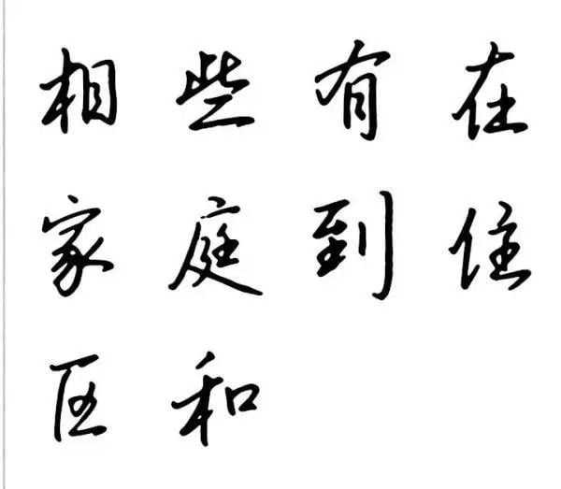
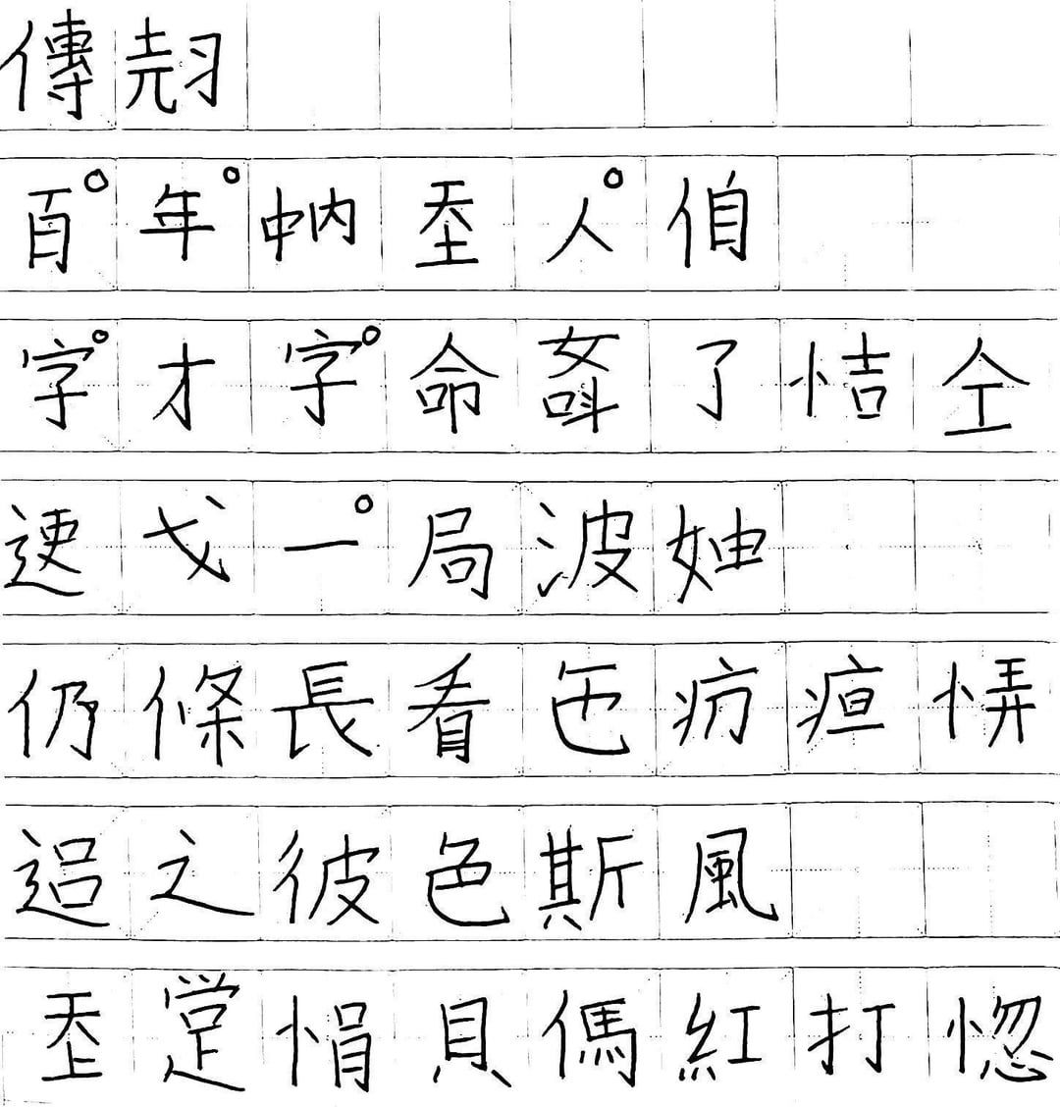
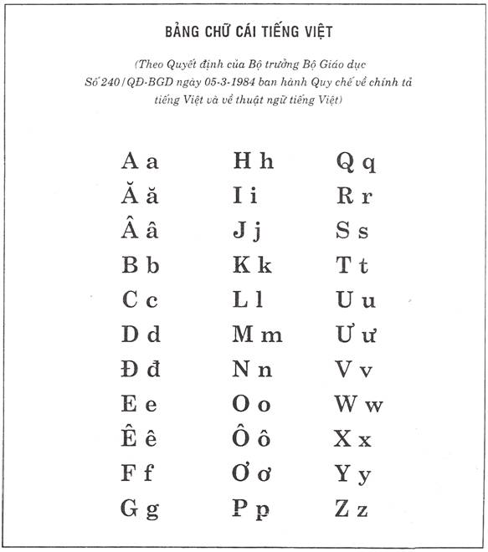
03 | BACKGROUND
Quốc ngữ is the current endpoint of a layered writing history, not a single-inventor story.
.
.
.
Chữ Hán
Chữ Nôm
Quốc ngữ
Chinese characters
administration, scholarship
→
vernacular Vietnamese
adapted/created characters
→
Latin-based Vietnamese
missionary codification, later mass adoption
.
Clarification
The modern script was shaped by several European missionaries. Portuguese Jesuits were central in early romanization; Alexandre de Rhodes published an influential Vietnamese-Portuguese-Latin dictionary in 1651. Later French colonial schooling/administration and Vietnamese print culture helped Quốc ngữ spread.
Why this matters here: the modern script is alphabetic and spaced, but spacing does not make Vietnamese word boundaries simple.
Sources: Fernandes & Assunção, 2017; DeFrancis, 1977; Encyclopaedia Britannica, 2026
Vietnamese LDT | RP2 Colloquium 2
Notes:
Answer the common question gently: it is not accurate to say that one French or Italian person created Quốc ngữ. The better version is a collaborative missionary history, with Portuguese influence and de Rhodes' 1651 publication, followed by colonial and Vietnamese adoption.

Slide 4
04 | TOKENIZATION PROBLEM
Vietnamese spaces often separate syllables, while lexical words may contain several syllables.
Example string
sinh viên học tiếng Việt
.
Key point
space ≠ lexical word boundary
This is why Vietnamese word segmentation is non-trivial for NLP and for stimulus selection.
Syllable-spaced orthography
sinh
viên
học
tiếng
Việt
Lexical-word interpretation
.
.
sinh viên
học
tiếng Việt
Sources: Ha, 2003; Đinh et al., 2008; Verdonschot et al., 2022
Vietnamese LDT | RP2 Colloquium 2
Notes:
Use the example sinh viên. Orthographically it has a space, but it is one lexical word. This motivates why syllable count and lexical-word status must be controlled rather than assumed.

Slide 5
05 | PROJECT SCOPE
The project does not solve Vietnamese tokenization; it tests frequency and syllable length in lexical decision.
.
.
.
Not the goal
Actual goal
Contribution
Build a full Vietnamese word segmenter
Resolve all lexical boundary ambiguity
Classify every possible multi-syllable string
Use a controlled lexical decision task
Manipulate frequency group and syllable length
Measure RT and accuracy
A clean psycholinguistic test case for Vietnamese visual word recognition.
Core predictor structure: frequency group (low / mid / high) x syllable length (1 / 2 / 3 / 4)
Vietnamese LDT | RP2 Colloquium 2
Notes:
This scope slide protects the project from overclaiming. The broader tokenization problem motivates the work, but the actual experiment tests frequency and syllable-length effects.

Slide 6
06 | RESEARCH QUESTION
Do frequency group and syllable length predict Vietnamese lexical-decision response times?
.
How do corpus frequency group and syllable length affect log reaction time for correct Vietnamese real-word responses?
.
.
.
H1: frequency
H2: length
H3: interaction
High-frequency words should be recognized faster than low-frequency words.
Longer syllable length should increase RT because longer words require more visual/lexical processing.
The size of the frequency effect may vary across syllable lengths.
Interpretation rule: interaction evidence will be treated as preliminary unless it is stable across diagnostics and follow-up checks.
Vietnamese LDT | RP2 Colloquium 2
Notes:
State the research question slowly. The hypotheses are directional for frequency and length, but the interaction is framed carefully as possible variation rather than a strong prediction.

Slide 7
07 | EXPERIMENTAL DESIGN
The real-word design is balanced: 3 frequency groups x 4 syllable lengths, within participant.
Frequency
1 syll.
2 syll.
3 syll.
4 syll.
.
72
real words
low
6
6
6
6
6 per real-word cell
.
mid
6
6
6
6
48
pseudowords
high
6
6
6
6
12 per length
.
120
cell value = number of real-word items
main trials
per participant
All participants see all main trials in randomized order.
Vietnamese LDT | RP2 Colloquium 2
Notes:
Explain that within participant means each participant contributes responses across all conditions. The real-word manipulation is balanced, and pseudowords are added for the lexical-decision task.

Slide 8
08 | STIMULI
Pseudowords keep the task genuinely lexical: participants must distinguish words from nonwords.
Type
Length 1
Length 2
Length 3
.
Length 4
Example real words
real words
18
18
18
18
núi
loại sản phẩm
điện thoại di động
pseudowords
12
12
12
12
total
30
30
30
30
.
Example pseudowords
bệc viện ← bệnh viện
mối quan hế ← mối quan hệ
trính độ học vấn ← trình độ học vấn
Pseudoword construction changes a syllable while keeping the item Vietnamese-like enough for the task.
tone changes
vowel changes
final-consonant changes
Vietnamese LDT | RP2 Colloquium 2
Notes:
Use one or two examples only when speaking. The point is not that pseudowords are perfect, but that they prevent participants from pressing word for everything.

Slide 9
09 | TASK PROCEDURE
The procedure is short, randomized, and keyboard-based to keep lexical decisions clean.
.
.
.
.
.
Instructions
Practice
Main task
Response
Export
F = word
J = nonword
→
4 trials
with feedback
→
120 trials
randomized
→
keyboard RT
accuracy
→
CSV files
per participant
.
Main-trial order is randomized for each participant.
Response mapping
F key: word
J key: nonword
Vietnamese LDT | RP2 Colloquium 2
Notes:
Explain the participant experience. Four practice trials come before the 120 main trials, and F/J responses allow keyboard timing without mouse movement.

Slide 10
10 | BIAS CONTROLS
The design reduces common task artifacts and monitors the ones it cannot remove.
.
.
Potential issue
Control / monitoring
.
.
Practice / learning
Practice trials before the main task; randomized main trials.
.
.
Response bias
Pseudowords require word/nonword discrimination; QC checks one-key overuse.
.
.
Key / side bias
F/J supports balanced keyboard responding, but does not fully eliminate side bias.
.
.
Fatigue / automatic pressing
Monitor accuracy, missing RTs, unusually fast RTs, and one-key patterns.
Important wording: F/J helps reduce motor-response delay and makes responses more balanced; it does not completely remove bias.
Vietnamese LDT | RP2 Colloquium 2
Notes:
This is a defensibility slide. Avoid saying that F and J solve bias. The stronger claim is that the setup reduces motor delay and makes the response layout balanced, while QC monitors behavior.

Slide 11
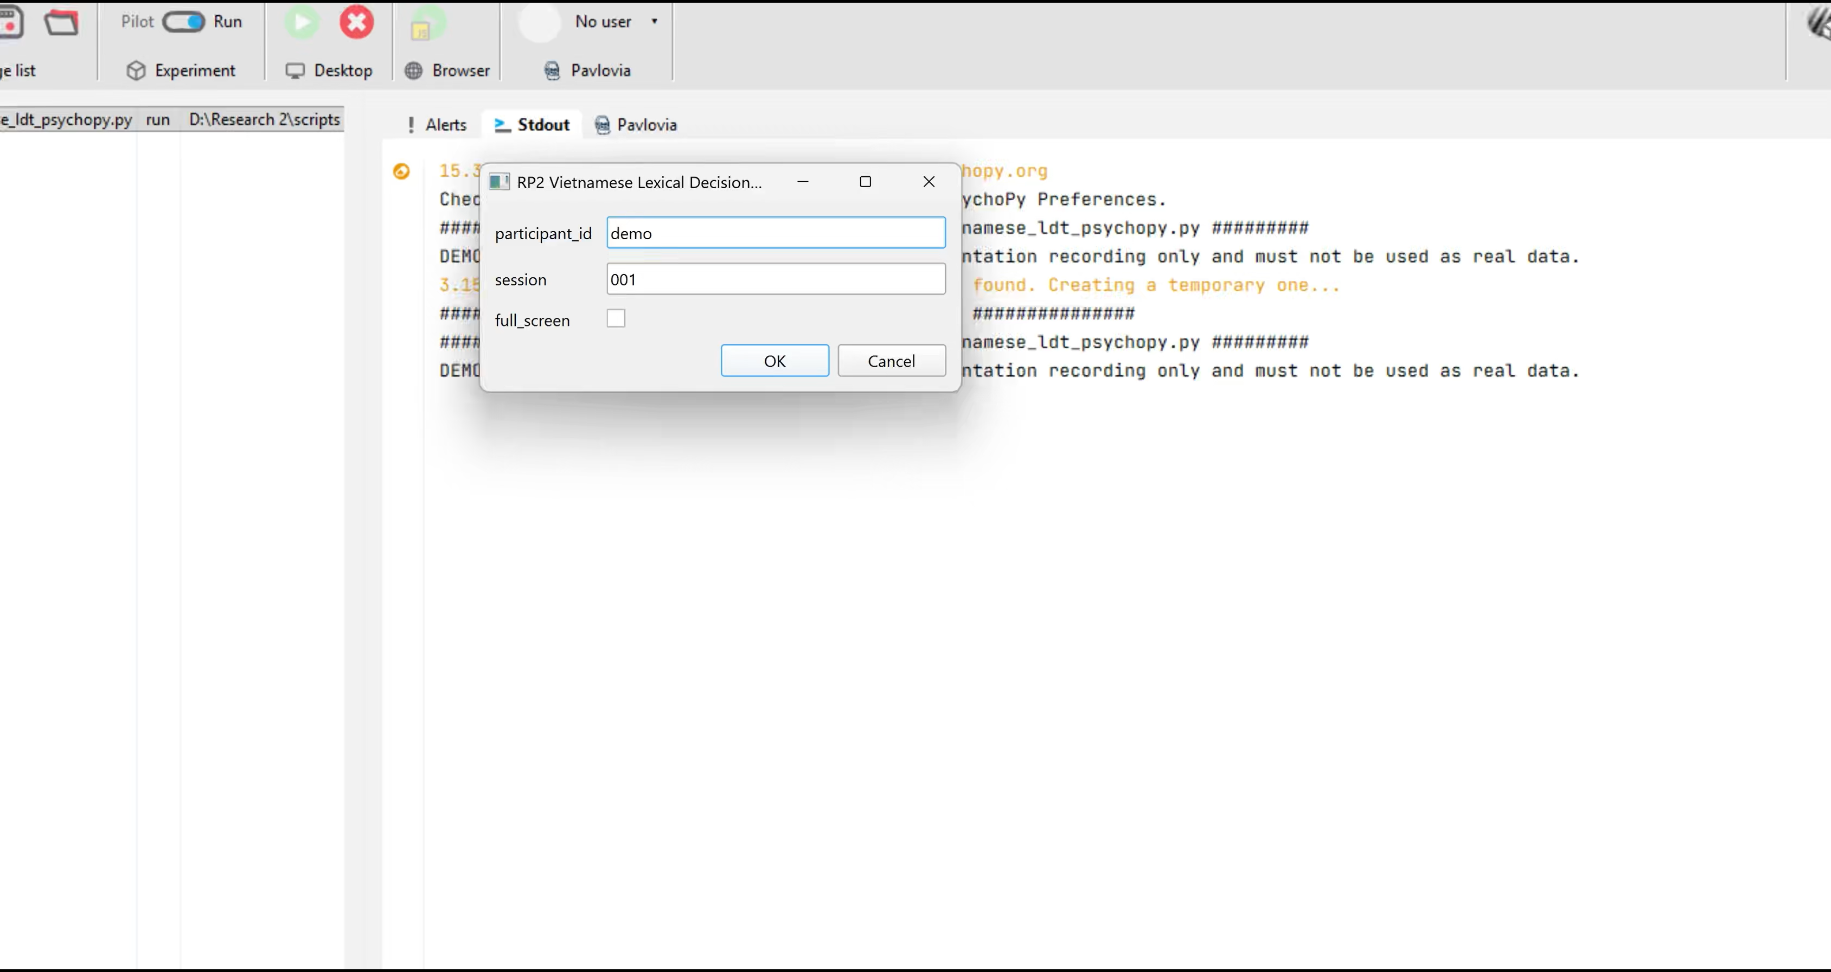
11 | EXPERIMENT DEMO
A short PsychoPy video can show the task more clearly than more procedure text.
Vietnamese LDT | RP2 Colloquium 2
Notes:
Pause here during the talk to play or insert the demo. Keep the spoken explanation short because the next section covers the full data pipeline.

Slide 12

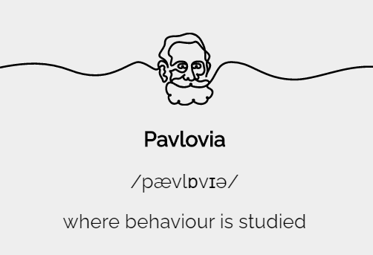



12 | METHODOLOGY PIPELINE
The project is reproducible from experiment implementation through R Markdown modeling.
.
.
.
.
.
→
→
→
→
PsychoPy
Pavlovia
Python
pandas
R
Experiment
Raw CSV
.
.
Cleaning/QC
Analysis
PsychoPy / Pavlovia
→
participant files
→
Python + pandas
→
R Markdown
lme4 / lmerTest
Vietnamese LDT | RP2 Colloquium 2
Notes:
This is the main methods pipeline. Emphasize that every step has an output: raw CSVs, cleaned datasets, QC summaries, R Markdown, tables, figures and model files.

Slide 13
13 | CLEANING AND QC
Cleaning was designed to preserve raw data while making analysis copies auditable.
.
.
Read participant CSVs
Convert RT
multiple encodings: utf-8-sig, utf-8, cp1258
numeric RT, log_rt, missing/timeout flags
.
.
Validate IDs
Validate stimuli
participant ID in filename and file content
trial_id and stimulus list matched against final design
.
.
Check trial counts
Create outputs
4 practice + 120 main trials per participant
cleaned datasets + participant/item/design QC
.
.
Check response mapping
Preserve raw files
F/J labels and accuracy recomputed
raw CSVs are read, not modified
Vietnamese LDT | RP2 Colloquium 2
Notes:
Walk through the cleaning steps as quality protection, not as technical detail for its own sake. The raw data were preserved; the script creates separate analysis copies.

Slide 14
14 | QC STATUS
The current dataset passes the main participant, trial, and stimulus-validation checks.
.
.
.
.
48
48
0
Validation passed
files read
participants
flagged
Stimulus file readable
120 unique main trial IDs
72 real words, 48 pseudowords
Every trial_id has 48 presentations
No unexpected trial IDs
Raw data were not modified
participant CSVs
unique IDs
participant QC
.
.
.
5,760
5,715
3,306
main trials
valid RTs
RT model rows
48 x 120
main trials
correct real words
Current stage: ready for Colloquium 2 presentation, but results remain preliminary.
Vietnamese LDT | RP2 Colloquium 2
Notes:
Use this slide to show that the analysis is not based on uninspected files. The project has reached the minimum N, but keep the interpretation preliminary.

Slide 15
15 | REPRODUCIBILITY
The workflow keeps raw data, cleaned analysis copies, QC outputs, and the analysis report separate.
.
.
.
Raw PsychoPy CSVs
Cleaning script
Cleaned datasets
data/experiment_results
read only
→
analysis/01_prepare_clean_data.py
→
all_trials_clean
main_trials_clean
rt_realword_correct
.
.
.
QC outputs
R Markdown
Analysis outputs
participant/item/design
stimulus validation
→
analysis/RP2_final_analysis_v2.Rmd
→
figures, tables,
model summaries
Reproducibility principle: every transformation has a named script or output file.
Vietnamese LDT | RP2 Colloquium 2
Notes:
This slide is useful for questions about reproducibility. The key point is separation: raw data are preserved, cleaned copies are generated, and the R Markdown report can be rendered again.

Slide 16
16 | ANALYSIS PLAN
Log RT and mixed-effects models match the structure of repeated lexical-decision data.
.
.
.
Why log RT?
Why mixed effects?
RT model data
Reaction-time data are typically right-skewed.
Using log_rt reduces skew and makes linear-model assumptions more plausible.
Diagnostics are still checked.
Each participant sees many items.
Each item is seen by many participants.
Random intercepts account for participant and item variability.
Correct real-word main trials only
n = 3,306
participants = 48
items = 72
Accuracy is summarized separately because pseudowords are central for task quality but not part of the real-word RT model.
Sources: Baayen et al., 2008; Bates et al., 2015; Ratcliff, 1993; Whelan, 2008
Vietnamese LDT | RP2 Colloquium 2
Notes:
Explain log RT in simple terms: reaction times have a long right tail, so log transformation makes the model better behaved. Mixed effects are needed because observations are crossed by participant and item.

Slide 17
17 | MODEL
The main model estimates frequency, syllable length, and their interaction with participant and item intercepts.
.
log_rt ~ frequency_group * syllable_length +
(1 | participant_id) + (1 | trial_id)
Random effect
Variance
Std. dev.
.
Model status
participant_id
0.0148
0.1217
Observations: 3,306
Participants: 48
Items: 72
Singular fit: false
trial_id
0.0008
0.0291
residual
0.0469
0.2165
This structure avoids treating 3,306 rows as fully independent observations.
Vietnamese LDT | RP2 Colloquium 2
Notes:
Do not read every coefficient here. The purpose is to justify the model structure: fixed effects for the experimental predictors and random intercepts for participants and items.

Slide 18
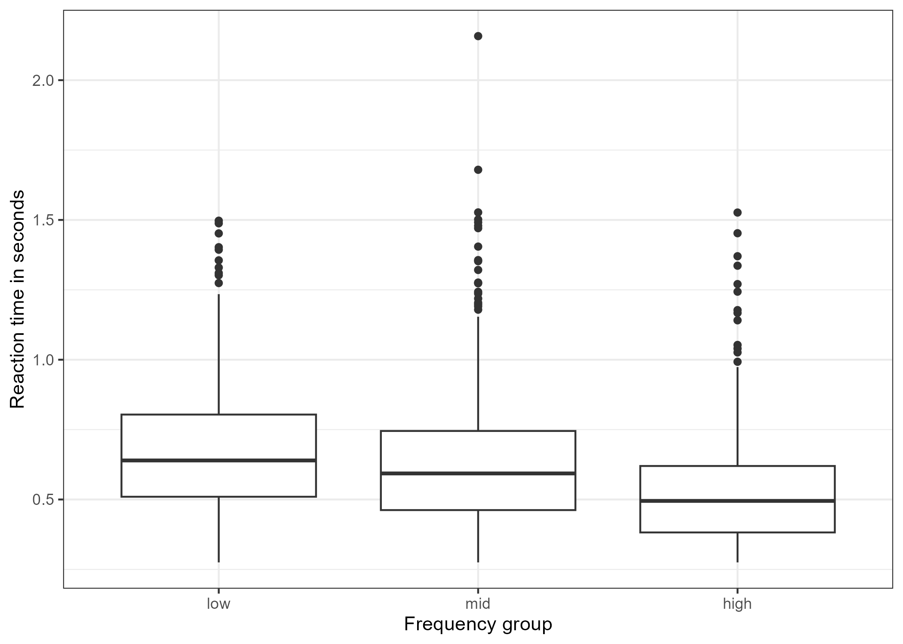
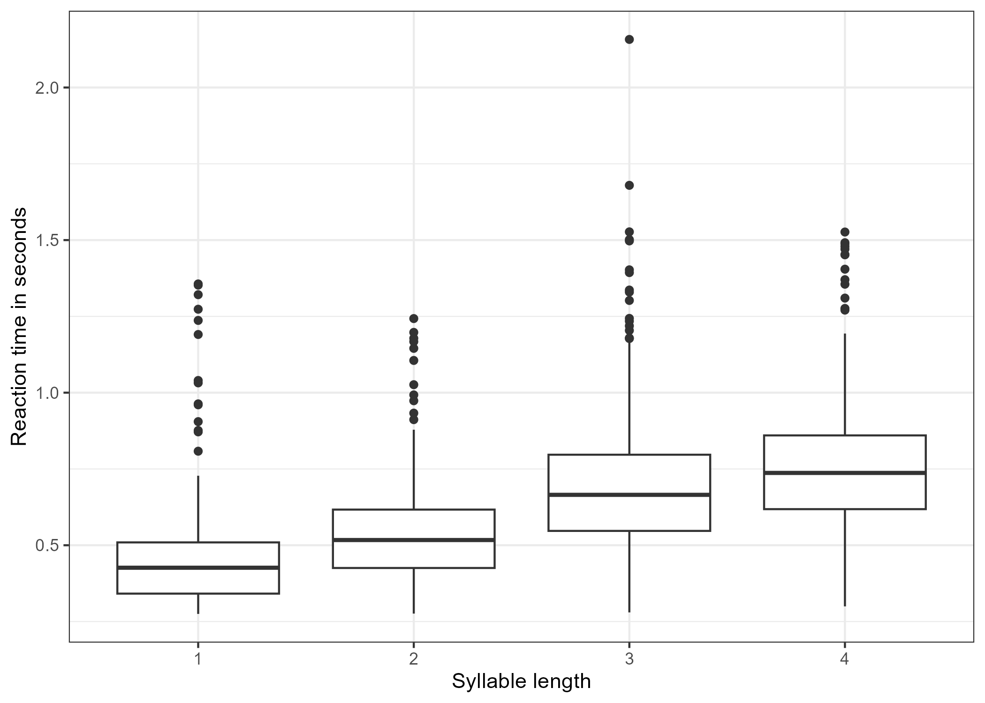
18 | PRELIMINARY RESULTS
Descriptively, high-frequency words are faster and longer words are slower.
Frequency
low
mid
high
Length
1
2
3
4
Mean RT
0.668
0.618
0.510
Mean RT
0.441
0.528
0.684
0.748
Vietnamese LDT | RP2 Colloquium 2
Notes:
Keep this descriptive. The pattern is clear: high-frequency words are faster, and reaction times increase with syllable length. The model comparison will handle inference.

Slide 19
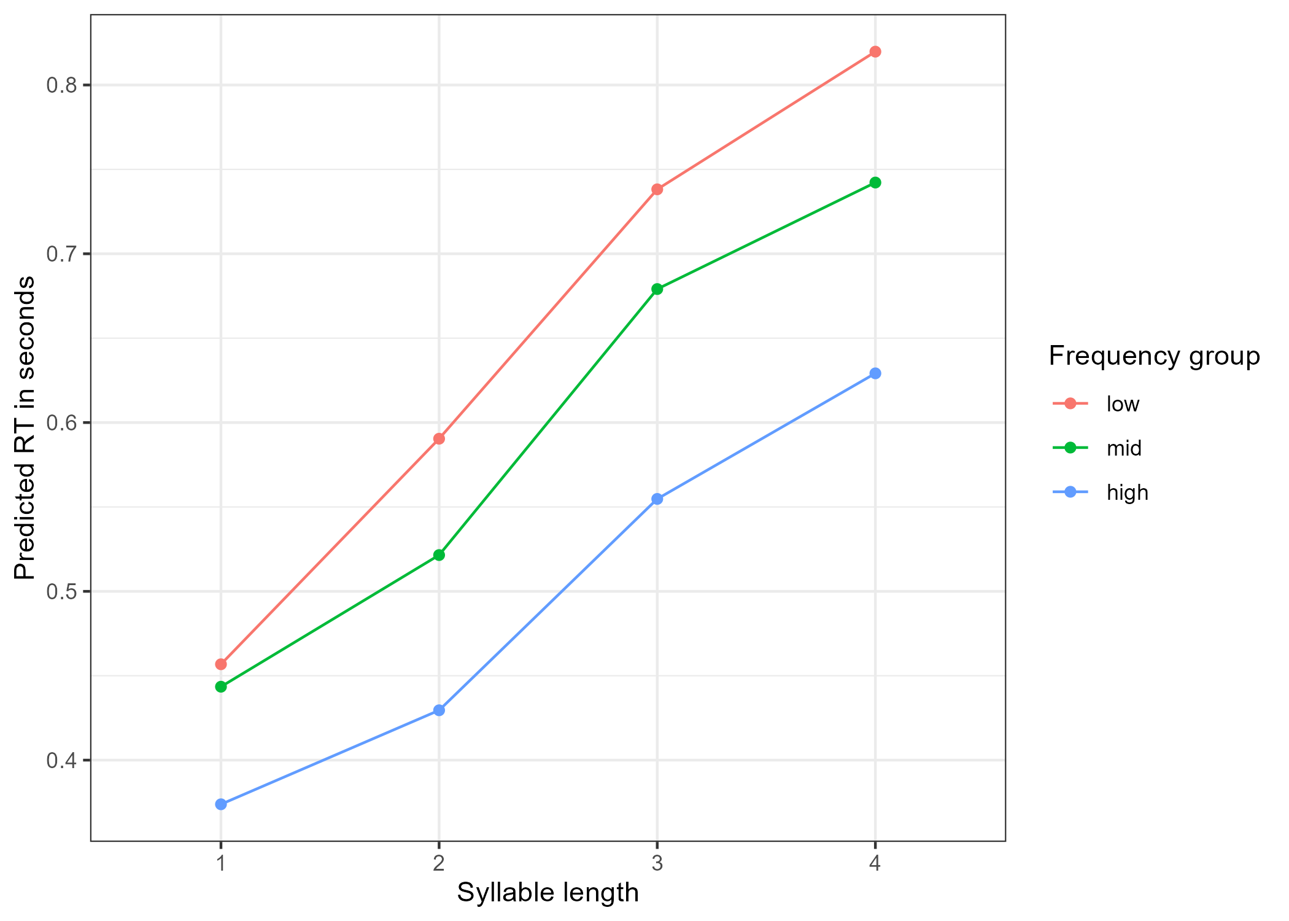
19 | INTERACTION
The frequency advantage may vary by syllable length, but the interaction is modest.
.
Cautious read
Interaction model improves fit over the additive model.
Likelihood-ratio p = .0449.
Treat as evidence of possible variation, not a large final conclusion.
Result wording: frequency and length effects are clearer than the interaction.
Vietnamese LDT | RP2 Colloquium 2
Notes:
Use cautious language. The interaction is statistically borderline and should be described as possible variation in the frequency effect across lengths, not as the central finding.

Slide 20
20 | MODEL COMPARISON
Adding frequency and syllable length improves model fit; the interaction adds only a small increment.
Model
npar
AIC
BIC
Chisq
p
.
Largest step
model0
4
-286.3
-261.9
-
-
Adding syllable length gives the biggest model-fit improvement.
model1 + freq
6
-299.2
-262.6
16.95
< .001
model2 + length
9
-511.0
-456.1
217.80
< .001
.
model3 + interaction
15
-511.9
-420.4
12.89
.0449
Small step
The interaction improves fit, but weakly. It should guide follow-up checks rather than stand alone.
Vietnamese LDT | RP2 Colloquium 2
Notes:
Point out the model sequence. Frequency improves over baseline; length strongly improves the model; the interaction is statistically present but modest.

Slide 21
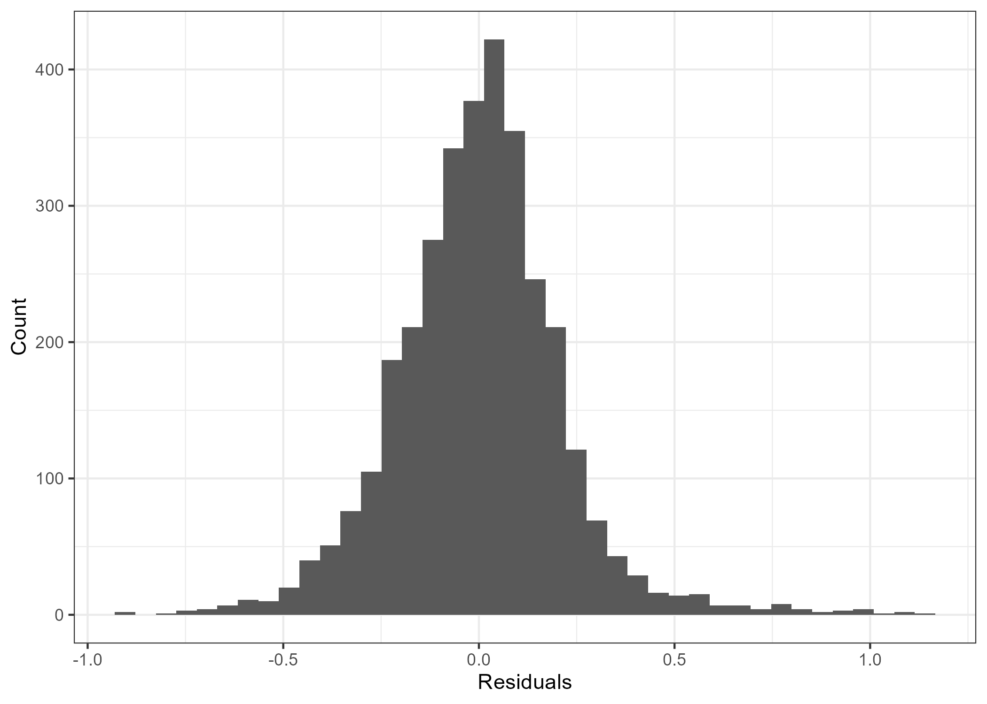
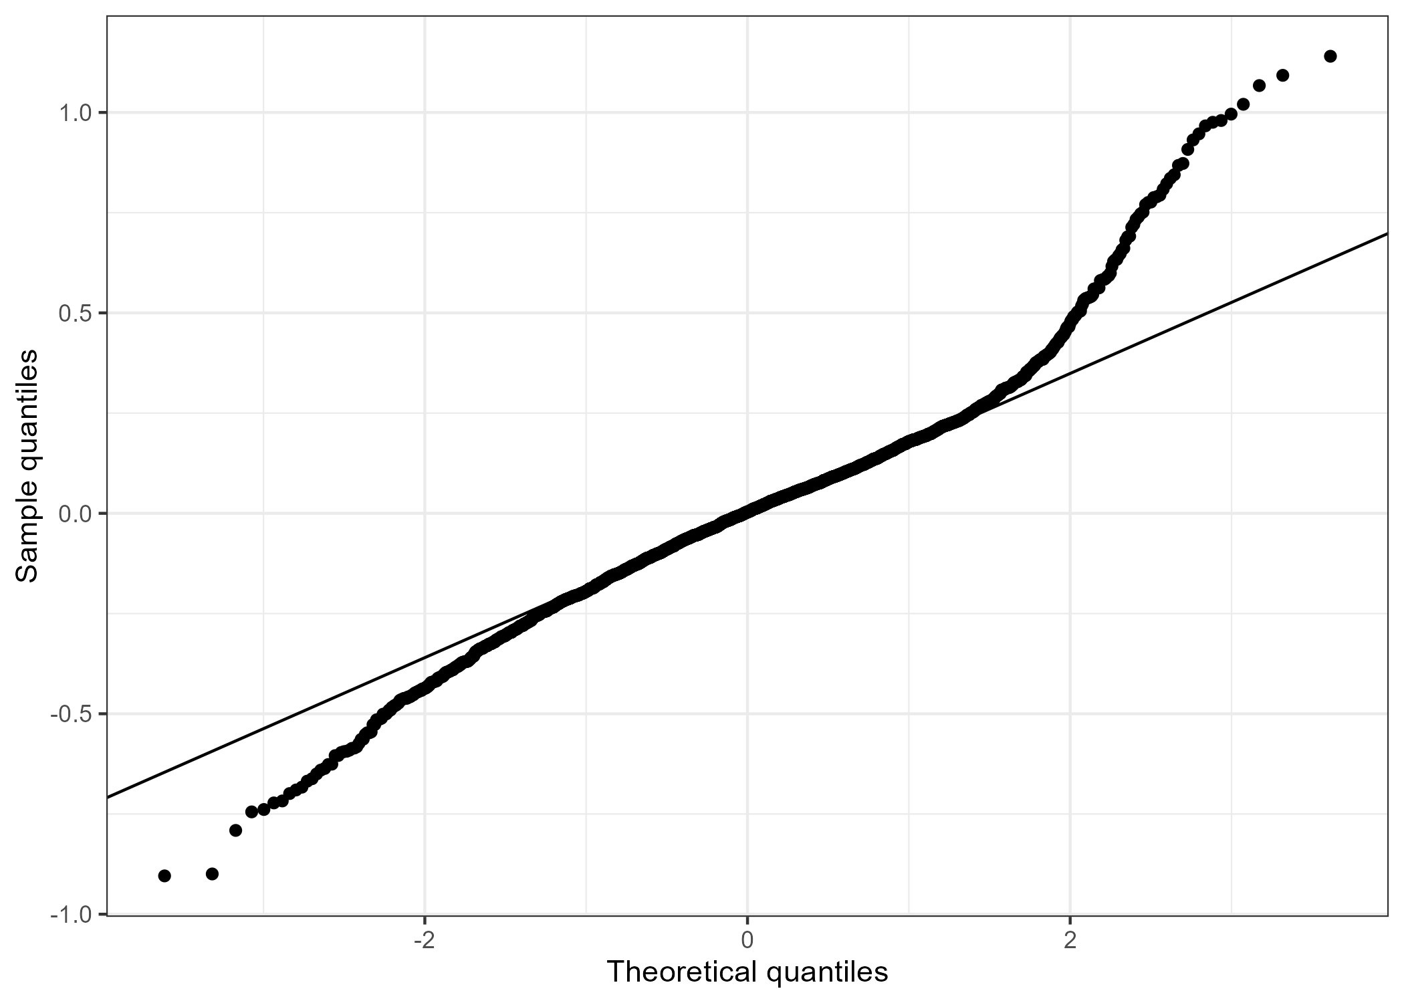
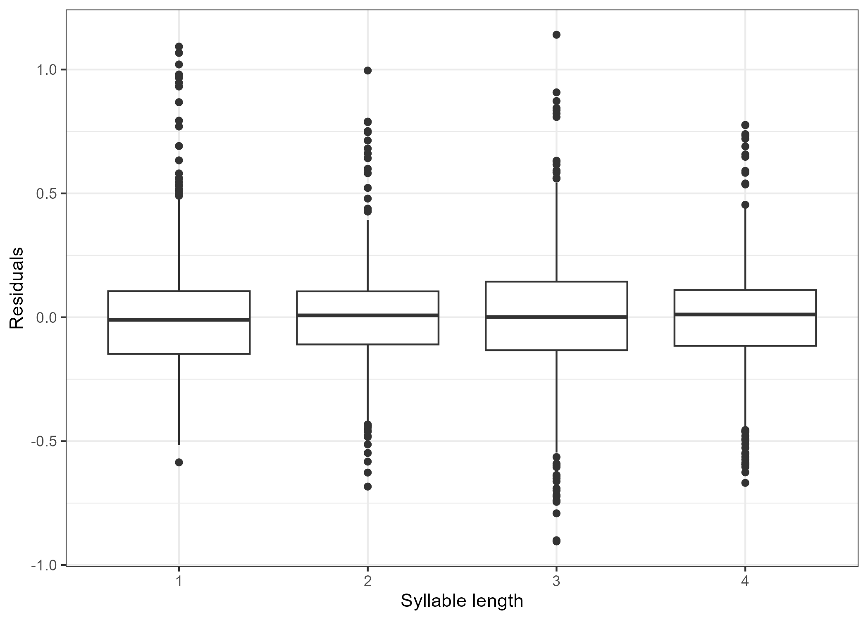
21 | DIAGNOSTICS
Model checks support cautious reporting, not overconfident final claims.
.
.
.
Singularity
VIF check
Remaining caution
model0, model1, model2, model3:
FALSE
Adjusted GVIF values remain below common concern thresholds.
RT diagnostics should be reviewed again before thesis-level claims.
Vietnamese LDT | RP2 Colloquium 2
Notes:
This slide is a bridge between statistics and caution. Diagnostics do not show a major singularity issue, but residual behavior and model assumptions still deserve final review.

Slide 22
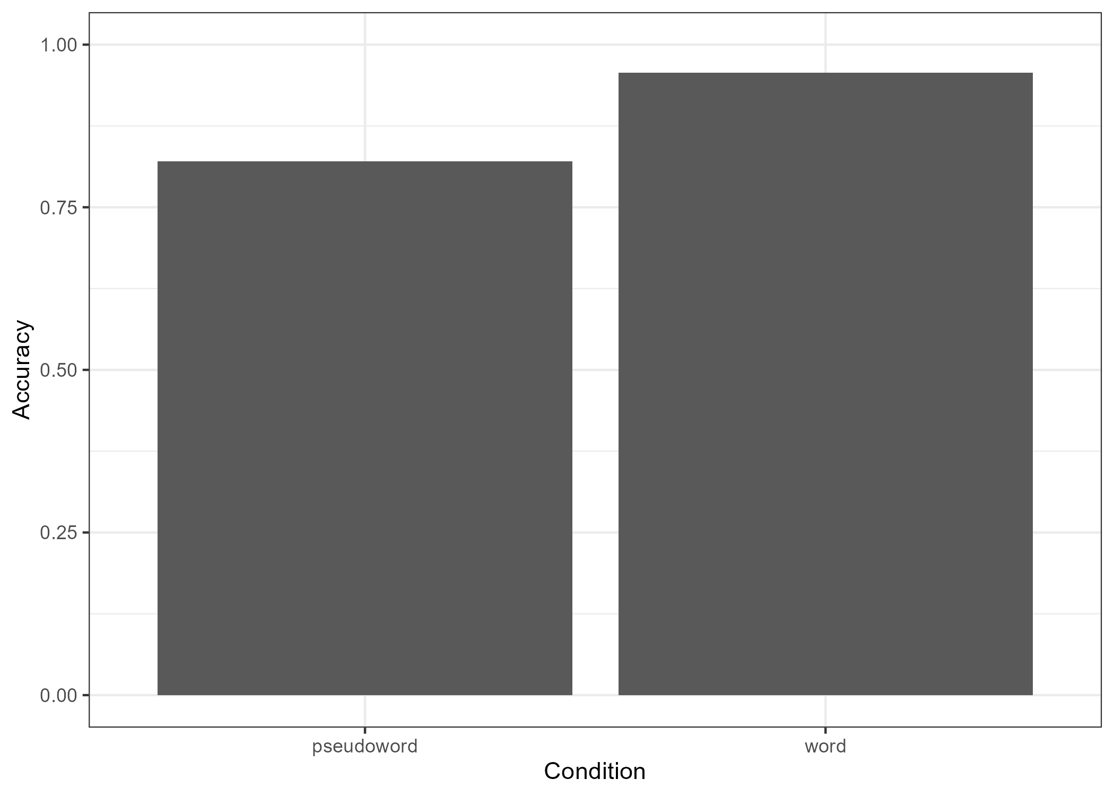
22 | TASK QUALITY
Accuracy and response QC suggest participants generally performed the task seriously.
95.7%
82.0%
word accuracy
pseudoword accuracy
main trials
main trials
0
45
participants
missing RTs
flagged by QC
of 5,760 main trials
Pseudoword accuracy is lower than word accuracy, but still high enough to show nonword discrimination.
Vietnamese LDT | RP2 Colloquium 2
Notes:
Use accuracy to support task validity. Word accuracy is high; pseudoword accuracy is lower, which is expected, but participants were not simply pressing one key.

Slide 23
23 | INTERPRETATION
The strongest preliminary story is frequency plus syllable length, with a tentative interaction.
.
.
.
1. Frequency
2. Syllable length
3. Interaction
High-frequency words were responded to faster than low-frequency words.
Mean RT increased from one-syllable to four-syllable words.
Possible variation in the frequency effect, but modest.
.
Cautious interpretation: lexical-decision RT reflects lexical processing plus task-decision processes, so the results should not be reduced to pure lexical access.
Vietnamese LDT | RP2 Colloquium 2
Notes:
This is the interpretation slide. Keep the conclusion defensible: frequency and length are the main patterns, interaction is tentative, and lexical decision includes a decision stage.

Slide 24
24 | LIMITATIONS
The current analysis is ready for discussion, but not yet a final thesis conclusion.
N = 48 reaches the minimum target but is still a minimum sample.
Pseudowords should be reviewed for plausibility and matching before final reporting.
Frequency source and item matching may need dispersion/register checks.
The current model uses random intercepts; richer structures can be tested if stable.
The project does not solve full Vietnamese word segmentation.
.
Next analytical step
Review diagnostics, check sensitivity decisions, consider supplementary accuracy models, and refine the interaction interpretation.
Vietnamese LDT | RP2 Colloquium 2
Notes:
Limitations make the project stronger, not weaker. They show what has been controlled and what still needs careful follow-up.

Slide 25
25 | TIMELINE
The six-month plan moves from design and data collection toward final modeling and write-up.
Month 1
Month 2
Month 3
Month 4
Month 5
Month 6
literature
final RQ
stimuli
pseudowords
PsychoPy /
Pavlovia
data
collection
cleaning/QC
R Markdown
final models
write-up
done / draft
done / draft
done / draft
done / draft
done / draft
next
.
Current position
Data collection, cleaning, first R Markdown analysis, figures, tables, and diagnostics are ready. Final interpretation and write-up still need review.
Vietnamese LDT | RP2 Colloquium 2
Notes:
Use this to show project management. The project is already beyond design and data collection; the remaining work is interpretation, robustness and writing.

Slide 26
26 | REFERENCES I
Selected sources for orthography, lexical decision, frequency, and methods.
Baayen, R. H. (2008). Analyzing linguistic data. Cambridge University Press. https://doi.org/10.1017/CBO9780511801686
DeFrancis, J. (1977). Colonialism and language policy in Viet Nam. De Gruyter Mouton. https://doi.org/10.1515/9783110802405
Baayen, R. H., Davidson, D. J., & Bates, D. M. (2008). Mixed-effects modeling with crossed random effects. Journal of Memory and Language, 59(4), 390-412. https://doi.org/10.1016/j.jml.2007.12.005
Encyclopaedia Britannica. (2026). Quoc-ngu. https://www.britannica.com/topic/Quoc-ngu
Balota, D. A., & Chumbley, J. I. (1984). Are lexical decisions a good measure of lexical access? JEP: HPP, 10(3), 340-357. https://doi.org/10.1037/0096-1523.10.3.340
Đinh, Q. T., Lê, H. P., Nguyễn, T. M. H., Nguyễn, C. T., Rossignol, M., & Vũ, X. L. (2008). Word segmentation of Vietnamese texts: A comparison of approaches. LREC 2008. https://aclanthology.org/L08-1355/
Bates, D., Mächler, M., Bolker, B., & Walker, S. (2015). Fitting linear mixed-effects models using lme4. Journal of Statistical Software, 67(1), 1-48. https://doi.org/10.18637/jss.v067.i01
Fernandes, G., & Assunção, C. (2017). First codification of Vietnamese by 17th-century missionaries. Histoire Épistémologie Langage, 39(1), 155-176. https://doi.org/10.3406/hel.2017.3592
Brysbaert, M., Mandera, P., & Keuleers, E. (2018). The word frequency effect in word processing. Current Directions in Psychological Science, 27(1), 45-50. https://doi.org/10.1177/0963721417727521
Vietnamese LDT | RP2 Colloquium 2
Notes:
References are included for academic completeness. Do not read this slide aloud in detail.

Slide 27
27 | REFERENCES II
Selected sources for pseudowords, software, and RT handling.
Ha, L. A. (2003). A method for word segmentation in Vietnamese. Proceedings of Corpus Linguistics 2003, 282-287.
Pham, H., Tucker, B. V., & Baayen, R. H. (2019). Constructing two Vietnamese corpora and building a lexical database. Language Resources and Evaluation, 53(3), 465-498. https://doi.org/10.1007/s10579-019-09451-x
Keuleers, E., & Brysbaert, M. (2010). Wuggy: A multilingual pseudoword generator. Behavior Research Methods, 42(3), 627-633. https://doi.org/10.3758/BRM.42.3.627
R Core Team. (2026). R: A language and environment for statistical computing. R Foundation for Statistical Computing. https://doi.org/10.32614/R.manuals
McKinney, W. (2010). Data structures for statistical computing in Python. Proceedings of the 9th Python in Science Conference, 56-61. https://doi.org/10.25080/Majora-92bf1922-00a
Ratcliff, R. (1993). Methods for dealing with reaction time outliers. Psychological Bulletin, 114(3), 510-532. https://doi.org/10.1037/0033-2909.114.3.510
Meyer, D. E., & Schvaneveldt, R. W. (1971). Facilitation in recognizing pairs of words. Journal of Experimental Psychology, 90(2), 227-234. https://doi.org/10.1037/h0031564
Verdonschot, R. G., Hoàng, T. L. P., & Tamaoka, K. (2022). Phonological encoding in Vietnamese. Quarterly Journal of Experimental Psychology, 75(7), 1355-1366. https://doi.org/10.1177/17470218211053244
New, B., Ferrand, L., Pallier, C., & Brysbaert, M. (2006). Reexamining the word length effect. Psychonomic Bulletin & Review, 13(1), 45-52. https://doi.org/10.3758/BF03193811
Whelan, R. (2008). Effective analysis of reaction time data. The Psychological Record, 58(3), 475-482. https://doi.org/10.1007/BF03395630
Peirce, J. W., Gray, J. R., Simpson, S., MacAskill, M. R., Höchenberger, R., Sogo, H., Kastman, E., & Lindeløv, J. K. (2019). PsychoPy2. Behavior Research Methods, 51, 195-203. https://doi.org/10.3758/s13428-018-01193-y
Yap, M. J., & Balota, D. A. (2009). Visual word recognition of multisyllabic words. Journal of Memory and Language, 60(4), 502-529. https://doi.org/10.1016/j.jml.2009.02.001
Pham, H., & Baayen, H. (2015). Vietnamese compounds show an anti-frequency effect in visual lexical decision. Language, Cognition and Neuroscience, 30(9), 1077-1095. https://doi.org/10.1080/23273798.2015.1054844
Vietnamese LDT | RP2 Colloquium 2
Notes:
Close briefly and invite questions about the design, QC, or model interpretation.

Slide 28
Thank you for your attention!
Vietnamese Lexical Decision Task
Dang Nhat Quang Nhat.Dang@edu.ruhr-uni-bochum.de

