Slide 1
Vietnamese Lexical
Decision Task
Research Project 2
Colloquium 2
Dang Nhat Quang
Supervisor: Prof. Dr. Tibor Kiss
07 July 2026
Notes:
Today I present my RP2 project on Vietnamese lexical decision. The focus is how frequency group and syllable length relate to response time, using a collected dataset and a cautious preliminary analysis.

Slide 2
02 | RESEARCH STORY
The talk follows the project from linguistic motivation to cautious preliminary results.
.
.
.
.
Background
Problem
Design
Pipeline
Vietnamese writing and spacing
→
syllables are spaced, lexical words may be multi-syllabic
→
3 x 4 within-participant lexical decision
→
PsychoPy/Pavlovia, Python/pandas, R Markdown
.
.
.
QC
Results
Next steps
participant, item, trial, RT, response checks
→
frequency, length, interaction, diagnostics
→
limitations and six-month plan
Vietnamese LDT | RP2 Colloquium 2
Notes:
I will begin with the route of the talk, my research story. First, the Vietnamese writing and spacing problem, then explain how that motivates a lexical decision experiment. After that, I present the design, the data pipeline, the cleaning and quality checks, and finally the preliminary results. The main goal is to show that the project is methodologically controlled and that the results are interpreted cautiously.

Slide 3
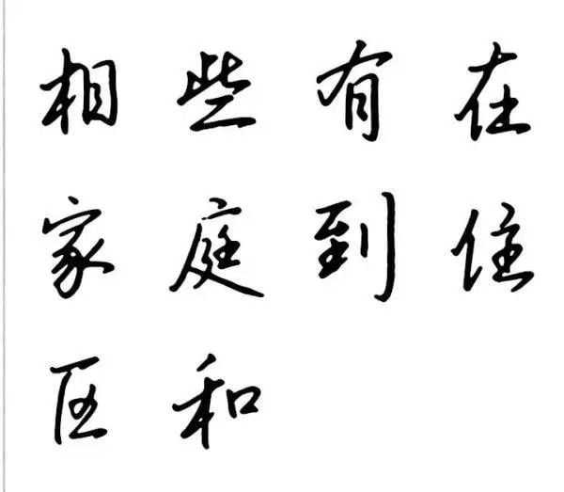
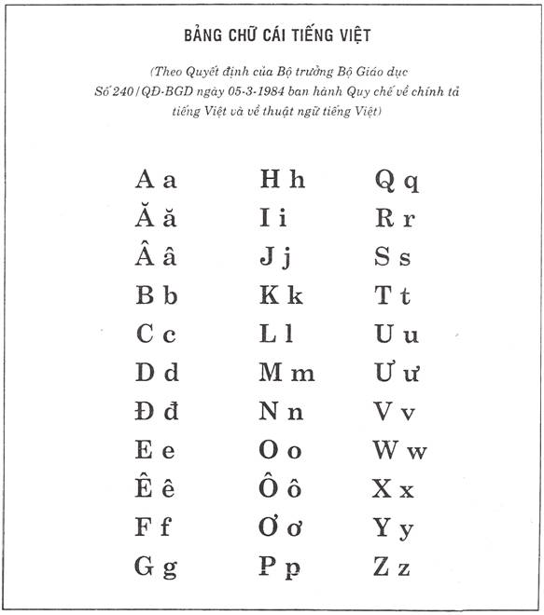
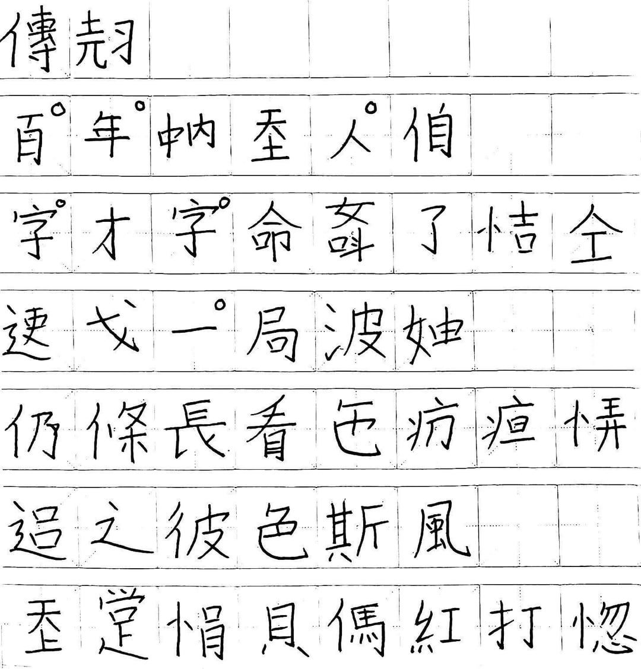
03 | BACKGROUND
Quốc ngữ is the current endpoint of a layered writing history, not a single-inventor story.
.
.
.
Chữ Hán
Chữ Nôm
Quốc ngữ
Chinese characters
administration, scholarship
→
vernacular Vietnamese
adapted/created characters
→
Latin-based Vietnamese
missionary codification, later mass adoption
.
Clarification
The modern script was shaped by several European missionaries. Portuguese Jesuits were central in early romanization; Alexandre de Rhodes published an influential Vietnamese-Portuguese-Latin dictionary in 1651. Later French colonial schooling/administration and Vietnamese print culture helped Quốc ngữ spread.
Why this matters here: the modern script is alphabetic and spaced, but spacing does not make Vietnamese word boundaries simple.
Sources: Fernandes & Assunção, 2017; DeFrancis, 1977; Encyclopaedia Britannica, 2026
Vietnamese LDT | RP2 Colloquium 2
Notes:
Vietnamese writing has a layered history: Chữ Hán, Chữ Nôm, and then Quốc ngữ. Quốc ngữ was shaped by several missionaries and later spread through schooling, administration, and print culture, so it is not a single-inventor story.

Slide 4
04 | TOKENIZATION PROBLEM
Vietnamese spaces often separate syllables, while lexical words may contain several syllables.
Example string
sinh viên học tiếng Việt
.
Key point
space ≠ lexical word boundary
This is why Vietnamese word segmentation is non-trivial for NLP and for stimulus selection.
Syllable-spaced orthography
sinh
viên
học
tiếng
Việt
Lexical-word interpretation
.
.
sinh viên
học
tiếng Việt
Sources: Ha, 2003; Đinh et al., 2008; Verdonschot et al., 2022
Vietnamese LDT | RP2 Colloquium 2
Notes:
Vietnamese spacing creates a useful research problem. Spaces often separate syllables, but a lexical word can contain more than one syllable, such as sinh viên. The project does not solve tokenization; it tests frequency group and syllable length in lexical decision.

Slide 5
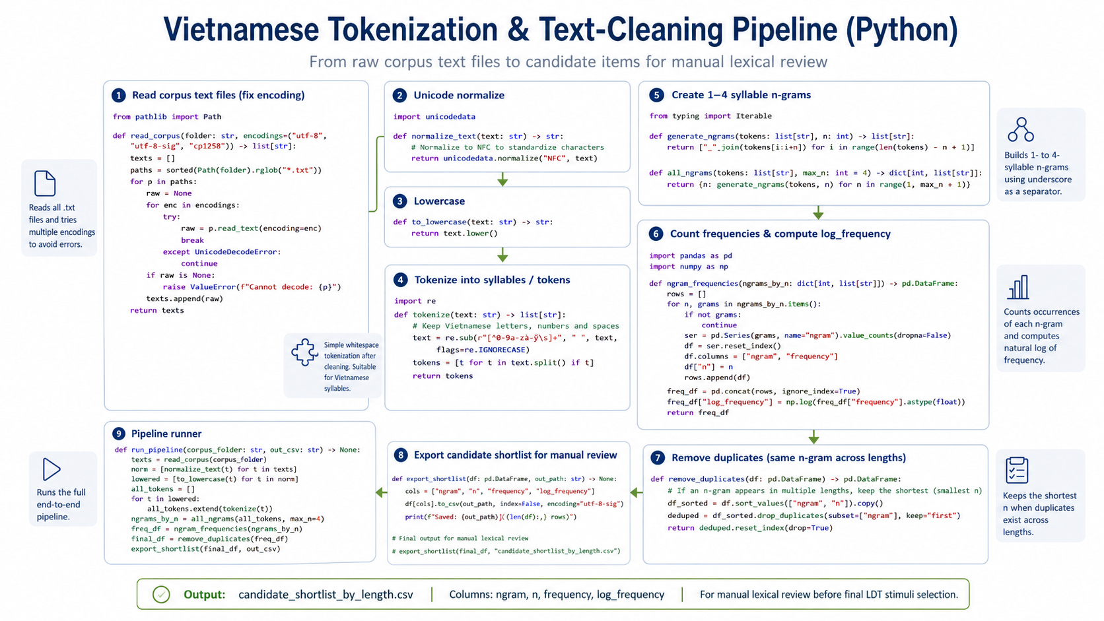
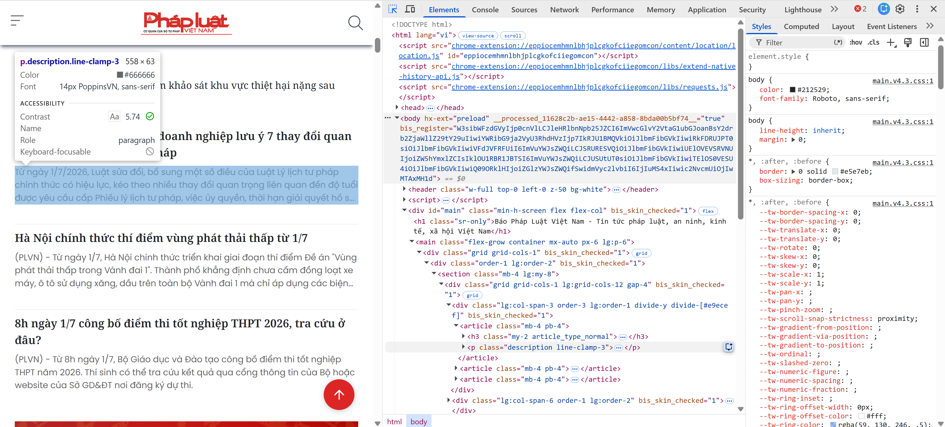


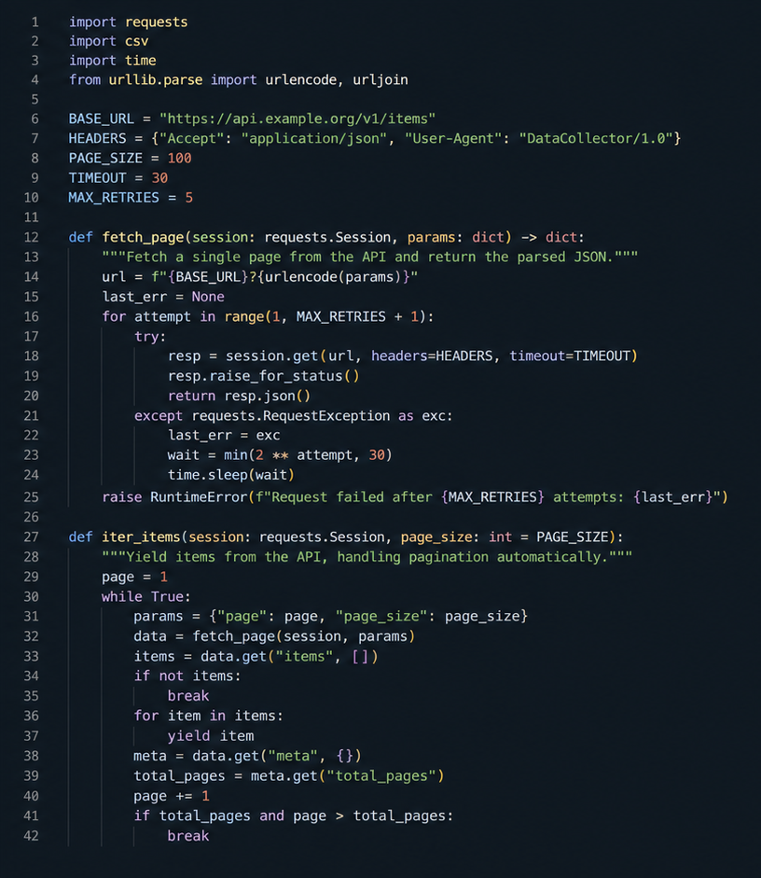
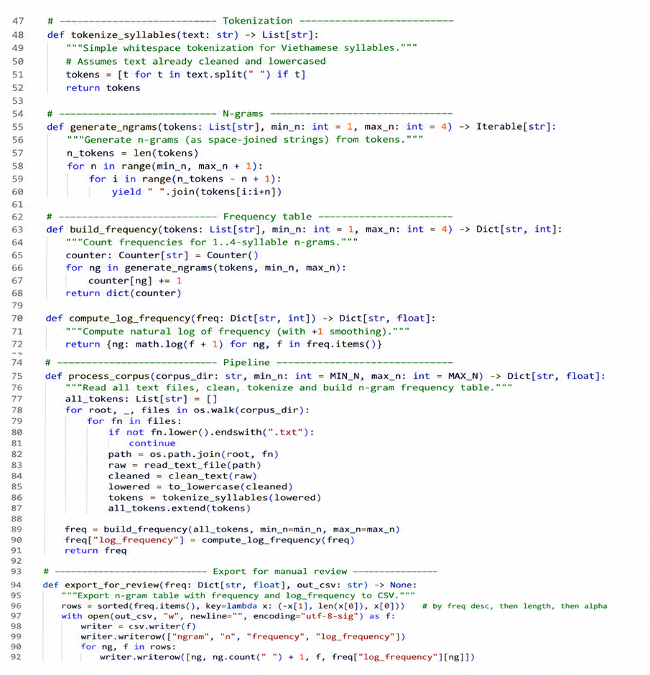



Open APIs
Various topics
Cleaning & frequency listing
The Human

Slide 6
06 | RESEARCH QUESTION
Do frequency group and syllable length predict Vietnamese lexical-decision response times?
.
How do corpus frequency group and syllable length affect log reaction time for correct Vietnamese real-word responses?
.
.
.
H1: frequency
H2: length
H3: interaction
High-frequency words should be recognized faster than low-frequency words.
Longer syllable length should increase RT because longer words require more visual/lexical processing.
The size of the frequency effect may vary across syllable lengths.
Interpretation rule: interaction evidence will be treated as preliminary unless it is stable across diagnostics and follow-up checks.
Vietnamese LDT | RP2 Colloquium 2
Notes:
So the tokenization problem gives the motivation, but I do not treat automatic tokenization as the final answer. I use it to prepare candidate items, then rely on manual lexical review for the final stimuli. This slide gives the main research question and hypotheses. I test whether frequency group and syllable length predict log reaction time for correct Vietnamese real-word responses. H1 predicts that high-frequency words are faster. H2 predicts that longer syllable length increases response time. H3 tests whether the frequency effect changes across syllable lengths. I treat the interaction cautiously because the main effects are the clearer part of the analysis.

Slide 7
07 | STIMULUS DATA PIPELINE
Corpus text was converted into candidate items, manually reviewed, and grouped for final LDT stimuli.
.
.
.
.
.
Corpus text
Frequency tables
Candidate pool
Manual lexical review
Final stimuli
Vietnamese Corpus Data.zip
->
1-4 syllable n-grams
->
log_frequency + syllable length variables
->
candidate items checked before final stimuli
->
72 real words + 48 pseudowords
.
.
Dataset artifacts
Python / pandas sketch for stimulus preparation
data/processed/*grams_frequency.csv
candidate_shortlist_by_length.csv
manual_selection_sheet.csv
final_ldt_stimuli_3x4_v1.csv
files = ["unigrams", "bigrams", "trigrams", "fourgrams"]
freq = pd.concat(pd.read_csv(f) for f in files)
items = (freq
.assign(
syllable_length=lambda d: d.lexical_item.str.split().str.len(),
log_frequency=lambda d: np.log(d.frequency))
.query("1 <= syllable_length <= 4")
.drop_duplicates("lexical_item"))
review_sheet = items.sort_values(["syllable_length", "log_frequency"])
.
Key caution
N-grams are candidate items, not automatically final lexical words.
.
Traceable dataset: corpus frequency -> filtered candidates -> manual lexical review -> final stimuli.
Vietnamese LDT | RP2 Colloquium 2
Notes:
This is how the stimuli were prepared for the lexical decision experiment. I first used corpus frequency data to collect candidate real-word items, then checked them through manual lexical review because automatic tokenization alone was not reliable enough. After this preparation, I selected the final real words and created pseudowords for the actual task.

Slide 8
08 | EXPERIMENTAL DESIGN
The real-word design is balanced: 3 frequency groups x 4 syllable lengths, within participant.
Frequency
1 syll.
2 syll.
3 syll.
4 syll.
.
72
real words
low
6
6
6
6
6 per real-word cell
.
mid
6
6
6
6
48
pseudowords
high
6
6
6
6
12 per length
.
120
cell value = number of real-word items
main trials
per participant
All participants see all main trials in randomized order.
Vietnamese LDT | RP2 Colloquium 2
Notes:
Here, I show the core experimental design. It is a 3 x 4 within-participant design: three frequency groups and four syllable lengths. Each participant sees items from every condition, so differences are compared within the same participants rather than between separate participant groups. The balanced cells make the later model easier to interpret.

Slide 9
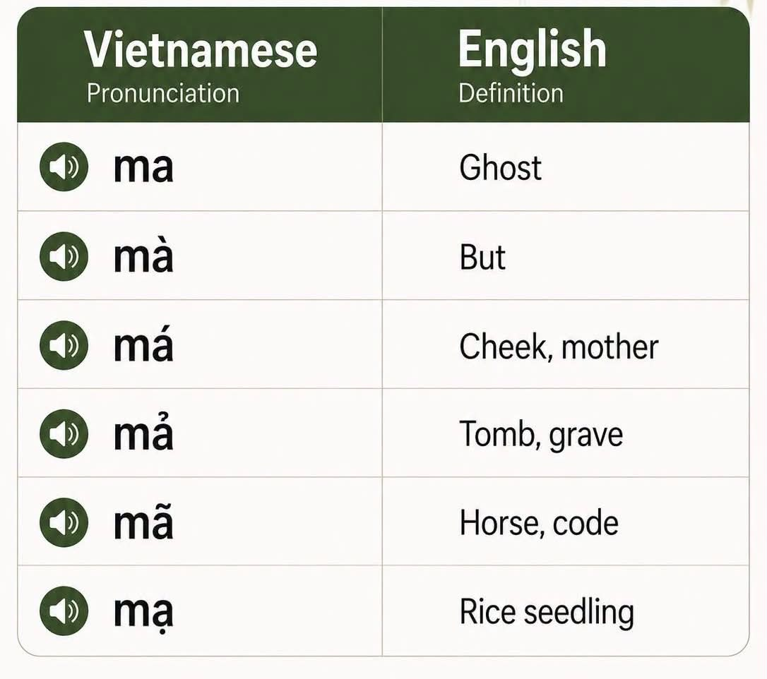
09 | STIMULI
Pseudowords keep the task genuinely lexical: participants must distinguish words from nonwords.
Type
Length 1
Length 2
Length 3
Length 4
.
Example real words
real words
18
18
18
18
núi
loại sản phẩm
điện thoại di động
pseudowords
12
12
12
12
total
30
30
30
30
.
Example pseudowords
bệc viện ← bệnh viện
mối quan hế ← mối quan hệ
trính độ học vấn ← trình độ học vấn
Pseudoword construction changes a syllable while keeping the item Vietnamese-like enough for the task.
tone changes
vowel changes
final-consonant changes
Vietnamese LDT | RP2 Colloquium 2
Notes:
Here, I explain why pseudowords are included. Without pseudowords, participants could treat the task as simple word reading. Pseudowords force a real lexical decision, because participants must decide whether each string is a word or not. Their accuracy also helps check task quality and response bias.

Slide 10
10 | TASK PROCEDURE
The procedure is short, randomized, and keyboard-based to keep lexical decisions clean.
.
.
.
.
.
Instructions
Practice
Main task
Response
Export
F = word
J = nonword
→
4 trials
with feedback
→
120 trials
randomized
→
keyboard RT
accuracy
→
CSV files
per participant
.
Main-trial order is randomized for each participant.
Response mapping
F key: word
J key: nonword
Vietnamese LDT | RP2 Colloquium 2
Notes:
All of the previous preparation steps lead to this lexical decision experiment.
After selecting the real words and creating the pseudowords, participants completed the actual task shown here. First, they saw the instructions, where F meant “word” and J meant “nonword.” Then they completed four practice trials with feedback, so they understood the response mapping before the main experiment. In the main task, each participant saw 120 randomized trials, including both real words and pseudowords. For each item, the experiment recorded the keyboard response, reaction time, and accuracy, and exported one CSV file per participant.

Slide 11
11 | BIAS CONTROLS
The design reduces common task artifacts and monitors the ones it cannot remove.
.
.
Potential issue
Control / monitoring
.
.
Practice / learning
Practice trials before the main task; randomized main trials.
.
.
Response bias
Pseudowords require word/nonword discrimination; QC checks one-key overuse.
.
.
Key / side bias
F/J supports balanced keyboard responding, but does not fully eliminate side bias.
.
.
Fatigue / automatic pressing
Monitor accuracy, missing RTs, unusually fast RTs, and one-key patterns.
Important wording: F/J helps reduce motor-response delay and makes responses more balanced; it does not completely remove bias.
Vietnamese LDT | RP2 Colloquium 2
Notes:
To control task artifacts, the experiment uses practice trials, randomized main trials, pseudowords, and QC checks. Practice trials reduce learning effects during the main task. Randomization prevents item order from driving the result. Pseudowords help detect response bias, and QC checks look for fatigue, missing RTs, very fast responses, or one-key overuse. F and J make responses balanced and fast, but they do not completely remove key-side bias.

Slide 12
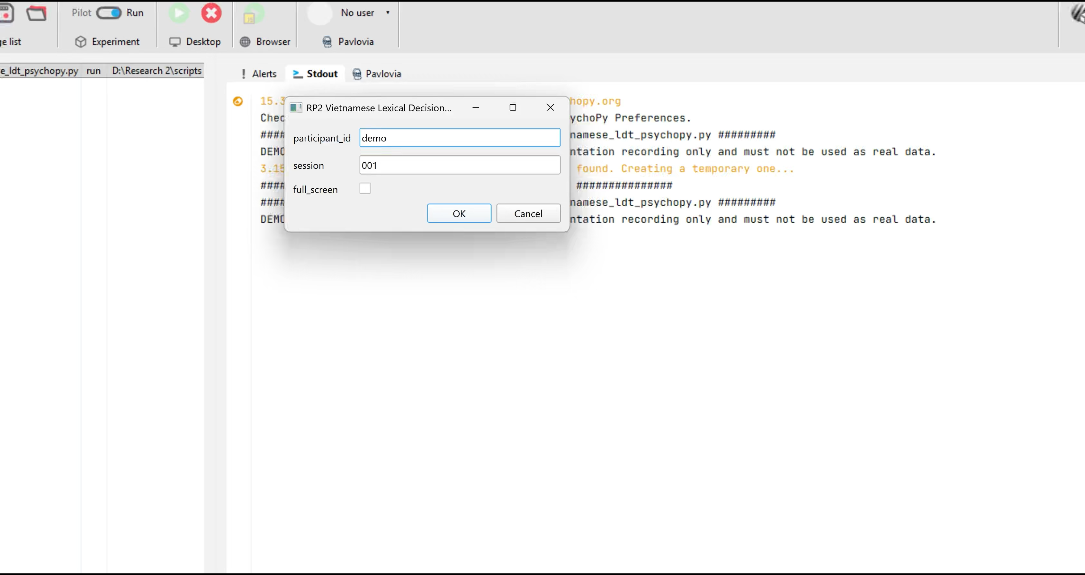
12 | EXPERIMENT DEMO
A short PsychoPy video can show the task more clearly than more procedure text.
Vietnamese LDT | RP2 Colloquium 2
Notes:
A short PsychoPy demo can be inserted here to show the actual timing and response screen. The demo helps make the procedure concrete before moving into data handling.

Slide 13
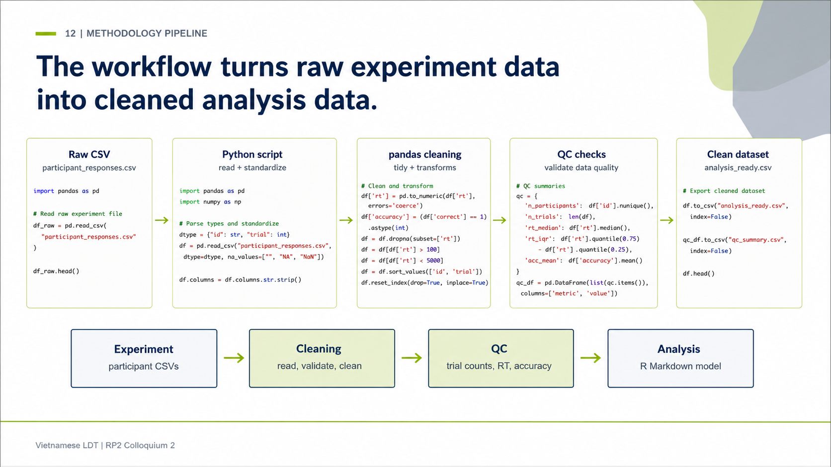

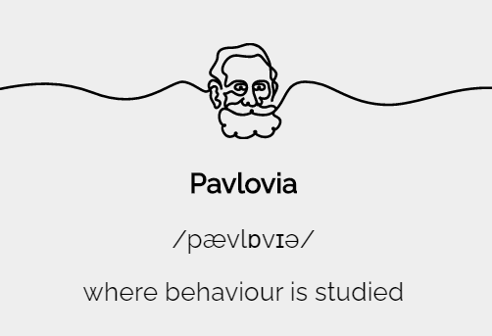



13 | METHODOLOGY PIPELINE
The big workflow runs from experiment implementation to cleaned data and R Markdown modeling.
.
.
.
.
.
→
→
→
→
PsychoPy
Pavlovia
Python
pandas
R
Experiment
Raw CSV
.
.
Cleaning/QC
Analysis
PsychoPy / Pavlovia
→
participant files
→
Python + pandas
→
R Markdown
lme4 / lmerTest
Vietnamese LDT | RP2 Colloquium 2
Notes:
The methodology pipeline shows the big workflow: PsychoPy and Pavlovia for the experiment, CSV export, Python and pandas for cleaning, then R Markdown and mixed-effects models for analysis.

Slide 14
14 | CLEANING AND QC
Cleaning and QC check whether the exported participant files are usable for analysis.
.
.
Read participant CSVs
Convert RT
multiple encodings: utf-8-sig, utf-8, cp1258
numeric RT, log_rt, missing/timeout flags
.
.
Validate IDs
Validate stimuli
participant ID in filename and file content
trial_id and stimulus list matched against final design
.
.
Check trial counts
Create outputs
4 practice + 120 main trials per participant
cleaned datasets + participant/item/design QC
.
Check response mapping
.
F/J labels and accuracy recomputed
Preserve raw files
raw CSVs are read, not modified
Vietnamese LDT | RP2 Colloquium 2
Notes:
Cleaning and QC focus on concrete checks: encoding, participant IDs, trial counts, response mapping, numeric RT conversion, log_rt, missing values, and stimulus validation. Raw files are preserved and analysis copies are created separately.

Slide 15
15 | QC STATUS
The current dataset passes the main participant, trial, and stimulus-validation checks.
.
.
.
.
48
48
0
Validation passed
files read
participants
flagged
Stimulus file readable
120 unique main trial IDs
72 real words, 48 pseudowords
Every trial_id has 48 presentations
No unexpected trial IDs
Raw data were not modified
participant CSVs
unique IDs
participant QC
.
.
.
5,760
5,715
3,306
main trials
valid RTs
RT model rows
48 x 120
main trials
correct real words
Vietnamese LDT | RP2 Colloquium 2
Notes:
The dataset currently has 48 participants and the expected trial structure. The RT model uses correct real-word main trials, while accuracy is summarized separately because pseudowords are central for task quality.

Slide 16
16 | REPRODUCIBILITY
Reproducibility comes from keeping raw data, cleaned data, QC outputs, and R Markdown separate.
.
.
.
Raw PsychoPy CSVs
Cleaning script
Cleaned datasets
data/experiment_results
read only
→
analysis/01_prepare_clean_data.py
→
all_trials_clean
main_trials_clean
rt_realword_correct
.
.
.
QC outputs
R Markdown
Analysis outputs
participant/item/design
stimulus validation
→
analysis/RP2_final_analysis_v2.Rmd
→
figures, tables,
model summaries
Reproducibility principle: every transformation has a named script or output file.
Vietnamese LDT | RP2 Colloquium 2
Notes:
Reproducibility comes from keeping raw CSVs, cleaning scripts, cleaned datasets, QC outputs, and the R Markdown analysis separate. Each transformation has a named input and output.

Slide 17
17 | ANALYSIS PLAN
Log RT and mixed-effects models match the structure of repeated lexical-decision data.
.
.
.
Why log RT?
Why mixed effects?
RT model data
Reaction-time data are typically right-skewed.
Using log_rt reduces skew and makes linear-model assumptions more plausible.
Diagnostics are still checked.
Each participant sees many items.
Each item is seen by many participants.
Random intercepts account for participant and item variability.
Correct real-word main trials only
n = 3,306
participants = 48
items = 72
Accuracy is summarized separately because pseudowords are central for task quality but not part of the real-word RT model.
Sources: Baayen et al., 2008; Bates et al., 2015; Ratcliff, 1993; Whelan, 2008
Vietnamese LDT | RP2 Colloquium 2
Notes:
For the reaction-time analysis, I do not model raw RT directly, because RT data are usually skewed and have a long right tail. So I use log RT to make the data more suitable for linear modeling. I also use a mixed-effects model because the same participant answered many items, and the same item was seen by many participants. Accuracy is kept separate, because it tells me more about task quality, especially whether participants could distinguish real words from pseudowords.

Slide 18
18 | MODEL
The main model estimates frequency, syllable length, and their interaction with participant and item intercepts.
.
log_rt ~ frequency_group * syllable_length +
(1 | participant_id) + (1 | trial_id)
Random effect
Variance
Std. dev.
.
Model status
participant_id
0.0148
0.1217
Observations: 3,306
Participants: 48
Items: 72
Singular fit: false
trial_id
0.0008
0.0291
residual
0.0469
0.2165
This structure avoids treating 3,306 rows as fully independent observations.
Vietnamese LDT | RP2 Colloquium 2
Notes:
This is the main model I use for correct real-word responses. The fixed effects are frequency group, syllable length, and their interaction. I also include random intercepts for participants and items, because some participants are naturally faster or slower, and some words are naturally easier or harder. The important point is that I should not treat all 3,306 observations as completely independent.

Slide 19
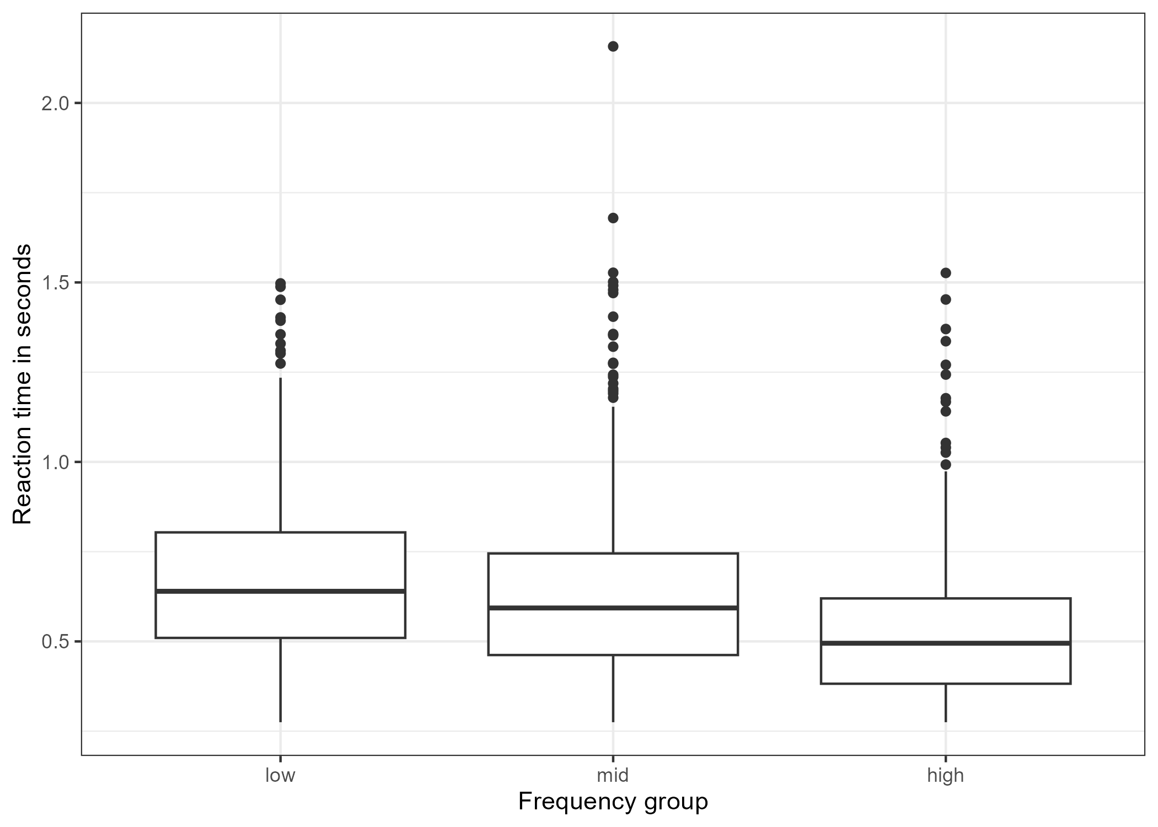
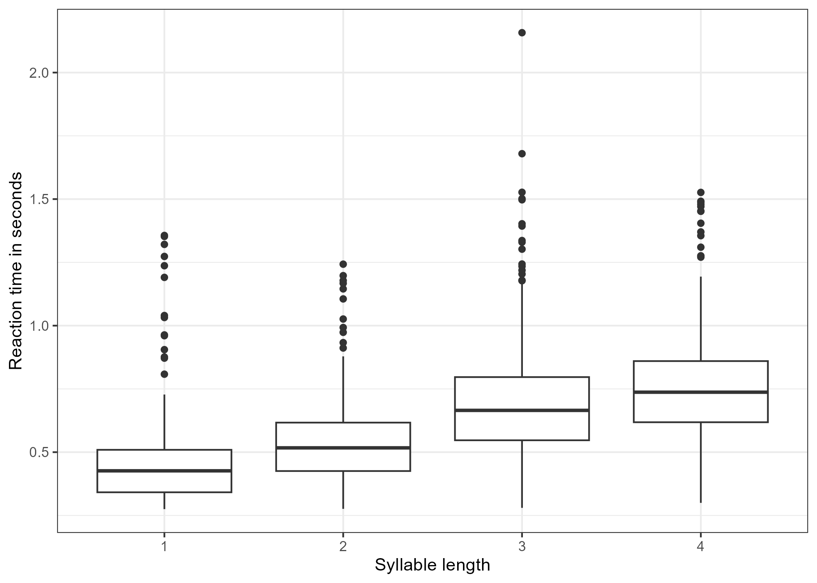
19 | PRELIMINARY RESULTS
Descriptively, high-frequency words are faster and longer words are slower.
Frequency
low
mid
high
Length
1
2
3
4
Mean RT
0.668
0.618
0.510
Mean RT
0.441
0.528
0.684
0.748
Vietnamese LDT | RP2 Colloquium 2
Notes:
Here, lower RT means a faster response. These values are descriptive raw RTs in seconds, while the statistical model later uses log RT. The pattern goes in the expected direction: high-frequency words are responded to faster than low-frequency words, and reaction time increases as syllable length becomes longer. So this slide gives the first descriptive evidence for the frequency and length effects, before I move to the model comparison.

Slide 20
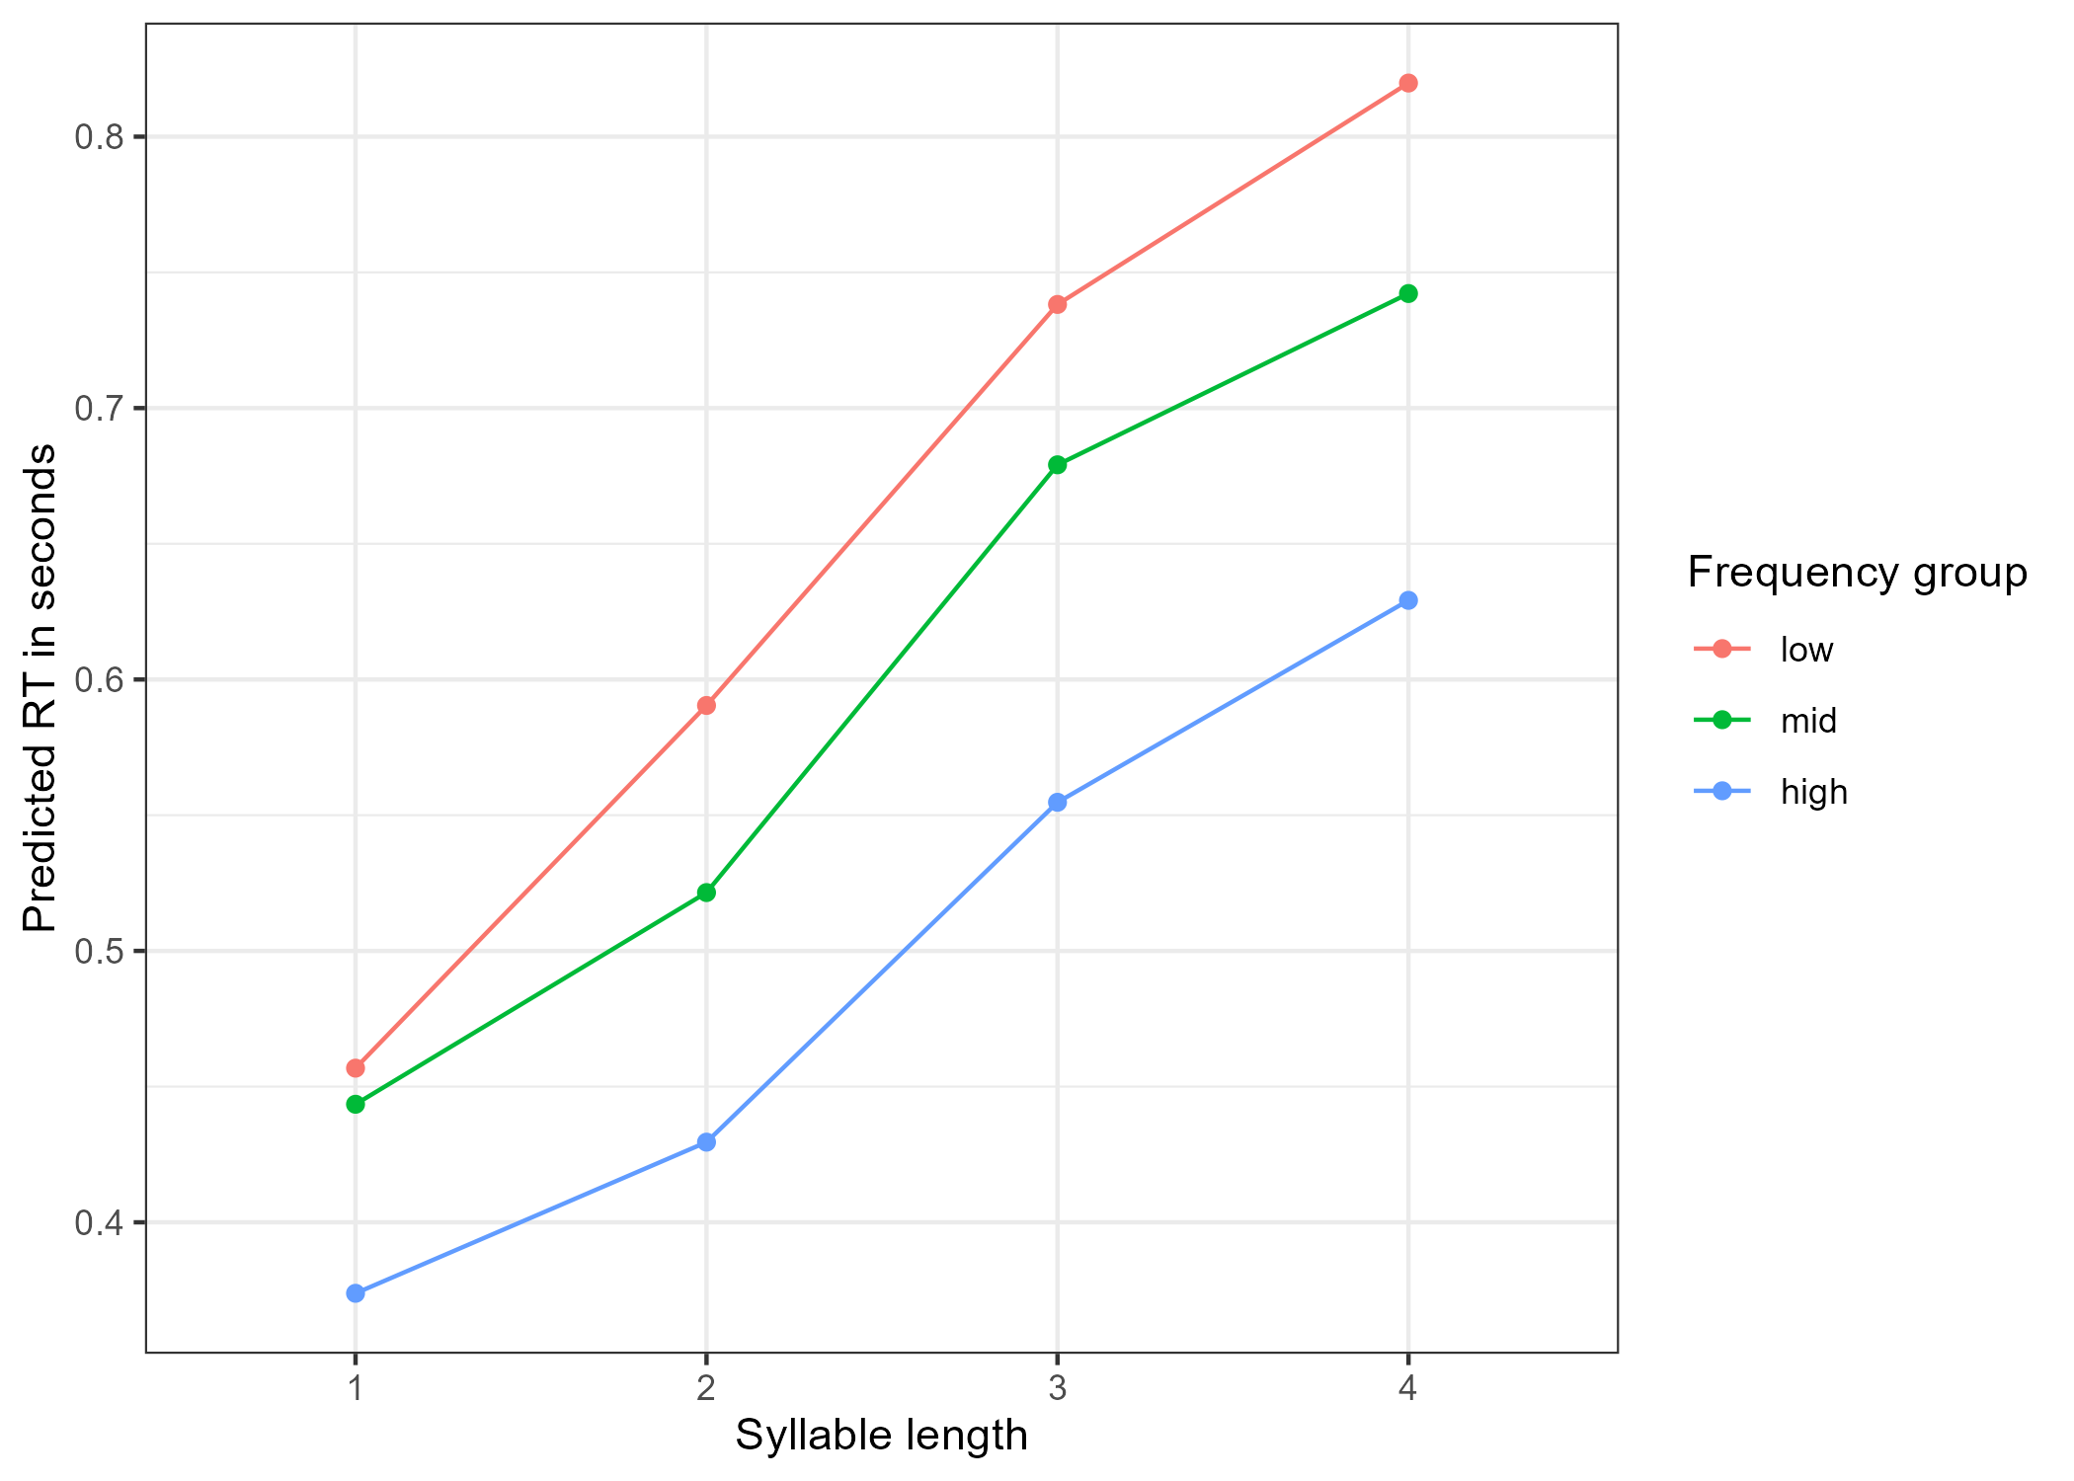
20 | INTERACTION
The frequency advantage may vary by syllable length, but the interaction is modest.
.
Cautious read
Interaction model improves fit over the additive model.
Likelihood-ratio p = .0449.
The interaction is modest and should not be overclaimed.
Result wording: frequency group and syllable length effects are clearer than the interaction.
Vietnamese LDT | RP2 Colloquium 2
Notes:
The interaction asks whether the frequency effect changes depending on syllable length. The result is statistically below .05, with p = .0449, but it is very close to the threshold. So I do not want to overstate it. I interpret it as a possible interaction pattern, while the clearer findings are still the main effects of frequency group and syllable length.

Slide 21
21 | MODEL COMPARISON
Syllable length gives the largest model-fit improvement; the interaction adds only a small increment.
Model
npar
AIC
BIC
Chisq
p
.
Largest step
Syllable length gives the largest model-fit improvement.
model0
4
-286.3
-261.9
-
-
model1 + frequency_group
6
-299.2
-262.6
16.95
< .001
model2 + syllable_length
9
-511.0
-456.1
217.80
< .001
.
Small step
model3 + interaction
15
-511.9
-420.4
12.89
.0449
The interaction improves fit, but weakly. It should guide follow-up checks rather than stand alone.
Vietnamese LDT | RP2 Colloquium 2
Notes:
This table shows the model-building logic step by step. The baseline model is compared with a model adding frequency group, then syllable length, and finally the interaction. Frequency group improves the model, but the biggest improvement comes from syllable length. The interaction adds only a small improvement, and because the model becomes more complex, I treat that part cautiously.

Slide 22
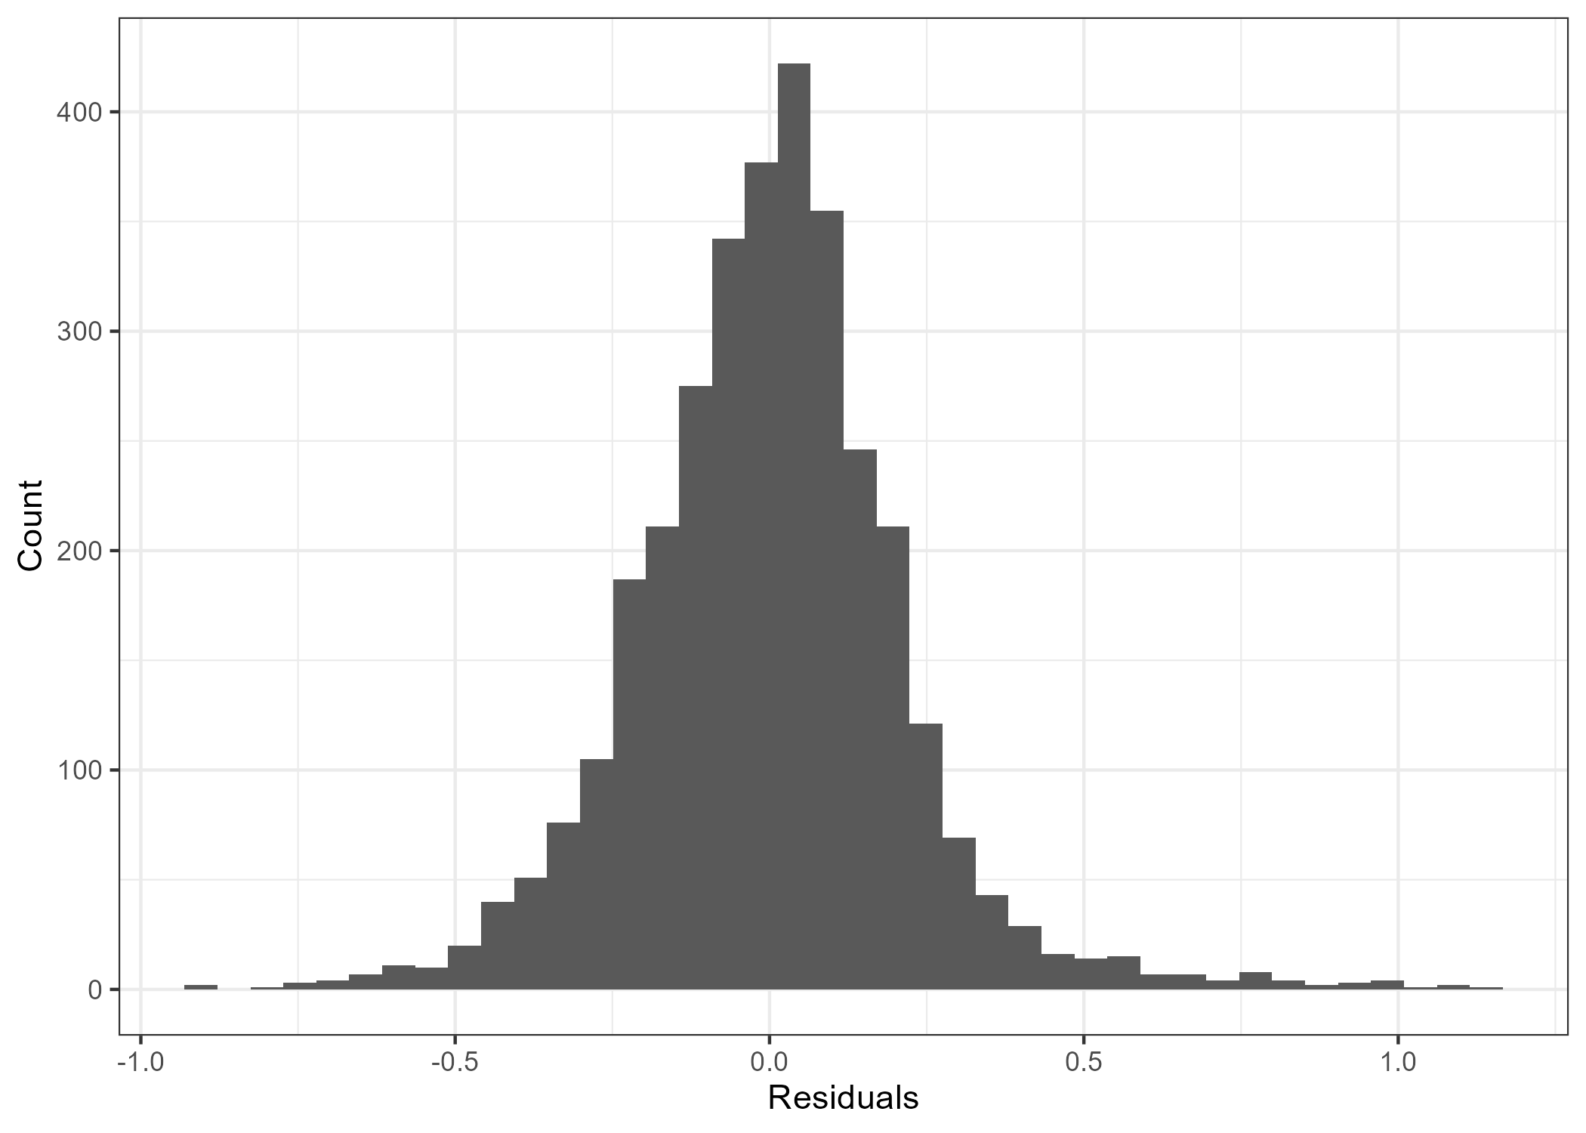
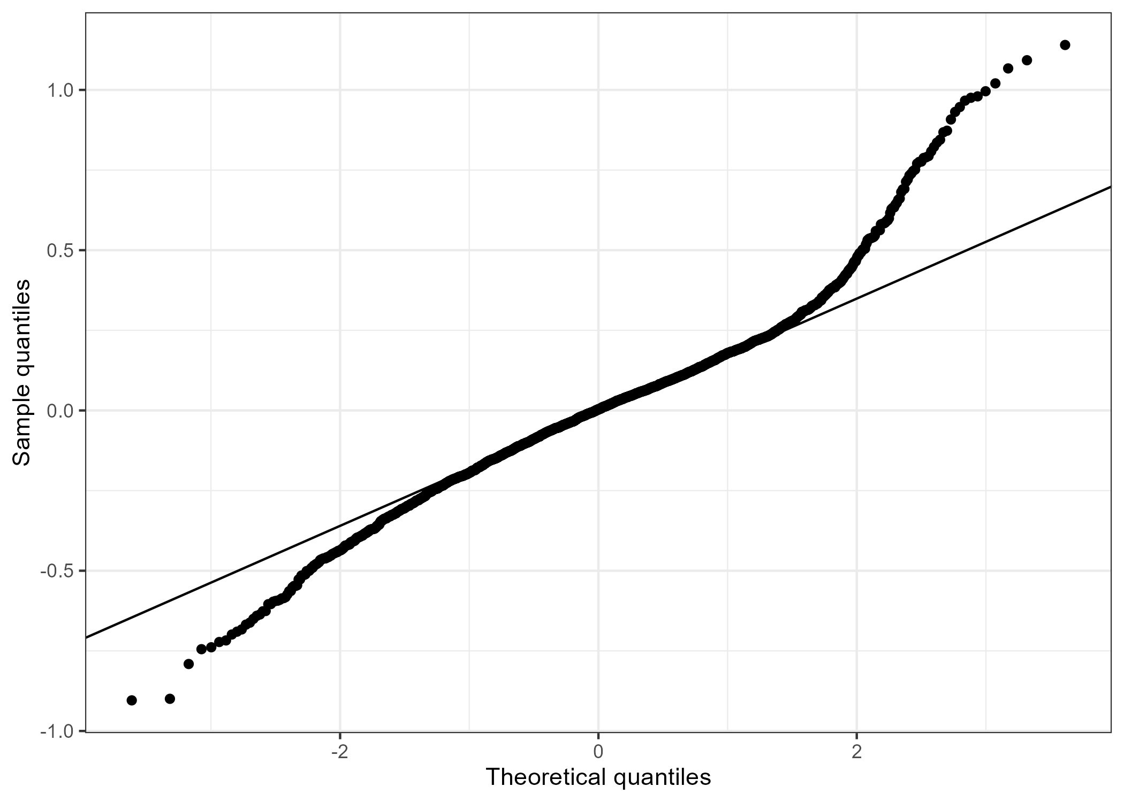
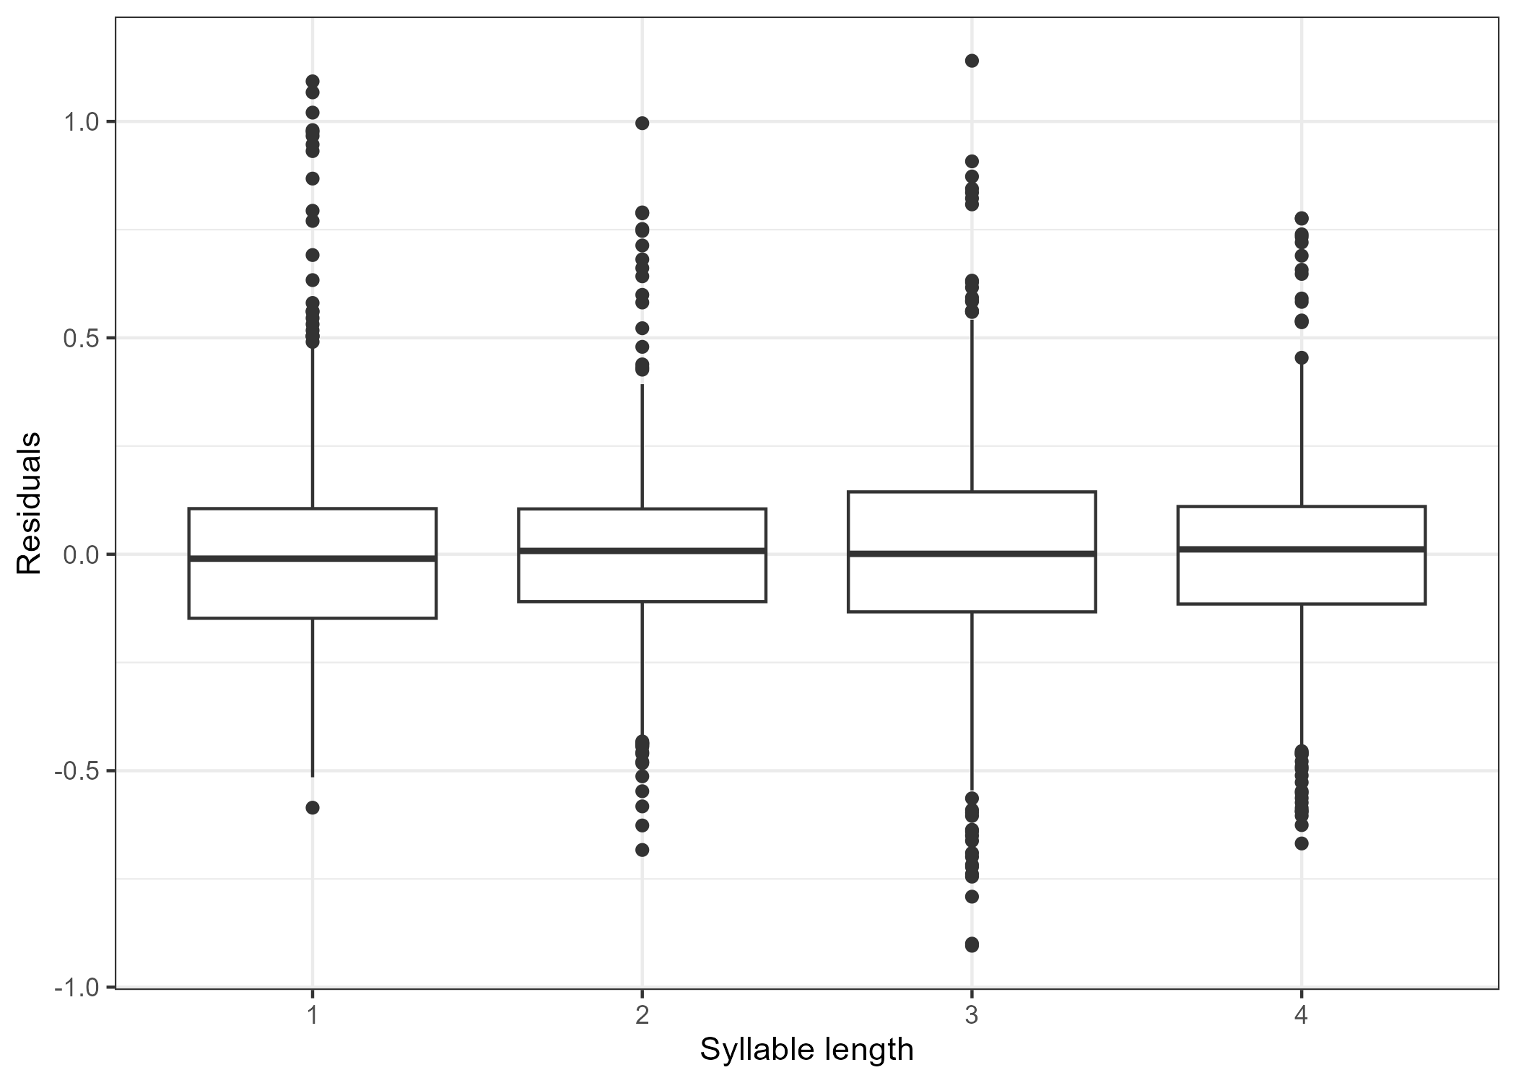
22 | DIAGNOSTICS
No singular fit was detected; diagnostics support cautious preliminary reporting.
.
.
.
Singularity
VIF check
Remaining caution
model0, model1, model2, model3:
FALSE
Adjusted GVIF values remain below common concern thresholds.
RT diagnostics should be reviewed again before thesis-level claims.
Vietnamese LDT | RP2 Colloquium 2
Notes:
Here, I use diagnostics to check whether the model is trustworthy enough for preliminary interpretation. The residual plots check whether the errors look reasonably random. The QQ plot checks whether residuals are close to normal. VIF checks whether predictors are too strongly correlated. The singular-fit check tests whether the random effects are overfitted or unsupported. No singular fit was detected, which is good. These diagnostics do not prove the model is perfect; they support cautious preliminary reporting.

Slide 23
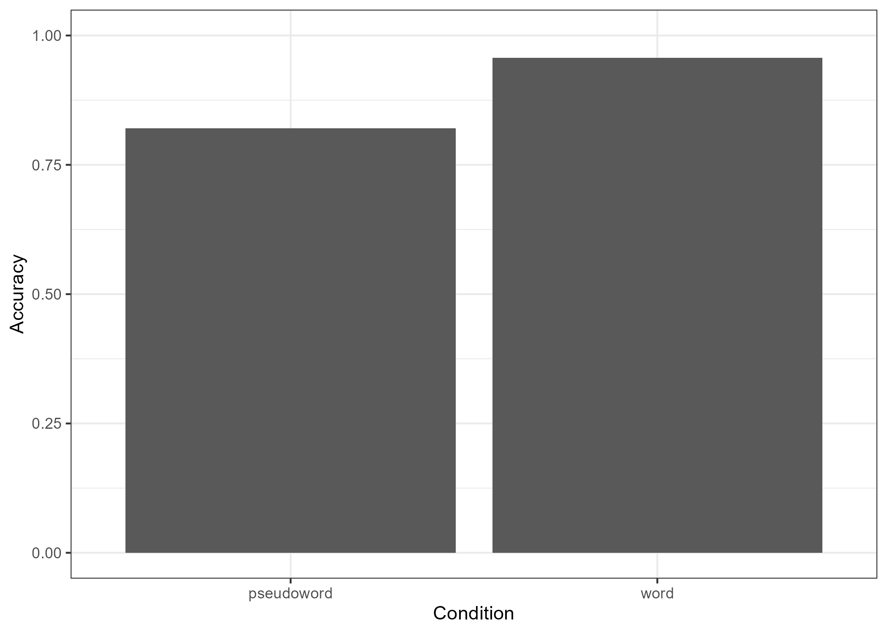
23 | TASK QUALITY
Accuracy and response QC suggest participants generally performed the task seriously.
95.7%
82.0%
word accuracy
pseudoword accuracy
main trials
main trials
0
45
participants
missing RTs
flagged by QC
of 5,760 main trials
Pseudoword accuracy is lower than word accuracy, but still high enough to show nonword discrimination.
Vietnamese LDT | RP2 Colloquium 2
Notes:
Here, I connect accuracy to task validity. High word accuracy suggests real words were recognized reliably. Pseudoword accuracy is lower, which is expected because pseudowords are harder, but 82 percent still suggests participants were not simply pressing word for everything. Zero flagged participants and few missing RTs support usable data quality. This strengthens the interpretation of the lexical decision task.

Slide 24
24 | INTERPRETATION
The strongest preliminary story is frequency plus syllable length, with a tentative interaction.
.
.
.
1. Frequency
2. Syllable length
3. Interaction
High-frequency words were responded to faster than low-frequency words.
Mean RT increased from one-syllable to four-syllable words.
Possible variation in the frequency effect, but modest.
.
Cautious interpretation: lexical-decision RT reflects lexical processing plus task-decision processes, so the results should not be reduced to pure lexical access.
Vietnamese LDT | RP2 Colloquium 2
Notes:
Here, I bring the results back to the research question. The strongest result is that frequency group and syllable length follow the expected directions: high frequency is faster, and longer syllable length is slower. The interaction is interesting, but secondary and should be treated cautiously. Lexical decision RT reflects both lexical processing and decision or response processes, so the final report should avoid claiming pure lexical access.

Slide 25
25 | LIMITATIONS
The current analysis is ready for discussion, but not yet a final thesis conclusion.
N = 48 reaches the minimum target but is still a minimum sample.
Pseudowords should be reviewed for plausibility and matching before final reporting.
Frequency source and item matching may need dispersion/register checks.
The current model uses random intercepts; richer structures can be tested if stable.
The project does not solve full Vietnamese word segmentation.
.
Next analytical step
Review diagnostics, check sensitivity decisions, consider supplementary accuracy models, and refine the interaction interpretation.
Vietnamese LDT | RP2 Colloquium 2
Notes:
The main point of this slide is caution. The dataset is usable, but 48 participants is still a minimum sample. Pseudowords, item matching, and the frequency source should be checked again before final reporting. The current model is also a starting model with random intercepts, so richer structures can be tested later if stable. Overall, the results are ready for discussion, but not yet a final thesis-level conclusion.

Slide 26
26 | TIMELINE
The six-month plan moves from design and data collection toward final modeling and write-up.
01/2026
02/2026
03/2026
04/2026
05/2026
06/2026
literature
final RQ
stimuli
pseudowords
PsychoPy /
Pavlovia
data
collection
cleaning/QC
R Markdown
final models
write-up
done / draft
done / draft
done / draft
done / draft
done / draft
next
.
Current position
Data collection, cleaning, first R Markdown analysis, figures, tables, and diagnostics are ready. Final interpretation and write-up still need review.
Vietnamese LDT | RP2 Colloquium 2
Notes:
The six-month plan is realistic because design, data collection, cleaning, and first analysis are already in place. The remaining work is robustness checking, interpretation, and writing.

Slide 27
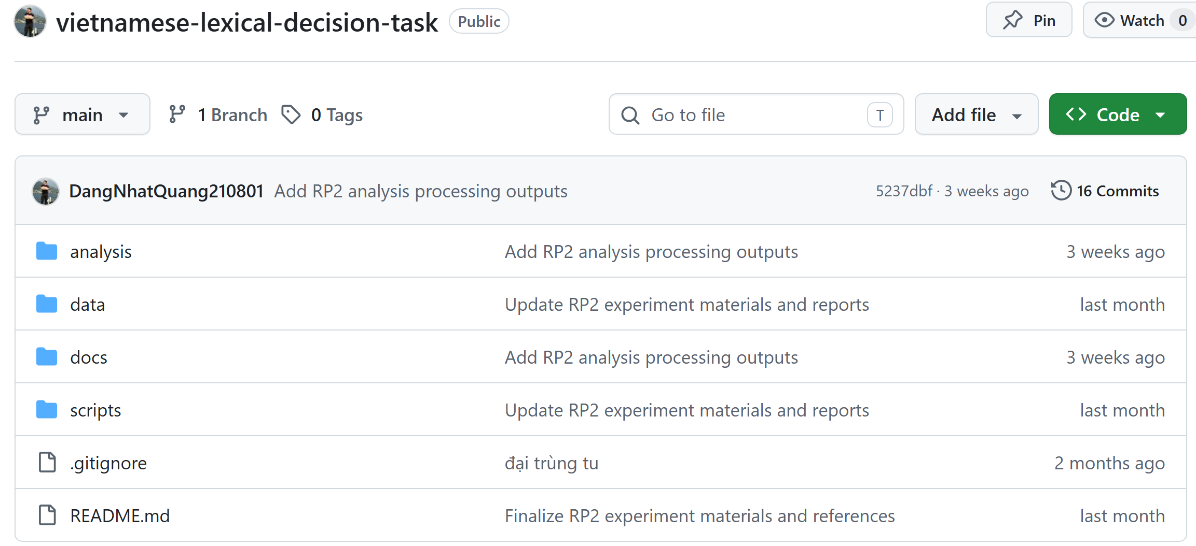
https://github.com/DangNhatQuang210801/vietnamese-lexical-decision-task.git

Slide 28
28 | REFERENCES I
Selected sources for orthography, lexical decision, frequency, and methods.
Baayen, R. H. (2008). Analyzing linguistic data. Cambridge University Press. https://doi.org/10.1017/CBO9780511801686
DeFrancis, J. (1977). Colonialism and language policy in Viet Nam. De Gruyter Mouton. https://doi.org/10.1515/9783110802405
Baayen, R. H., Davidson, D. J., & Bates, D. M. (2008). Mixed-effects modeling with crossed random effects. Journal of Memory and Language, 59(4), 390-412. https://doi.org/10.1016/j.jml.2007.12.005
Encyclopaedia Britannica. (2026). Quoc-ngu. https://www.britannica.com/topic/Quoc-ngu
Balota, D. A., & Chumbley, J. I. (1984). Are lexical decisions a good measure of lexical access? JEP: HPP, 10(3), 340-357. https://doi.org/10.1037/0096-1523.10.3.340
Đinh, Q. T., Lê, H. P., Nguyễn, T. M. H., Nguyễn, C. T., Rossignol, M., & Vũ, X. L. (2008). Word segmentation of Vietnamese texts: A comparison of approaches. LREC 2008. https://aclanthology.org/L08-1355/
Bates, D., Mächler, M., Bolker, B., & Walker, S. (2015). Fitting linear mixed-effects models using lme4. Journal of Statistical Software, 67(1), 1-48. https://doi.org/10.18637/jss.v067.i01
Fernandes, G., & Assunção, C. (2017). First codification of Vietnamese by 17th-century missionaries. Histoire Épistémologie Langage, 39(1), 155-176. https://doi.org/10.3406/hel.2017.3592
Brysbaert, M., Mandera, P., & Keuleers, E. (2018). The word frequency effect in word processing. Current Directions in Psychological Science, 27(1), 45-50. https://doi.org/10.1177/0963721417727521
Vietnamese LDT | RP2 Colloquium 2
Notes:
References are included for academic completeness. Do not read them aloud; just mention that they support the background, lexical decision, frequency, and modeling choices.

Slide 29
29 | REFERENCES II
Selected sources for pseudowords, software, and RT handling.
Ha, L. A. (2003). A method for word segmentation in Vietnamese. Proceedings of Corpus Linguistics 2003, 282-287.
Pham, H., Tucker, B. V., & Baayen, R. H. (2019). Constructing two Vietnamese corpora and building a lexical database. Language Resources and Evaluation, 53(3), 465-498. https://doi.org/10.1007/s10579-019-09451-x
Keuleers, E., & Brysbaert, M. (2010). Wuggy: A multilingual pseudoword generator. Behavior Research Methods, 42(3), 627-633. https://doi.org/10.3758/BRM.42.3.627
R Core Team. (2026). R: A language and environment for statistical computing. R Foundation for Statistical Computing. https://doi.org/10.32614/R.manuals
McKinney, W. (2010). Data structures for statistical computing in Python. Proceedings of the 9th Python in Science Conference, 56-61. https://doi.org/10.25080/Majora-92bf1922-00a
Ratcliff, R. (1993). Methods for dealing with reaction time outliers. Psychological Bulletin, 114(3), 510-532. https://doi.org/10.1037/0033-2909.114.3.510
Meyer, D. E., & Schvaneveldt, R. W. (1971). Facilitation in recognizing pairs of words. Journal of Experimental Psychology, 90(2), 227-234. https://doi.org/10.1037/h0031564
Verdonschot, R. G., Hoàng, T. L. P., & Tamaoka, K. (2022). Phonological encoding in Vietnamese. Quarterly Journal of Experimental Psychology, 75(7), 1355-1366. https://doi.org/10.1177/17470218211053244
New, B., Ferrand, L., Pallier, C., & Brysbaert, M. (2006). Reexamining the word length effect. Psychonomic Bulletin & Review, 13(1), 45-52. https://doi.org/10.3758/BF03193811
Whelan, R. (2008). Effective analysis of reaction time data. The Psychological Record, 58(3), 475-482. https://doi.org/10.1007/BF03395630
Peirce, J. W., Gray, J. R., Simpson, S., MacAskill, M. R., Höchenberger, R., Sogo, H., Kastman, E., & Lindeløv, J. K. (2019). PsychoPy2. Behavior Research Methods, 51, 195-203. https://doi.org/10.3758/s13428-018-01193-y
Yap, M. J., & Balota, D. A. (2009). Visual word recognition of multisyllabic words. Journal of Memory and Language, 60(4), 502-529. https://doi.org/10.1016/j.jml.2009.02.001
Pham, H., & Baayen, H. (2015). Vietnamese compounds show an anti-frequency effect in visual lexical decision. Language, Cognition and Neuroscience, 30(9), 1077-1095. https://doi.org/10.1080/23273798.2015.1054844
Vietnamese LDT | RP2 Colloquium 2
Notes:
Close briefly and invite questions about the design, cleaning decisions, model structure, or cautious interpretation. The references should not be read aloud unless someone asks about a specific source.

Slide 30
30 | Thank you for your attention
Vietnamese Lexical Decision Task
Nhat.Dang@edu.ruhr-uni-bochum.de
Vietnamese LDT | RP2 Colloquium 2

