Slide 1
Tutored Project
Estate agency management
29 / 05 / 2012
Gilles Coulais <gilles.coulais@etu.u-bordeaux1.fr>
Sébastien Piquemal <sebastien.piquemal@etu.u-bordeaux1.fr>
Icham Sirat <icham.sirat@etu.u-bordeaux1.fr>

Slide 2
Plan
Let's start the project
Design: ACSI, UML
Development: Database, classes, tools

Slide 3
I) Start of project
Two sets of technologies tested:
PHP, Html / CSS
Qt / C++

Slide 4
PHP
Designed to build dynamic websites
Works primarily with HTML (Hypertext Markup Language)

Slide 5
PHP - Advantages
Html / Php code integration
Easy hosting
Easy to learn

Slide 6
PHP - Drawbacks
Main drawbacks from our point of view
  Mixed code impacts maintenance and readility
  Naming conventions

Slide 7
Qt/C++
Our choice
A step forward for us
A cross platform environment

Slide 8

Database
PostgreSQL
Management system of relational databases

Slide 9

Other tools
  A free software
  Distributed Version Control System

Slide 10
II) Design
ACSI
GUI Prototyping
UML

Slide 11
ACSI
Design of a chart actor flow (GAF):
Objectives :
Identify internal and external actors of the system
Identify trade flows between actors
Flows between external actors outside the study area

Slide 12
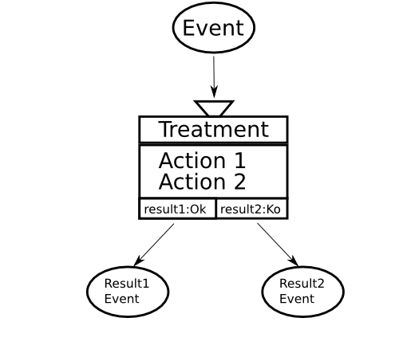
ACSI
MCT : Conceptual Model of Treatments

Slide 13

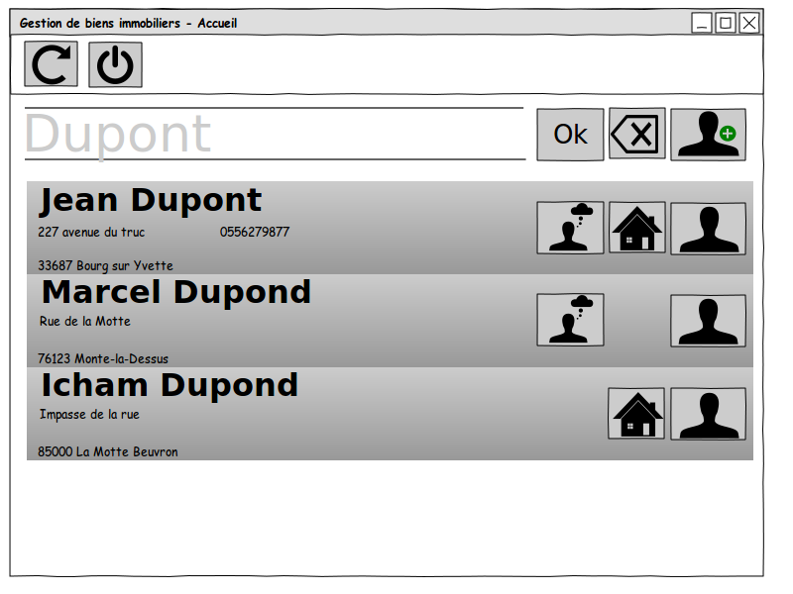
Pencil
Diagrams and GUI prototyping

Slide 14
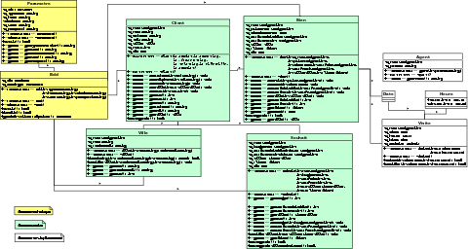
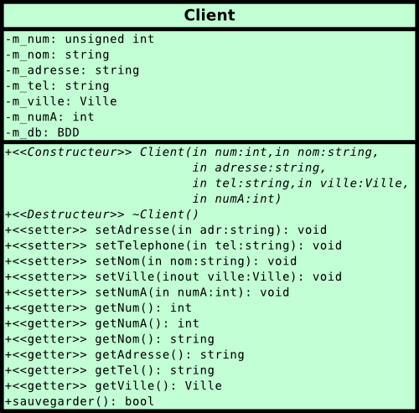
UML
Engine Classes : software architecture

Slide 15
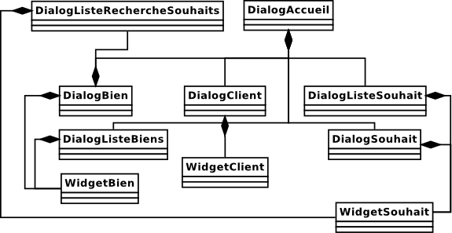
UML
Graphics Classes

Slide 16
III) Development
Database
Engine and User Interface
Some examples

Slide 17
Database
Installation of the PostGreSQL Engine
Creation of the database
    Database structure
    Test Data
PgAdmin III
  graphical administration
  querying tool

Slide 18
Qt
A cross platform integrated development environment
A set of tools and modules built around the C++ language

Slide 19
Qt Creator
C++ code editor
Integrated UI designer
Project and build management tools
Seamless integration with gdb and CDB debuggers
Support for version control systems

Slide 20
QT Designer
GUI layout and forms builder
Generates C++ code from the interface prototypes

Slide 21
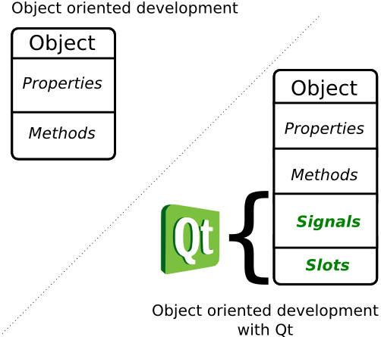
Qt signals and slots

Slide 22
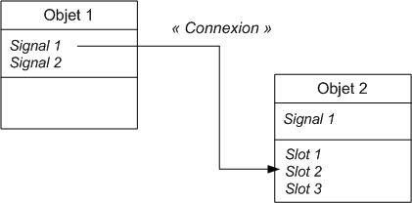
SIGNALS and SLOTS operation

Slide 23
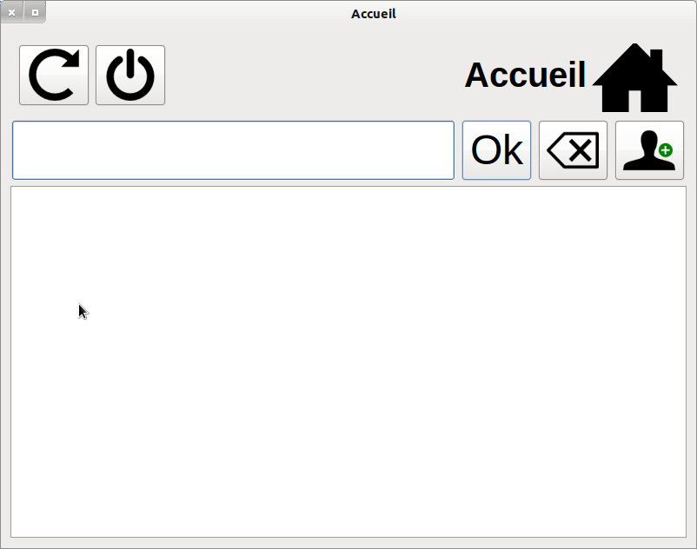
An example
Homepage of our software

Slide 24

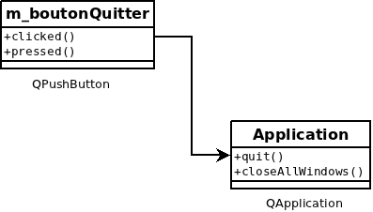
An example
When clicked, the application is shutdown.

Slide 25
An example
The corresponding code
A single line of code is enough
QObject::connect(m_menu.pushButton_2, SIGNAL(clicked()), qApp, SLOT(quit()));

Slide 26
Conclusion
A rich project
A clean and functional software
A professional approach

