Slide 1
RTCF Code Generation and V&V Notes
Long Endurance Multi-INT Vehicle (LEMV)
May 25, 2011
Mike Sufana

Slide 2
Contents
These charts are meant to answer the following questions:
Autocode Prerequisites
RTW CodeCheck
How do I ensure that the code generated properly?
RTCF Notes
How do I obtain the LEMV MKS repository
How do I code generate a block into an RTCF component using CSA Library utilities?
How do I run a sim in RTCF?
Instantiate an RTCF component
Connecting components
Initializing signals
Activating data recorders
Viewing signals
Note: Major LEMV-specific files are highlighted in green

Slide 3
Code Generation V&V: Prerequisites
MATLAB 2010a
\\martini.ccc.northgrum.com\matlab
To run the sim, you’ll need these toolboxes: matalb, simulink, stateflow
To code generate the sim, you’ll also need: real-time_workshop, stateflow_coder
Microsoft Visual Studio 2005
TortoiseSVN & Account
Account setup: http://vodka.ccc.northgrum.com/contact/contact.htm
The LEMV Simulation itself
http://vodka.ccc.northgrum.com/svn/LEMV/trunk/

Slide 4
Code Generation V&V

Slide 5
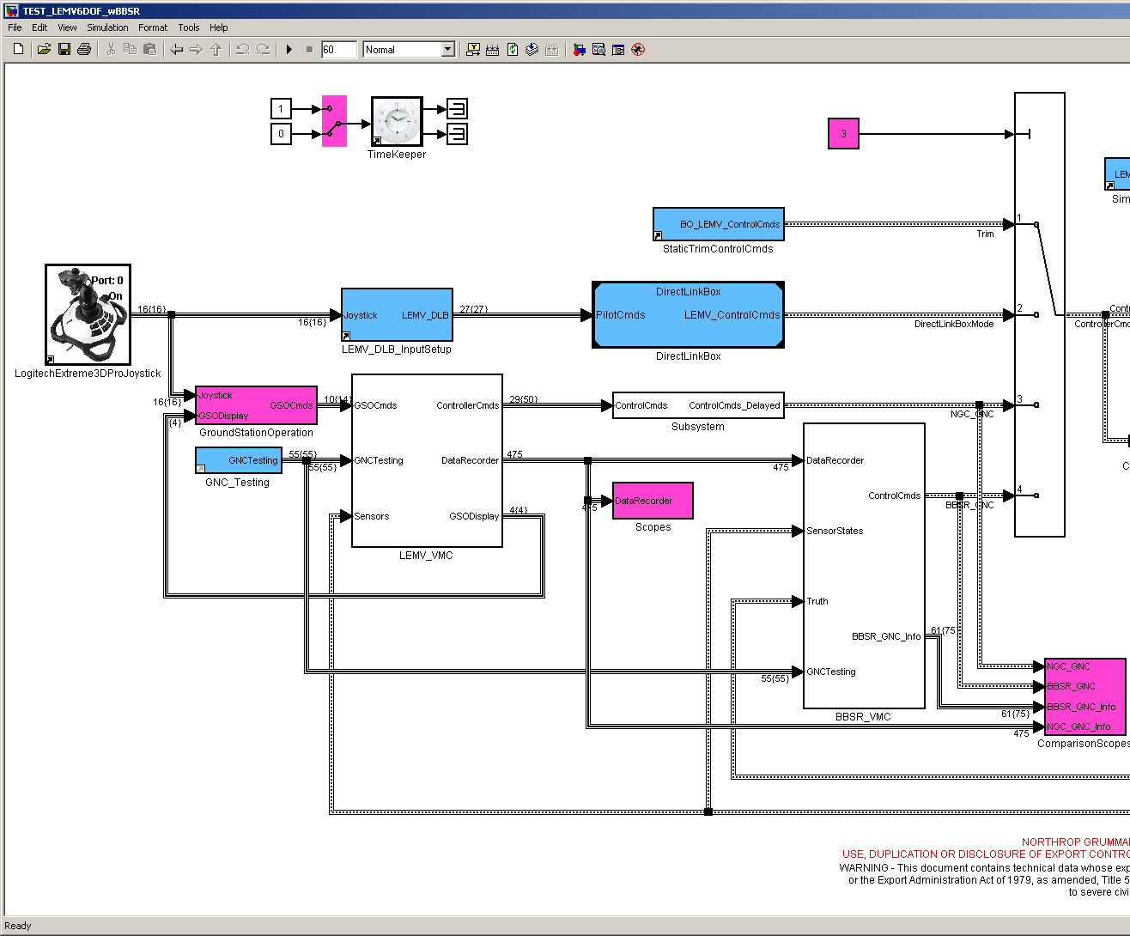
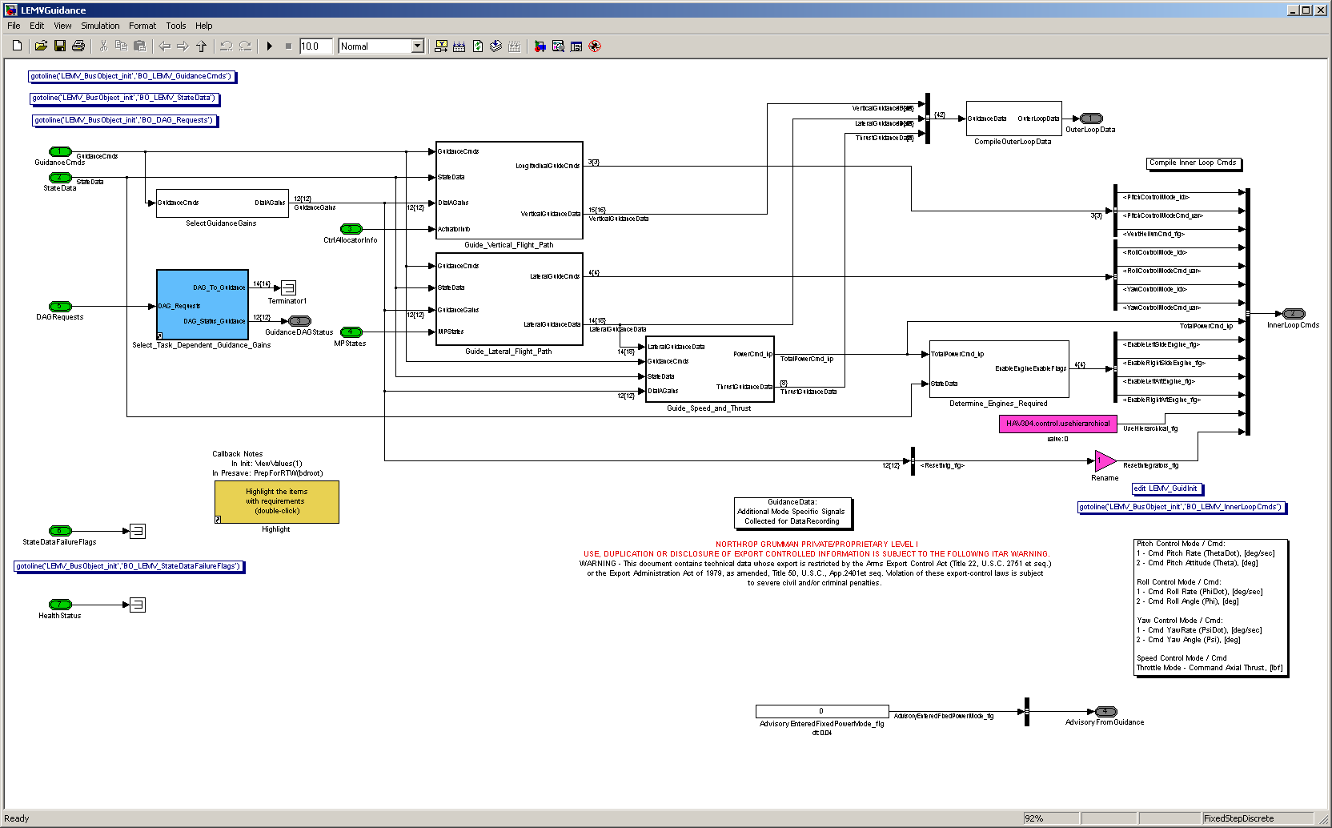
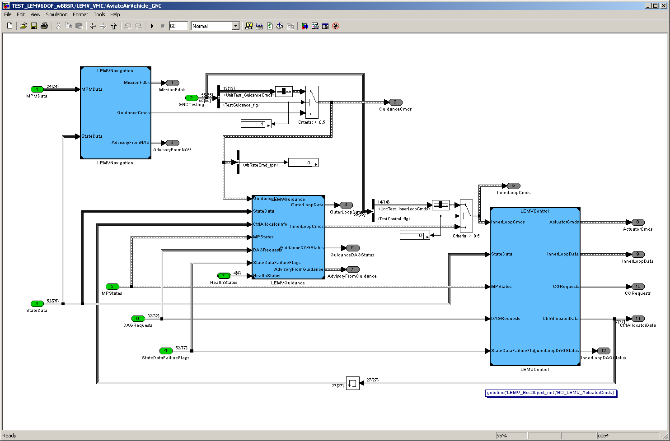
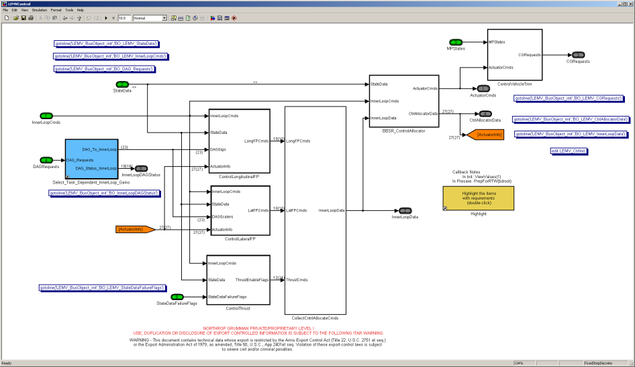
Code Generation V&V
Assumptions
Any block that is destined to be code generated is built up within it’s own model file which can be model referenced by the main simulation
Inputs and Outputs are specified using BusObjects
TEST_LEMV6DOF_wBBSR.mdl
LEMVGuidance.mdl
LEMVControl.mdl

Slide 6
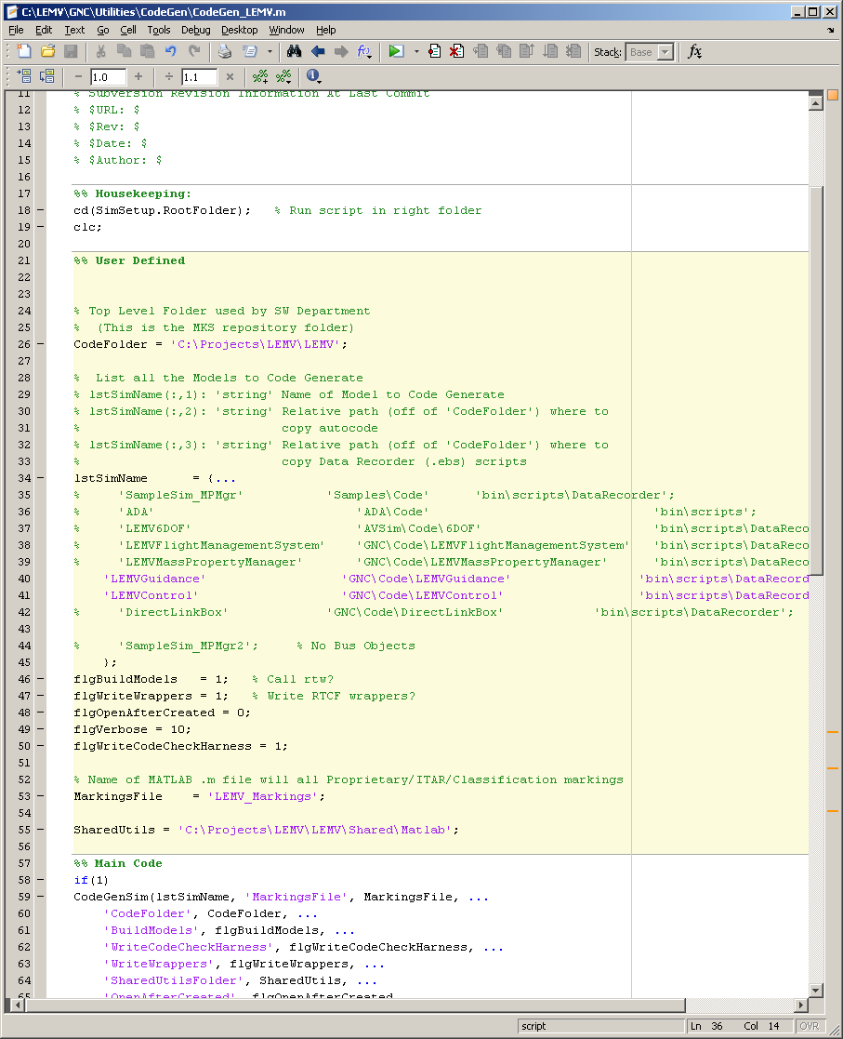
Code Generation V&V
Main Script to Run: CodeGen_LEMV.m
This is the LEMV-specific script that will…
Call the main CSA Library function ‘CodeGenSim’ which will…
Properly configures the model’s RTW settings (RTW_config.m)
Codes the model (rtwbuild.m)
Writes all necessary autocode check files (via Write_CodeCheck_Harness.m)
Writes all necessary RTCF wrapper files (via Write_RTCF_Wrapper)
Copies or moves necessary files into destination folders
Write RTCF files that will connect components within the RTCF environment (Write_RTCF_Connect_Components)
Write RTCF initialization files so PSIL can initialize the RTCF sim (Build_PSIL_TestCases.m & LEMV_WriteRTCF_ICs.m)

Slide 7
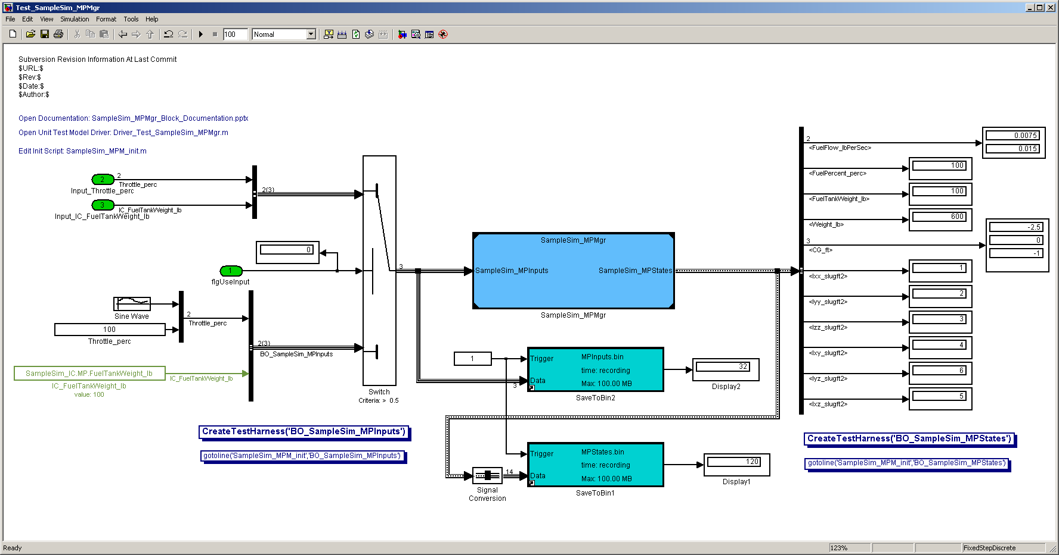
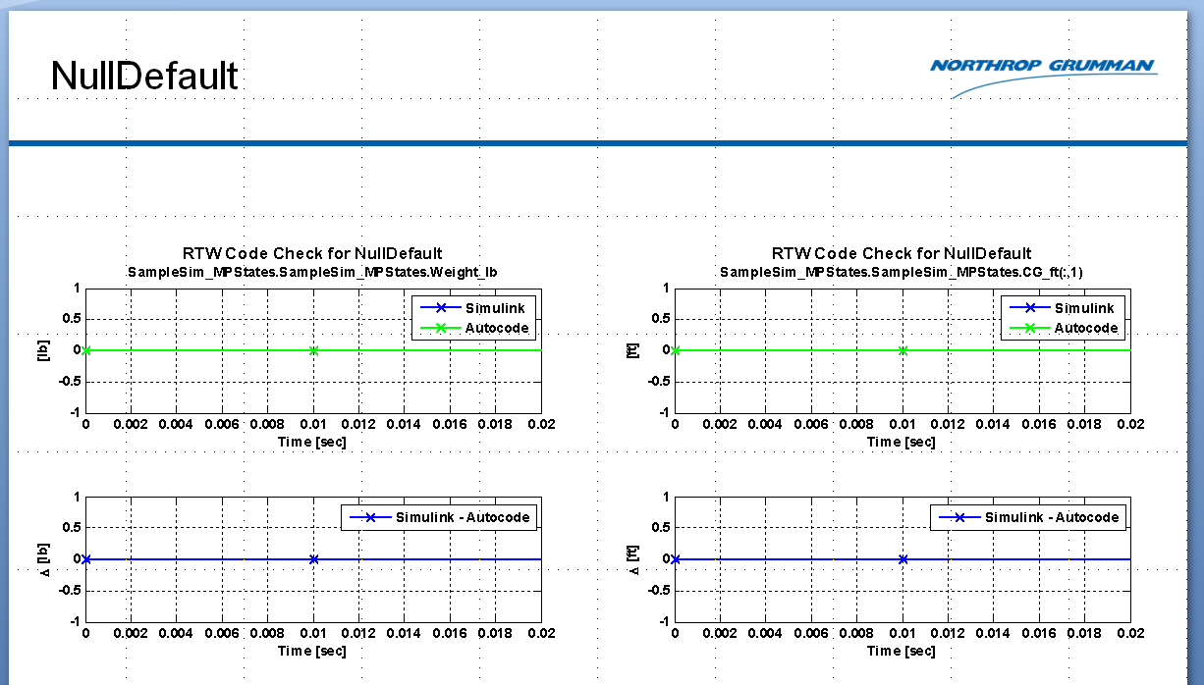
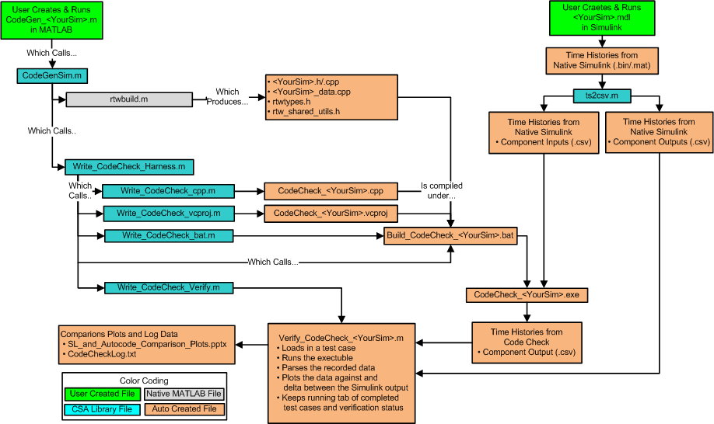
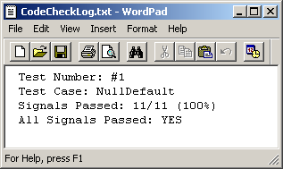
Code Generation V&V
Ensuring proper code generation is a multi-step process
Scripts/functions were developed to help expedite the process, but there is some user-interaction required
Step 1: Drop data recorders into the “main” sim to record all block inputs & outputs. Ensure that the recorded data can saved to a csv file (one file per input/output port)
Step 2: Run the sim in Simulink for a variety of test cases
Step 3: Run CodeGen_LEMV.m to write and compile all the code check files. Note that a ‘CodeCheck_<Block>.exe’ is created
Step 4: Use the auto-created ‘Verify_CodeCheck_<Block>.m’ script to run the .exe at all test cases recorded in Step 2. Outputs will be recorded to .csv, then parsed to timeseries, and plotted/compared against the same outputs from Simulink
Simulink Simulation with Block to be Coded and I/O Data Recorders
Comparison Plots
Master Check Log
CodeCheck Toolbox Flow Diagram

Slide 8
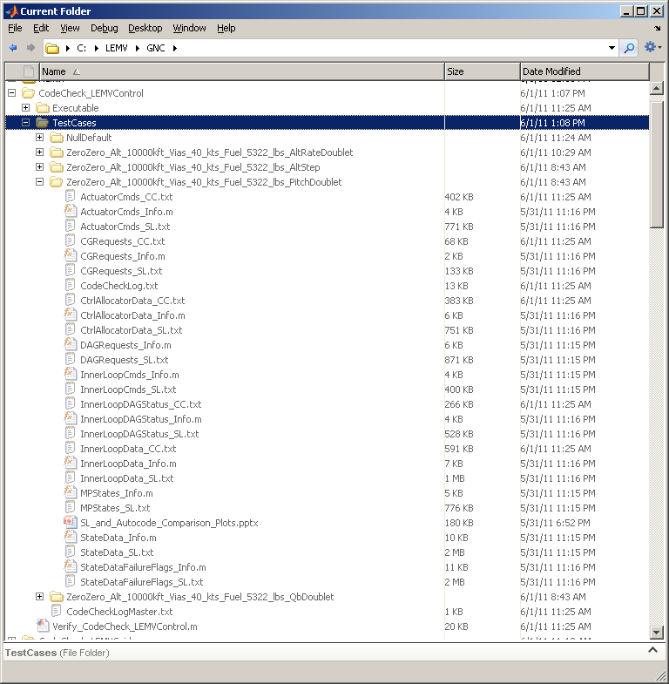
Code Generation V&V Notes
Write_CodeCheck_Harness.m will build a master folder for each component in the ‘SimSetup.RootFolder’
Files written by Write_CodeCheck_Harness support functions.m
Write_CodeCheck_Verify.m
Establishes ‘TestCases’ folder
Writes ‘NullDefault’ inputs so executable and subsequent scripts can be tested
Writes the main Verify_CodeCheck_<Block>.m function
Note that it is up to the user to develop their own script for population the other test cases.
For LEMV, one such script has already been developed. See ‘Run_GNC_Tests.m’. Note ‘Run_GNC_Tests.m’ calls ‘BuildCodeCheckFiles.m’

Slide 9
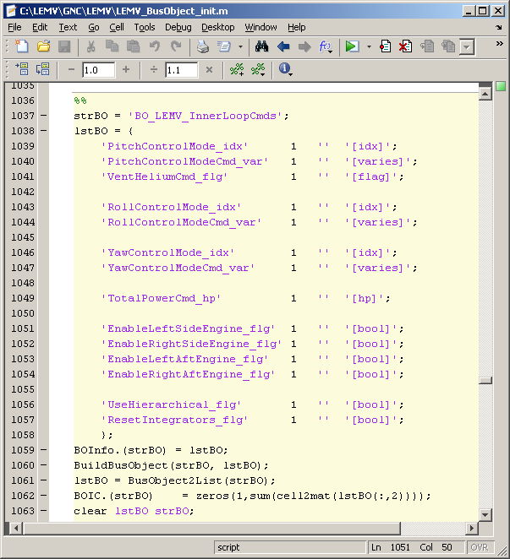
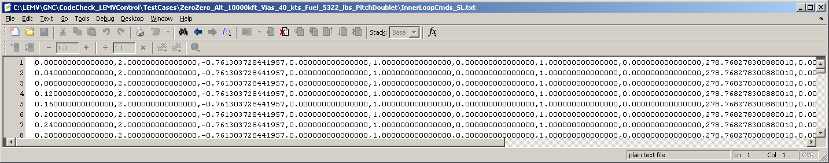
Code Generation V&V Notes
CodeCheck.exe reads in inputs from .csv files
One .txt file per input port
File must include time as its first element
CSA Library ‘ts2csv’ will format data properly
CodeCheck.exe writes outputs to .csv file
One .txt file per output port
File will include time as its first element
LEMV users should be able to run ‘BuildCodeCheckFiles.m’ to build all necessary .csv files
Time
#1 #2 #3…
Example: 8th Bus element member, ‘TotalPowerCmd_hp’ maps to the 9th .csv column

Slide 10
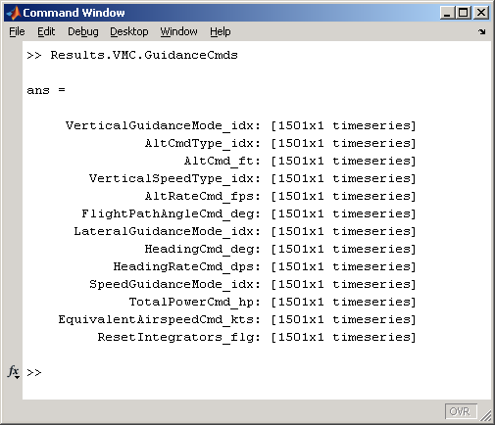
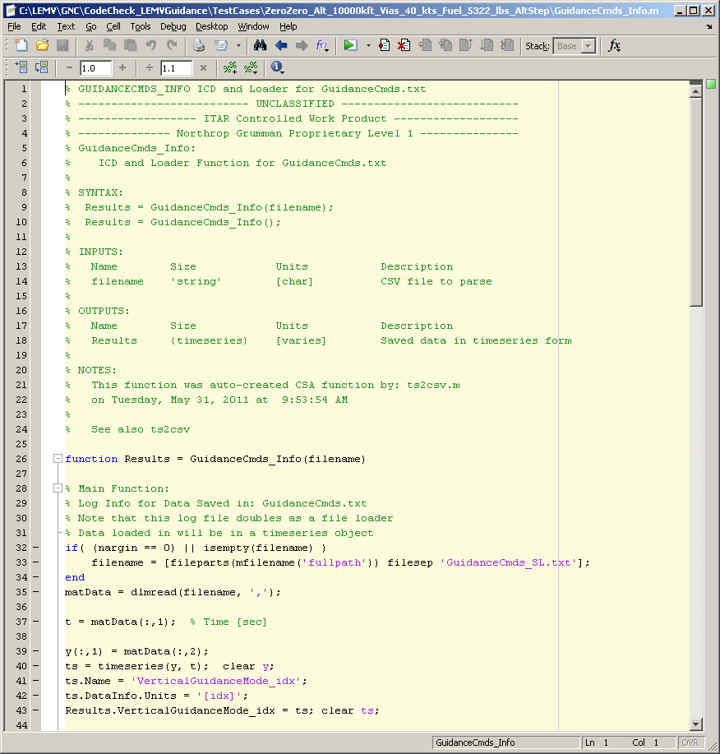
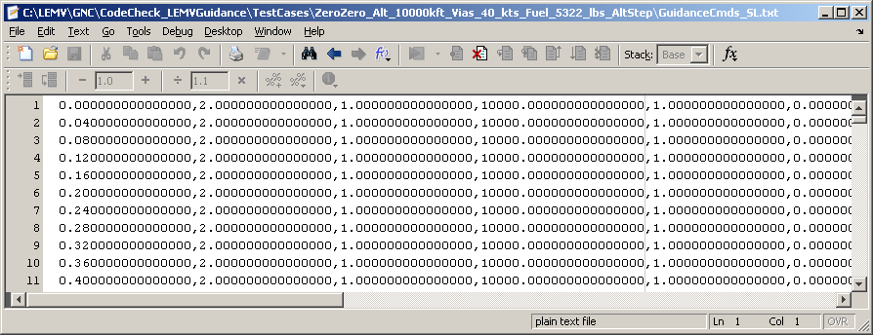
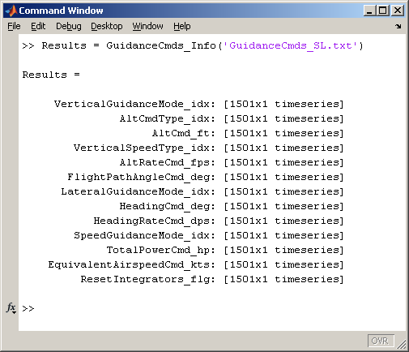
Code Generation V&V Notes
Added benefit of using ts2csv.m is that the function will create the .csv file AND a parse script
Original Results structure
the .csv file
parse script

Slide 11
Obtaining the LEMV MKS repository

Slide 12
Retrieving LEMV Project from MKS
Using Windows Explorer, created a ‘C:\Projects\LEMV’ directory with 3 subfolders: ‘RTCF’, ‘LEMV’, and ‘Build’
Using MKS, created a sandbox for ‘d:/MKS_Projects/LEMV/Build/Build.pj’
Use the ‘lf’ for the Line Terminator option under ‘Options >>’
Edit ‘c:\Projects\LEMV\Build\lemv.bat’ in a text editor
Change ‘SET DEFAULT_BASE=c:\projects’ → ‘SET DEFAULT_BASE=c:\projects\LEMV’
Run the lemv.bat
Check the environment variables. Make sure you’ve got these 3 variables:
LEMV_HOME: ‘c:\Projects\LEMV\LEMV
RTCF_HOME: ‘c:\Projects\LEMV\RTCF
RTCF_PATH: ‘c:\Projects\LEMV\LEMV\bin’
Using Windows Explorer, made the ‘RTCF’ directory ‘writable’ (e.g. removed the Read-only from it)
Open and rebuild the two RTCF solutions in Studio .NET 2005
C:\Projects\LEMV\RTCF\RTCF.sln
C:\Projects\LEMV\RTCF\RTCF_clients.sln
To run just the LEMV6DOF, follow the rest of the steps that I outlined in step (3) below.
To run the full LEMV sim
Create a ‘ICD’ folder within ‘C:\Projects\LEMV\LEMV’
Using MKS, create a sandbox in this ‘ICD’ folder for ‘d:/MKS_Projects/LEMV/ICD/ICD.pj’
Open ‘C:\Projects\LEMV\LEMV\LEMV.sln’ and rebuild
With windows explorer, navigate to the ‘C:\Projects\LEMV\LEMV’ folder
Right click on ‘bin’ and select ‘Cmd prompt here’
At the prompt enter ‘WindSrvr.exe –W bin/scripts/LEMV.ebs’ to launch RTCF. The necessary .ebs scripts are in ‘C:\Projects\LEMV\LEMV\bin\scripts’

Slide 13
How RTCF Works

Slide 14
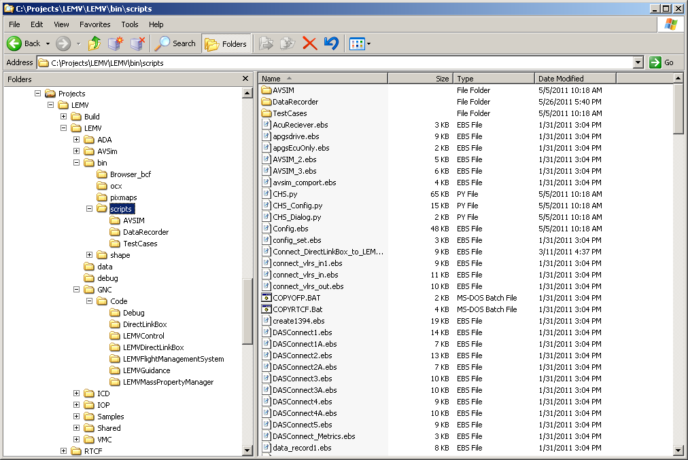
How RTCF Works Folder Structure
Assuming that you’ve checked out the LEMV MKS repository to C:\Projects\LEMV, your folder structure should look like…
Solutions (.sln) for each component stored here
Main “sim” run scripts
DLLs from compiling solutions are stored here
All DataRecorder scripts
All RTCF data recorder outputs are saved here
All initial conditions. These files were build using Build_PSIL_TestCases.m and LEMV_WriteRTCF_ICs.m
Non-program specific RTCF files
(like CSA_Lib)
CodeGenSim.m copies files to here

Slide 15
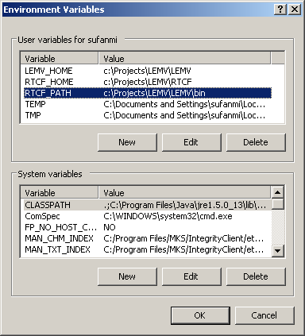
Environment variables will be used to help compile RTCF code

Slide 16
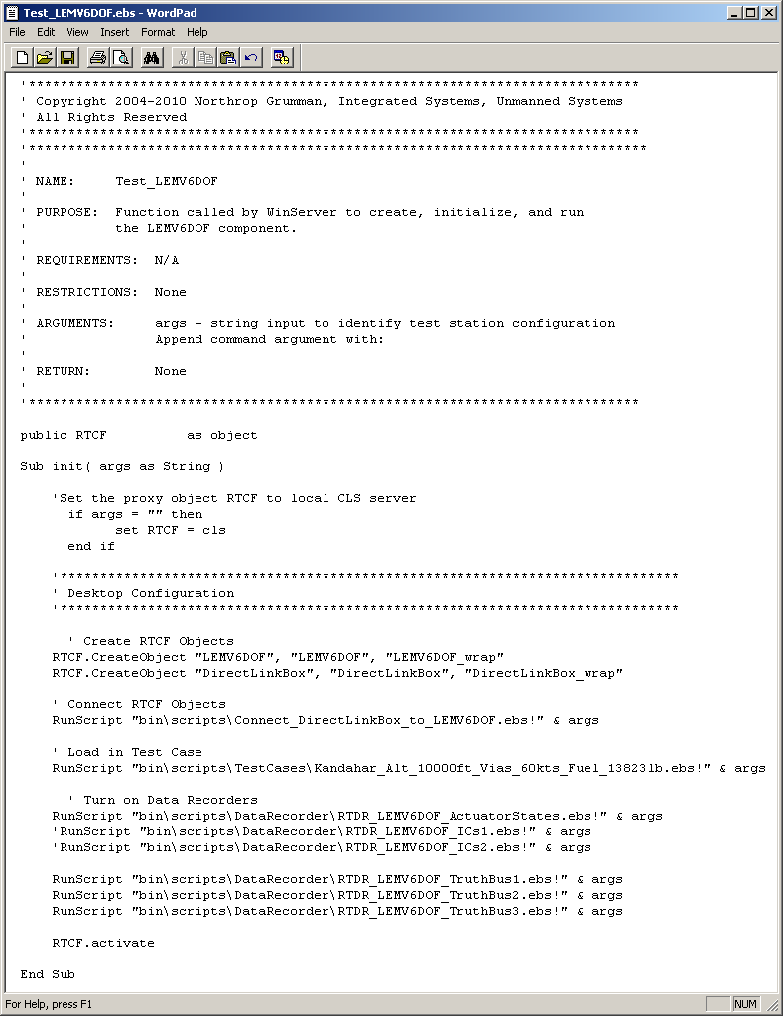
How RTCF Works
An RTCF simulation is created first in an .ebs script and then run using WinSrvr.exe (an RTCF program) from the command line
All .ebs scripts are saved in the LEMV\bin\scripts folder
Nice thing is that you only have to create this script once
Step 1: Create the RTCF Objects
(via Write_RTCF_Wrapper.m)
Step 2: Connect the Objects together
(via Write_RTCF_Connect_Componets.m)
Step 3: Load in a test case
(via LEMV_WriteRTCF_ICs.m)
Step 4: Turn on data recorders
(via Write_RTCF_RTDR.m)
Step 5: Run the sim
(just like pushing play)
Following Slides will go discuss each Step in greater detail

Slide 17
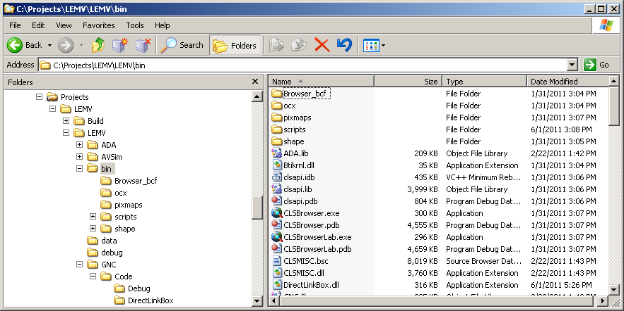
How RTCF Works Step 1: Create the RTCF Objects
WORK IN PROGRESS
RTCF Objects are created by compiling Studio.NET project files (.vcproj)
The MKS folder structure is a little dated and confusing. Autocode for each component is not uniform. Important folder locations:
LEMV6DOF is in LEMV\AVSim\Code\6DOF
ADA is in LEMV\ADA\Code
All other components (DirectLinkBox, LEMVControl, LEMVGuidance, LEMVNavigation, LEMVMassPropertyManager) is in LEMV\GNC\Code
When compiled, a <Component>.dll is created in the LEMV\bin folder. These DLLs are then used in RTCF

Slide 18
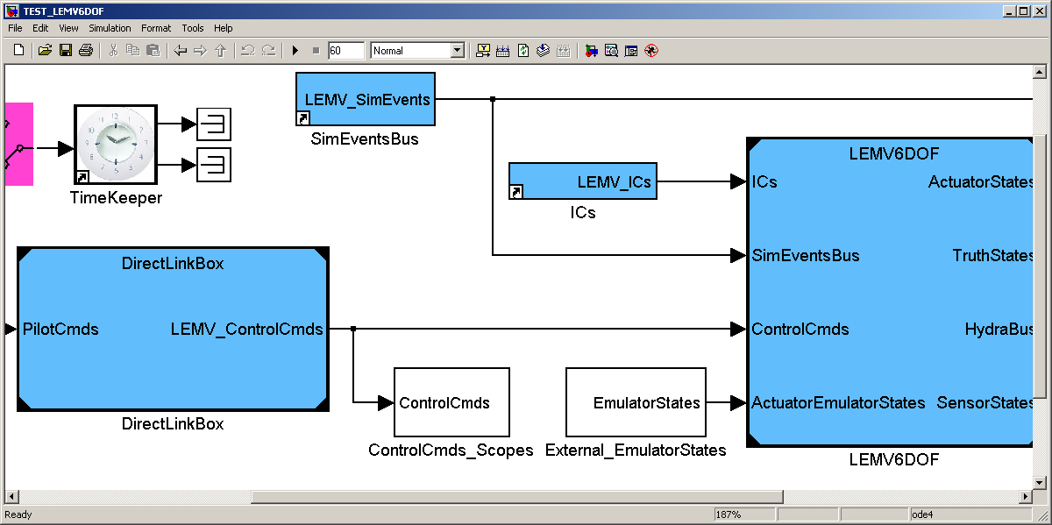
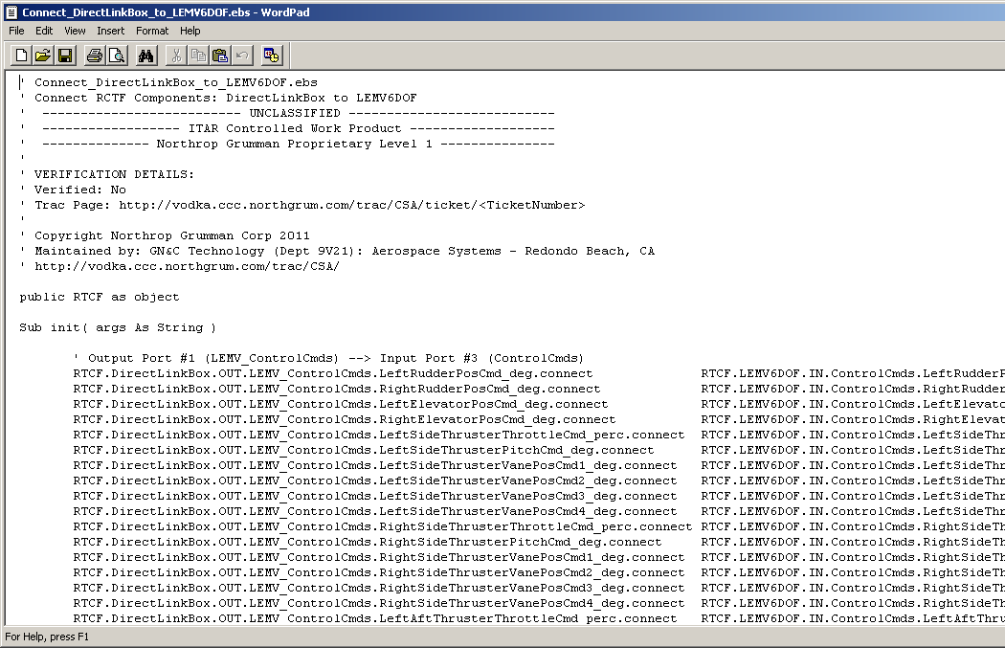
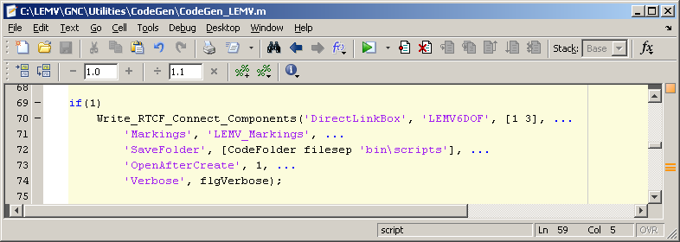
How RTCF Works Step 2: Connecting Components
Components are connected via RTCF commands
These commands can be stored in script form
Scripts can be auto-generated using CSA_Library function ‘Write_RTCF_Connect_Components.m’
Example: Connect the ‘DirectLinkBox’ to ‘LEMV6DOF’
This .ebs script now called from ‘Test_LEMV6DOF.ebs’ (previous slide)
Translation: Use ‘Write_RTCF_Connect_Components’ to connect the ‘DirectLinkBox’ to the ‘LEMV6DOF’, output port #1 to input port #3, and save the file to the ‘bin\scripts’ folder

Slide 19
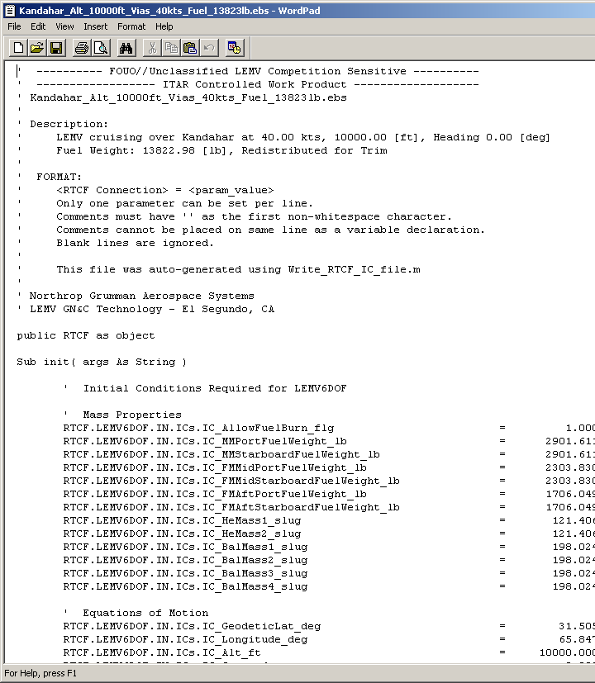
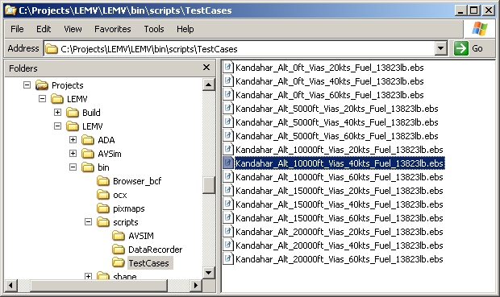
How RTCF Works Step 3: TestCase Initialization
Assumption: Any block initial condition is passed in using an input port (translating into an RTCF connection point)
These connection points can have their values initialized via RTCF commands, which can be stored in script form
Because ICs can vary greatly from component to component, it is left to the user to write the appropriate script
For LEMV, this script is LEMV_WriteRTCF_ICs.m
All test cases are saved in the LEMV\bin\scripts\TestCases folder

Slide 20
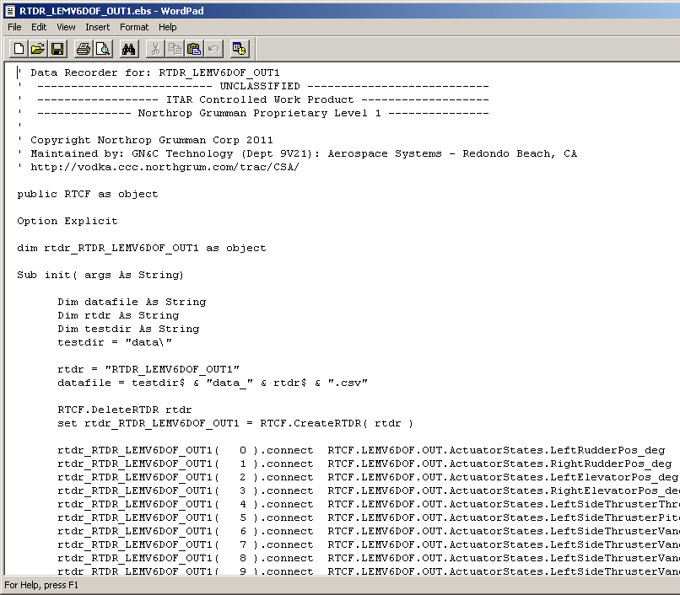
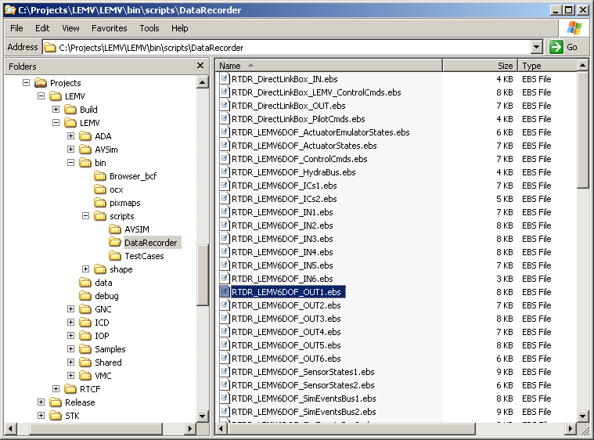
How RTCF Works Step 4: Turning on DataRecorders
Any component input or output (e.g. RTCF connection point) can be recorded to a .csv file using the built-in RTCF data recorder
Data recorders will save data to the ‘data’ folder
Limitations
Each data recorder can record up to 64 signals
Maximum number of data recorders is 16
1024 signals max (64 signals/DR x 16 DR)

Slide 21
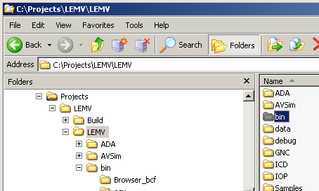
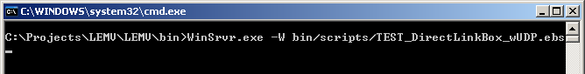
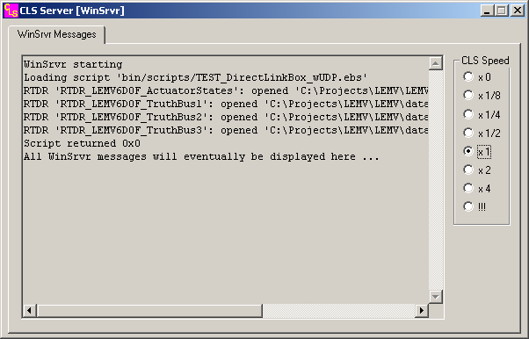
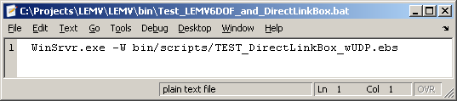
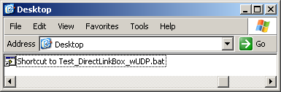
How RTCF Works Step 5: Running an RTCF Sim
An RTCF simulation is run using WinSrvr.exe (an RTCF program) from the command line
Long Method
Navigate to ‘C:\Projects\LEMV\LEMV’, right click on the ‘bin’ folder, and select ‘Cmd Prompt Here’
Type in: WinSrvr.exe –W bin/scripts/<Sim>.ebs
Preferred Method
Write a .bat file that does it for you. Then you can create a shortcut to it from your desktop or some other folder you frequent.
WinSrvr.exe will launch an informational ‘CLS Server’ window which should show you what scripts have been loaded and what data recorders (if any) have been opened
Long Method
Both do the same thing and take you here…
Preferred (Easier) Method

Slide 22
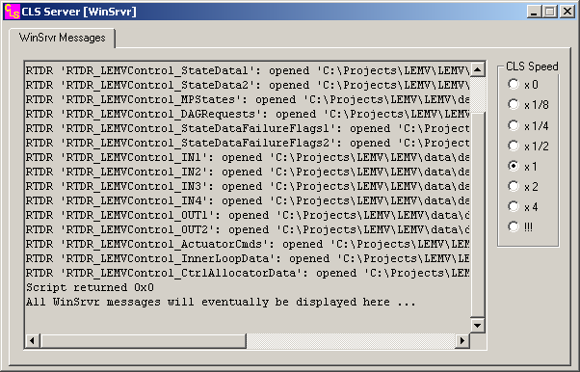
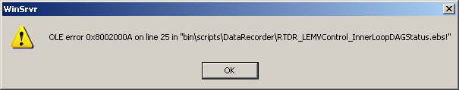
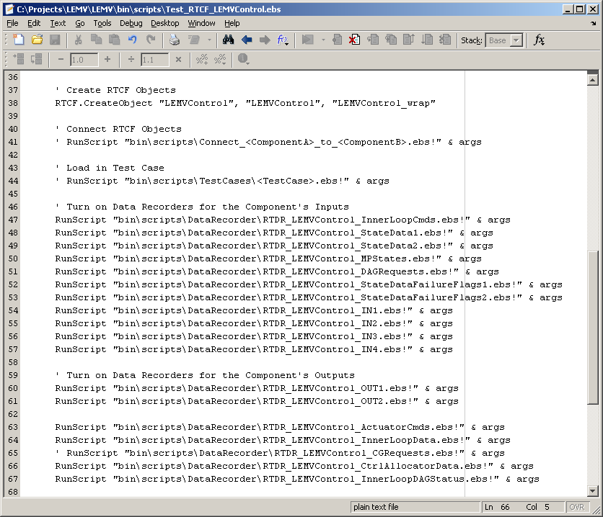
How RTCF Works Known RTCF Error Messages and what they really mean…
If you get something like this… … doublet check the number of data recorders you’ve tried to establish in your run script. Remember that the max is 16 so be selective.
1
2
3
4
5
6
7
8
9
10
11
12
13
This one will throw the error
14
15
16
17

Slide 23
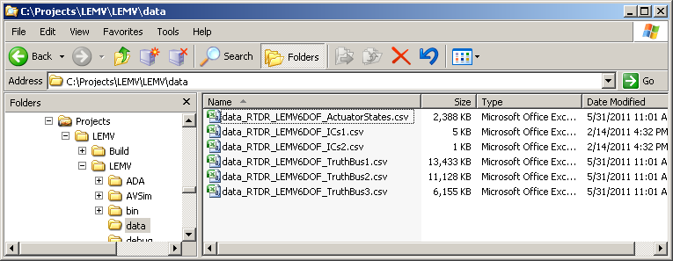
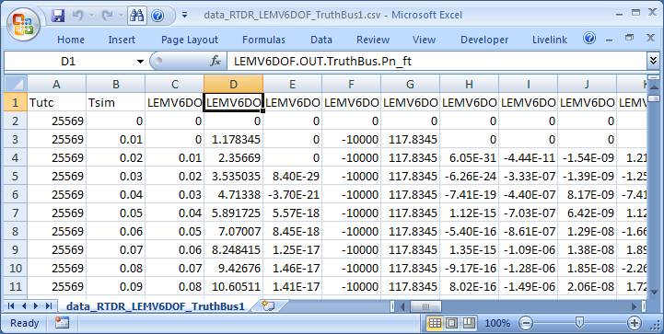
How RTCF Works Step 6: DataRecorder Output
All RTCF DataRecorders are set up to save its data to the ‘data’ folder
Notes
Only one file is created for each data recorder so long simulations will produce huge files
The first two columns (UTC Time and Sim Time) were auto-inserted by the data recorder. The first connection point recorded is the 3rd column (e.g. offset of 2 columns)
Use csv2ts.m to parse this file back into a timeseries for plotting in MATLAB (see Plot_RTCF_Outputs.m)

Slide 24
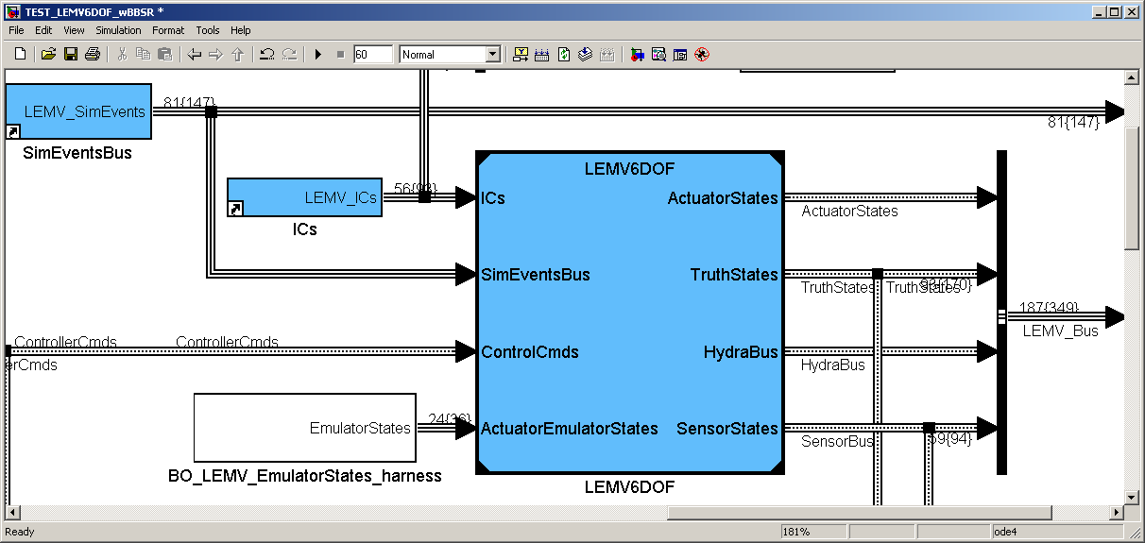
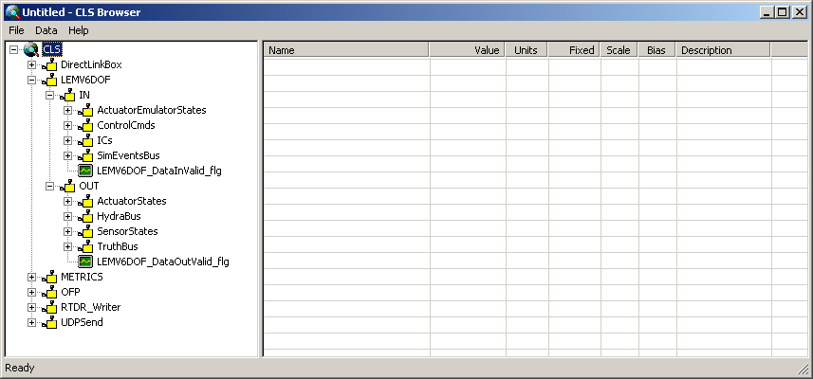
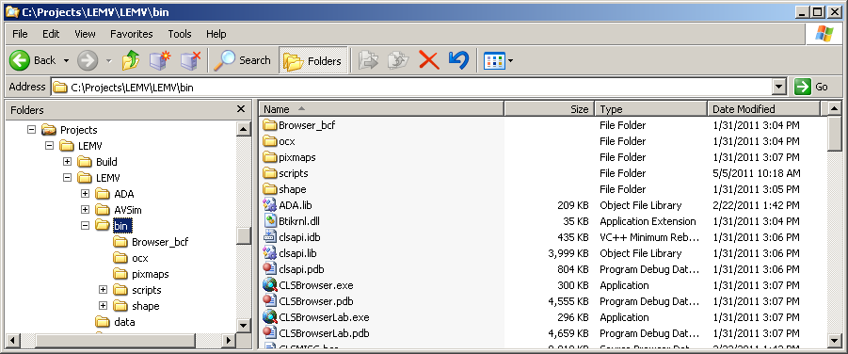
How RTCF Works Step 7: Viewing the Simulation as it Runs
Use the ‘CLSBroswer.exe’, located in the LEMV\bin folder to view the values of the inputs/outputs of runing RTCF components
Notes:
The Simulink input/output port names will be used to define the CLSBrowser structure.

Slide 25
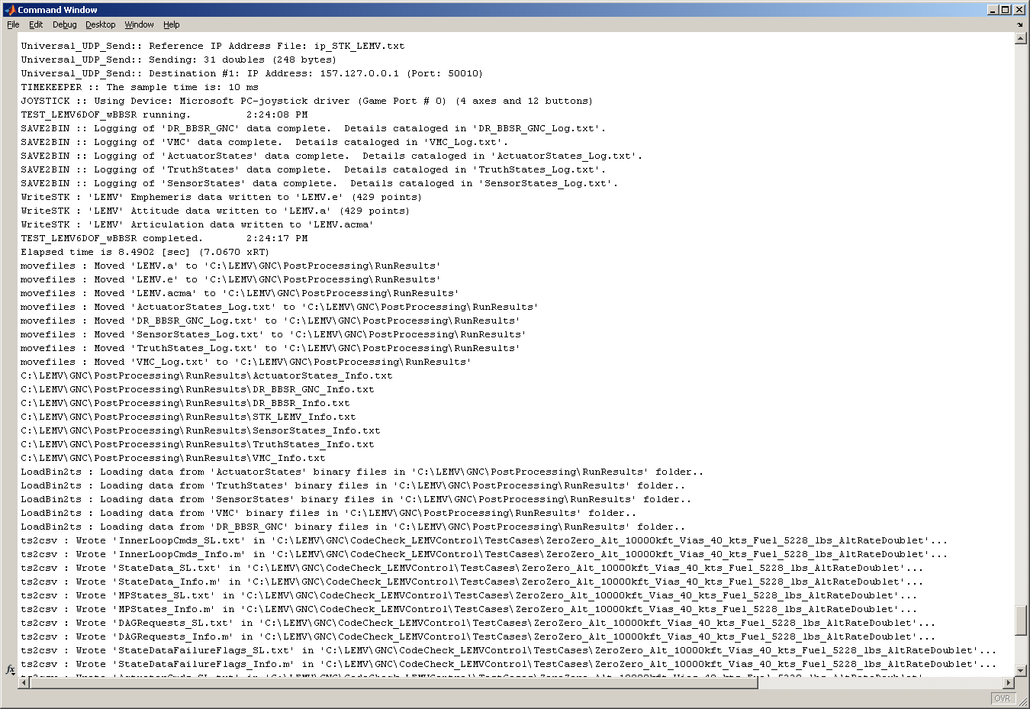
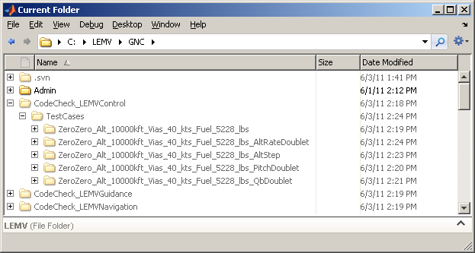
How to Set Up your PC for Code Checking
Note that Steps 1 & 2 can be done in either order
Step 1: Run the main sim and record data
Run TEST_LEMV6DOF_wBBSR.mdl at various flight conditions and GNC tests, record the data to binary, parse the data into timeseries, and then convert the timseries to .csv files. So what you really have to do:
Ensure TEST_LEMV6DOF_wBBSR.mdl updates and runs
Run Run_GNC_Tests.m
This will call BuildCodeCheckFiles.m which will call ParseAll() and then ts2csv.m to build csv files for each input/output port.
If a component’s code check folder (e.g. CodeCheck_LEMVControl) hasn’t been created, it will be created with a ‘TestCases’ folder inside each

Slide 26
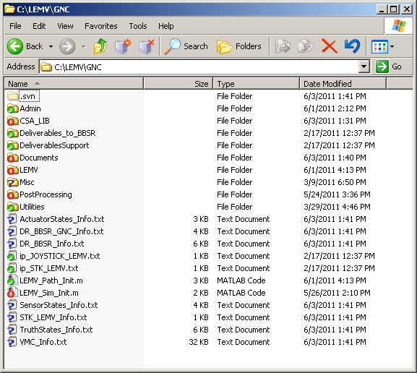
How to Set Up your PC for Code Checking
Step 2: CodeGen the Sim
Run CodeGen_LEMV.m to build and compile all the CodeCheck files for each model reference you want (LEMVControl.mdl, LEMVGuidance.mdl, etc.). The CodeCheck functions will spit out a Verify_CodeCheck_<model>.m script that you can

Slide 28
Backup

Slide 29
Verification of Autocode Status CodeCheck Toolbox
CodeCheck Toolbox Flow Diagram

Slide 30
MATLAB / RTCF Datatypes
MATLAB class | Description | Bytes per element | RTCF name | Class range
Boolean |  | 1 bit | CCLSBool
single | single-precision (32-bit) | 4 | CCLSFloat
double | double-precision (64-bit) | 8 | CCLSDouble
uint8 | Unsigned 8-bit integer | 1 | CCLSByte | 0 to 2⁸ – 1
uint16 | Unsigned 16-bit integer | 2 | CCLSShort | 0 to 2¹⁶ – 1
uint32 | Unsigned 32-bit integer | 4 | CCLSLong | 0 to 2³² – 1
uint64 | Unsigned 64-bit integer | 8 | <Should not be used by RTCF> | 0 to 2⁶⁴ – 1
int8 | Signed 8-bit integer | 1 | CCLSByte | -2⁷ to 2⁷ – 1
int16 | Signed 16-bit integer | 2 | CCLSShort | -2¹⁵ to 2¹⁵ – 1
int32 | Signed 32-bit integer | 4 | CCLSLong | -2³¹ to 2³¹ – 1
int64 | Signed 64-bit integer | 8 | <Should not be used by RTCF> | -2⁶³ to 2⁶³ – 1
1 byte = 8 bits

Slide 31
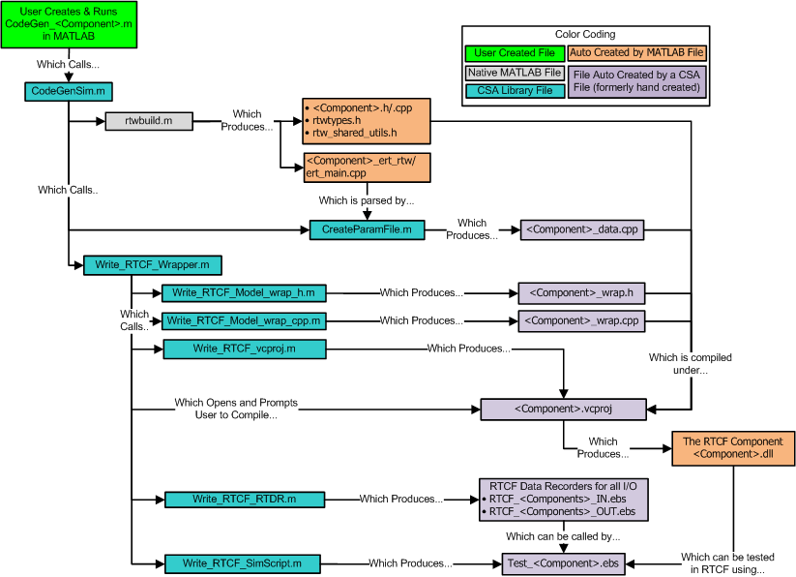
Overview of CSA RTCF Utilities How going from Simulink to RTCF is now a 2 step process
Whenever possible, utilities have been built to write files that used to hand created
Total lines of code (n_{loc}), for each RTCF file (excluding comments) are a function of the component’s inputs (n_{in}), outputs (n_{out}), inputs to the ‘step’ call pulled from ert_main.cpp (n_{step}), and internal variables (n_{data})
Requires knowing…
Names, order & data types of I/O
ert_main inputs
n_{loc} = (~20) + n_{in} + n_{out} + n_{step}
Used to be a big copy/paste task
n_{loc} = (~4) + n_{data}
Requires knowing names and order of I/O and ‘step’ call
n_{loc} = (~48) + 2*(n_{in} + n_{out} + n_{step})
Requires knowing what MATLAB shared utilities (support functions) were generated during autocode
Requires knowing names and order of I/O
RTCF_Component_Flow.vsd

Slide 32
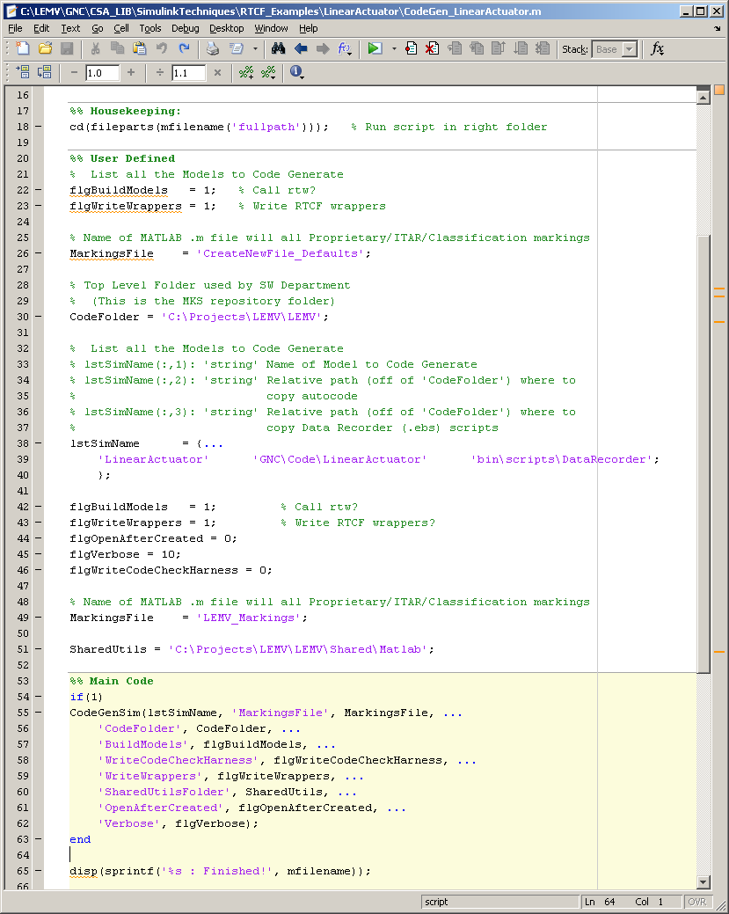
Overview of CSA RTCF Utilities Benefits of CSA Approach
Approach has been proven to work quickly and successfully (LEMV)
Simulink → RTCF Component is a 2 step process
Assumes that your model(s) are CSA compliant (in model reference form with bus objects, etc.)
Step 1: Call ‘CodeGenSim’ with name of models to code, desired location for created files, and template to use for coding. This is typically thrown into a script for easy repetition (e.g. ‘CodeGen_<Component>.m’)
Step 2: Rebuild the Visual Studio solution when prompted. CSA functions will create needed RTCF files, co-locate them, build the .vcproj solution, and open Visual Studio. All user has to do is right click and ‘rebuild’ (SUPER EASY)
Approach also creates numerous ‘nice to have’ files that can be used in RTCF
Data Recorders
Test run script

