Slide 1
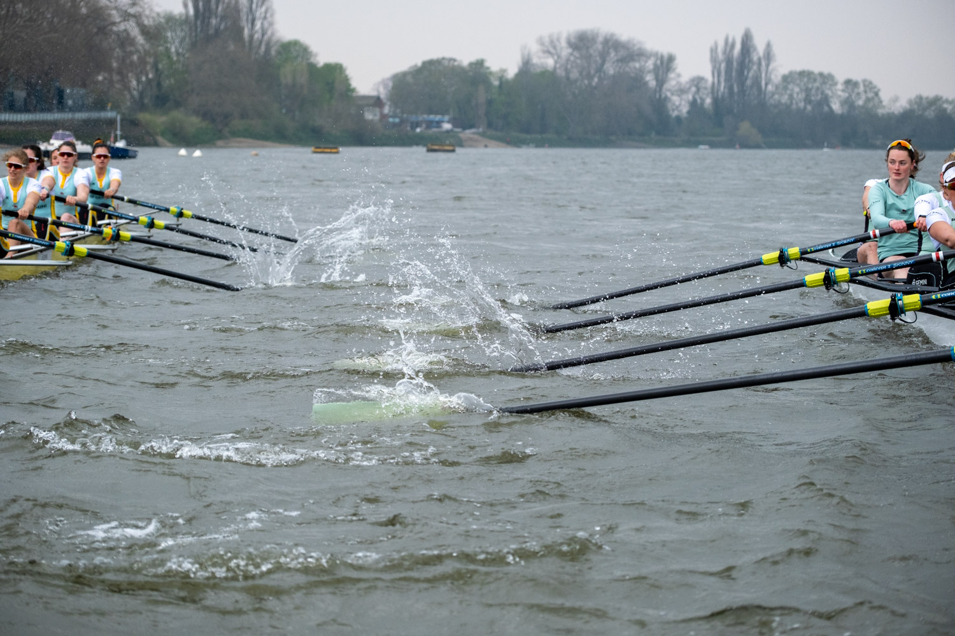
A MANET to Facilitate Collision Avoidance in Rowing Boats
Photo by Freddie Dyke
Notes:
Define MANET

Slide 2
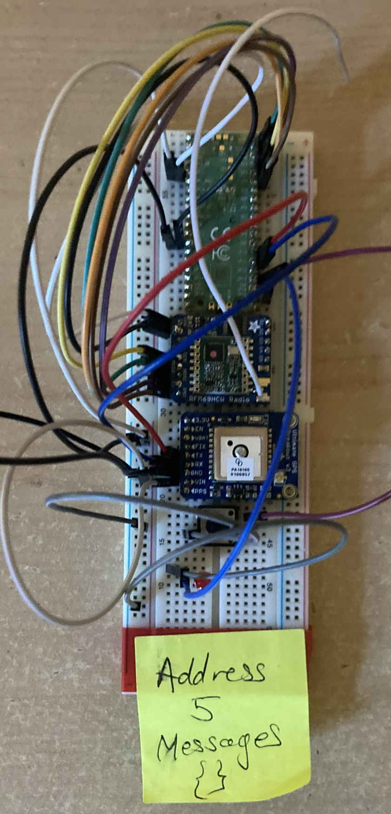
The Project
A mobile ad-hoc network (MANET) to help reduce the number of collisions between rowing boats
Epidemic routing protocol
Modified to include medium access control
Using hardware
Node shown on the right with Raspberry Pi Pico, RFM69 chip, GPS, button and LED
Notes:
MANETs – no preexisiting infrastructure - applications in many situations such as disaster relief, autonomous vehicles and military applications
Explain how the MANET helps prevent collisions – velocity is taken, and if the (use cases include coxless boats, and coxed boats in extremely foggy conditions)
Epidemic paper came out of Duke uni in 2000
Define anti-entropy
Medium access control is based on MACAW, and is implemented in the networking layer bc distributed systems time
Also no exponentiated backoff – simply tries to send when a HELLO packet is received

Slide 3
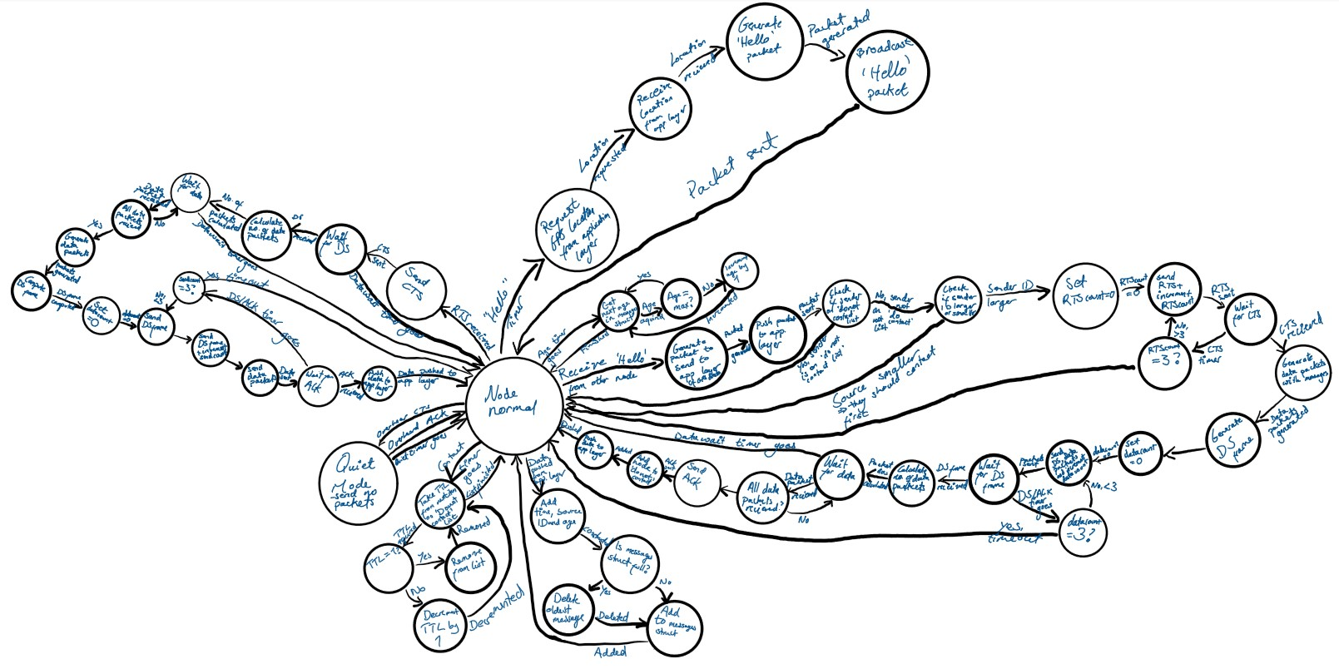
Work so Far
Interfacing with RFM69 and GPS chips
Built network
Epidemic routing with medium access control
Designed state machine
Implemented in hardware CircuitPython and AdaFruit libraries
Issues with radio communication
Started testing, tweaking and evaluation
Started work on the application
Notes:
Note – the state machine has been modified while I was implemted it – the data send packets have been merged into the data packets to reduce the number of packets that are sent by each anti-entropy session
Elaborate on issues:
The radio often picked up entirely fictitious packets and these issues were fixed by changing to a fixed packet size
The AdaFruit library didn’t support fixed size packets so I modified that and fixed a couple of bugs
Tests on next slide

Slide 4
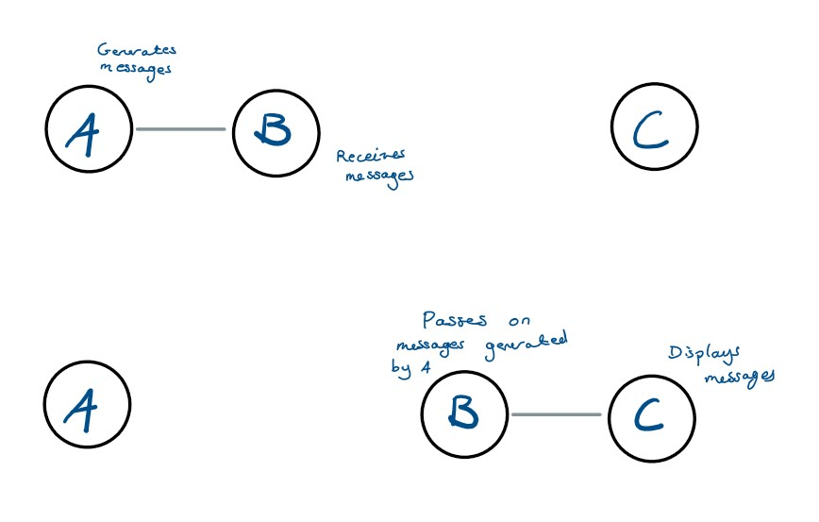
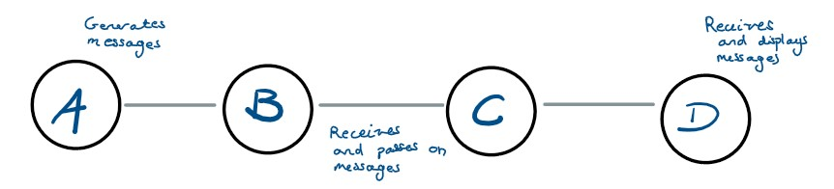
Checking the MANET
First test – checking the MANET propagates messages
Second test – checking the MANET is delay tolerant
Notes:
First test has four nodes in a row, connected to at most 2 nodes. Node A (on the far left) generates messages with a TTL of at least 3 (so they can feasibly get to D), and node D displays any messages it receives. A setup similar to this will be used in the evaluation
The second test displays a network segmentation, with node B acting as a carrier between A what generates messages and C that displays messages

Slide 5
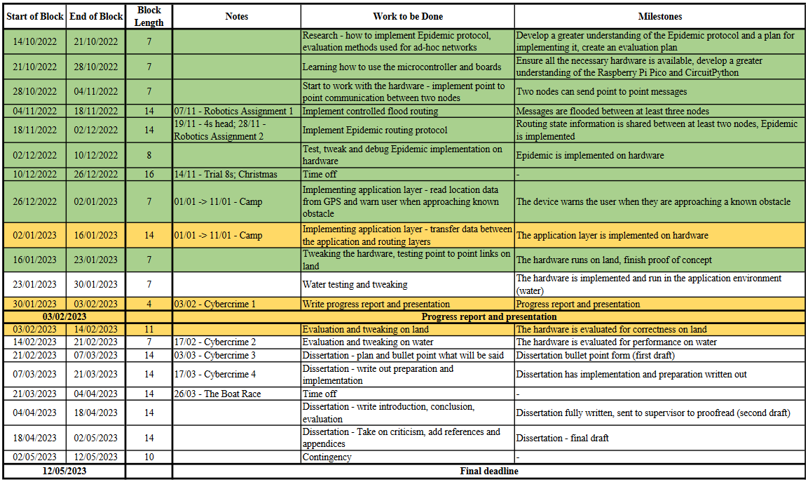
Timetable
About two weeks behind schedule
Notes:
Green is done, yellow in progress, white not started

Slide 6
Remaining Work
Finish application
Bringing the networking and application machines together in MicroPython
Evaluation
Including testing on water (the potential use environment)
GPS location to assist routing
Time dependant
Notes:
Concurrency control requires micropython
Evaluation metrics will include the percentage of packets received, the delay transfer and variance and the time taken to propagate messages after a network partition
GPS location will allow each node to only communicate with nodes suitably close – paper?
Prioritising messages can be done by giving some messages a higher TTL, so they will propagate faster

Slide 7
Questions
Photo by Freddie Dyke
Notes:
Define MANET

