Slide 1
PALLET SCAN & PRINT
Created by:
Daniel PANDELE

Slide 2
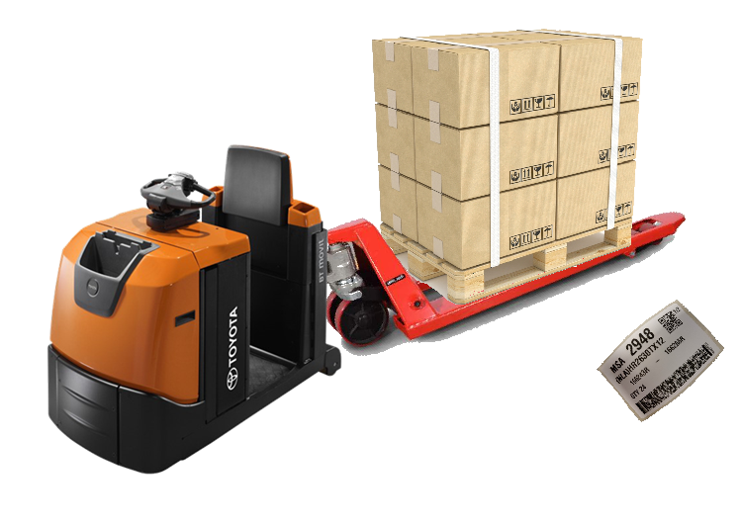


Old process Vs. New process
Old process problems:
Transport problems:
Labels can get lost when towing the pallets
Shipment delays:
A lot of time waisted not only for export operator but also for MAP

Slide 3





Old process Vs. New process
Old process problems:
Slow :
The process involved the operator look for the label in the wrapped pallet.
Can cause errors:
The wrong label could be placed on the pallet.

Slide 4
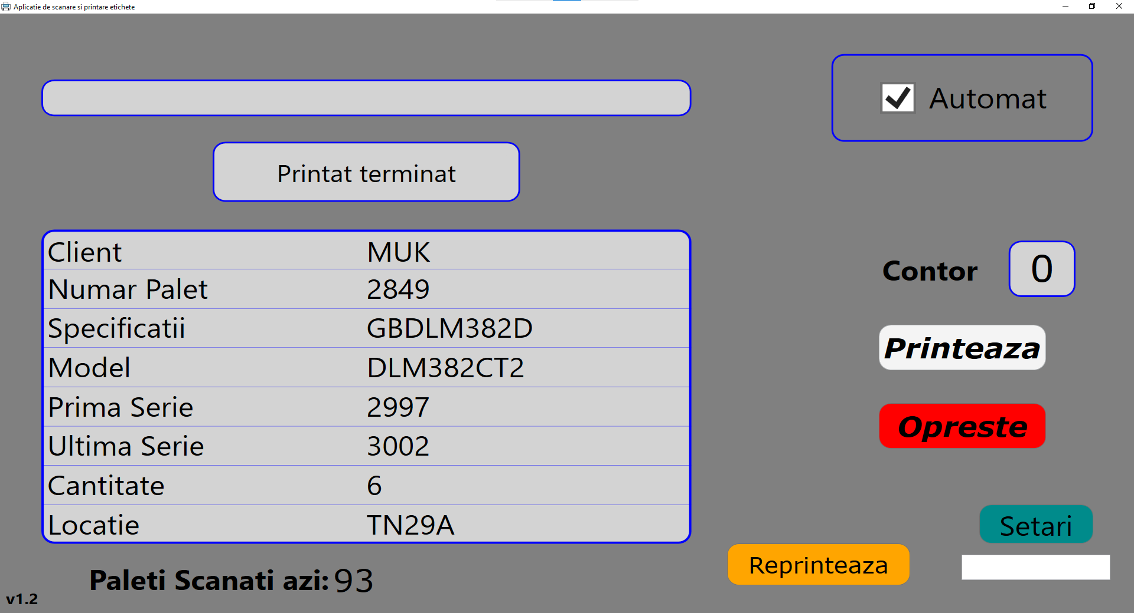
SCAN & PRINT APPLICATION
FUNCTIONALITIES:
Scanner tool
Status bar
Information Display
Total amount of scanned pallets (current day)
Automated printing function
Countdown tool for printer
Print & Stop Button
Settings
Reprint function

Slide 5

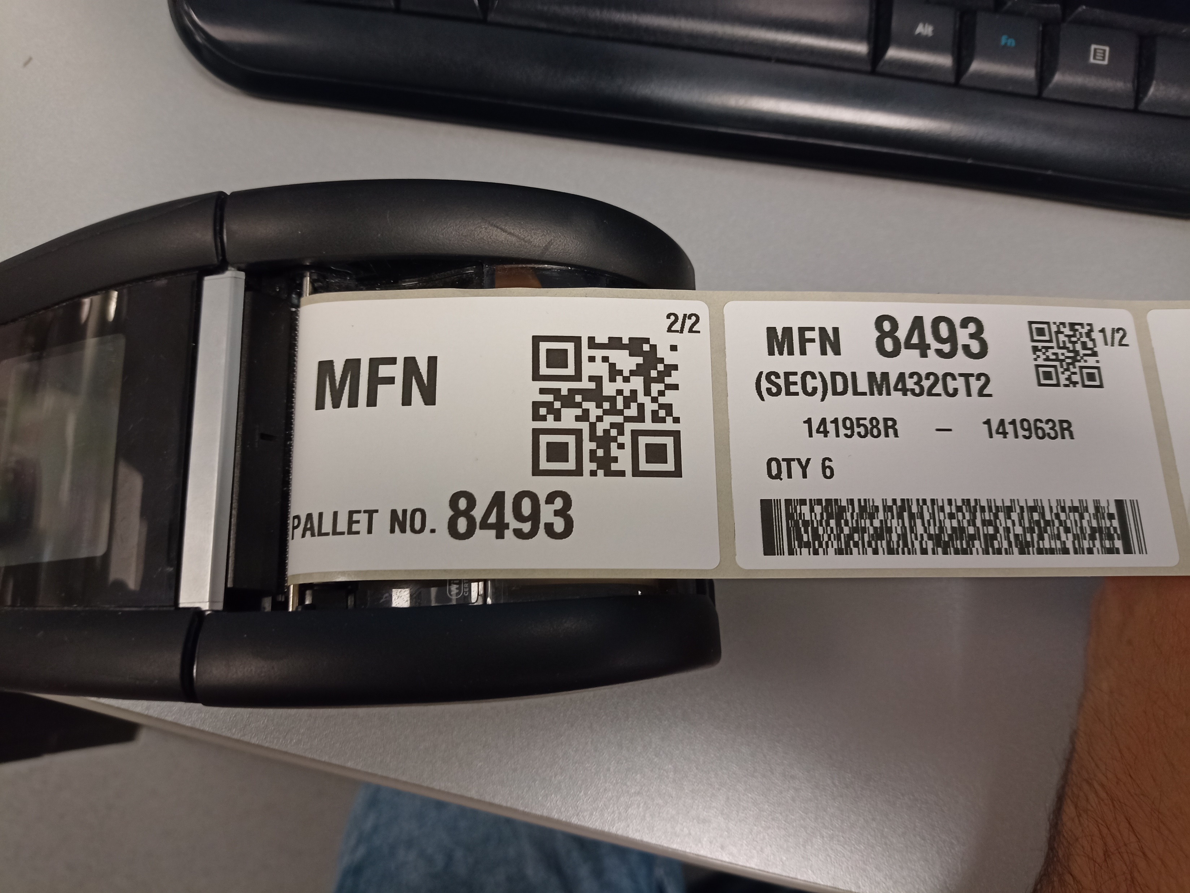
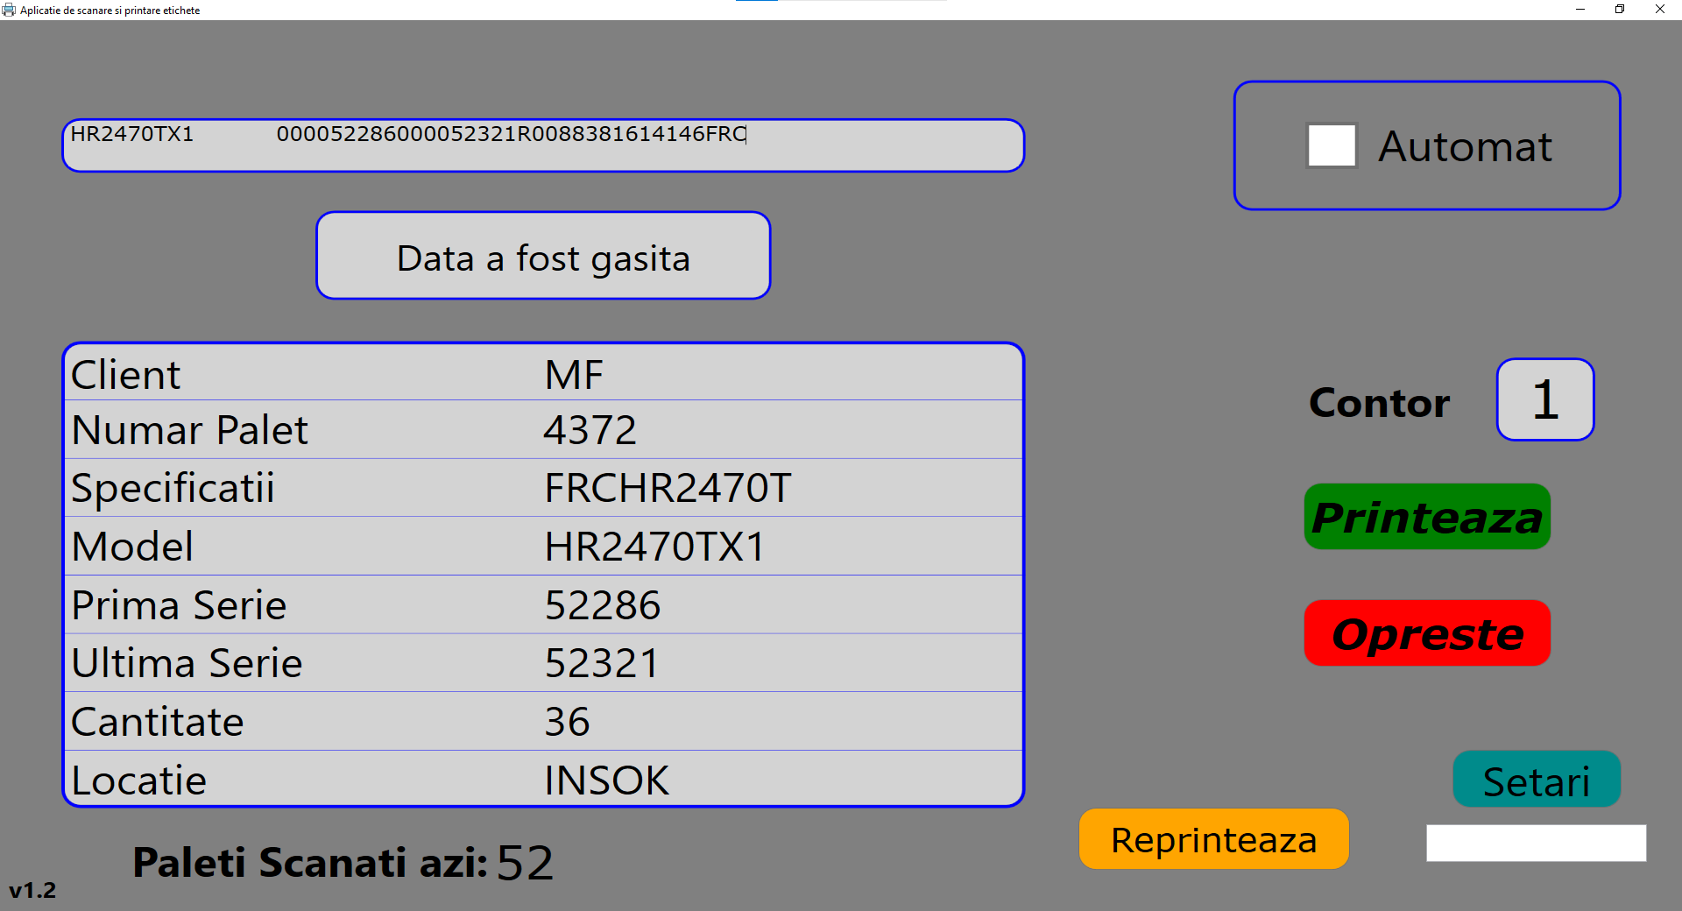

Old process Vs. New process
New system solutions:
Speed up the process by eliminating the need to look for the label. Just scan and print.

Slide 6



Old process Vs. New process
New system solutions:
Print one label set for one pallet ”Poka Yoke”
One pallet -> one label set.
Will print only one set of labels.
The user cannot mix up the pallets.
1x Pallet
1x Label set

Slide 7
Gain
Quality:
Cost:
Reduce mislabelling errors. This can cause the pallet to be shipped to the wrong customer
Save 20 seconds per pallet operation. With 500 pallets per day it equals ~ 60 hours per month.
Save 5 minutes per lost label. Around 5 labels per day lost it equals ~ 10 hours per month.

Slide 8



Future steps:
Automatization:
Replace two operators in the process with a machine in order to minimize error frequency reduce expenses and gain more time
Reduction of man power
Eliminate the need for 3 operators on process
Further reduction of process time
Reduce valuable times on process

Slide 9
Learning curve
CHALLENGES
ACHIEVEMENTS
Understanding the Export Process
Cooperate with Export dept. to understand flow
Lack of Server Base Programming
Study of SQL & WPF involved in writing process
Fear of failure
Support from my team
PROFESSIONAL GROWTH

Slide 10
THANK YOU

