Slide 1

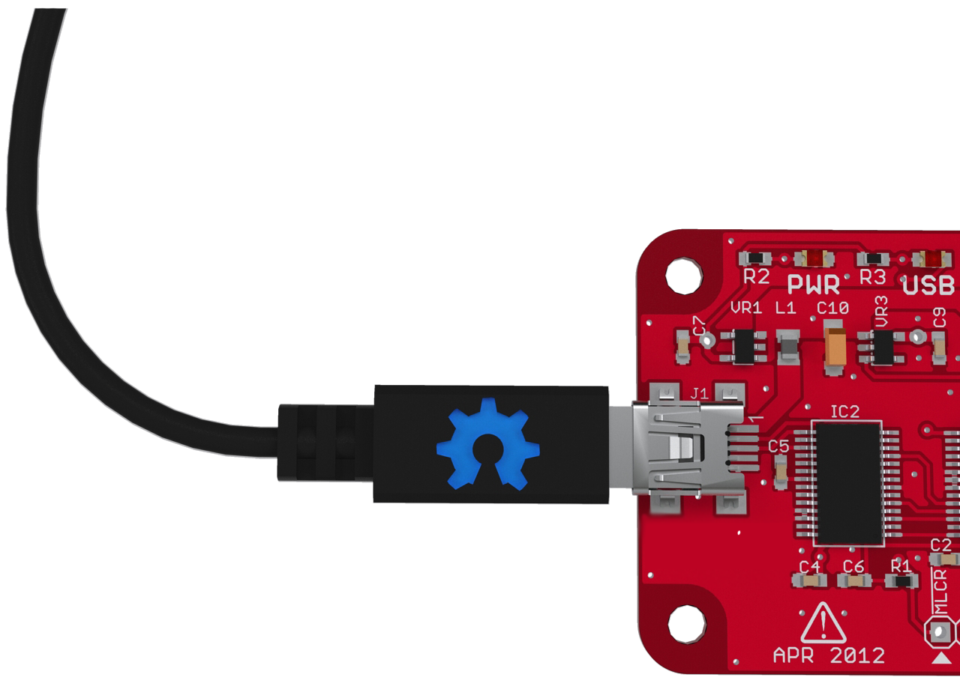
USB and Open Source
A Sketchy
History
Ian Lesnet

Slide 2
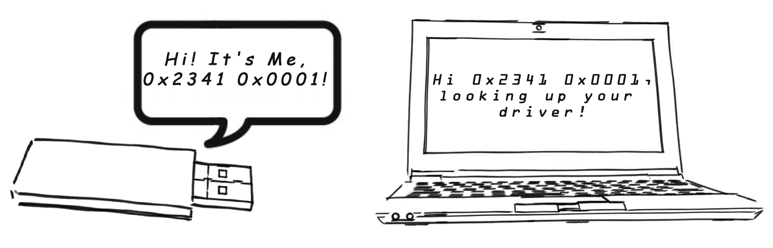
What is a USB ID?
Every USB device has an ID number:
“Hi! It's Me, 0x2341 0x0001!”
Can you find my driver?
Notes:
What is USB ID
Number every USB device passes to a computer to identify itself
“Hi! It's Me, 0x0000 0x0000!” Can you find my driver? (graphic maybe?)
(Filip renders?)
two parts,
0x0000 is the manufacturer (vendor) ID
0x0000 is the part ID
Example USB descriptor
There's some other stuff about the device in there too
(Highlighted USB descriptor image)

Slide 3

USB Vendor ID (2 bytes)
0x2341= (9025)
Image: http://www.arduino.cc
Notes:
2341 hexidecimal, thats 9025 in people years

Slide 4

USB Product ID (2 bytes)
0x2341 =
0x0001 =
(1)
Images: http://www.arduino.cc

Slide 5
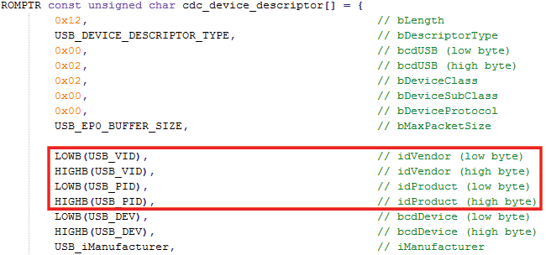
Example USB descriptor
Other stuff about the device too

Slide 6

Get a USB ID
$2000 to USB Implementers Forum
  Group oversees USB, issues USB IDs
  65K individual PIDs all your own (kind of..)
  To do with as you please (not really...)
Image: http://www.flickr.com/photos/68751915@N05/6629107607/
Notes:
Getting a USB ID
USB Implementers Forum
VID $2000
Scores you 65K individual PIDs all your own (kind of..)
To do with as you please (not really...)
0x1337 is already taken
(we asked)
You can't get a custom vanity number
vendor INTEL 0x8086 Intel
...unless you're a founding member (evidently)
Contract, restrictions
Can't share, sublicense, or sell,
Except in very limited situations when selling eg FTDI chips

Slide 7

0x1337 is already taken
(we asked)
Image: http://www.flickr.com/photos/paddyis1337/3087104882/

Slide 8
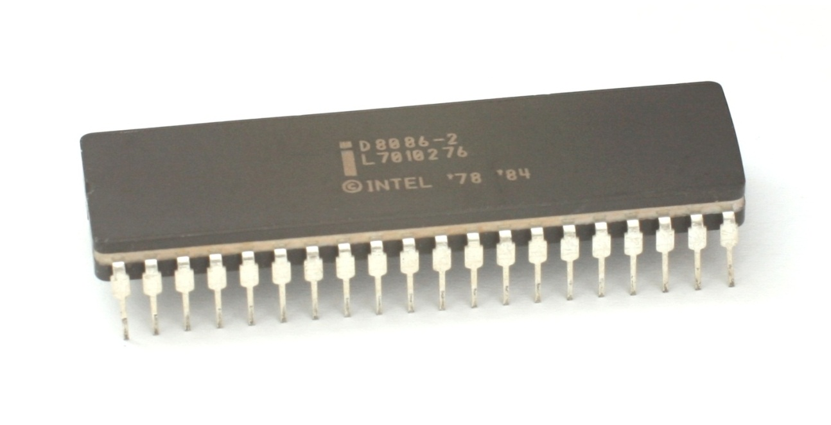
You can't get a custom vanity number...
vendor INTEL 0x8086 Intel
...unless you're a founding member (evidently)
Image: http://en.wikipedia.org/wiki/File:KL_Intel_D8086.jpg

Slide 9

USB and Open Source
Distribution restrictions
  Can’t be shared under an open source license, can't be sublicensed
Image CC: http://creativecommons.org/about/downloads
Image GNU: http://www.gnu.org/graphics/agnuhead.html
Notes:
USB and Open Source
Costs
$2000 not much for a big company
Not a big deal for a giant corporation, but it’s a hefty investment for a small open hardware community or kitchen table start up.
Distribution restriction
The ID also comes with restrictions that don’t jive with open source, namely it can’t be shared under an open source license. Projects may have open source code, but a compiled firmware with a USB ID can’t be used freely. For example, the ATMEGA-based USB to serial converter chip on the latest Arduino requires a USB vendor ID. Anyone who wants to manufacture their own UNO-inspired project has to cough up $2000 bucks to get their own ID, Arduino can’t share theirs.

Slide 10
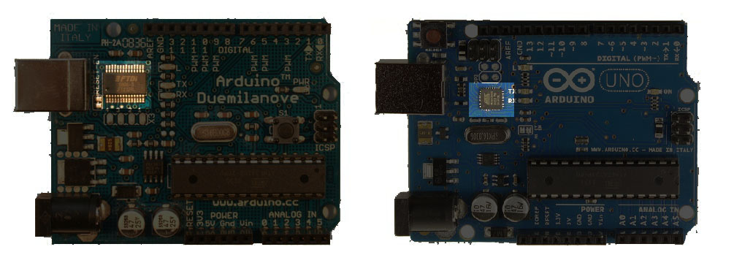
An actual problem
  ATMEGA-based USB to serial converter chip on the latest Arduino
Image: http://www.arduino.cc

Slide 11
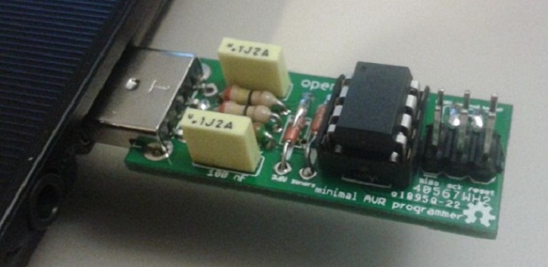
Everyone buys their own?
$2000 is a hefty investment for a hackerspace, open hardware project or kitchen table startup
Image: http://www.littlewire.cc

Slide 12
Resale
Each USB Vendor ID block has 65,000 numbers, so why not resell them?
  It's against the USB ID contract/license
  Let’s talk about the Dutch guys who tried
  Can't MacGyver our way around it
Notes:
The shady past.
How open hardware projects and hobbyists have tried to engineer around the USB ID problem
Resell them
Each USB vendor ID is block as 65,000 numbers, so why not resell them? Let’s talk about the Dutch guys who tried. Despite Dutch law supporting resale, the USB Forum harassed two hobby electronics shops until they gave up. Now the shell of the OpenMoko open source smart phone is having a go too, we’ll talk a bit more about their approach too.
Can't mcGyver your way around it silly engineer.
Squat a range
USB Forum can’t recycle a number once it’s assigned. Open hardware can squat an abandoned or revoked (eg, the Dutch guys’) number.
This is open MOKO's approach, the company is shut down and the USB ID abandoned to the community. The community now unofficially reserving Ids on a wiki. (we did not contact the USB IF for comment)
There’s no law to prevent it (*probably, yet) and it’s unlikely to duplicate an existing device.
Fine for testing but not very professional, and the USB Forum may still send nasty-grams if you sell devices with it.
FTDI chip
Use a manufacturer's chip that already has an ID
Also LPC with USB
Sub license
Microchip, FTDI, and other USB hardware makers are allowed to sub license USB IDs to use with their hardware. This is Dangerous Prototypes does USB projects. The number can’t be shared (not open source friendly), and may have a limit like 10,000 units.
Bus Pirate v4 with Microchip (one per request)
Bus Blaster with FTDI (a bunch of VIDs)
Little wire with adafruit

Slide 13
Squat a Range
USB IF can’t resell abandoned or revoked IDs
vendor VOTI 0x16C0 Voti
Not exactly professional but common in cheap electronics

Slide 14
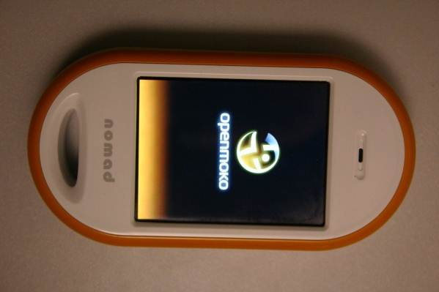

OpenMOKO USB ID scheme
OpenMOKO open source phone
Company dissolved, ID left to the community
Reserving IDs on a wiki
There’s no law to prevent it (*probably, yet)
Fine for testing but not very professional
Might still get nastygrams
Images: http://wiki.openmoko.org

Slide 15
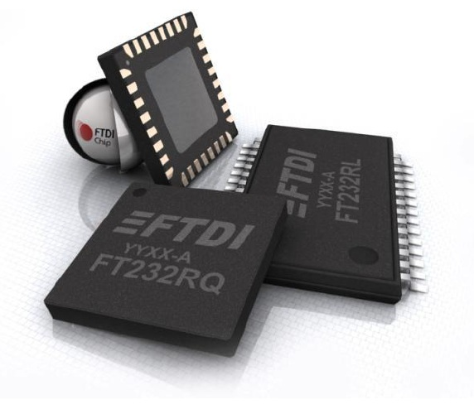
Chips that come with an ID
Use a USB chip that already has an ID
  FTDI FT232 in Arduinos
  LPC ARMs with IDs built in

Slide 16
Sub license
Hardware makers may sub license USB IDs for their chips
Microchip (0x04D8)
  USB enabled PIC microcontrollers
  10K limit
FTDI (0x0403)
  USB to serial converters
  Block of 8

Slide 17
Potential solutions
  Relax resale and sub licensing policy
  Testing block, reserved IDs for standards
  Open block, legitimize Open Moko approach
  Wait, run out, selling singles is marketing gold
Notes:
Hardware engineers often want to engineer a solution that fits a loophole in the USB Forum’s contract, but the Forum just changes the rules.
Relax resale policy
A political approach such as lobbying for a change in resale policy could be effective. So far though the rules are only getting more strict. Even with a relaxed resale policy, there’s still licensing and sharing restrictions are not open hardware friendly.
Testing block
There’s no block of IDs for internal testing. A free-for-all range would be great, with some reserved IDs for common services like USB to serial. No restrictions on this range, but no guarantee devices won’t conflict.
Open block
A block of IDs available to open hardware projects. It’s probably not worth the USB forum’s time to sell individual numbers, but even if they’re adverse to resale maybe they would allow a non-profit to issue numbers for qualified open hardware licensed projects. The key is that open source project be able to share these numbers so we don’t have to dance around proper open source distribution.
Wait
Eventually the USB Forum will run out of vendor ID blocks
Selling individual numbers at a premium will be the next brilliant idea out of the marketing department

Slide 18
Reform for Open Hardware
We need to do something, not currently a problem, but with more and more USB hardware the gray area of USB and Open Source will probably need to be addressed.
When there is an Open Hardware Foundation we hope they would consider doing this work on behalf of open source hardware hackers who swear too much and don't care to get waist deep in the political side.
Notes:
Advocating reform for Open Hardware
When there is an Open Hardware Foundation we hope they would consider doing this work on behalf of open source hardware hackers who swear too much and don't care to get waist deep in the political side.

