Slide 1
Introduction Dense Text Representations
Nils Reimers
Author of Sentence Transformers
www.SBERT.net

Slide 2
Content
Part 1: Introduction
Background
Applications
Part 2: Basic Training Methods
Part 3: Advanced Training Methods

Slide 3
Why Dense Representations?
Text = Sentence, Paragraph, Document
Traditionally: Sparse, Lexical Representation (Bag-of-words)
Each word has it own dimension
Issues:
Lexical gap: US, USA, United States
Ambigue words
Same distance between all words
Word order not preserved
How are you?
[0, 0, 1, 0, 0, 0, 1, 0, 1, …]
How
are
you

Slide 4

Dense Representation
Formally: $f\left(Text\right)→ ℝ^{n}$
n dimensional representation (embedding)
Find function f such that semantically similar text is close

Slide 5

What does semantically similar mean?
Find function f such that semantically similar text is close
There cannot be universal text representations
Nuclear energy is safe!
Nuclear energy is dangerous!
Semantically similar depends on the task!

Slide 6
What does semantically similar mean?
Find function f such that semantically similar text is close
There cannot be universal text representations
S1: Heidi Klum is pregnant
S2: Heidi Klum is a model
S3: Naomi Campbell is pregnant
Semantically similar depends on the task!

Slide 7
Application - Clustering
Clustering

Slide 8
Application – Bitext Mining
Hello world!
Hallo Welt!
Bitext Mining

Slide 9
Application – Search
Relevant
Document
Query
Search

Slide 10
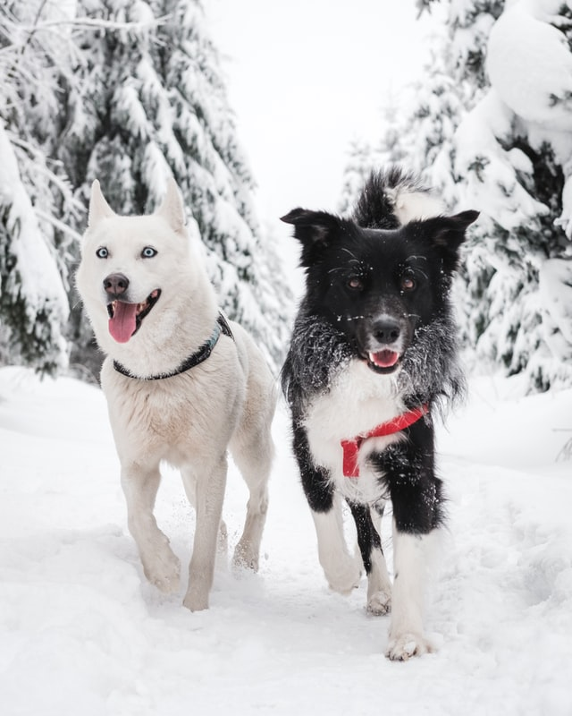
Multi-Modal Search
A cat on a table
Image Embedding
Dos perros en la nieve
Text Embedding
Zwei Hunde im Schnee
两只狗在雪中
Two dogs in the snow
Two dogs in the snow
London at night

Slide 11
Zero-Shot Image Classification
Cat
Image Embedding
Label Embedding
Dog
London at day
London at night

Slide 12
Few-Shot Intent Classification
What is my account balance?
What is my current balance?
What is my balance?
Transfer money from savings
Transfer money to checking
Transfer money
Search
Have some examples for every intent (checking balance, transfer money)
New utterance => find closest example => use intent

Slide 13
Application – Automate E-Mail Support
Canned e-mail response
Incoming e-mail
Clustering
Search
Find most common e-mails in your inbox
Create canned responses for top 100 questions
Train model on (email, response)
For new email: What is the closest (canned) response?

Slide 14
Conclusion
Map text/images/… to low dimensional dense vector space
Semantically similar text should be close
No clear definition what “semantically similar” means => depends on task
Many applications. Most promising:
Search
Mining – find related items

Slide 15
Basic Training Dense Text Representations
Nils Reimers
Author of Sentence Transformers
www.SBERT.net

Slide 16
Content
Part 1: Introduction
Part 2: Basic Training Methods
Basic training method
Loss functions
Improving training quality with hard negatives
Part 3: Advanced Training Methods

Slide 17
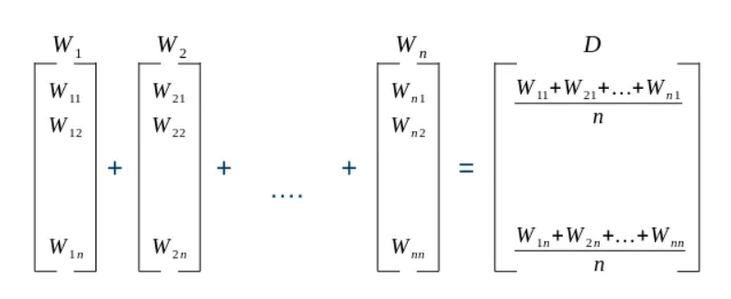
Average Word Embeddings
Simple baseline: Average word embeddings in a sentence
Improvement: Weight word embeddings by tf-idf
Content words contribute more than stop words
Fast and simple method
Can be used with custom trained word embeddings
Source: http://yaronvazana.com/2018/09/20/average-word-vectors-generate-document-paragraph-sentence-embeddings/

Slide 18
Can we just average BERT? => No!
Task | Avg. performance on 14 datasets
bert-base-uncased | 48.5
Avg. word embeddings | 51.1
Best unsupervised method based on BERT-large | 60.8
SBERT (NLI data) | 62.5
SBERT (large train data) | 68.0
BERT out-of-the-box performs badly
Labeled / structured data important
Source: https://arxiv.org/abs/2104.06979

Slide 19
Sentence BERT – Cosine Similarity Loss
Gold label: 0.9
Loss
0.4
Cosine-Similarity
[0.4, 0.3, 0.7 … ]
[0.1, 0.8, 0.9 … ]
Pooling
Pooling
[ [0.1, 0.2, …], [0.8, 0.5], … ]
[ [0.2, 0.1, …], [0.7, 0.6], … ]
BERT
Shared Weights
BERT
How to learn C?
How to learn C++?
Nils Reimers, Iryna Gurevych. Sentence-BERT: Sentence Embeddings using Siamese BERT-Networks. EMNLP 2019

Slide 20
Loss Functions
Various loss functions available to train vector space models:
CosineSimilarityLoss
SoftmaxLoss
Constrative- & OnlineConstrativeLoss
TripletLoss
Batch-[All | Hard | SemiHard | HardSoftMargin]-TripletLoss
MegaBatchMarginLoss
MultipleNegativesRankingLoss
….

Slide 21
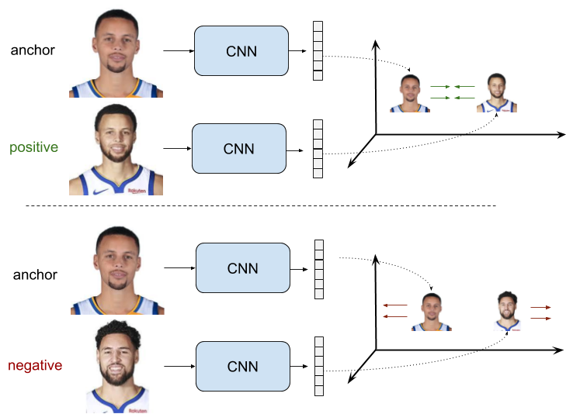
Constrative Loss
Positive pairs
Pull together
Negative pairs
Push away
https://gombru.github.io/2019/04/03/ranking_loss/

Slide 22
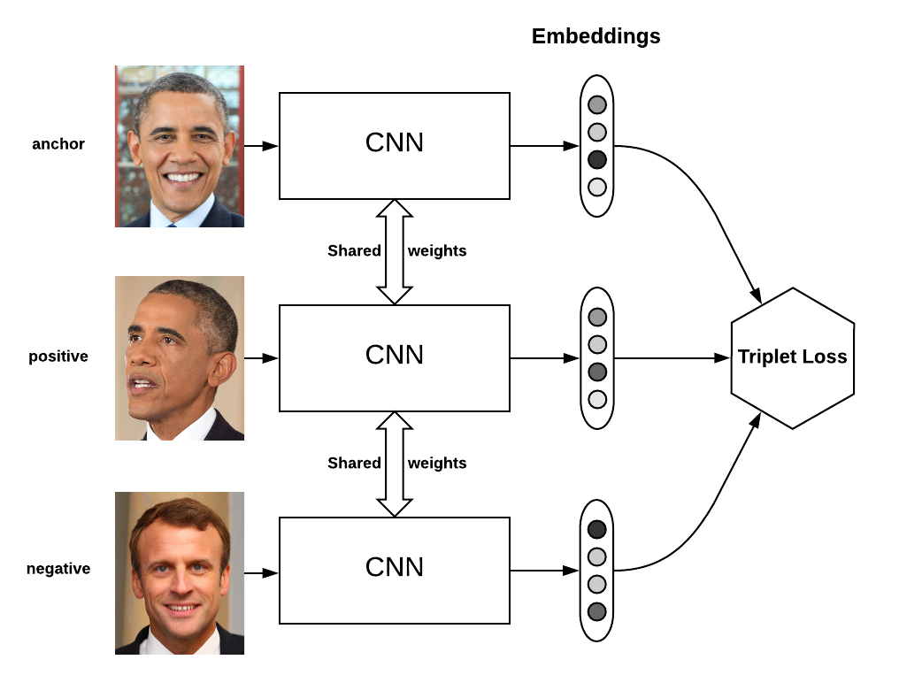
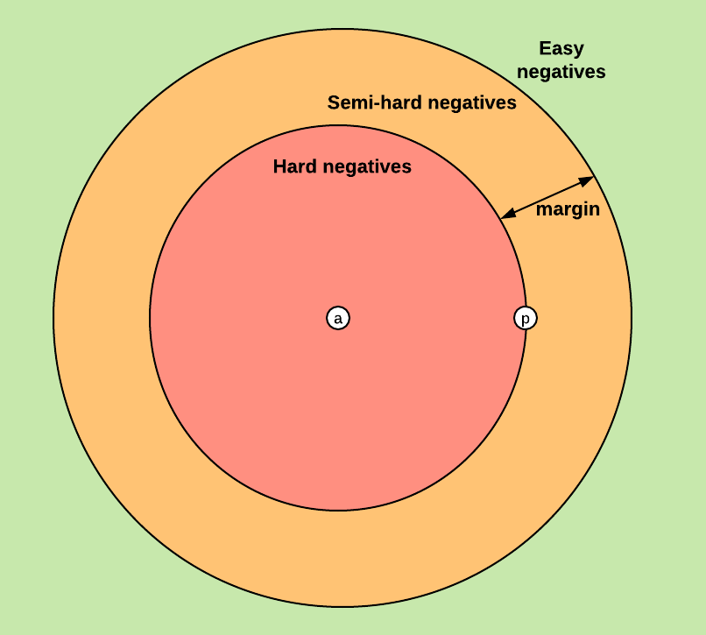
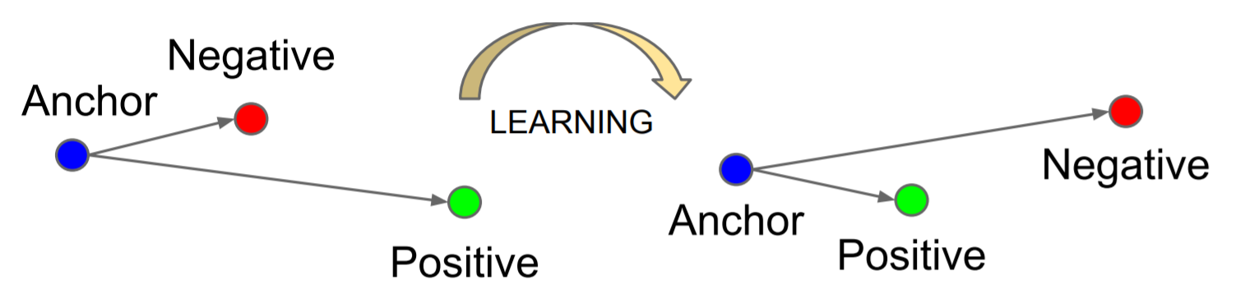
Triplet Loss
Triplet loss
Requires (anchor, positive, negative)
Anchor & negative should be further away than anchor & positive
To work well: requries good triplets

Slide 23
Global And Local Structure of Vector Space
Global structure: Relation of two random sentences
Local structure: Relation of two similar sentences
Loss function must optimize local and global structure
Constrative / Triplet loss might only optimize the local structure
Bad global structure
Good global structure

Slide 24
Batch Hard Triplet Loss
Have a batch with multiple examples for each class
Take an element as anchor
Take the farthest away element as positive
Take the closest element as negative
Train with triplet loss
Loss automatically creates hard triplets
Anchor
Negative
Positive

Slide 25
Multiple Negative Ranking Loss
Have positive pairs: (a₁, p₁) (a₂, p₂) (a₃, p₃)
Examples:
(query, answer-passage)
(question, duplicate_question)
(paper title, cited paper title)
(a_{i}, p_{i}) should be close in vector space and (a_{i}, p_{j}) should be distant in vector space (i != j)
Unlikely that e.g. two randomly selected questions are similar
Computed as ranking loss with Cross-Entropy:
Given a₁, which is the right answer out of [p₁, p₂, p₃]?
Compute scores: [s(a₁, p₁), s(a₁, p₂), s(a₁, p₃)]
Cross-Entropy loss with gold label: [1, 0, 0]
Also called “training with in-batch negatives”, InfoNCE or NTXentLoss
p₃
a₁
p₄
p₅
p₁
p₂

Slide 26
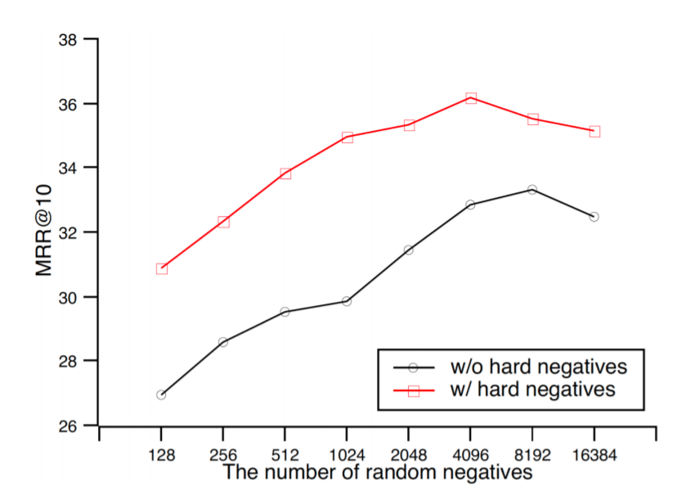
Multiple Negative Ranking Loss Hard Negatives
Larger batch size => task more difficult => better results
Given query, which of the 10 passages provide the answer?
Given query, which of the 1k passages provide the answer?
Image: https://arxiv.org/pdf/2010.08191.pdf

Slide 27
Multiple Negative Ranking Loss Hard Negatives
n₃
Train with tuples:
(a₁, p₁, n₁)
(a₂, p₂, n₂)
n_{i} should be similar to p_{i} but not match with a_{i}
Bad example: a: How many people live in London? p: Around 9 million people live in London n: London has a population of 9 million people.
Good example: a: How many people live in London? p: Around 9 million people live in London n: Around 1 million people live in Birmingham, second to London.
p₃
n₄
a₁
p₄
p₅
n₅
n₁
n₂
p₁
p₂

Slide 28
How to find hard-negatives?
Quality of hard-negatives significantly improves the performance
Finding good hard negatives not easy
Strategy 1: Exploit structure in your data
Citation graph: (Title, Cited_Paper, Paper_Cited_by_Cited_Paper)
Q&A: (Question, Answer with most stars, Answer with less stars)
Strategy 2: Mine hard negatives (simple):
Use BM25 to find top-100 most similar texts to anchor / positive
Select one of these randomly

Slide 29
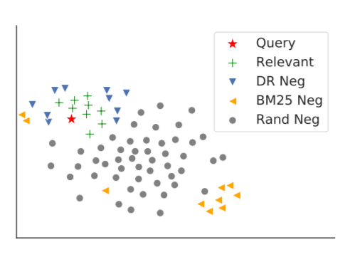
Issue with BM25-Negatives
BM25 negatives not necessarily hard negatives for the Dense Representations (DR)
Img: https://arxiv.org/pdf/2007.00808.pdf

Slide 30
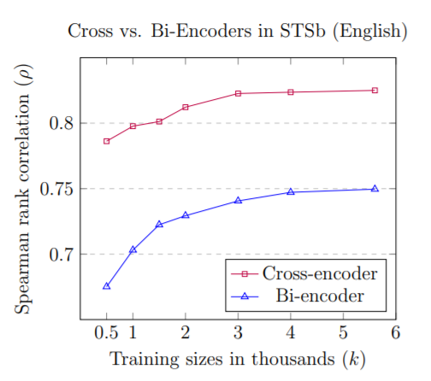
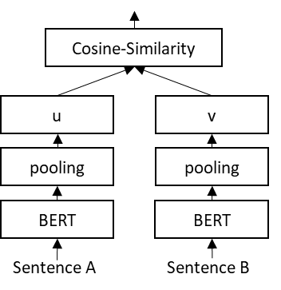
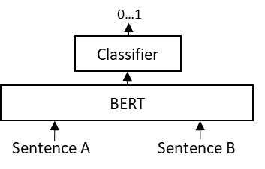
Bi- vs Cross-Encoders
Bi-Encoder
Cross-Encoder
Image: https://arxiv.org/abs/2010.08240
Notes:
Advantages Cross-Encoder:
Better Performance
Better data efficiency
More robust to domain shifts
Disadvantage Cross-Encoders:
- Do not scale to large comparisons

Slide 31
How to find hard-negatives?
Train Bi-Encoder
Mine close points with bi-encoder
Classify with cross-encoder
Hard negatives
Training data
Train Cross-Encoder

Slide 32
How big is the improvement?
Approach | MRR@10 on MSMARCO Dev
Random negatives | 26.1
BM25 negatives | 29.9
Mined hard negatives w/o denoising | 26.0
Mined hard negatives with denoising | 36.4
Source: https://arxiv.org/pdf/2007.00808.pdf and https://arxiv.org/pdf/2010.08191.pdf

Slide 33
Conclusion
Many different loss functions available
In many cases, MultipleNegativeRankingLoss work well
Adding hard negatives improves performance for search
but not for clustering!
Finding hard negatives not trivial
Usage of powerful cross-encoders to mine those

Slide 34
Advanced Training Dense Text Representations
Nils Reimers
www.SBERT.net

Slide 35
Content
Part 1: Introduction
Part 2: Basic Training Methods
Part 3: Advanced Training Methods
Multilingual Text Embeddings
Data Augmentation using Cross-Encoders
Unsupervised Embedding Learning
Neural Search / BEIR

Slide 36
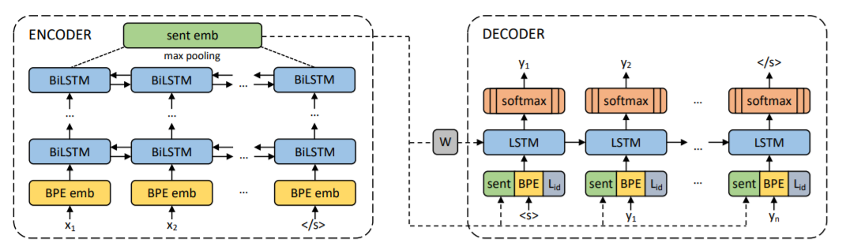
Multilingual Sentence Embeddings: LASER
Use output of encoder from translation system
Issues:
Cannot control what type of embeddings are learned
Works poorly on identifying similar sentences
https://arxiv.org/abs/1812.10464

Slide 37
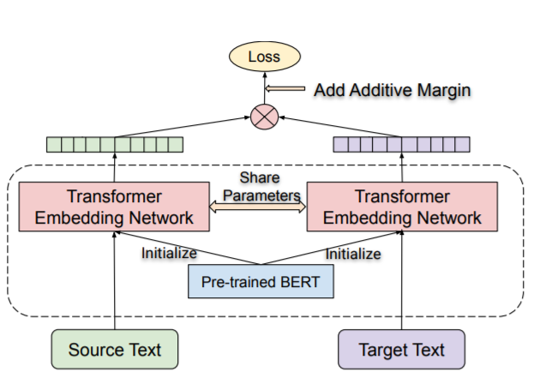
Multilingual Sentence Embeddings: LaBSE
Translation ranking task
Issues:
Cannot control what type of embeddings are learned
Works poorly on identifying similar sentences
https://arxiv.org/abs/2007.01852

Slide 38
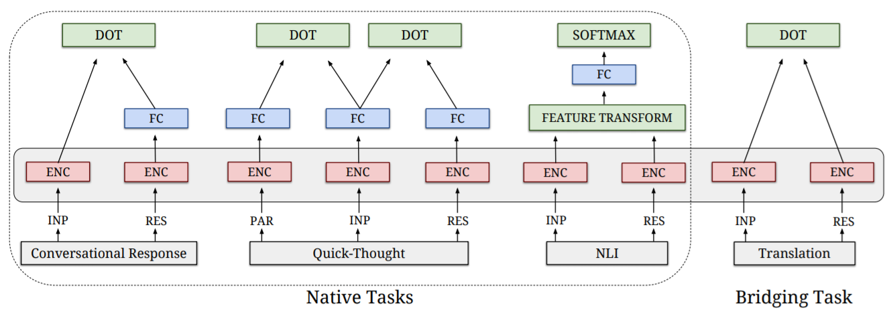
Multilingual Sentence Embeddings: mUSE
Multi-task setup with bridging task
Issues:
Getting bridging task right is challenging + requires large batch sizes
Hard to extend model afterwards to new languages
https://arxiv.org/abs/1810.12836

Slide 39

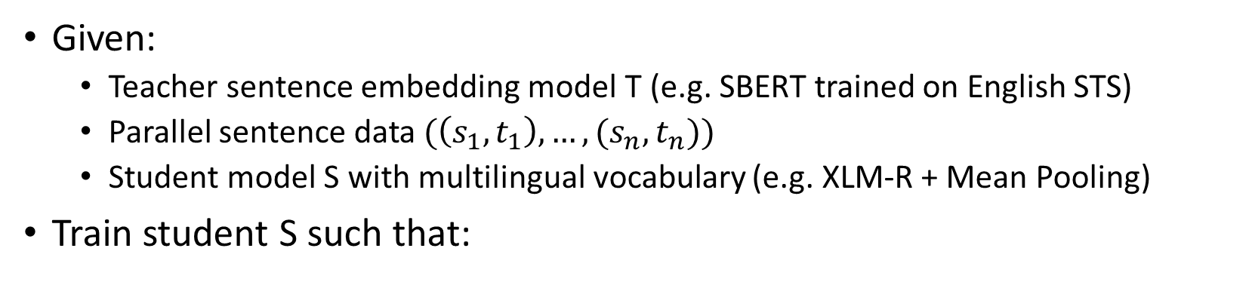

Multilingual Knowledge Distillation
Teacher
Model
Teacher EN sentence vector
Hello World
0.8 -0.2 0.3
MSE-Loss
Parallel Data (EN-DE)
Hallo Welt
Student EN sentence vector
0.7 -0.1 0.3
MSE-Loss
Student
Model
0.9 -0.2 0.4
Student DE sentence vector
Given:
Teacher sentence embedding model T (e.g. SBERT trained on English STS)
Parallel sentence data $(\left(s_{1},t_{1}\right), …, (s_{n},t_{n}))$
Student model S with multilingual vocabulary (e.g. XLM-R + Mean Pooling)
Train student S such that:
$$S\left(s_{i}\right) ≈T(s_{i})$$
$$S\left(t_{i}\right) ≈T(s_{i})$$
https://arxiv.org/abs/2004.09813

Slide 40
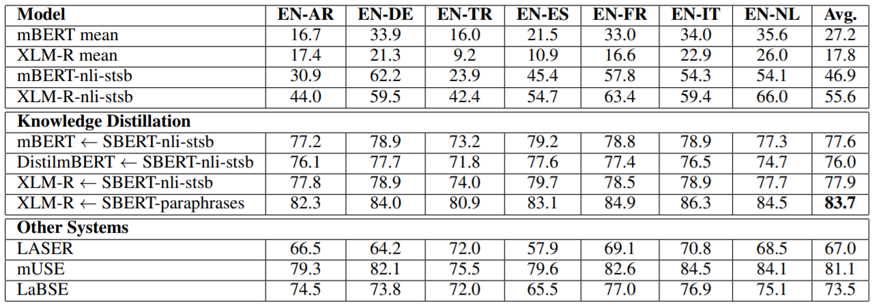
Results – Multilingual Semantic Similarity
Training on English-only insufficient
LASER & LaBSE perform badly

Slide 41
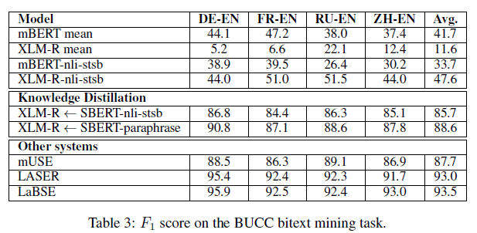
Bitext Mining
Given two corpora: Find parallel (translated) sentences
LASER & LaBSE better than mUSE & Knowledge Distillation
Issue with mUSE & KD: They find similar sentences, that are not perfect translations

Slide 42
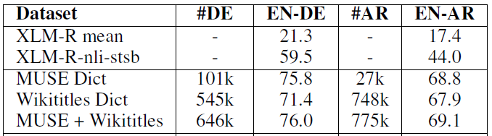
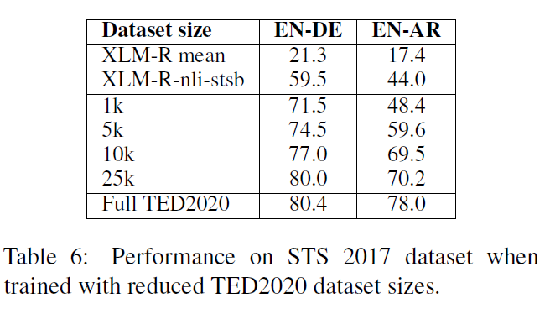
Data Efficiency

Slide 43
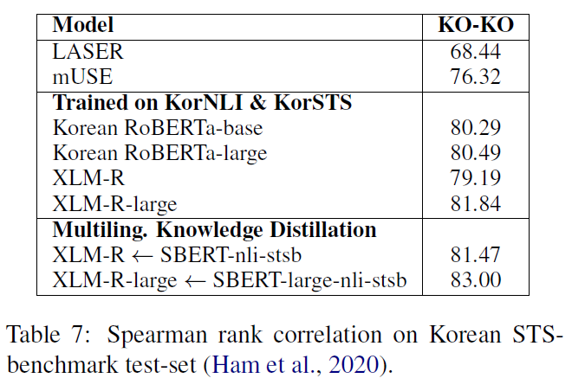
Knowledge Distillation vs. Training on Target Language

Slide 44
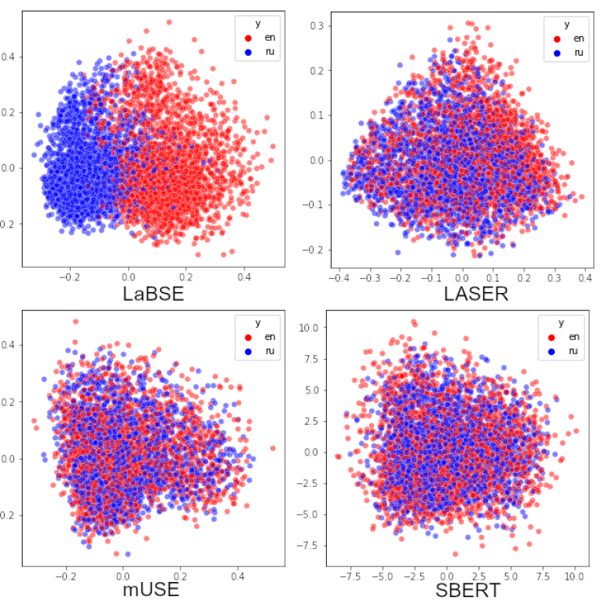
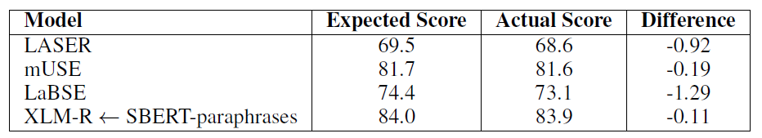
Language Bias
Preference of certain language combinations
Language bias impacts performance negatively on multilingual pools
LASER and LaBSE with strong language bias

Slide 45
Augmented SBERT
Nils Reimers
www.SBERT.net

Slide 46
Bi- vs Cross-Encoders – Data Efficiency
Bi-Encoder
Cross-Encoder
Image: https://arxiv.org/abs/2010.08240
Notes:
Advantages Cross-Encoder:
Better Performance
Better data efficiency
More robust to domain shifts
Disadvantage Cross-Encoders:
- Do not scale to large comparisons

Slide 47
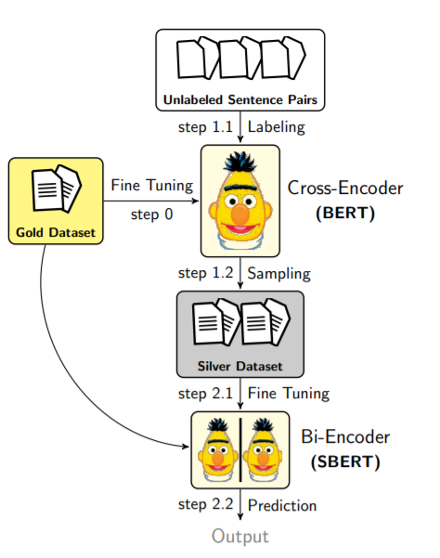
Augmented SBERT
Train Cross-Encoder
Sample new sentence pairs
Label pairs with Cross-Encoder
Train Bi-Encoder
Nandan Thakur, Nils Reimers, Johannes Daxenberger, Iryna Gurevych. Augmented SBERT: Data Augmentation Method for Improving Bi-Encoders for Pairwise Sentence Scoring Tasks

Slide 48
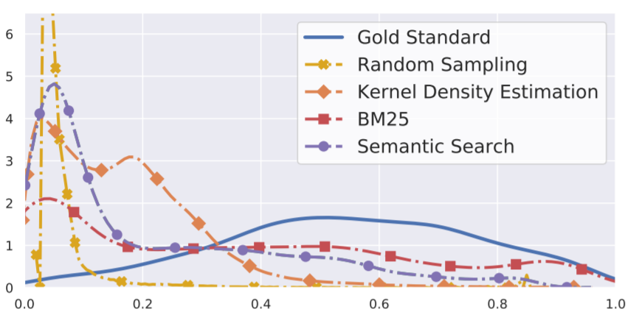
Augmented SBERT - Sampling
Random sampling yields mainly pairs with low similarity:
BM25 sampling & Semantic Search yields best results

Slide 49
Augmented SBERT – In-Domain Results
Model | Spanish-STS | Argument Similarity | Duplicate Questions | Paraphrase Identification
BERT (Cross-Encoder) | 77.5 | 65.1 | 80.4 | 89.0
SBERT (Bi-Encoder) | 68.4 | 58.0 | 73.4 | 84.4
AugSBERT (Bi-Encoder) | 75.1 | 61.5 | 79.3 | 85.5
In-domain improvement up to 6.7 points
Nandan Thakur, Nils Reimers, Johannes Daxenberger, Iryna Gurevych. Augmented SBERT: Data Augmentation Method for Improving Bi-Encoders for Pairwise Sentence Scoring Tasks, NAACL 2021

Slide 50
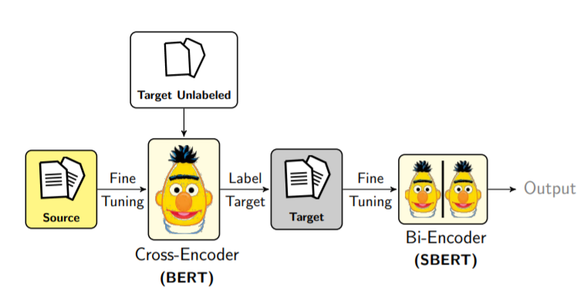
Augmented SBERT – Cross-Domain
Labeled training data on source domain only (Quora)
Evaluation on specialized domains
Eval-Dataset | SBERT (Quora) | AugSBERT
AskUbuntu | 50.1 | 60.2
Sprint | 50.5 | 87.5
SuperUser | 50.4 | 64.5
Cross-domain improvement up to 37 points

Slide 51
Unsupervised Embedding Methods
Nils Reimers
www.SBERT.net

Slide 52
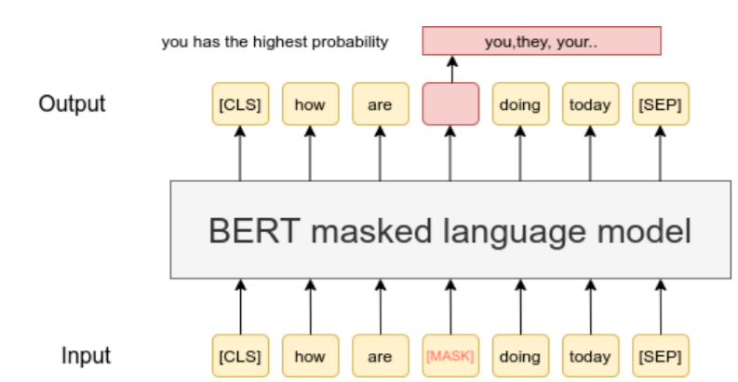
Masked Language Model (MLM)

Slide 53
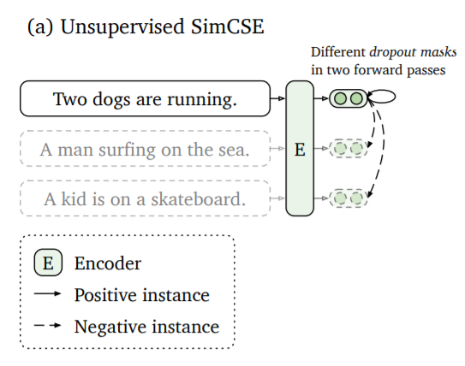
SimCSE
Usage of MultipleNegativeRankingLoss
Input pairs: (sent1, sent1) (sent2, sent2) ….
Due to dropout: slightly different embeddings for f(sent1) and f(sent1)
https://arxiv.org/abs/2104.08821

Slide 54
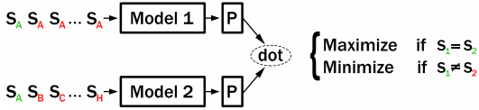
Contrastive Tension (CT)
Initialize with two identical models
Pass pairs with identical and with different sentences
Maximize dot-score for identical sentences
Minimize dot-score for different sentences
https://openreview.net/pdf?id=Ov_sMNau-PF

Slide 55
TSDAE
Delete randomly words in the text
Pass through the encoder
Apply pooling to get fixed-sized text embedding
Decoder must reconstruct text without noise from this text embedding
Text without noise
BERT Decoder
Pooling
BERT Encoder
Text with noise
https://arxiv.org/abs/2104.06979

Slide 56
Issues in the Evaluation
So far unsupervised methods evaluated on STS data
Extremely bad way to evaluate unsupervised methods on STS datasets
Performance has near zero correlation to performance on real-world task
Simple sentences without domain specific knowledge
Unrealistic label distribution
In TSDAE: Evaluation on domain specific datasets
AskUbuntu, StackExchange, Twitter, Scientific Publications

Slide 57
Evaluation
Method | Avg. over 4 datasets
TSDAE | 55.2
MLM | 52.9
CT | 52.4
SimCSE | 50.6
Out-of-the-box model
SBERT on NLI+STSb | 52.3

Slide 58
How good are unsupervised methods?
 | AskUbuntu | Twitter Paraphrases | StackExchange | SciDocs
Unsupervised in-domain TSDAE on bert-base | 55.6 | 74.1 | 36.2 | 74.5
Supervised out-of-domain mpnet + NLI + STSb | 56.0 | 78.9 | 35.7 | 71.4
Supervised out-of-domain distilbert + MS MARCO | 56.1 | 74.6 | 40.3 | 70.8
Supervised pre-trained models hard to beat
Diversity of pre-training dataset critical
Large, diverse dataset => great results across tasks

Slide 59
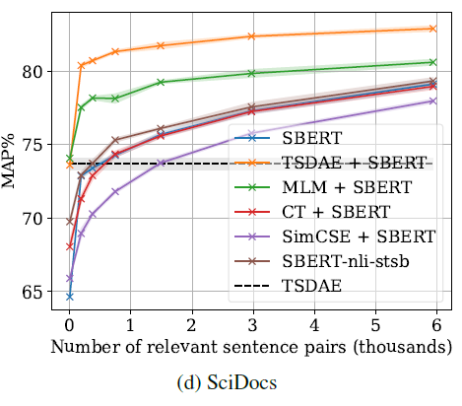
Unsupervised Method for Pre-Training
Train unsupervised on large corpus from your domain
Train supervised with some labels from your domain
SimCSE / CT: Not helpful
TSDAE / MLM: Big improvement

Slide 60
Domain Adaptation
Method | Unsupervised | NLI+STS -> Unsupervised | Unsupervised -> NLI+STS
TSDAE | 55.2 | 54.2 | 56.5
MLM | 52.9 | 51.1 | 55.9
CT | 52.4 | 52.9 | 53.0
SimCSE | 50.6 | 51.2 | 52.4
First train unsupervised on your domain
Then train supervised on available training data from other domains

Slide 61
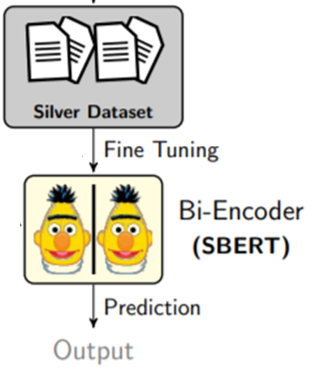
GenQ: Synthetic Query Generation
“Python is a high-level programming language …”
T5
“What is Python”
https://arxiv.org/abs/2104.08663

Slide 62

https://github.com/UKPLab/beir

Slide 63

Types of Search – BM25
How are you?
[0, 0, 0.3, 0, 0, 0, 0.1, 0, 0.2, …]
Strong baseline
Advantages:
Fast
Small index
No training required
Disadvantages:
Lexical gap
Word order not preserved
How
are
you
Img: https://en.wikipedia.org/wiki/Okapi_BM25

Slide 64
Types of Search – Dense Retrieval
Maps query & docs to vector spaces
Advantages:
Fast
Overcomes lexical gap
Can deal with word order
Disadvantages:
Require training data
Relevant
Document
Query
Search

Slide 65

Types of Search- Re-Ranking
Document Collection
Retrieval
Re-Ranker Cross-Encoder
Search Query / Question
Retrieve candidates
Ranked hits
Uses a Cross-Encoder to re-rank candidates
Advantages:
High accuracy
Disadvantages:
Slow
Requires training data

Slide 66
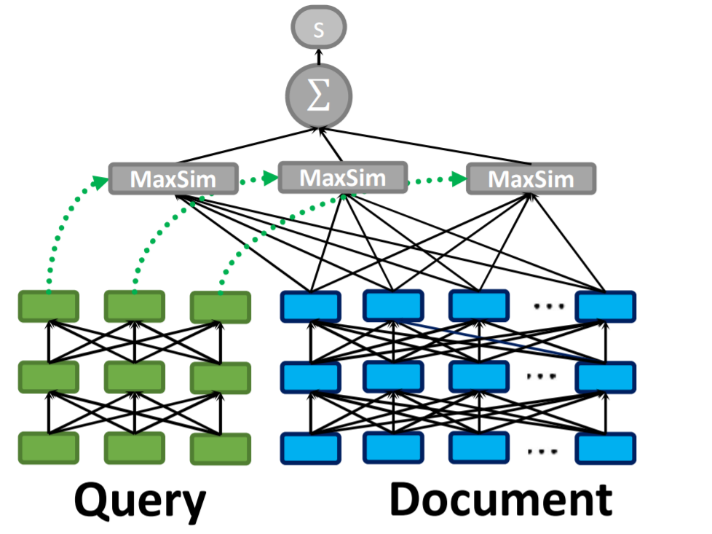
Types of Search- ColBERT
Maps query & docs to token embeddings
Advantages:
Good accuracy
Disadvantages:
Large index size
Slow
Requires training data
https://arxiv.org/pdf/2004.12832.pdf

Slide 67
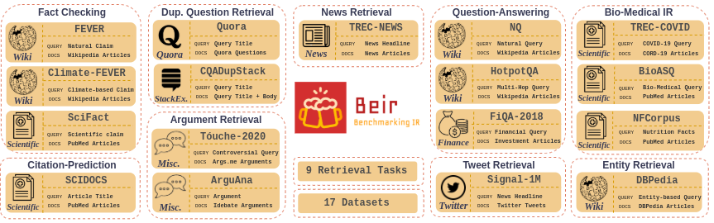
Diverse Zero-Shot Evaluation of Neural Retrieval Methods
How do neural retrieval models perform without in-domain training data?
https://arxiv.org/pdf/2104.08663.pdf

Slide 68
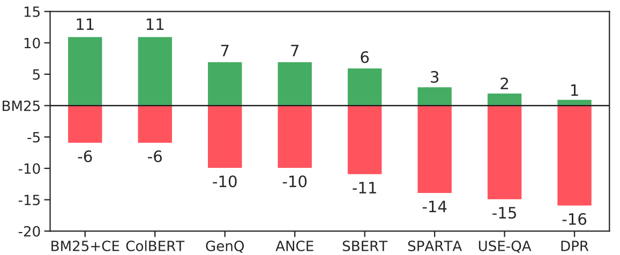
Which models generalize well?
BM25 (Lexical) BM25 is an overall strong baseline for retrieval. It doesn’t require to be fine-tuned for any dataset.
ColBERT, BM25 + CE (Rerank) Reranking Models overall generalize well across diverse domains, and outperform BM25 on retrieval tasks
ANCE, GenQ, SBERT.. (Dense) Dense models overall are unable to generalize. They perform well with a huge source overlap with target domain
https://arxiv.org/pdf/2104.08663.pdf

Slide 69
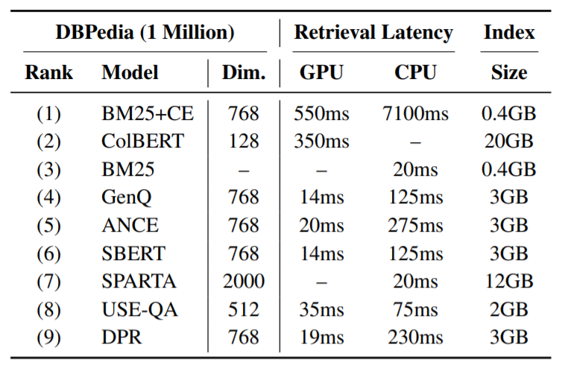
Speed – Quality – Memory-Trade-off
BM25+CE & ColBERT best systems
Slow / large index
SBERT/ANCE better than BM25 if task similar to training data
Larger index (3GB vs. 0.4GB)
Slower on CPU (125ms vs 20ms)
https://arxiv.org/pdf/2104.08663.pdf

Slide 70
Conclusion
Multilingual Knowledge Distillation
Cross-Encoder useful to augment Bi-Encoder with additional data
Unsupervised embeddings
Challenging
Performance not matching supervised methods
Information retrieval
Trade-off: Memory-Speed-Quality

