Slide 1
Generation based Conversational AI
An Introduction
Thy Thy Tran, PhD
06.2021

Slide 2
Outline
Introduction
Building a Conversational Agent
Summary
Notes:
Here is the outline, we will first introduce conversational AI and applications.
After that, we then discuss steps for building a conversational agent.

Slide 3
Two Main Types of Dialogue Systems
How is the weather today?
Information consumption
Task-oriented conversations
Right now is 21 degrees with cloudy.
Is it good to go out for dinner at 6 pm?
help users achieve some goals/tasks
complete requests with least turns
Absolutely, the sky will be clear by 6.
Decision Support
Ok. Then please book me a table for 2 at Sushi Bar at 6 pm
Confirm a table for 2 at 6 pm.
Anything else?
Task completion
Open-domain chit chat
That’s it. Thanks.
Happy to help
free-form, open-domain
engage users for long conversations
[Fung et al., 2020]
Notes:
There are two main types of dialog systems: task-oriented and open-domain chat bots.
The categories are divided mainly by their functionality.
As named, Task Oriented conversational agents help users achieve some goals or tasks.
They aim to complete user requests with the least number of turns.
There are three common scenarios of task-oriented conversational agents.
The first one is for information consumption such as weather query.
the second one is to support decision making process, such as here is it good to go out at 6. Other decision making includes suggestions for taking some online courses, book recommendation.
Last, conversational agents help users to complete a task such as restaurant reservation, airplane booking, and scheduling meeting.
= Differently, Open-domain chit chat aims for free-form conversations and unbounded topics.
Open-domain chatbots are expected to engage users for long conversations.
The openness of possible conversational topics makes it challenging to build an open-domain conversational agent.
As the agent may do well on the topics that have been seen but cannot give a good conversation about unseen topics.

Slide 4
Conversational AI Applications
How is the weather today?
Lots of applications
Personal assistants [Siri, Google, Alexa, Cortana, etc.]
Education [Kerry et al., 2008, Mesgar et al., 2019]
Health care: therapy chatbot [Fitzpatrick et al., 2017]
Customer service: [Cui et al., 2017]
...
Right now is 21 degrees with cloudy.
Is it good to go out for dinner at 6 pm?
Absolutely, the sky will be clear by 6.
Ok. Then please book me a table for 2 at Sushi Bar at 6 pm
Confirm a table for 2 at 6 pm.
Anything else?
That’s it. Thanks.
Happy to help
Notes:
Why should we work on conversational AI? There are many real-world applications, including one that we are very familiar with: personal assistants, Siri, Google, Alexa, Cortana and so on.
There are other areas calling for dialog systems such as education, and health care, and customer service.
For online education platforms, conversational agents can act as tutors and learning companions to support users practice languages, provide training and facilitate discussion.
In terms of health care, we have chatbots that help to identify symptoms of anxiety & depression through conversations and provide mental health tips.
You may have experiences with chatbots for customer service. These chatbots usually provide information regarding a particular product and perform actions requested by users.
Here I mostly talk about text, but dialog systems are not limited in terms of input and even output. The input and output can be texts, images, data or videos.

Slide 5
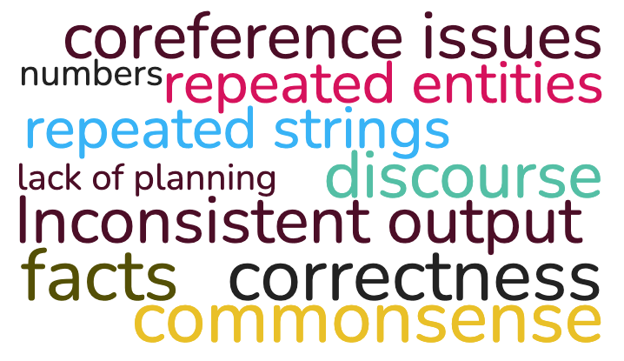
Challenges of Generation Dialogue Systems
Notes:
There are many challenges in building a generation based dialog systems.
including coreference resolution, conversational discourse, consistent responses, diverse responses, and factual correctness.
We will show you methods that tackle some of these challenges.

Slide 6
Building a Conversational Agent
4-step recipe
Data
Model
Training
Evaluation
[Fung et al., 2020]
Notes:
To build a conversational agent, we can break it into 4 steps.
First, we need to select the data for our task.
Next, we select a model architecture to learn from the selected data.
Then, we train the model on such data.
and finally we evaluate the trained model with different evaluation metrics.

Slide 7
Building a Conversational Agent
Types of Conversational Corpora
Machine to machine
Generated from dialog templates
Issues: data quality, naturalness, noises
Human to machine
Collected from existing dialog systems
Issues: limited domains, biases, noises
Human to human
Twitter, Reddit, etc.
Customer service
Issues: small size, limited domains
4-step recipe
Data
Model
Training
Evaluation
[Fung et al., 2020]
MultiWOZ, DSTC
Twitter, Reddit, OpenSubtitles, Persona Chat,
Notes:
first of all, data
what kind of data can we use for generation based conversational agents?
We can collect data from machine-to-machine conversations, human-to-machine, or human-to-human conversations.
Each type has their own benefits and limitation.
Machine to machine conversations are the easiest to collect. However, these data are often noisy and unnatural.
Meanwhile, human to machine data though are also available, such data only cover limited domains and usually include biases and noises.
Human to human data are the most difficult to get, we can only gather a small size in some particular domains.
Building new datasets for conversational AI is really difficult and we need to trade off some aspects depending on what we are aiming for.

Slide 8
Some Terms
How is the weather today?
Utterance
Right now is 21 degrees with cloudy.
4-step recipe
Data
Model
Training
Evaluation
[Fung et al., 2020]
Dialogue history
Is it good to go out for dinner at 6 pm?
Absolutely, the sky will be clear by 6.
Ok. Then please book me a table for 2 at Sushi Bar at 6 pm
Confirm a table for 2 at 6 pm.
Anything else?
Response
That’s it. Thanks.
Happy to help
Notes:
Next, I will introduce some terms that are used in this field.
Each grey box is an user utterance, it could be a word, a phrase, a sentence, a short text.
A response is denoted in blue, which is generated by the system. We can use templates, or machine learning models to generate a response.
Dialogue history includes multiple user utterances and the responses, which is used to track the context and past statements.

Slide 9
Basic Architecture of
Generation based Conversational Models
Input x
NLG model
Output y
4-step recipe
Data
Model
Training
Evaluation
Encoder
Decoder
Understanding input (natural language understanding)
Generating the output based on
the input
target task
Notes:
Next, we will talk about model.
the basic architecture of our generation based conversational models can be represented with this simple framework of the encoder-decoder.
In this framework, the input is the dialog history, which can be the current user input, an image or even a video. But in this talk, we only consider textual input.
The job of encoder is to take the input and convert that into a dense vector.
And the decoder then takes the vector to generate response, which is a sequence of text.

Slide 10
Input and Output
Input x
Encoder-Decoder Framework
Output y
Open-domain chit chat
Input
Dialogue history
Output
Response
Task-oriented dialogs
Input
Dialogue history
Belief state
Database/API results (state)
Output
Response
Belief state
Database query
API Service
Notes:
First, let’s have a look at the Input
In open-domain chit chat, the input is simply dialog history and the output is response to user
Meanwhile, In generation based task-oriented dialog systems, Input can be the dialog history, belief state, database or API results,which I will give more details in next slide.
And the output will be response to the user, the belief state given the dialogue history, or a database query or API service to obtain the required information for task completion

Slide 11
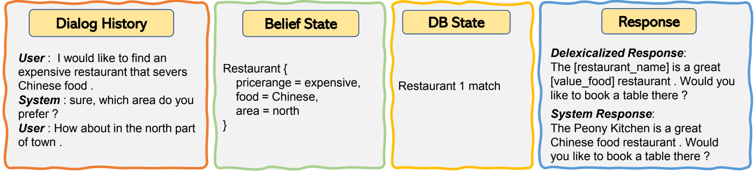
Input and Output: Task Oriented Dialogue Systems
Each input/output is by itself a sequence of tokens
[Peng et al., 2020]
Notes:
Here is an example of input and output of task oriented dialog systems.
Each input/output is by itself a sequence of tokens
The dialog history contains previous user utterances and previous responses generated by the system.
The belief state is the dialogue state containing domain of the current conversation, user intent, and the slot values of the whole conversations.
The database state is the results returned by querying data from a task-specific knowledge base or API service.
And the response which is first generated by the system is a delexicalized response, in which slot values are masked by some placeholder such as restaurant_name and value_food.
The system then will fill these placeholders with the information from belief state and database state.
The user finally will get the completed response.

Slide 12
Input and Output: Task Oriented Dialogue Systems
Each input/output is by itself a sequence of tokens
1
[Peng et al., 2020]
Notes:
In task-oriented dialog, we detect user’s intent from the utterance and the corresponding slot values.
In this example, the intent is find_restaurant and the corresponding slot values are expensive , chinese food and location is the north of the town from dialogue history.
Gather intents and slot values of the entire dialogue history, we get the belief state.
This is the 1st step of the e2e TOD model, the input is the dialog history, previous belief state, and the current user input. the output is the updated belief state.

Slide 13
Input and Output: Task Oriented Dialogue Systems
Each input/output is by itself a sequence of tokens
0 match
>1 match
1
[Peng et al., 2020]
Notes:
The belief state is then used to query a task-specific database (DB) to obtain the DB state.
For example here, we query the database to get restaurants that match the price range, food and area requested by the user.
The query returns a list of restaurants that match the query.
Here only one restaurant matches the user requirement.
There are two other cases of the returned results.
One is that no match is found from the database, in this case, the system is expected to suggest different restaurants for the user or to ask user slot changing question.
Another case is when there are multiple matches found.
The system can either show all matches to the user and let the user select one of them.
Or the system can ask user clarification question so that the user can give more slot values to reduce number of matches.

Slide 14
Input and Output: Task Oriented Dialogue Systems
Each input/output is by itself a sequence of tokens
1
2
2.1 system action
[Peng et al., 2020]
Notes:
So to generate response, both the belief state and database state are used.
responses can be varied depending on the context, but usually in conversational data, only one response is given and we only learn to generate such response.
So, in summary, the e2e TOD model generally performs 2 steps.
First, taking dialog history as input, and generate belief state.
The second step is after getting database state using the belief state, the model will generation response given all current information.
Note that some models try to generate system actions before producing response.
A system action is a predefined action that the system should react to user given a situation.
For example here, the action is “confirm booking”
E2e TOD will learn these steps in one unified model for sequence generation.

Slide 15
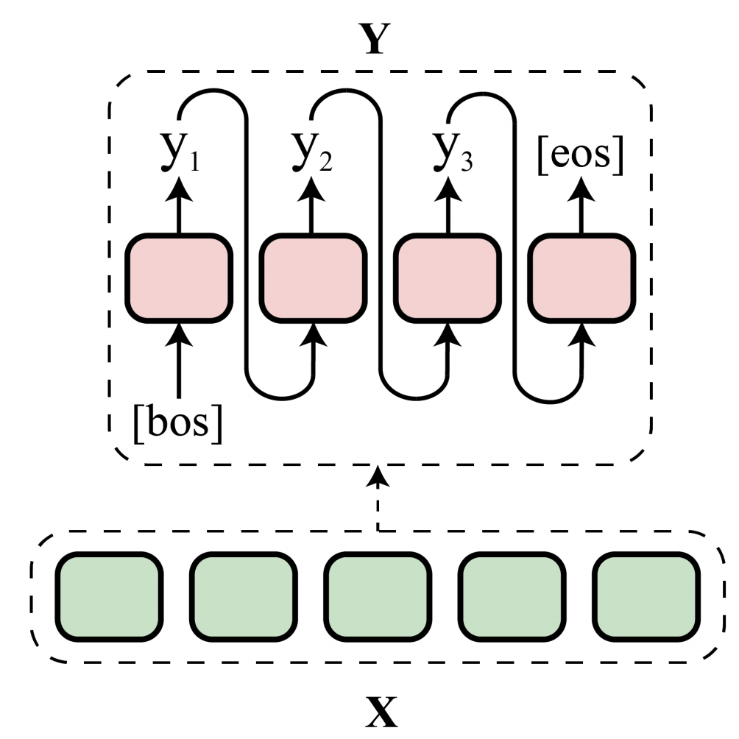
Encoder-Decoder
Input x
Encoder-Decoder Framework
Output y
Issue with AG
Error accumulation
worse generation at one step → even worse at following steps
Autoregressive Generation [AG]
[Su et al., 2021]
Notes:
We have gone through the input and output of a conversation model.
Now we will talk about the model.
The encoder-decoder framework has been introduced in previous lecture.
The encoder takes the input text and produces a context vector.
And the decoder then generates the output text given the context vector.
We have learned that the decoder generates one word at each time step.
Such generation is called an autoregressive generation as the current output is conditioned on the previous output, e.g., y2 is conditioned on y1.
- A main issue with the autoregressive generation is error accumulation during decoding. if the model generates a bad output at one step then the following generated sequence will get even worser.

Slide 16
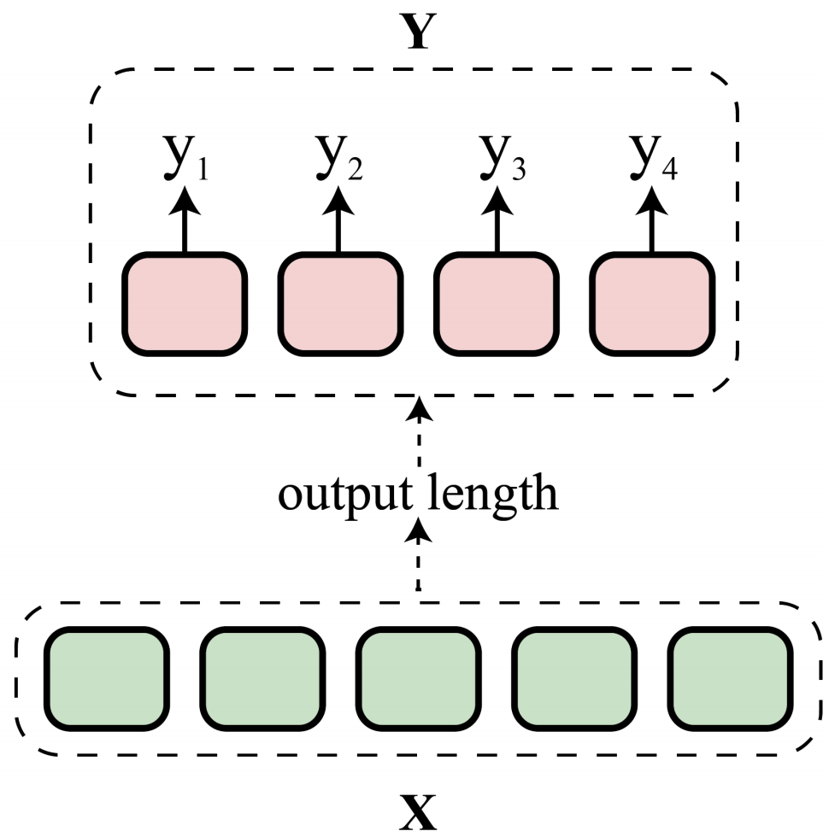
Encoder-Decoder
Input x
Encoder-Decoder Framework
Output y
Issues with NAG
Need to know target sequence length to generate all words in parallel
Token repetition: conditional independence → repeat high probability tokens
Non-Autoregressive Generation [NAG]
[Su et al., 2021]
Notes:
So why don’t we generate all words at the same time?
Non-autoregressive generation is proposed to address this.
In non-autoregressive generation approaches, we first predict the output length and then generate all the target tokens according to the predicted length.
The constraint on output length is the main issue in such generation approaches.
Another issue is due to the condition independence of output tokens, such approaches may generate repeated tokens. usually the high probability ones.

Slide 17
Encoder-Decoder
Input x
Encoder-Decoder Framework
Output y
Autoregressive Generation [AG]
Non-Autoregressive Generation [NAG]
[Su et al., 2021]
[Su et al., 2021]
Notes:
So far, I have introduced the two types of generation.
In conversational AI, we mainly use autoregressive generation approaches.

Slide 18
Output Generation
Input x
Encoder-Decoder Framework
Output y
Starts with [bos] (begin-of-sequence)
At each step
take previous generated token
generate a distribution over the vocabulary
Stops by [eos] (end-of-sequence)
Terminate when [eos] is predicted
Stop when max target sequence length is reached
Autoregressive Generation [AG]
[Su et al., 2021]
Notes:
Here is the generation process of autoregressive generation approaches.
We starts with a special token [bos], begin of sequence, indicating the start of generation
At each time step t, the model computes the scores of each token in our vocabulary taking previous generated token as input
The model will continue generating until it produces the [eos] token, end of sequence, or when the generated sequence reaches the maximum length
How do we select a token at each time step?

Slide 19
Output Generation: Decoding Strategies
 | Greedy | Beam Search | Top-k Sampling | Top-p (Nucleus) Sampling
At each step | Pick the best word | Try a few best words | Random sample from top-k | smallest set with cumulative probability > p
Output | One sequence | Several partial sequences | One sequence | One sequence
Notes:
There are several decoding strategies for selecting the token at each time step.
We will talk about some main strategies that are used in dialog systems.

Slide 20
Output Generation: Greedy Decoding
 | Greedy | Beam Search | Top-k Sampling | Top-p (Nucleus) Sampling
At each step | Pick the best word | Try a few best words | Random sample from top-k | smallest set with cumulative probability > p
Output | One sequence | Several partial sequences | One sequence | One sequence
0.5
0.3
like
my
0.9
dog
Weakness
Repetition as always select the most frequent token
I
0.4
have
0.4
a
cat
0.135
0.5
buy
the
house
0.08
Notes:
The simplest approach is to pick the token with the highest probability, called greedy decoding.
The output is one sequence with the highest probability at each time step
- The major drawback of greedy decoding is that it may miss the high probability sequence due to selecting the highest probability of a previous timestep
For example here, At first greedy decoding will select the highest probability token “have” then following that, it will lead to the sequence I have a house, the overall probability of this sequence is 0.08.
While we can see, from another direction, we have the sequence I like my cat which has higher probability in overall.
So the pick at the first step affects the whole sequence after leading to a sequence with lower probability.

Slide 21
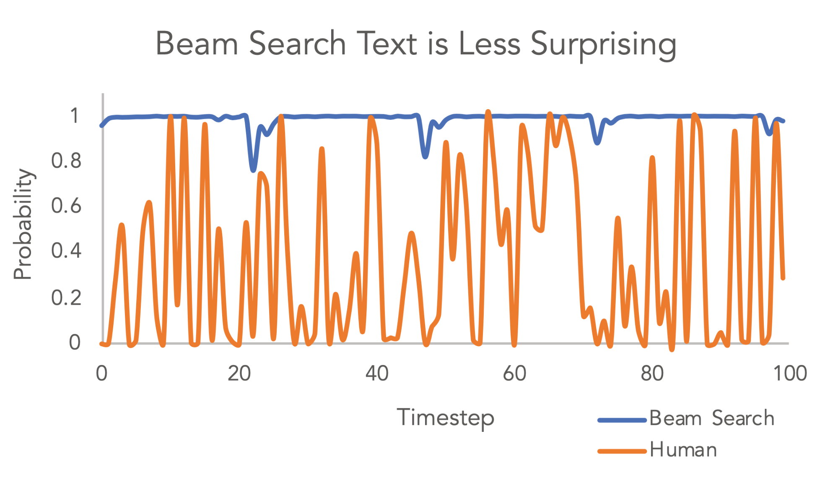
Output Generation: Beam Search
 | Greedy | Beam Search | Top-k Sampling | Top-p (Nucleus) Sampling
At each step | Pick the best word | Try a few best words | Random sample from top-k | smallest set with cumulative probability > p
Output | One sequence | Several partial sequences | One sequence | One sequence
[Holtzman et al., 2019]
Common beam: 5 or 10
0.5
0.3
like
my
0.9
dog
Weakness
Short sentences
Less diversity
I
0.4
have
0.4
a
cat
0.135
0.5
buy
the
house
0.08
Notes:
Beam search reduce the risk by tracking of n best candidates at each time step, producing several sequences at the end.
N best candidates at each time step is called beam size, we commonly use 5 or 10.
At the end, the sequence with the highest probability is selected.
For example here, we will keep track of 2 best candidates, so we will keep like and have and expand the sequence. At the end, we will get the highest probability sequence which is I like my cat instead of I have a house.
- According to recent evidence, beam search can work well in tasks where the length of the generated sequence is predictable such as machine translation.
But for open-ended generation, beam search can vary greatly. but we can use length penalty to reduce the sequence length issue.
Another issue of beam search is repeated word sequences and less diverse sequences.
- Here is a figure comparing the probability of tokens selected by beam search and selected by human.
While beam search select high probability tokens, human in contrast, tend to select tokens have much higher variance in the predicted probability. And because of the variance, the sequence is more surprising.
so random sampling is proposed to give the surprisal to the output.

Slide 22
Output Generation: Top-k Sampling
 | Greedy | Beam Search | Top-k Sampling | Top-p (Nucleus) Sampling
At each step | Pick the best word | Try a few best words | Random sample from top-k | smallest set with cumulative probability > p
Output | One sequence | Several partial sequences | One sequence | One sequence
Common k: 5, 10, 20
0.5
0.3
like
my
0.9
dog
Note
k=1 → Greedy algorithm
↑k → more diverse/risky
↓k → more generic/safe
I
0.4
have
0.4
a
cat
0.5
buy
the
house
[Holtzman et al., 2019]
Notes:
The first sampling method we consider is the top-k sampling, which samples a word from the most likely k words.
Sampling here means that the next token is randomly selected from the set of k tokens according to its conditional probability distribution.
Note that using sampling decoding, the generation process is not deterministic anymore as we may sample different tokens from the top-k.
This approach is expected to generate more novel and less repetitive sequence.
- When k=1, it’s the greedy decoding method that we have introduced in the previous slide.
When increasing k, we get more diverse output but also more risky as we may sample unrelated tokens
So weird n-grams may occur using top-k sampling, and the output maybe not coherent.
While decreasing k, we get safer output as tokens occur frequently
But choosing k is an empirical decision, there is no best k that fits all tasks.

Slide 23
Output Generation: Top-p (Nucleus) Sampling
 | Greedy | Beam Search | Top-k Sampling | Top-p (Nucleus) Sampling
At each step | Pick the best word | Try a few best words | Random sample from top-k | smallest set with cumulative probability > p
Output | One sequence | Several partial sequences | One sequence | One sequence
0.95
0.95
0.95
Common p: 0.95
like
my
dog
Weakness
May not include surprising words
I
have
a
cat
buy
the
house
[Holtzman et al., 2019]
Notes:
So instead of using a fixed k of tokens for sampling that may include unrelated ones, why not depend on the predicted probabilities to find the set of tokens?
Top-p sampling is proposed for this purpose.
The idea is to select a smallest subset of tokens whose cumulative probability is higher than a predefined threshold. We usually use 0.95 as threshold.
This way, the size of the set of tokens can dynamically increase or decrease according to the next word’s probability distribution.
For example here, having threshold is 0.95, at the first step, top-p sampling picks the minimum of word exceed together 0.95 of the probability.
This includes 4 words in total. while in the second step, top 3 words together exceed 0.95. And in the third step, only 2 words are considered.
In theory, top-p seems more elegant than top-k.
In practice, both works well and are usually used in combination to avoid low ranked words and allow dynamic word set.
- despite of the dynamic set, top-p sampling still may not include surprising words in the candidate set.

Slide 24
Output Generation: Decoding Strategies
 | Greedy | Beam Search | Top-k Sampling | Top-p (Nucleus) Sampling
At each step | Pick the best word | Try a few best words | Random sample from top-k | smallest set with cumulative probability > p
Output | One sequence | Several partial sequences | One sequence | One sequence
Notes:
In general, all these decoding strategies select tokens based on the predicted probability of the generation model.
Although top-k and top-p samplings are proposed to reduce repeated sequence and produce more surprising response, recent analysis shows that they still suffer from these issues.
The main cause of these issues is the way a model is trained.
So Let’s have a look of how do we often train a encoder-decoder model.

Slide 25
Training
4-step recipe
Data
Model
Training
Evaluation
Teacher forcing: Maximum Likelihood Estimation (MLE)
Maximize the conditional probability of target sequence
[Fung et al., 2020]
Unlikelihood training [Welleck et al., 2020]
Minimize likelihood of undesired tokens
Notes:
In general, the model is trained using maximum likelihood estimation (MLE).
MLE encourages the model to maximize the conditional probability of target text.
This is also called teacher forcing training.
However, MLE focuses on maximizing probability of the next token by
first, sharpens the entire probability distribution instead of maximizing the rank of the next token in a more uniform distribution.
Also, it does not optimize the entire sequence but only the next token at each time step.
So frequent words are often predicted leading to repeated sequence.
And any wrong token prediction will lead to error accumulation, the following generated sequence is getting worse and worse.
- Unlikelihood training is proposed to alleviate the problems by minimizing the likelihood of undesired tokens.
So far, we talk about an encoder-decoder architecture for building conversational agents.
But we have not included any attribute that defines a good conversation.

Slide 26
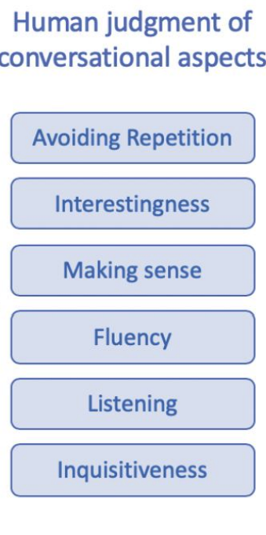
What makes a good conversation ?
internal repetition; repetition across responses; partner repetition
interesting response: knowledge, engagingness
coherent response
grammatically correct
response related to user’s utterance
response and ask information about user
[See et al., 2019]
Notes:
So what makes a good conversation?
This is a list of several aspects defined by See and colleagues.
First, we don’t want repeated responses by conversational agents.
Repetition includes internal repetition, which is repeating words or phrases within a response.
or repetition across responses, as different responses from an agent are the same.
And last partner repetition, that simply repeat what the user said.
The generated response is also expected to be interesting.
Interesting can be defined by having common sense when reacting to the user, or having knowledge about the discussing topic.
Interesting responses can also leads to engaging conversations.
The response of course should be coherent and fluent.
Wrong grammatical or wordy and redundant sequences cause difficult while reading or listening, and sometimes, annoying.
The response should also be related to what the user just said, to bring the feeling of being listen to the user. So the user knows that the system pays attention to them.
And a conversation is a mutual interaction process. Don’t expect the user to be the only questioner. The agent is also expected to be inquisitive and ask to know more about the user.
In the next few slides, I will introduce some methods to make a conversation better.

Slide 27
Some Methods to Make a Good Conversation
Input x
Encoder-Decoder Framework
Output y
Large pretrained models: BART, T5, GPT-1/2/3 → more fluent & diverse response thanks to large scale pretraining
Input modification
Integrating attribute description
Type embeddings
Using learned attribute embeddings
Decoding strategies
Top-k sampling, top-p (nucleus) sampling → reduce repetition
Guided decoding
Reinforcement learning
Notes:
Let’s go back to the encoder-decoder framework. This is a general framework for text generation tasks. To consider different attributes that make a good conversation, we can modify either neural architecture or training setting.
- Recent methods often initialize the framework based on large pretrained models such as BART, T5, and GPT as the large scale pretraining helps to generate more fluent and diverse responses.
- Decoding strategies can also help to modify the generated sequence. Top-p and top-K are proposed to generate better than greedy and beam search. However, in practice, the repetitive word flaws are still presented using these two sampling. We also cannot control the generation towards a target attribute. Guided decoding can direct the decoder to generate attribute-related output.
- We can either modify the input sequence to include attribute descriptions
- Or to condition the model on the embeddings of such attributes
- Or train with reinforcement learning where attribute scores define the rewards

Slide 28
Large Scale Pretraining
Input x
Encoder-Decoder Framework
Output y
Large pretrained models: BART, T5, GPT-1/2/3 → proposed for general text generation
PLATO | DialoGPT | Meena | BlenderBot | TOD-BERT
Twitter, Reddit (En) | Reddit (En) | public domain social media conversations (En) | Reddit discussions (En) | 9 task-oriented datasets (En)
BERT | GPT-2 | Evolved Transformer | Poly-encoder Transformer + Seq2seq | BERT
- Response generation - Latent act recognition | - Response generation - Maximum Mutual Information | - Minimize perplexity of next token | - Masked LM - Ranking for retrieval - Response generation - Retrieve & refine - Unlikelihood training | - Masked LM - Response contrastive loss
Notes:
The large pretrained models mentioned in previous slide are trained for generic text generation.
It does not include specific biases towards dialogue generation
Several models have then been proposed to extend the pre-training to dialogue data.
Most of these models use social media data for pretraining, such as twitter and reddit.
Meena uses public domain conversations but the data and model are not publicly available.
TO-BERT uses 9 TOD datasets.
All of these models employ transformer-based architecture.
While BlenderBot uses poly-encoder transformer that produces multiple representations for a context, other only have one single representation.
Most models are trained by generating response.
Each of them has their own additional objectives to improve training, such as latent act recognition that predicts the response action, the response is generated conditioned on the latent variable and the context.
Another interesting objective is maximum mutual information, it employs a pre-trained backward model to predict source sentences from given responses.
More details can be found in these papers.

Slide 29
Guided Decoding
Input x
Encoder-Decoder Framework
Output y
Modify probability
Re-sampling
Attribute Model
Define an attribute model to score the generated sequence
Guide the decoding process
Re-sampling if not satisfy attribute guide
Modify the probability distribution with attribute scores [Madotto et al., 2020]
Notes:
So how can we encourage a model generate towards a predefined attribute?
For example, how can we generate response with positive or negative sentiment ?
To do so, we need to define an attribute model to score the generated sequence.
If the expected output should be positive, we resample the sequence if it is predicted as negative by the attribute model.
Or we use the loss with respect to the attribute score to train the model.

Slide 30
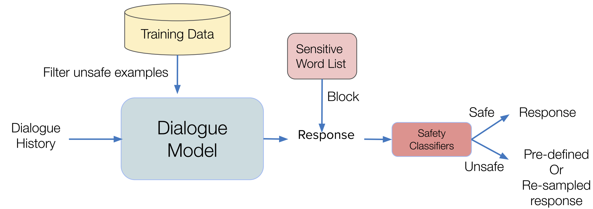
Guided Decoding
Safety in Open-domain chatbots
Dialogue systems trained on large scale data may inherit biases from such data
→ may produce toxic, harmful and biased responses
→ bring bad experience to user
Human: I hate everyone. Acceptable?
Bot: I accept that, I hate you too.
Bot: Are you ok? Do you want to talk about something else?
[Fung et al., 2020]
Notes:
Well, that’s very abstractive , let’s have a look at a related work on safety in open-domain chatbots.
Dialogue systems that are pretrained on large scale data
these data are gathered from online web, on which human users can freely express anything without consor
Such data unfortunately may include human’s biases.
And training on such data may lead to toxic response generation.
Which will bring bad experience to the user.
- For example, when a person talks to the system that he hates everyone, the reaction of the system is unacceptable. At this point, the system should try to talk to the person.
- So we can define a sensitive word list and block the model to generate any of these tokens
We can also add safety classifiers to identify whether the generated response is safe or unsafe. For unsafe response, we can simply re-sample another response and repeat the safety process again.

Slide 31
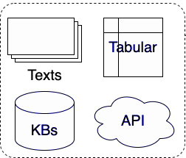
Input Modification
Input x
Encoder-Decoder Framework
Output y
+
Attribute description
E.g., Dialog history + [positive]; [sad] + Dialog history
Knowledge
Retrieval methods:
IR systems (TF-IDF, BM25)
Neural retriever: dense vectors
Generating API query
Knowledge to text → add to input E.g., “Input” + [restaurant] Sushi Bar
Notes:
Another method is to modify the input to incorporate attribute while training a model.
We can add attribute description to the input and train the model to generate sequence according to the description.
Common attribute description to the input sequence such as style, topic, emotion, Persona profile, or situation description.
If the attribute is real world knowledge, we first need to retrieve such knowledge using some information retrieval methods.
The results can be transferred into text and add to input. such as the example here.

Slide 32
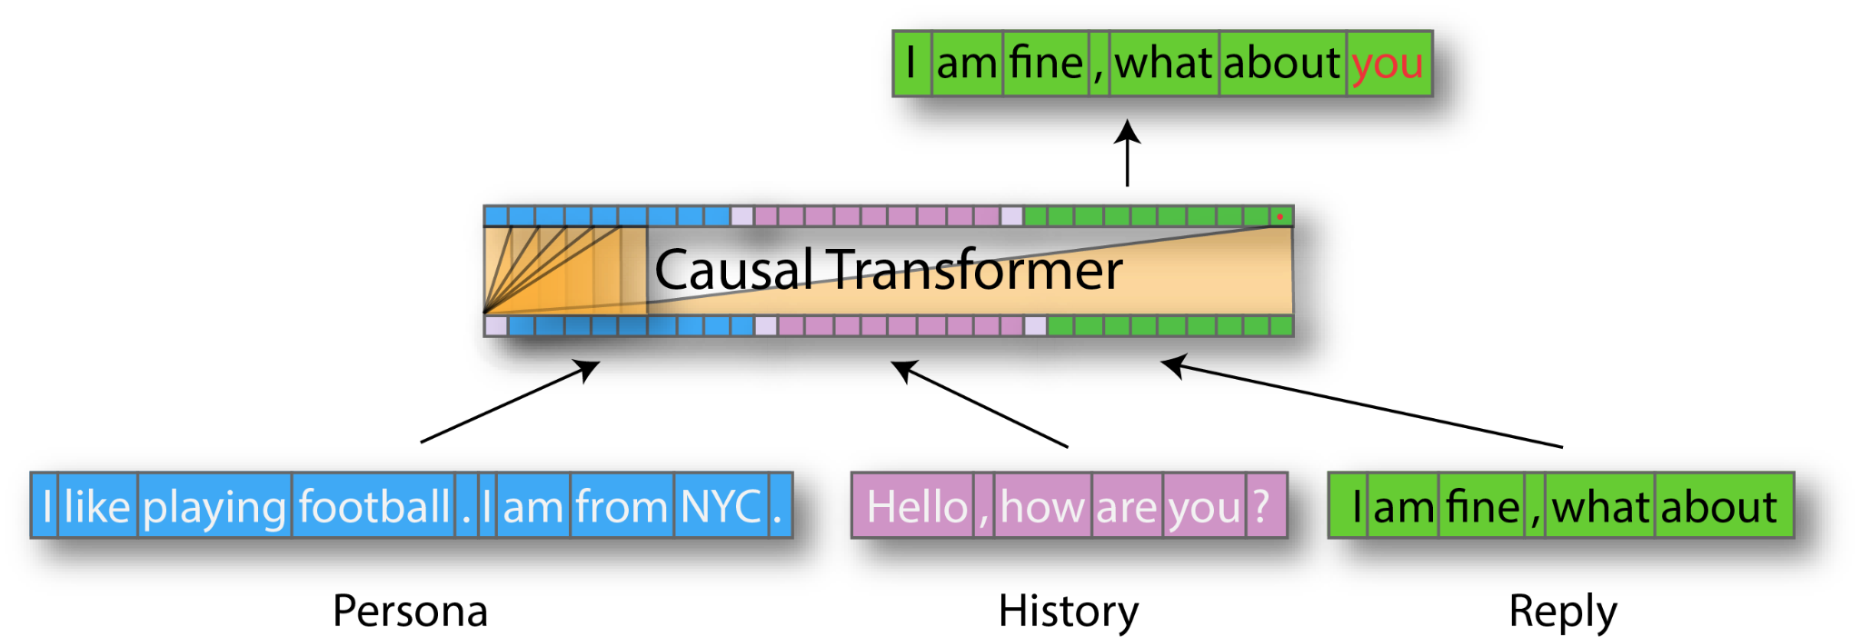
Input Modification
Personalization: TransferTransfo Model
Notes:
Here is an example of adding attribute description to the input text
This is the TransferTransfo model using GPT architecture for generating persona response.
The input includes dialog history and persona description of the system.
And the generated response at time step t.
The task is to predict the next token. Note that al the input are in a single sequence.

Slide 33
Attribute Embeddings
Input x
Encoder-Decoder Framework
Output y
Attribute Embeddings
Embeddings of the target attributes
Learned during training the conversational model
Obtained from additional methods such as clustering, link prediction for knowledge base integration
Notes:
Instead of adding attribute description to the input, we can condition the model on the attribute embeddings.
Attribute embeddings can be obtained from two ways.
Either train simultaneously with the generative model
Or obtained from additional models such as clustering or link prediction models to integrate knowledge bases

Slide 34
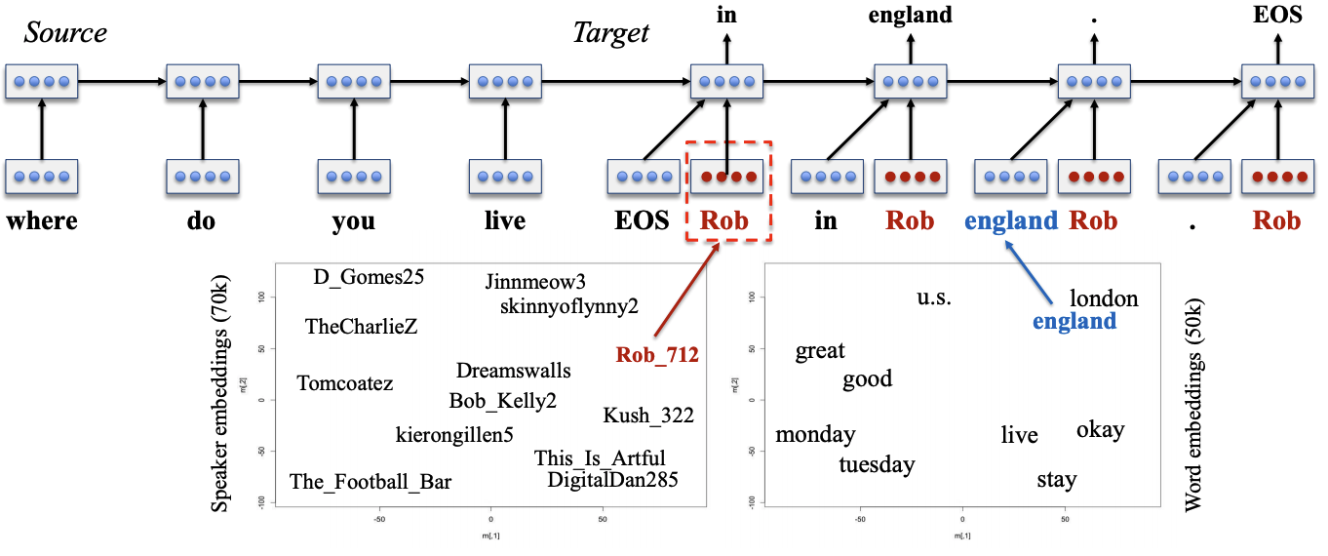
Attribute Embeddings
Personalization: Speaker Model
Notes:
Here is another example of personalized conversations.
The speaker model is proposed to encode personas in dense vectors that capture the speaker’s characteristics such as background information and speaking style.
The speaker embeddings are used in concatenation with the input of the decoder.
These speaker embeddings are learned jointly with word embeddings and all other parameters of the neural model.
Due to the training of speaker embeddings in response generation, Speaker IDs close in embedding space tend to respond in the same manner.

Slide 35
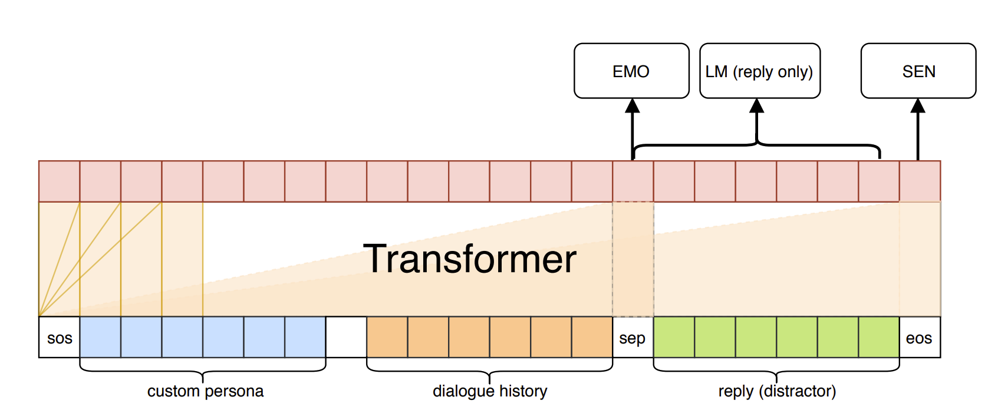
Attribute Embeddings
Empathy: CAiRE
Human: I finally got promoted.
Bot: Why would anyone promote you?
Bot: Congrats! That’s great!
Notes:
Here is another example of attribute embeddings for building Empathetic conversational agent.
An empathetic conversational agent is expected to understand the feeling of the human partner and reply them accordingly.
- For example here, it’s relevant if the bot said why would anyone promote you but it’s harsh and rude.
Congrats and that’s great sounds more empathic because it knows the proud feeling of the user.
The model here instead of learning specific embeddings to represent attributes, it learns to predict the emotion of the dialogue at the current time step and generate the response as knowing the current emotion.

Slide 36

Reinforcement learning
Reinforcement learning
Cast a text generation model as markov decision process
State: dialog history + previous generated tokens
Actions: possible tokens
Policy: conversational model + decoding strategy
Rewards: attribute models for a good conversation
Politeness, sentiment, ..
Notes:
We can also define the desired attributes as rewards signals to learn a model using reinforcement learning.
In reinforcement learning, the model takes the current state which is dialog history and previous generated tokens as input and select an action which is the next token.
The rewards are often provided by attribute models or some types of metrics such as similarity score

Slide 37
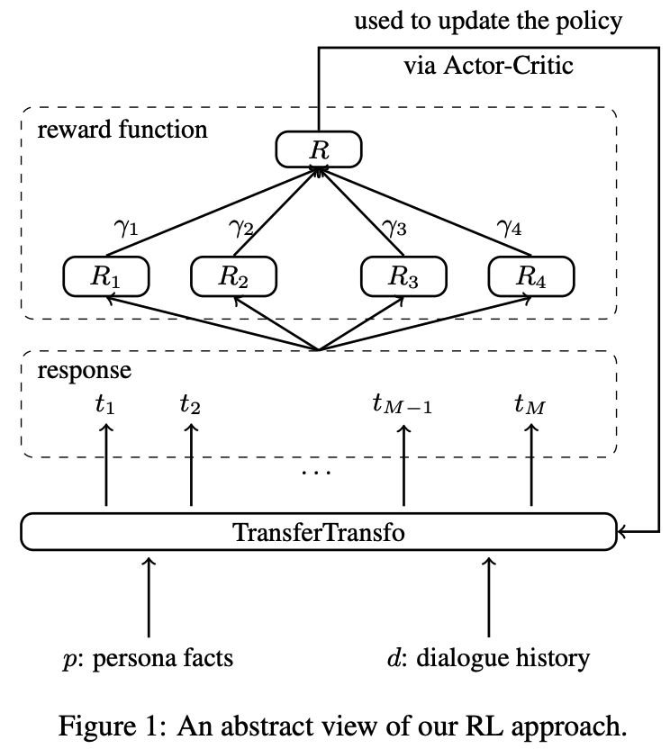
Reinforcement learning
Personalization:
Reward function: capture consistency between a response and persona facts
Persona consistency
Topical coherence
Fluency
Repeated tokens
[Mesgar et al., 2021]
Notes:
Here is an example of using reinforcement learning for personalized response generation.
The authors define 4 different reward signals that encourages the consistency between a response and persona profile.
The 4 different rewards include persona consistency that expects the generated response can be entailed by the persona facts
The 2nd is topical coherence which ensures the similarity between response and the last user utterance
Fluency and repeated tokens to make sure that the response is grammatically correct and coherent.

Slide 38


Evaluation
4-step recipe
Data
Model
Training
Evaluation
[Fung et al., 2020]
System: The brown fox jumps
Reference: The fox
Automatic Evaluation
Human Evaluation
[Ji et al., 2020]
Notes:
So, we have learned some methods to build a good conversational model.
We now see how to evaluate such model
As other natural language applications, we have automatic and human evaluation for dialogue systems

Slide 39
Automatic Evaluation
Compare with reference response
System: The brown fox jumps
Reference: The fox
Main categories
Perplexity: how likely a model generate the reference response
N-gram based overlap: BLEU, ROUGE-L
Distinct N-gram: diversity → Weakness: surface level, correlate poorly with human judgement
Model based metrics: BERTScore [Zhang et al., 2020], Adversarial Success [Kannan & Vinyals, 2017; Li et al., 2017] → Weakness: not interpretable, not always align with human judgement
Notes:
Automatic evaluation metrics compare the generated response with the reference response.
These metrics can be grouped into several categories.
The perplexity computes how likely a model generate the reference response
N-gram based overlapping metrics such as BLEU and ROUGE are also used to compute the overlapping words between the two responses
Distinct n-gram measures the diversity of a response, which focuses on number of distinct n-gram in the response and penalizes responses with many repeated words.
These metrics detect only the surface form similarity without considering semantic similarity
To compute the semantic similarity, model based metrics have been proposed, among them, the two well-known metrics are BERTScore and adversarial success. BERTScore computes the semantic relatedness of the generated response to the reference.
Adversarial Success classifies whether the generated response is machine-generated or human-generated. A model is expected to generate fluent and natural response that can fool the classifier.
these model based metrics are not interpretable and not always align with human judgement.

Slide 40
Human Evaluation
Interaction setup
Dialogue history, gold response, generated response
Directly interact with systems
Evaluation setup
Likert: give ratings according to some criteria, e.g., fluency, consistency, factual etc.
Selection preference: select one system among presented systems (usually btw 2)
Weaknesses
Expensive & time consuming
Difficult quality control, inconsistency in evaluation
Notes:
- Due to the limitation of automatic evaluation metrics, human evaluation is often in combination with them.
- There are two evaluation interaction for human judgement.The first scenario, a person is given a dialogue history, gold response and generated response for evaluation. The second scenario, the person is provided interactive interface to communicate with a system and then evaluate on the interaction outcome.
- There are two ways of evaluation, first, human judgement is required to give ratings of a model according to some predefined criteria. The second way is to select between two given systems given their output.
- Note that human evaluation is known for expensiveness and time-consuming. Also, people are very subjective, it’s difficult to control the evaluation quality of different judges as well as a single person and themselves. So, generally, both automatic and human evaluation are often used together.

Slide 41
Summary: Evaluation
4-step recipe
Data
Model
Training
Evaluation
[Fung et al., 2020]
System: The brown fox jumps
Reference: The fox
Automatic Evaluation
Human Evaluation
Improper or offensive language
Factual consistency
[Ji et al., 2020]
Notes:
In general, there are still lack of metrics for evaluating how efficiently a generation system can avoid generating improper or offensive language.
We also need to evaluate the generated text based on factual consistency. Factual evaluation is more important than ever in text generation as neural models can generate fluent and coherent text but not grounded in the real world knowledge.

Slide 42
Summary
A lot efforts have been made
But still many improvements ahead in Conversational AI
Evaluation remains a huge challenge
Need better ways of automatic evaluation
Most exciting areas of NLP!
Notes:
We have introduced several techniques that are used to build a conversational model as well as evaluation efforts
There are still many rooms ahead for improvement
We still need better automatic evaluation metrics.

