Slide 1
AI FOR MEDICAL TREATMENT
Course 3 · AI for Medicine Specialization · DeepLearning.AI
Course: Introduction to Machine Learning
B1
BIZ 1
B2
BIZ 2
D1
DEV 1
D2
DEV 2
40 slides · 40 min talk + 10 min Q&A = 50 min total
Notes:
Cover slide. BIZ 1 opens. Introduce the four members in under 30 seconds, then go straight to the logic flow slide.

Slide 2
The Logic Flow of Course 3
The three modules are not independent — each one creates the need for the next
MODULE 1 · Treatment Effect Estimation
1
Does this treatment actually help — and which patients does it help most?
Slides 5–16
BIZ 1 → DEV 1
ARR / NNT → RCT → Y(1), Y(0) → ATE → CATE → T-learner / S-learner → C-for-benefit
↓ Every model above needs LABELLED DATA at scale — and in medicine those labels sit inside free-text reports
MODULE 2 · Medical Question Answering
2
Where does the labelled data come from in the first place?
Slides 17–27
DEV 2 → BIZ 2
Extractive QA / BERT → synonyms → is-a relationships → negation → precision / recall / F1
↓ The model is now accurate but opaque — clinicians will not act on it and regulators will not approve it
MODULE 3 · ML Interpretation
3
Why did the model predict this — and would a clinician trust it?
Slides 28–37
DEV 2 → BIZ 2 → DEV 1 → DEV 2
Drop column → permutation → individual importance → Shapley → localization map → heat map
AI For Medical Treatment · Course 3
2
Notes:
[BIZ 1 · 1.5 min] ORIENTATION SLIDE FOR THE TEAM AND THE AUDIENCE. Read it downwards: each module solves a problem, and that problem is what creates the need for the next module. Build a model, but the model needs labelled data, so Module 2 produces the labels; the model is still a black box, so Module 3 opens it. If everyone understands this slide, nobody gets lost presenting their own section.

Slide 3
Presentation Structure
Following the course’s own three-module structure
Treatment Effect Estimation
TIME ALLOCATION
1
Week 1 · 12 videos · BIZ 1 → DEV 1
B1
BIZ 1
10 min
Depends on: Independent — start here. Inside the module the slides build in a straight line.
B2
BIZ 2
11 min
Medical Question Answering
2
D1
DEV 1
9.5 min
Week 2 · 10 videos · DEV 2 → BIZ 2
Depends on: Technically independent of Module 1, but it supplies the labelled data every model needs.
D2
DEV 2
9.5 min
ML Interpretation
3
Total 40 min
Week 3 · 9 videos · DEV 2 → BIZ 2 → DEV 1 → DEV 2
Depends on: Applies to the structured-data models of Course 2 and the image models of Course 1.
+ 10 min Q&A
AI For Medical Treatment · Course 3
3
Notes:
[BIZ 1] Show the audience that the talk follows the course structure exactly. Do not read the slide aloud — point at the three modules and move on.

Slide 4
INTERNAL SLIDE — HIDE BEFORE PRESENTING
Assignment by Capability
Technical level: ●○○ no ML background needed · ●●○ notation or technical detail, still explainable in words — needs a developer on Q&A · ●●● real ML background needed
B1
BIZ 1
Logic flow · Module 1 videos 1–7 (ARR → CATE) · Conclusion
Max level ●●○
10 slides
10 min
Clinical and statistical foundation
DEV 1 backs Q&A
D1
DEV 1
Module 1 videos 8–12 (T/S-learner, C-for-benefit) · Module 3 Shapley
Max level ●●●
7 slides
9.5 min
Treatment effect modelling
—
D2
DEV 2
Module 2 videos 1–3 (BERT) · Module 3 importance + localization/heat maps
Max level ●●●
10 slides
9.5 min
Medical NLP and image interpretation
—
B2
BIZ 2
Module 2 videos 4–10 · Individual importance · Critical assessment
Max level ●●○
10 slides
11 min
Terminology, measurement and assessment
DEV 2 backs Q&A
IF YOU RUN OVER TIME, CUT IN THIS ORDER
CHECKED: no level ●●● slide is assigned to a business member.
1. Is-a Relationships → 2. Multiple Disease Categories → 3. Synonyms → 4. Interpreting CNN Models → 5. merge Permutation into Drop Column
VISUALS: each slide owner produces the image for their own slide. Two are mandatory — the SHAP force plot and the X-ray heat map.
NEVER cut Causal Inference, S-Learner or the Critical Assessment.
Hide this slide before presenting: right-click → Hide Slide.
AI For Medical Treatment · Course 3
4
Notes:
INTERNAL SLIDE — hide before presenting. Used so the team agrees the split. Rule: the two business members take no level ●●● slide, and every level ●●○ slide they do own has a named developer behind it for questions.

Slide 5
1
MODULE 1
Treatment Effect Estimation
12 videos · 43 min · Week 1 · Speaking order: BIZ 1 → DEV 1
This divider is read by BIZ 1
Notes:
Section divider for MODULE 1. Hand over the microphone here. Keep it under 30 seconds.

Slide 6
MODULE 1
Introduction to Course 3
B1
BIZ 1
Time 1 min
Level ●○○
Depends on None — can stand alone
Course source Intro to Course 3 · About Course 3
The specialization covers three branches of medicine: diagnosis, prognosis, treatment
Course 3 question: what is the effect of a treatment on THIS patient?
Week 1 treatment effects · Week 2 information extraction from text · Week 3 interpretation
Week 3 interprets both the Course 1 image models and the Course 2 structured-data models
SUGGESTED VISUAL
Diagram: the three courses in sequence
Place image here — Diagram: the three courses in sequence
Replace these bullets with your own wording — this is the outline to say, not text to read out.
AI For Medical Treatment · Course 3
6
Notes:
[BIZ 1 · 1 min] Opening. The course frames Week 3 as interpreting the models built in Courses 1 and 2, not as a standalone topic — say that, it ties the whole specialization together.

Slide 7
MODULE 1
Absolute Risk Reduction
B1
BIZ 1
Time 1.5 min
Level ●○○
Depends on None — can stand alone
Course source Absolute Risk Reduction
Treatment arm vs control arm; controls receive a placebo or the standard of care
Absolute risk = fraction of a group that suffers the adverse outcome
Course example: 2% of the treatment arm and 5% of the control arm had a heart attack
ARR = risk(control) − risk(treatment) = 0.05 − 0.02 = 0.03
NNT = 1 / ARR = 1 / 0.03 = 33.3 patients treated to save one from a heart attack
SUGGESTED VISUAL
Bar chart: 5% control vs 2% treatment
Place image here — Bar chart: 5% control vs 2% treatment
Replace these bullets with your own wording — this is the outline to say, not text to read out.
AI For Medical Treatment · Course 3
7
Notes:
[BIZ 1 · 1.5 min] Note the ARR direction: control minus treatment, so a POSITIVE ARR means the treatment helps. This is the opposite ordering from the ATE two slides later — the course is deliberate about it and so must we be. Use the exact course numbers (2%, 5%, NNT 33.3).

Slide 8
MODULE 1
Randomized Control Trials
B1
BIZ 1
Time 1 min
Level ●○○
Depends on slide 7
Course source Randomized Control Trials
Patients are randomly assigned to the treatment or control arm
Randomisation makes the two arms comparable, so the difference is attributable to treatment
RCTs reveal the causal effect of a treatment on a population
Without randomisation, group differences confound the comparison
Place a diagram, table or image here
Replace these bullets with your own wording — this is the outline to say, not text to read out.
AI For Medical Treatment · Course 3
8
Notes:
[BIZ 1 · 1 min] Keep this to 60 seconds. Its only job is to justify why the simple difference of group means is allowed on the ATE slide.

Slide 9
MODULE 1
Causal Inference
B1
BIZ 1
Time 1.5 min
Level ●●○
Depends on slide 8
Course source Causal Inference
Q&A backup DEV 1
Neyman–Rubin causal model: each patient has two potential outcomes
Y(1) = outcome if treated · Y(0) = outcome if untreated · 1 means the adverse event happens
Unit treatment effect = Y(1) − Y(0), taking values −1, 0 or +1
−1 = benefit · 0 = no effect · +1 = harm
Four patient patterns exist: benefit, harm, and two kinds of no effect
SUGGESTED VISUAL
Diagram: one patient, two potential outcomes
Place image here — Diagram: one patient, two potential outcomes
Replace these bullets with your own wording — this is the outline to say, not text to read out.
AI For Medical Treatment · Course 3
9
Notes:
[BIZ 1 · 1.5 min] THE MOST IMPORTANT SLIDE FOR THE SIGN CONVENTION. Treatment first, control subtracted, so NEGATIVE means the treatment helped. Say it out loud twice. Every later slide in this module depends on the audience holding this convention.

Slide 10
MODULE 1
Average Treatment Effect
B1
BIZ 1
Time 1 min
Level ●●○
Depends on slide 9 + slide 7
Course source Average Treatment Effect
Q&A backup DEV 1
Fundamental problem of causal inference: only one potential outcome is ever observed
The observed one is factual; the missing one is counterfactual
ATE = E[Y(1) − Y(0)]; from RCT data, ATE = E[Y | W=1] − E[Y | W=0]
Course example: 0.32 − 0.51 = −0.19, so the ATE is −0.19
ARR = −ATE = 0.19, a 19% average reduction in risk
Place a diagram, table or image here
Replace these bullets with your own wording — this is the outline to say, not text to read out.
AI For Medical Treatment · Course 3
10
Notes:
[BIZ 1 · 1 min] ARR and ATE are the same quantity with opposite sign — that is the single cleanest way to state it. The grouping estimator is only valid for RCT data; the instructor says observational data needs strong assumptions. That caveat seeds the critique at the end of the talk.

Slide 11
MODULE 1
Conditional Average Treatment Effect
B1
BIZ 1
Time 1 min
Level ●●○
Depends on slide 10
Course source Conditional Average Treatment Effect
Q&A backup DEV 1
CATE = E[Y(1) − Y(0) | X = x], the treatment effect conditioned on patient features
Course example patient: x = (age 56, blood pressure 130)
Exact matching fails: 0 treated and only 1 control patient match both values
Solution: learn the relationship between features and outcome instead of matching
Two learned functions: μ̂₁ treatment response, μ̂₀ control response
Place a diagram, table or image here
Replace these bullets with your own wording — this is the outline to say, not text to read out.
AI For Medical Treatment · Course 3
11
Notes:
[BIZ 1 · 1 min] The data-sparsity example is the whole argument for using ML here — zero matching treated patients on just two features. This is the handover point from BIZ 1 to DEV 1.

Slide 12
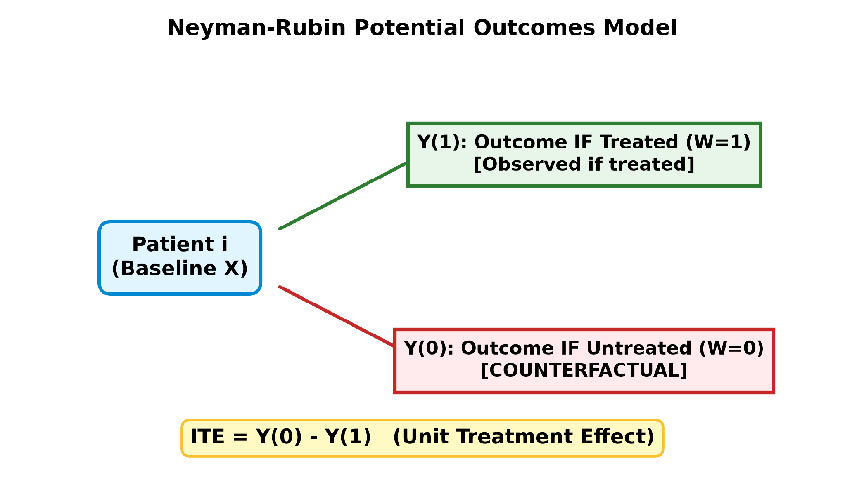
MODULE 1
Causal Inference
DEV 1 | 1 min
Tech Level: ●●○
KEY CONCEPTS & TAKEAWAYS
• Causal Inference
• Neyman–Rubin causal model: each patient has two potential outcomes
• Y(1) = outcome if treated · Y(0) = outcome if untreated · 1 means the adverse event happens
• Unit treatment effect = Y(1) − Y(0), taking values −1, 0 or +1
• −1 = benefit · 0 = no effect · +1 = harm
• Four patient patterns exist: benefit, harm, and two kinds of no effect

Slide 13
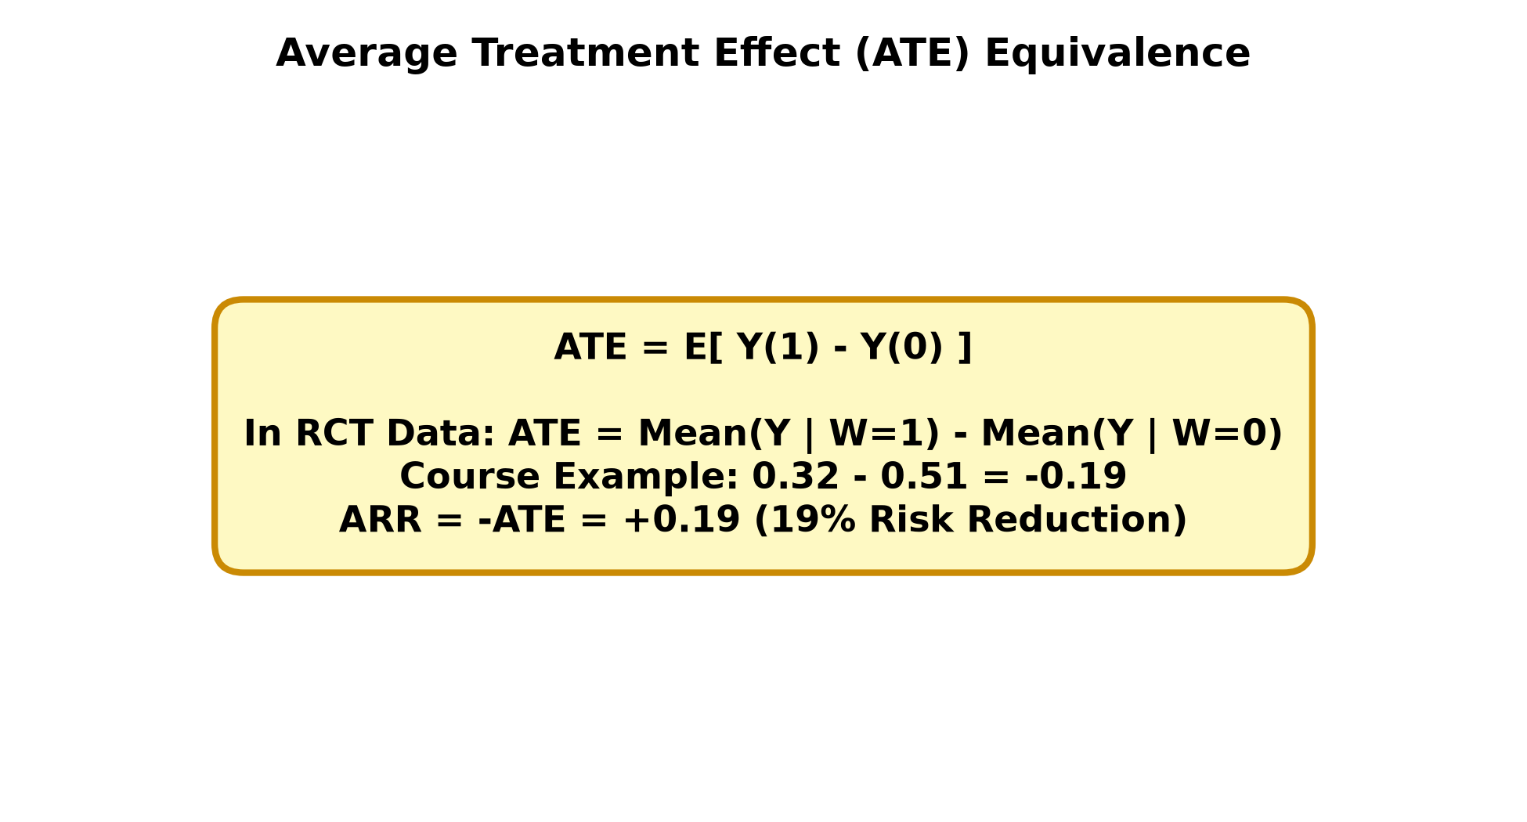
MODULE 1
Average Treatment Effect
DEV 1 | 1 min
Tech Level: ●●○
KEY CONCEPTS & TAKEAWAYS
• Average Treatment Effect
• Fundamental problem of causal inference: only one potential outcome is ever observed
• The observed one is factual; the missing one is counterfactual
• ATE = E[Y(1) − Y(0)]; from RCT data, ATE = E[Y | W=1] − E[Y | W=0]
• Course example: 0.32 − 0.51 = −0.19, so the ATE is −0.19
• ARR = −ATE = 0.19, a 19% average reduction in risk

Slide 14
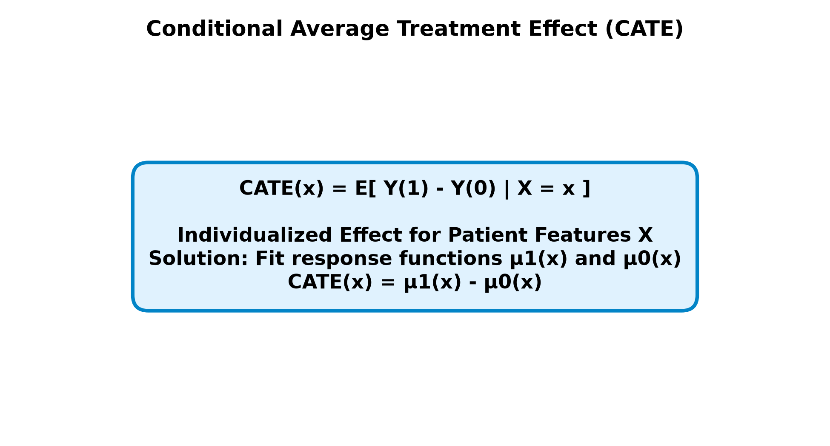
MODULE 1
Conditional Average Treatment Effect
DEV 1 | 1 min
Tech Level: ●●○
KEY CONCEPTS & TAKEAWAYS
• Conditional Average Treatment Effect
• CATE = E[Y(1) − Y(0) | X = x], the treatment effect conditioned on patient features
• Course example patient: x = (age 56, blood pressure 130)
• Exact matching fails: 0 treated and only 1 control patient match both values
• Solution: learn the relationship between features and outcome instead of matching
• Two learned functions: μ̂₁ treatment response, μ̂₀ control response

Slide 15
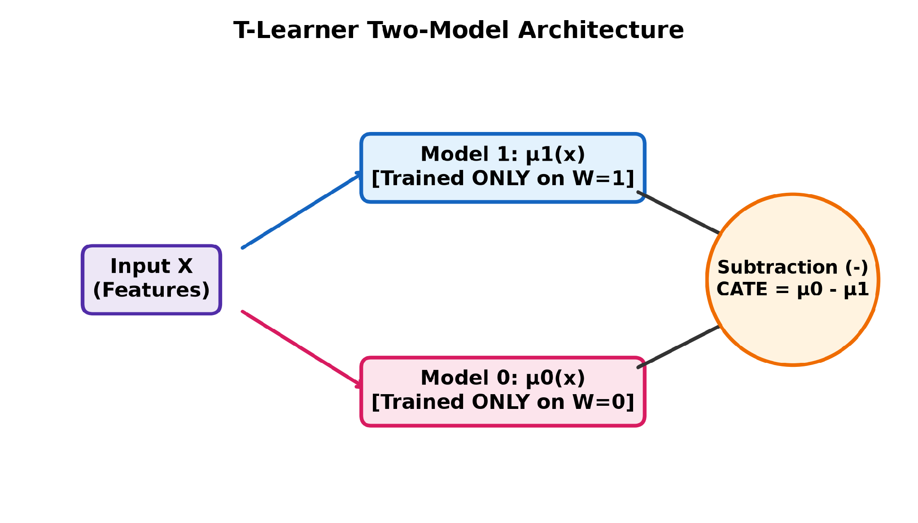
MODULE 1
T-Learner
DEV 1 | 1 min
Tech Level: ●●○
KEY CONCEPTS & TAKEAWAYS
• Also called the two-tree method; μ̂₁ and μ̂₀ are fitted separately
• μ̂₁ is trained only on treated patients, μ̂₀ only on control patients
• CATE(x) = μ̂₁(x) − μ̂₀(x)
• Base learners are free: decision trees, linear models, or two different types
• Course example: 0.21 − 0.45 = −0.24, a predicted benefit
• Diagram: two model boxes side by side

Slide 16
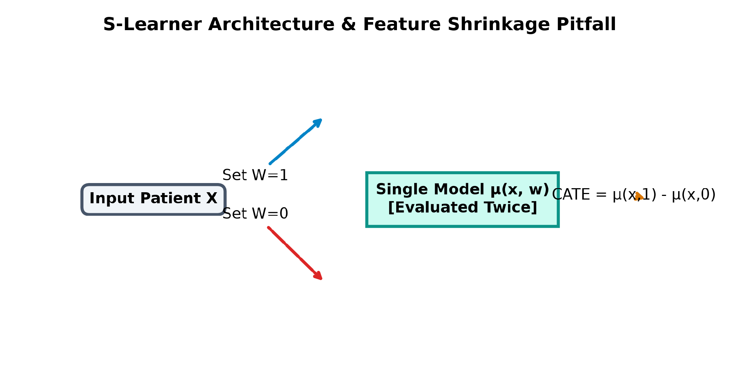
MODULE 1
S-Learner
DEV 1 | 1 min
Tech Level: ●●○
KEY CONCEPTS & TAKEAWAYS
• Also called the single-tree method; one model μ̂(X, W) for both arms
• Treatment W is included as an ordinary feature alongside age and blood pressure
• CATE(x) = μ̂(x, W=1) − μ̂(x, W=0), evaluating the same model twice
• Course example: 0.4 − 0.5 = −0.1
• Failure mode: if the tree never splits on W it returns 0.45 both times, so the effect is 0 for every patient
• Diagram: one model, evaluated twice

Slide 17
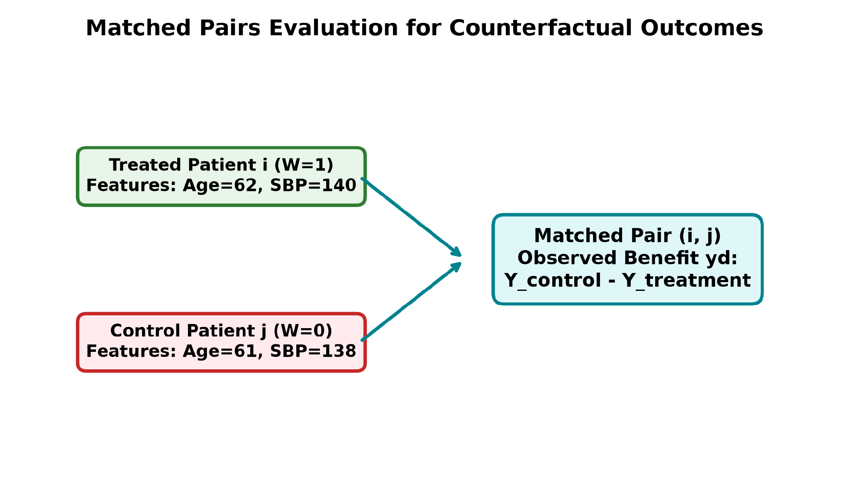
MODULE 1
Evaluate Individualized Treatment Effect
DEV 1 | 1 min
Tech Level: ●●○
KEY CONCEPTS & TAKEAWAYS
• Evaluate Individualized Treatment Effect
• We can never observe one patient under both arms, so there is no direct ground truth
• Fix: match each treated patient with a control patient and treat the pair as one unit
• Two matching options: match on features, or match on the estimated treatment effect
• Pair outcome y_d = Y(1) − Y(0) ∈ {−1 benefit, 0 no effect, +1 harm}
• Pair prediction = the average of the two patients’ individual effect estimates

Slide 18
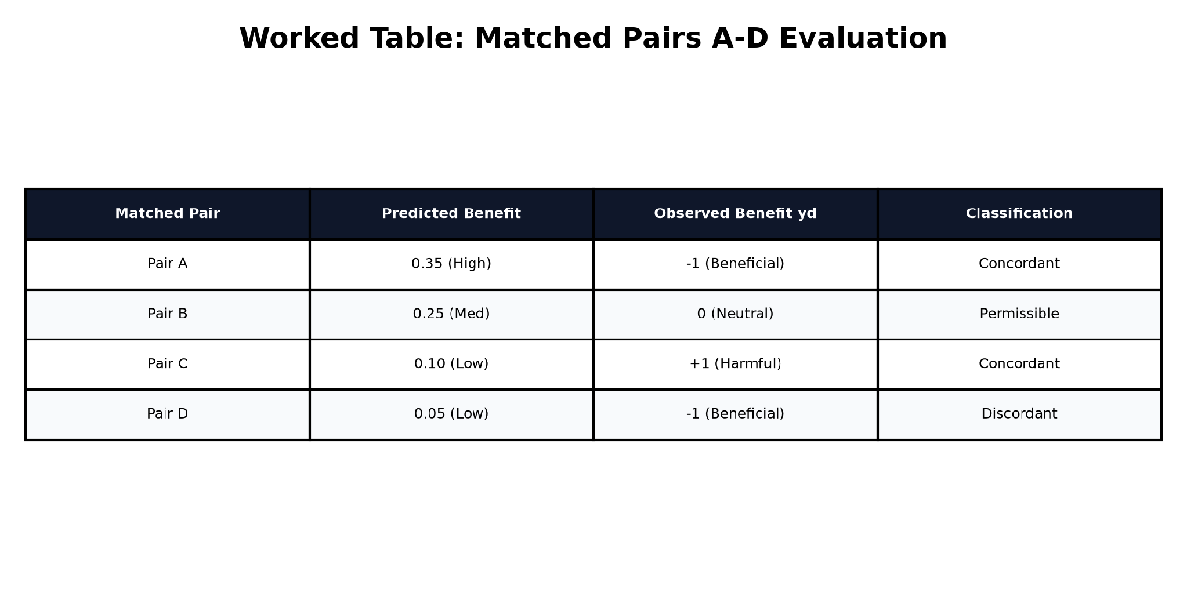
MODULE 1
C-for-benefit
DEV 1 | 1 min
Tech Level: ●●○
KEY CONCEPTS & TAKEAWAYS
• C-for-benefit
• Same idea as the C-index, but applied to pairs of matched pairs
• The outcome now takes three values (−1, 0, +1) rather than two
• A negative outcome is an observed benefit, matching a negative estimate as a predicted benefit
• Permissible = the two matched pairs have different outcomes; ties on outcome cannot be ranked
• C-for-benefit = (concordant + 0.5 × risk ties) / permissible

Slide 19
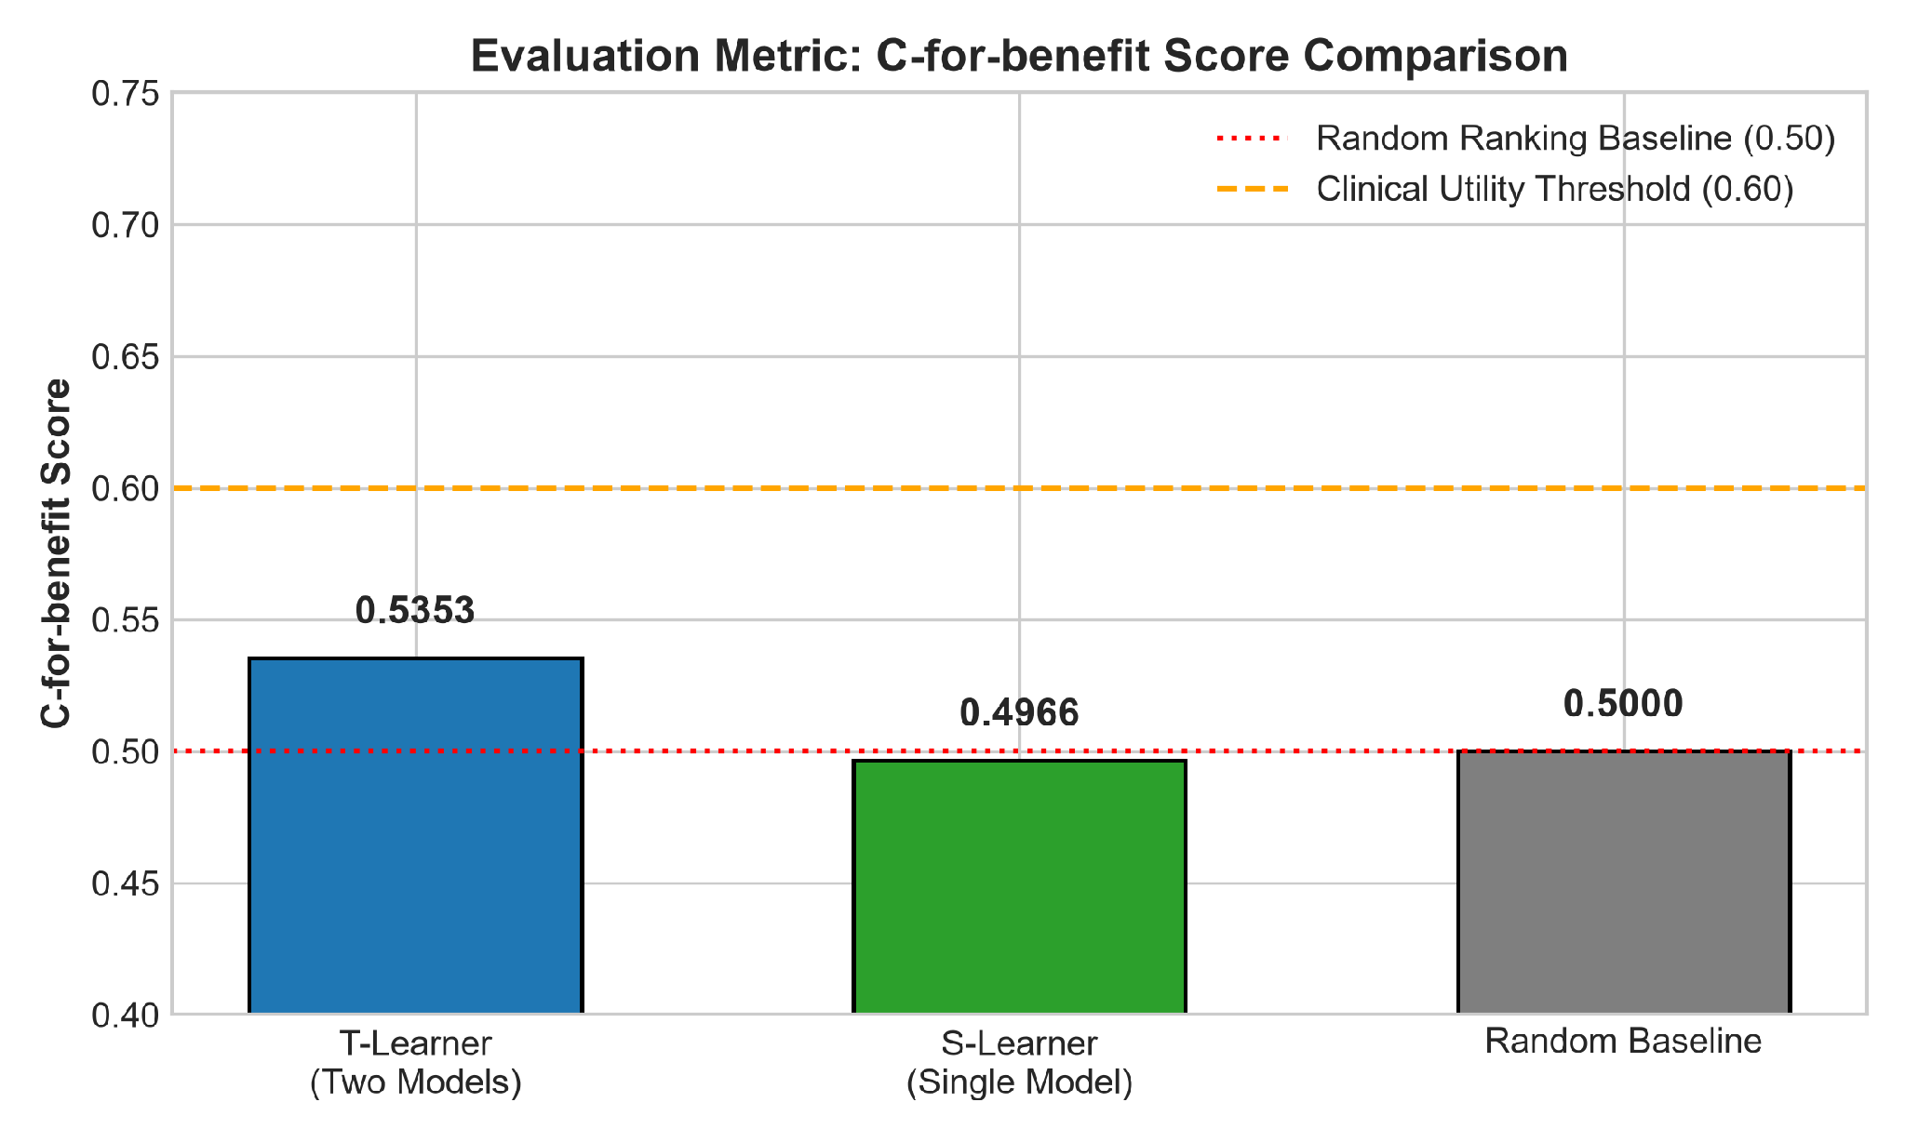
MODULE 1
Module 1 Summary
DEV 1 | 1 min
Tech Level: ●●○
KEY CONCEPTS & TAKEAWAYS
• Module 1 Summary
• ARR and NNT express treatment benefit in the language clinicians already use
• ATE is the population effect; CATE conditions it on the individual patient
• T-learner and S-learner are the two simplest ways to estimate CATE with ML
• C-for-benefit tests whether predicted benefit matches observed benefit
• AI For Medical Treatment · Course 3

Slide 20
2
MODULE 2
Medical Question Answering
10 videos · 32 min · Week 2 · Speaking order: DEV 2 → BIZ 2
This divider is read by DEV 2
Notes:
Section divider for MODULE 2. Hand over the microphone here. Keep it under 30 seconds.

Slide 21
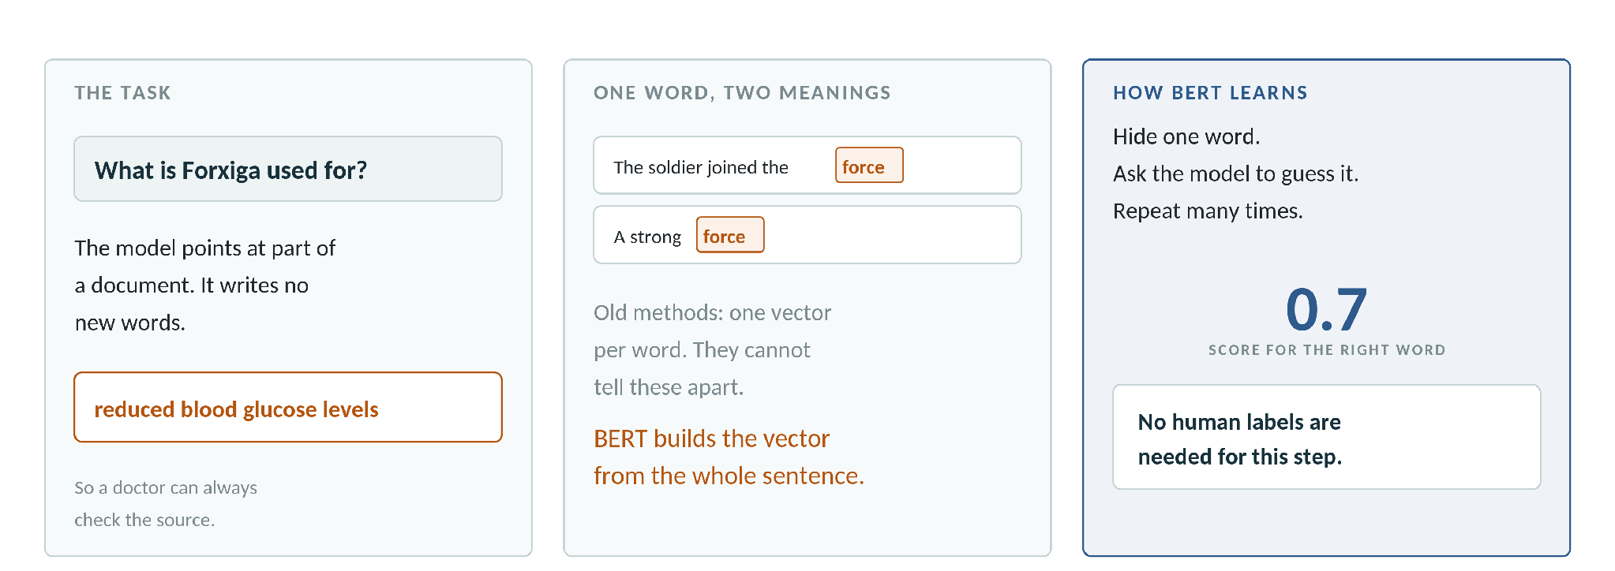
MODULE 2
Medical Question Answering with BERT
The model reads a passage and returns a short part of it. It writes no new words
Course example: "What is Forxiga used for?" gives back "reduced blood glucose levels"
One word can have two meanings, so a fixed vector per word is not enough
BERT builds each vector from the whole sentence; BioBERT does the same on medical papers
AI For Medical Treatment · Course 3
18
Notes:
[DEV 2 · 1.5 min] Two lessons merged, lab content moved to its own slide. Lead with the Forxiga example, then the word "force" for the two-meanings point. Keep it plain — no transformer internals.

Slide 22
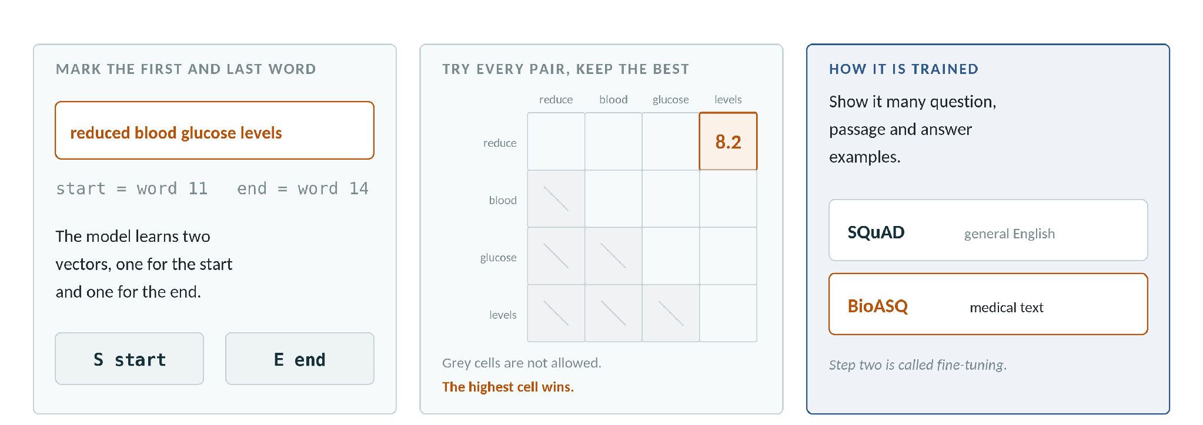
MODULE 2
Define the Answer in a Text
The answer is marked by its first word and its last word
The model learns two vectors, S for the start and E for the end
Each word gets a start score and an end score, then every pair is tried
The end cannot come before the start, so only half the table is used
AI For Medical Treatment · Course 3
19
Notes:
[DEV 2 · 1.5 min] Point at the grid and say the winning cell is 8.2, which gives words 11 to 14. Training uses SQuAD first, then medical text such as BioASQ.

Slide 23
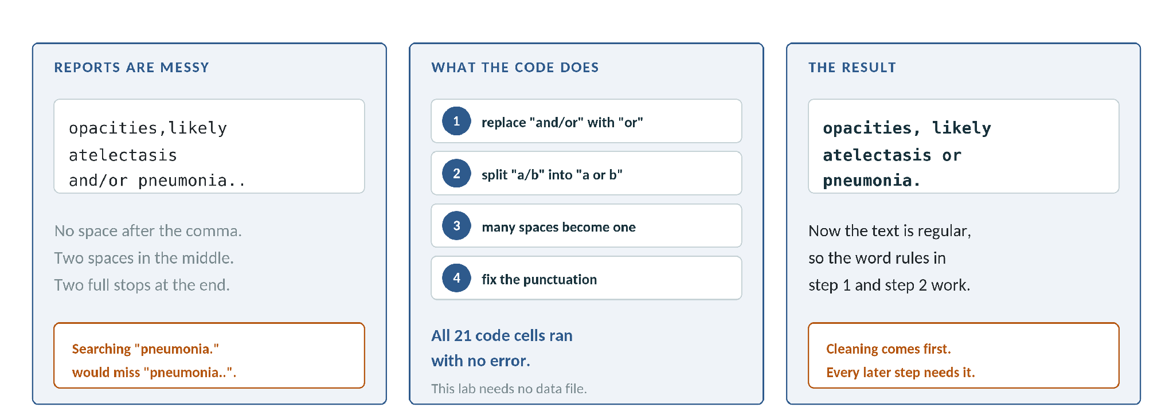
MODULE 2
Lab: Cleaning the Report Text
Real reports are messy: missing spaces, double spaces, "and/or", double full stops
A search for "pneumonia." would miss the same word written "pneumonia.."
The lab replaces "and/or", splits "a/b", collapses spaces and fixes punctuation
All 21 code cells ran with no error, and this lab needs no data file
AI For Medical Treatment · Course 3
23
Notes:
[BIZ 2 · 1 min] This is the first lab and the easiest to show. Its point is that every later rule depends on regular text. This one runs exactly as the course intended.

Slide 24
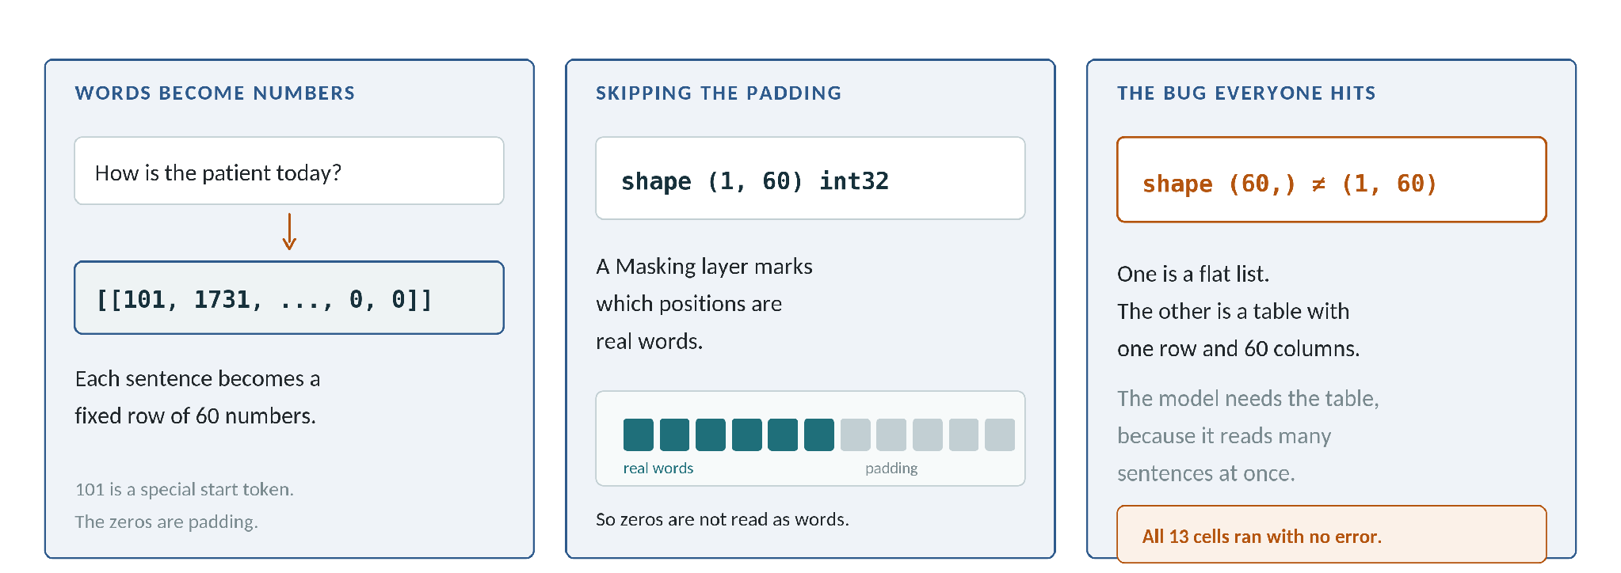
MODULE 2
Lab: Preparing Input for BERT
Words must become numbers before BERT can read them
A sentence becomes a fixed row of 60 numbers, starting with the special token 101
Zeros at the end are padding, and a Masking layer tells the model to skip them
The common bug is shape (60,) against shape (1, 60) — a flat list against a table
AI For Medical Treatment · Course 3
25
Notes:
[DEV 2 · 1 min] Keep this concrete: a sentence goes in, a row of integers comes out. All 13 cells ran. The shape bug is worth showing because every student meets it.

Slide 25
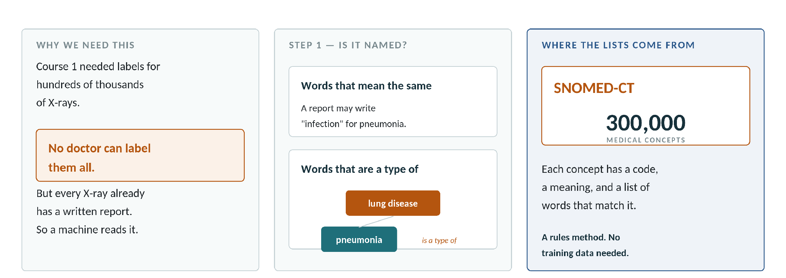
MODULE 2
Automatic Label Extraction: Finding Mentions
Course 1 needed labels for hundreds of thousands of X-rays, and no doctor can label them all
Every X-ray already has a written report, so we read the report by machine
Step 1 asks one question: is the disease named at all?
This needs words that mean the same, and words that are a type of the disease
AI For Medical Treatment · Course 3
20
Notes:
[BIZ 2 · 1.5 min] Three lessons merged. SNOMED-CT gives both lists — about 300,000 concepts. End on the trap: the name is in the text, but the report may say no.

Slide 26
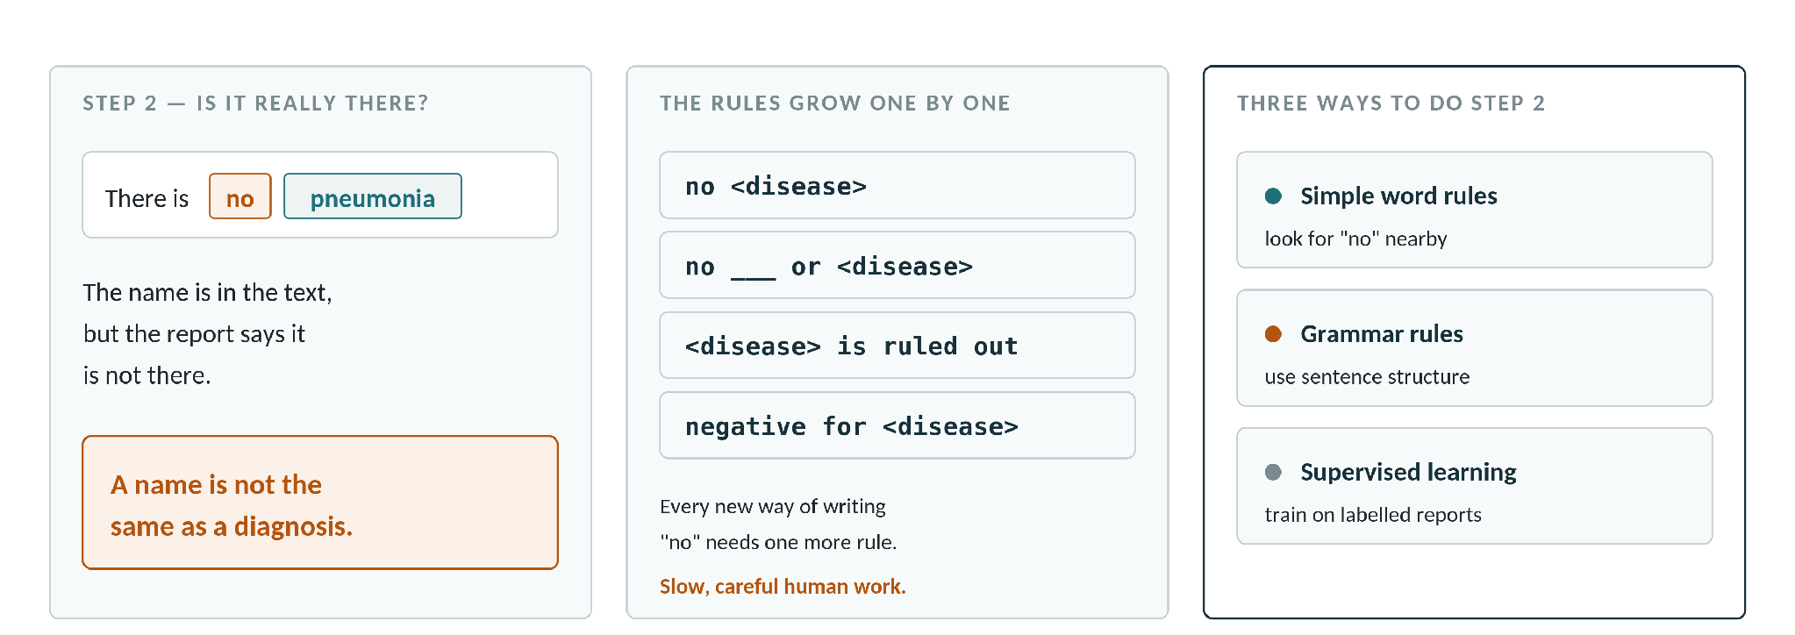
MODULE 2
Presence or Absence: Negation Detection
Step 2 asks whether the named disease is really there
A name in the text is not the same as a diagnosis
Each new way of writing "no" needs one more rule, so the rule list grows slowly
Three options: simple word rules, grammar rules, or supervised learning
AI For Medical Treatment · Course 3
21
Notes:
[BIZ 2 · 1.5 min] Read one negation phrase out loud. The rules approach needs no training data, but it does need time and medical knowledge — that trade-off is the lesson.

Slide 27
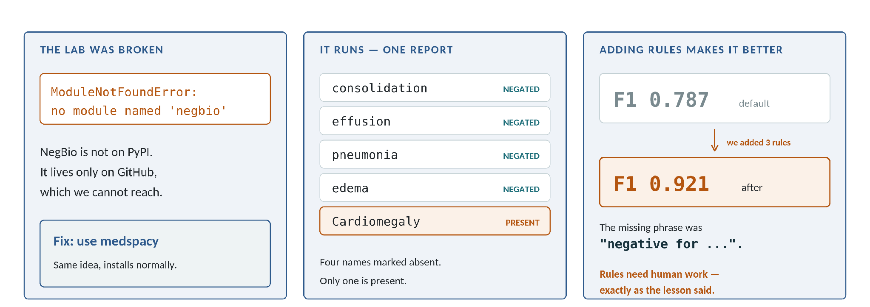
MODULE 2
Lab: Negation Detection that Runs
The course lab fails today: NegBio is not on PyPI, only on GitHub
We replaced it with medspacy, which installs normally and uses the same idea
On 1000 reports the default rules gave F1 0.787
Adding three rules, including "negative for", raised F1 to 0.921
AI For Medical Treatment · Course 3
24
Notes:
[DEV 2 · 1 min] This slide shows a broken lab being fixed and then improved. The missing rule was the phrase "negative for". That is exactly the point the lesson makes: rule sets need patient human work.

Slide 28
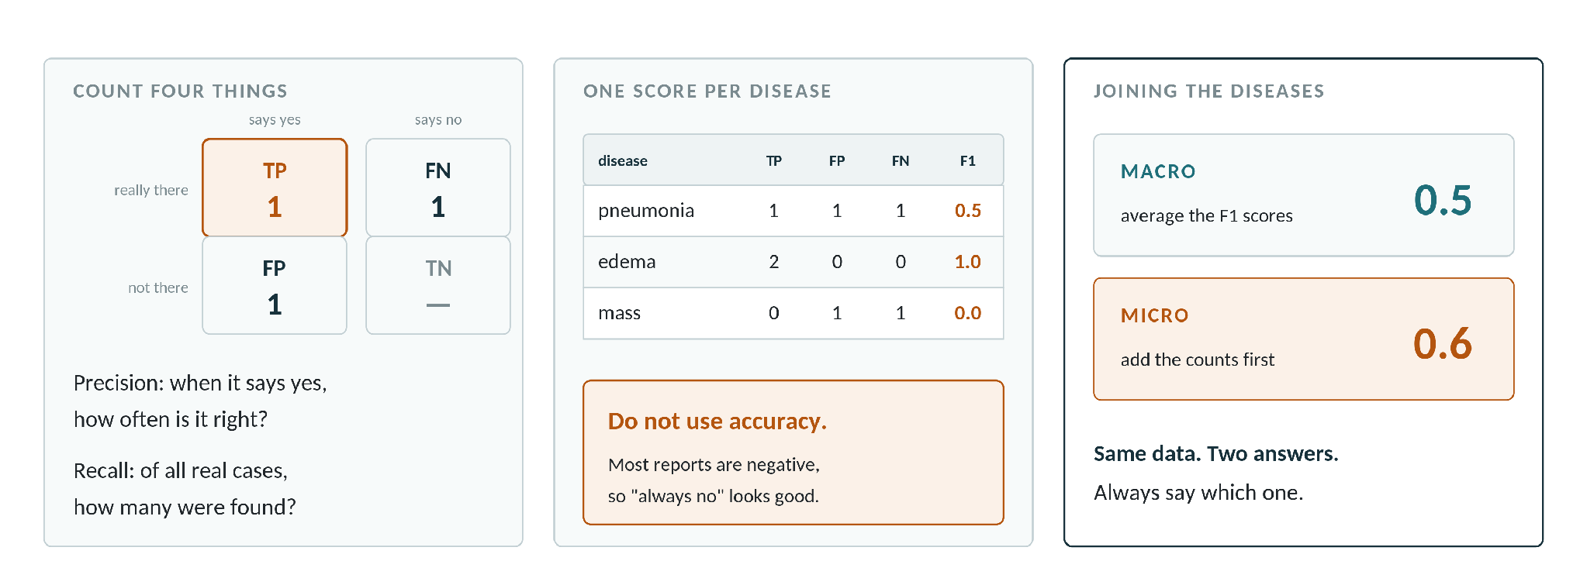
MODULE 2
Evaluating Label Extraction
Precision asks: when the model says yes, how often is it right?
Recall asks: of all the real cases, how many did it find?
F1 joins the two into one number; the course example gives 0.5 for all three
Macro averages the per-disease scores; micro adds up the counts first
AI For Medical Treatment · Course 3
22
Notes:
[BIZ 2 · 1.5 min] Do not use accuracy — most reports are negative, so a model that always says no would look good and be useless. Macro 0.5 against micro 0.6 on the same data makes the averaging choice visible.

Slide 29
3
MODULE 3
ML Interpretation
9 videos · 29 min · Week 3 · Speaking order: DEV 2 → BIZ 2 → DEV 1 → DEV 2
This divider is read by DEV 2
Notes:
Section divider for MODULE 3. Hand over the microphone here. Keep it under 30 seconds.

Slide 30
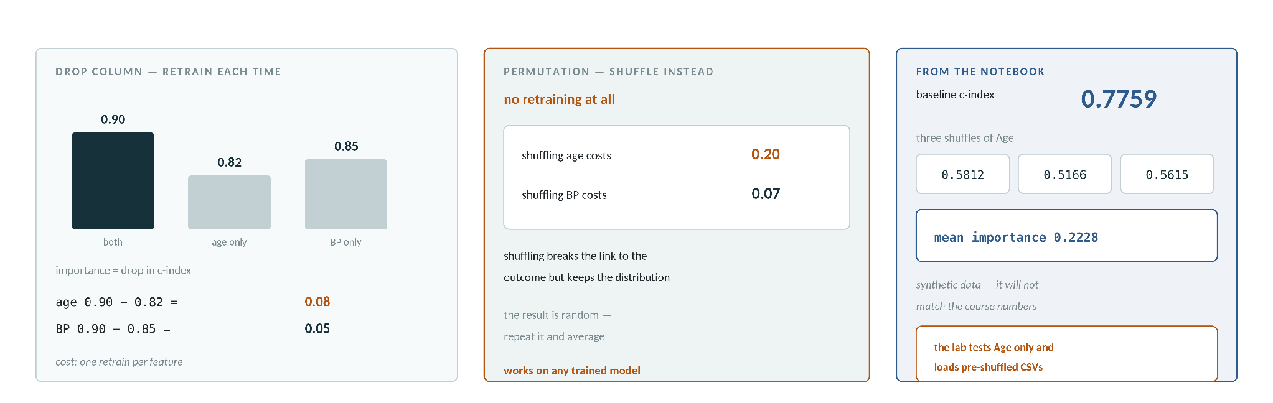
MODULE 3
Drop Column and Permutation Methods
Drop column: remove a feature, retrain, and measure the fall in performance
Permutation: shuffle the column in the test data instead, so no retraining is needed
Course example: shuffling age costs 0.20 of c-index, blood pressure only 0.07
LAB — baseline c-index 0.7759, mean Age importance 0.2228 across three shuffles
AI For Medical Treatment · Course 3
28
Notes:
[DEV 2 · 2 min] Two lessons plus the lab merged. The lab number differs from the course because our data was synthetic — say so. Note the lab never actually shuffles in code: it loads pre-shuffled CSVs and only tests Age, so it cannot reproduce the age-versus-BP comparison the video concludes with.

Slide 31
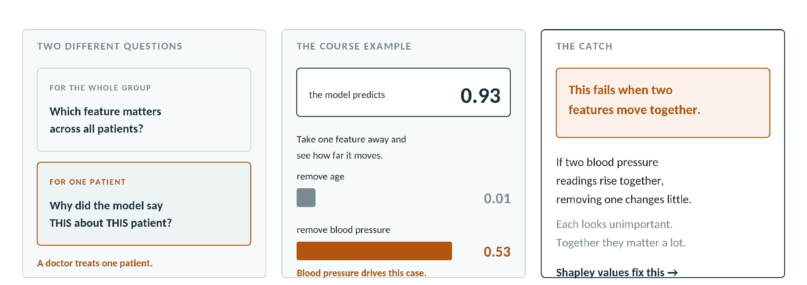
MODULE 3
Individual Feature Importance
Group-level importance asks which feature matters across all patients
Individual importance asks why the model said THIS about THIS patient
Course example: the model predicts 0.93; removing blood pressure moves it by 0.53
The simple method fails when two features rise and fall together
AI For Medical Treatment · Course 3
29
Notes:
[BIZ 2 · 1.5 min] This is the business case for interpretability and it sets up Shapley values, which exist to fix exactly the correlated-feature failure. Hand to DEV 1 on that sentence.

Slide 32
MODULE 3
Shapley Values
D1
DEV 1
Time 2 min
Level ●●●
Depends on slide 31
Course source Shapley Values · Combining Importances
Idea: measure a feature’s contribution across every subset of features, not just the full set
With 3 features there are 8 subsets, so 8 models; the empty set is defined as the prevalence
Imagine building the feature set one feature at a time — 3 features give 3! = 6 orderings
For each ordering, take the contribution of the feature against those that came before it
The Shapley value I is the average of those 6 marginal contributions; for SBP it was 0.38
Place a diagram, table or image here
Replace these bullets with your own wording — this is the outline to say, not text to read out.
AI For Medical Treatment · Course 3
32
Notes:
[DEV 1 · 2 min] Present the ordering-average definition, which is exactly what the course teaches. Do NOT put the general weighted-subset Shapley formula on the slide — the course never shows it and it will invite a question you cannot answer from the material.

Slide 33
MODULE 3
Shapley Values for all Patients
D1
DEV 1
Time 1.5 min
Level ●●○
Depends on slide 32
Course source Shapley Values for all Patients
Additivity: the Shapley values sum to the full prediction minus the population base risk
So they explain the extra risk this patient carries above the population average
Force plot: base value and output value, each feature drawn as a segment between them
Red pushes the prediction up, blue pushes it down
Course example: output 0.26 from base 0.00, with SBP +0.3, DBP +0.01 and age −0.05
IMAGE REQUIRED
SHAP force plot or summary plot
Place image here — SHAP force plot or summary plot
Replace these bullets with your own wording — this is the outline to say, not text to read out.
AI For Medical Treatment · Course 3
33
Notes:
[DEV 1 · 1.5 min] Show a real force plot and read it out loud in plain language. The additivity property is what lets you say "this patient is 0.26 above baseline, and here is exactly where that came from".

Slide 34
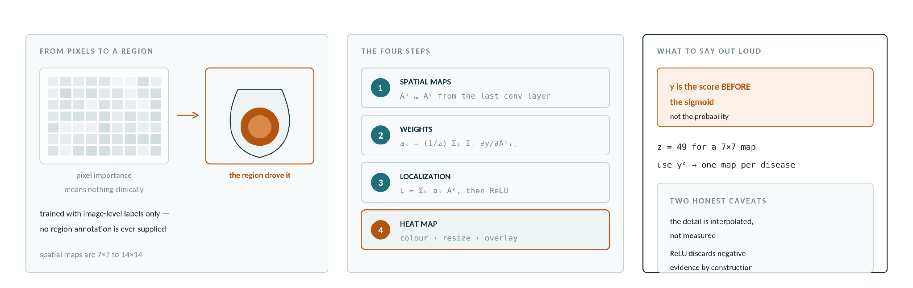
MODULE 3
Interpreting CNN Models with Grad-CAM
For an image the useful unit is a region, not a pixel
Weight each spatial map by its average gradient, then sum: L = Σₖ aₖ Aᵏ
y is the class score BEFORE the sigmoid, not the probability
ReLU, colour-map, resize and overlay — and use yᶜ to get one map per disease
AI For Medical Treatment · Course 3
32
Notes:
[DEV 2 · 2 min] Three lessons merged into one pipeline. Two honest caveats: the detail on screen is interpolated rather than measured, and ReLU discards negative evidence by construction. The course shows separate cardiomegaly and edema maps on the same image.

Slide 35
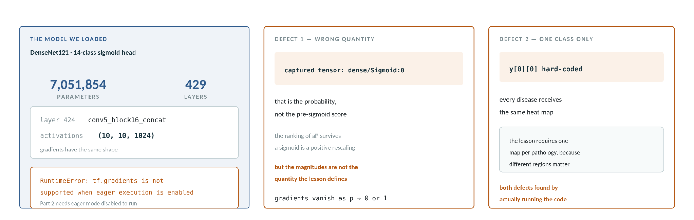
MODULE 3
Grad-CAM in the Notebook
LAB — DenseNet121 with a 14-class sigmoid head, 7,051,854 parameters
LAB — spatial maps from layer 424, conv5_block16_concat, shape (10, 10, 1024)
LAB — Part 2 fails on modern TensorFlow: tf.gradients needs eager execution disabled
DEFECT — it differentiates the probability, and hard-codes class index 0
AI For Medical Treatment · Course 3
33
Notes:
[DEV 2 · 1.5 min] Show that the concepts survive contact with code, and that the lab has two real defects. Ranking of the weights survives the sigmoid mistake because it is a positive rescaling, but the magnitudes are not the quantity the lesson defines, and gradients vanish when the probability saturates.

Slide 36
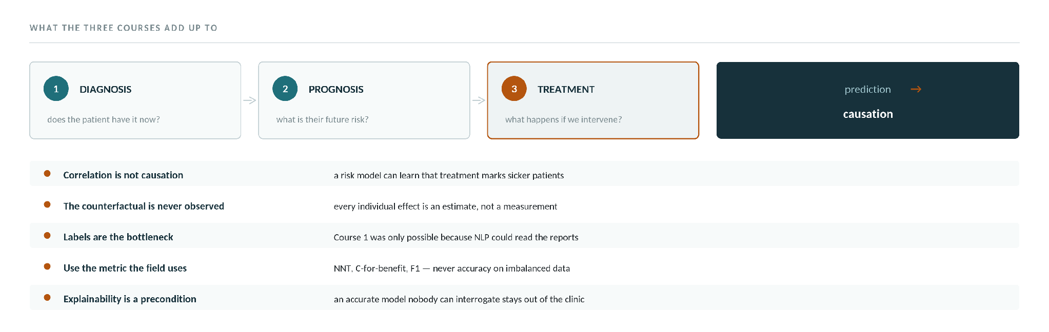
WRAP-UP
Key Insights from the Specialization
Three clinical questions — diagnosis, prognosis, treatment — need three kinds of model
Course 3 is the only one that asks what happens IF we intervene, not what will happen
The five lessons below carry across every course in the specialization
AI For Medical Treatment · Course 3
35
Notes:
[All members · 2.5 min] Closing slide, delivered by the whole team — each member takes the insight from their own module. This replaces the separate assessment and conclusion slides. Keep it to seven sentences and stop; do not re-teach the content.

Slide 37
WRAP-UP
Questions
ALL
All members
Time 10 min
Level ●○○
Depends on None — can stand alone
Course source Whole course
[BIZ 1] Why not just use a risk prediction model instead of causal inference?
[DEV 1] Is a C-for-benefit of 0.6 good enough to use in practice?
[DEV 1] Which is better, the S-learner or the T-learner?
[DEV 2] Does a Grad-CAM heat map prove the model is correct?
[BIZ 2] If the NLP in Module 2 is dated, why study it?
[BIZ 2] Labels extracted by rules are noisy — why does training on them still work?
Replace these bullets with your own wording — this is the outline to say, not text to read out.
AI For Medical Treatment · Course 3
40
Notes:
[All members · 10 min] Each question already has an owner, so nobody is left silent. Suggested answers are in Section 6.1 of AI_For_Medical_Treatment_Course3_Summary.docx. For an unlisted question, the owner of the relevant slide answers first and a developer covers the technical detail.

