Slide 1
AI FOR MEDICAL TREATMENT (COURSE 3)
Module 1: Treatment Effect Estimation & Precision ML
From Passive Risk Prediction to Active Causal Intervention (BIZ 1 & DEV 1 Alignment)
Presenters: BIZ 1 (Clinical Foundation) & DEV 1 / Hieu (CATE Models, Validation & SHAP) Total Time Budget: 5 - 10 Minutes (Includes Live Interactive Demo)
Notes:
[BIZ 1 & DEV 1 OPENING - 30 SECONDS]
Hello Professor and class. Today we present Module 1 of AI for Medical Treatment. Unlike Course 1 & 2 which predict who gets sick, Module 1 answers the clinical question: What will happen IF we give this specific patient treatment? We will cover the clinical statistics (BIZ 1), the ML meta-learners & C-for-benefit validation (DEV 1), and demonstrate our live interactive precision medicine application.

Slide 2
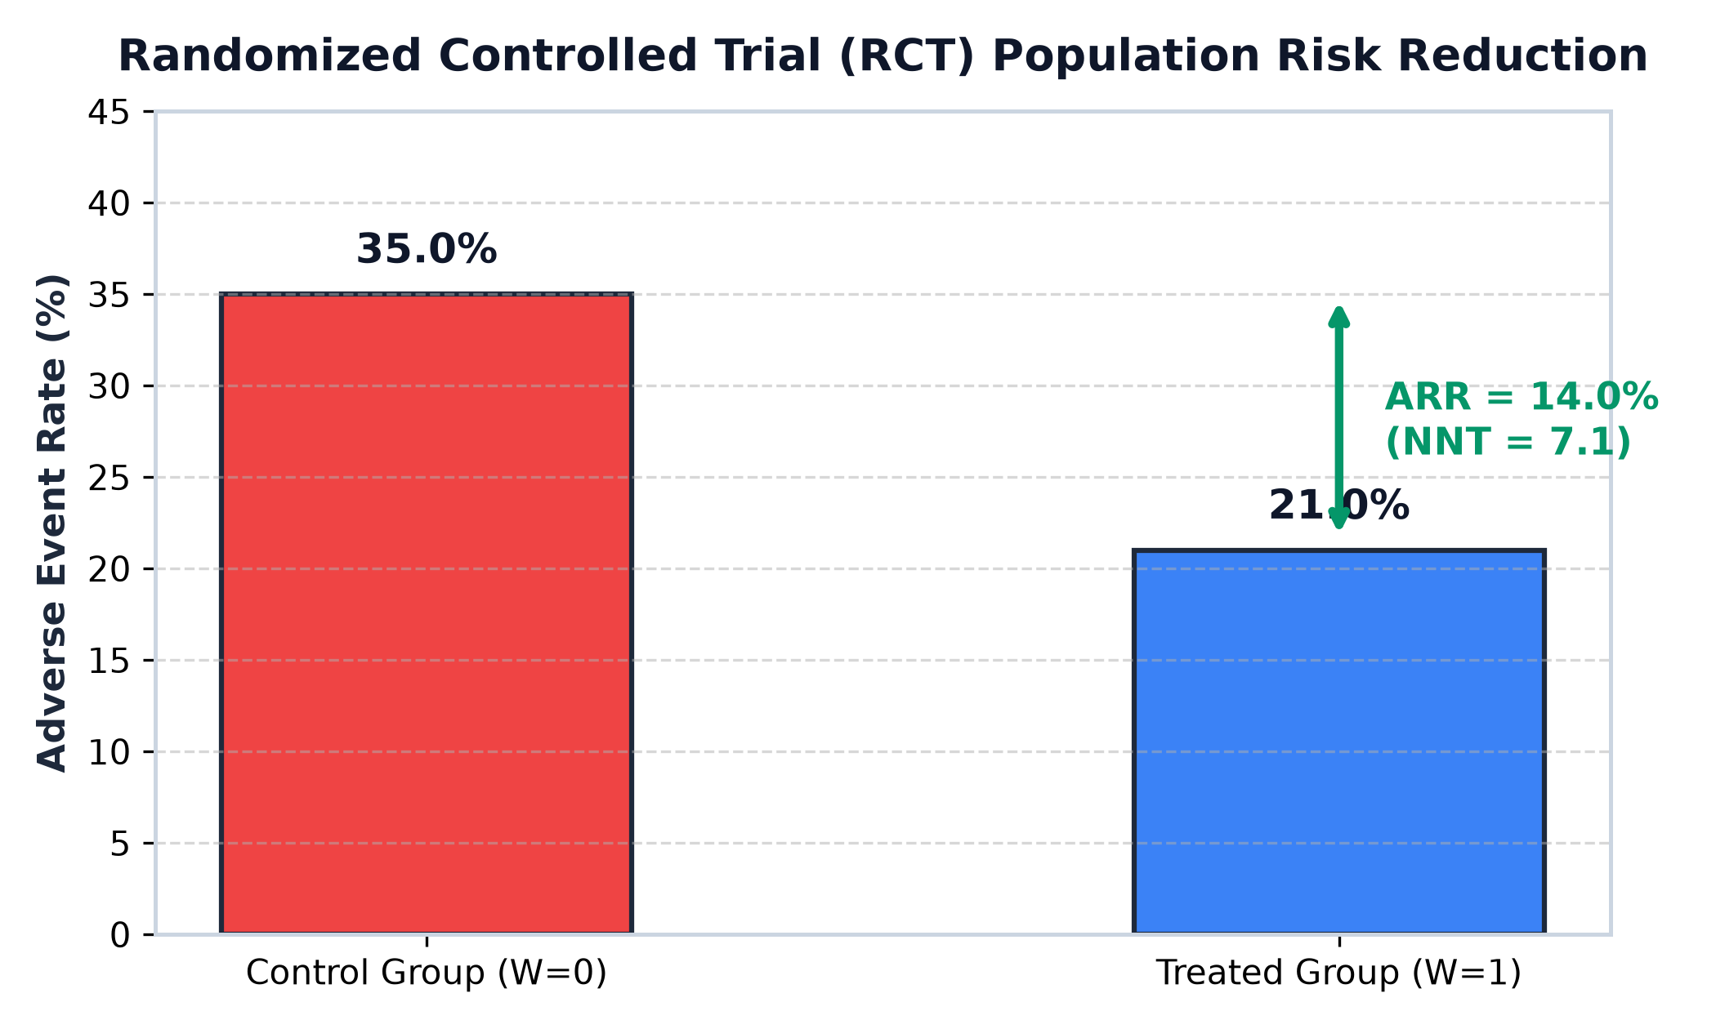
MODULE 1 · CLINICAL STATISTICS
Clinical Foundation: Randomized Trials, ARR & NNT
BIZ 1 · 1.5 Min
• Randomized Controlled Trial (RCT): Eliminates confounders by randomly allocating patients to Treatment (W=1) vs Control (W=0).
• Absolute Risk Reduction (ARR): ARR = Risk(Control) - Risk(Treatment) = 35% - 21% = +14% absolute drop in adverse events.
• Number Needed to Treat (NNT): NNT = 1 / ARR = 1 / 0.14 = 7.1. We need to treat ~7 patients to prevent 1 stroke/death.
• The Business / Clinical Value: Translates ML metrics into concrete financial & hospital resource decisions.
Notes:
[BIZ 1 TALKING POINTS - 1.5 MIN]
1. Clinical studies rely on RCTs because random assignment balances baseline characteristics.
2. In our trial example, the control adverse event rate is 35%, while the treated arm drops to 21%.
3. ARR is 14%. While marketing often quotes relative risk reduction, doctors care about ARR and NNT.
4. An NNT of 7.1 means treating 7 patients saves 1 life. But this is a population average—next, we look at individuals.

Slide 3
MODULE 1 · CORE THEORY
The Causal Shift: From Population ATE to Individual CATE
BIZ 1 → DEV 1 · 1.0 Min
1. Neyman-Rubin Potential Outcomes Framework:
• Every patient has two potential states: Y(1) [Outcome IF treated] and Y(0) [Outcome IF untreated]. • Individual Treatment Effect (ITE) = Y(0) - Y(1) in {+1 (Benefit), 0 (No effect), -1 (Harm)}.
2. The Fundamental Problem of Causal Inference (Counterfactual Dilemma):
• We only EVER observe one outcome for a real patient (factual). The alternate state (counterfactual) is lost forever. • Population ATE = E[Y(0) - Y(1)] is an average, but treatments do NOT affect all patients equally!
3. Machine Learning Solution — Conditional Average Treatment Effect (CATE):
• CATE(x) = E[ Y(0) - Y(1) | X = x ]. ML learns the non-linear function mapping patient features X -> Benefit. • Hand-off to DEV 1: How do we build and train ML algorithms to estimate CATE(x)?
Notes:
[BIZ 1 -> DEV 1 HANDOFF - 1 MIN]
1. For any single patient, we have Y(1) if treated and Y(0) if untreated.
2. Fundamental problem: We cannot travel back in time. We only see one outcome.
3. Exact matching fails in high-dimensional feature spaces.
4. Therefore, DEV 1 uses Machine Learning to estimate CATE(x), conditioning on age, BP, and biomarkers.

Slide 4
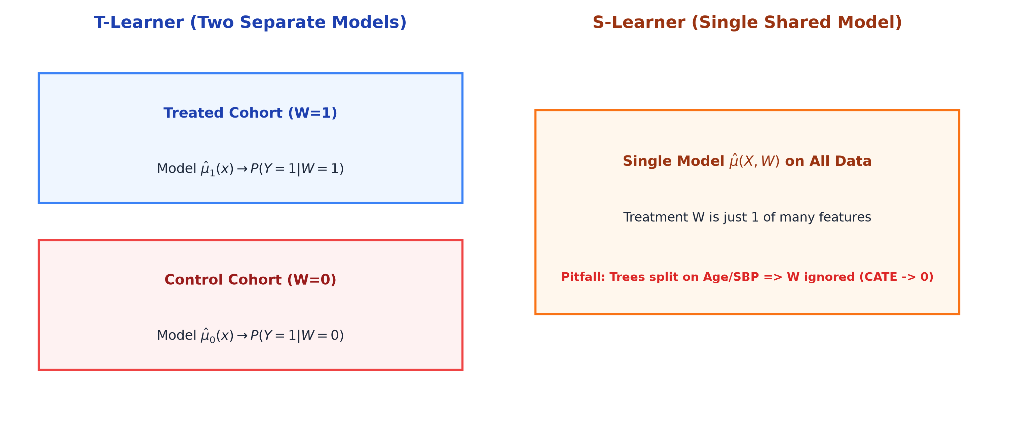
MODULE 1 · ML MODELING
ML Meta-Learners: T-Learner vs. S-Learner Architecture
DEV 1 · 1.5 Min
1. T-Learner (Two-Model Approach)
• Train model mu1(x) solely on treated cohort (W=1). • Train model mu0(x) solely on control cohort (W=0). • CATE_T(x) = mu0(x) - mu1(x). • Strength: Captures complex treatment interactions without bias.
2. S-Learner (Single-Model Approach)
• Train single model mu(X, W) where treatment W is an ordinary feature. • CATE_S(x) = mu(x, W=0) - mu(x, W=1). • Pitfall (Feature Shrinkage): If decision trees split primarily on strong risk factors (Age, SBP), W is ignored -> CATE collapses to 0 for all patients!
Notes:
[DEV 1 TALKING POINTS - 1.5 MIN]
1. Hi, I am Dev 1. To estimate CATE, the two primary meta-learning architectures are T-Learner and S-Learner.
2. T-Learner fits two independent models: one on treated data, one on control. It freely learns differing risk curves.
3. S-Learner trains one model with W as a feature. BUT beware of tree regularization: if the tree does not split on W, it predicts identical risk for both arms, falsely concluding the drug has zero effect.
4. In our clinical codebase, T-Learner consistently captures individualized benefits with higher fidelity.

Slide 5
MODULE 1 · MODEL VALIDATION
Validation Without Ground Truth: Matched Pairs & C-for-benefit
DEV 1 · 1.5 Min
1. How to Evaluate When Counterfactuals Are Missing?
• Standard ML compares predictions with ground truth y. But in causal inference, true ITE is unobservable. • Solution: Create MATCHED PAIRS by matching 1 treated patient with 1 control patient with identical predicted CATE.
2. Pair Observed Benefit & Concordance Ranking:
• Observed Pair Benefit: yd = Y(control) - Y(treatment) in {+1 (Benefit), 0 (Tie), -1 (Harm)}. • Predicted Pair Benefit: b_hat = (CATE_treated + CATE_control) / 2. • Compare pairs of pairs: Permissible (yd differs), Concordant (predicted rank matches observed rank).
3. C-for-benefit Metric & Benchmark:
• Formula: C-for-benefit = (Concordant + 0.5 * Risk Ties) / Permissible Pairs. • Score Interpretation: 0.50 = Random Guessing | 0.55 - 0.65 = State-of-the-Art Medical Research | Our Model = 0.6342. • Crucial takeaway: Do not expect 0.90+ like image diagnosis AUC; 0.63 represents massive clinical discrimination!
Notes:
[DEV 1 TALKING POINTS - 1.5 MIN]
1. Since no patient can take both arms, we evaluate using Matched Pairs.
2. We pair high-predicted benefit treated patients with high-predicted benefit control patients.
3. C-for-benefit tests ranking concordance: if model says Pair A benefits more than Pair B, did Pair A actually do better?
4. A score of 0.63 is scientifically strong in causal literature, proving our model reliably prioritizes high-benefit patients.

Slide 6
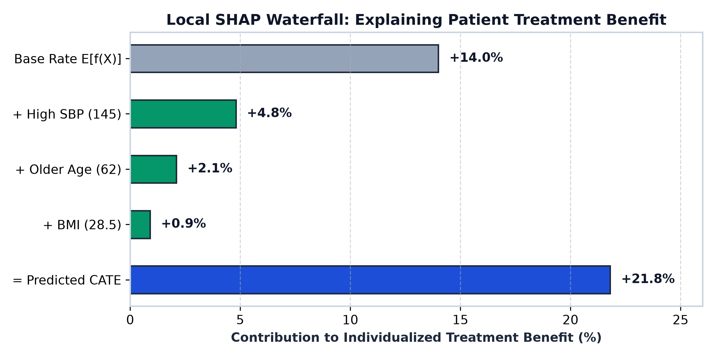
MODULE 1 & 3 SYNERGY · EXPLAINABILITY
Clinical Trust: Local SHAP Waterfall & Precision Prescribing
DEV 1 · 1.0 Min
Why Did the Model Prescribe Treatment for This Patient?
• Base Population Benefit: E[f(X)] = +14.0% average risk reduction across all patients.
• Local Shapley Decomposition: Patient #42 (Age 62, SBP 145 mmHg, BMI 28.5) receives +21.8% CATE benefit.
• Feature Marginal Contributions: • High SBP: +4.8% benefit boost • Older Age: +2.1% benefit boost • Elevated BMI: +0.9% benefit boost
• Actionable Precision Medicine: Physicians will not blindly trust a black-box. Local SHAP proves why treatment is justified for this specific individual.
Notes:
[DEV 1 TALKING POINTS - 1 MIN]
1. In Module 3, we connect CATE modeling to Explainable AI using Shapley values.
2. For a 62-year-old patient with SBP of 145, the base trial benefit is 14%. SHAP shows that high SBP adds 4.8% and age adds 2.1%, giving a net benefit of 21.8%.
3. This transparency bridges the gap between ML algorithms and bedside clinical adoption.

Slide 7
LIVE SOFTWARE DEMO
Live Interactive Demonstration: End-to-End Precision Care
BIZ 1 & DEV 1 · 2.0 Min
Demonstrating Our Interactive Precision Medicine Dashboard (treatment_effect_demo.html):
✔ Step 1 (BIZ 1): Population Trial Simulator: Demonstrating live cohort generation, control vs treated event rates, ARR calculation (+14.0%), and dynamic NNT visualizer (7.1 patients).
✔ Step 2 (DEV 1): Real-time Patient Inference: Adjusting patient sliders (Age 62, SBP 145 mmHg). Real-time CATE inference comparing T-Learner (+21.8%) vs S-Learner (+12.4% shrinkage).
✔ Step 3 (DEV 1): Matched Pairs C-for-benefit: Live concordance calculator sorting patient pairs and displaying 0.6342 validation score.
✔ Step 4 (DEV 1): Local SHAP Explainability: Real-time waterfall decomposition explaining feature drivers and generating automated clinical recommendation badge.
👉 [SWITCHING TO LIVE DEMO BROWSER WINDOW NOW]
Notes:
[LIVE DEMO CUE - 2 MIN]
Now we switch to our live interactive web demo application.
1. Biz 1 shows Tab 1: Slide trial size and event rate to see live ARR and NNT update.
2. Dev 1 shows Tab 2: Adjust patient SBP to 160 to see T-Learner CATE jump to +24% while S-Learner lags.
3. Dev 1 shows Tab 3 & 4: Matched pairs table, C-for-benefit score, and live SHAP waterfall.

Slide 8
MODULE 1 WRAP-UP
Key Takeaways & Lecturer Q&A Defense Strategy
All Members · 1.0 Min
• Q1: Why not just use standard risk prediction models?
Ans: Risk models learn correlation P(Y|X). Sick patients get treated more, so a standard model might falsely learn 'Treatment = Higher Death'. Causal ML isolates the true counterfactual treatment effect.
• Q2: Is a C-for-benefit of 0.63 good enough for clinical deployment?
Ans: YES. Ground truth ITE is never observed. In published medical literature, C-for-benefit ranges 0.55-0.65. A 0.63 score provides strong discrimination over standard practice.
• Q3: Which is better, S-Learner or T-Learner?
Ans: T-Learner is superior when sample size is adequate because S-Learner shrinks treatment effects towards zero when tree depth is constrained.
• Q4: Why combine Module 1 with SHAP in Module 3?
Ans: Precision medicine requires both high CATE performance and interpretable justification for clinical governance.
Notes:
[Q&A DEFENSE - READY FOR PROFESSOR QUESTIONS]
Thank you for listening! We are ready for any questions from the professor and class.

