Slide 1
ADENIO Data Science Project

Slide 2
Introduction
ADENIO Digital has run a digital advertising campaign for one of our clients, targeting mobile users in the Southeast. The goal of the campaign was to drive conversions -- users clicking through the ad and accepting our client's offer.
Our campaigns are executed on real-time bidding (RTB) exchanges. Web pages or mobile apps submit bid requests to potential advertisers on these exchanges.
Did the new creative increase conversions?
Would retargeting have improved performance for this campaign?

Slide 3
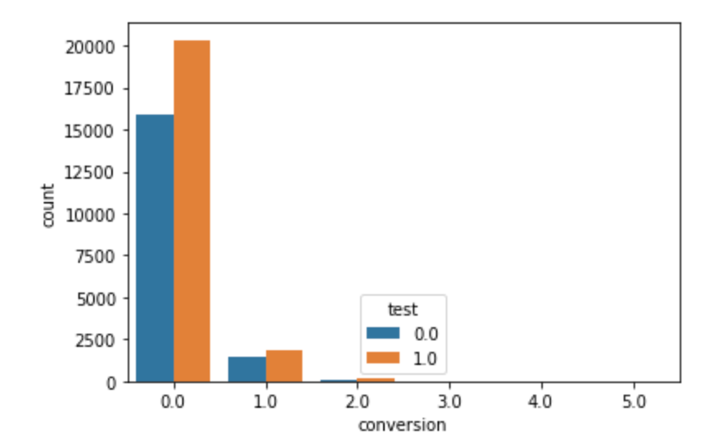
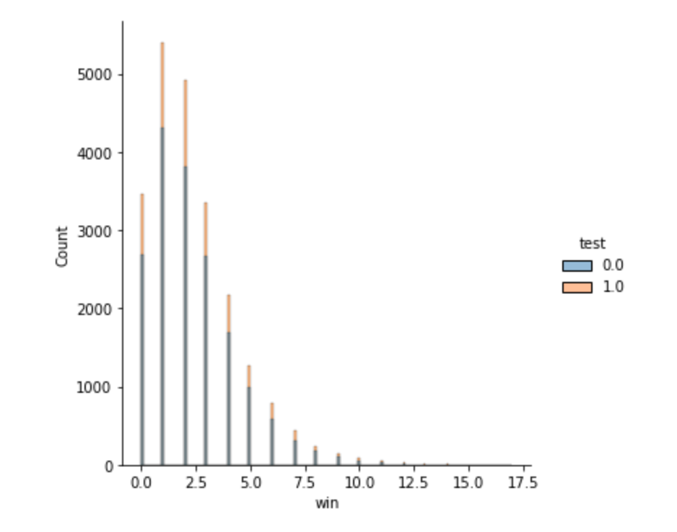
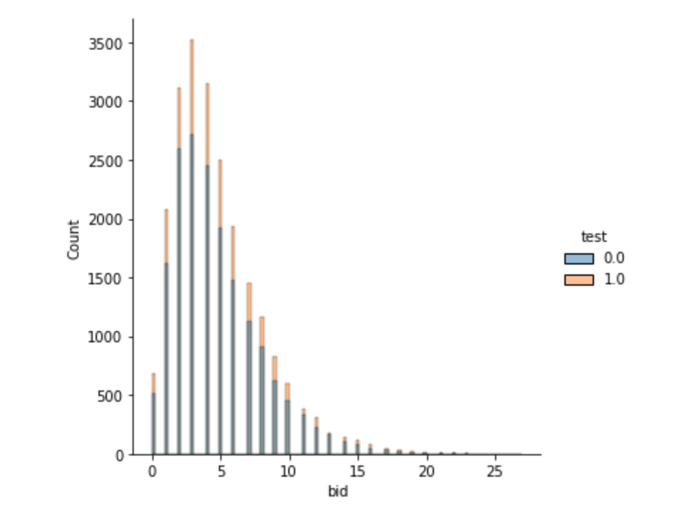
Data Visualization

Slide 4
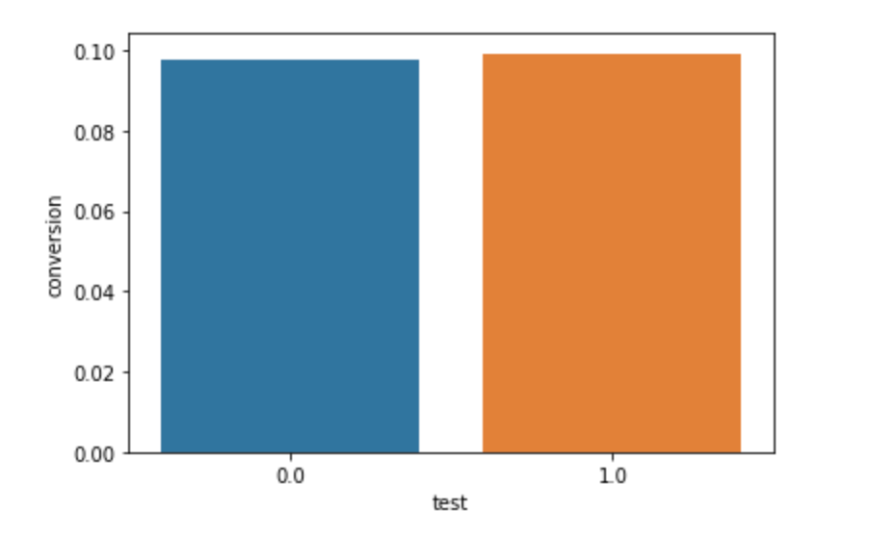
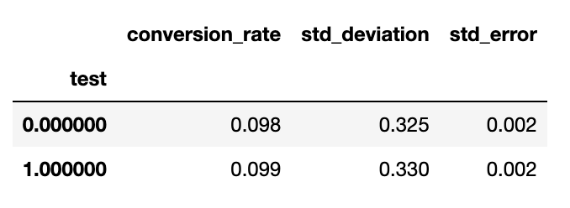
Data Analysis
From the picture on the left, it is obvious to say that the conversions in control and test groups are almost the same. 0 represents the control group and 1 represents the test group.
The conversion rate for the control group is 0.098 and the conversion rate for the test group is 0.099.

Slide 5
Conclusion
Next, we performed the z test.
Since our p-value=0.618 is way above our α=0.05 threshold, we fail to reject the Null hypothesis, which means that our new creative design did not perform significantly different (let alone better) than our old one.
Additionally, we notice that: the confidence interval for the control group ([0.093, 0.102], or 9.3-10.2%) and the confidence interval for the test group ([0.095, 0.103], or 9.5-10.3%)
This is further proof that our new design is not likely to be an improvement on our old design and that unfortunately we are back to the drawing board!
The conversion rate to retarget the converted users is 8.49%
We may conclude that the new creative did not increase conversions after comparing the conversion rates of the control and test groups. Retargeting would not have improved campaign results

